Slide 1
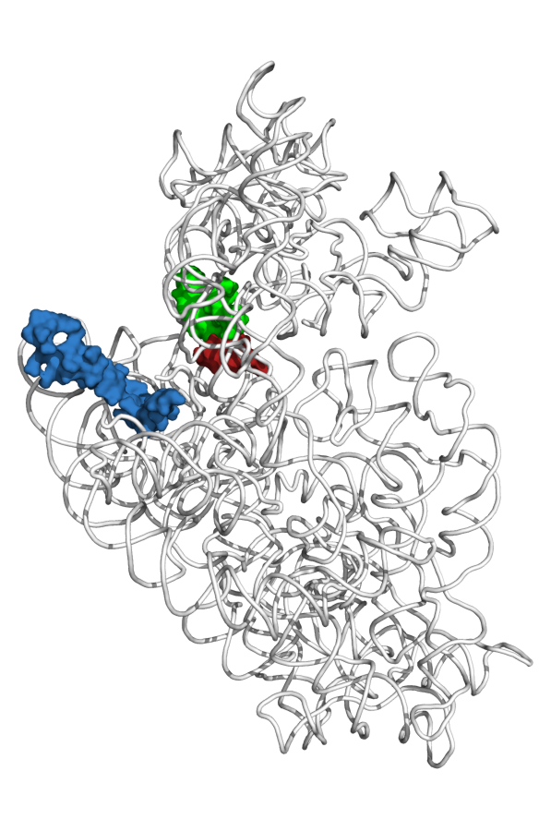
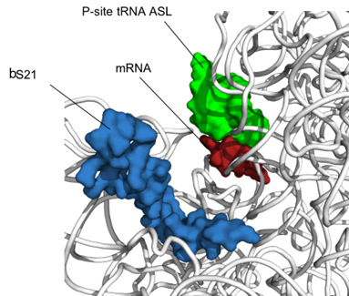
bS21, a small subunit ribosomal protein
Involved in translation initiation
Non-essential
Impacts different phenotypes in different species
Encoded by phage
Take home: bS21 may act as a regulator of translation
mRNA channel
bS21
30S subunit of E. coli
Notes:
Mention that the only protein depicted in the image is the bS21, folded 16s
IT HAS BEEN implicatred in blah blah
Phage don’t encode their own machinery, their own translation machinery (be more specific)
Transition:

