Slide 1
Investigating the Autogenous Regulation of bS21 Homologs
In Francisella tularensis
KRamsey Lab | Sierra Schmidt
The University of Rhode Island
Notes:
Add an outline

Slide 2
Outline
Background
  Francisella tularensis
  Ribosomal protein bS21
Transcriptional regulation of bS21-2
Protein abundance of bS21-2
Conclusions

Slide 3
Outline
Background
  Francisella tularensis
  Ribosomal protein bS21
Transcriptional regulation of bS21-2
Protein abundance of bS21-2
Conclusions

Slide 4
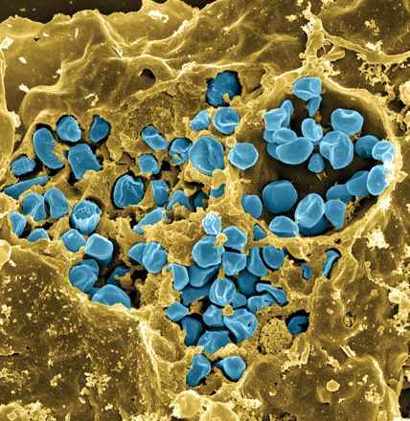
Francisella tularensis
Causes tularemia
Highly infectious
Potential bioweapon
F. tularensis subsp. holarctica LVS
Intracellular growth is essential to cause disease
Fischer, PNAS cover 2006
Notes:
Aersolization doesn’t lead to bioweapon status
Attenuated in humans, not in animal models

Slide 5
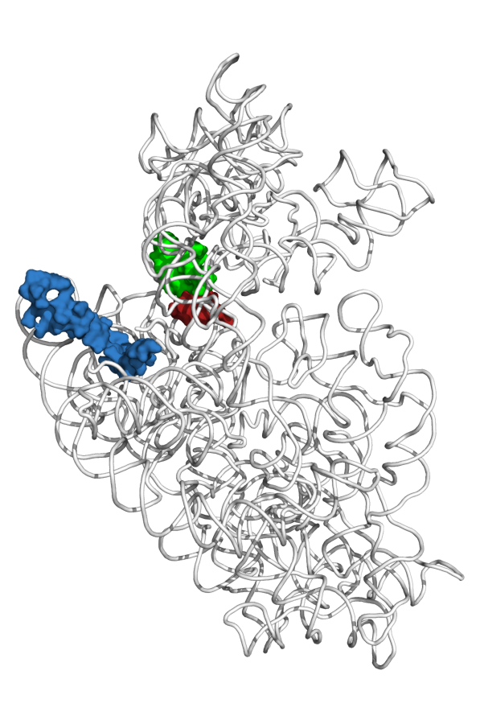
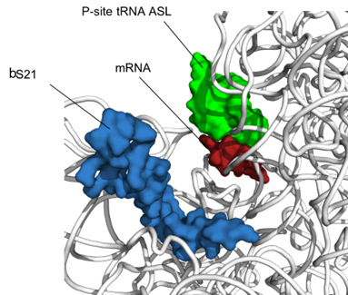
bS21, a small subunit ribosomal protein
Involved in translation initiation
Non-essential
Impacts different phenotypes in different species
Encoded by phage
Take home: bS21 may act as a regulator of translation
mRNA channel
bS21
30S subunit of E. coli
Notes:
Take a little time, mRNA exit channel, implicated in initiation

Slide 6
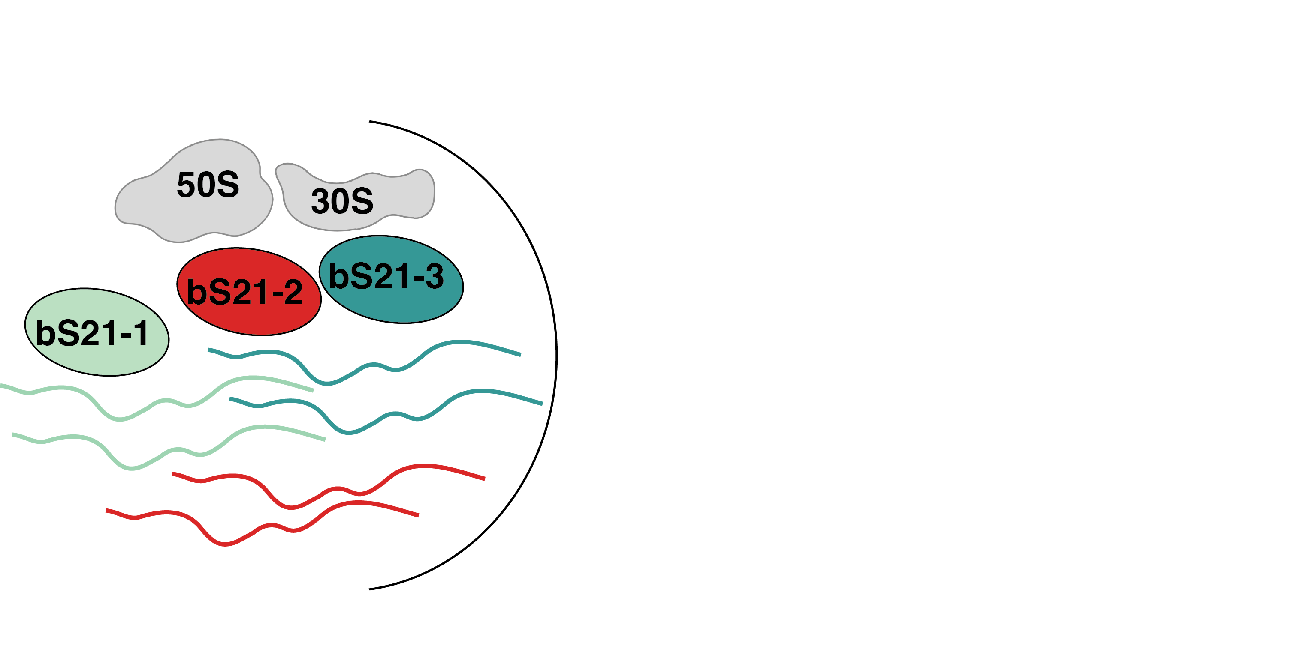
Despite reduced genome, multiple genes encode the same ribosomal protein, bS21
F. tularensis LVS genome: 1.89 Mbp, ~2,000 genes
cspC
rpsU1
rpsU2
yqeY
dnaG
rpoD
rpsU3
Notes:
Even though francisella has a reduced genome, it encodes three copies of the rpsU genes, which encode bS21, a protein in the small ribosomal subunit. Most bacteria have 0 or 1 of this gene. We originally, hypothesized, and have since shown, that these three proteins are produced and incorporated into ribosomes. This is a western blot of purified ribosomes from our wild-type strain as well as strains ectopically expressing each of the bS21 proteins, with a VSVG tag. This, along with some mass spec data we have of purified ribosomes, indicates that multiple classes of ribosomes are possible and occurring
This protein is also interesting to us because it is located close to the mRNA exit channel in the ribosome, and early research has identified that it is involved in translation initiation, so it is in an ideal location to be regulating gene expression at the level of translation initiation.
So this heterogeneity of ribosomes may be a mechanism of regulation, but you may not know that ribosomes are heterogeneous so let me show you other ways that may occur.

Slide 7
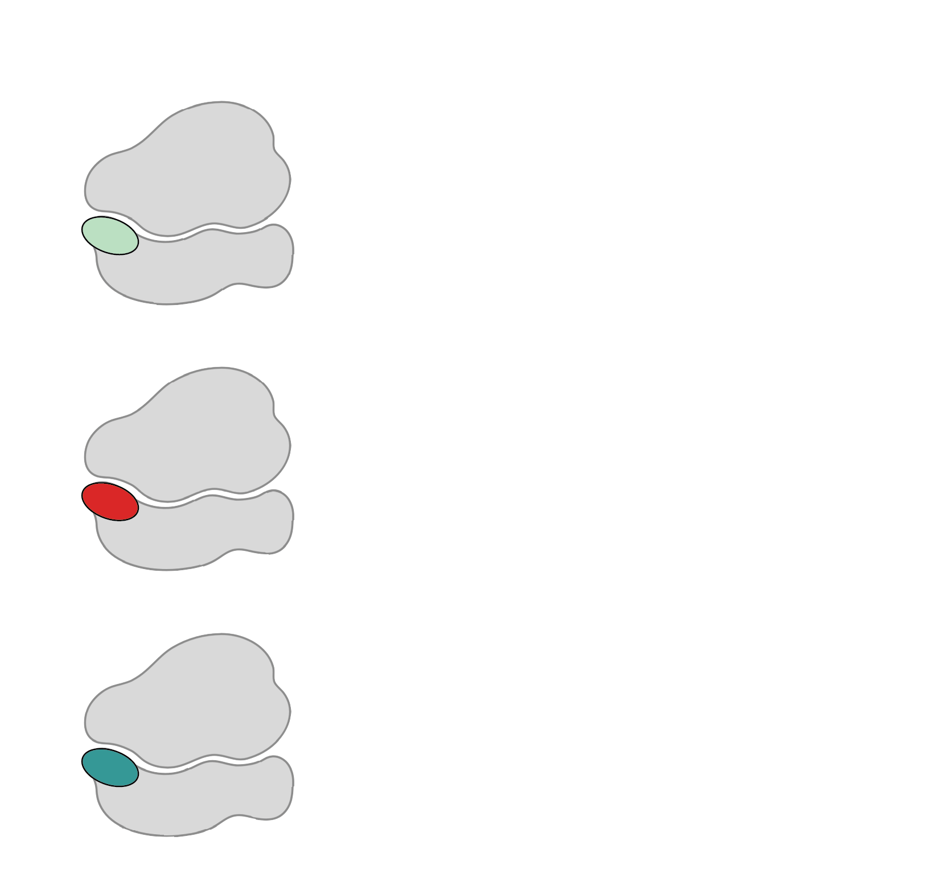

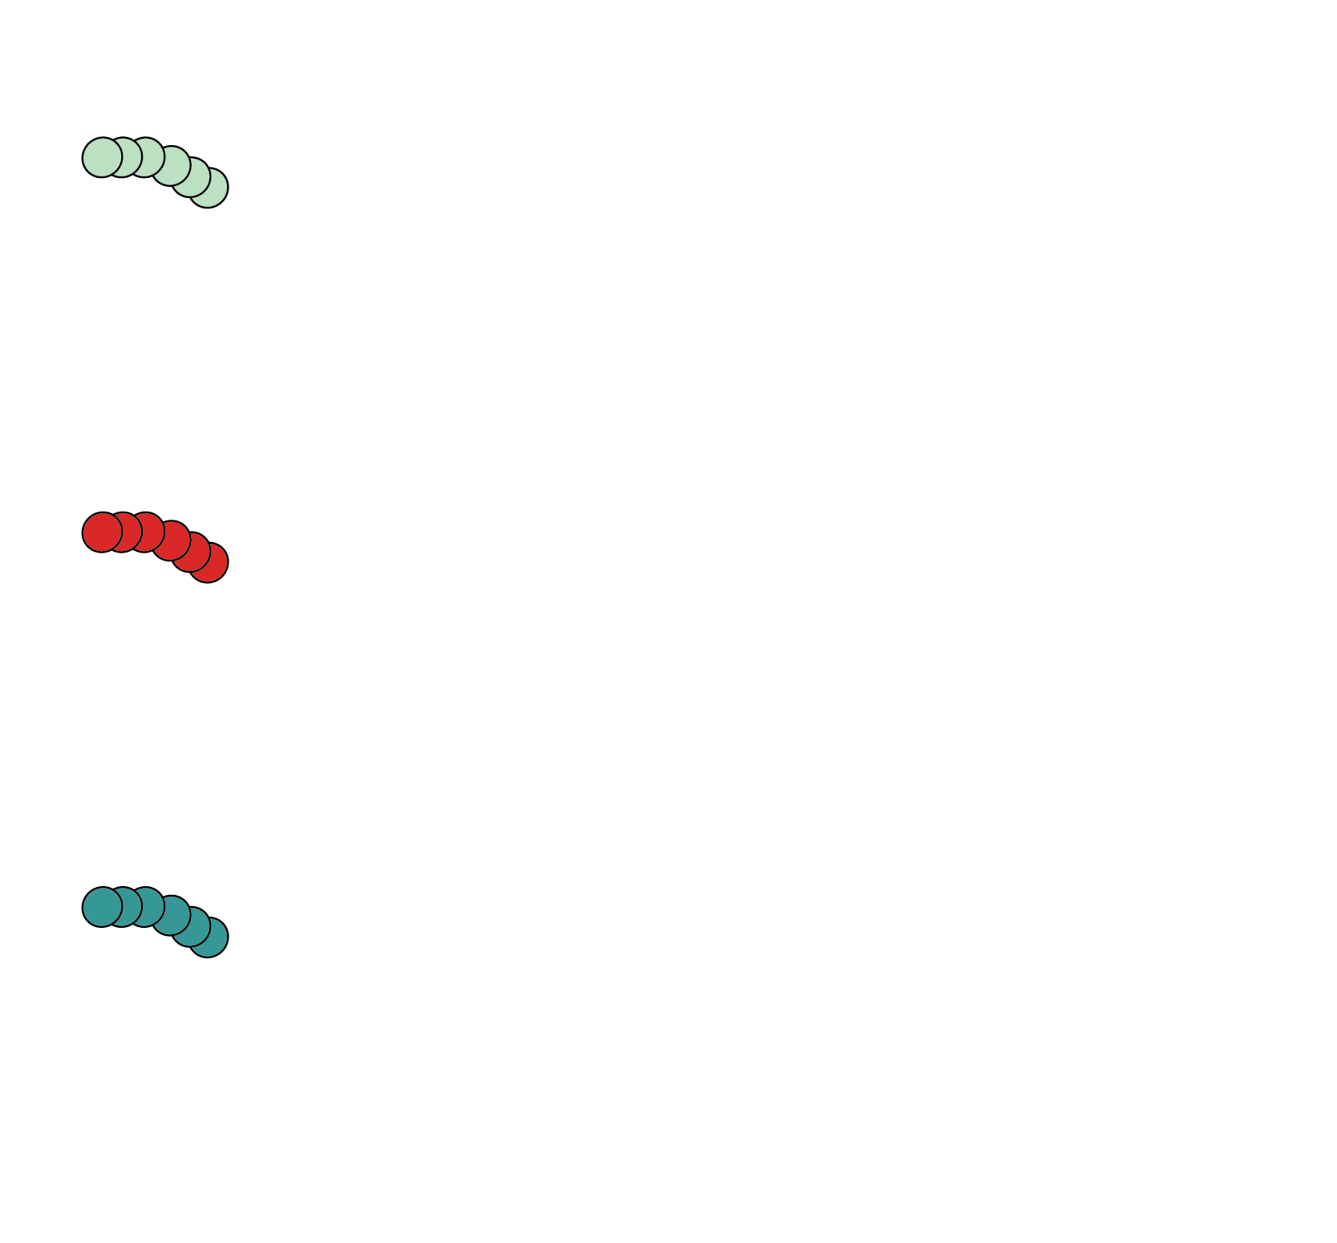

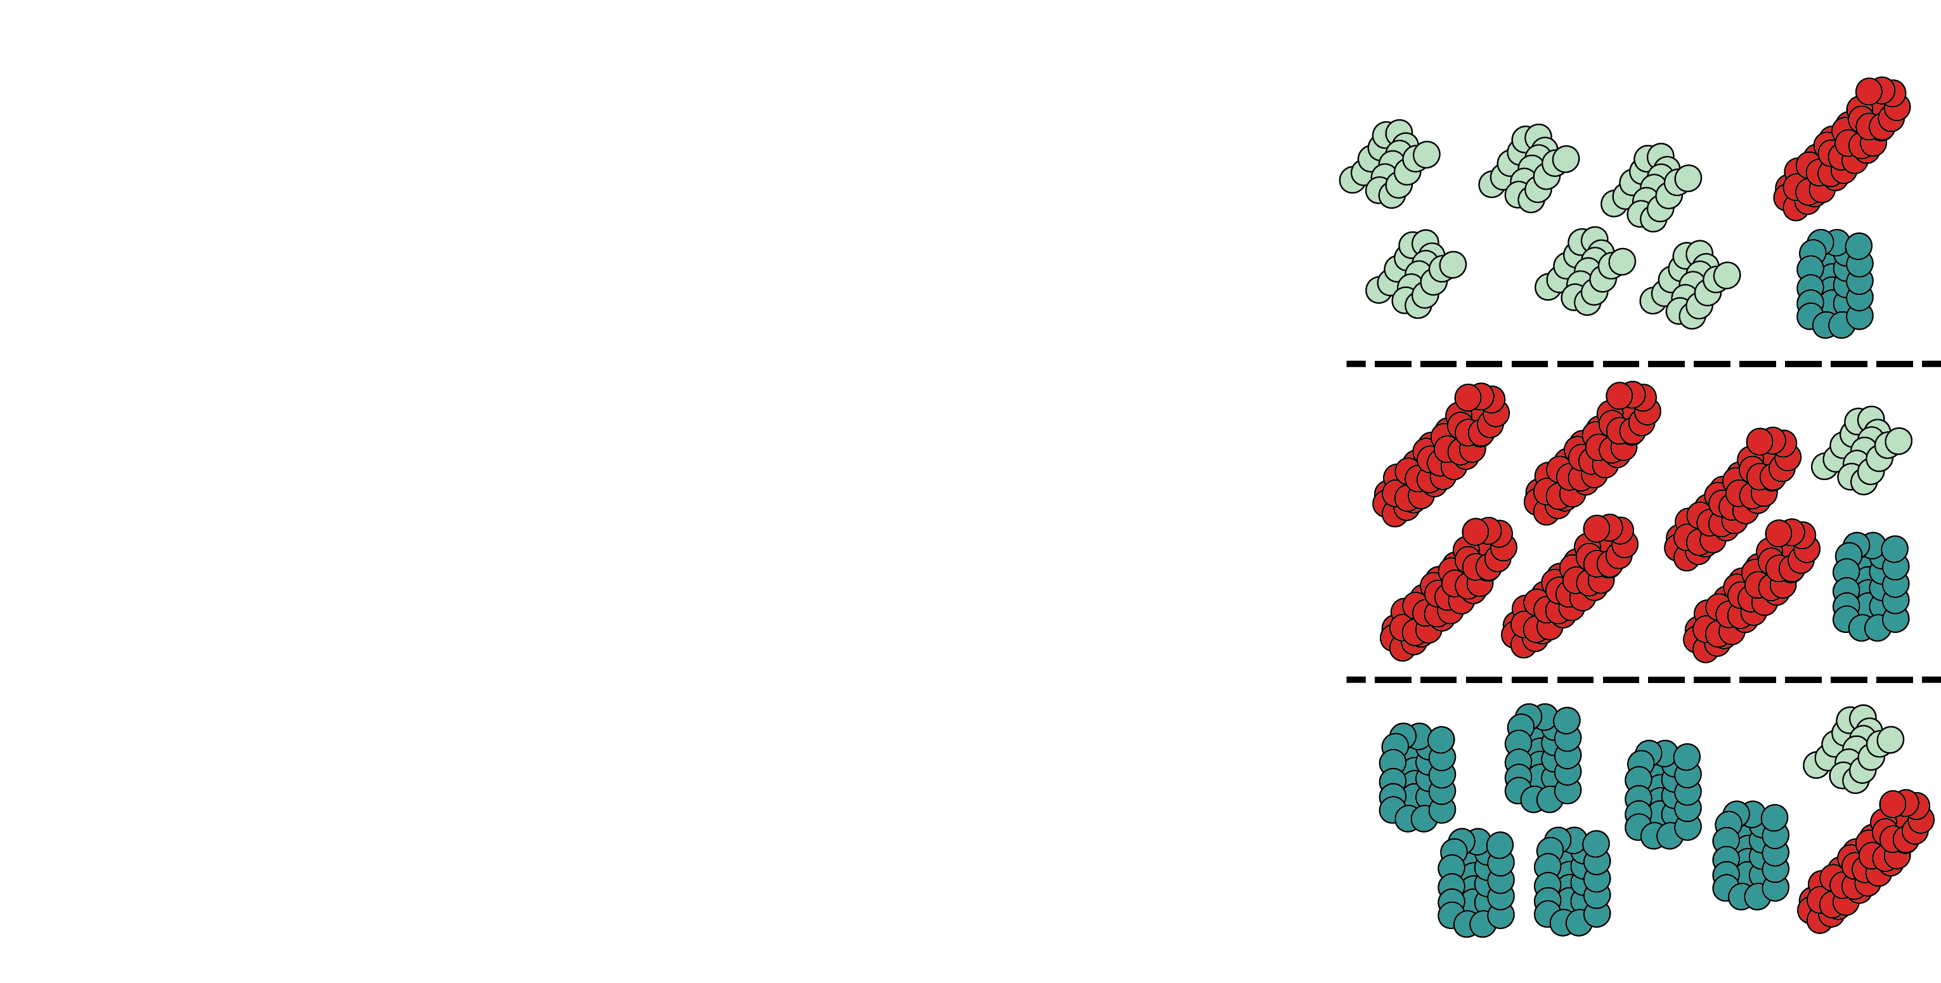
Why have multiple bS21 homologs?

Slide 8
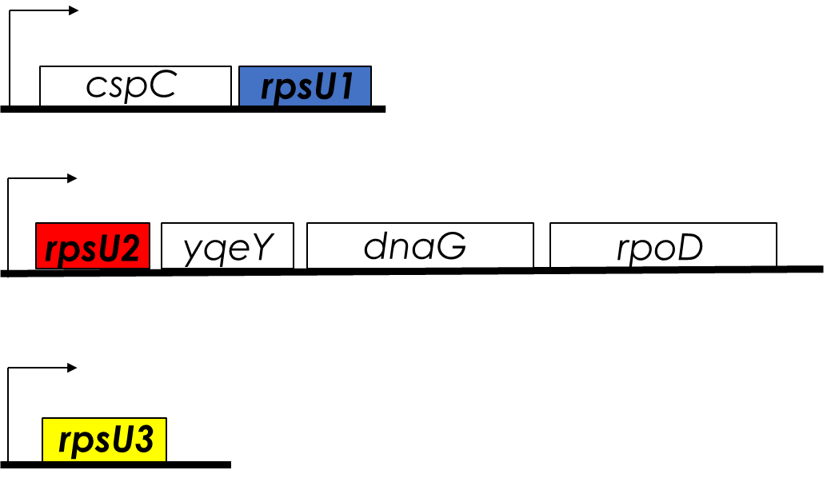
bS21-2 in F. tularensis
Loss of bS21-2
  change in virulence protein abundance
  reduces ability to grow in macrophage
*bS21 is encoded by rpsU
Notes:
End by asking the question: what controls the production of each of these bS21 homologs

Slide 9
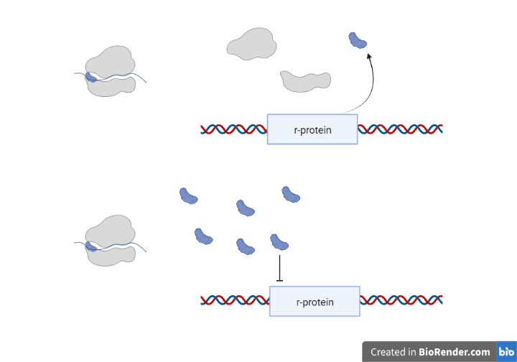
Ribosomal Protein Expression is Tightly Controlled
Notes:
Look we know that rprotein expression is important, and we have a hint that some of these may have these types of controls acting on bs21-2 because of:

Slide 10
RNA Seq Data Suggest bS21-2 Negatively Regulates its Own mRNA
bS21-2 is encoded by rpsU2

Slide 11
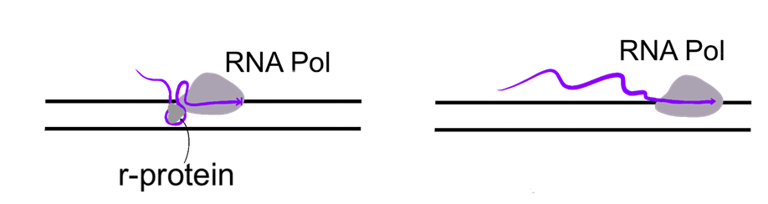
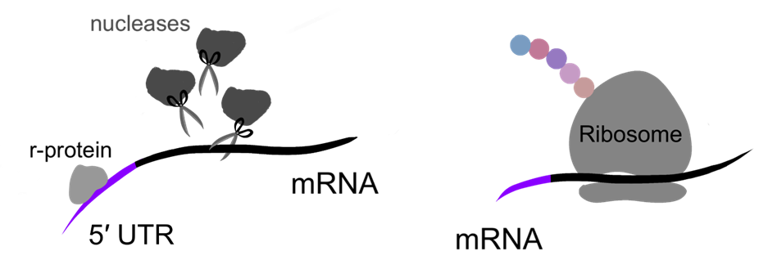
Classic Models of Ribosomal Protein Autoregulation
Balanced r-protein
Imbalanced r-protein
Attenuation
Regulating r-protein will interact with secondary structures as transcription is occurring
Stalls the RNA polymerase
Balanced r-protein
Imbalanced r-protein
Post-Transcriptional Control
Regulating r-protein may recruit nucleases and degrade transcript
Regulating r-protein may sequester the Shine-Dalgarno sequence
Translation is unable to proceed

Slide 12
Outline
Background
  Francisella tularensis
  Ribosomal protein bS21
Transcriptional regulation of bS21-2
Protein abundance of bS21-2
Conclusions

Slide 13
How does bS21-2 regulate its transcript abundance?
Promoter
5′UTR
rpsU2
Notes:
What elements allow for the regulation we observe

Slide 14

Testing 5′ UTR vs Promoter Contribution to Regulation by bS21-2
Cells with bS21-2 (WT) | Cells without bS21-2 (∆rpsU2)
tul4 promoter
tul4
5′ UTR
lacZ
rpsU2 promoter
rpsU2
5′ UTR
lacZ
tul4 promoter
rpsU2
5′ UTR
lacZ
?
?
rpsU2 promoter
tul4
5′ UTR
lacZ
?
?
Notes:
Test the contribution of the promoter and the contribution of the UTR
Recaptiulate data we see at native locus using reporter assay

Slide 15
The 5′ UTR of rpsU2 is Sufficient for Regulation
*
*
+ | -
tul4 | tul4
tul4 | tul4
+ | - | + | -
rpsU2 | rpsU2 | tul4 | tul4
rpsU2 | rpsU2 | rpsU2 | rpsU2
bS21-2
Promoter
5′ UTR
* p<0.05 by t-test.

Slide 16
The 5′ UTR is Sufficient for Regulation by bS21-2
Cells with bS21-2 (WT) | Cells without bS21-2 (∆rpsU2)
tul4 promoter
tul4
5′ UTR
lacZ
1.0
1.1
rpsU2 promoter
rpsU2
5′ UTR
lacZ
1.0
9.3
tul4 promoter
rpsU2
5′ UTR
lacZ
1.0
4.3
rpsU2 promoter
tul4
5′ UTR
lacZ
?
?

Slide 17
Classic Models: Stability Predictions
Attenuation
Regulating r-protein will interact with secondary structures as transcription is occurring
Stalls the RNA polymerase
Prediction: No expected change in stability
Balanced r-protein
Imbalanced r-protein
Balanced r-protein
Imbalanced r-protein
Post-Transcriptional Control
Regulating r-protein may recruit nucleases and degrade transcript
Regulating r-protein may sequester the Shine-Dalgarno sequence
Translation is unable to proceed
Prediction: mRNA changes stability

Slide 18
bS21-2 destabilizes its own transcript
CV
CV
rpsU2 Half-Life (min)
LVS | 2.72
ΔrpsU2 | 15.38

Slide 19
Outline
Background
  Francisella tularensis
  Ribosomal protein bS21
Transcriptional regulation of bS21-2
Protein abundance of bS21-2
Conclusions

Slide 20
yqeY
bS21-2 is encoded by rpsU2
6-fold increase in transcript abundance
No statistically significant change in protein abundance
Notes:
yqeY is here, which we can use to report on protein abundance of rpsU2 operon
We can measure protein for yqeY but not bS21-2 and we found no change in protein abundance despite the six fold increase in transcr. In order to study this more closely we took our reporter approach to see if we could recapitulate our findings using our reporter assay

Slide 21
Leader sequence controls rpsU2 transcript abundance and protein synthesis
bS21 homologs repress rpsU2 transcript abundance
  Mediated by rpsU2 5ʹ UTR
Translation of rpsU2 5ʹ UTR is influenced by unidentified factor(s)

Slide 22
Outline
Background
  Francisella tularensis
  Ribosomal protein bS21
Transcriptional regulation of bS21-2
Protein abundance of bS21-2
Transcriptional regulation of bS21-1 and bS21-3
Conclusions

Slide 23
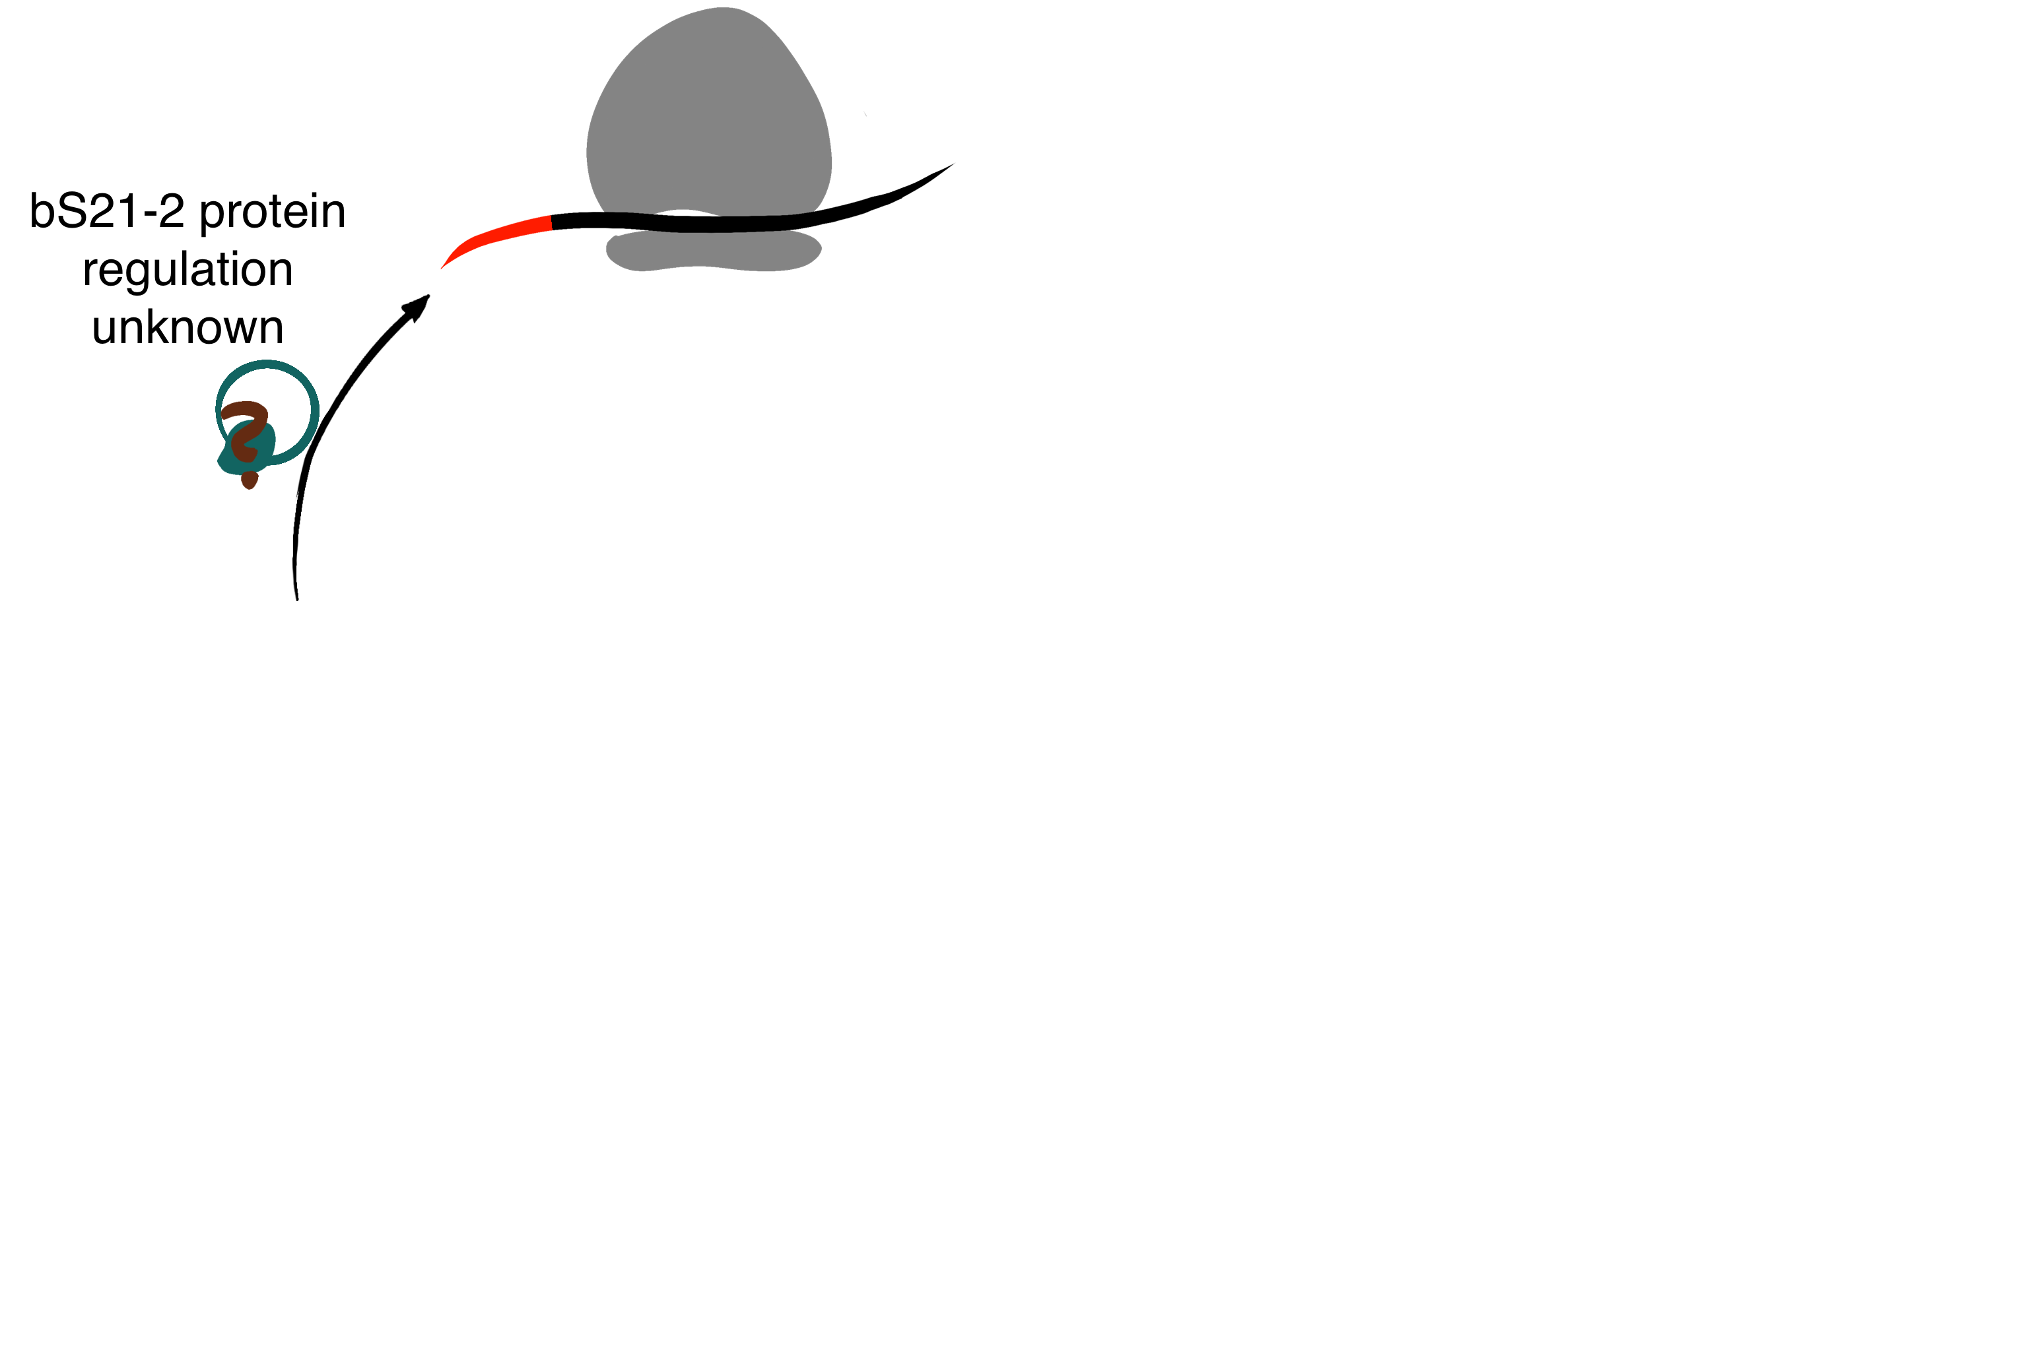
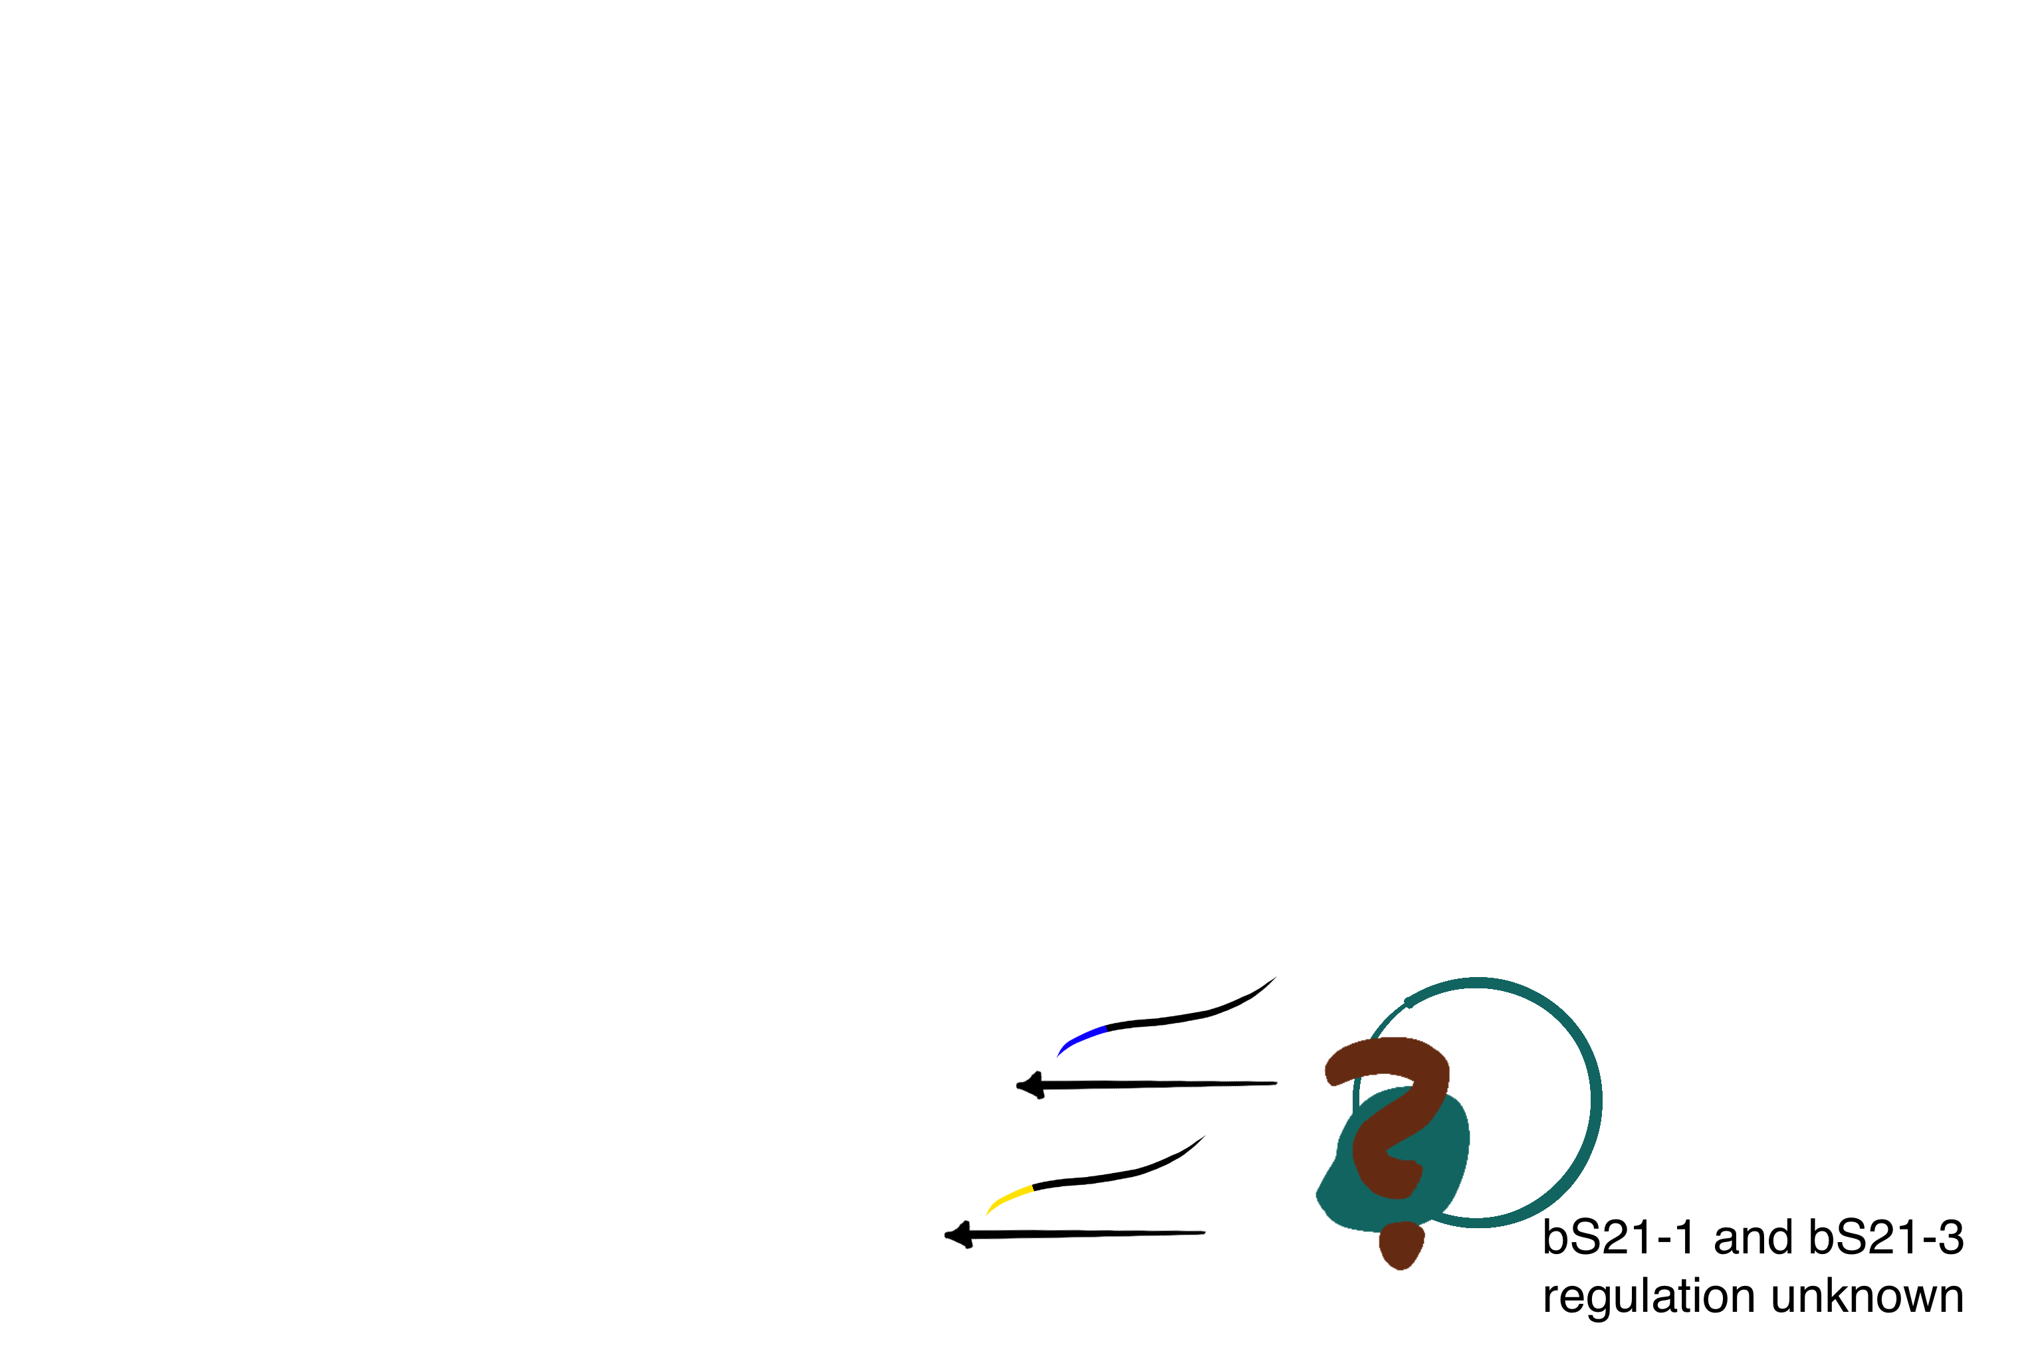
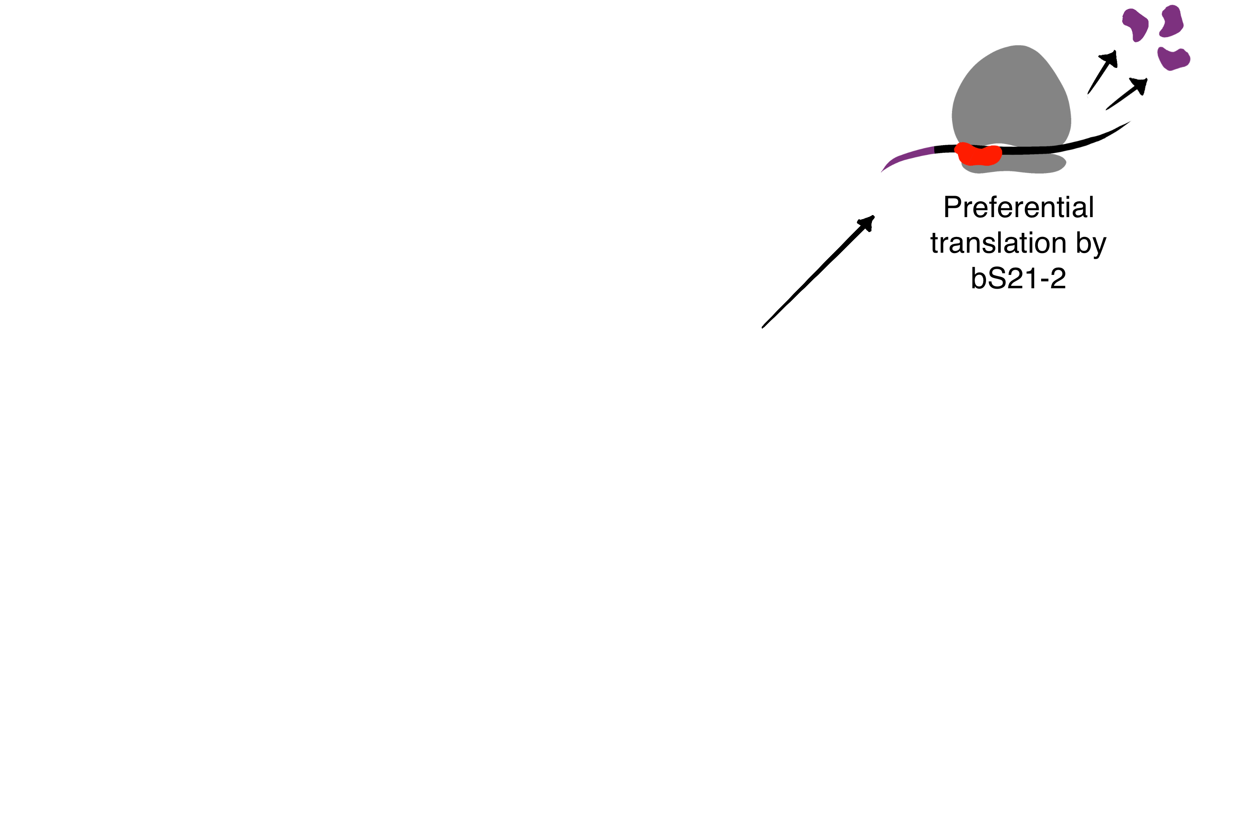
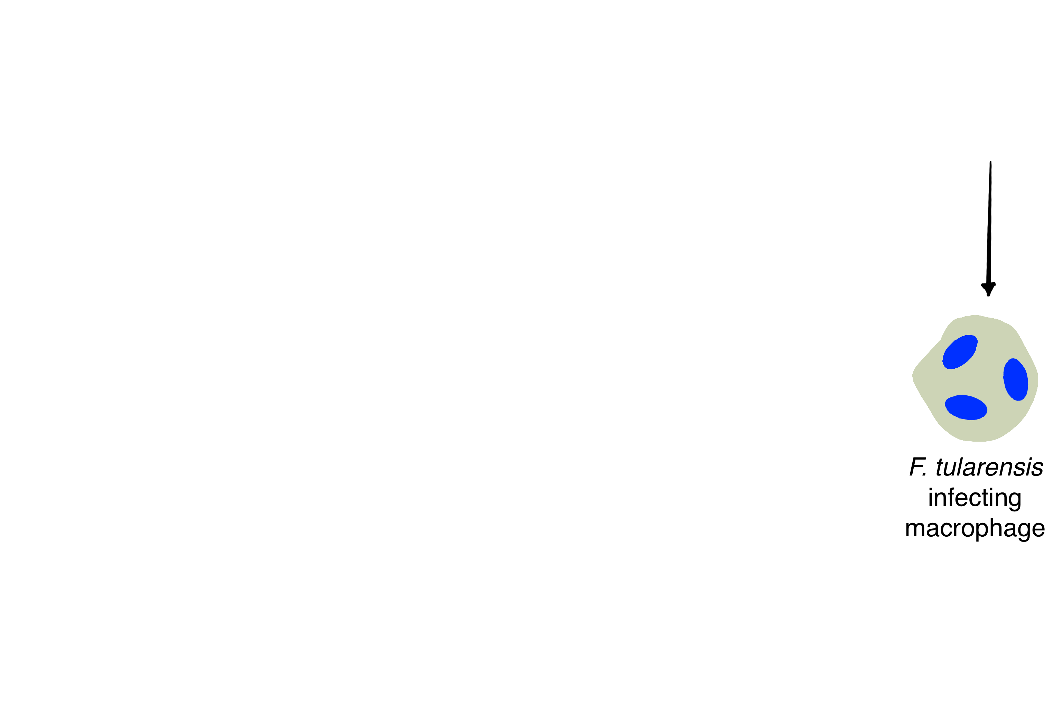
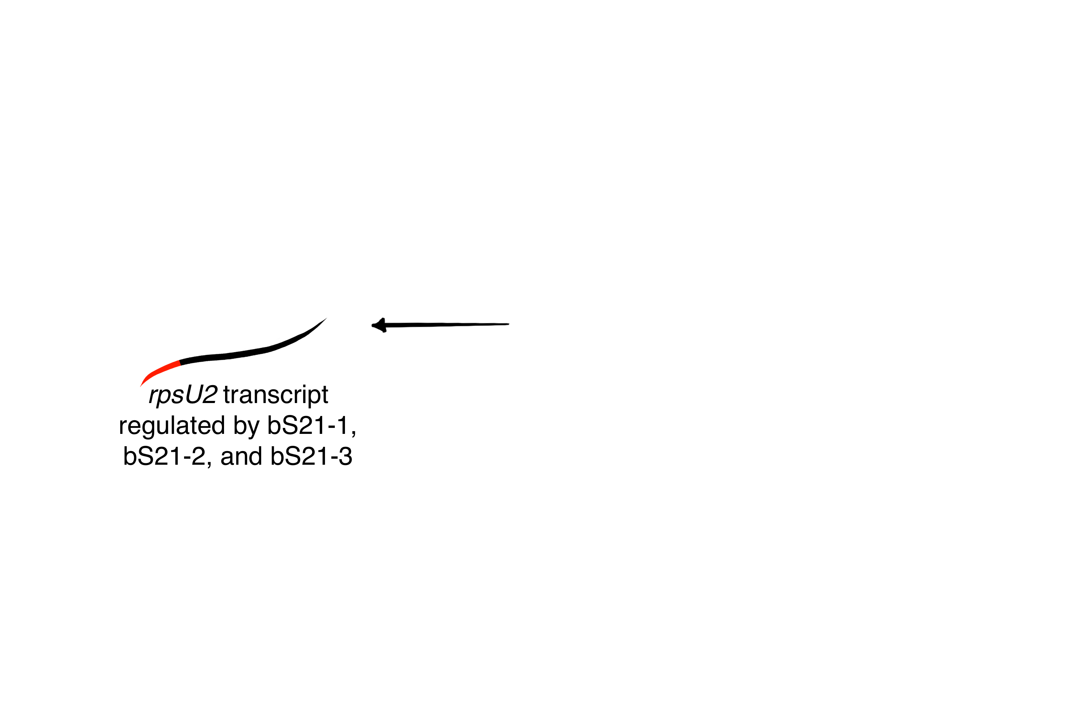
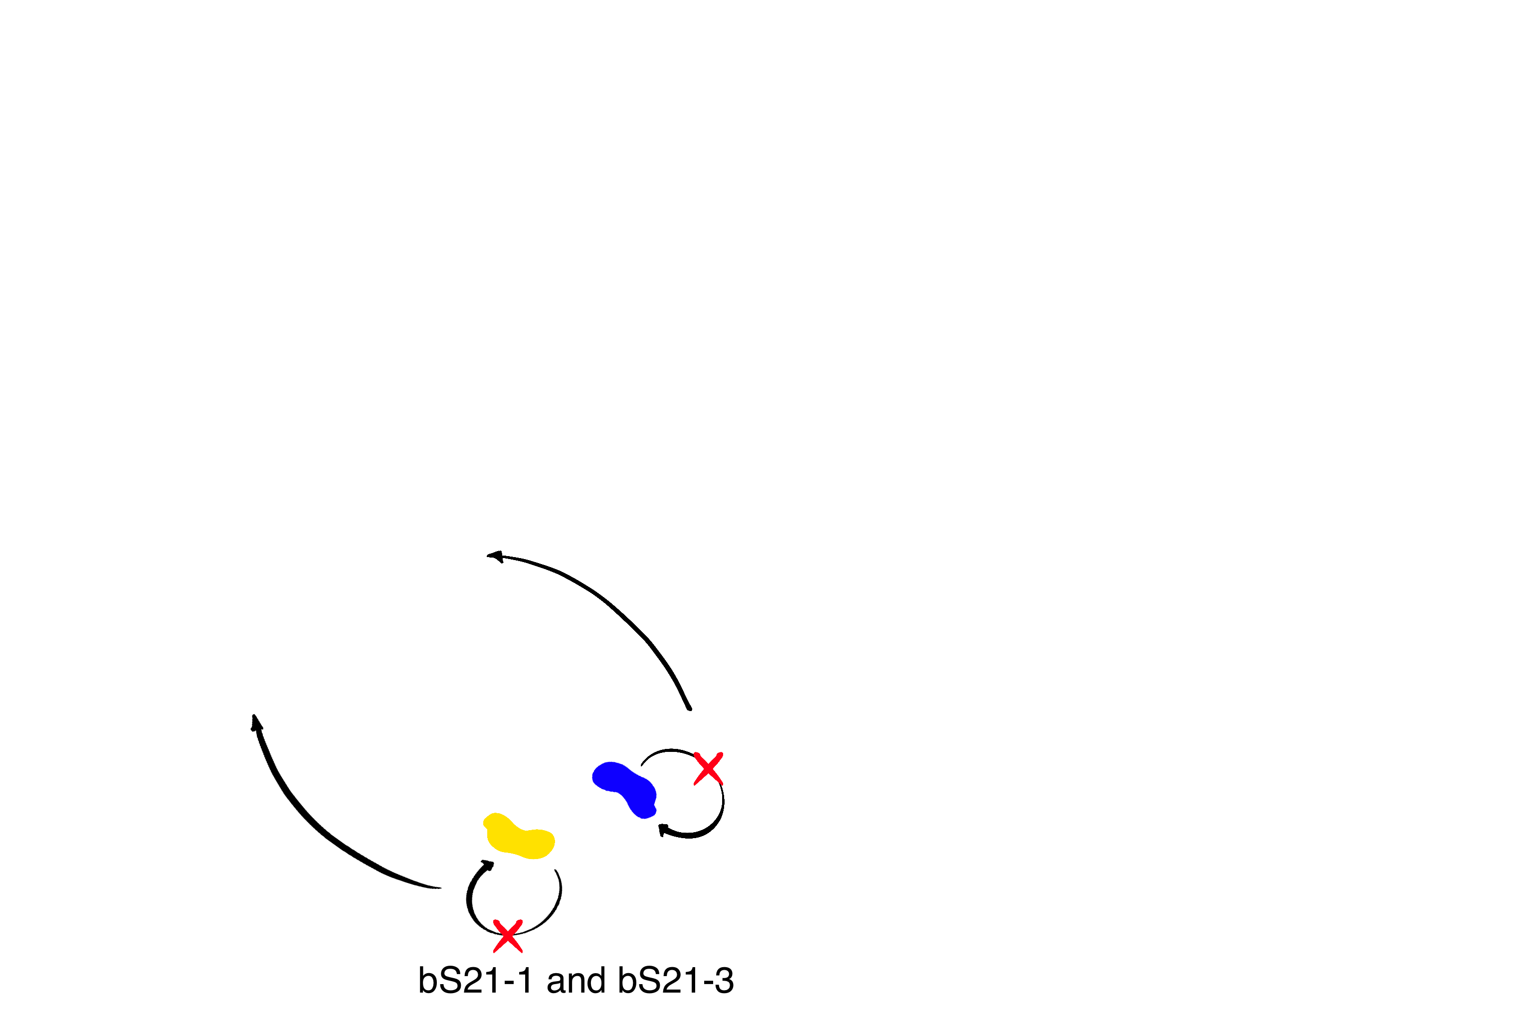
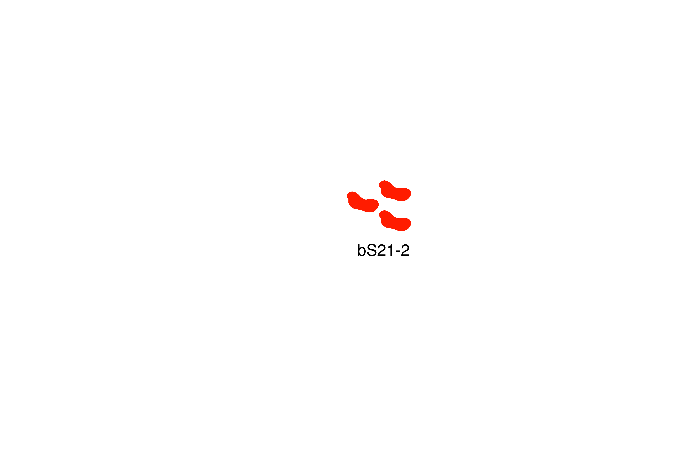
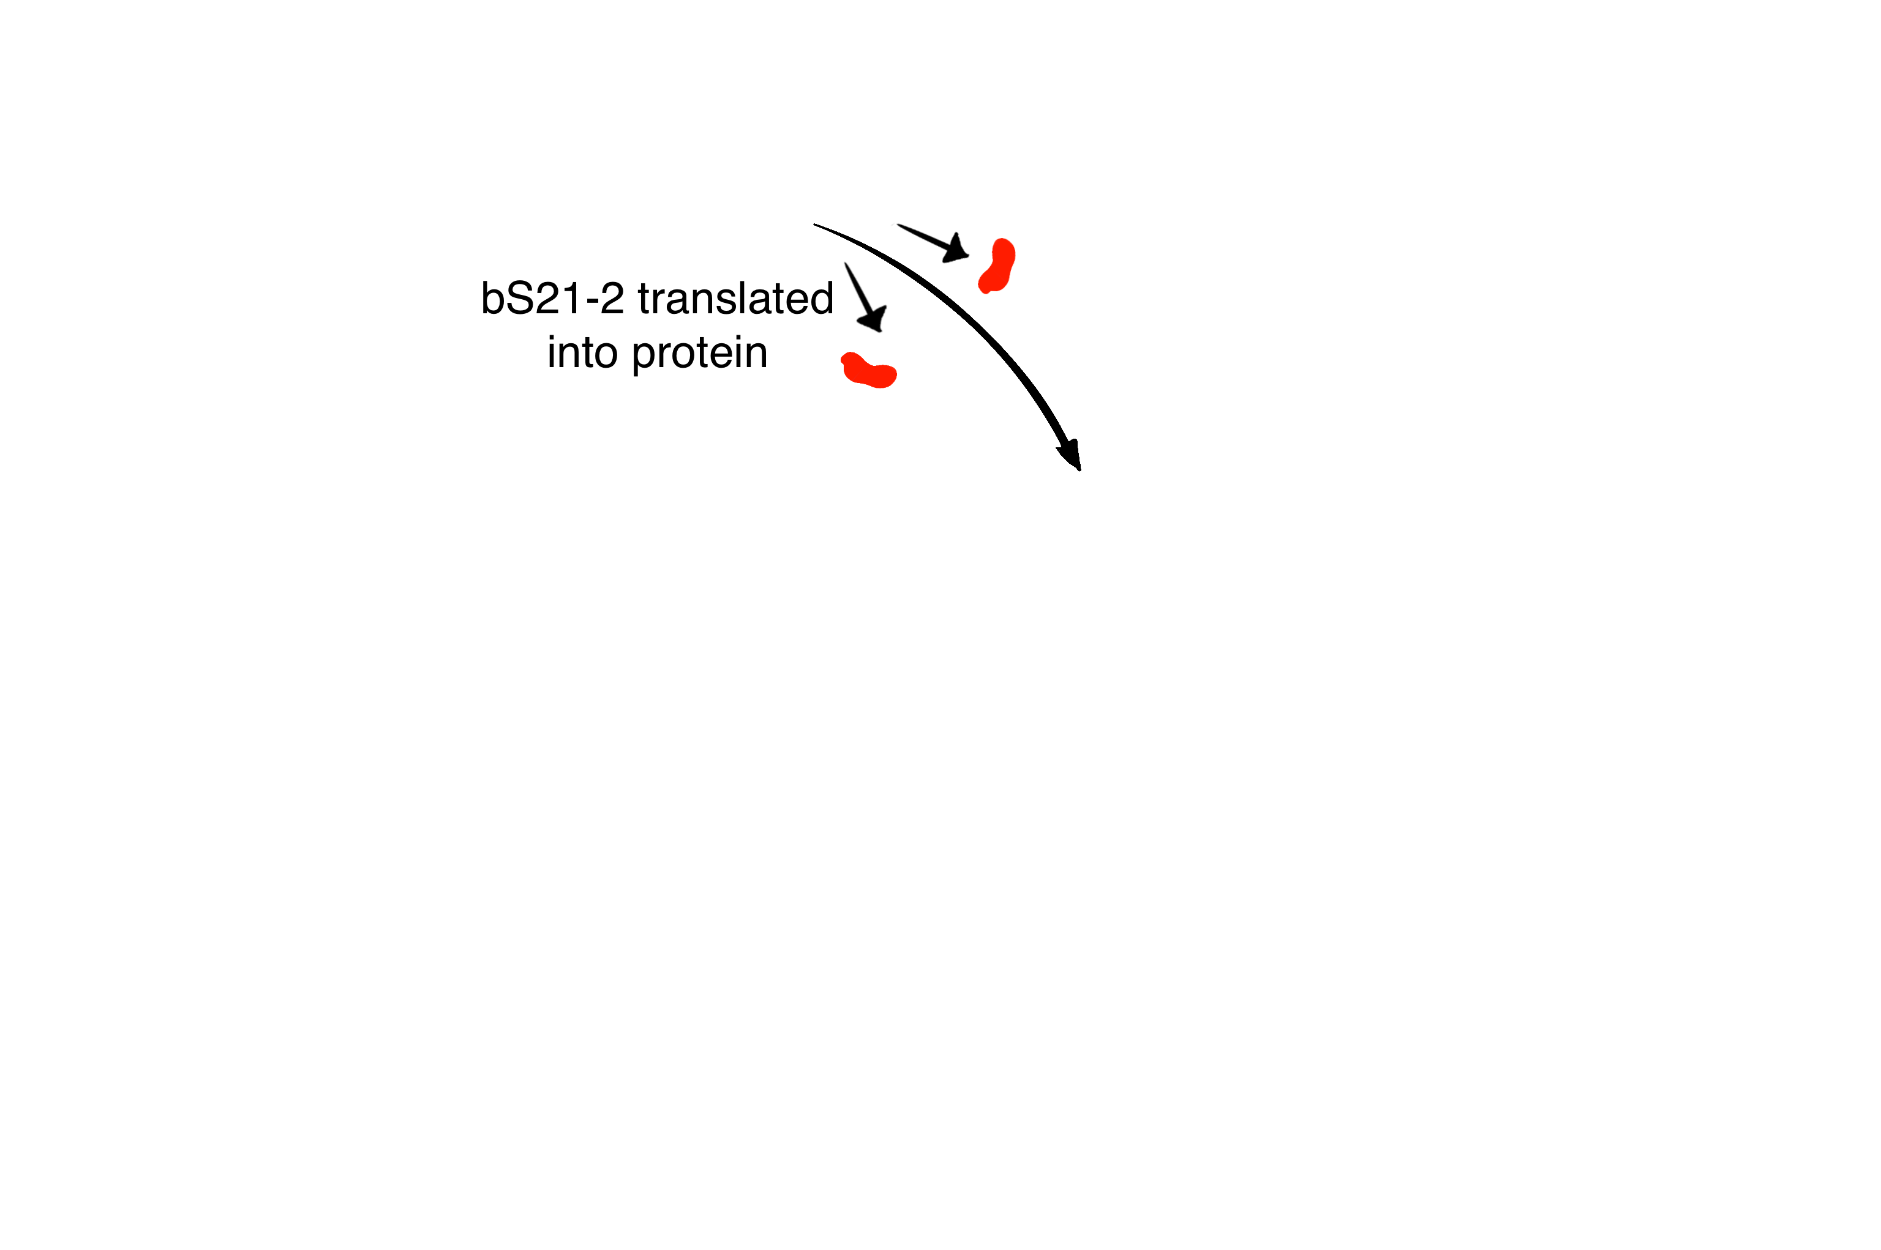
bS21-2 Regulatory Network
bS21-2 controls translation initiation
bS21-2 contributes to the abundance of its own transcript
bS21-1 and bS21-3 do not autoregulate
Regulation of bS21-1 and bS21-3 remains undefined
bS21-2 protein abundance is throttled by some other mechanism

Slide 24
Remaining Questions
What cis and trans factors lead to the control of the rpsU2 transcript stability?
What controls translation of the rpsU2 transcript?
What controls production of bS21-1 and bS21-3?

Slide 25







ACKNOWLEDGEMENTS
Dr. Kathryn Ramsey
  Hannah Trautmann
  Ben Moore
  Kira Barnabe
  Aisling Macaraeg
  Dan Floyd
  Former lab members
Dr. Steven Gregory
URI INBRE core
Notes:
I want to thank everyone in the Ramsey lab for their support especially Kathryn. We have fantastic collaborators at URI and Duke whom I want to thank, and then our funding sources, and I will happily take any questions.
Notes:
Motility and biofilm – bacillus subtilis
Acid stress resistance – listeria monocytogenes
Antibiotic resistance – staph aureus
Virulence – burkholderia pseudomallei and francisella in this work
Phage paper – Mizuno et al. 2019, Chen 2022
Bacteriodetes – Jha et al 2020 – probably autoregulating its own expression because rpsU is one of the few genes with a strong SD

Slide 26
Any Questions?

Slide 27
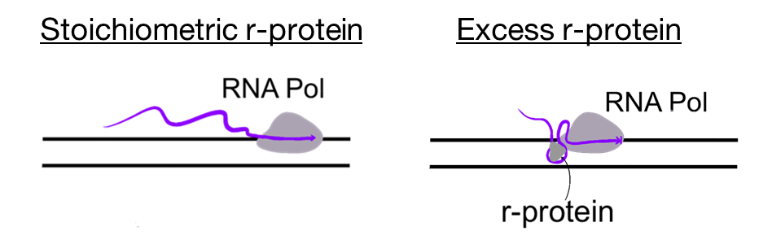
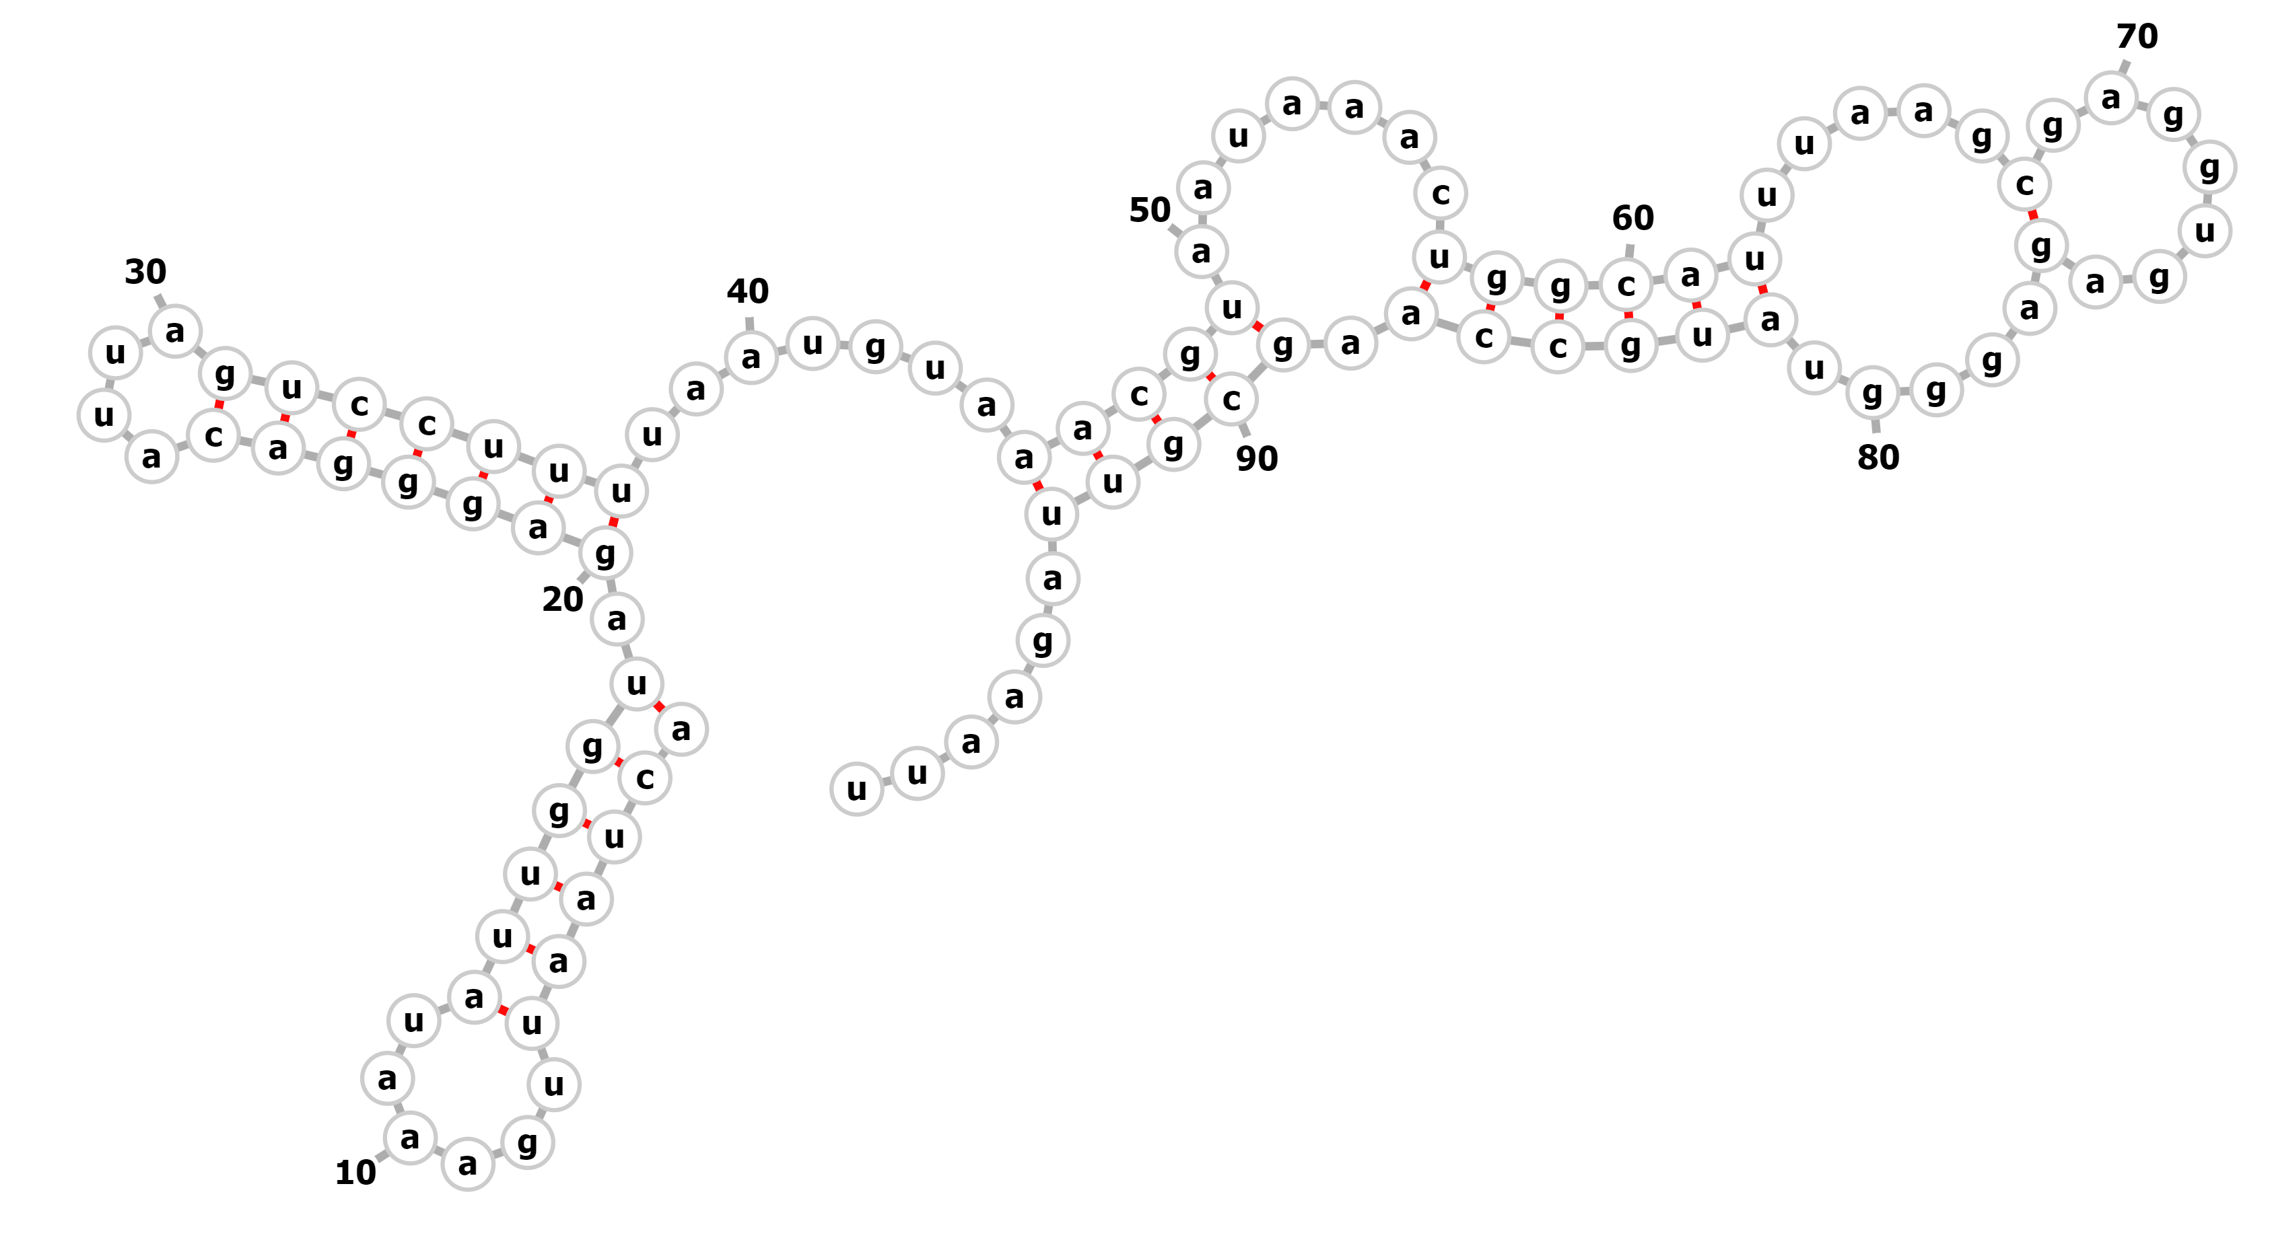
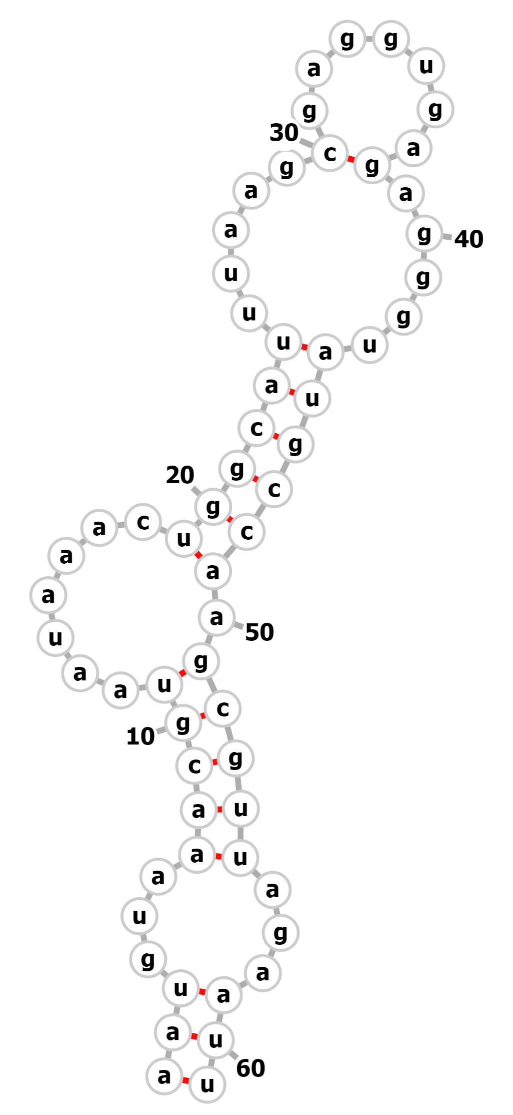
Testing for attenuation of the rpsU2 transcript
Testing the 5′ UTR via fusion to GFP
Deletion of the two stem loop structures
The predicted structure has two stem loops
          Potential site of termination
          Pause site bp +58-+69

Slide 28
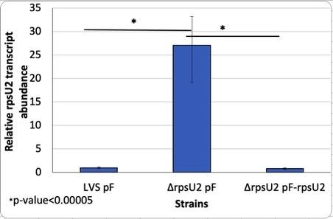
Previous RT-PCR
When bS21-2 is present there is a relatively low transcript abundance
With no protein present, transcript abundance increases significantly
Further suggests that bS21-2 is regulating its own expression
Notes:
Another piece of preliminary data that was used is showing transcript abundance between LVS and delta rpsU2
As you can see, when there the rpsu2 gene is deleted there is a 25 fold increase in transcript abundance
This is clearly showing that when there is no protein present, there is an increase in transcript. The protein is suppressing itself.
What could be happening?
One option is that it is preventing its own transcription.
Binding to DNA for example
Another option is that it could be inhibiting translation leading to quick degradation
Which would be similar to the example that I showed you earlier
With this idea that the protein bS21-2 is preventing its own transcription, we were interested to investigate which specific part of the sequence could the protein be influencing? Is this regulation occuring at the level of transcription or translation?

