Slide 1
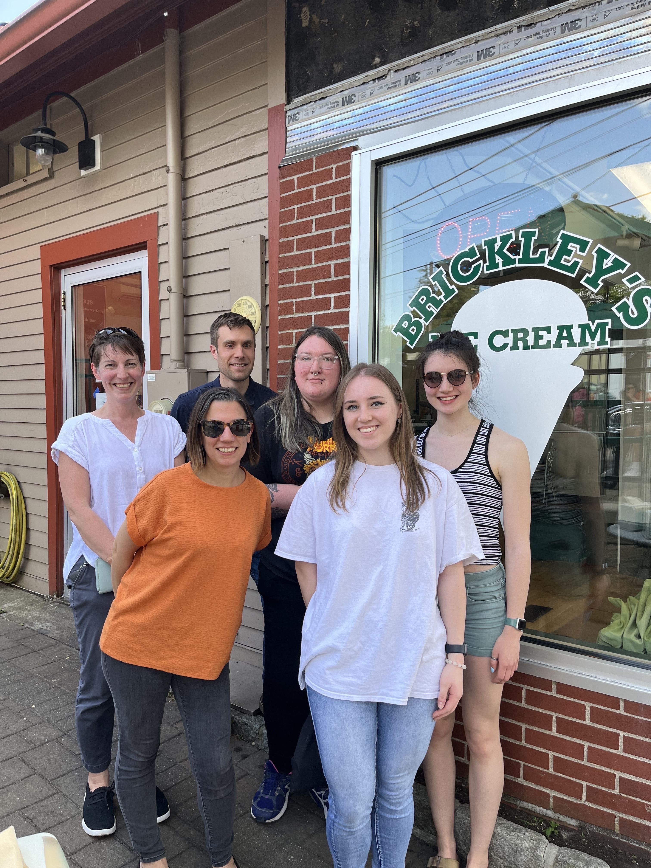
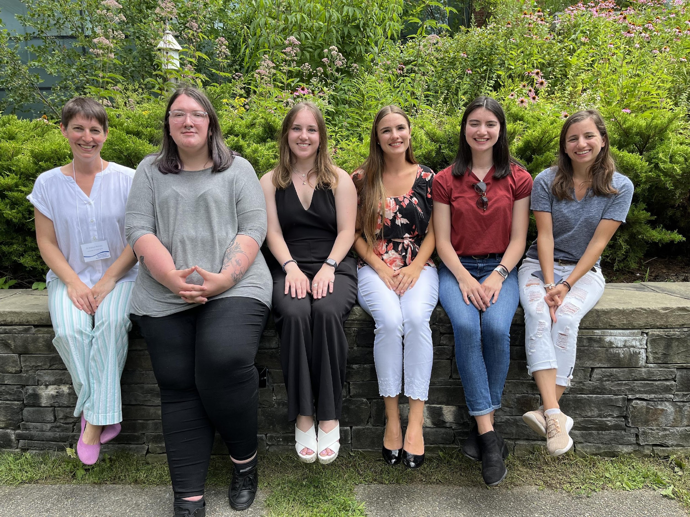





ACKNOWLEDGEMENTS
Dr. Kathryn Ramsey
  Hannah Trautmann
  Ben Moore
  Kira Bernabe
  Aisling Macaraeg
  Dan Floyd
  Current and former lab members
Dr. Steven Gregory
URI INBRE core
Notes:
I want to thank everyone in the Ramsey lab for their support especially Kathryn. We have fantastic collaborators at URI and Duke whom I want to thank, and then our funding sources, and I will happily take any questions.
Notes:
Motility and biofilm – bacillus subtilis
Acid stress resistance – listeria monocytogenes
Antibiotic resistance – staph aureus
Virulence – burkholderia pseudomallei and francisella in this work
Phage paper – Mizuno et al. 2019, Chen 2022
Bacteriodetes – Jha et al 2020 – probably autoregulating its own expression because rpsU is one of the few genes with a strong SD

