Slide 1

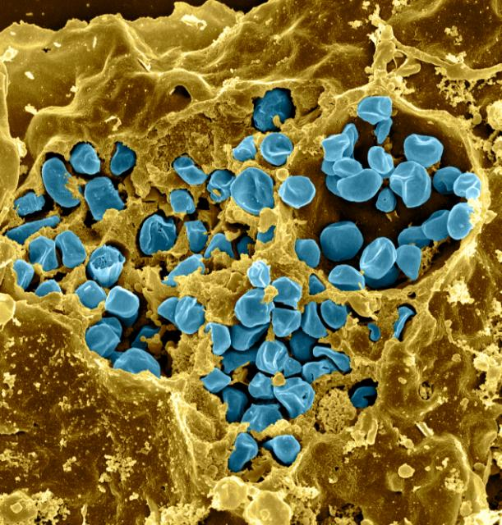

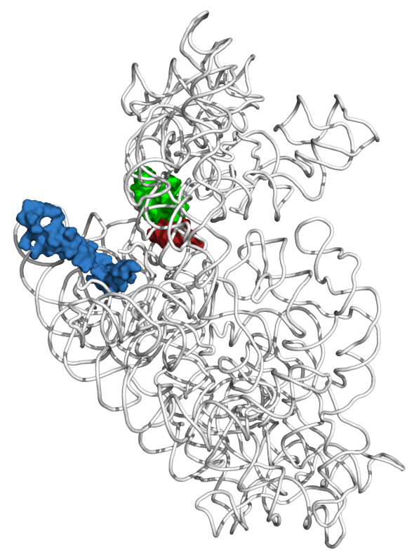
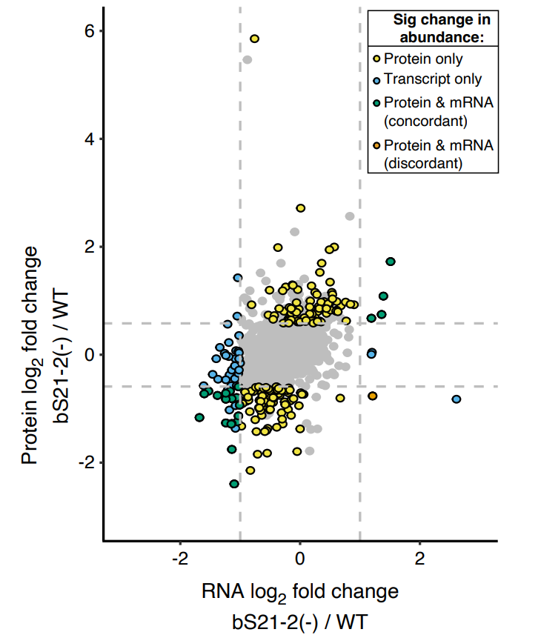


Investigating the Regulation of bS21 Homologs in Francisella tularensis
Sierra Schmidt¹, Aisling Macaraeg¹, Dan Floyd¹, Hannah Trautmann¹, Kathryn Ramsey ^{1,2}
¹Department of Cell and Molecular Biology
²Department of Biomedical and Pharmaceutical Sciences
Introduction
Study Goals
bS21-2 Translational Control
Francisella tularensis
Ribosomal Heterogeneity in F. tularensis
Understand the regulation of the bS21 homologs
Transcript Abundance
  How do bS21-1, bS21-2, and bS21-3 affect their own production?
Protein Abundance
  What affects the translation of the bS21 coding transcript?
Evidence of regulated bS21-2 translation
Gram-negative
Intracellular pathogen
Causes tularemia
Potential bioweapon
Figure 5. The protein abundance of bS21-2 is not correlated with changes in its transcript abundance. β-galactosaidase activity, in Miller Units (y-axis), of indicated translational fusions in cells with or without bS21-2. Error bars are 1 SD, * p<0.05 by t-test.
  bS21-1
bS21: small subunit ribosomal protein involved in translation initiation
bS21 homologs repress bS21-2 transcript, rpsU2
*
  bS21-2
mRNA channel
+ | - | + | -
tul4 | tul4 | rpsU2 | rpsU2
tul4 | tul4 | rpsU2 | rpsU2
  Three homologs in F. tularensis
    Leads to ribosome heterogeneity
  Loss of bS21-2
    Influences virulence factors and intramacrophage growth
bS21-2
Promoter
5′ UTR
bS21
  bS21-3
rpsU2 5' UTR is sufficient for regulation
30S ribosomal subunit
*
*
Figure 6. The 5′ UTR is sufficient to prevent increased translation of the rpsU2 transcript. β-galactosidase activity of indicated translational fusions in cells with or without bS21-2. Error bars are 1 SD, * p<0.05 by t-test.
Figure 1. Location of bS21 in the small subunit of the E. coli ribosome
bS21-2 controls gene expression at the level of translation and influences abundance of its own transcript
Figure 3. bS21-2 transcript abundance is controlled by all three bS21 homologs. RNA-Seq of wild-type (LVS) cells or cells lacking bS21-2 (∆rpsU2) and either empty vector (pF) or vector producing indicated bS21 homolog. Y-axis is truncated at 10,000 for clarity. Note that reads corresponding to plasmid-encoded rpsU2 map to the native operon. A subset of data are published (Trautmann & Ramsey, 2022).
Translational Fusion Constructs and Predictions
bS21-2
Promoter
5′ UTR
+ | - | + | -
rpsU2 | rpsU2 | tul4 | tul4
rpsU2 | rpsU2 | rpsU2 | rpsU2
Transcript Abundance
Protein Abundance
Figure 2. Cells lacking bS21-2 have changes in protein abundance that are not due to changes in transcript abundance. Each data point represents a gene and the axes represent log2 fold-change in either transcript (x-axis) or protein (y-axis) abundance, comparing wild-type cells and cells lacking bS21-2 (Trautmann & Ramsey, 2022).
Cells with bS21-2 (WT) | Cells without bS21-2 (∆rpsU2)
Cells with bS21-2 (WT) | Cells without bS21-2 (∆rpsU2)
bS21-1 and bS21-3
tul4 promoter
tul4
5′ UTR
lacZ
bS21-1 and bS21-3 do not autoregulate
Models for R-Protein Regulation
rpsU2 promoter
rpsU2
5′ UTR
lacZ
Figure 7. bS21-1 and bS21-3 do not significantly influence the abundance of their transcripts. The relative transcript abundance of the 5′ UTR of either rpsU1 or rpsU3 in wild-type cells or cells lacking rpsU1 or rpsU3, respectively. Error bars are 1 SD.
MODEL 1: Attenuation
rpsU2 promoter
tul4
5′ UTR
lacZ
?
?
?
?
Stoichiometric r-protein
Excess r-protein
tul4 promoter
rpsU2
5′ UTR
lacZ
?
?
?
?
bS21-2 Transcriptional Control
WT ΔrpsU1
WT ΔrpsU3
rpsU2 5′UTR is sufficient for regulation by bS21
Conclusions
Future Directions
MODEL 2:
Post-Transcriptional Control
*
*
bS21-2 transcript abundance is repressed by all three bS21 homologs
The 5' UTR is sufficient for control of rpsU2 transcript abundance and translation
Transcript regulation is not equivalent to protein regulation
Determine if transcript abundance is due to changes in stability or termination during transcription
Assess how the 5′ UTR structure of the rpsU2 transcript impacts translation
Stoichiometric r-protein
Excess r-protein
+ | -
tul4 | tul4
tul4 | tul4
+ | - | + | -
rpsU2 | rpsU2 | tul4 | tul4
rpsU2 | rpsU2 | rpsU2 | rpsU2
bS21-2
Promoter
5′ UTR
Figure 4. The leader sequence of rpsU2 is sufficient for autoregulation by bS21-2. The indicated translational fusions, in cells with or without bS21-2, were assessed by qPCR for relative abundance of lacZ. Results from reporter fusions containing the promoter and 5′ UTR of either tul4 only or rpsU2 only reveal that the fusions recapitulate regulation of the native genes. Error bars are 1 SD, * p<0.05 by t-test.
Reference
Trautmann HS, Ramsey KM. A Ribosomal Protein Homolog Governs Gene Expression and Virulence in a Bacterial Pathogen. J Bacteriol. 2022 Oct 18;204(10):e0026822.
Notes:
Know that transcriptional repressors interacts on polycistronic opersons at a specific target site; this happens near or at the transcriptional initiation site (demonstrated in the promoter)
There is a possibility for some to have multiple binding sites for egulation
Many of the regulatory r-prtoeins bind near the initiation sites of ribosomes so its speculated that the regulation may come from a similar structure recognition between rrnas and mrnas tha they regulate (with higher binding affinity in the rrnas) (this indicates an ability to control translation as well, rather than transcription but obviously I’m looking at just transcriptional control)
Models: binding of r-protein to mRNA recruits nucleases, inhibition by r-protein terminations the transcription of the cistrons downstream (first interacts with first cistron) (this termination of translation would occur prior to the translational start site of the first gene)

