Slide 1

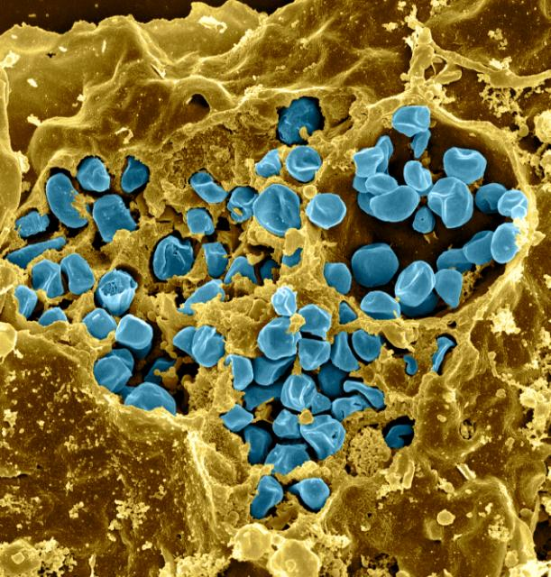
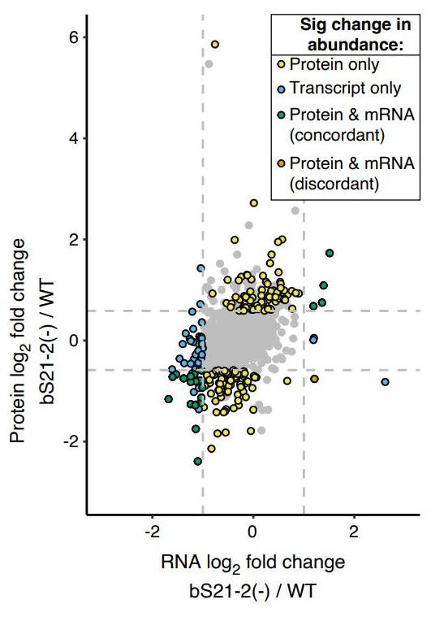
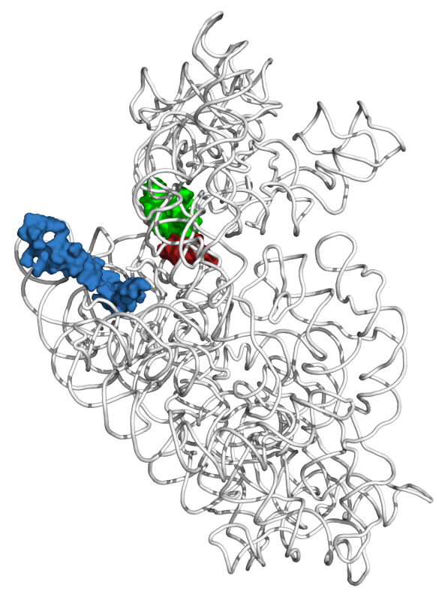
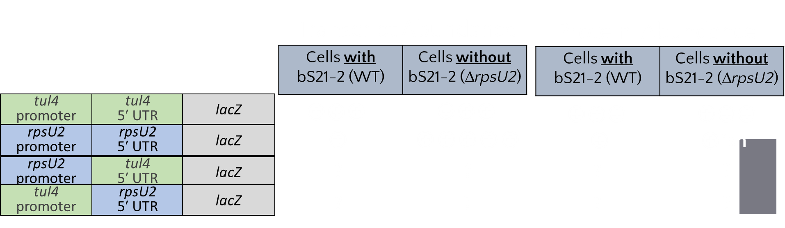
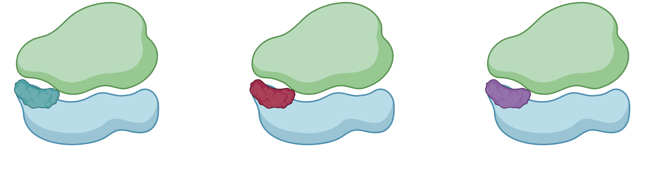

Investigating the Regulation of bS21 Homologs in Francisella tularensis
Sierra Schmidt¹, Aisling Macaraeg¹, Dan Floyd¹, Hannah Trautmann¹, Kathryn Ramsey ^{1,2}
¹Department of Cell and Molecular Biology
²Department of Biomedical and Pharmaceutical Sciences
Introduction
Study Goals
bS21-2 Translational Control
Francisella tularensis
Understand the regulation of the bS21 homologs
Transcript Abundance
  How do bS21-1, bS21-2, and bS21-3 affect their own production?
Protein Abundance
  What controls bS21-2?
tul4 protein abundance not affected by bS21-2
Gram-negative
Intracellular pathogen
Causes tularemia
Potential bioweapon
Figure 6. β-galactosaidase activity of translational fusion constructs containing like promoter and 5′ UTR of either rpsU2 or tul4.
bS21 homologs repress bS21-2 transcript, rpsU2
bS21: small subunit ribosomal protein involved in translation initiation
Figure 3. RNASeq transcript reads mapped to the native rpsU2 operon. In strains with ectopic expression of rpsU2, plasmid transcript reads are also mapped to the native operon.
+ | - | + | -
tul4 | tul4 | rpsU2 | rpsU2
tul4 | tul4 | rpsU2 | rpsU2
  Three homologs in F. tularensis
    Leads to ribosome heterogeneity
  Loss of bS21-2
    Influences virulence factors and intramacrophage growth
Figure 2. Each data point indicates a gene, mapped according to changes in transcript and protein abundance changes between wild-type and cells backing bS21-2. 161 genes had protein changes not explained by transcript changes. 1 gene had tracript but not protein changes. 23had concordant protein and transcript abundance changes. 60 genes have altered transcript abundance only.
bS21-2
Promoter
5′ UTR
rpsU2 5′UTR is sufficient for regulation by bS21
Disconnect between transcript and protein abundance in cells lacking
bS21-2
Figure 7. β-galactosaidase activity of translational fusion constructs containing the tul4 promoter and 5′ UTR of rpsU2 compared to the construct containing both elements from the rpsU2 gene.
Figure 1. Location of bS21 in the small subunit of the E. coli ribosome
Translational Fusion Constructs and Predictions
bS21 leads to ribosomal heterogeneity in F. tularensis
bS21-2
Promoter
5′ UTR
+ | - | + | -
rpsU2 | rpsU2 | tul4 | tul4
rpsU2 | rpsU2 | rpsU2 | rpsU2
bS21-2 Transcriptional Control
bS21-1 and bS21-3
  bS21-1
  bS21-2
  bS21-3
tul4 transcript abundance not affected by bS21-2
bS21-1 and bS21-3 do not auto-regulate
Models for R-Protein Regulation
Figure 4.Relative transcript abundance reads of the lacZ gene, fused to the translational fusion constructs containing like promoter and 5′ UTR of either rpsU2 or tul4.
Figure 8.Relative transcript abundance reads of the 5′ UTR of either rpsU1 or rpsU3 in wild-type or strains lacking either rpsU1 or rpsU3.
MODEL 1: Attenuation
+ r-protein
- r-protein
WT ΔrpsU1
WT ΔrpsU3
+ | - | + | -
rpsU2 | rpsU2 | tul4 | tul4
rpsU2 | rpsU2 | tul4 | tul4
bS21-2
Promoter
5′ UTR
Conclusions
Future Directions
MODEL 2:
Post-Transcriptional Control
rpsU2 5′UTR is sufficient for regulation by bS21
The 5′ UTR of the rpsU2 gene is sufficient to permit regulation by bS21
bS21-2 transcript is uniquely repressed by all three homologs
Regulation of transcript is not equivalent to the regulation at the protein level
Determine if transcript abundance is due to changes in stability or termination during transcription
Assess how the 5′ UTR structure of the rpsU2 transcript impacts translation
Protein Abundance
Figure 5.Relative transcript abundance reads of the lacZ gene, fused to the translational fusion constructs containing the tul4 promoter and 5′ UTR of rpsU2 compared to the construct containing both elements from the rpsU2 gene.
+ r-protein
- r-protein
+ | - | + | -
rpsU2 | rpsU2 | tul4 | tul4
rpsU2 | rpsU2 | rpsU2 | rpsU2
References
Burgos, H. L., O'Connor, K., Sanchez-Vazquez, P., & Gourse, R. L. (2017). Roles of Transcriptional and Translational Control Mechanisms in Regulation of Ribosomal Protein Synthesis in Escherichia coli. J. Bacteriol. Res., 199(21), e00407-17.
Lindahl, L., Archer, R., & Zengel, J. M. (1983). Transcription of the S10 ribosomal protein operon is regulated by an attenuator in the leader. Cell, 33(1), 241–248.
Nomura, M., Gourse, R., & Baughman, G. (1984). Regulation of the synthesis of ribosomes and ribosomal components. Annu. Rev. Biochem., 53, 75–117.
Trautmann, H. S., Ramsey, K. M., (2022). A ribosomal protein homolog governs gene expression and virulence in a bacterial pathogen. J. Bacteriol. Res., In Press.
Zengel, J. M., & Lindahl, L. (1994). Diverse mechanisms for regulating ribosomal protein synthesis in Escherichia coli. Prog Nucleic Acid Res Mol Biol47, 331–370.
bS21-2
Promoter
5′ UTR
Notes:
Know that transcriptional repressors interacts on polycistronic opersons at a specific target site; this happens near or at the transcriptional initiation site (demonstrated in the promoter)
There is a possibility for some to have multiple binding sites for egulation
Many of the regulatory r-prtoeins bind near the initiation sites of ribosomes so its speculated that the regulation may come from a similar structure recognition between rrnas and mrnas tha they regulate (with higher binding affinity in the rrnas) (this indicates an ability to control translation as well, rather than transcription but obviously I’m looking at just transcriptional control)
Models: binding of r-protein to mRNA recruits nucleases, inhibition by r-protein terminations the transcription of the cistrons downstream (first interacts with first cistron) (this termination of translation would occur prior to the translational start site of the first gene)

