Slide 1
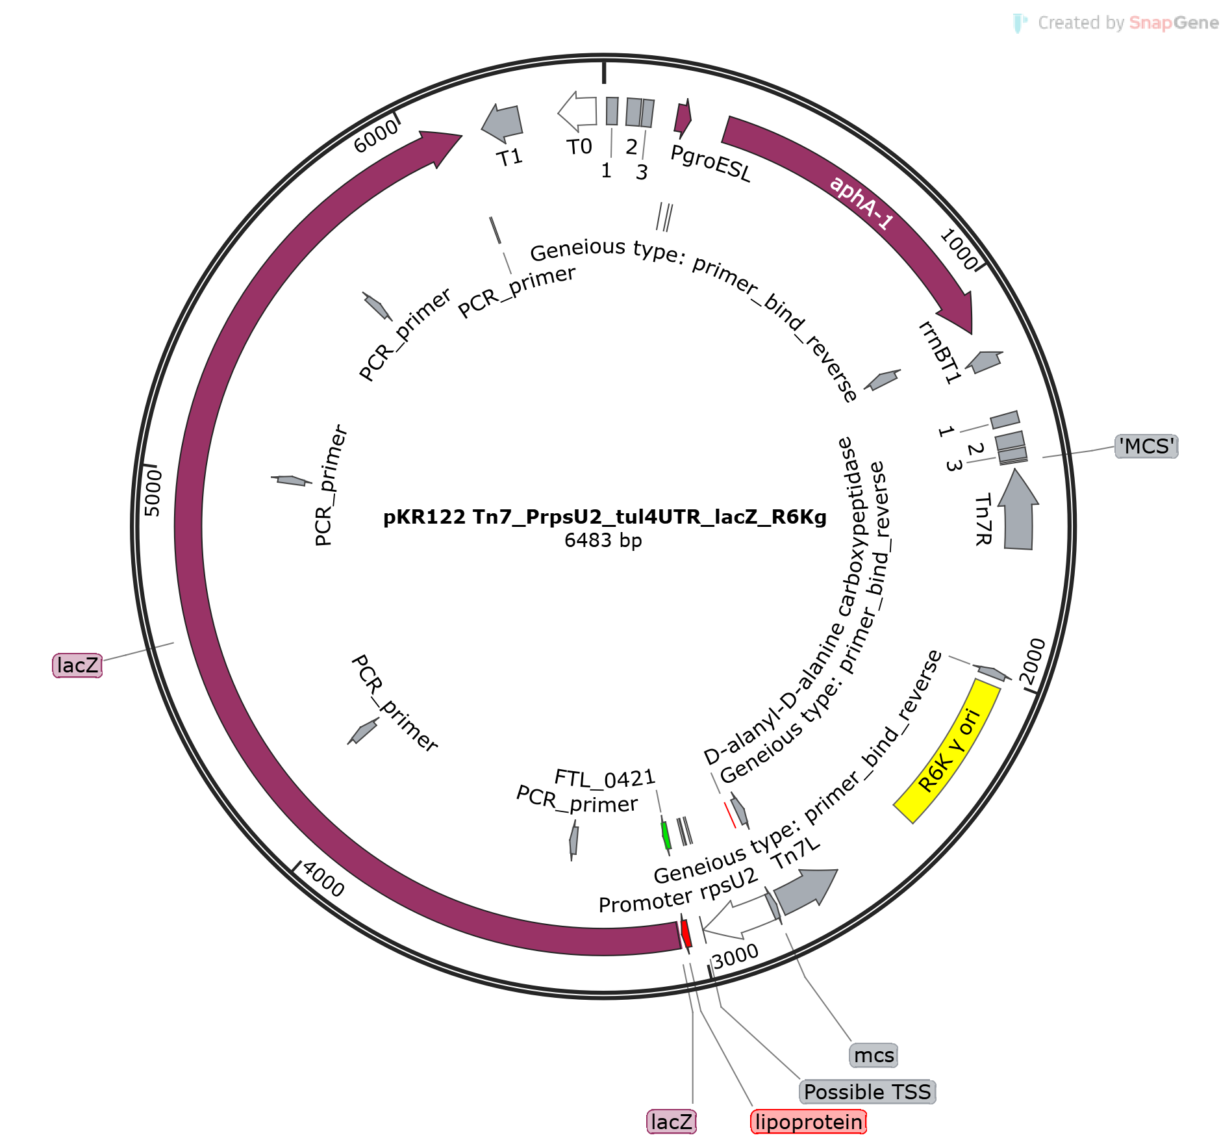
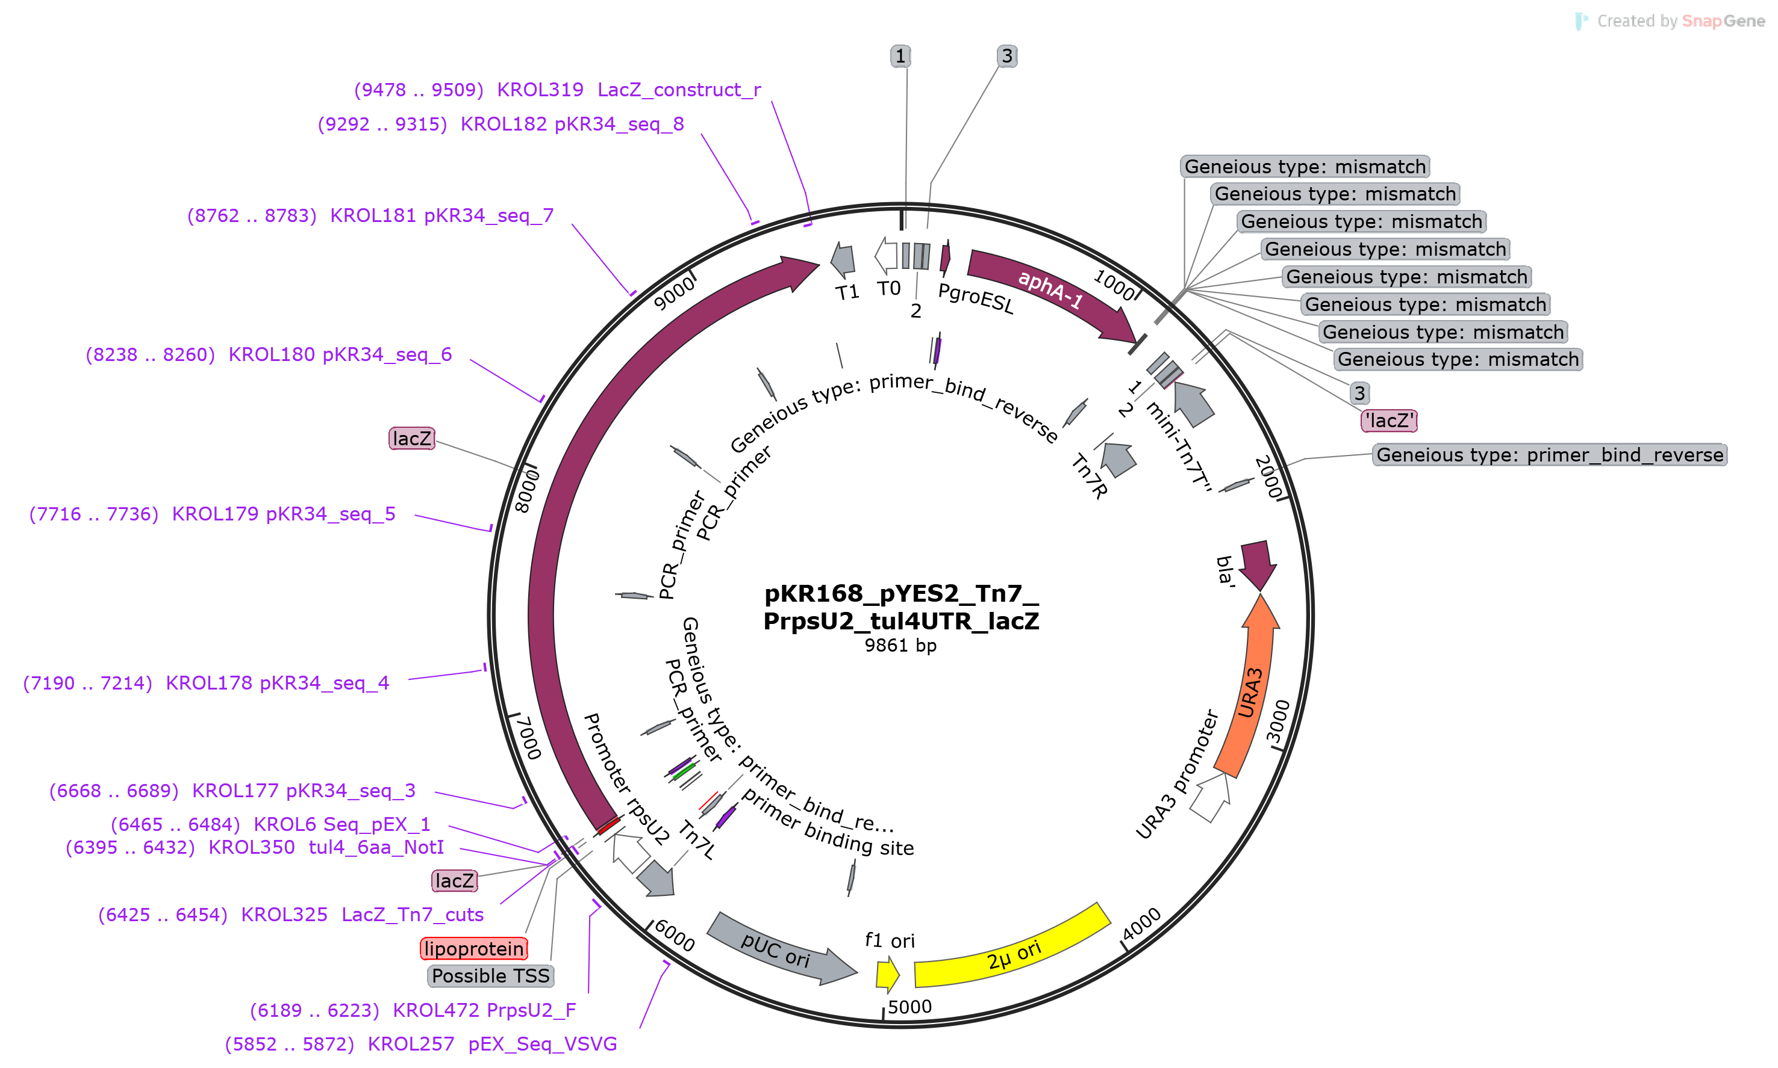
PIR1 cells
yeast cells
0 colonies
7 colonies, unfortunately some backbone

