Slide 1
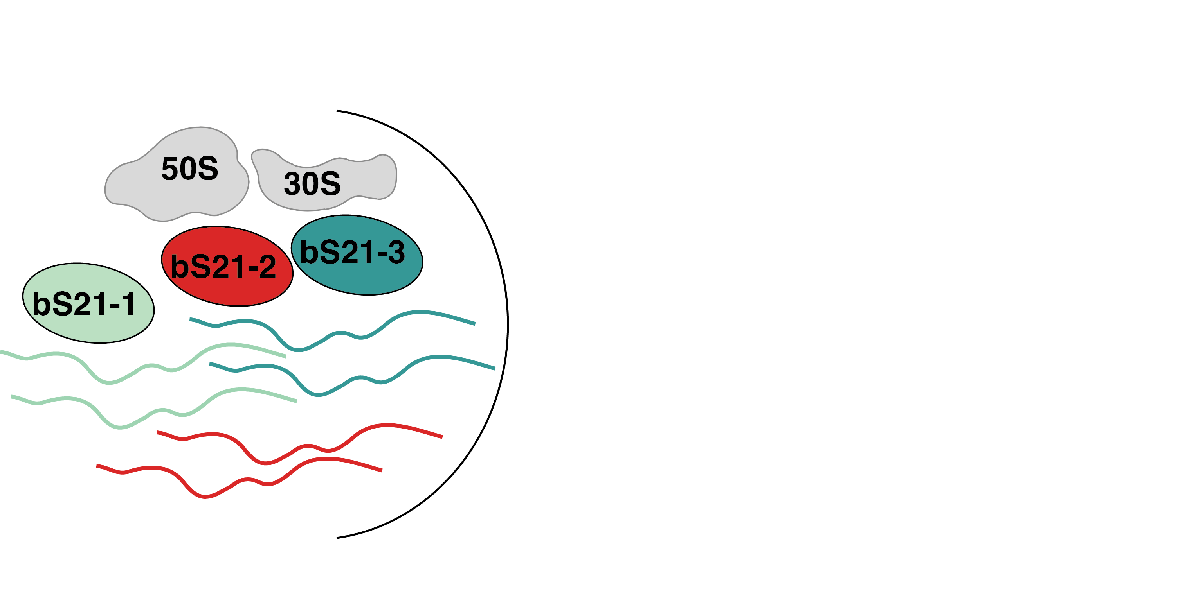
Despite reduced genome, multiple genes encode the same ribosomal protein, bS21
F. tularensis LVS genome: 1.89 Mbp, ~2,000 genes
cspC
rpsU1
rpsU2
yqeY
dnaG
rpoD
rpsU3
Notes:
Even though francisella has a reduced genome, it encodes three copies of the rpsU genes, which encode bS21, a protein in the small ribosomal subunit. Most bacteria have 0 or 1 of this gene. We originally, hypothesized, and have since shown, that these three proteins are produced and incorporated into ribosomes. This is a western blot of purified ribosomes from our wild-type strain as well as strains ectopically expressing each of the bS21 proteins, with a VSVG tag. This, along with some mass spec data we have of purified ribosomes, indicates that multiple classes of ribosomes are possible and occurring
This protein is also interesting to us because it is located close to the mRNA exit channel in the ribosome, and early research has identified that it is involved in translation initiation, so it is in an ideal location to be regulating gene expression at the level of translation initiation.
So this heterogeneity of ribosomes may be a mechanism of regulation, but you may not know that ribosomes are heterogeneous so let me show you other ways that may occur.

Slide 2
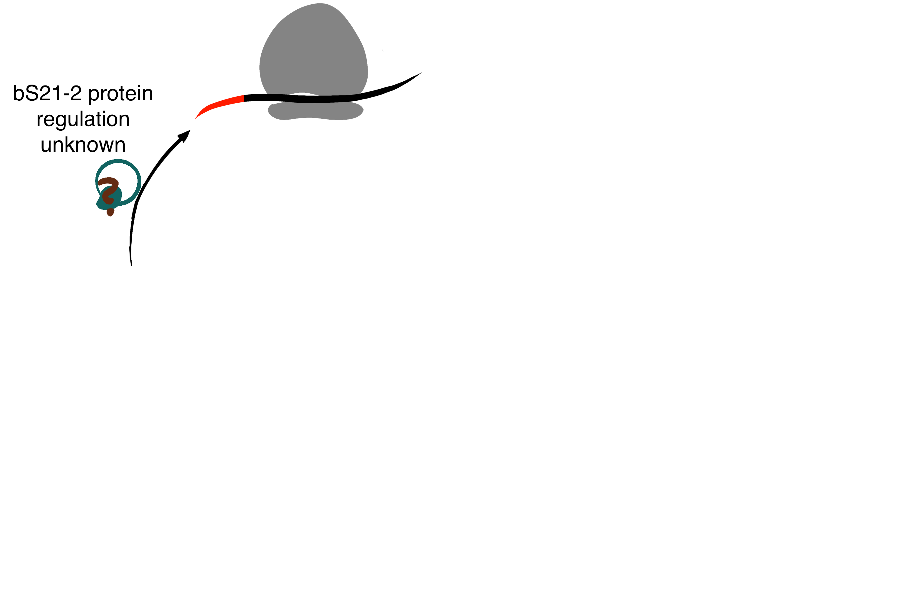
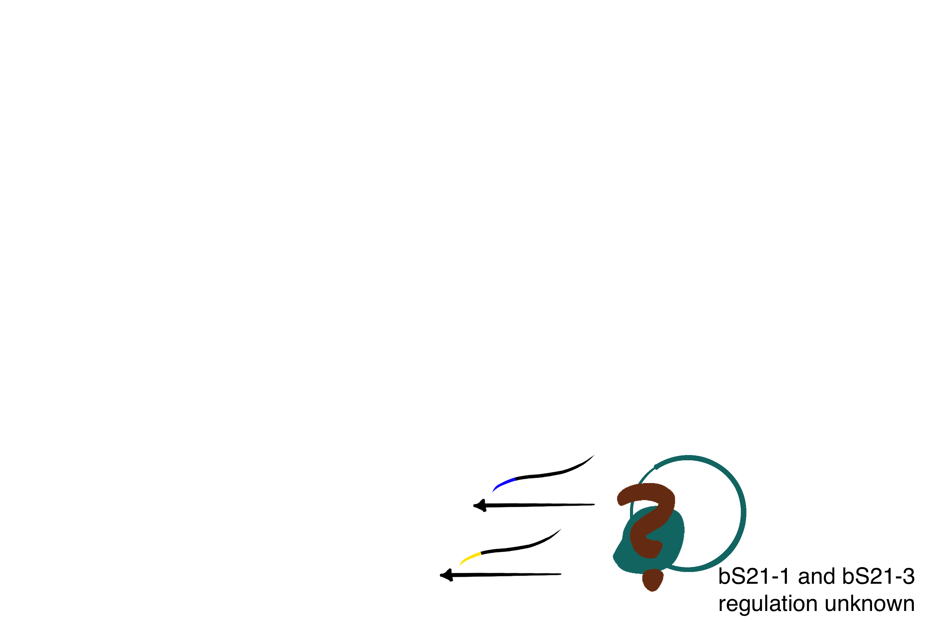
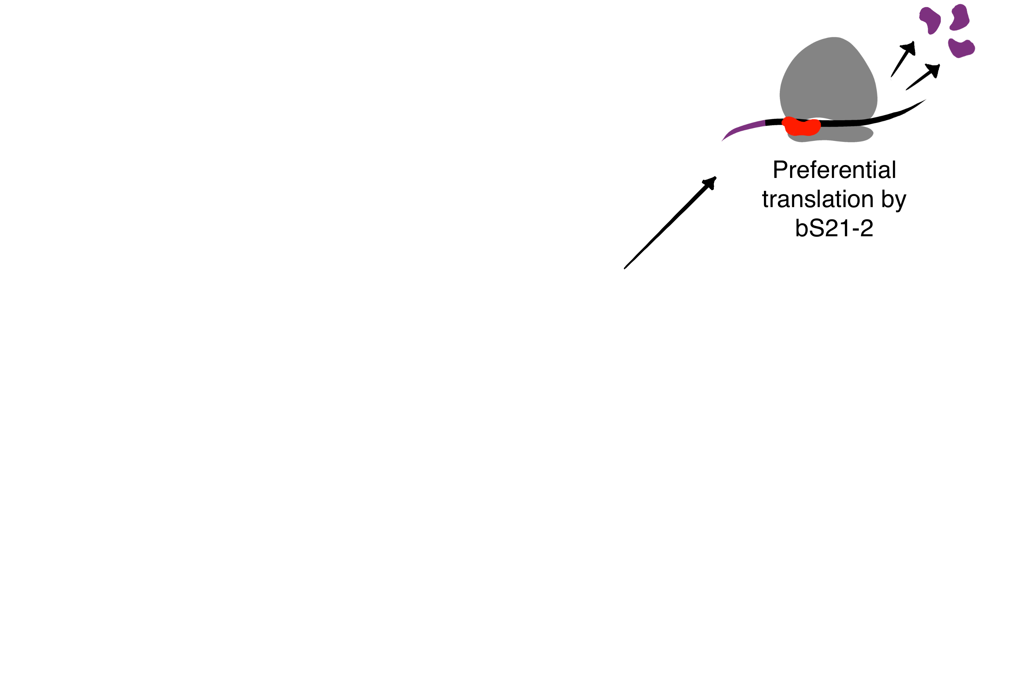
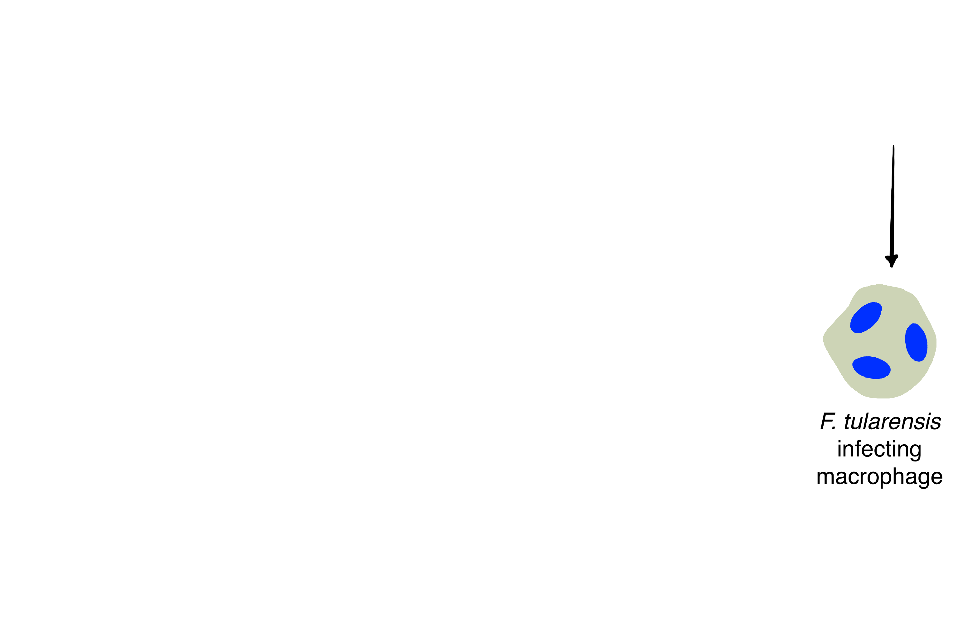
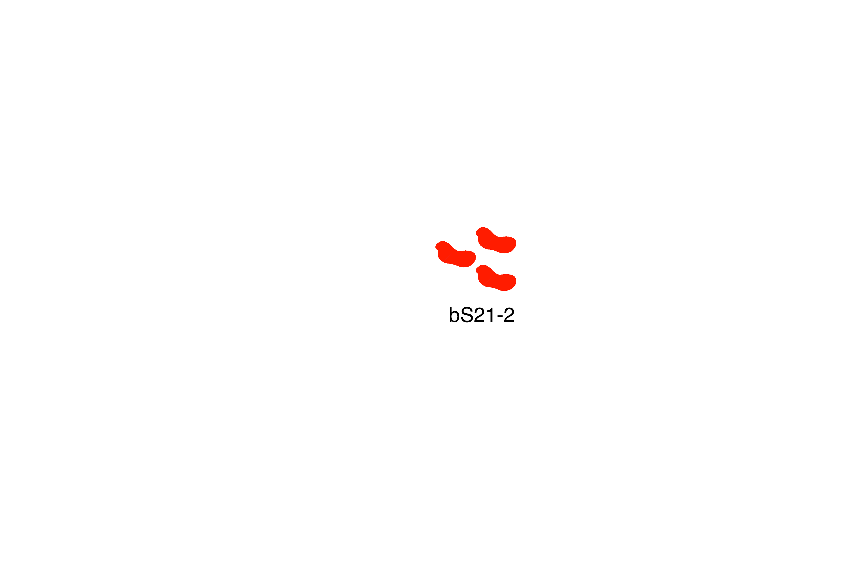
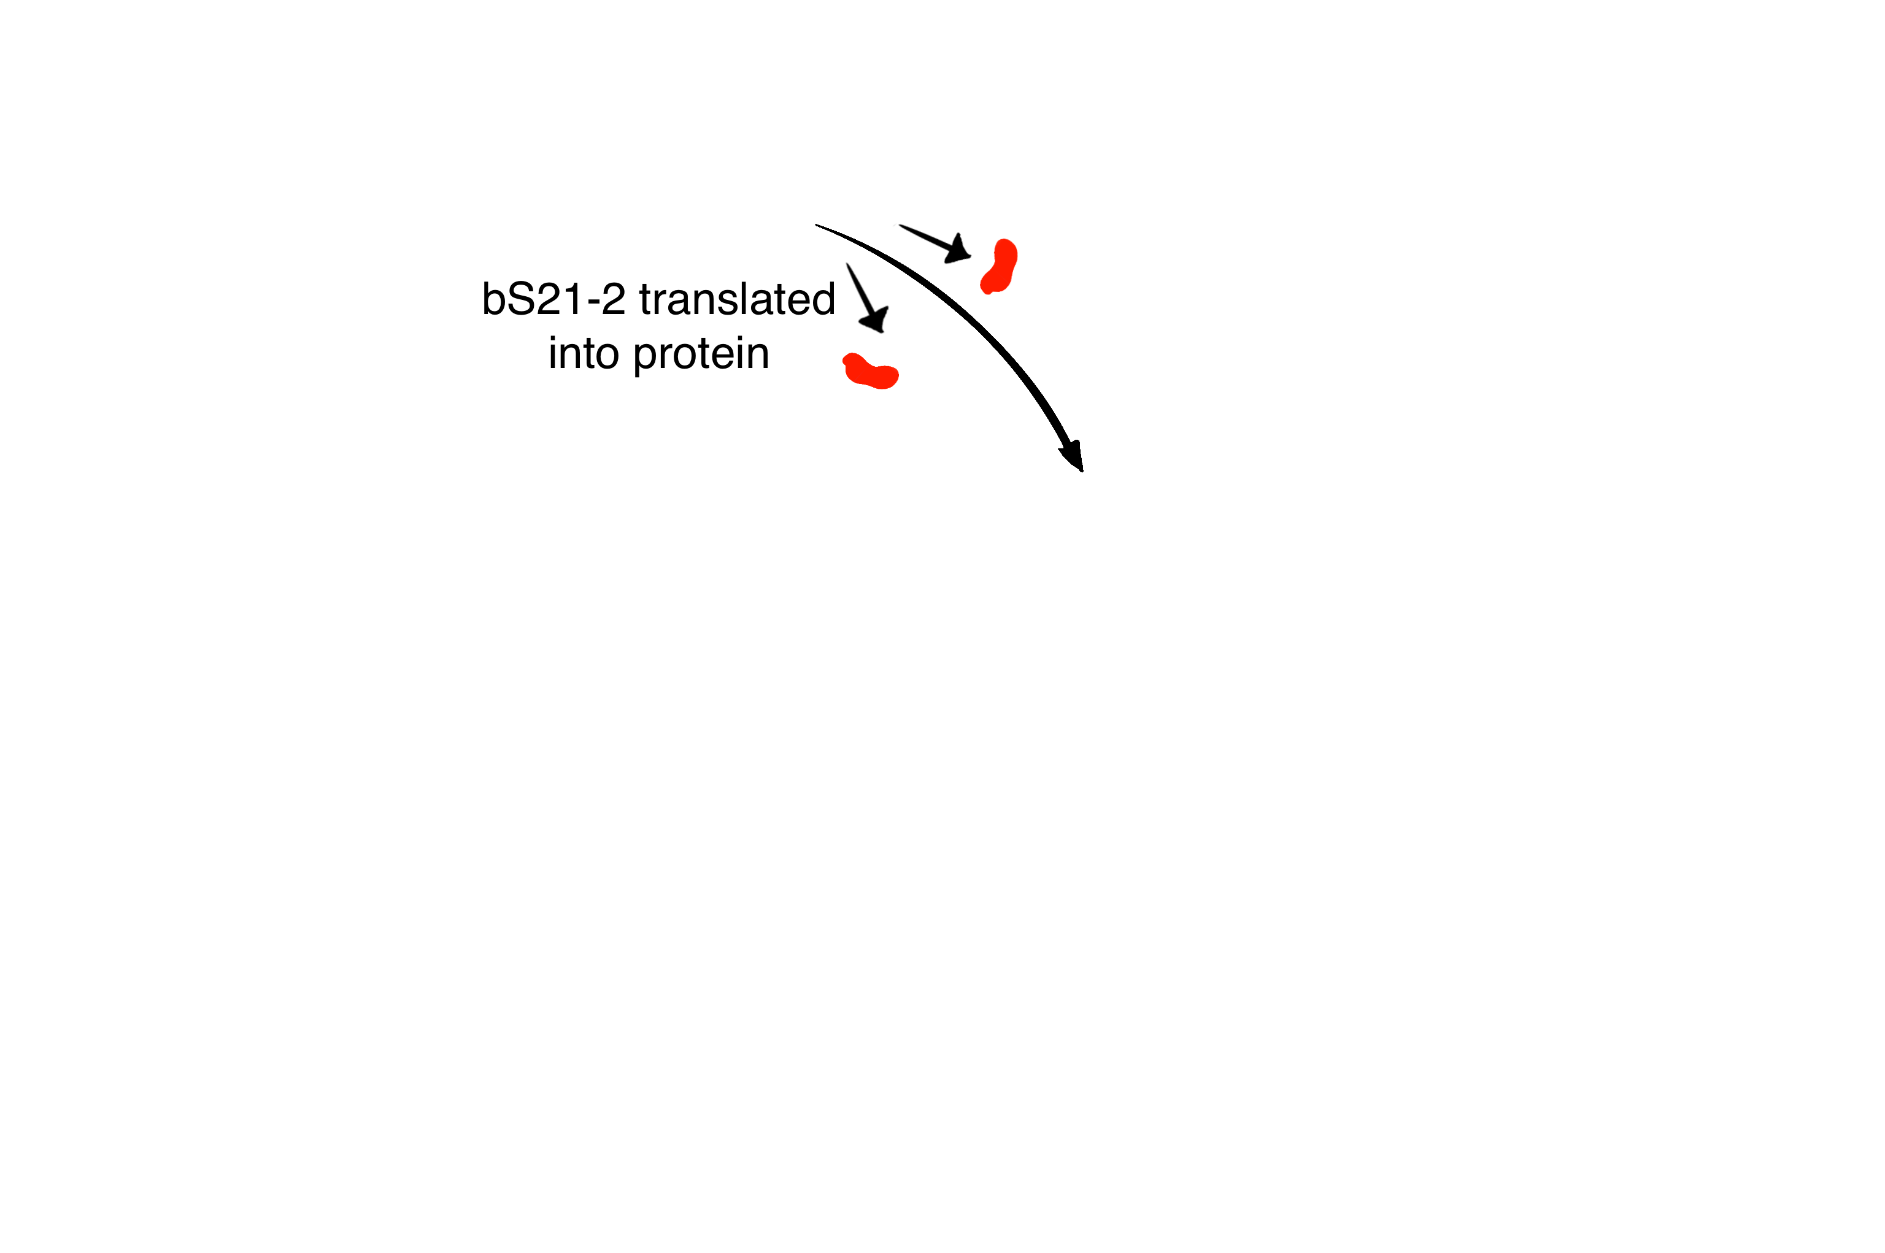
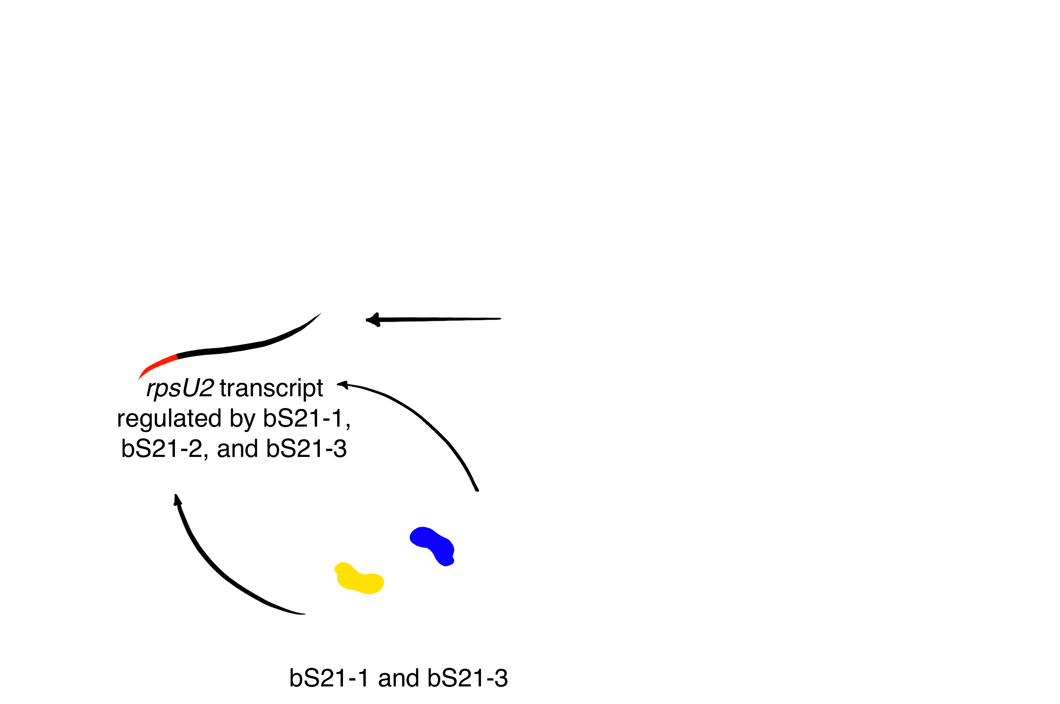

Model for bS21-2 Regulatory Network
bS21-2 controls translation initiation
RNASeq data shows bS21-2 contributes to the abundance of its own transcript
                bS21-1 and bS21-3 also regulate rpsU2 transcript
                lacZ fusions recapitulate native locus data and identify the 5′ UTR as sufficient to cause regulation
                rpsU2 transcript shown to have half-life of 2.5 min, ~6-fold lower than in ΔrpsU2
bS21-1 and bS21-3 do not autoregulate
  qPCR of 5′ UTR regions of these genes show no significant changes in delta strains
Regulation of bS21-1 and bS21-3 remains undefined
bS21-2 protein abundance is throttled by some other mechanism
β-galactosaidase activity only shows 1.3 fold increase of protein in cells lacking bS21-2
Notes:
Mention all the stuff on the right is stuff we already knew, but this is what I’ve talkeda bout
Animate the bS21-1 and -3 with the trext of the mRNA

