Slide 1
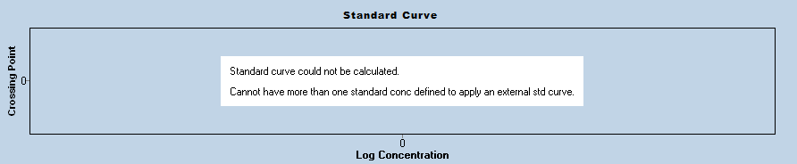
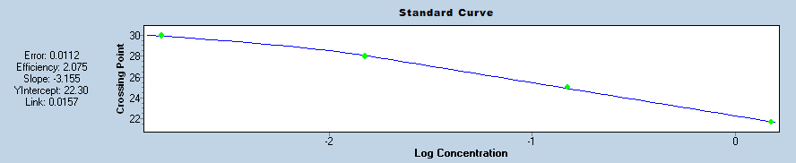
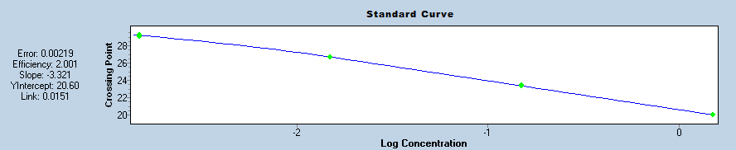


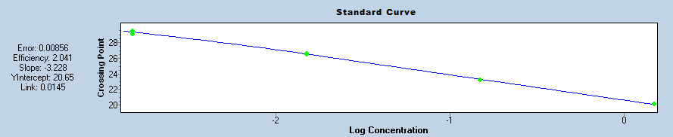
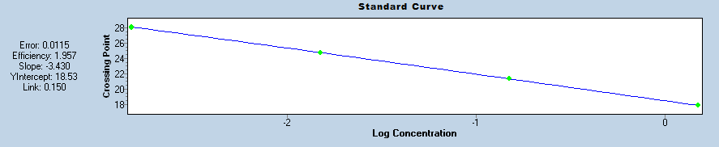
A.
B.
C.
D.
E.
F.
G.
Question: Are the secG and rpsO qPCR primers decently efficient?
Controls: KROL63+64 tul4 primer set
Interpretation: KROL642+643 is efficient and has the lowest secG C_{p} . KROL650+651

Slide 2
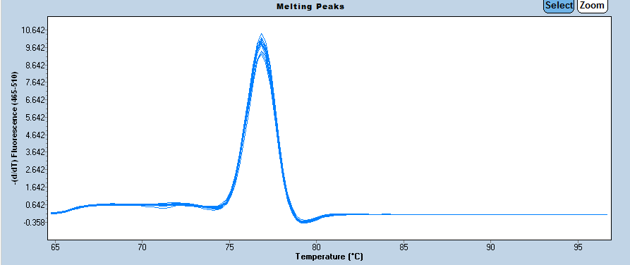
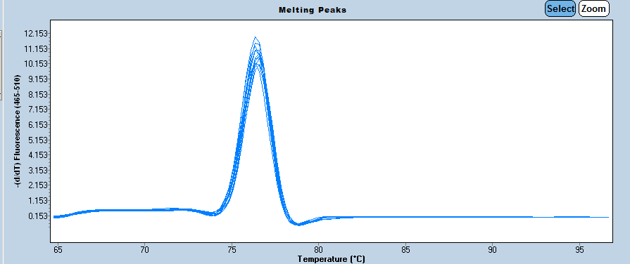
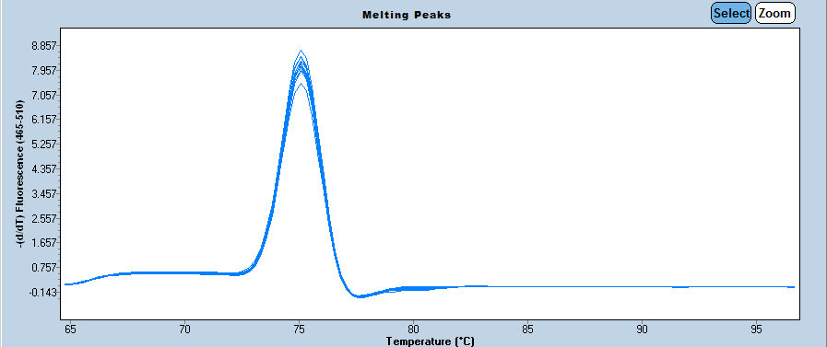
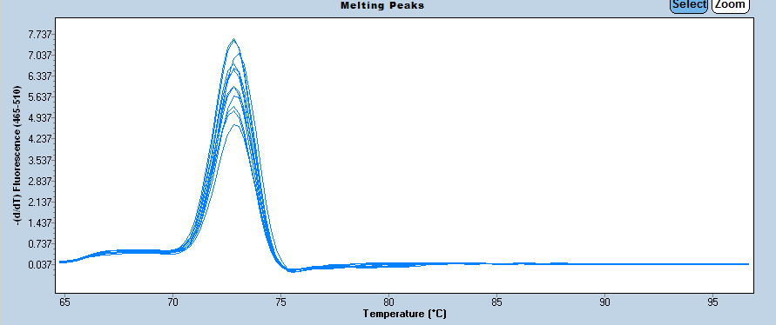
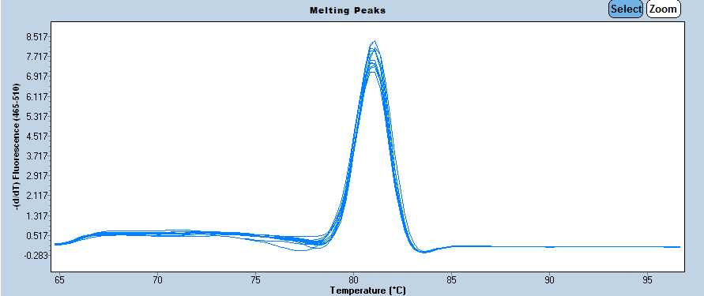
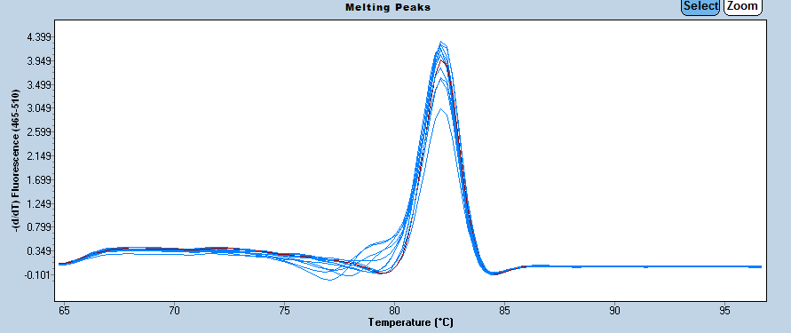
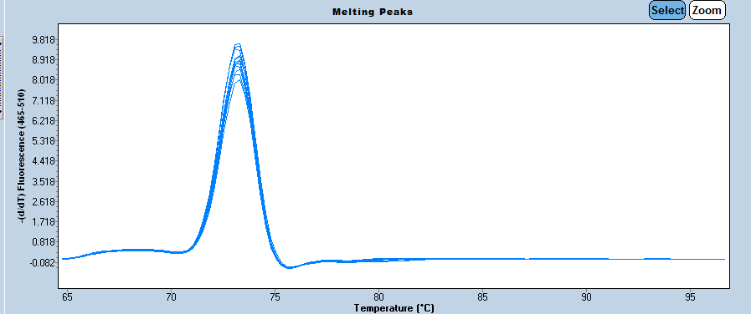
A.
E.
B.
F.
C.
G.
D.
Question: Are the secG and rpsO qPCR primers amplifying a single product?
Controls: KROL63+64 tul4 primer set
Interpretation: All of the primer sets are amplifying a single product.

Slide 3
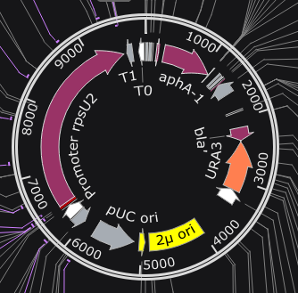
pKR168: Tn7 PrpsU2 tul4 UTR lacZ

Slide 4
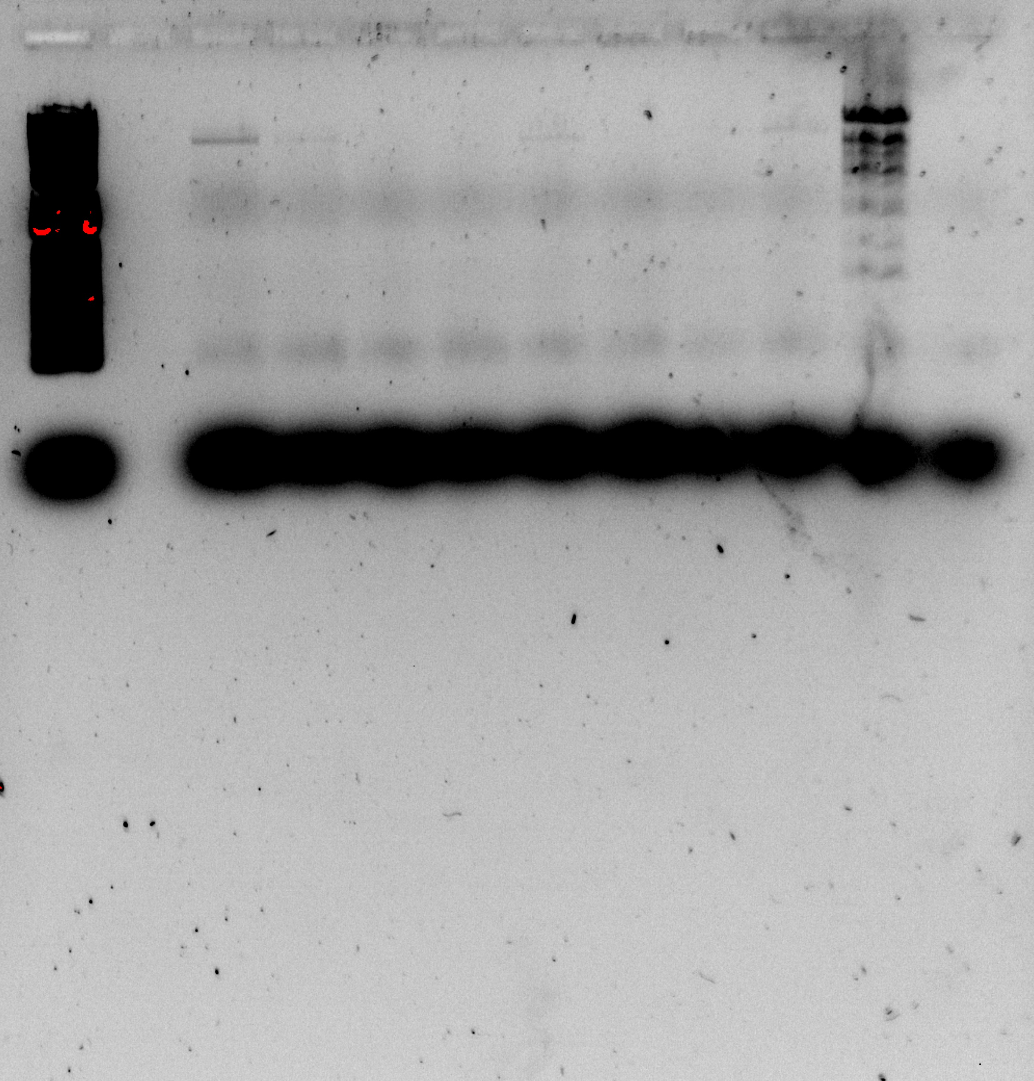
Candidate Integrations
LVS gDNA
Ladder
1
2
3
4
5
6
7
8
(-)
Question: Is pKR168 integrated into WT?
Controls: LVS and water
Interpretation: Candidate 1, 2, 5, and 8 are potentially promising.

Slide 5
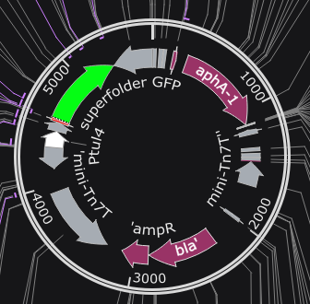
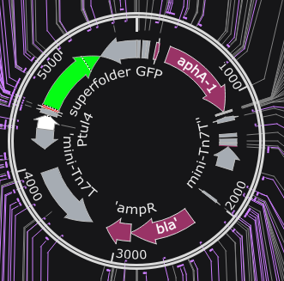
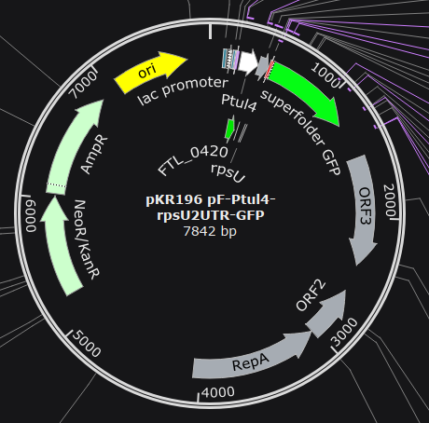
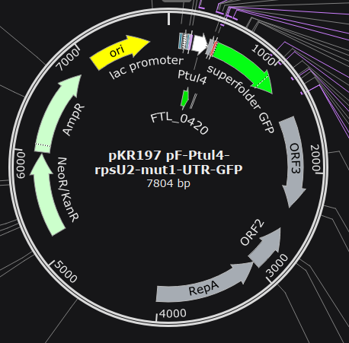
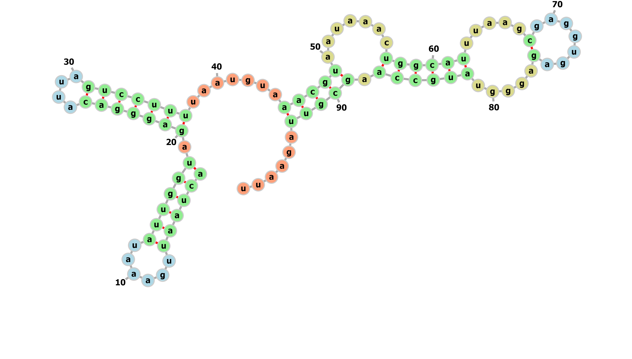
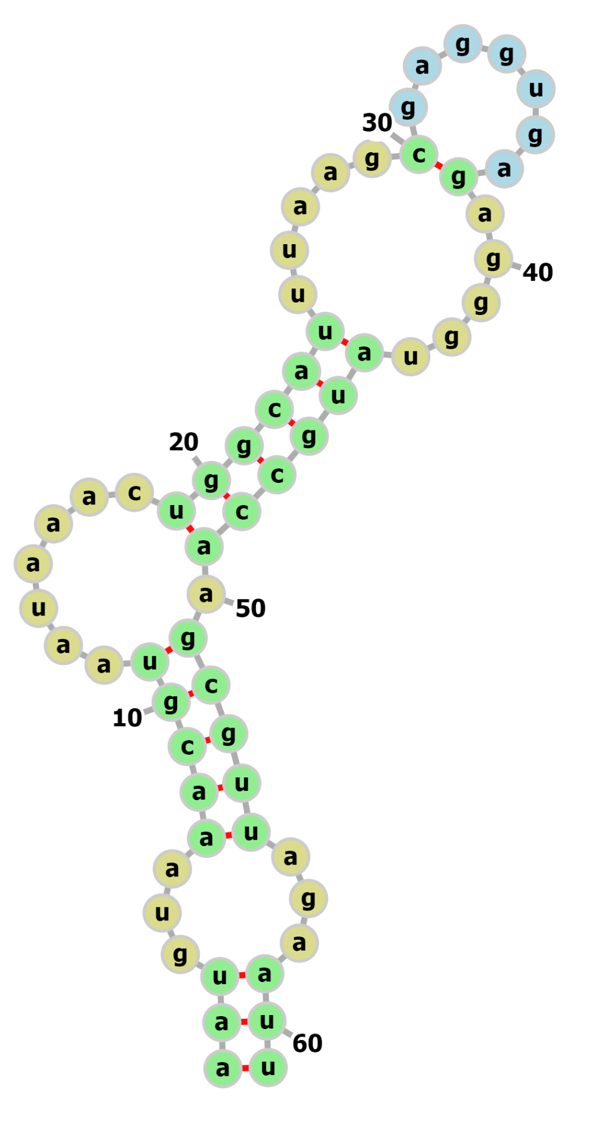
pKR168: Tn7 PrpsU2 tul4 UTR lacZ
To test whether the promoter of rpsU2 is sufficient for bS21-2 autoregulation
pKR184: Tn7 Ptul4 rpsU2 UTR gfp
pKR191: Tn7 Ptul4 rpsU2 UTR-Mut.1 gfp
pKR196: pF Ptul4 rpsU2 UTR gfp
pKR197: pF Ptul4 rpsU2 UTR-Mut.1 gfp

