Slide 1
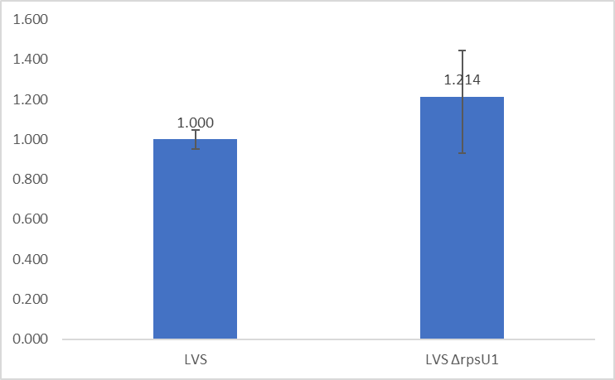
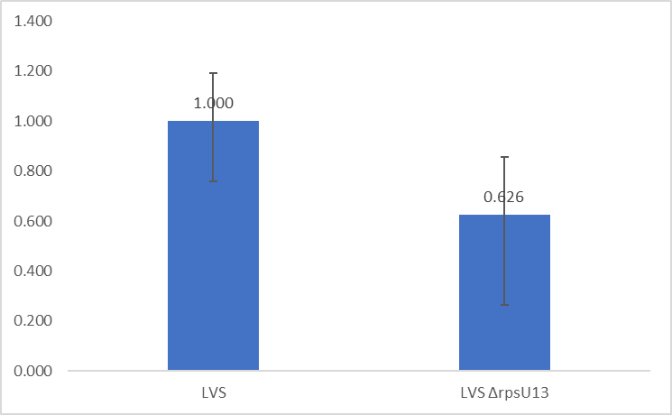
Question: Do bS21-1 and bS21-3 regulate their own expression?
Controls:Test C_{P} values normalized to tul4 (rpsU1) or rpoA1 (rpsU3)
Interpretation: No significant changes to relative transcript abundance in ΔrpsU1 or ΔrpsU3* as compared to WT, suggesting that there is no statistically significant autoregulation of the rpsU1 or rpsU3 transcript by their own proteins.

Slide 2
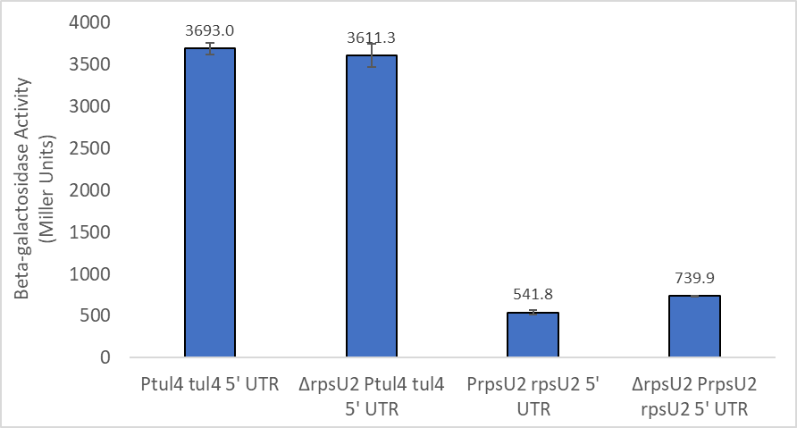
Question: Do our control strains act like we think they should?
Controls:Test Ptul4 tul4 5’ UTR strains with and without bS21-2.
Interpretation: The data looks pretty similar to the previous run, tul4 does not significantly change in cells lacking bS21-2. bS21-2 protein increases in cells lacking bS21-2, at a smaller fold change than transcript. Supporting that bS21-2 negatively regulates its own expression, differently at the transcript and translation level. Ultimately, though, these controls are behaving as they have previously.

Slide 3
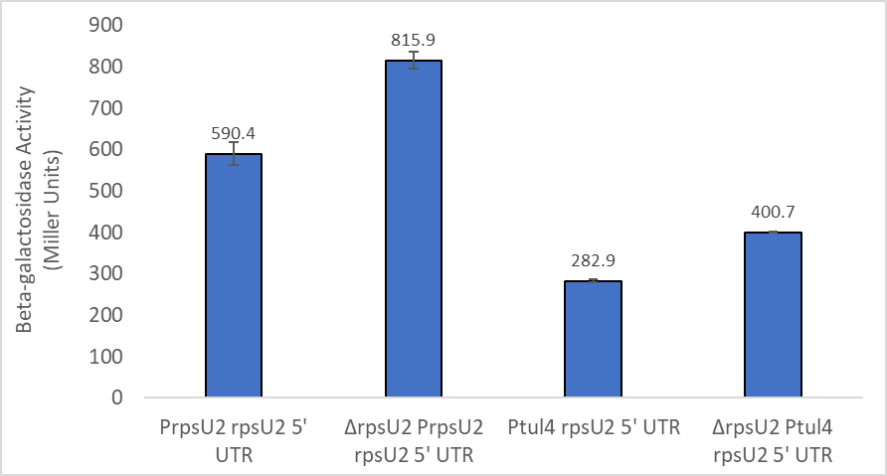

Question: Is the rpsU2 5’ UTR sufficient to cause regulation of bS21-2 at the protein level?
Controls:Test The construct containing both the promoter and 5’ UTR of rpsU2 with and without bS21-2 in the cell.
Interpretation: Given the increase in protein abundance, as indicated by the lacZ proxy, the rpsU2 5’ UTR is sufficient to cause regulation at the protein level. As previously established in the construct containing PrpsU2 rpsU2 5’ UTR, there is a smaller fold-change at the protein level than at the transcript level. There is an overall decrease of protein in this construct versus the control, however the fold-change remains the same.

