Slide 1
Examining the Regulation of bS21 Homologs in Francisella tularensis
KRamsey Lab | Sierra Schmidt

Slide 2
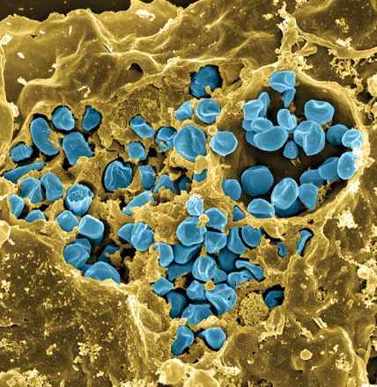
Francisella tularensis
Causes tularemia
Highly infectious
Potential bioweapon
F. tularensis subsp. holarctica LVS
Intracellular growth is essential to cause disease
Fischer, PNAS cover 2006
Notes:
Francisella tularensis is a gram-negative pathogen known for calling tularemia, also known as rabbit fever. Despite the name this pathogen does affect humans and is highly infectious, comparable to Mycobacterium tubuerculosis with a potential mortality rate of up to 30%.In the lab specifically we use the Francisella tularensis holartica Live Vaccine Strain, which I will refer to as LVS for the purposes of this presentation. This strain has been attenuated to humans, but maintains components available for study. As you can see in this false color scanning electron micrograph, the blue picted Francisella is an intracellular pathogen and can be found in many eukaryotic cells, as pictured here the macrophage.
Gram-negative, gamma facultative intracellular pathogen
Infectivity similar to Mtb, can upwards of 30% mortality
Tier 1 Select Agent like Ebola
Cover image: Scanning electron micrograph of a murine macrophage infected with Francisella tularensis strain LVS. Macrophages were dry-fractured by touching the cell surface with cellophane tape after critical point drying to reveal intracellular bacteria. Bacteria (colored in blue) are located either in the cytosol or within a membrane-bound vacuole.

Slide 3
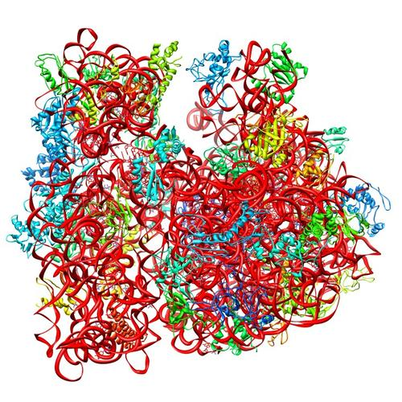
Ribosomes can be heterogenous
E. coli ribosome
3 rRNAs
49 proteins
Sources of heterogeneity
Multiple rRNA operons
rRNA modifications
Ribosomal protein modifications
Multiple versions of ribosomal proteins
PDB 4V50
Berk et al., 2006
Notes:
Generally, there is this concept that ribosomes are a monolithic structure, that they are static in every cell. Apparent in Francisella tularensis is the heterogeneity of ribosomes. This phenomenon can arise from a few different sources: multiple rRNA operons, rRNA modifications, ribosomal protein modifications. But the most intriguing for the Kramsey lab is the idea that there can be multiple ribosomal proteins.

Slide 4
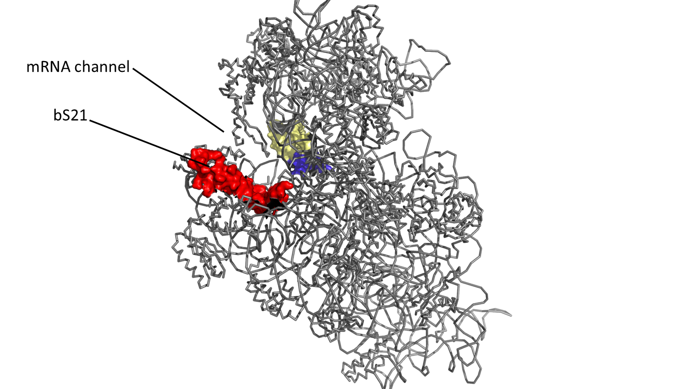
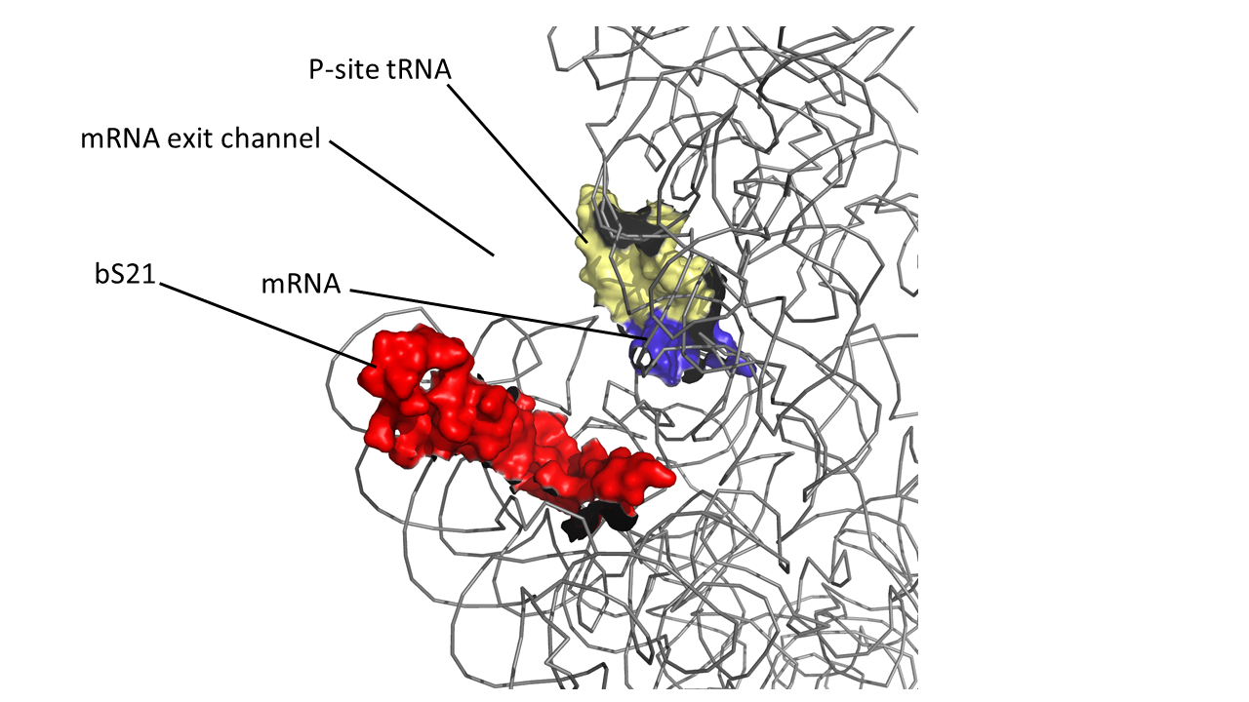
bS21, a small subunit ribosomal protein
Involved in translation initiation
Non-essential
Impacts different phenotypes in different species
Take home: bS21 may act as a regulator of translation
30S subunit, modeled from PDB entry: 4V50
Notes:
Even though francisella has a reduced genome, it encodes three copies of the rpsU genes, which encode bS21, a protein in the small ribosomal subunit. Most bacteria have 0 or 1 of this gene. We originally, hypothesized, and have since shown, that these three proteins are produced and incorporated into ribosomes. This is a western blot of purified ribosomes from our wild-type strain as well as strains ectopically expressing each of the bS21 proteins, with a VSVG tag. This, along with some mass spec data we have of purified ribosomes, indicates that multiple classes of ribosomes are possible and occurring
This protein is also interesting to us because it is located close to the mRNA exit channel in the ribosome, and early research has identified that it is involved in translation initiation, so it is in an ideal location to be regulating gene expression at the level of translation initiation.

Slide 5
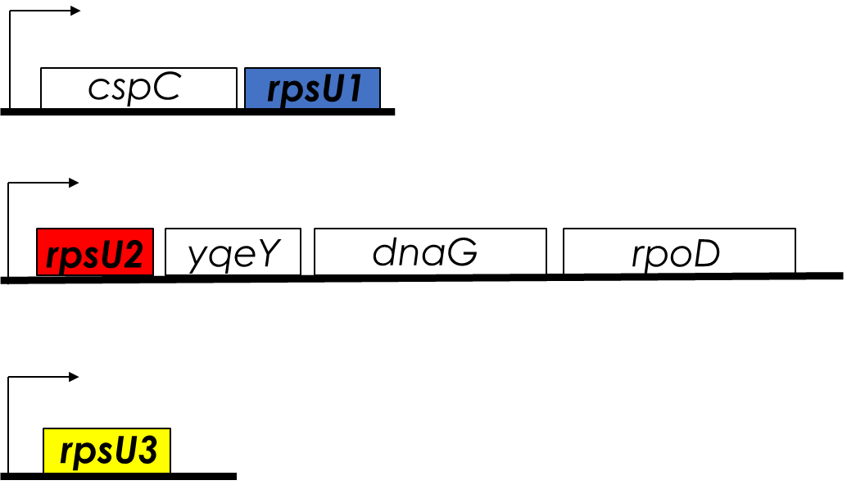
Multiple bS21 Homologs Lead to Heterogenous Ribosome Populations in Francisella tularensis
bS21 is encoded by rpsU
Notes:
Even though francisella has a reduced genome, it encodes three copies of the rpsU genes, which encode bS21, a protein in the small ribosomal subunit. Most bacteria have 0 or 1 of this gene. We originally, hypothesized, and have since shown, that these three proteins are produced and incorporated into ribosomes. This is a western blot of purified ribosomes from our wild-type strain as well as strains ectopically expressing each of the bS21 proteins, with a VSVG tag. This, along with some mass spec data we have of purified ribosomes, indicates that multiple classes of ribosomes are possible and occurring
This protein is also interesting to us because it is located close to the mRNA exit channel in the ribosome, and early research has identified that it is involved in translation initiation, so it is in an ideal location to be regulating gene expression at the level of translation initiation.

Slide 6

Ribosomal Protein Expression is Tightly Controlled

Slide 7
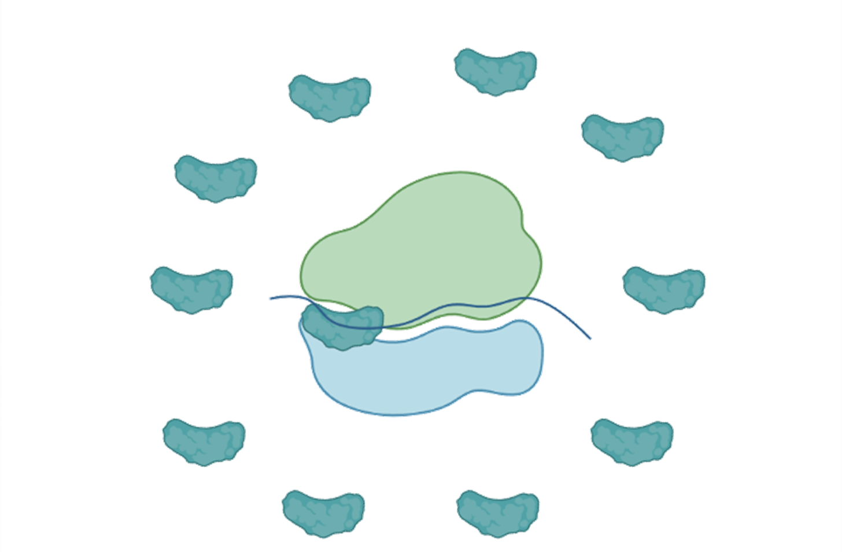
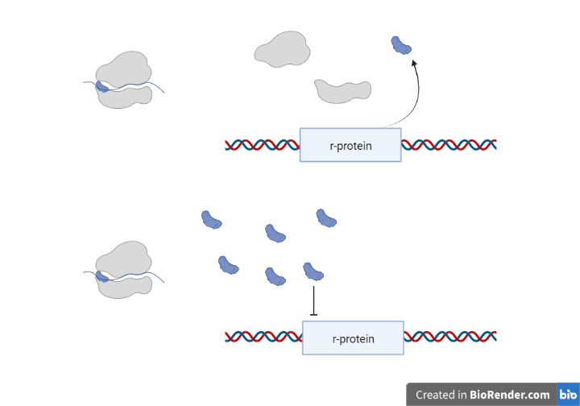
Ribosomal Protein Expression is Tightly Controlled

Slide 8
Ribosomal Protein Expression is Tightly Controlled

Slide 9
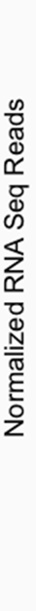
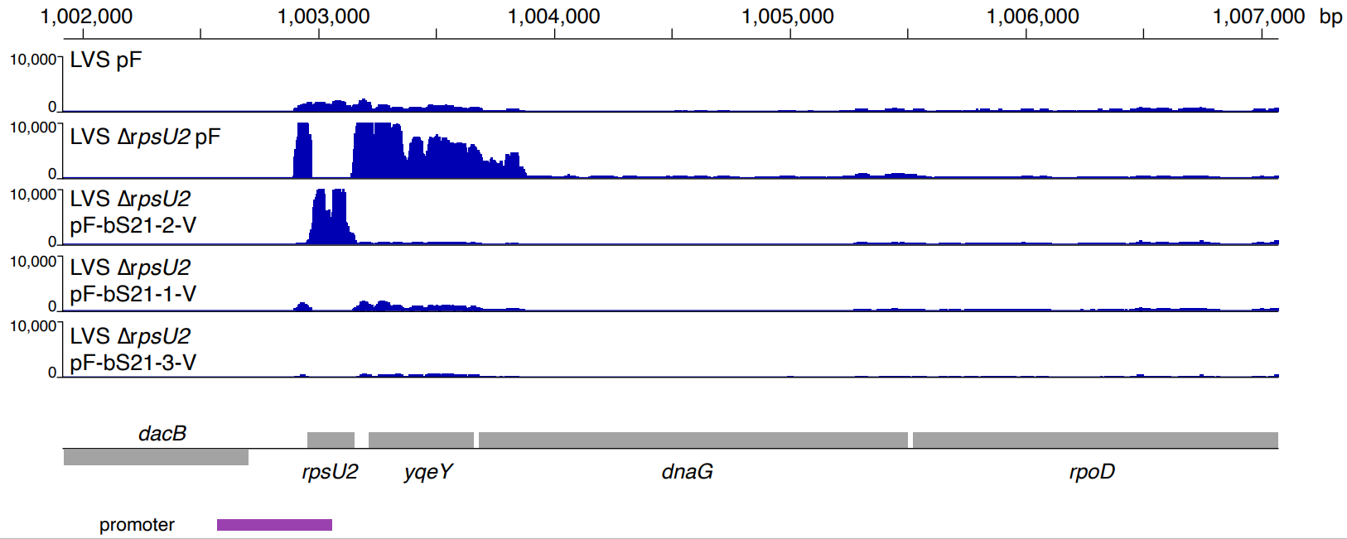
rpsU1 and rpsU3 Complement ΔrpsU2 Phenotype

Slide 10
What regulates bS21-1 and bS21-3?

Slide 11
I. Environmental Factors

Slide 12
GFP Reporter Assay and Environments Tested
Temperature
Salinity
pH
H₂O₂ induced stress
UV induced stress
Growth in Chamberlain’s Defined Media
Growth on Cysteine Heart Agar with 2% hemoglobin
Growth to stationary phase
Different magnesium concentrations
Different iron concentrations
PrpsU1/cspC
GFP
PrpsU3
GFP

Slide 13
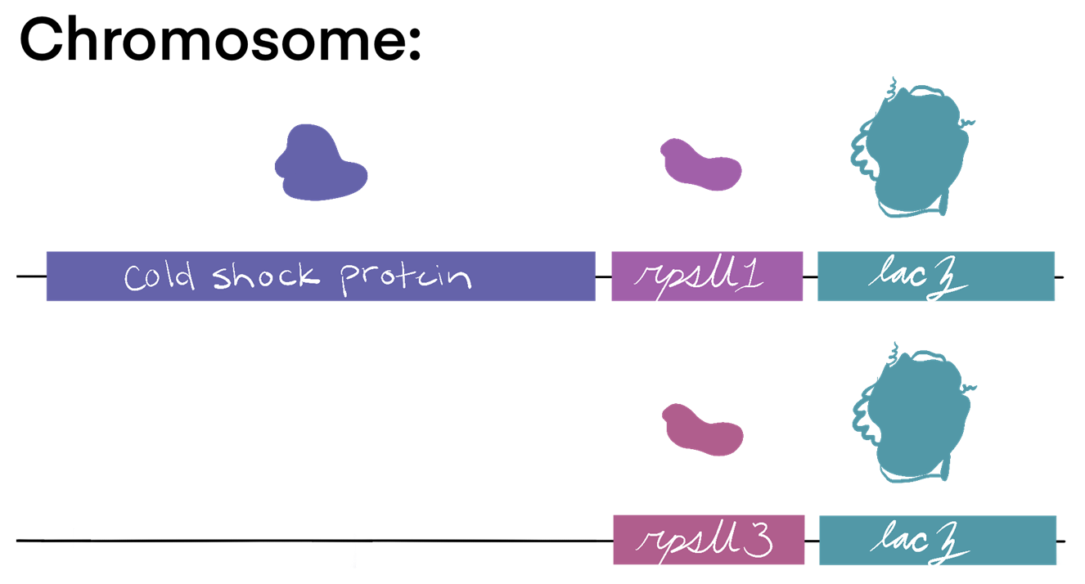
β-galactosidase Assay
Integrated into the native operon
Approximates level of translation
rpsU1
lacZ
rpsU3
lacZ

Slide 14
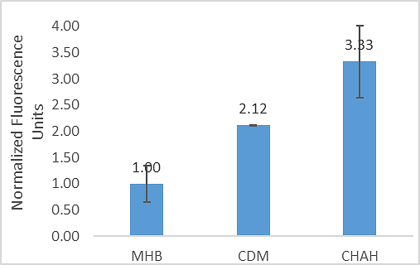
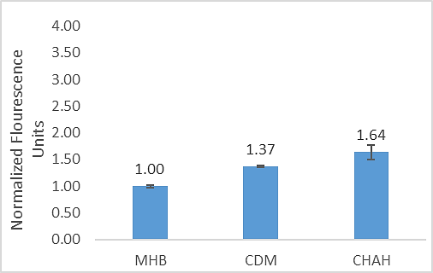
P_{rpsU1}-GFP and P_{rpsU3}-GFP Up-Regulated in CDM and CHAH
***
*
***
rpsU1
rpsU3
* p-value < 0.02, *** p-value < 0.004

Slide 15
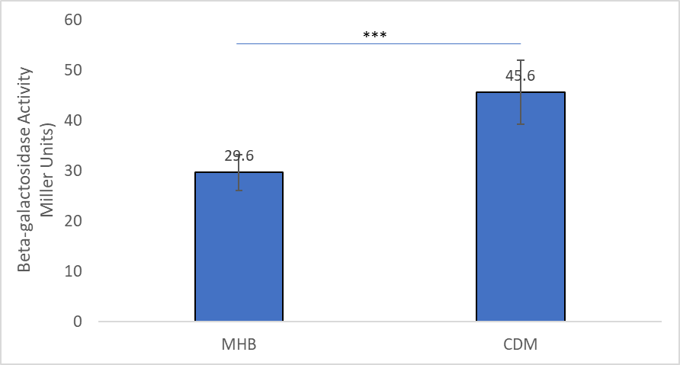
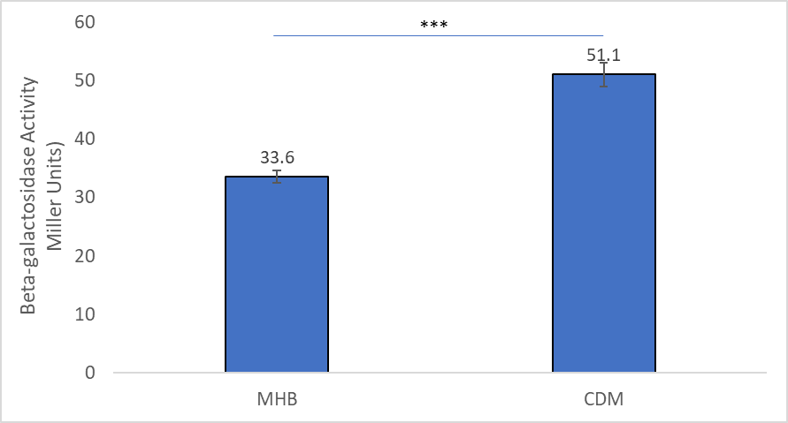
bS21-1 and bS21-3 Up-Regulated in CDM
rpsU1
rpsU3
*** p-value < 0.00001

Slide 16
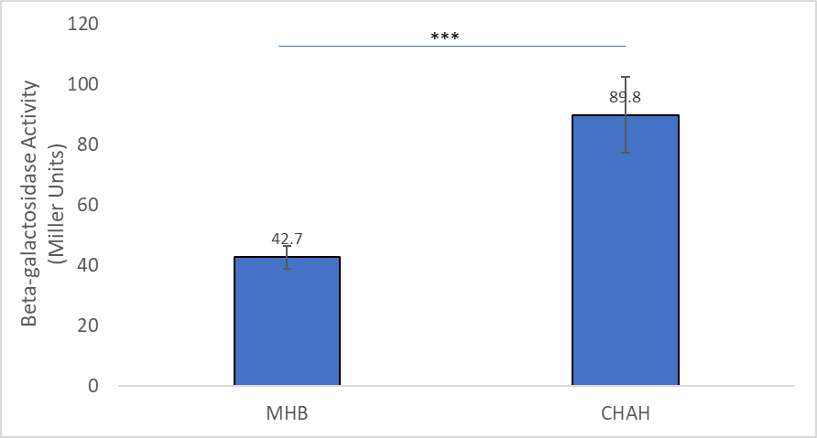
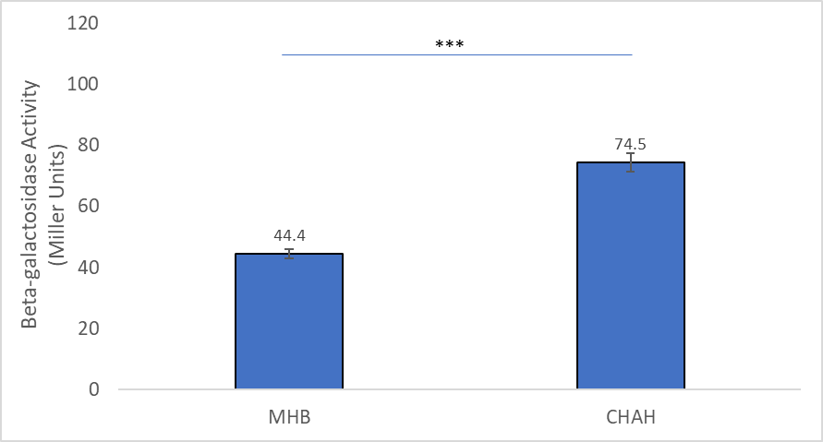
bS21-1 and bS21-3 Up-Regulated in CHAH
rpsU1
rpsU3
*** p-value < 0.0001

Slide 17
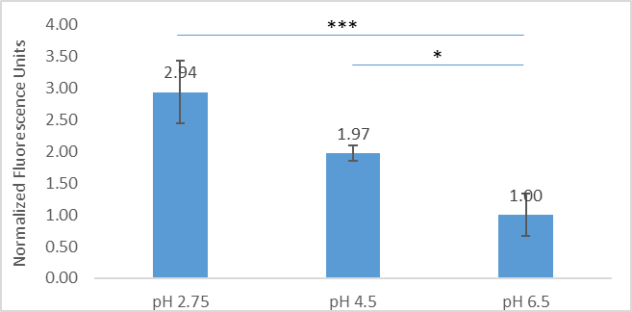
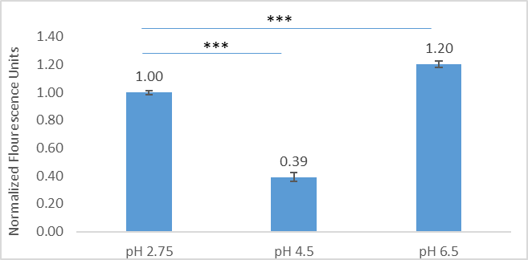
P_{rpsU1}-GFP is Up-Regulated in Low pH
rpsU1
rpsU3
* p-value < 0.025, *** p-value < 0.004

Slide 18

What about β-galactosidase activity of bS21-1 and bS21-3 in low pH?

Slide 19
I. Internal Factors

Slide 20
rpsU1 and rpsU3 Complement ΔrpsU2 Phenotype

Slide 21
Experimental Set-Up
rpsU1 Primer Sets
rpsU1
rpsU3 Primer Sets
rpsU3

Slide 22
rpsU1 and rpsU3 Do Not Appear to be Auto-Regulated

Slide 23






ACKNOWLEDGEMENTS
Dr. Kathryn Ramsey
  Hannah Trautmann
  Aisling Macaraeg
  Dan Floyd
  Former lab members
Dr. Steven Gregory
URI INBRE core
Notes:
I want to thank everyone in the Ramsey lab for their support especially Kathryn. We have fantastic collaborators at URI and Duke whom I want to thank, and then our funding sources, and I will happily take any questions.
Notes:
Motility and biofilm – bacillus subtilis
Acid stress resistance – listeria monocytogenes
Antibiotic resistance – staph aureus
Virulence – burkholderia pseudomallei and francisella in this work
Phage paper – Mizuno et al. 2019, Chen 2022
Bacteriodetes – Jha et al 2020 – probably autoregulating its own expression because rpsU is one of the few genes with a strong SD

Slide 24
Fin

