Slide 1
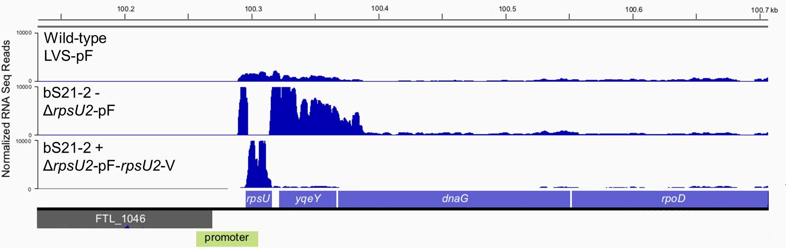

RNA Seq Data Suggest bS21-2 Negatively Regulates its Own mRNA
Wild-type
(LVS pF)
bS21-2 -
(ΔrpsU2 pF)
bS21-2 +
(ΔrpsU2 pF-rpsU2-V)
bS21-2 is encoded by rpsU2
Notes:
I will be showing you some RNA seq data, but to first orient you to where on the chromosome we are looking, we have thi FTL region, followed by the promoter for rpU2, the rpsU2 gene, as well as the ret of the genes of the operate, yqeY, dnaG, ropA.Now in the wildtype confirguation of this this operon, we see some peaks in the first part of the operon, rpsU2 and its promoter, followed by a decrease in the relative abundance of the following genes. ON this scale, it doesn’t seem too drastic, but there is that relationship. So, next, in order to look at the effects of bS21=2 on the operon, we took it out of the cells and we see this. There is high level of transcript abundance for the promoter of rpsU2, this empty region which is bS21-2, which of course we took out so we see no transcript abundance, followed by high levels of expression of the rest of the genes in the operon. Now this presents two possibilities: Some indirect effect by the loss of bS21-2 or bS21-2 itelf is unctioning as a negative regulation of its own transcription. To test this, bS21-2 was added back to the cell on a plasmid, as this would eptopically express the protein, were this negative regulation to be recovered, then we would expect the second possibility to be true, and, in fact, we do.

Slide 2
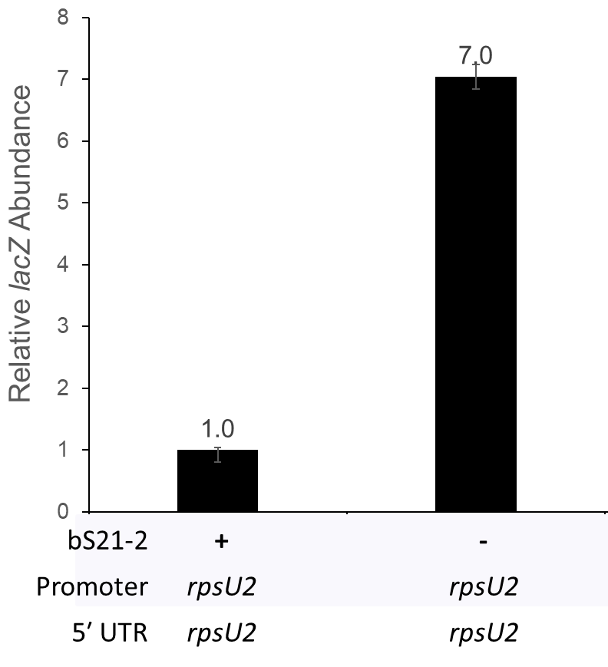
rpsU2 Promoter and 5′ UTR Lead to Regulation
*
* p-value < 0.015

Slide 3
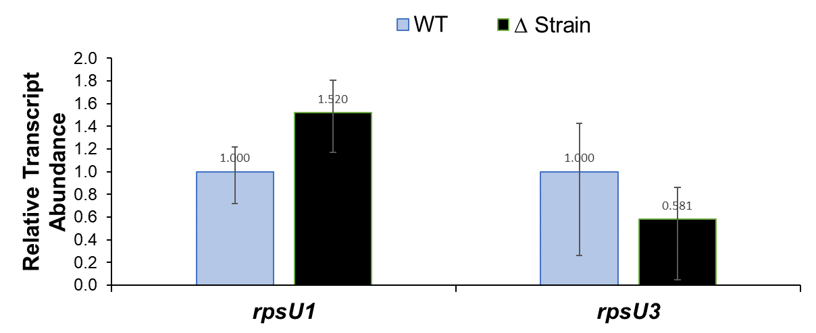
Question: Do bS21-1 and bS21-3 regulate their own expression?
Controls:Test C_{P} values normalized to tul4
Interpretation: No significant changes to relative transcript abundance in Δ strains as compared to WT, suggesting that there is no statistically significant autoregulation of either the rpsU1 or rpsU3 transcripts by their own protein.

