Slide 1
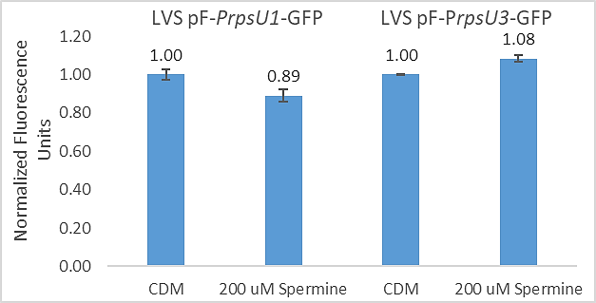
Question: What environmental conditions may lead to the up-regulation of rpsU1 and rpsU3?
Controls:
Cultures grown in standard CDM. LVS grown in standard CDM.
Interpretation: No change in either rpsU1 and rpsU3 when grown in 200 uM Spermine.

Slide 2

Electroporations
pF is fine obviously

