Slide 1
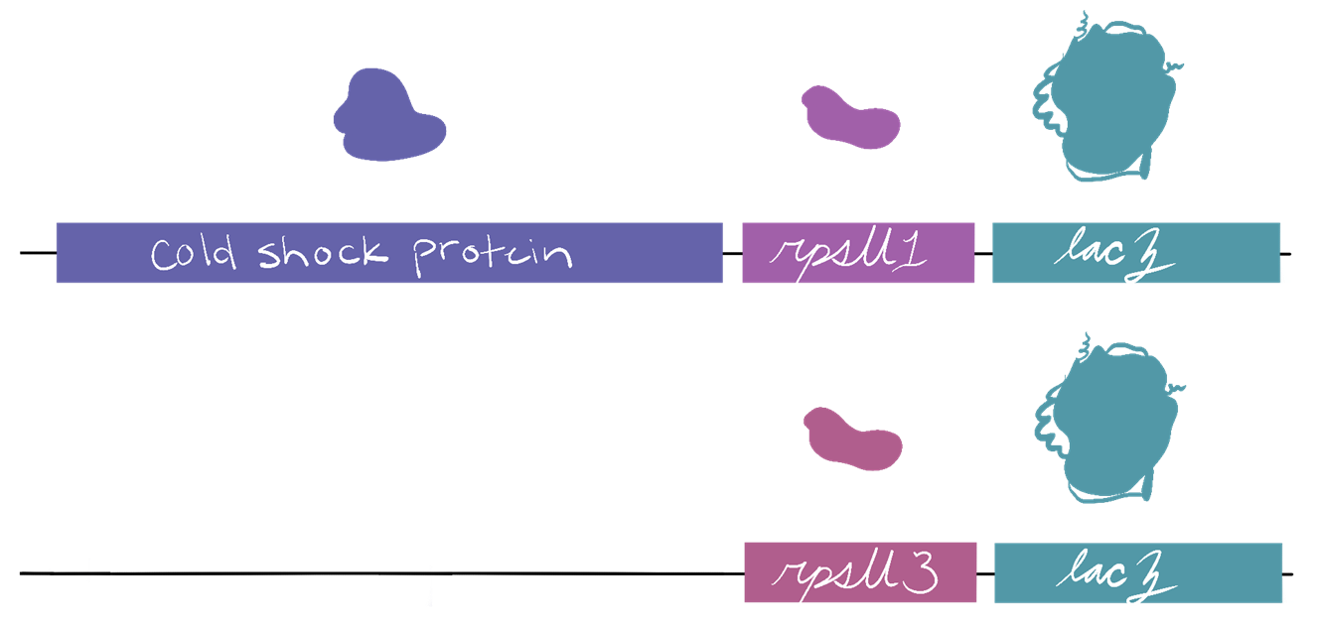
Detecting Abundance of rpsU1 and rpsU3 with β-galactosidase Activity
bS21-1 and bS21-3 encoded by rpsU1 and rpsU3 are less abundant in the cell than bS21-2
  Makes it hard to study
  Are there conditions which up-regulate them?
Growth of cells in testing environment
Measure β-galactosidase activity as
reporter for bS21-1 and
bS21-3 production

Slide 2
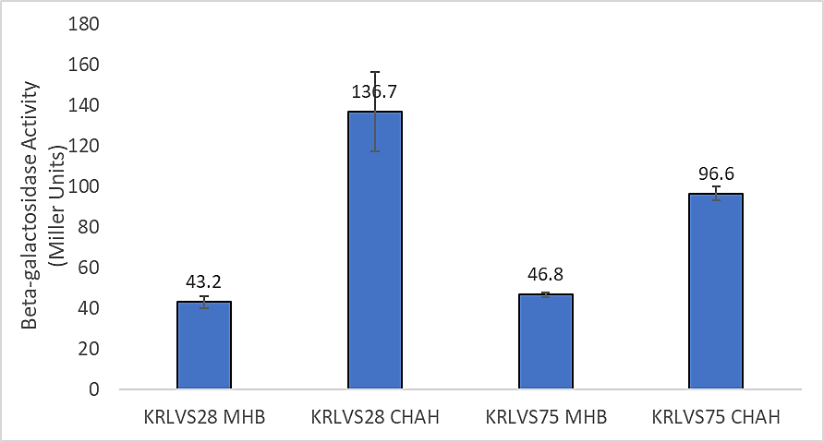
Question: What environmental conditions may lead to the up-regulation of rpsU1 and rpsU3?
Controls:
Control reaction with plain MHB.
Interpretation: Some increase of protein abundance in both rpsU1 and rpsU3 when grown on CHAH.

Slide 3
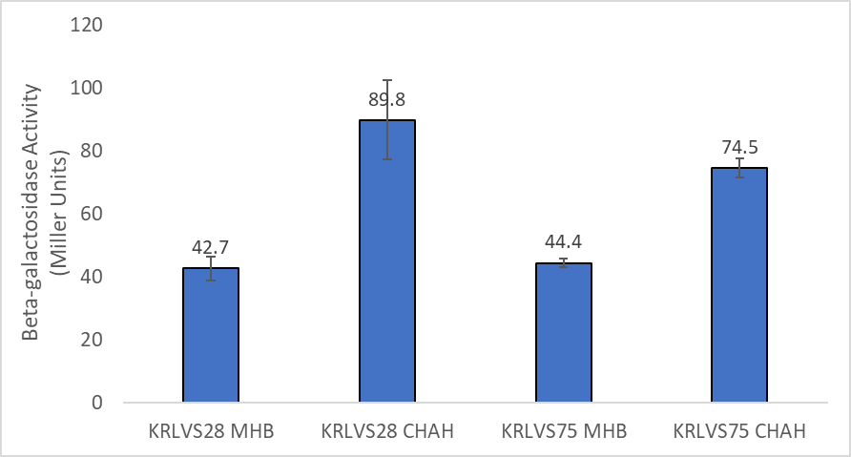
Question: What environmental conditions may lead to the up-regulation of rpsU1 and rpsU3?
Controls:
Control reaction with plain MHB.
Interpretation: Some increase of protein abundance in both rpsU1 and rpsU3 when grown on CHAH. But potentially variable.

