Slide 1
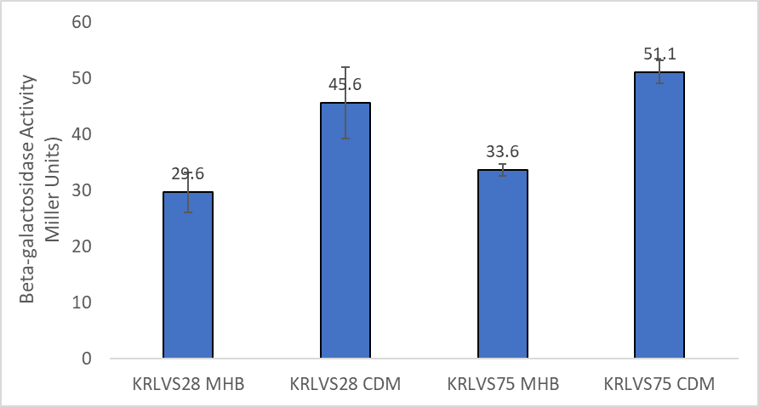
Question: What conditions lead to the up-regulation of either rpsU1 or rpsU3?
Controls:
Blank with CDM or MHB; cultures relative to growth in MHB.
Interpretation: Both bS21-1 and bS21-3 have a fold increase of ~1.5, which is less than indicated by the GFP assay for rpsU1 and more than indicated by the GFP assay for rpsU3 (though not by as much).

Slide 2
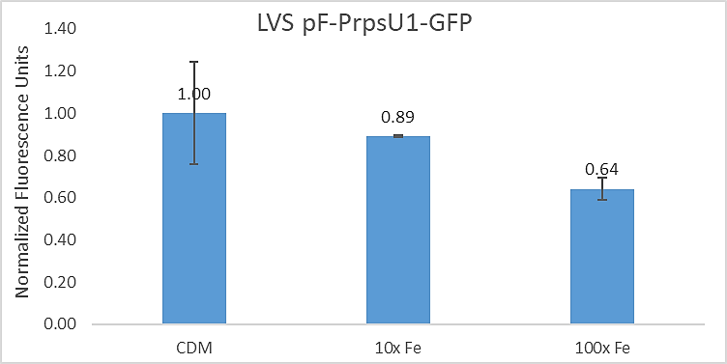
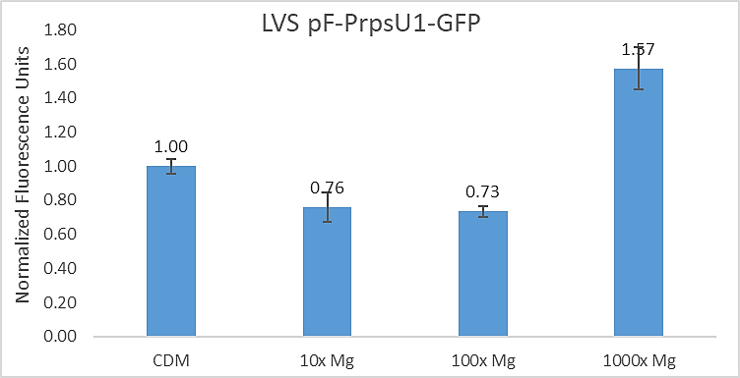
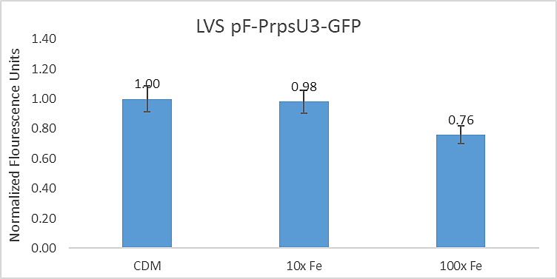
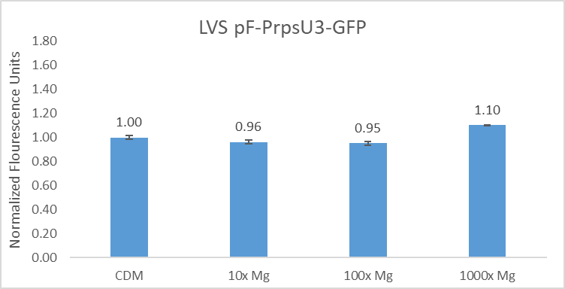
Question: What environmental conditions may lead to the up-regulation of rpsU1 and rpsU3?
Controls:
Normalized to LVS grown in CDM. Relative to CDM with standard Fe or Mg concentrations.
Interpretation: Some increase of abundance of rpsU1 when grown in 1000x Mg, but otherwise no significant relationships in Fe or pertaining to rpsU3 in these conditions.

