Slide 1
Investigating what environments lead to changes of bS21-1 and bS21-2 protein abundance in Francisella tularensis
KRamsey Lab | Sierra Schmidt

Slide 2
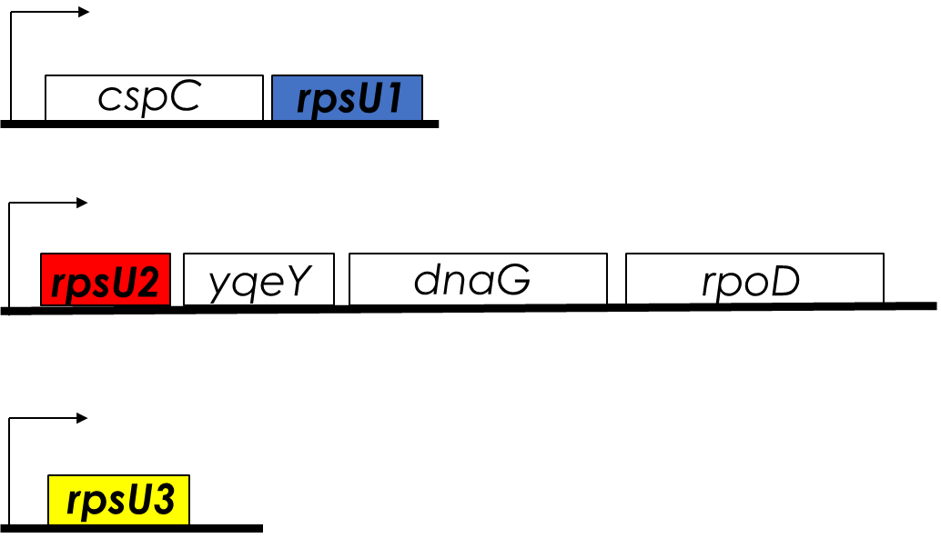
bS21, a small subunit ribosomal protein
Involved in translation initiation
Non-essential
Encoded by phage
Impacts different phenotypes in different species
Take home: bS21 may act as a regulator of translation
Notes:
Even though francisella has a reduced genome, it encodes three copies of the rpsU genes, which encode bS21, a protein in the small ribosomal subunit. Most bacteria have 0 or 1 of this gene. We originally, hypothesized, and have since shown, that these three proteins are produced and incorporated into ribosomes. This is a western blot of purified ribosomes from our wild-type strain as well as strains ectopically expressing each of the bS21 proteins, with a VSVG tag. This, along with some mass spec data we have of purified ribosomes, indicates that multiple classes of ribosomes are possible and occurring
This protein is also interesting to us because it is located close to the mRNA exit channel in the ribosome, and early research has identified that it is involved in translation initiation, so it is in an ideal location to be regulating gene expression at the level of translation initiation.

Slide 3
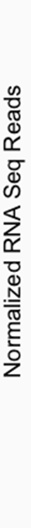
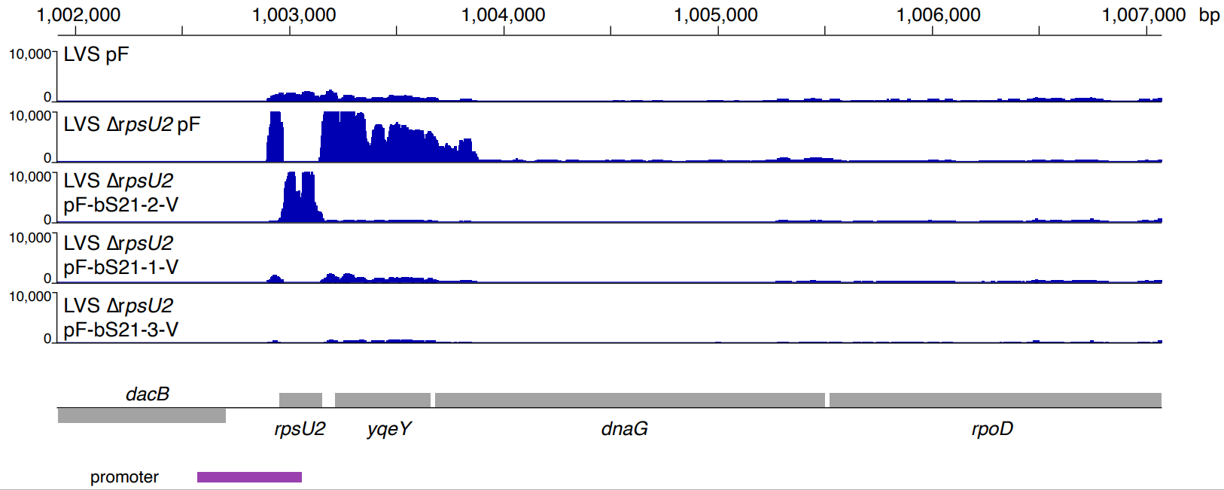
rpsU1 and rpsU3 Complement ΔrpsU2 Phenotype

Slide 4
How are rpsU1 and rpsU3 regulated?

Slide 5
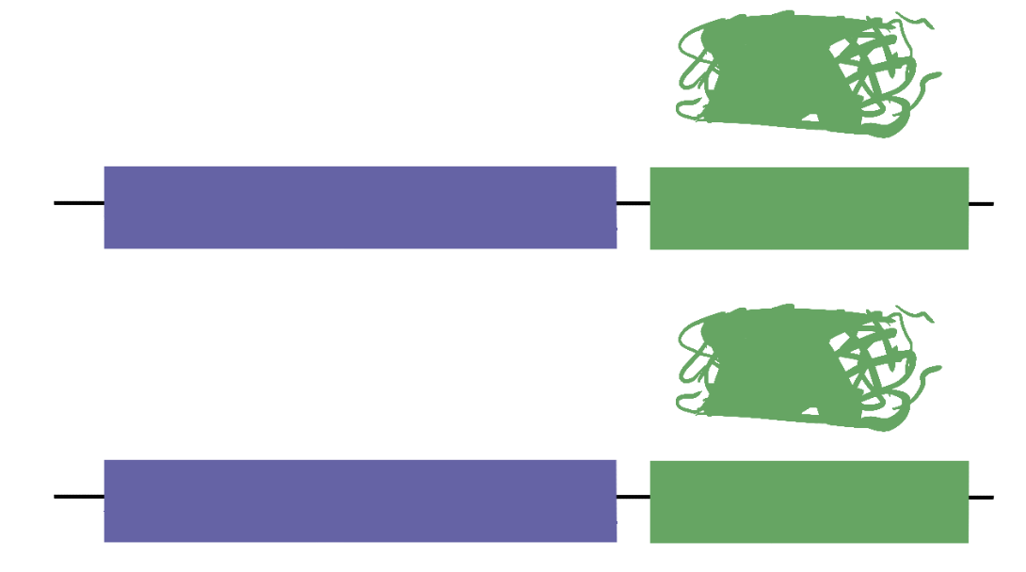
GFP Reporter Assay and Environments Tested
Temperature
Salinity
pH
H₂O₂ induced stress
UV induced stress
Growth in Chamberlain’s Defined Media
Growth on Cysteine Heart Agar with 2% hemoglobin
Growth to stationary phase
Different magnesium concentrations
Different iron concentrations
cspC 5′ UTR + Promoter
gfp
rpsU3 5′ UTR + Promoter
gfp

Slide 6
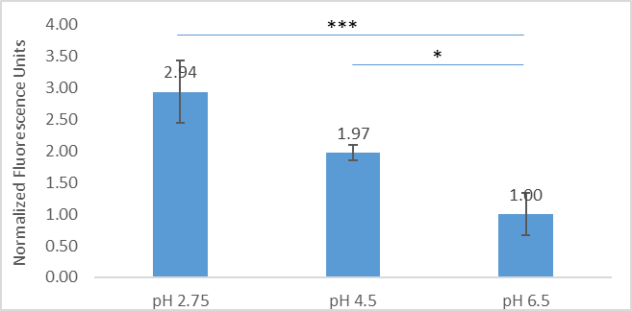
P_{rpsU1}-GFP is Up-Regulated in Low pH
* p-value < 0.025, *** p-value < 0.004

Slide 7
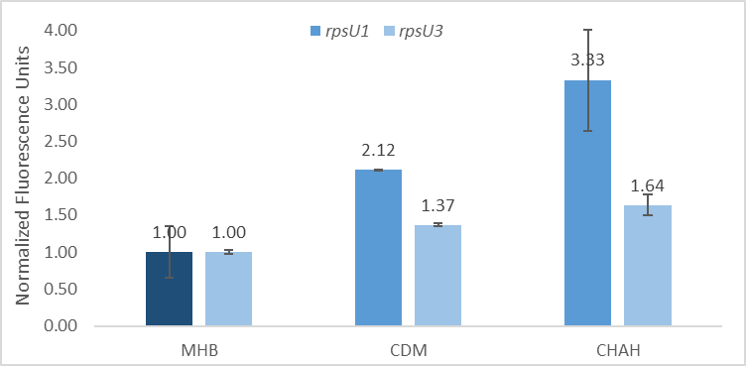
Preliminary: P_{rpsU1}-GFP and P_{rpsU3}-GFP Up-Regulated

Slide 8
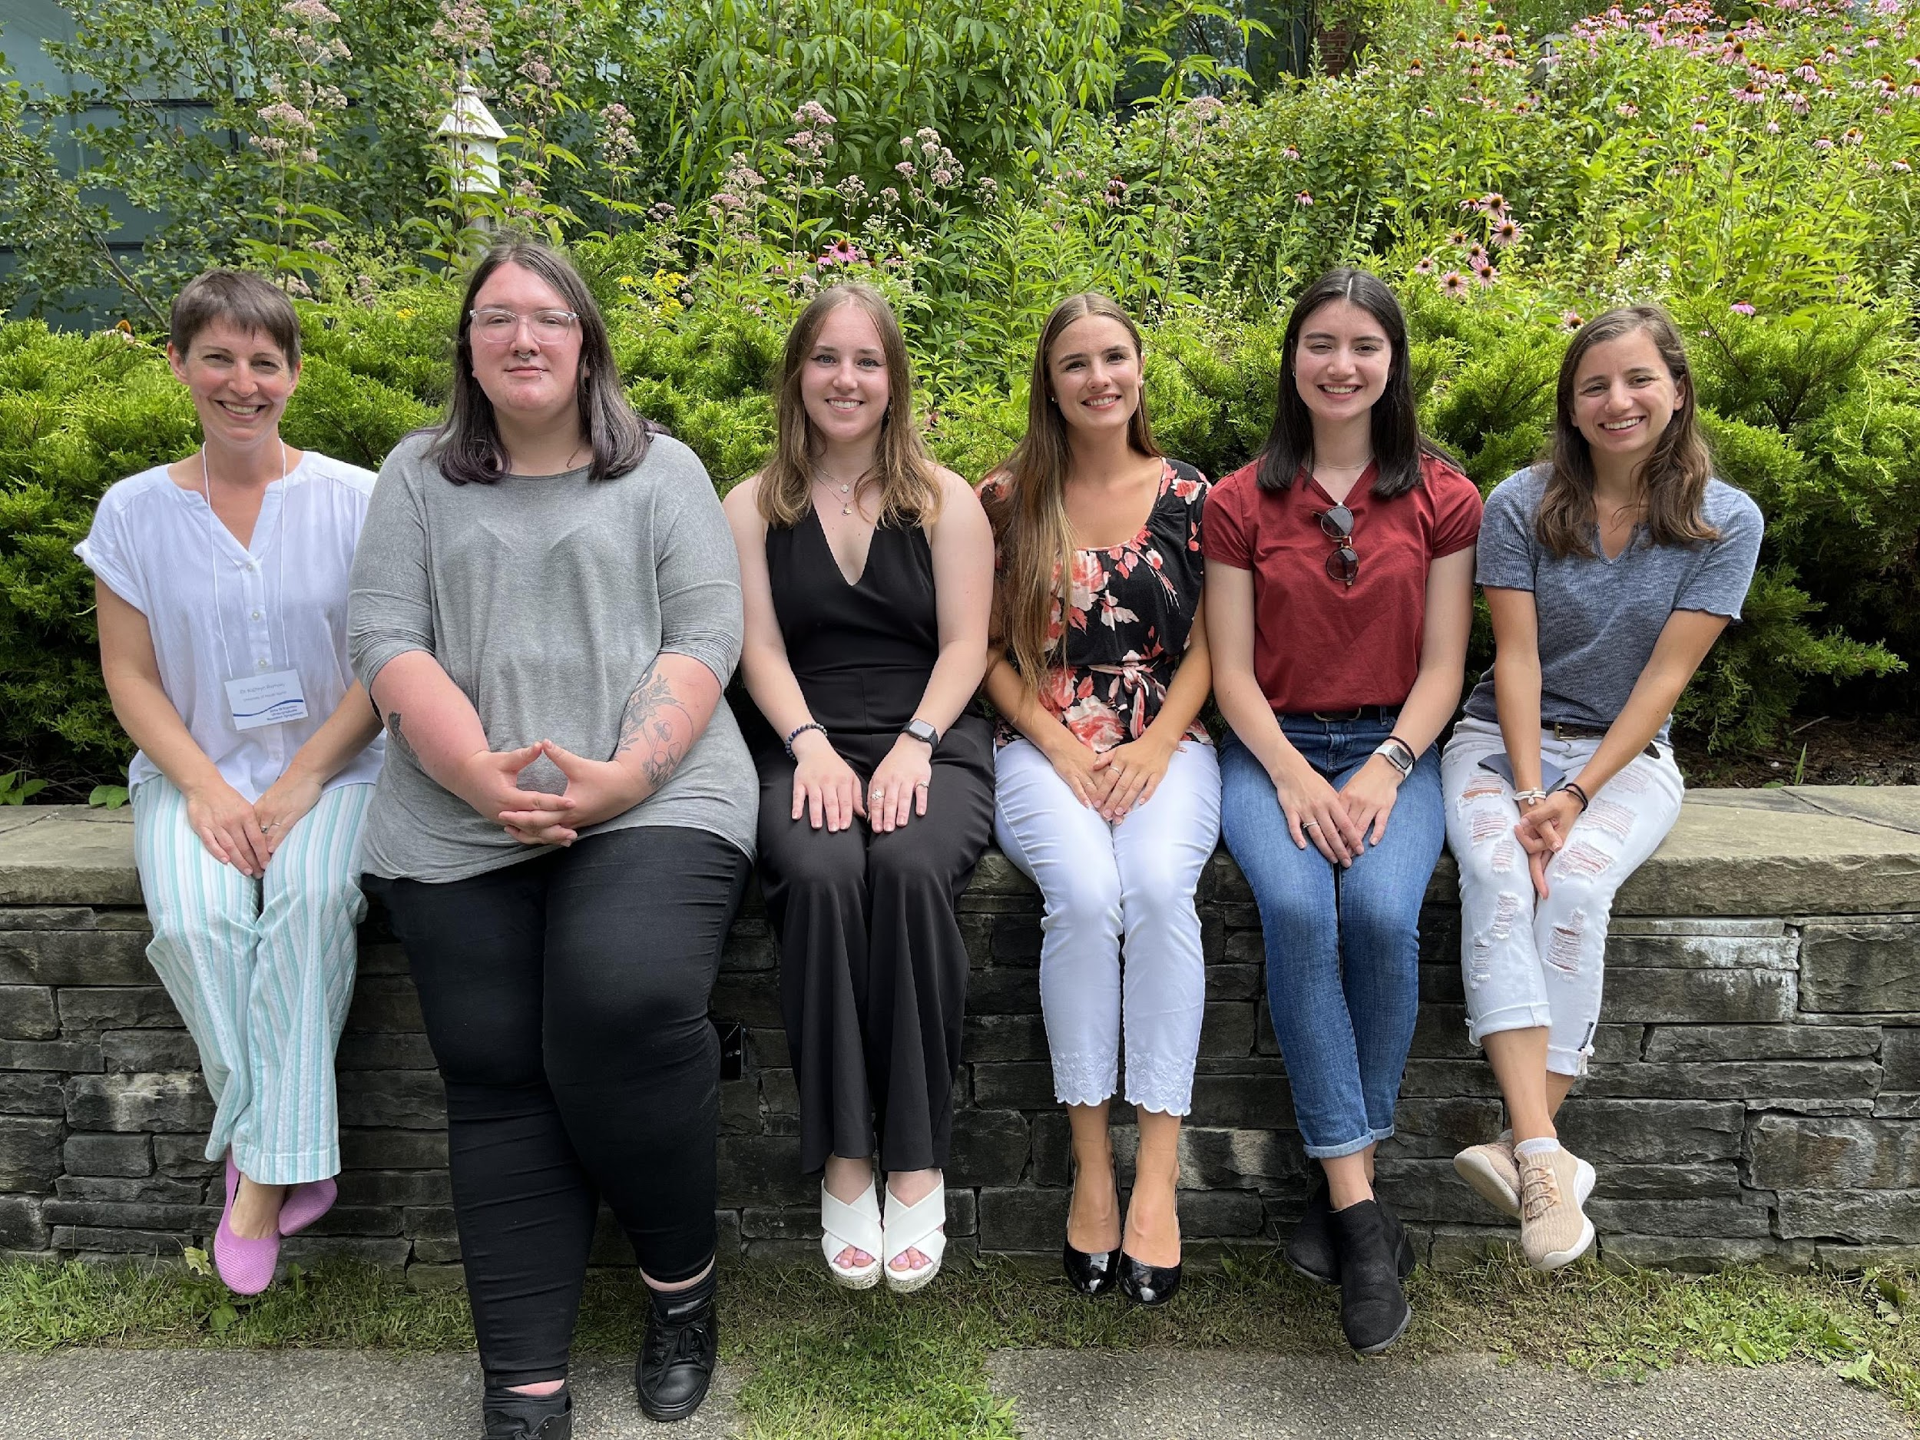





ACKNOWLEDGEMENTS
Dr. Kathryn Ramsey
  Hannah Trautmann
  Aisling Macaraeg
  Dan Floyd
  Former lab members
Dr. Steven Gregory
URI INBRE core
Notes:
I want to thank everyone in the Ramsey lab for their support especially Kathryn. We have fantastic collaborators at URI and Duke whom I want to thank, and then our funding sources, and I will happily take any questions.
Notes:
Motility and biofilm – bacillus subtilis
Acid stress resistance – listeria monocytogenes
Antibiotic resistance – staph aureus
Virulence – burkholderia pseudomallei and francisella in this work
Phage paper – Mizuno et al. 2019, Chen 2022
Bacteriodetes – Jha et al 2020 – probably autoregulating its own expression because rpsU is one of the few genes with a strong SD

