Slide 1
Investigating the Autogenous Regulation of bS21 Homologs
In Francisella tularensis
KRamsey Lab | Sierra Schmidt

Slide 2
bS21, a small subunit ribosomal protein
Involved in translation initiation
Non-essential
Encoded by phage
Impacts different phenotypes in different species
30S subunit, modeled from PDB entry: 4V50
Notes:
Even though francisella has a reduced genome, it encodes three copies of the rpsU genes, which encode bS21, a protein in the small ribosomal subunit. Most bacteria have 0 or 1 of this gene. We originally, hypothesized, and have since shown, that these three proteins are produced and incorporated into ribosomes. This is a western blot of purified ribosomes from our wild-type strain as well as strains ectopically expressing each of the bS21 proteins, with a VSVG tag. This, along with some mass spec data we have of purified ribosomes, indicates that multiple classes of ribosomes are possible and occurring
This protein is also interesting to us because it is located close to the mRNA exit channel in the ribosome, and early research has identified that it is involved in translation initiation, so it is in an ideal location to be regulating gene expression at the level of translation initiation.

Slide 3
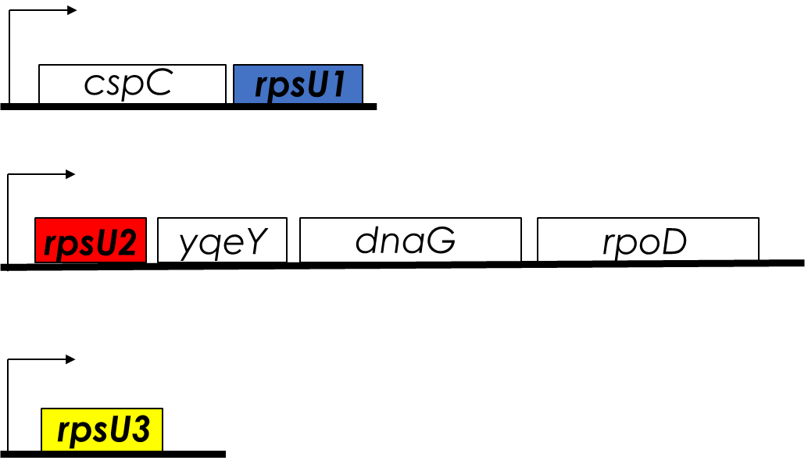
Multiple bS21 Homologs Cause Heterogenous Ribosome Populations in Francisella tularensis
Loss of bS21-2
  change in virulence protein abundance
  reduces ability to grow in macrophage, and subsequently, virulence
Notes:
Even though francisella has a reduced genome, it encodes three copies of the rpsU genes, which encode bS21, a protein in the small ribosomal subunit. Most bacteria have 0 or 1 of this gene. We originally, hypothesized, and have since shown, that these three proteins are produced and incorporated into ribosomes. This is a western blot of purified ribosomes from our wild-type strain as well as strains ectopically expressing each of the bS21 proteins, with a VSVG tag. This, along with some mass spec data we have of purified ribosomes, indicates that multiple classes of ribosomes are possible and occurring
This protein is also interesting to us because it is located close to the mRNA exit channel in the ribosome, and early research has identified that it is involved in translation initiation, so it is in an ideal location to be regulating gene expression at the level of translation initiation.

Slide 4
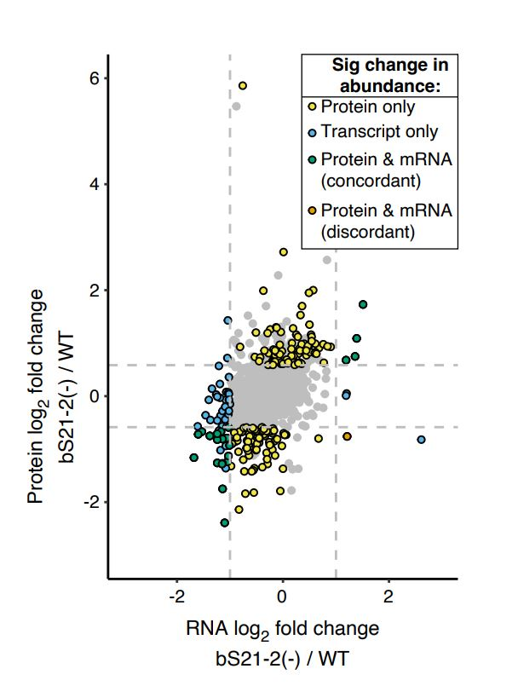
Differences Between Protein and Transcript Abundance in Cells Lacking bS21-2
Mostly show change in protein, not transcript abundance
Trautmann and Ramsey, 2022
Notes:
Comparison of cells lacking bS21-2 to wild-type
X-axis: RNA-Seq, dashed lines indicate 2-fold change
Y-axis: whole cell mass spec, dashed lines indicate 1.5-fold change

Slide 5
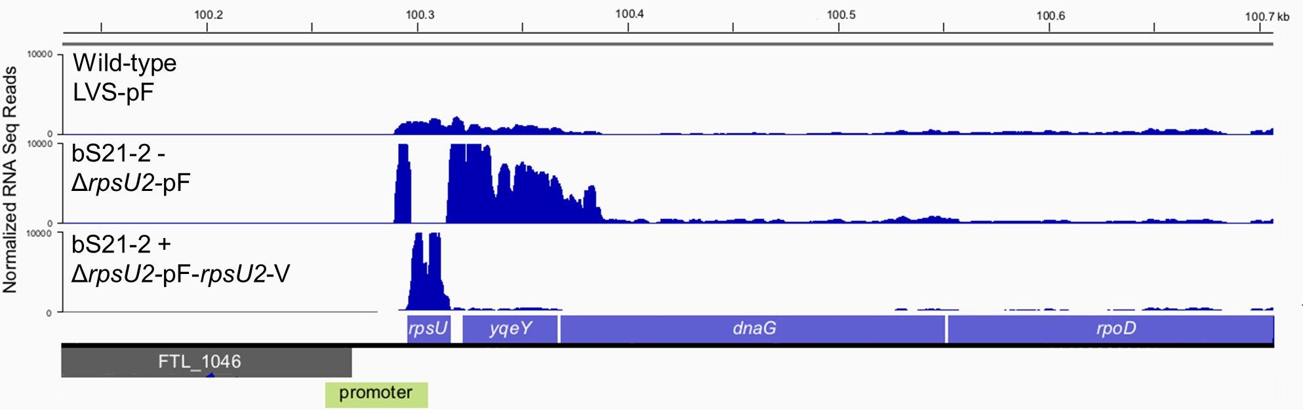
RNA Seq Data Suggest bS21-2 Negatively Regulates its Own mRNA
bS21-2 is encoded by rpsU2
Notes:
I will be showing you some RNA seq data, but to first orient you to where on the chromosome we are looking, we have thi FTL region, followed by the promoter for rpU2, the rpsU2 gene, as well as the ret of the genes of the operate, yqeY, dnaG, ropA.Now in the wildtype confirguation of this this operon, we see some peaks in the first part of the operon, rpsU2 and its promoter, followed by a decrease in the relative abundance of the following genes. ON this scale, it doesn’t seem too drastic, but there is that relationship. So, next, in order to look at the effects of bS21=2 on the operon, we took it out of the cells and we see this. There is high level of transcript abundance for the promoter of rpsU2, this empty region which is bS21-2, which of course we took out so we see no transcript abundance, followed by high levels of expression of the rest of the genes in the operon. Now this presents two possibilities: Some indirect effect by the loss of bS21-2 or bS21-2 itelf is unctioning as a negative regulation of its own transcription. To test this, bS21-2 was added back to the cell on a plasmid, as this would eptopically express the protein, were this negative regulation to be recovered, then we would expect the second possibility to be true, and, in fact, we do.

Slide 6

Ribosomal Protein Expression is Tightly Controlled

Slide 7
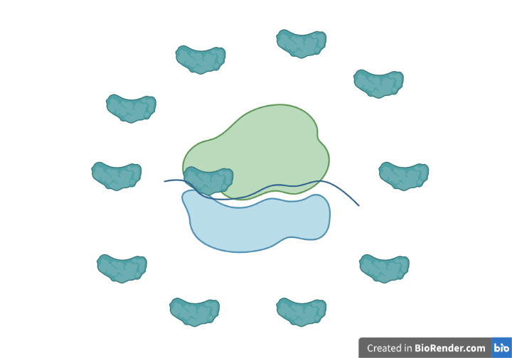
Ribosomal Protein Expression is Tightly Controlled

Slide 8
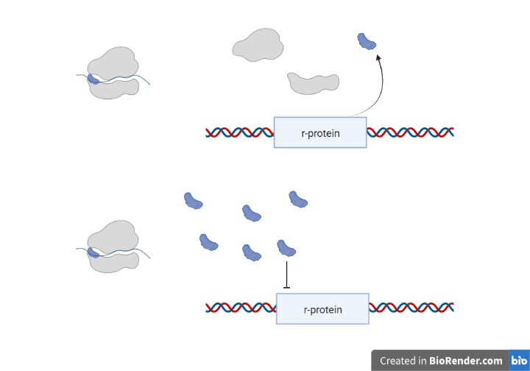
Ribosomal Protein Expression is Tightly Controlled

Slide 9
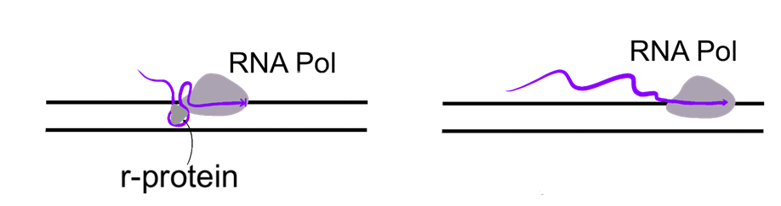
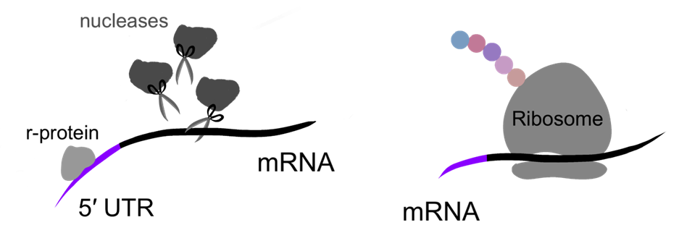
Classic Models of Ribosomal Protein Autoregulation
With r-protein
Without r-protein
Attenuation
Regulating r-protein will interact with secondary structures as transcription is occurring
Stalls the RNA polymerase
With r-protein
Without r-protein
Post-Transcriptional Control
Regulating r-protein may recruit nucleases and degrade transcript
Regulating r-protein may sequester the Shine-Dalgarno sequence
Translation is unable to proceed

Slide 10
1. How does bS21-2 affect its own expression?
Research Questions
2. How do all three homologs affect their own and each other’s expression?

Slide 11
1. How does bS21-2 affect its own expression?
Research Questions
2. How do all three homologs affect their own and each other’s expression?

Slide 12
Which Site Does bS21-2 Need to Affect Transcript Abundance?
Promoter
5′UTR
rpsU2

Slide 13

Testing 5′ UTR vs Promoter Contribution to Regulation by bS21-2
Cells with bS21-2 (WT) | Cells without bS21-2 (∆rpsU2)
tul4 promoter
tul4
5′ UTR
lacZ
rpsU2 promoter
rpsU2
5′ UTR
lacZ
tul4 promoter
rpsU2
5′ UTR
lacZ
?
?
rpsU2 promoter
tul4
5′ UTR
lacZ
?
?

Slide 14
rpsU2 Promoter and 5′ UTR Lead to Regulation
*
Relative Transcript Abundance
5′UTR:
Promoter:
bS21-2:

Slide 15
Testing 5′ UTR vs Promoter Contribution to Regulation by bS21-2
Cells with bS21-2 (WT) | Cells without bS21-2 (∆rpsU2)
tul4 promoter
tul4
5′ UTR
lacZ
1.0
1.1
rpsU2 promoter
rpsU2
5′ UTR
lacZ
1.0
7.0
tul4 promoter
rpsU2
5′ UTR
lacZ
?
?
rpsU2 promoter
tul4
5′ UTR
lacZ
?
?

Slide 16
The 5′ UTR of rpsU2 is Sufficient for Regulation
***
*
Relative Transcript Abundance
5′UTR:
Promoter:
bS21-2:

Slide 17
The 5′ UTR is Sufficient for Regulation by bS21-2
Cells with bS21-2 (WT) | Cells without bS21-2 (∆rpsU2)
tul4 promoter
tul4
5′ UTR
lacZ
1.0
1.1
rpsU2 promoter
rpsU2
5′ UTR
lacZ
1.0
9.3
tul4 promoter
rpsU2
5′ UTR
lacZ
1.0
4.3
rpsU2 promoter
tul4
5′ UTR
lacZ
?
?

Slide 18
Classic Models
With r-protein
Without r-protein
Attenuation
Regulating r-protein will interact with secondary structures as transcription is occurring
Stalls the RNA polymerase
With r-protein
Without r-protein
Post-Transcriptional Control
Regulating r-protein may recruit nucleases and degrade transcript
Regulating r-protein may sequester the Shine-Dalgarno sequence
Translation is unable to proceed

Slide 19
Next Steps
Use an RNA stability assay to distinguish between the attenuation and post-transcriptional models
Assess the relationship between transcript and protein abundance using lacZ
Test the rpsU2 promoter’s contribution to autoregulation by bS21-2

Slide 20
1. How does bS21-2 affect its own expression?
Research Questions
2. How do all three homologs affect their own and each other’s expression?

Slide 21
1. How does bS21-2 affect its own expression?
Research Questions
2. How do all three homologs affect their own and each other’s expression?

Slide 22
Overview
Initial Observations
bS21-1 and bS21-3 seem to contribute a similar negative regulatory affect on rpsU2 transcript abundance
Future Directions
Exploring environmental conditions to determine what may up-regulate the production of either bS21-1 and bS21-3
Address the contribution of bS21-1 and bS21-3 on the regulation of bS21-2

Slide 23






Acknowledgements
Dr. Kathryn Ramsey
  Hannah Trautmann
  Aisling Macaraeg
  Former lab members
Dr. Steven Gregory
URI INBRE core
Notes:
I want to thank everyone in the Ramsey lab for their support especially Kathryn. We have fantastic collaborators at URI and Duke whom I want to thank, and then our funding sources, and I will happily take any questions.
Notes:
Motility and biofilm – bacillus subtilis
Acid stress resistance – listeria monocytogenes
Antibiotic resistance – staph aureus
Virulence – burkholderia pseudomallei and francisella in this work
Phage paper – Mizuno et al. 2019, Chen 2022
Bacteriodetes – Jha et al 2020 – probably autoregulating its own expression because rpsU is one of the few genes with a strong SD

Slide 24
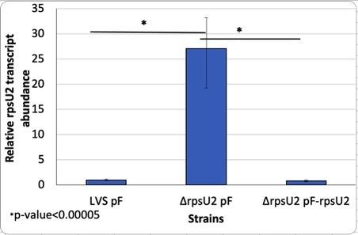
Previous RT-PCR
When bS21-2 is present there is a relatively low transcript abundance
With no protein present, transcript abundance increases significantly
Further suggests that bS21-2 is regulating its own expression
Notes:
Another piece of preliminary data that was used is showing transcript abundance between LVS and delta rpsU2
As you can see, when there the rpsu2 gene is deleted there is a 25 fold increase in transcript abundance
This is clearly showing that when there is no protein present, there is an increase in transcript. The protein is suppressing itself.
What could be happening?
One option is that it is preventing its own transcription.
Binding to DNA for example
Another option is that it could be inhibiting translation leading to quick degradation
Which would be similar to the example that I showed you earlier
With this idea that the protein bS21-2 is preventing its own transcription, we were interested to investigate which specific part of the sequence could the protein be influencing? Is this regulation occuring at the level of transcription or translation?

