Slide 1
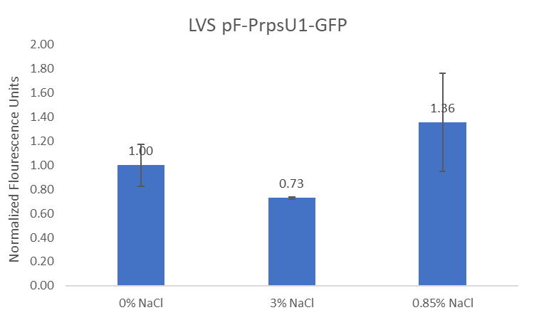
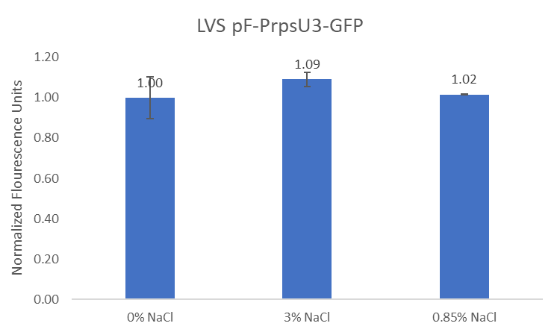
Question: What conditions lead to the up-regulation of rpsU1 and rpsU3?
Controls:
GFP strains grown at 37°C in 0% added NaCl, and LVS grown at 37°C in 0% added NaCl
Interpretation: rpsU3 has no noticeable difference in production as a result of NaCl. There is a slight increased in rpsU1 abundance at 0.85%.

Slide 2
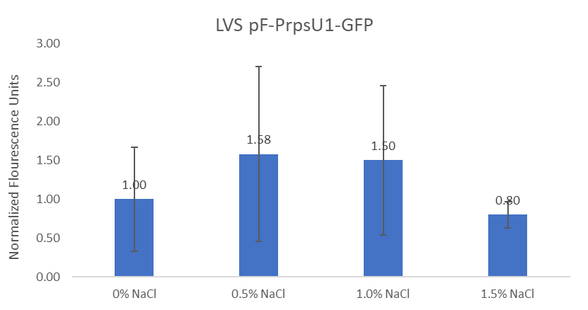
Question: What conditions lead to the up-regulation of rpsU1 and rpsU3?
Controls:
GFP strains grown at 37°C in 0% added NaCl, and LVS grown at 37°C in 0% added NaCl
Interpretation: rpsU1 abundance at 0.5% and 1.0% look slightly increased, but large error bars show variability (or perhaps I mixed up something?)

Slide 3
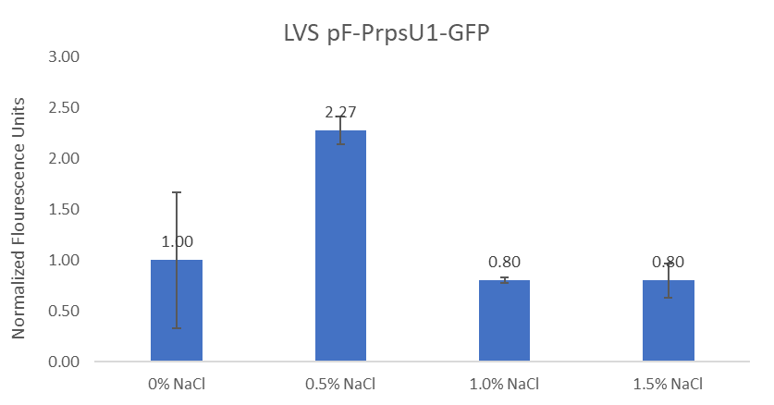
Question: What conditions lead to the up-regulation of rpsU1 and rpsU3?
Controls:
GFP strains grown at 37°C in 0% added NaCl, and LVS grown at 37°C in 0% added NaCl
Interpretation: Just wanted to check what the graph would look like if I had somehow mixed up samples, so either 0.5% or 1.0% would have the fluorescence unit of 2.27. Regardless, its not a significant difference.

