Slide 1

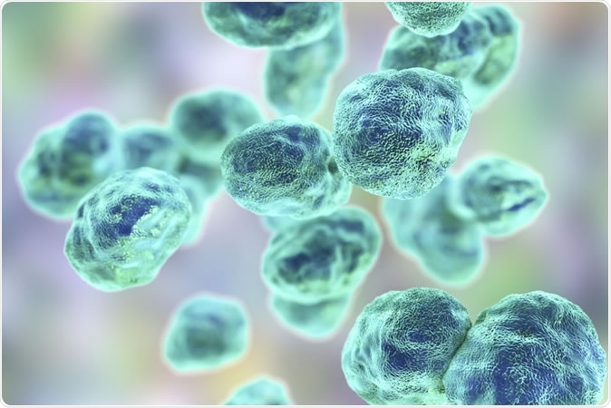

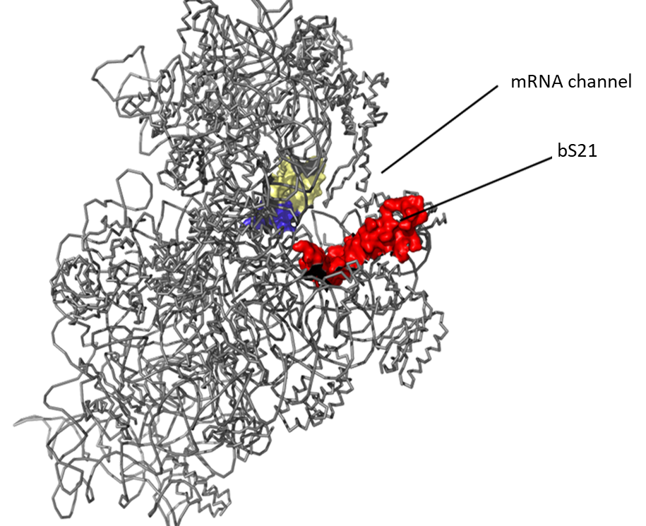

Examining the Mechanism of the Self-Regulation of rpsU2 in Francisella tularensis
Sierra Schmidt¹, Hannah Trautmann¹, Kathryn Ramsey ^{1,2}
¹Department of Cell and Molecular Biology
²Department of Biomedical and Pharmaceutical Sciences
Introduction
Results
Francisella tularensis
Constructs and Predictions
A Title Eventually
Gram-negative
Intracellular pathogen
Causes tularemia
Potential bioweapon
If in cells with bS21-2 (WT) | If in cells without bS21-2 (∆rpsU2)
tul 4 promoter
tul 4
5’ UTR
lacZ
rpsU2 promoter
rpsU2
5’ UTR
lacZ
bS21: a small subunit ribosomal protein involved in translation initiation
rpsU2 promoter
tul 4
5’ UTR
lacZ
?
?
tul 4 promoter
rpsU2
5’ UTR
lacZ
?
?
Ribosomal Protein Regulation
  Three homologs in F. tularensis
    Leads to ribosome heterogeneity
  Loss of bS21-2
    Influences virulence factors and intramacrophage growth
rpsU2 5’UTR Permits Regulation by bS21
MODEL 1: Attenuation
rpsU2 promoter
rpsU2 5’ UTR
lacZ
+ rpsU2
tul 4 promoter
rpsU2 5’ UTR
lacZ
+ rpsU2
With bS21-2
Without bS21-2
rpsU2 promoter
rpsU2 5’ UTR
lacZ
- rpsU2
tul 4 promoter
rpsU2 5’ UTR
lacZ
- rpsU2
Location of bS21 in the small subunit of the E. coli ribosome
Study Goals
MODEL 2:
Post-Transcriptional Control
Understand the regulation of
the bS21 homologs
How does bS21-2 affect itself?
How do bS21-1 and bS21-3 affect bS21-2?
5’UTR
downstream rpsU2
lacZ
Native Context:
P_{rpsU2}
5’UTR_{rpsU2}
rpsU2
yqeY
Tn7 Site:
P_{tul4}
5’UTR_{rpsU2}
lacZ
bS21-2 Regulates its Own Expression
  LVS pF
Conclusions
The 5’UTR of the rpsU2 gene leads to regulation by bS21
Future Directions
Test the rpsU2 promoter’s contribution to the regulation of bS21-2
Assess the relationship between transcript and protein abundance with lacZ
Examine post-transcriptional model via degradation assays
  ΔrpsU2 pF
  ΔrpsU2 pF rpsU2-V
References
Burgos, H. L., O'Connor, K., Sanchez-Vazquez, P., & Gourse, R. L. (2017). Roles of Transcriptional and Translational Control Mechanisms in Regulation of Ribosomal Protein Synthesis in Escherichia coli. Journal of bacteriology, 199(21), e00407-17. https://doi.org/10.1128/JB.00407-17
Lindahl, L., Archer, R., & Zengel, J. M. (1983). Transcription of the S10 ribosomal protein operon is regulated by an attenuator in the leader. Cell, 33(1), 241–248. https://doi.org/10.1016/0092-8674(83)90353-7
Nomura, M., Gourse, R., & Baughman, G. (1984). Regulation of the synthesis of ribosomes and ribosomal components. Annual review of biochemistry, 53, 75–117. https://doi.org/10.1146/annurev.bi.53.070184.000451
Zengel, J. M., & Lindahl, L. (1994). Diverse mechanisms for regulating ribosomal protein synthesis in Escherichia coli. Progress in nucleic acid research and molecular biology, 47, 331–370. https://doi.org/10.1016/s0079-6603(08)60256-1
Notes:
Know that transcriptional repressors interacts on polycistronic opersons at a specific target site; this happens near or at the transcriptional initiation site (demonstrated in the promoter)
There is a possibility for some to have multiple binding sites for egulation
Many of the regulatory r-prtoeins bind near the initiation sites of ribosomes so its speculated that the regulation may come from a similar structure recognition between rrnas and mrnas tha they regulate (with higher binding affinity in the rrnas) (this indicates an ability to control translation as well, rather than transcription but obviously I’m looking at just transcriptional control)
Models: binding of r-protein to mRNA recruits nucleases, inhibition by r-protein terminations the transcription of the cistrons downstream (first interacts with first cistron) (this termination of translation would occur prior to the translational start site of the first gene)

