Slide 1

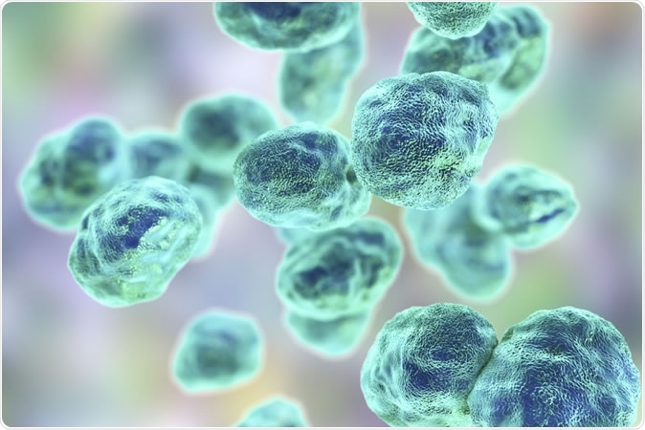

Examining the Mechanism of the Self-Regulation of rpsU2 in Francisella tularensis
¹Schmidt, S.; ¹Traubman, H.; ^{1,2}Ramsey, K.
¹Department of Cell and Molecular Biology
²Department of Biomedical and Pharmaceutical Sciences
Introduction
Results
Models for r Protein Regulation
Francisella tularensis
Constructs and Predictions
MODEL 1: Attenuation
Gram negative
Intracellular pathogen
Causative agent of tularemia
Potential bioweapon
If in cells with bS21-2 (WT) | If in cells without bS21-2 (∆rpsU2)
rpsU2 promoter
rpsU2
5’ UTR
lacZ
tul 4 promoter
tul 4
5’ UTR
lacZ
bS21
rpsU2 promoter
tul 4
5’ UTR
lacZ
A small subunit ribosomal protein involved in translation initiation
?
?
  F. tularensis:
  Three homologs
    Potential lead to ribosome heterogeneity
  Loss of bS21-2
    Influences virulence factors
tul 4 promoter
rpsU2
5’ UTR
lacZ
?
?
qPCR
bS21 depicted in the E. coli ribosome
Study Goals
Understand the regulation of bS21 homologs
How does bS21-2 affect itself? How do -1 and -3 affect -2?
MODEL 2:
Post-Transcriptional Control
bS21-2 Affects its Own Expression
Conclusions
The abundance of the transcript downstream of
Future Directions
Test the relative transcript abundance of these primer sets in the fourth construct
Protein activity of these constructs
Examine post-transciprtional model via degradation assays
References
Burgos, H. L., O'Connor, K., Sanchez-Vazquez, P., & Gourse, R. L. (2017). Roles of Transcriptional and Translational Control Mechanisms in Regulation of Ribosomal Protein Synthesis in Escherichia coli. Journal of bacteriology, 199(21), e00407-17. https://doi.org/10.1128/JB.00407-17
Lindahl, L., Archer, R., & Zengel, J. M. (1983). Transcription of the S10 ribosomal protein operon is regulated by an attenuator in the leader. Cell, 33(1), 241–248. https://doi.org/10.1016/0092-8674(83)90353-7
Nomura, M., Gourse, R., & Baughman, G. (1984). Regulation of the synthesis of ribosomes and ribosomal components. Annual review of biochemistry, 53, 75–117. https://doi.org/10.1146/annurev.bi.53.070184.000451
Zengel, J. M., & Lindahl, L. (1994). Diverse mechanisms for regulating ribosomal protein synthesis in Escherichia coli. Progress in nucleic acid research and molecular biology, 47, 331–370. https://doi.org/10.1016/s0079-6603(08)60256-1
Notes:
Know that transcriptional repressors interacts on polycistronic opersons at a specific target site; this happens near or at the transcriptional initiation site (demonstrated in the promoter)
There is a possibility for some to have multiple binding sites for egulation
Many of the regulatory r-prtoeins bind near the initiation sites of ribosomes so its speculated that the regulation may come from a similar structure recognition between rrnas and mrnas tha they regulate (with higher binding affinity in the rrnas) (this indicates an ability to control translation as well, rather than transcription but obviously I’m looking at just transcriptional control)
Models: binding of r-protein to mRNA recruits nucleases, inhibition by r-protein terminations the transcription of the cistrons downstream (first interacts with first cistron) (this termination of translation would occur prior to the translational start site of the first gene)

