Slide 1
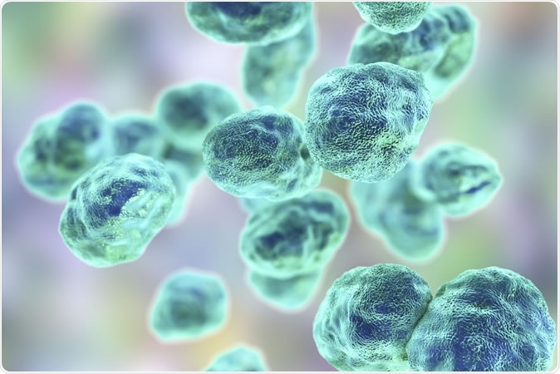

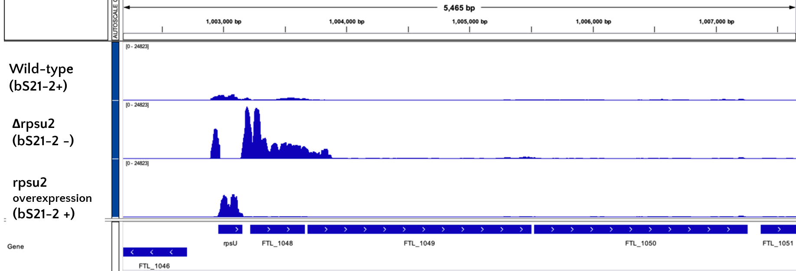
Examining the Mechanism of the Self-Regulation of rpsU2 in Francisella tularensis
Schmidt, S.; Traubman, H.; Ramsey, K.
Introduction
Models in Other R Proteins
Results
Francisella tularensis
MODEL 1: Transcriptional Regulation
Constructs and Predictions
A small subunit ribosomal promote involved in translation initiation
If in cells with bS21-2 (WT) | If in cells without bS21-2 (∆rpsU2)
Gram negative
Intracellular pathogen
Causative agent of tularemia
Potential bioweapon
rpsU2 promoter
rpsU2
5’ UTR
LacZ
tul 4 promoter
tul 4
5’ UTR
LacZ
rpsU2 promoter
tul 4
5’ UTR
LacZ
?
?
bS21
tul 4 promoter
rpsU2
5’ UTR
LacZ
?
?
A small subunit ribosomal protein involved in translation initiation
qPCR
  bS21 in F. tularensis:
  Three homologs
    Potential lead to ribosome heterogeneity
  Loss of bS21-2
    Causes phenotypic changes
bS21 depicted in the E. coli ribosome
MODEL 2: Post-Transcriptional Regulation
rRNA Seq
Results
References
Burgos, H. L., O'Connor, K., Sanchez-Vazquez, P., & Gourse, R. L. (2017). Roles of Transcriptional and Translational Control Mechanisms in Regulation of Ribosomal Protein Synthesis in Escherichia coli. Journal of bacteriology, 199(21), e00407-17. https://doi.org/10.1128/JB.00407-17
Lindahl, L., Archer, R., & Zengel, J. M. (1983). Transcription of the S10 ribosomal protein operon is regulated by an attenuator in the leader. Cell, 33(1), 241–248. https://doi.org/10.1016/0092-8674(83)90353-7
Nomura, M., Gourse, R., & Baughman, G. (1984). Regulation of the synthesis of ribosomes and ribosomal components. Annual review of biochemistry, 53, 75–117. https://doi.org/10.1146/annurev.bi.53.070184.000451
Notes:
Know that transcriptional repressors interacts on polycistronic opersons at a specific target site; this happens near or at the transcriptional initiation site (demonstrated in the promoter)
There is a possibility for some to have multiple binding sites for egulation
Many of the regulatory r-prtoeins bind near the initiation sites of ribosomes so its speculated that the regulation may come from a similar structure recognition between rrnas and mrnas tha they regulate (with higher binding affinity in the rrnas) (this indicates an ability to control translation as well, rather than transcription but obviously I’m looking at just transcriptional control)
Models: binding of r-protein to mRNA recruits nucleases, inhibition by r-protein terminations the transcription of the cistrons downstream (first interacts with first cistron) (this termination of translation would occur prior to the translational start site of the first gene)

