Slide 1
How does rpsu2 Regulate its own expression?

Slide 2
bS21, a small ribosome subunit protein
  bS21 in F. tularensis:
  Loss of bS21-2
  change in virulence protein abundance
  reduces virulence
  Changes of ribosome bS21 content alters sensitivity to kasugamycin
30S subunit, modeled from PDB entry: 4V50
Notes:
One such protein which is found in some, but not all ribosomes is the protein bs21. Particular bS21 paralogs translate specific transcripts more efficiently (ribosome “sigma factors”), playing a role in translation initiation. It is believed that ribosomes with specific bS21 paralogs could modulate gene expression That said, thus far it is believed to be non-essential, but implicated in the control of quite a few processes such as biofilm production, motility, acid stress resistance, antibiotic resistance, and virulence. Bs21 is also found encoded in some phage.

Slide 3
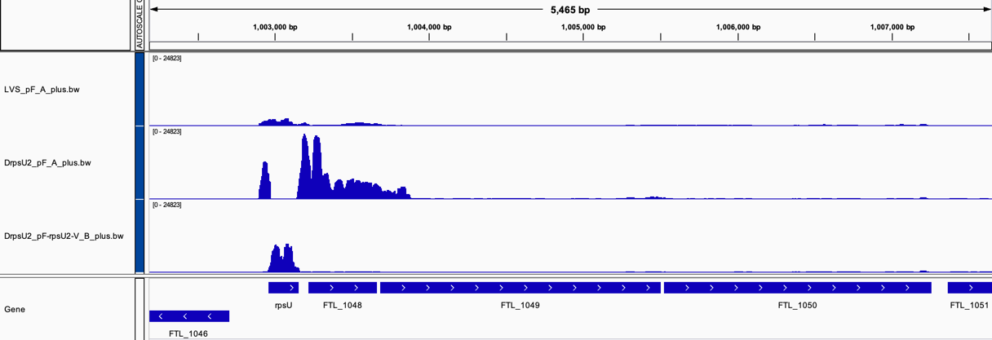
rRNA seq data suggest bS21-2 suppresses own mRNA
Wild-type
(bS21-2+)
Δrpsu2
(bS21-2 -)
rpsu2 overexpression
(bS21-2 +)
rpsU2
yqeY
dnaG
rpoD
Notes:
Our first piece of Data is showing the amount of transcript abundance (like a histogram situation)
X-axis are the genes
At the bottom is the sequence aligned and the red arrow is pointing to area that was of interest
Wild type cells, which have bS21-2, have low expression of rpsU2 and other genes surrounding
Delta rpsu2 have an increased abundance of genes surrounding
And the final is sort of like a control, it was a plasmid with rpsu2 and bS21 and there was a decent amount of rpsU2 transcript and none of anything else
Conclusion: When there is no bS21-2 present, there is an increased abundance of the rest of the operon

Slide 4
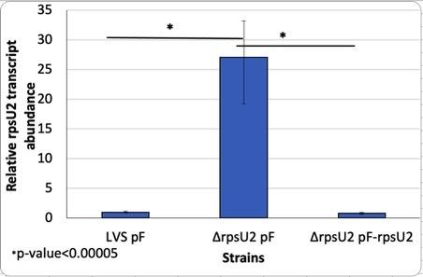
Previous RT-PCR
When bS21-2 is present there is a relatively low transcript abundance
With no protein present, transcript abundance increases significantly
Further suggests that bS21-2 is regulating its own expression
Notes:
Another piece of preliminary data that was used is showing transcript abundance between LVS and delta rpsU2
As you can see, when there the rpsu2 gene is deleted there is a 25 fold increase in transcript abundance
This is clearly showing that when there is no protein present, there is an increase in transcript. The protein is suppressing itself.
What could be happening?
One option is that it is preventing its own transcription.
Binding to DNA for example
Another option is that it could be inhibiting translation leading to quick degradation
Which would be similar to the example that I showed you earlier
With this idea that the protein bS21-2 is preventing its own transcription, we were interested to investigate which specific part of the sequence could the protein be influencing? Is this regulation occuring at the level of transcription or translation?

Slide 5
Lvs and Δrpsu2 qpcr
LVS and ΔrpsU2 relative transcript abundance of the operon
The same relationship is present as shown previously

Slide 6
Is BS21-2 interacting with the 5’UTR or the promoter region?
-10 and -35
5’UTR
rpsU2

Slide 7
Testing 5’UTR Vs promoter
rpsU2 promoter
rpsU2 5’ UTR
LacZ
tul 4 promoter
tul 4 5’ UTR
LacZ
rpsU2 promoter
tul 4 5’ UTR
LacZ
tul 4 promoter
rpsU2 5’ UTR
LacZ

Slide 8
Testing 5’UTR Vs promoter
Native Context
rpsU2 promoter
rpsU2 5’UTR
rpsU2
Plasmid
rpsU2 promoter
rpsU2 5’ UTR
LacZ
tul 4 promoter
tul 4 5’ UTR
LacZ
tul 4 promoter
rpsU2 5’ UTR
LacZ

Slide 9
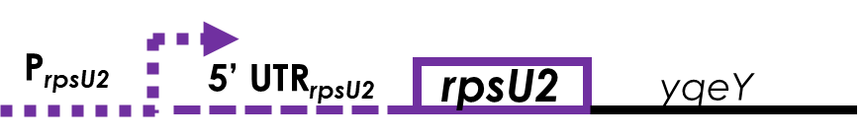
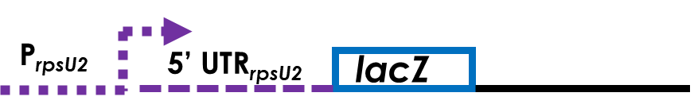
qPCR Results of Prpsu2 rpsu2_UTR Lacz With or without rpsu2
Three primer sets:
  5’UTR
  Downstream rpsu2
  tul4
Native context
Tn7 site

Slide 10
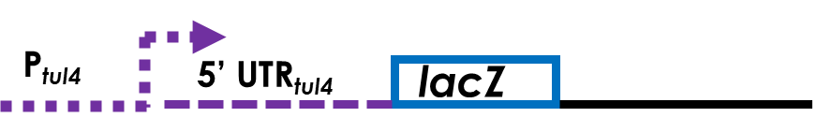
qPCR Results of Prpsu2 rpsu2_UTR Lacz With or without rpsu2
Three primer sets:
  5’UTR
  Downstream rpsu2
  tul4
Native context
Tn7 site

Slide 11
qPCR Results of Prpsu2 rpsu2_UTR Lacz With or without rpsu2
Four primer sets:
  5’UTR
  Downstream rpsu2
  Tul4
  LacZ
Native context
Tn7 site

Slide 12

qPCR Results of Prpsu2 rpsu2_UTR Lacz With or without rpsu2
Three primer sets:
  5’UTR
  Downstream rpsu2
  tul4
Native context
Tn7 site

Slide 13
Next steps
Repeating qPCR with the third primer set
Creating the fourth necessary plasmid
Completing qRT-PCR for the fourth context, and repeating the other three
B-galactosidase activity assay

Slide 14
A Big Thank you to the KRamsey Lab
Dr. Kathryn Ramsey
Hannah Trautmann
Dan Floyd
Aisling Macaraeg
Oli Horyn

