Slide 1
Tying up Loose Ends and Beginning Thesis Project
Sierra Schmidt

Slide 2
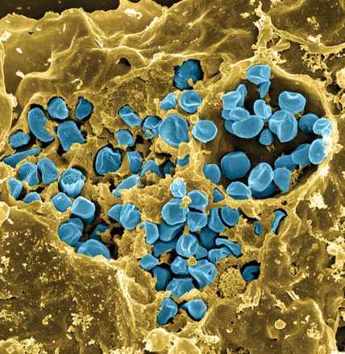
Francisella tularensis
Causes tularemia
Highly infectious
Potential bioweapon
F. tularensis subsp. holarctica LVS
Intracellular growth is essential to cause disease
Fischer, PNAS cover 2006
Notes:
Francisella tularensis is a gram-negative pathogen known for calling tularemia, also known as rabbit fever. Despite the name this pathogen does affect humans and is highly infectious, comparable to Mycobacterium tubuerculosis with a potential mortality rate of up to 30%.In the lab specifically we use the Francisella tularensis holartica Live Vaccine Strain, which I will refer to as LVS for the purposes of this presentation. This strain has been attenuated to humans, but maintains components available for study. As you can see in this false color scanning electron micrograph, the blue picted Francisella is an intracellular pathogen and can be found in many eukaryotic cells, as pictured here the macrophage.
Gram-negative, gamma facultative intracellular pathogen
Infectivity similar to Mtb, can upwards of 30% mortality
Tier 1 Select Agent like Ebola
Cover image: Scanning electron micrograph of a murine macrophage infected with Francisella tularensis strain LVS. Macrophages were dry-fractured by touching the cell surface with cellophane tape after critical point drying to reveal intracellular bacteria. Bacteria (colored in blue) are located either in the cytosol or within a membrane-bound vacuole.

Slide 3
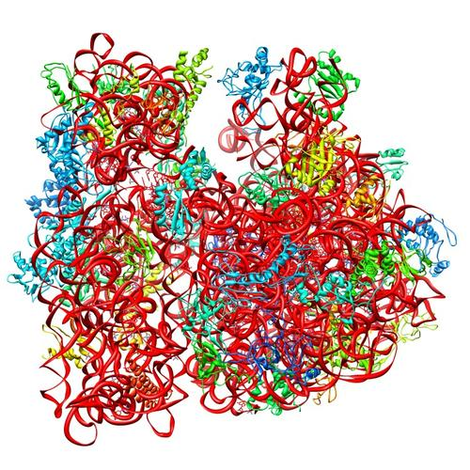
Ribosomes can be heterogenous
Sources of heterogeneity
Multiple rRNA operons
rRNA modifications
Ribosomal protein modifications
Multiple versions of ribosomal proteins
E. coli ribosome
3 rRNAs
49 proteins
PDB 4V50
Berk et al., 2006
How do changes in ribosome composition influence translation?
Notes:
Generally, there is this concept that ribosomes are a monolithic structure, that they are static in every cell. Apparent in Francisella tularensis is the heterogeneity of ribosomes. This phenomenon can arise from a few different sources: multiple rRNA operons, rRNA modifications, ribosomal protein modifications. But the most intriguing for the Kramsey lab is the idea that there can be multiple ribosomal proteins.

Slide 4
bS21, a small ribosome subunit protein
  non-essential
  involved in translation initiation
  implicated in control of specific processes
30S subunit, modeled from PDB entry: 4V50
Notes:
One such protein which is found in some, but not all ribosomes is the protein bs21. Particular bS21 paralogs translate specific transcripts more efficiently (ribosome “sigma factors”), playing a role in translation initiation. It is believed that ribosomes with specific bS21 paralogs could modulate gene expression That said, thus far it is believed to be non-essential, but implicated in the control of quite a few processes such as biofilm production, motility, acid stress resistance, antibiotic resistance, and virulence. Bs21 is also found encoded in some phage.

Slide 5
Multiples bS21 homologs suggest heterogenous ribosome populations in Francisella tularensis
cspC
rpsU1
rpsU2
yqeY
dnaG
rpoD
rpsU3
Notes:
Even though francisella has a reduced genome, it encodes three copies of the rpsU genes, which encode bS21, a protein in the small ribosomal subunit. Most bacteria have 0 or 1 of this gene. We originally, hypothesized, and have since shown, that these three proteins are produced and incorporated into ribosomes. This is a western blot of purified ribosomes from our wild-type strain as well as strains ectopically expressing each of the bS21 proteins, with a VSVG tag. This, along with some mass spec data we have of purified ribosomes, indicates that multiple classes of ribosomes are possible and occurring
This protein is also interesting to us because it is located close to the mRNA exit channel in the ribosome, and early research has identified that it is involved in translation initiation, so it is in an ideal location to be regulating gene expression at the level of translation initiation.

Slide 6
bS21, a small ribosome subunit protein
  non-essential
  involved in translation initiation
  implicated in control of specific processes
  bS21 in F. tularensis:
  Three homologs
  Lead to ribosome heterogeneity
  Loss of bS21-2
  change in virulence protein abundance
  reduces virulence
  Changes of ribosome bS21 content alters sensitivity to kasugamycin
30S subunit, modeled from PDB entry: 4V50
Notes:
One such protein which is found in some, but not all ribosomes is the protein bs21. Particular bS21 paralogs translate specific transcripts more efficiently (ribosome “sigma factors”), playing a role in translation initiation. It is believed that ribosomes with specific bS21 paralogs could modulate gene expression That said, thus far it is believed to be non-essential, but implicated in the control of quite a few processes such as biofilm production, motility, acid stress resistance, antibiotic resistance, and virulence. Bs21 is also found encoded in some phage.

Slide 7
Identity vs. Abundance

Slide 8
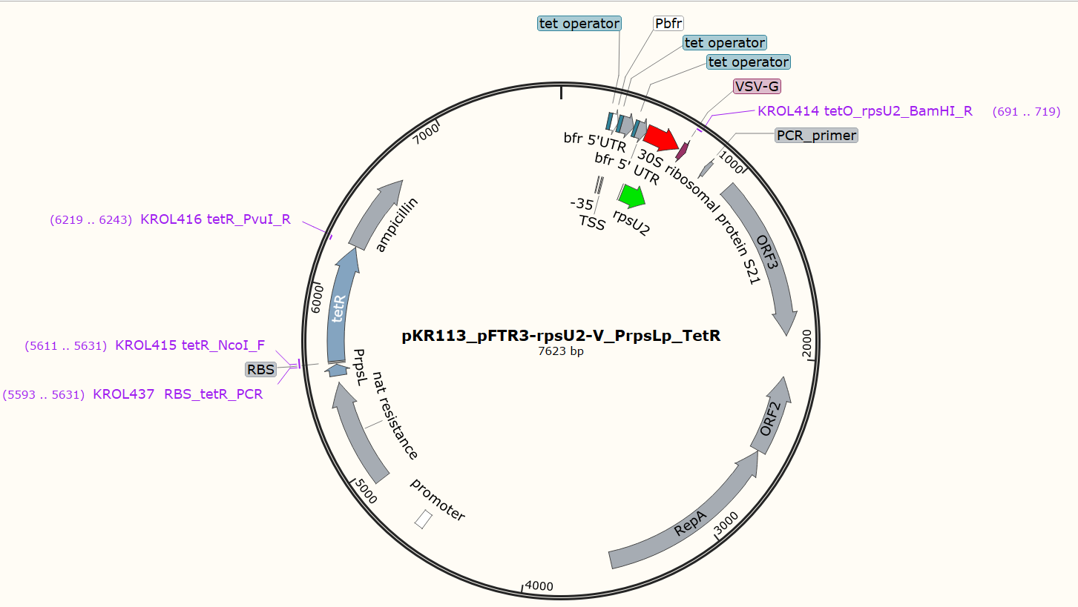

Slide 9
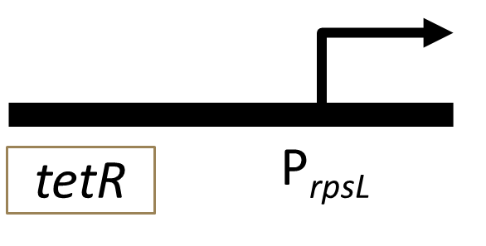
TetR gene regulation
tet repressor binds at the tetO site
Blocks RNA polymerase from transcribing DNA
Anhydrotetracycline (ATc) binds the Tet repressor, falls off DNA
Expression of the rpsU2 gene and production of bS21-2
P_{bfr}
tetO
tetO
tetO
rpsU2
VSVG
Notes:
Now specifically, this project centered on gene regulation using the tet-based indusible system. Here is an abridged form of the plasmid for easier viewing, and what we can see with this is that the tet resistance protein binds the tet operon, which stops expression of the bs21 protein by physically blocking the RNA polymerase and knocking it off the DNA. However, this tet regulated gene expression plasmid is anhydrotetracycline, or Atc, induced. SO when you add the Atc it binds to that repressor, causing the tet-Atc complex to fall off the DNA and to let transcription follow, the rpsU2 gene able to be expressed.

Slide 10
Expectations
- ATc | + ATc
- bS21-2 | + bS21-2

Slide 11
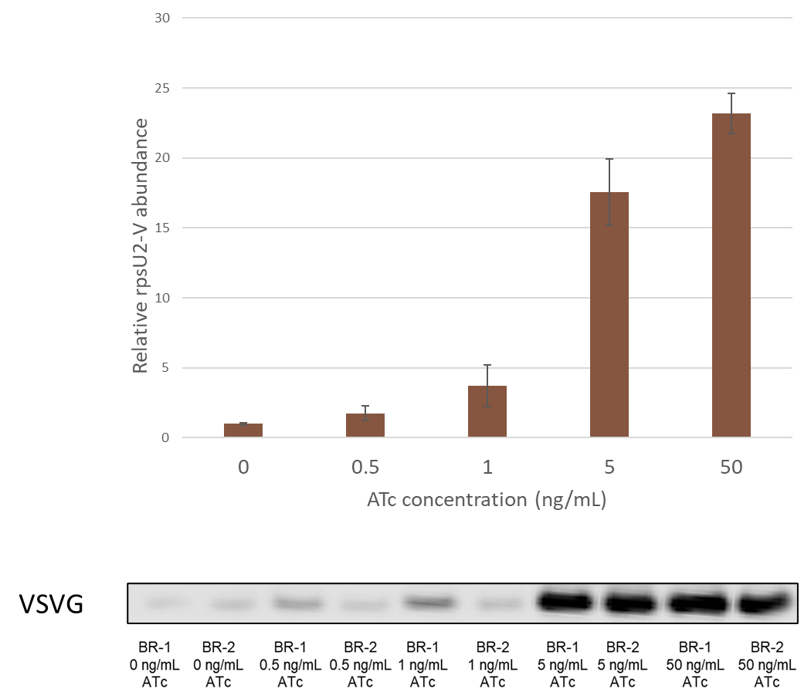
Titration of bS21-2 utilizing the inducible pkr113 plasmid in Δrpsu1 Δrpsu3 cells.

Slide 12
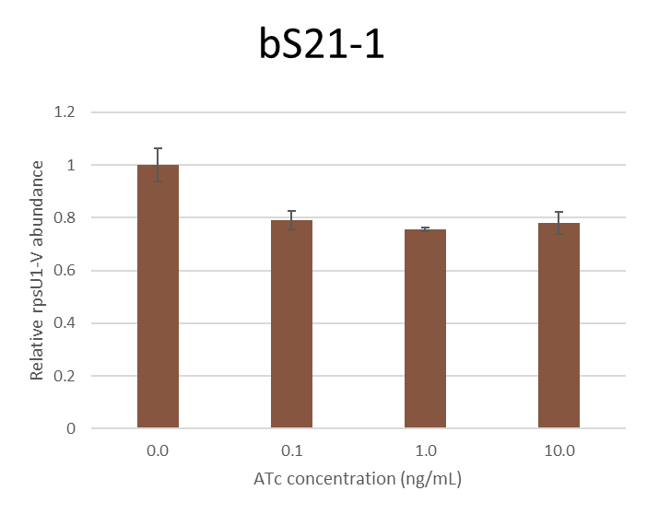
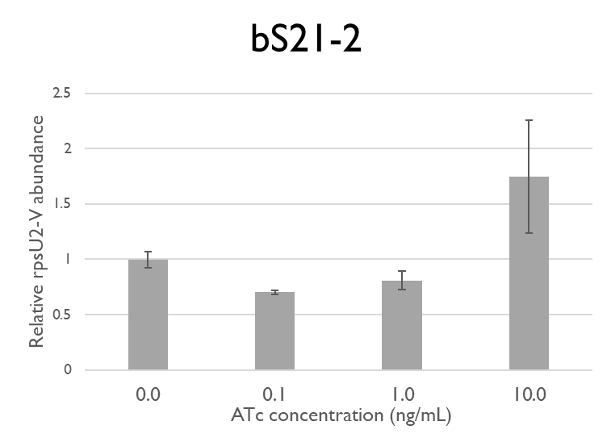
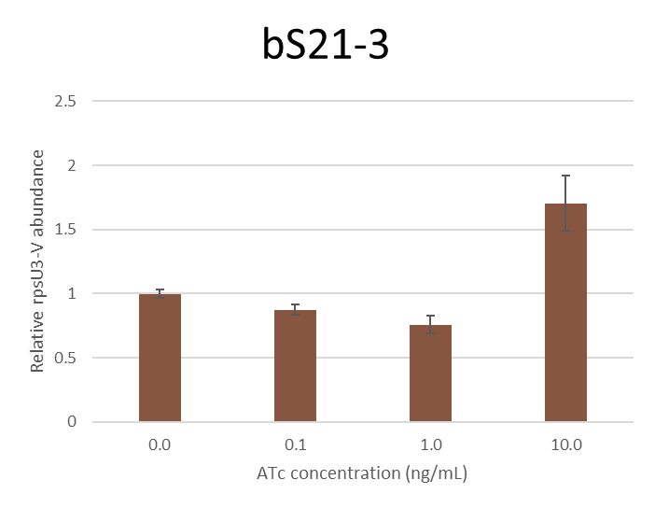
Titration of bS21-2 utilizing the inducible pkr113 plasmid in Δrpsu1 Δrpsu2 Δrpsu3 cells.

Slide 13
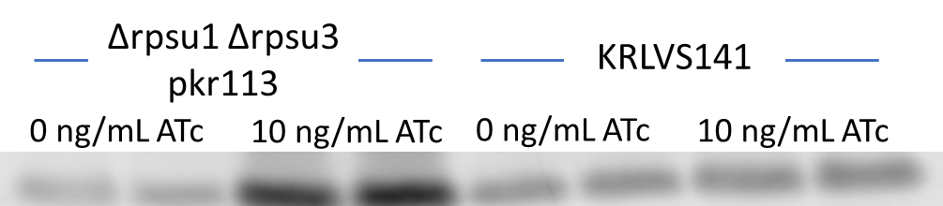
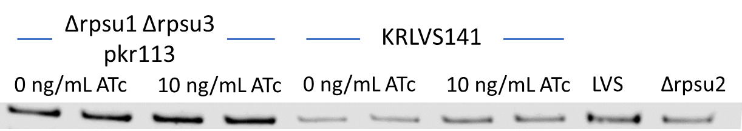
Control Comparing Doulbe and Triple Mutant Cells with ATc
bS21-2
PDPB

Slide 14
Whole Genome Sequencing
Nanopore + Illumina

Slide 15
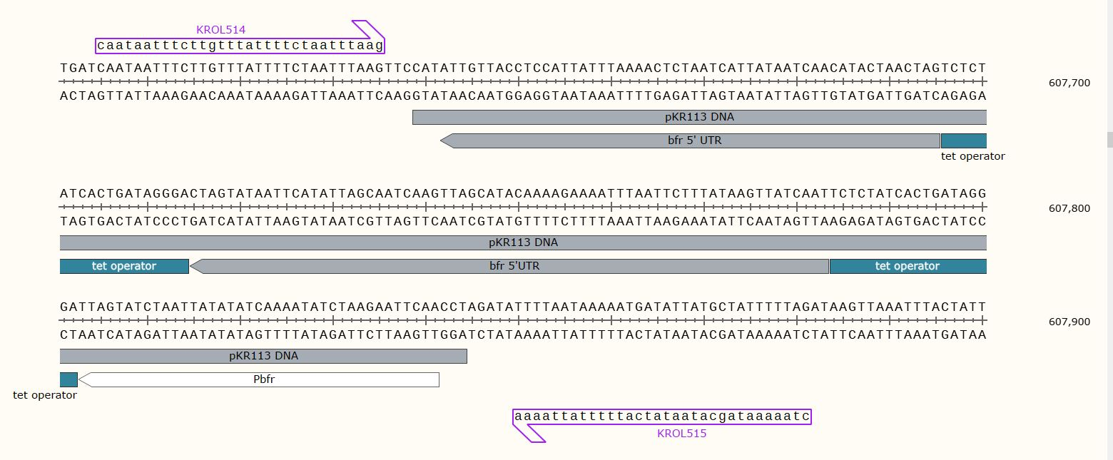

Slide 16
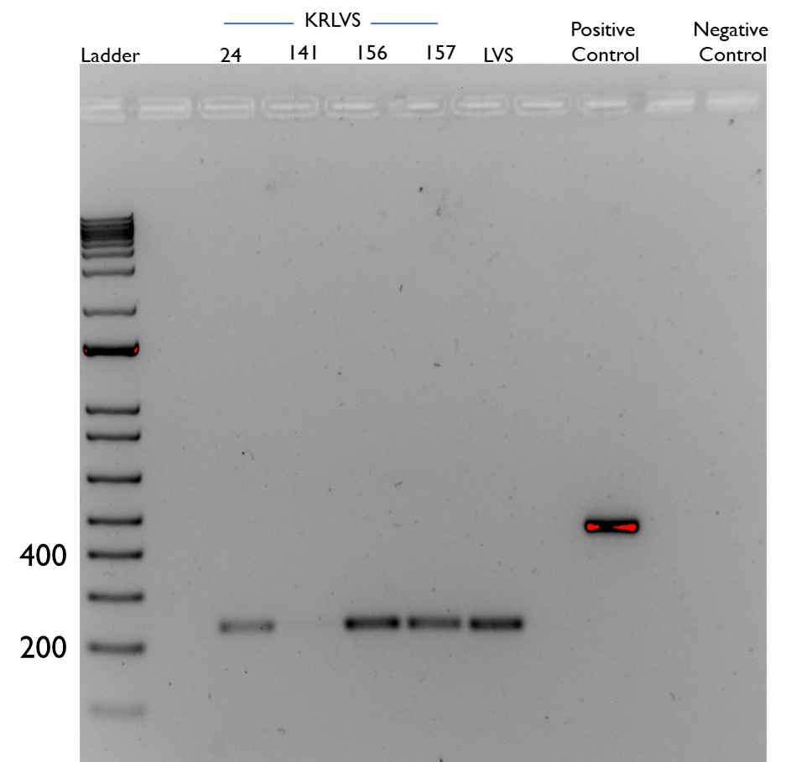
2% Agarose Gel to confirm sequencing results
Source DNA | Length (bps)
LVS gDNA | 441
- | -
KRLVS24 gDNA | 235
KRLVS141 gDNA | 277
KRLVS156 gDNA | 277
KRLVS157 gDNA | 277
LVS gDNA | 235

Slide 17
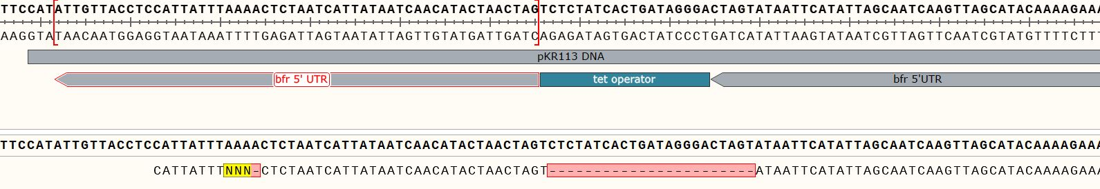
Next Steps...
Analyze sequencing results

Slide 18
Next Question

Slide 19
bS21-2
30S subunit, modeled from PDB entry: 4V50
Notes:
One such protein which is found in some, but not all ribosomes is the protein bs21. Particular bS21 paralogs translate specific transcripts more efficiently (ribosome “sigma factors”), playing a role in translation initiation. It is believed that ribosomes with specific bS21 paralogs could modulate gene expression That said, thus far it is believed to be non-essential, but implicated in the control of quite a few processes such as biofilm production, motility, acid stress resistance, antibiotic resistance, and virulence. Bs21 is also found encoded in some phage.

Slide 20
How is the expression of the rpsu Homologs regulated?

Slide 21
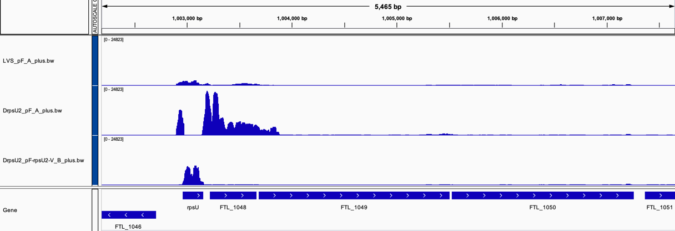
rRNA seq data suggest bS21-2 suppresses own mRNA
Wild-type
(bS21-2+)
Δrpsu2
(bS21-2 -)
rpsu2 overexpression
(bS21-2 +)
rpsU2
yqeY
dnaG
rpoD
Notes:
Our first piece of Data is showing the amount of transcript abundance (like a histogram situation)
X-axis are the genes
At the bottom is the sequence aligned and the red arrow is pointing to area that was of interest
Wild type cells, which have bS21-2, have low expression of rpsU2 and other genes surrounding
Delta rpsu2 have an increased abundance of genes surrounding
And the final is sort of like a control, it was a plasmid with rpsu2 and bS21 and there was a decent amount of rpsU2 transcript and none of anything else
Conclusion: When there is no bS21-2 present, there is an increased abundance of the rest of the operon

Slide 22
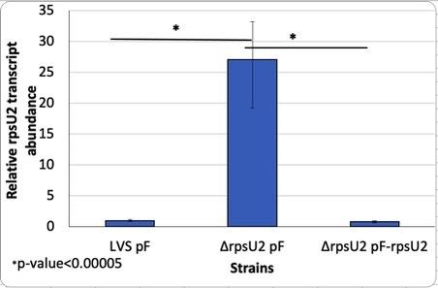
Previous RT-PCR
When bS21-2 is present there is a relatively low transcript abundance
With no protein present, transcript abundance increases significantly
Further suggests that bS21-2 is regulating its own expression
Notes:
Another piece of preliminary data that was used is showing transcript abundance between LVS and delta rpsU2
As you can see, when there the rpsu2 gene is deleted there is a 25 fold increase in transcript abundance
This is clearly showing that when there is no protein present, there is an increase in transcript. The protein is suppressing itself.
What could be happening?
One option is that it is preventing its own transcription.
Binding to DNA for example
Another option is that it could be inhibiting translation leading to quick degradation
Which would be similar to the example that I showed you earlier
With this idea that the protein bS21-2 is preventing its own transcription, we were interested to investigate which specific part of the sequence could the protein be influencing? Is this regulation occuring at the level of transcription or translation?

Slide 23
Is BS21-2 interacting with the 5’UTR or the promoter region?
-10 and -35
5’UTR
rpsu2

Slide 24

Testing 5’UTR Vs promoter
If in cells with bS21-2 (WT) | If in cells without bS21-2 (∆rpsU2)
rpsU2 promoter
rpsU2 5’ UTR
LacZ
tul 4 promoter
tul 4 5’ UTR
LacZ
rpsU2 promoter
tul 4 5’ UTR
LacZ
?
?
tul 4 promoter
rpsU2 5’ UTR
LacZ
?
?

Slide 25
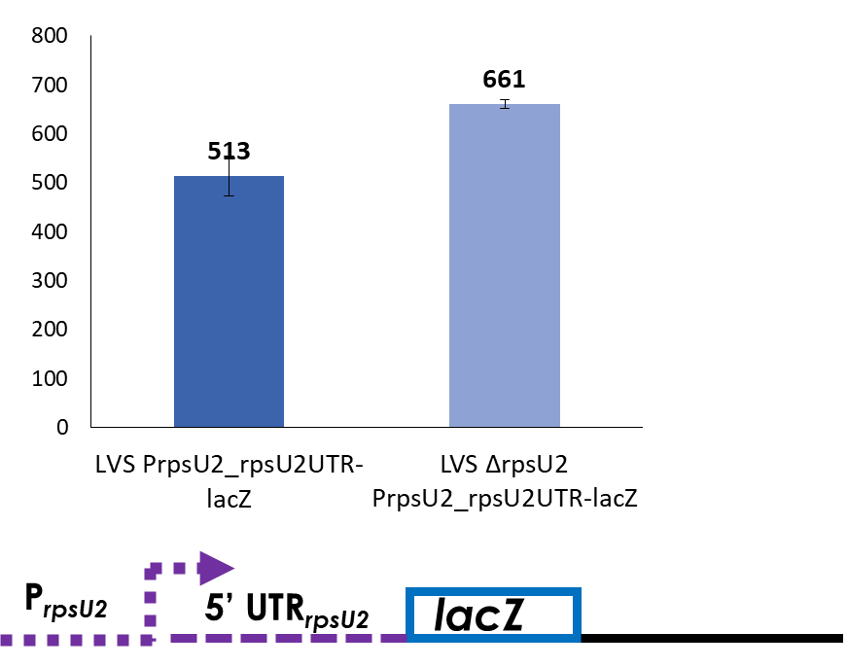
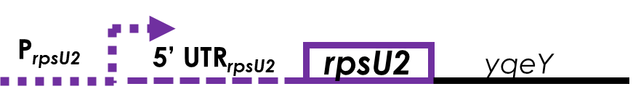
Results of the β-galactosidase assay
Native context
Tn7 site

Slide 26
How are the Rpsu homologs controlling their own gene expression?

Slide 27
First Experiment
Isolating RNA from LVS and Δrpsu2 and making cDNA
RT-PCR

Slide 28
A Big Thank you to the KRamsey Lab
Dr. Kathryn Ramsey
Hannah Trautmann
Dan Floyd
Aisling Macaraeg
Oli Horyn

