Slide 1
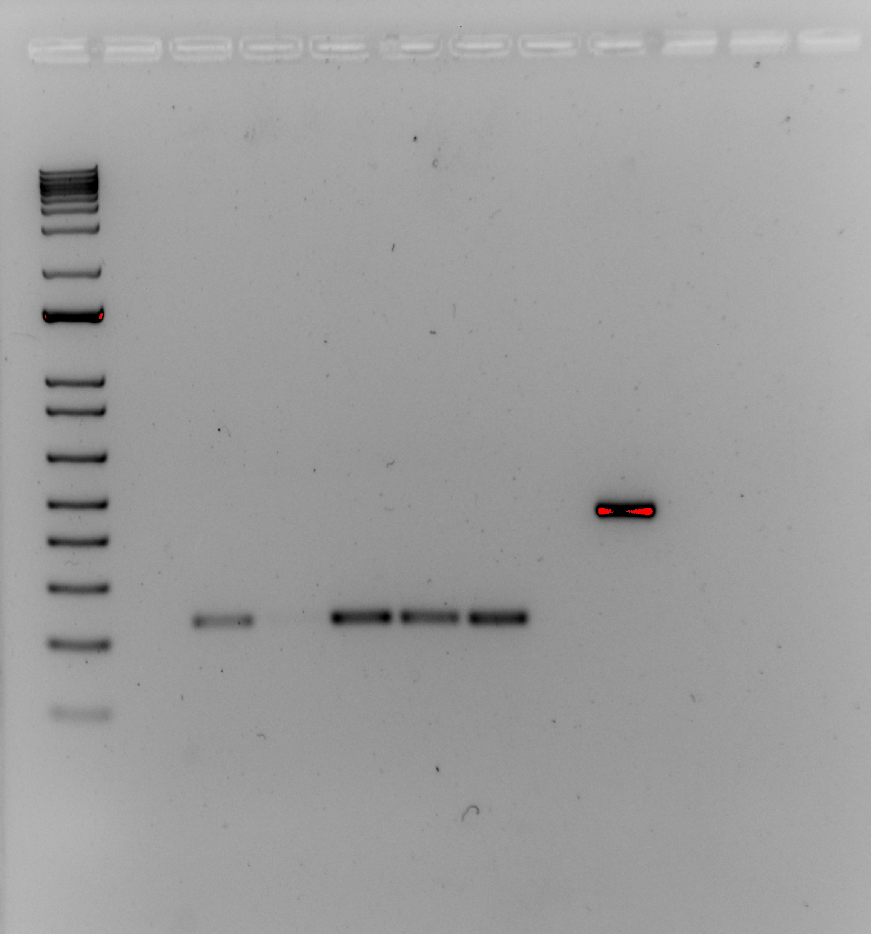
KRLVS
Positive
Control
Negative
Control
Ladder
24
141
156
157
LVS
Source DNA | Length (bps)
LVS gDNA | 441
- | -
KRLVS24 gDNA | 235
KRLVS141 gDNA | 277
KRLVS156 gDNA | 277
KRLVS157 gDNA | 277
LVS gDNA | 235
400
200
Question: Do the whole genome sequencing results of these strains match what DNA is actually in the cell?
Controls: positive/negative control for the efficacy of the PCR; LVS gDNA with the created primers to ensure that they work/to compare to the inducible strains.
Interpretation: Cannot particulary tell if there is a difference between KRLVS141, -156, -157, and LVS, KRLVS24. Negative is negative, positive is positive.

Slide 2
Transformation Plate Counts
Plasmid | Ligation |  | Backbone Only
 | 100 uL | Rem. | 100 uL | Rem.
pKR135 | 13 | 88 | 14 | 96
pKR135
Question: ~What does a negative control for the inducible strains look like? (Creating an empty vector of the pKR113 plasmid)
Controls: Positive control: pKR113 transformed into competent E. oli. Negative control: no DNA Additional backbone only control.
Interpretation: Transformed onto the correct plate and got plenty of positive control colonies. 1:1 ratio of backbone and ligation though.

