Slide 1
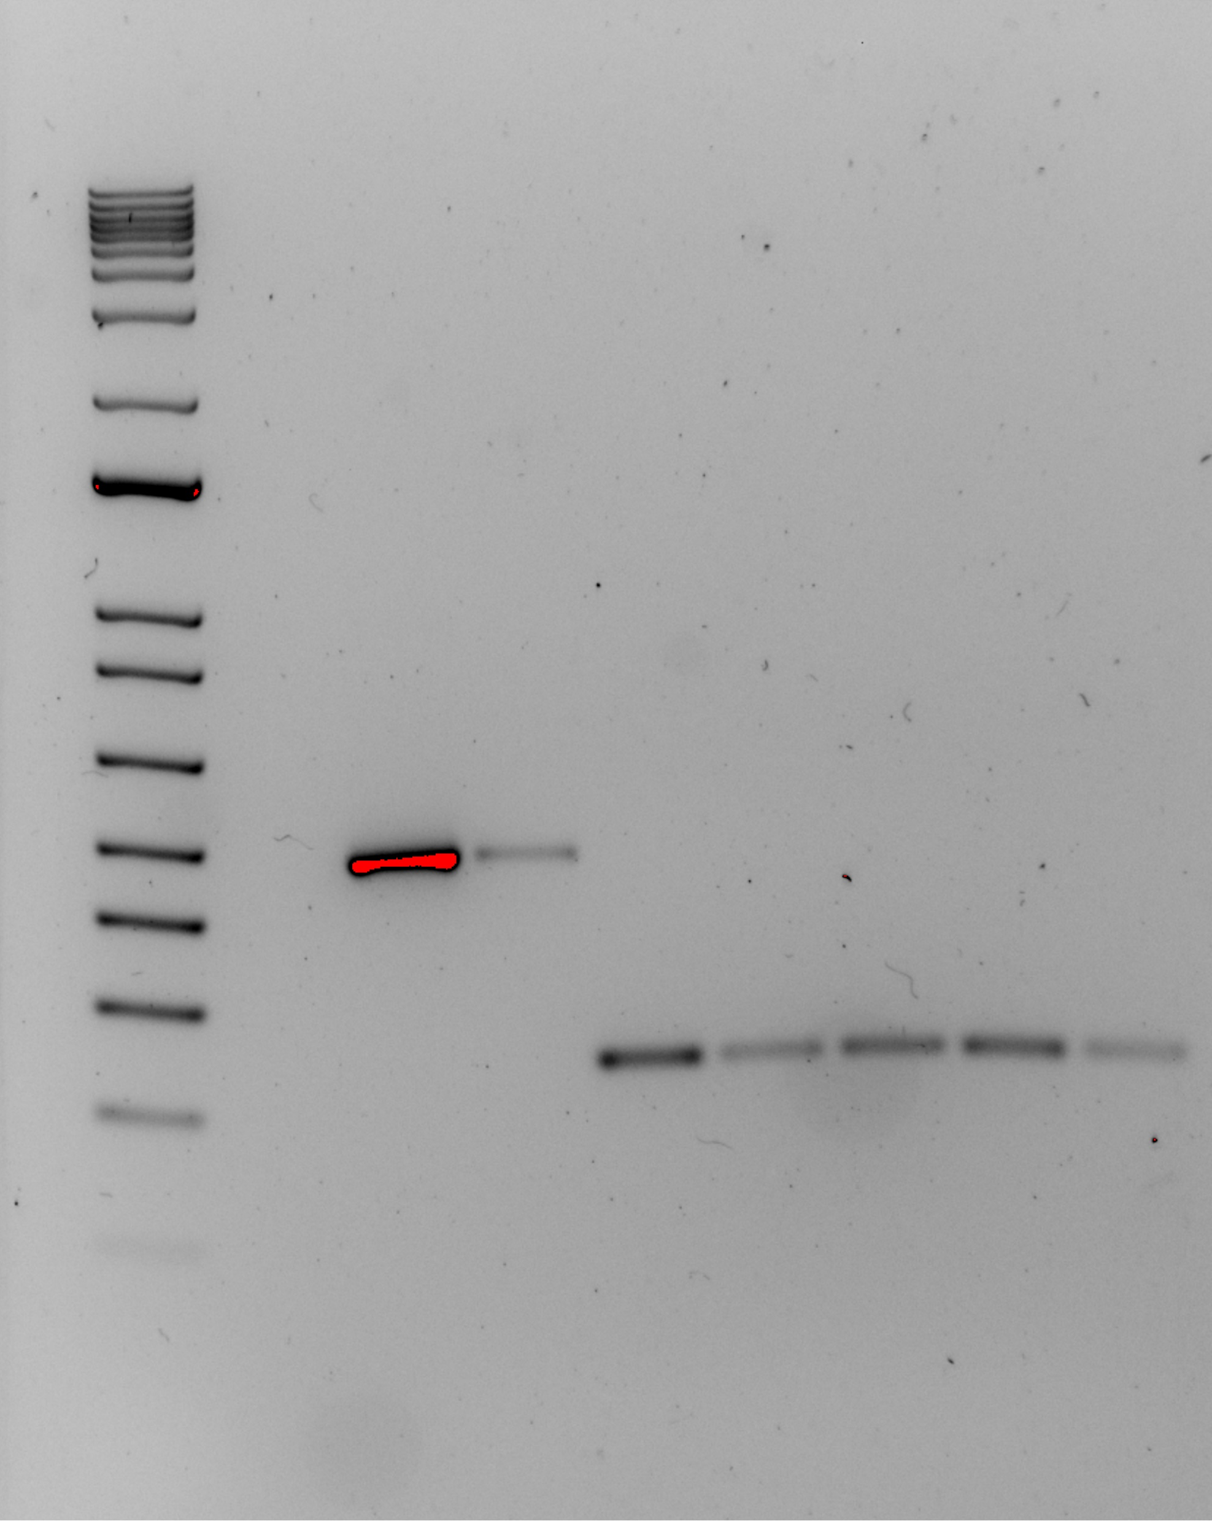
Positive
Control
Negative
Control
KRLVS
Ladder
LVS
24
141
156
157
Source DNA | Length (bps)
LVS gDNA | 441
- | -
KRLVS24 gDNA | 235
KRLVS141 gDNA | 277
KRLVS156 gDNA | 277
KRLVS157 gDNA | 277
LVS gDNA | 235
400
Question: Do the whole genome sequencing results of these strains match what DNA is actually in the cell?
Controls: positive/negative control for the efficacy of the PCR; LVS gDNA with the created primers to ensure that they work/to compare to the inducible strains.
Interpretation: KRLVS141, 156, and 157 may be slightly heavier. Obviously contamination in the negative again- replaced aliquots + used newly diluted KROL15 and 16.
200

Slide 2
Transformation Plate Counts
Plasmid | Ligation |  | Backbone Only
 | 100 uL | Rem. | 100 uL | Rem.
pKR135 | ☹ | ☹ | ☹ | ☹
 | 10 uL | 100 uL | 10 uL | 100 uL
pKR142 | 10 | TMTC | 3 | 71
pKR143 | 10 | TMTC | 3 | 71
Sample | Conc. (ng/uL) | A260 (Abs) | A280 (Abs) | 260/280 | 260/230
iLOV-V 1 | 238.4 | 4.769 | 2.519 | 1.89 | 2.32
iLOV-V 2 | 216.5 | 4.329 | 2.287 | 1.89 | 2.44
iLOV-V 3 | 289.9 | 5.798 | 3.068 | 1.89 | 2.37
iLOV-V 4 | 219.0 | 4.379 | 2.313 | 1.89 | 2.04
LanYFP-V 1 | 236.8 | 4.737 | 2.506 | 1.89 | 2.40
LanYFP-V 2 | 259.7 | 5.194 | 2.742 | 1.89 | 2.38
LanYFP-V 3 | 245.5 | 4.909 | 2.596 | 1.89 | 2.39
LanYFP-V 4 | 210.1 | 4.201 | 2.226 | 1.89 | 2.38
pKR135
pKR142 and pKR143
Question: ~What does a negative control for the inducible strains look like? (Creating an empty vector of the pKR113 plasmid)
Controls: Positive control: pKR113 transformed into competent E. oli. Negative control: no DNA Additional backbone only control.
Interpretation: No colonies grew on any of the plates: ligation, backbone, or positive control. Something wrong with the transformation? Did on same day as iLOV-V and LanYFP-V which did work.
Question: Can we make a successful fluorescent reporter in LVS?
Controls: Positive control: pF transformed into competent E. oli. Negative control: no DNA Additional backbone only control.
Interpretation: Positive control worked. Backbone:Ligation was ~ 1:3 for both, made overnights for four colonies each.

