Slide 1
Inducing bS21 in Francisella tularensis
KRAMSEY LAB | SIERRA SCHMIDT

Slide 2
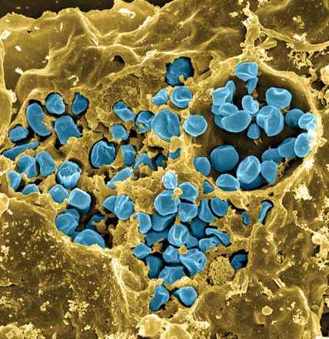
Francisella tularensis
Causes tularemia
Highly infectious
Potential bioweapon
F. tularensis subsp. holarctica LVS
Intracellular growth is essential to cause disease
Fischer, PNAS cover 2006
Notes:
Francisella tularensis is a gram-negative pathogen known for calling tularemia, also known as rabbit fever. Despite the name this pathogen does affect humans and is highly infectious, comparable to Mycobacterium tubuerculosis with a potential mortality rate of up to 30%.In the lab specifically we use the Francisella tularensis holartica Live Vaccine Strain, which I will refer to as LVS for the purposes of this presentation. This strain has been attenuated to humans, but maintains components available for study. As you can see in this false color scanning electron micrograph, the blue picted Francisella is an intracellular pathogen and can be found in many eukaryotic cells, as pictured here the macrophage.
Gram-negative, gamma facultative intracellular pathogen
Infectivity similar to Mtb, can upwards of 30% mortality
Tier 1 Select Agent like Ebola
Cover image: Scanning electron micrograph of a murine macrophage infected with Francisella tularensis strain LVS. Macrophages were dry-fractured by touching the cell surface with cellophane tape after critical point drying to reveal intracellular bacteria. Bacteria (colored in blue) are located either in the cytosol or within a membrane-bound vacuole.

Slide 3
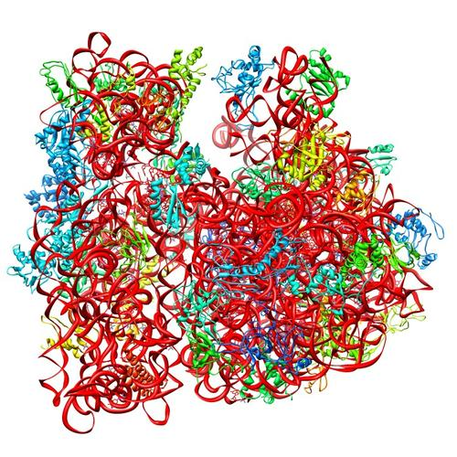
Ribosomes can be heterogenous
E. coli ribosome
3 rRNAs
49 proteins
Sources of heterogeneity
Multiple rRNA operons
rRNA modifications
Ribosomal protein modifications
Multiple versions of ribosomal proteins
PDB 4V50
Berk et al., 2006
How do changes in ribosome composition influence translation?
Notes:
Generally, there is this concept that ribosomes are a monolithic structure, that they are static in every cell. Apparent in Francisella tularensis is the heterogeneity of ribosomes. This phenomenon can arise from a few different sources: multiple rRNA operons, rRNA modifications, ribosomal protein modifications. But the most intriguing for the Kramsey lab is the idea that there can be multiple ribosomal proteins.

Slide 4
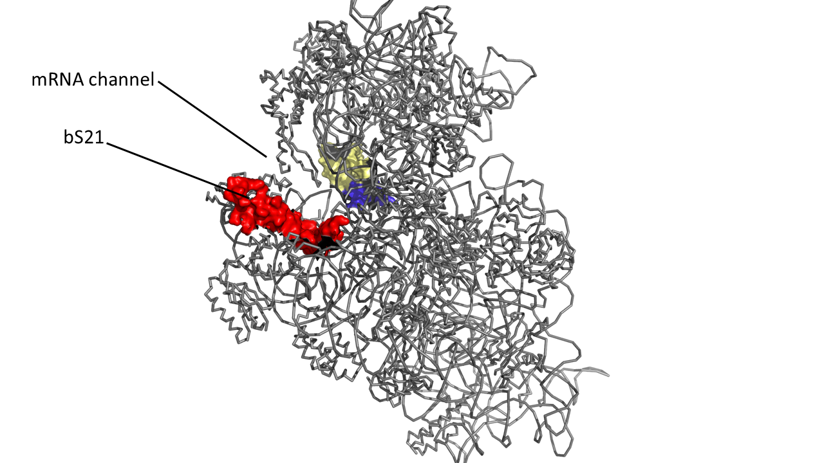
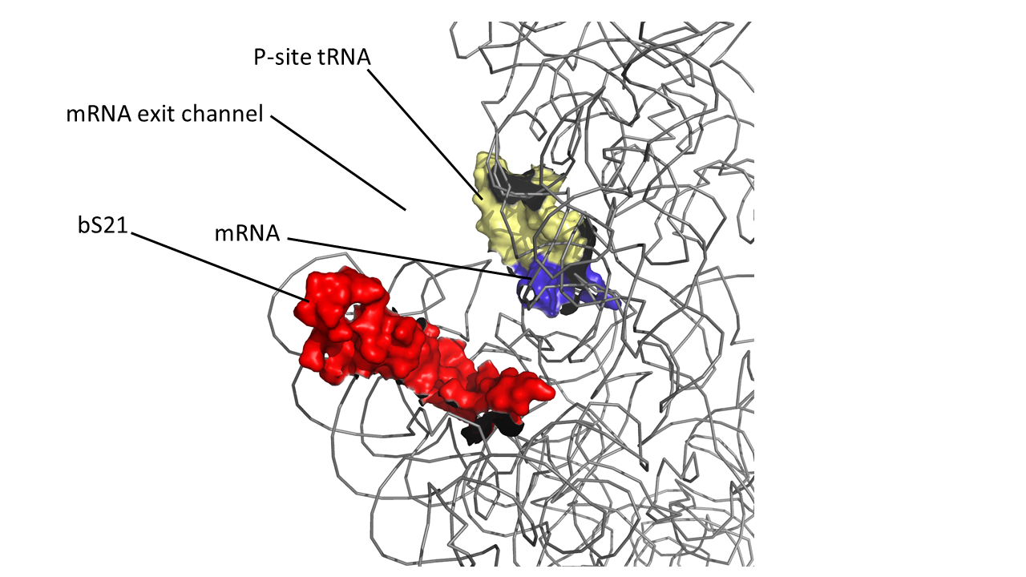
bS21, a small ribosome subunit protein
  non-essential
  involved in translation initiation
  implicated in control of specific processes
30S subunit, modeled from PDB entry: 4V50
Notes:
One such protein which is found in some, but not all ribosomes is the protein bs21. Particular bS21 paralogs translate specific transcripts more efficiently (ribosome “sigma factors”), playing a role in translation initiation. It is believed that ribosomes with specific bS21 paralogs could modulate gene expression That said, thus far it is believed to be non-essential, but implicated in the control of quite a few processes such as biofilm production, motility, acid stress resistance, antibiotic resistance, and virulence. Bs21 is also found encoded in some phage.

Slide 5
Multiples bS21 homologs suggest heterogenous ribosome populations in Francisella tularensis
cspC
rpsU1
rpsU2
yqeY
dnaG
rpoD
rpsU3
Notes:
Even though francisella has a reduced genome, it encodes three copies of the rpsU genes, which encode bS21, a protein in the small ribosomal subunit. Most bacteria have 0 or 1 of this gene. We originally, hypothesized, and have since shown, that these three proteins are produced and incorporated into ribosomes. This is a western blot of purified ribosomes from our wild-type strain as well as strains ectopically expressing each of the bS21 proteins, with a VSVG tag. This, along with some mass spec data we have of purified ribosomes, indicates that multiple classes of ribosomes are possible and occurring
This protein is also interesting to us because it is located close to the mRNA exit channel in the ribosome, and early research has identified that it is involved in translation initiation, so it is in an ideal location to be regulating gene expression at the level of translation initiation.

Slide 6
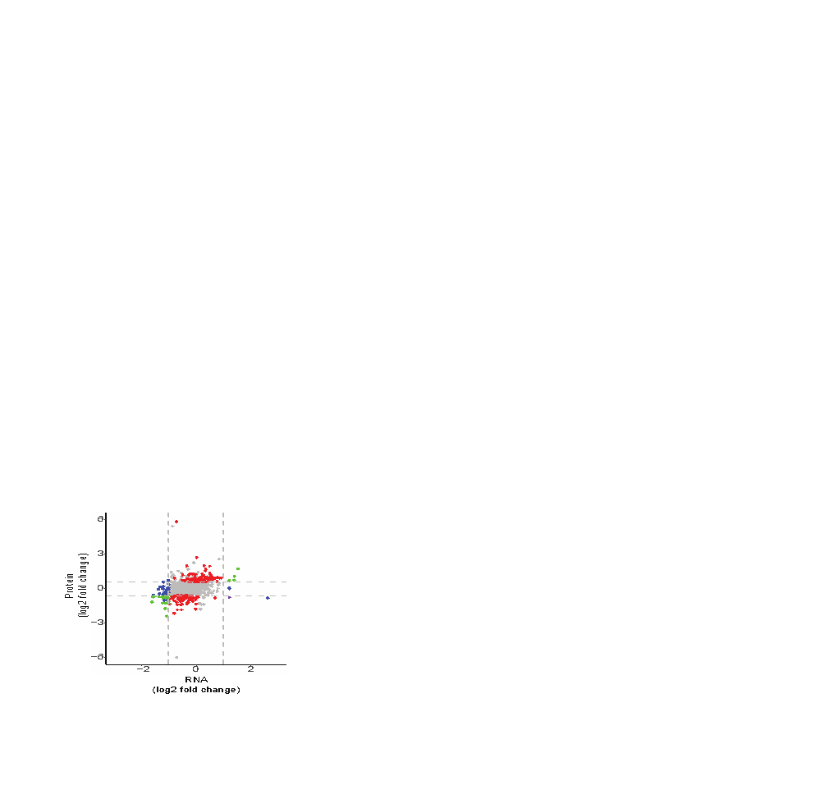


Cells lacking bS21-2 have changes in protein, not transcript, abundance
∆bS21-2 vs WT
Significant abundance change:
Protein (166)
Transcript (62)
Transcript and protein (concordant; 22)
Transcript and protein (discordant; 1)
Consistent with bS21 regulating gene expression at level of translation
Notes:
Comparison of cells lacking bS21-2 to wild-type
X-axis: RNA-Seq, dashed lines indicate 2-fold change
Y-axis: whole cell mass spec, dashed lines indicate 1.5-fold change

Slide 7
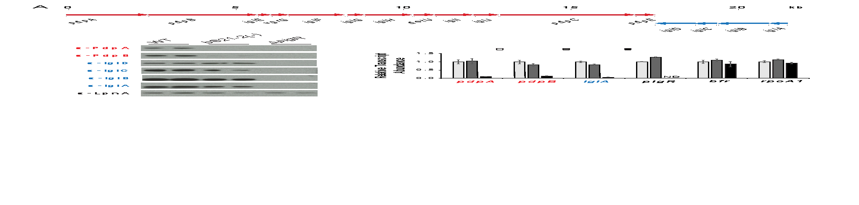
The Francisella Pathogenicity Island (FPI) is critical for virulence
Encodes a type VI secretion system
Multiple factors necessary for transcription
No previously identified factors regulating for translation
Notes:
16 genes
AT =~68% whole genome
FPI =~73% AT!
GC = ~32% whole genome
FPI= ~27%!

Slide 8
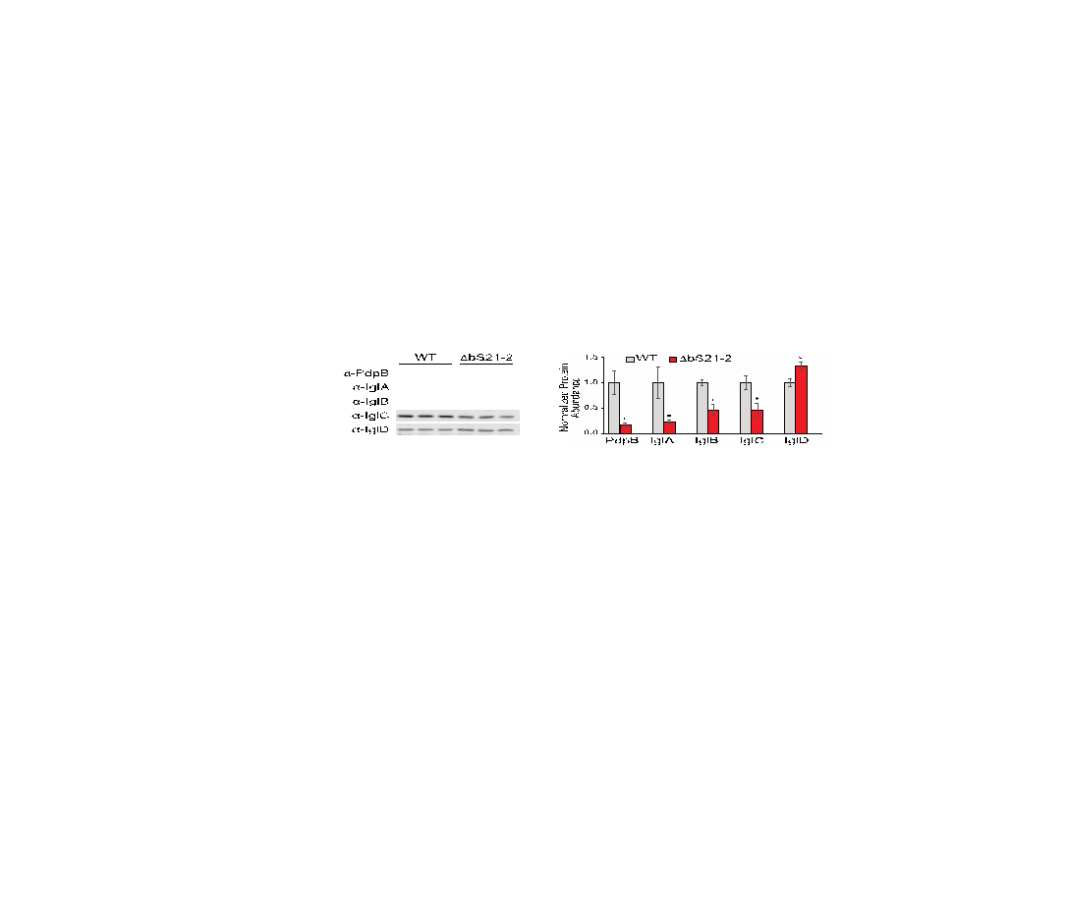

Loss of bS21-2 leads to reduced abundance of critical virulence proteins
* p < 0.01
Notes:
Here we have antibodies for five of the FPI proteins and we have our wild-type francisella in triplicate.
We were able to quantify these Westerns, normalizing to total protein, as you can see on this graph.
When we look at drpsU2, we see a significant decrease in abundance of some, most notably PdpB, which we have seen consistently to be about 3- to 5-fold less than in wild-type cells. Interestingly we do see that some proteins are unaffected by loss of rpsU2 and one protein, iglD, is actually MORE expressed.

Slide 9
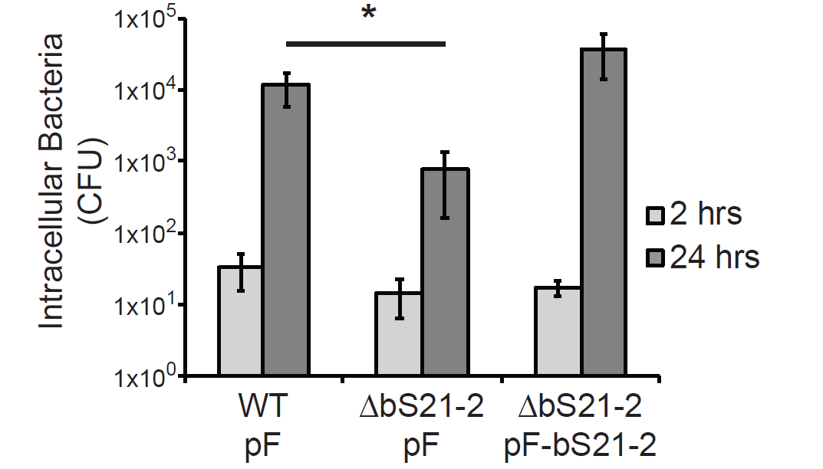
bS21-2 is important for intramacrophage growth
* p < 0.05
Notes:
J774A macrophage-like cells infected with F. tularensis
All bacteria can infect (2 hour timepoint), but cells lacking bS21-2 have about a log defect in intracellular replication. Can be complemented by ectopic expression of bS21-2 on a plasmid

Slide 10
bS21, a small ribosome subunit protein
  non-essential
  involved in translation initiation
  implicated in control of specific processes
  bS21 in F. tularensis:
  Three homologs
  Lead to ribosome heterogeneity
  Loss of bS21-2
  change in virulence protein abundance
  reduces virulence
  Changes of ribosome bS21 content alters sensitivity to kasugamycin
30S subunit, modeled from PDB entry: 4V50
Notes:
One such protein which is found in some, but not all ribosomes is the protein bs21. Particular bS21 paralogs translate specific transcripts more efficiently (ribosome “sigma factors”), playing a role in translation initiation. It is believed that ribosomes with specific bS21 paralogs could modulate gene expression That said, thus far it is believed to be non-essential, but implicated in the control of quite a few processes such as biofilm production, motility, acid stress resistance, antibiotic resistance, and virulence. Bs21 is also found encoded in some phage.

Slide 11
Identity vs. Abundance

Slide 12
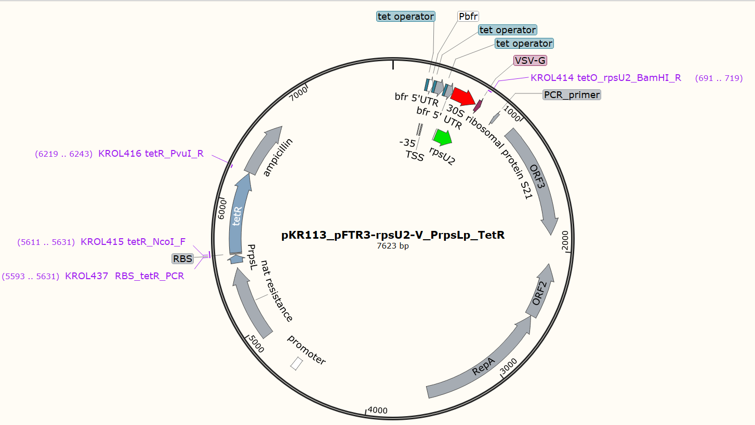

Slide 13
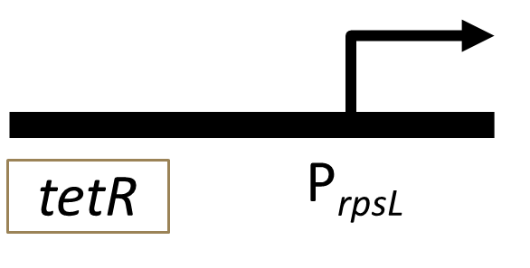
TetR gene regulation
tet repressor binds at the tetO site
Blocks RNA polymerase from transcribing DNA
Anhydrotetracycline (ATc) binds the Tet repressor, falls off DNA
Expression of the rpsU2 gene and production of bS21-2
P_{bfr}
tetO
tetO
tetO
rpsU2
VSVG
Notes:
Now specifically, this project centered on gene regulation using the tet-based indusible system. Here is an abridged form of the plasmid for easier viewing, and what we can see with this is that the tet resistance protein binds the tet operon, which stops expression of the bs21 protein by physically blocking the RNA polymerase and knocking it off the DNA. However, this tet regulated gene expression plasmid is anhydrotetracycline, or Atc, induced. SO when you add the Atc it binds to that repressor, causing the tet-Atc complex to fall off the DNA and to let transcription follow, the rpsU2 gene able to be expressed.

Slide 14
Expectations
- ATc | + ATc
- bS21-2 | + bS21-2

Slide 15
Rotation Project Goal
Confirm the tetR induction system by inducing bS21-2 in Δrpsu1 Δrpsu3 cells
Normalize bS21 production in different contexts

Slide 16
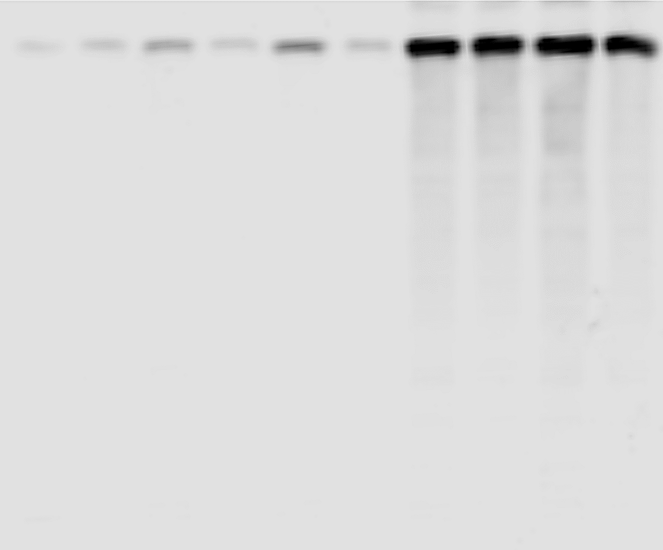
Titration of bS21-2 utilizing the inducible pkr113 plasmid in Δrpsu1 Δrpsu3 cells.
VSVG

Slide 17
Goals
Confirm and analyze the titration of this same system within the triple mutant for each homolog of bS21
Establish generation time for each of the triple mutant strains

Slide 18
LVS ∆rpsU1 ∆rpsU2 ∆rpsU3 pFTR3-rpsU2-V
Treatment | Generation Time
0 ng/mL | 312.034872
0.1 ng/mL | 427.5899834
1.0 ng/mL | 358.314536
10 ng/mL | 305.592477

Slide 19
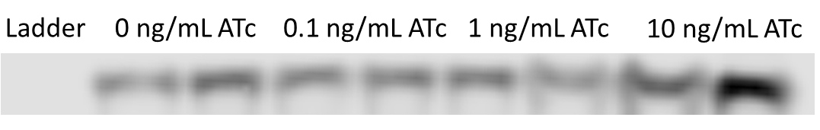
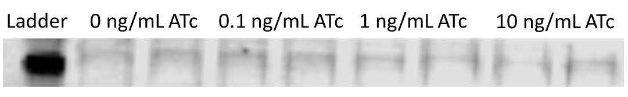
LVS ∆rpsU1 ∆rpsU2 ∆rpsU3 pFTR3-rpsU2-V
bS21-2
PDPB

Slide 20
LVS ∆rpsU1 ∆rpsU2 ∆rpsU3 pFTR3-rpsU2-V
Treatment | Generation Time
0 ng/mL | 258.7597034
0.1 ng/mL | 259.1645494
1.0 ng/mL | 244.8567255
10 ng/mL | 235.0281666

Slide 21
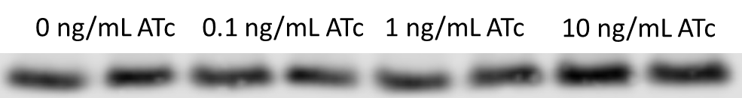
LVS ∆rpsU1 ∆rpsU2 ∆rpsU3 pFTR3-rpsU2-V

Slide 22
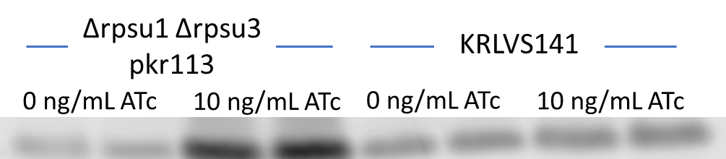
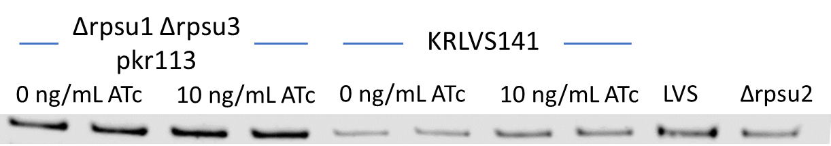
Control Comparing Doulbe and Triple Mutant Cells with ATc
bS21-2
PDPB

Slide 23
LVS ∆rpsU1 ∆rpsU2 ∆rpsU3 pFTR3-rpsU3-V
Treatment | Generation Time
0 ng/mL | 291.4827996
0.1 ng/mL | 291.4827996
1.0 ng/mL | 247.4881196
10 ng/mL | 219.7868345

Slide 24
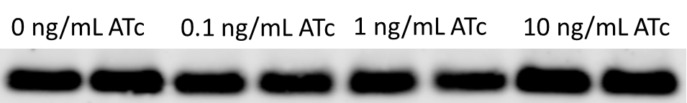
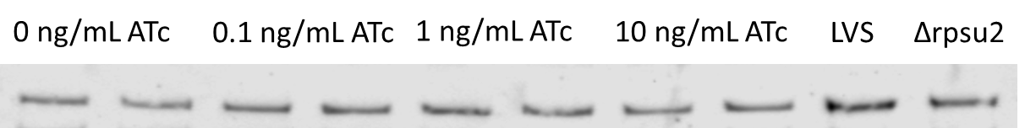
LVS ∆rpsU1 ∆rpsU2 ∆rpsU3 pFTR3-rpsU3-V
bS21-3
PDPB

Slide 25
LVS ∆rpsU1 ∆rpsU2 ∆rpsU3 pFTR3-rpsU1-V
Treatment | Generation Time
0 ng/mL | 119.2275079
0.1 ng/mL | 121.7265702
1.0 ng/mL | 123.5156469
10 ng/mL | 120.484567

Slide 26
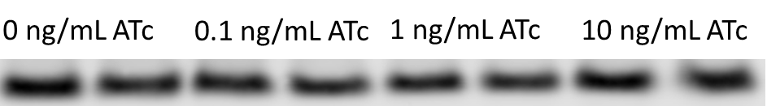
LVS ∆rpsU1 ∆rpsU2 ∆rpsU3 pFTR3-rpsU1-V
bS21-1
PDPB

Slide 27
Future Directions
Sending out samples for whole genome sequencing
Cloning an empty vector control of this plasmid

Slide 28
Thank you

Slide 29
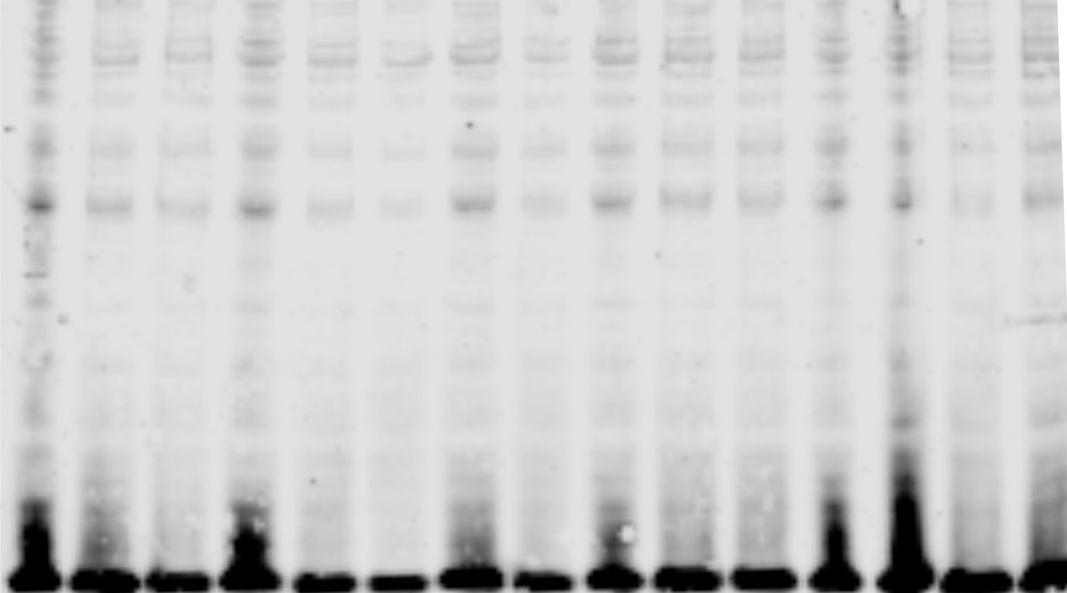
Assessing bS21 production in solid media
*
*
*
* p < 0.05

