Slide 1
Assessing induction of a bS21 homolog in Francisella tularensis
Kramsey Lab | Sierra Schmidt

Slide 2
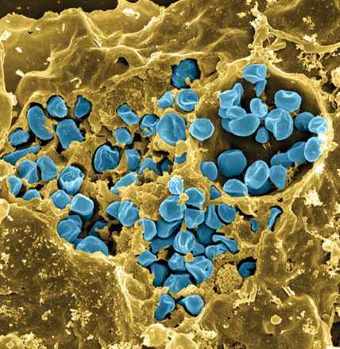
Francisella tularensis
Causes tularemia
Highly infectious
Potential bioweapon
F. tularensis subsp. holarctica LVS
Intracellular growth is essential to cause disease
Fischer, PNAS cover 2006
Notes:
Francisella tularensis is a gram-negative pathogen known for calling tularemia, also known as rabbit fever. Despite the name this pathogen does affect humans and is highly infectious, comparable to Mycobacterium tubuerculosis with a potential mortality rate of up to 30%.In the lab specifically we use the Francisella tularensis holartica Live Vaccine Strain, which I will refer to as LVS for the purposes of this presentation. This strain has been attenuated to humans, but maintains components available for study. As you can see in this false color scanning electron micrograph, the blue picted Francisella is an intracellular pathogen and can be found in many eukaryotic cells, as pictured here the macrophage.
Gram-negative, gamma facultative intracellular pathogen
Infectivity similar to Mtb, can upwards of 30% mortality
Tier 1 Select Agent like Ebola
Cover image: Scanning electron micrograph of a murine macrophage infected with Francisella tularensis strain LVS. Macrophages were dry-fractured by touching the cell surface with cellophane tape after critical point drying to reveal intracellular bacteria. Bacteria (colored in blue) are located either in the cytosol or within a membrane-bound vacuole.

Slide 3
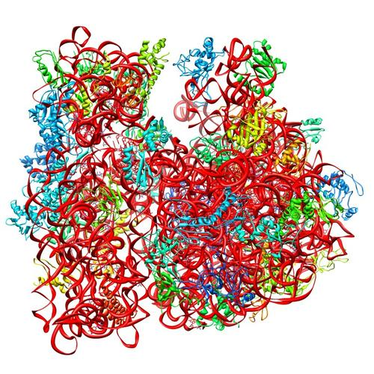
Ribosomes can be heterogenous
E. coli ribosome
3 rRNAs
49 proteins
Sources of heterogeneity
Multiple rRNA operons
rRNA modifications
Ribosomal protein modifications
Multiple versions of ribosomal proteins
PDB 4V50
Berk et al., 2006
How do changes in ribosome composition influence translation?
Notes:
Generally, there is this concept that ribosomes are a monolithic structure, that they are static in every cell. Apparent in Francisella tularensis is the heterogeneity of ribosomes. This phenomenon can arise from a few different sources: multiple rRNA operons, rRNA modifications, ribosomal protein modifications. But the most intriguing for the Kramsey lab is the idea that there can be multiple ribosomal proteins.

Slide 4
bS21, a small ribosome subunit protein
  non-essential
  involved in translation initiation
  implicated in control of specific processes
  bS21 in F. tularensis:
  Three homologs
  Lead to ribosome heterogeneity
  Loss of bS21-2
  change in virulence protein abundance
  reduces virulence
  Changes of ribosome bS21 content alters sensitivity to kasugamycin
30S subunit, modeled from PDB entry: 4V50
Notes:
One such protein which is found in some, but not all ribosomes is the protein bs21. Particular bS21 paralogs translate specific transcripts more efficiently (ribosome “sigma factors”), playing a role in translation initiation. It is believed that ribosomes with specific bS21 paralogs could modulate gene expression That said, thus far it is believed to be non-essential, but implicated in the control of quite a few processes such as biofilm production, motility, acid stress resistance, antibiotic resistance, and virulence. Bs21 is also found encoded in some phage.

Slide 5
Rotation Project Goal
Previous experiments show bS21 content changes certain phenotypes
Normalize bS21 production in different contexts
Induction of bS21-2
Using tetR induction system

Slide 6
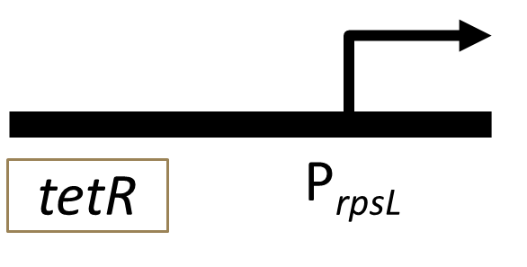
TetR gene regulation
tet repressor binds at the tetO site
Blocks RNA polymerase from transcribing DNA
Anhydrotetracycline (ATc) binds the Tet repressor, falls off DNA
Expression of the rpsU2 gene and production of bS21-2
P_{bfr}
tetO
tetO
tetO
rpsU2
VSVG
Notes:
Now specifically, this project centered on gene regulation using the tet-based indusible system. Here is an abridged form of the plasmid for easier viewing, and what we can see with this is that the tet resistance protein binds the tet operon, which stops expression of the bs21 protein by physically blocking the RNA polymerase and knocking it off the DNA. However, this tet regulated gene expression plasmid is anhydrotetracycline, or Atc, induced. SO when you add the Atc it binds to that repressor, causing the tet-Atc complex to fall off the DNA and to let transcription follow, the rpsU2 gene able to be expressed.

Slide 7
Expectations
- ATc | + ATc
- bS21-2 | + bS21-2

Slide 8
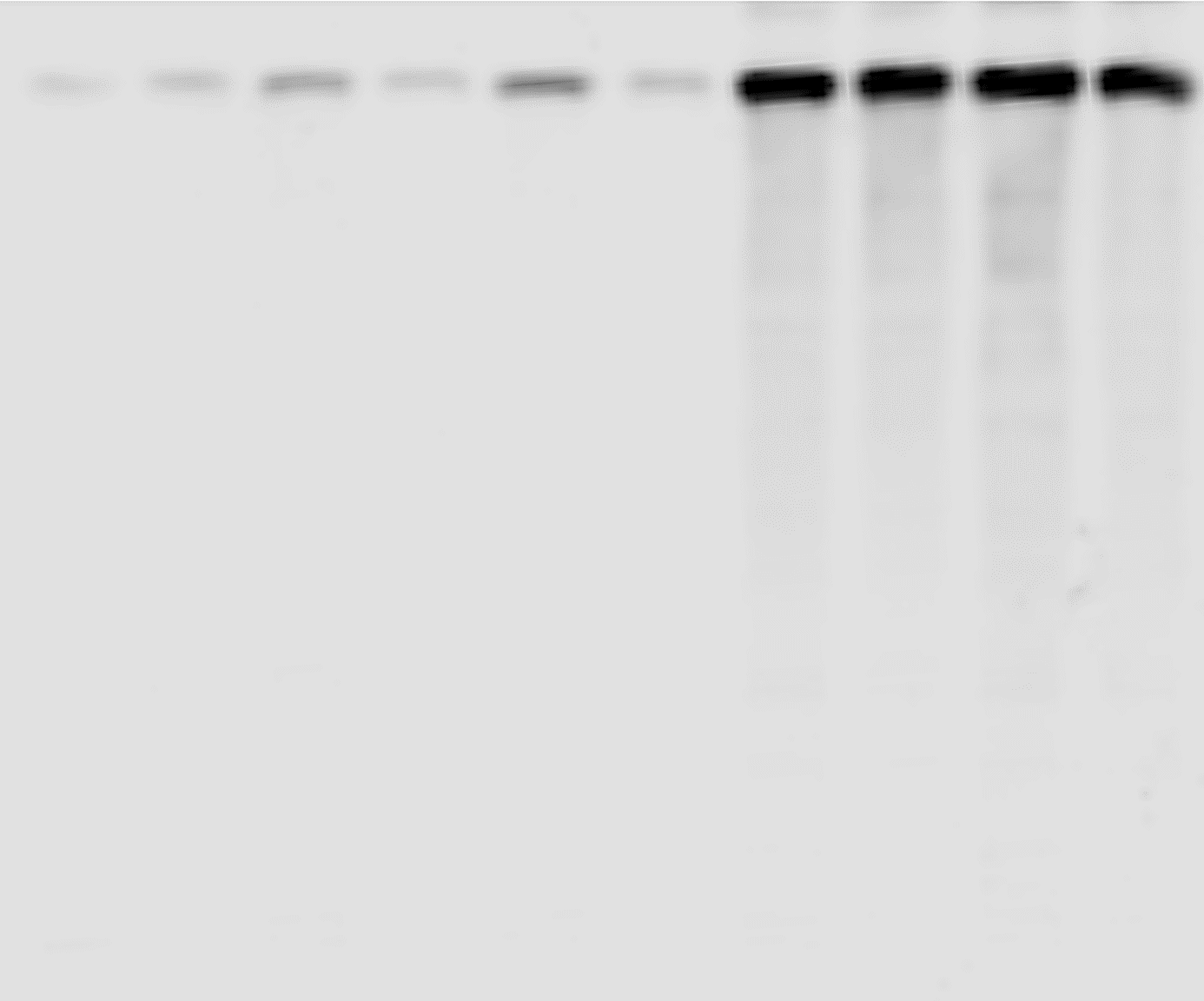
Assessing bS21 production in liquid media
*
*
*
*
*
*
* p < 0.05

Slide 9
Assessing bS21 production in solid media
*
*
*
* p < 0.05

Slide 10
Future Directions
Identifying conditions on solid media where we can tittrade bS21 concentration
Test the titration in DMEM-F media
Normalize the ATc concentration needed to titrate vS21 across the three homologs

Slide 11
A Big Thank you to the KRamsey Lab
Dr. Kathryn Ramsey
Hannah Trautmann
Dan Floyd
Aisling Macaraeg
Oli Horyn

Slide 12
Any Questions?

Slide 13
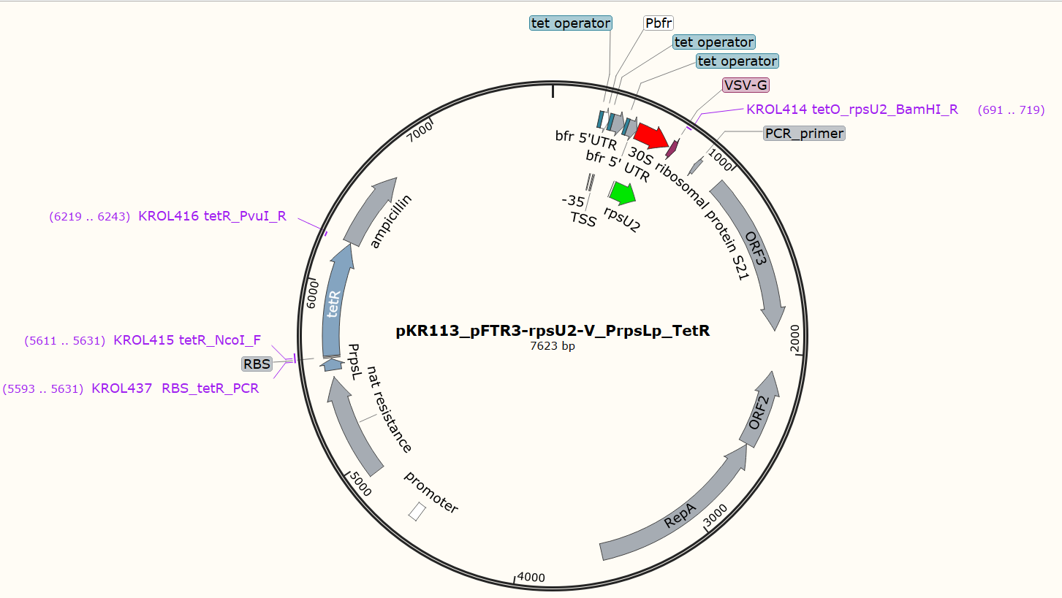

Slide 14
Total Protein Quantification – Liquid Media

Slide 15
Total Protein Quantification – Solid Media

