Slide 2
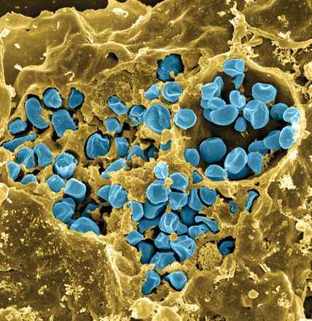
Francisella tularensis
Causes tularemia
Highly infectious
Potential bioweapon
F. tularensis subsp. holarctica LVS
Intracellular growth is essential to cause disease
Fischer, PNAS cover 2006
Notes:
Gram-negative, gamma facultative intracellular pathogen
Infectivity similar to Mtb, can upwards of 30% mortality
Tier 1 Select Agent like Ebola
Cover image: Scanning electron micrograph of a murine macrophage infected with Francisella tularensis strain LVS. Macrophages were dry-fractured by touching the cell surface with cellophane tape after critical point drying to reveal intracellular bacteria. Bacteria (colored in blue) are located either in the cytosol or within a membrane-bound vacuole.

Slide 3
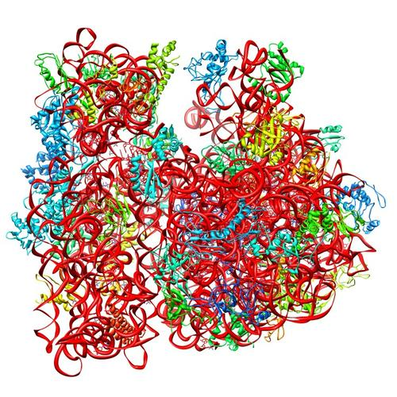
Ribosomes can be heterogenous
E. coli ribosome
3 rRNAs
49 proteins
Sources of heterogeneity
Multiple rRNA operons
rRNA modifications
Ribosomal protein modifications
Multiple ribosomal proteins
50S
30S
PDB 4V50
Berk et al., 2006
How do changes in ribosome composition influence translation?
Notes:
Generally, there is this concept that ribosomes are a monolithic structure, that they are static in every cell. Apparent in Francisella tularensis is the heterogeneity of ribosomes. This phenomenon can arise from a few different sources: multiple rRNA operons, rRNA modifications, ribosomal protein modifications. But the most intriguing for our lab is the idea that there can be multiple ribosomal proteins.

Slide 4
bS21, a small ribosomal protein
bS21 is:
  involved in translation initiation
  non-essential
  implicated in control of specific processes
    biofilm
    motility
    acid stress resistance
    antibiotic resistance
    virulence
  encoded by some phage
30S subunit, modeled from PDB entry: 4V50
Notes:
Particular bS21 paralogs translate specific transcripts more efficiently (ribosome “sigma factors”)
Ribosomes with specific bS21 paralogs could modulate gene expression

Slide 5
tetr
plasmid
Notes:
Particular bS21 paralogs translate specific transcripts more efficiently (ribosome “sigma factors”)
Ribosomes with specific bS21 paralogs could modulate gene expression

Slide 6
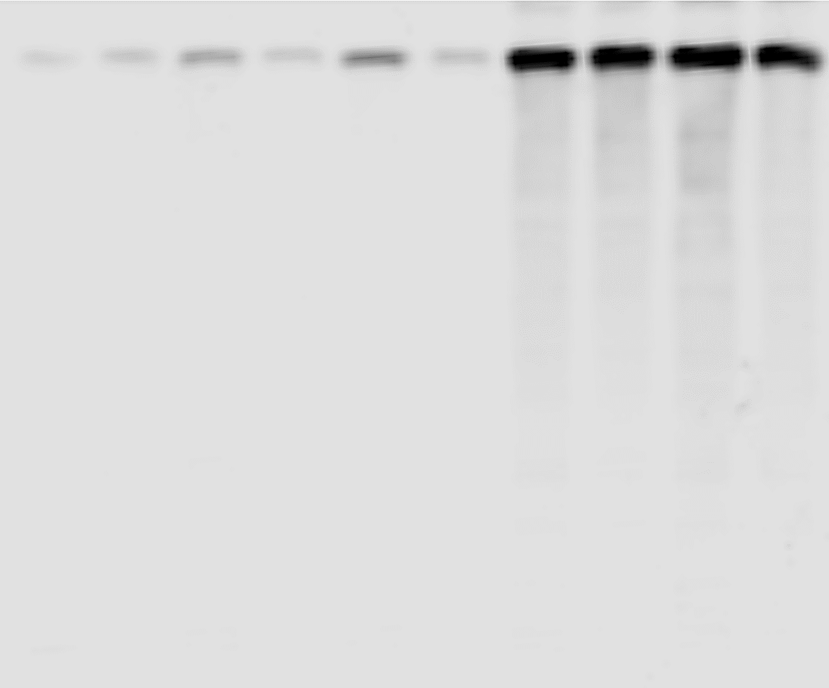
bS21 expression in MHB per [Atc]

Slide 7
bS21 expression in CHAH agar per [Atc]

