Slide 1
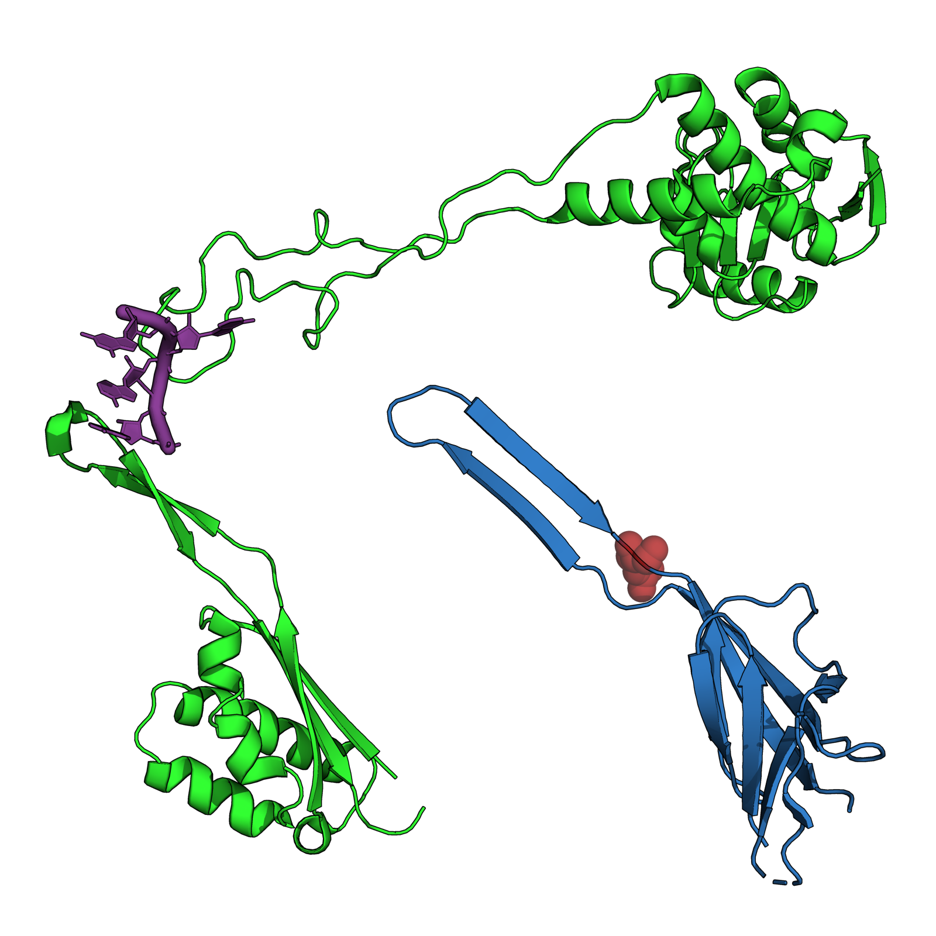
G2061
ribosomal protein uL4
A2058
R89
ribosomal protein uL22
ribosomal protein bL21
pdb entry 6yef

