Slide 1
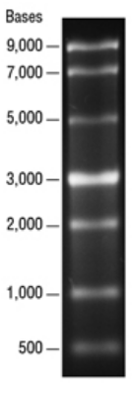
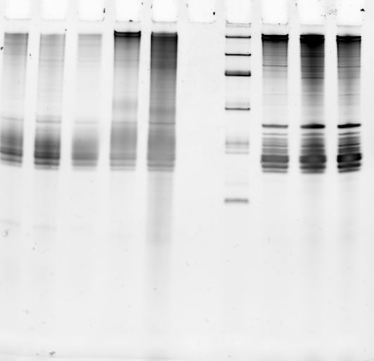
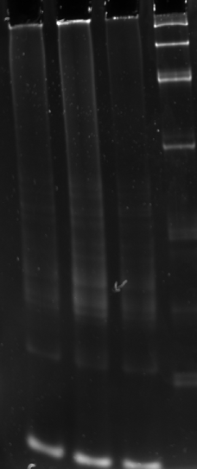
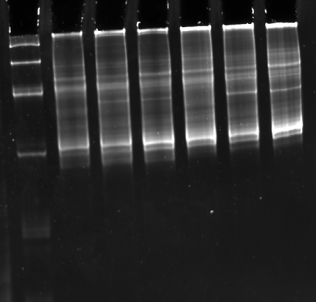
Kit used – Nanopore
cDNA barcoding kit
(SQK-PCB109)
cDNA (RT + strand switching)
cDNA PCR (Before Bead wash)
cDNA PCR (After Bead wash)
Microbe express
Poly A
Whole cell RNA
3
2
1
3
2
1
3
2
1
1
2
3
1
2
3
1
2
3
Workflow (whole cell RNA of F. tularensis)
Whole cell RNA > Poly A tailing > Microbe express (rRNA removal) > cDNA > cDNA PCR + Exo 1 > cDNA post Beads wash

