Slide 1
Analysis of Relative Transcript Abundance in Francisella tularensis
Kira Bernabe
Lab Meeting 3/16/21

Slide 2
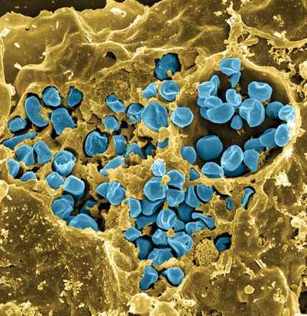
Francisella tularensis
Causes tularemia
Highly infectious
Potential bioweapon
Model: F. tularensis subsp. holarctica LVS
Intracellular growth is essential to cause disease
Fischer, PNAS cover 2006
Notes:
Gram-negative, gamma facultative intracellular pathogen
Infectivity similar to Mtb, can upwards of 30% mortality
Tier 1 Select Agent like Ebola
Cover image: Scanning electron micrograph of a murine macrophage infected with Francisella tularensis strain LVS. Macrophages were dry-fractured by touching the cell surface with cellophane tape after critical point drying to reveal intracellular bacteria. Bacteria (colored in blue) are located either in the cytosol or within a membrane-bound vacuole.

Slide 3
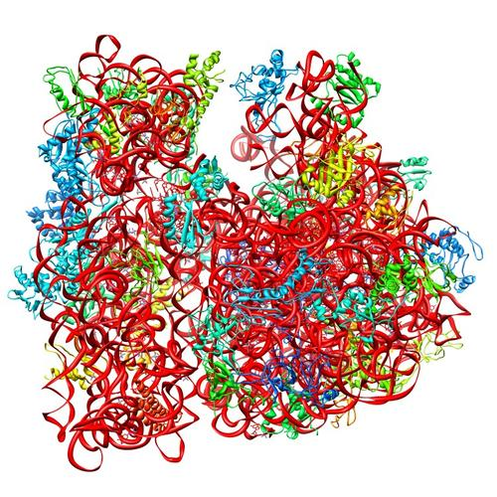
Ribosomes can be heterogenous
E. coli ribosome
3 rRNAs
49 proteins
Sources of heterogeneity
Multiple rRNA operons
rRNA modifications
Ribosomal protein modifications
Multiple ribosomal proteins
50S
30S
PDB 4V50
Berk et al., 2006
How do changes in ribosome composition influence translation?

Slide 4
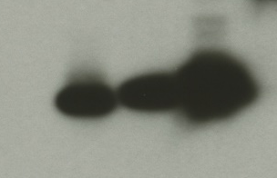
Multiple bS21 homologs create heterogenous ribosome populations in Francisella tularensis
rpsU1
cspC
bS21-3 - V
bS21-2 - V
bS21-1 - V
bS21-2-V
bS21-1-V
bS21-3-V
WT
rpsU2
yqeY
dnaG
rpoD
α-VSVG
Hannah Trautmann
rpsU3
Notes:
Even though francisella has a reduced genome, it encodes three copies of the rpsU genes, which encode bS21, a protein in the small ribosomal subunit. Most bacteria have 0 or 1 of this gene. We originally, hypothesized, and have since shown, that these three proteins are produced and incorporated into ribosomes. This is a western blot of purified ribosomes from our wild-type strain as well as strains ectopically expressing each of the bS21 proteins, with a VSVG tag. This, along with some mass spec data we have of purified ribosomes, indicates that multiple classes of ribosomes are possible and occurring
This protein is also interesting to us because it is located close to the mRNA exit channel in the ribosome, and early research has identified that it is involved in translation initiation, so it is in an ideal location to be regulating gene expression at the level of translation initiation.
So this heterogeneity of ribosomes may be a mechanism of regulation, but you may not know that ribosomes are heterogeneous so let me show you other ways that may occur.

Slide 5
The function of a bS21, a small ribosomal subunit protein
  Can be easily exchanged
  Non-essential (?)
  Involved in translation initiation
  Implicated in control of specific processes:
    biofilm
    motility
    acid stress resistance
    antibiotic resistance
    virulence
mRNA channel
P-site tRNA ASL
mRNA (P-site codon)
bS21
Hannah Trautmann

Slide 6
Is there preferential translation of a particular transcript by a given bs21 homolog?
Mass Spec identified the presence and abundance of all the proteins in the lysate
Proteomic data show proteins that are differentially expressed in the deletion strains compared to wild type
Is this happening during transcription or translation?

Slide 7
Genes
FTL_0097 hypothetical protein
FTL_1883 SpoU rRNA methylase family protein
FTL_1181 Potassium transporting ATPase subunit A

Slide 8
Mass Spec Analysis
Proteomic data in log₂ fold change

Slide 9
Protein Abundance

Slide 10
Transcript Abundance Relative to tul4
*
*
*
*

Slide 11
Transcript Abundance Compared to Protein Abundance
*
*
*
* log₂FC -1.296 Adj p-value 0.0005
* p-value: 0.0417

Slide 12
Transcript Abundance Compared to Protein Abundance
*
**
**
*
*
*p-value: 0.0141
** p-value: 0.0092
*log2FC: -1.646, Adj p-value: 0.0045

Slide 13
Transcript Abundance Compared to Protein Abundance
*
**
*
*log2FC: 1.122, Adj p-value: 0.000003659
**log2FC: 1.091, Adj p-value: 0.00001206
*P-value: 0.0299

Slide 14
Conclusion
Change in protein expression is probably due to transcription
Tn7::rpsU1 FTL_1181 may not be relevant to gene expression
Tn7::rpsU3 could be due to transcript abundance, but is it repeatable?

Slide 15
Next Steps
Repeat in triplicate
Validate Mass Spec data by epitope-tagging and running Western blots

