Slide 2
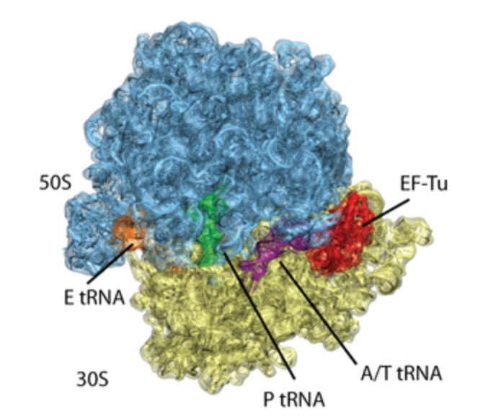
The Ribosome

Slide 3
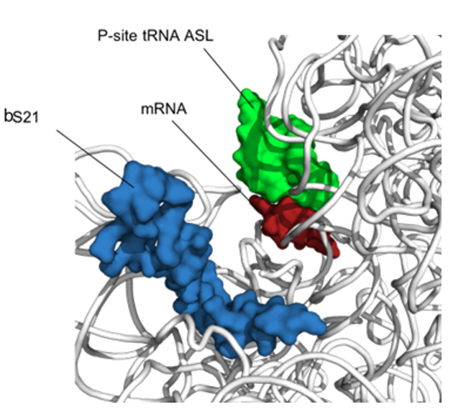
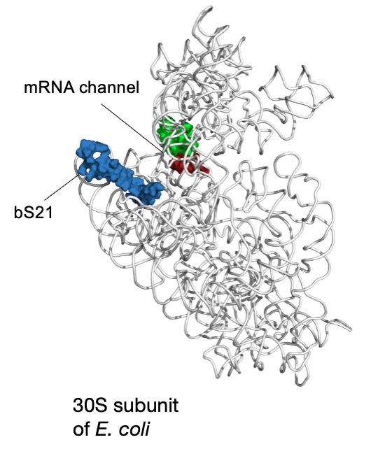
bS21: a small subunit ribosomal protein
bS21 is involved in translation initiation

Slide 4
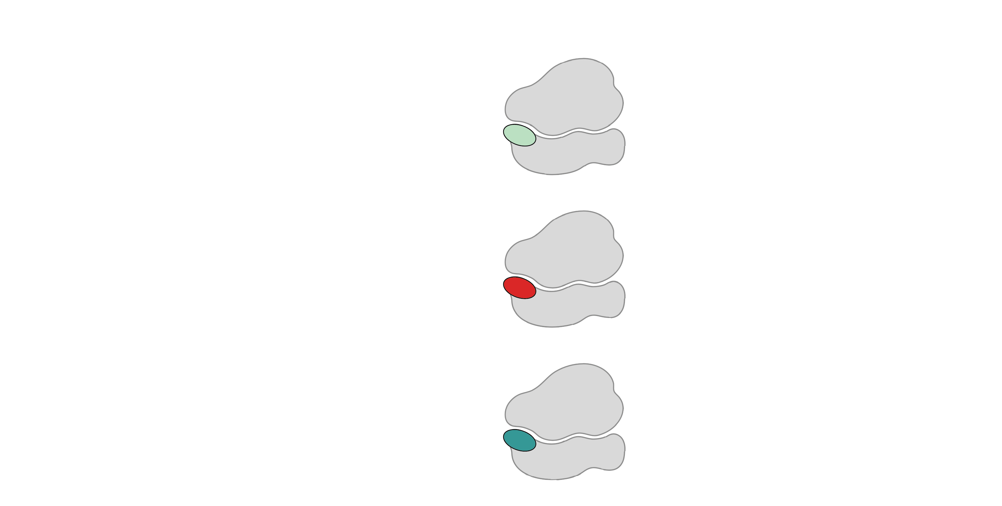
Multiple bS21 homologs lead to heterogenous ribosomes in Francisella tularensis
70S containing:
cspC
rpsU1
bS21-1
dnaG
bS21-2
rpsU2
yqeY
rpoD
rpsU3
bS21-3
Trautmann and Ramsey, 2022
How do changes in ribosome composition influence protein synthesis?
Notes:
Even though francisella has a reduced genome, it encodes three copies of the rpsU genes, which encode bS21, a protein in the small ribosomal subunit. Most bacteria have 0 or 1 of this gene. We originally, hypothesized, and have since shown, that these three proteins are produced and incorporated into ribosomes. This is a western blot of purified ribosomes from our wild-type strain as well as strains ectopically expressing each of the bS21 proteins, with a VSVG tag. This, along with some mass spec data we have of purified ribosomes, indicates that multiple classes of ribosomes are possible and occurring
This protein is also interesting to us because it is located close to the mRNA exit channel in the ribosome, and early research has identified that it is involved in translation initiation, so it is in an ideal location to be regulating gene expression at the level of translation initiation.
So this heterogeneity of ribosomes may be a mechanism of regulation, but you may not know that ribosomes are heterogeneous so let me show you other ways that may occur.

Slide 5
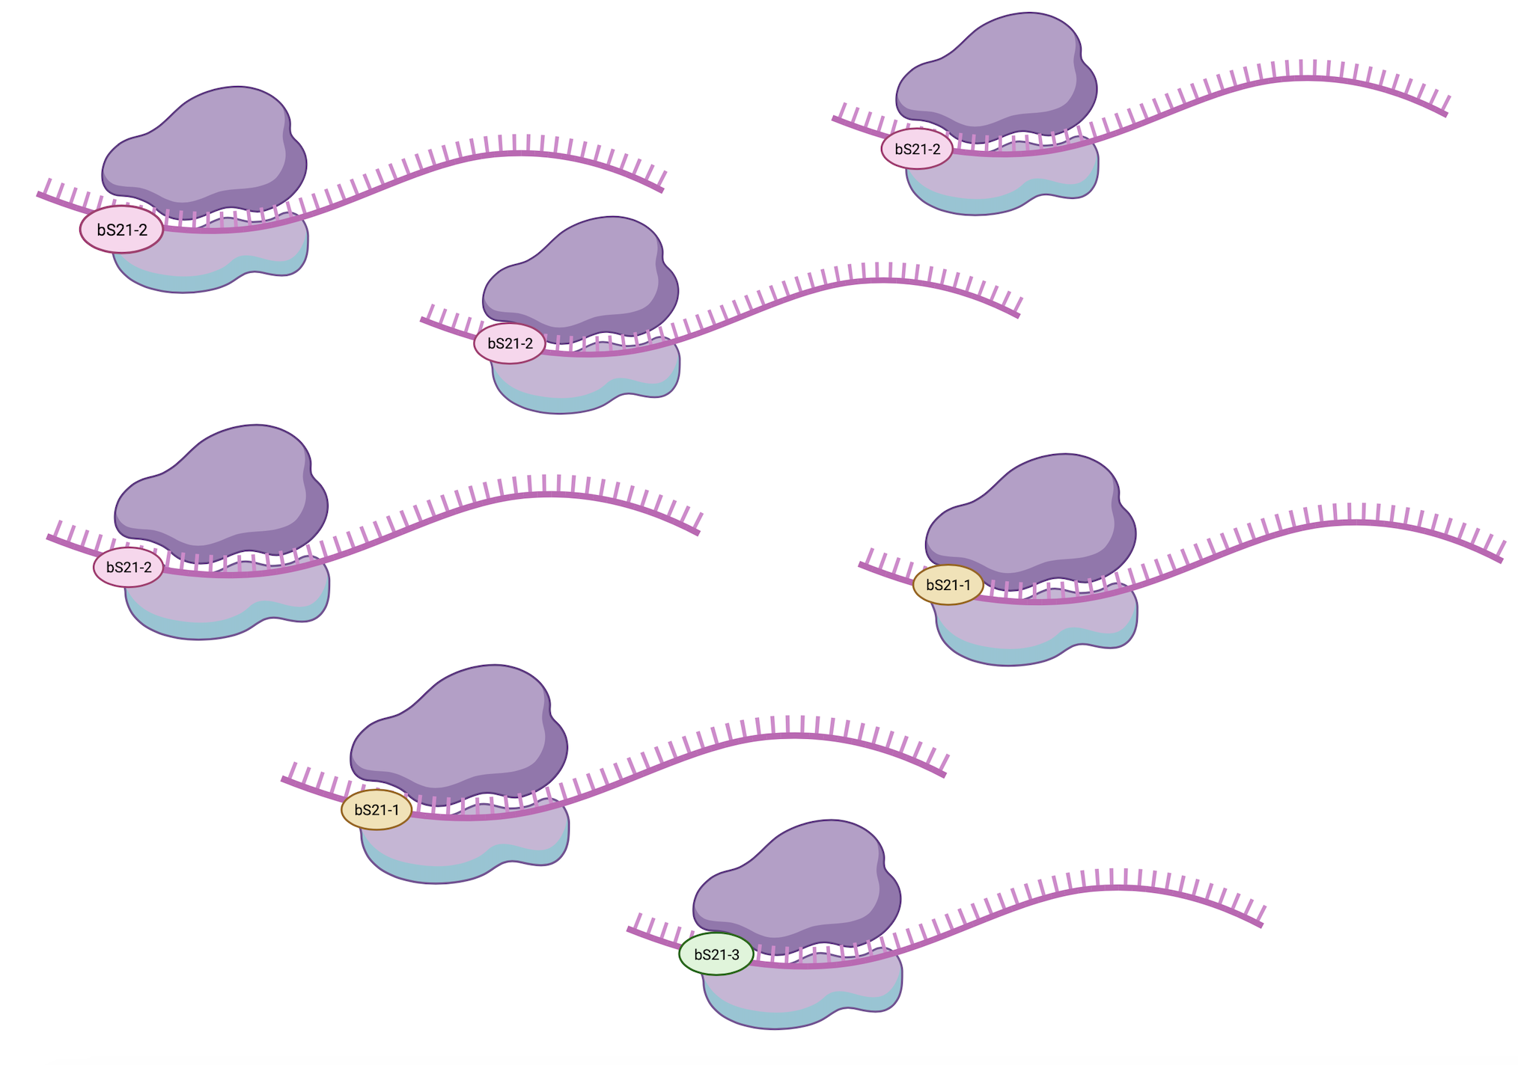
Heterogeneity of bS21 in LVS
How do we specifically identify translation by each homolog?

Slide 6
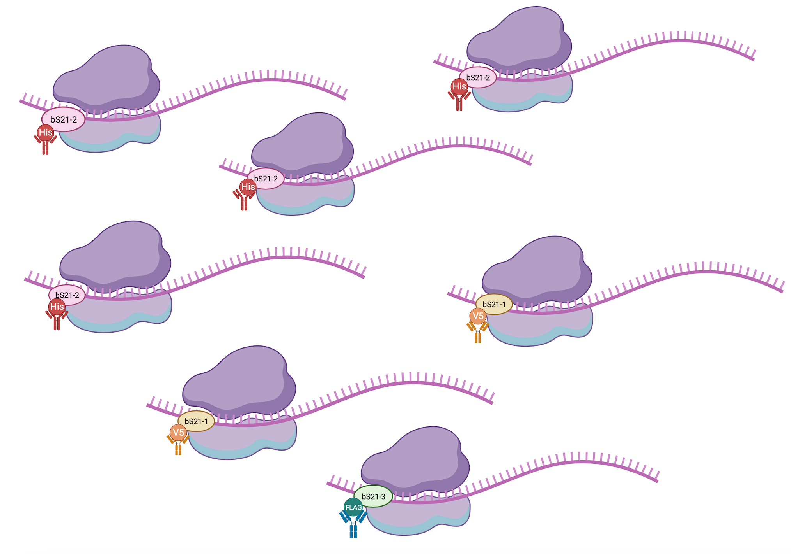
Heterogeneity of bS21 in LVS
How do we specifically identify translation by each homolog?

