Slide 1
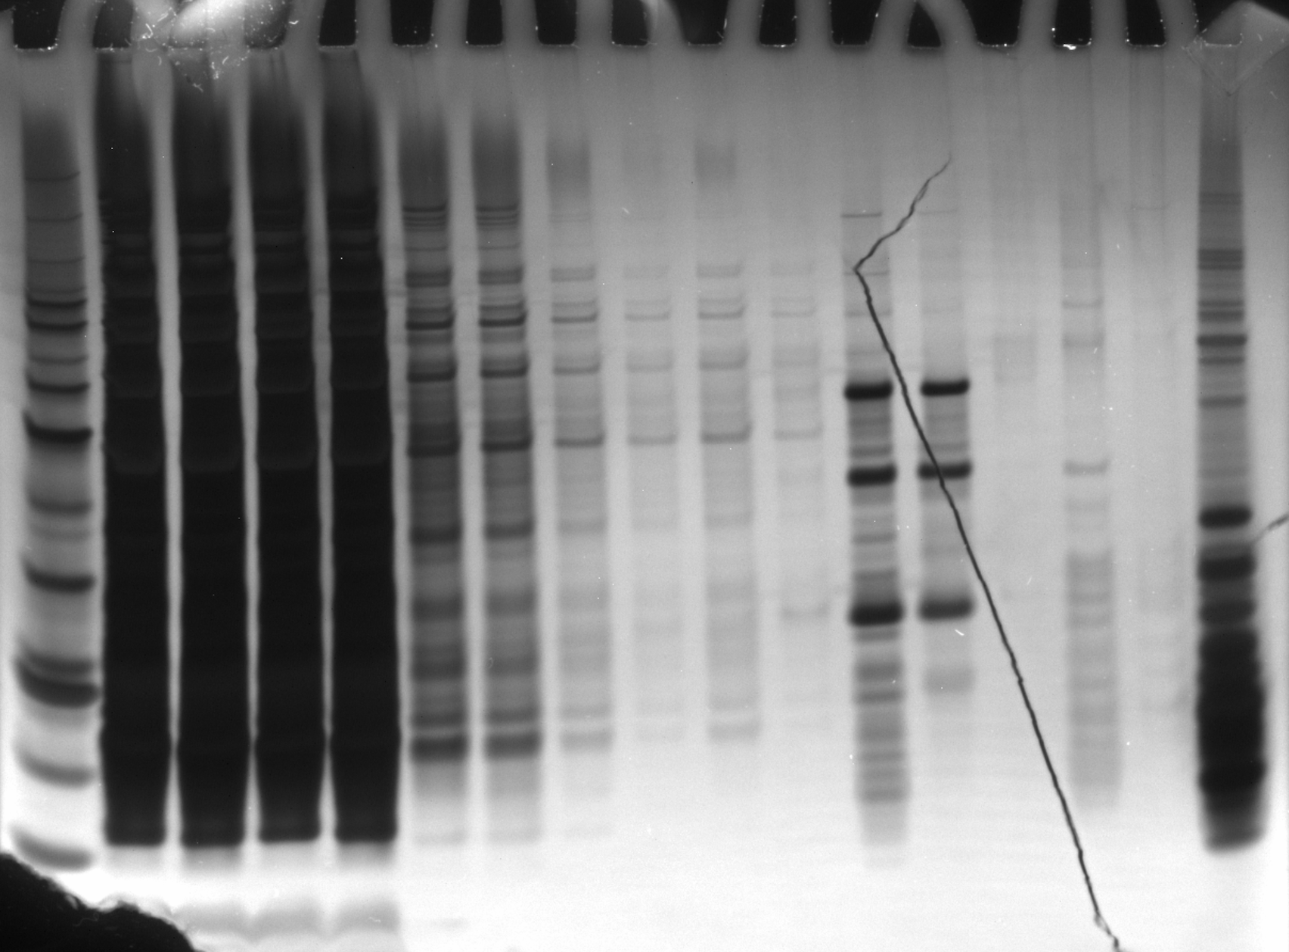
Anti-HA
Beads
Hannah’s
Ribosomes
LYS
FT1
FT2
FT3
FT4
Empty
EL1
kDa
+
-
+
-
+
-
+
-
+
-
+
-
+
-
60
50
HA-IP
Silver Stain
12/21/23
40
30
HA-IP
12/21/23
Silver Stain
20
15
10

Slide 2
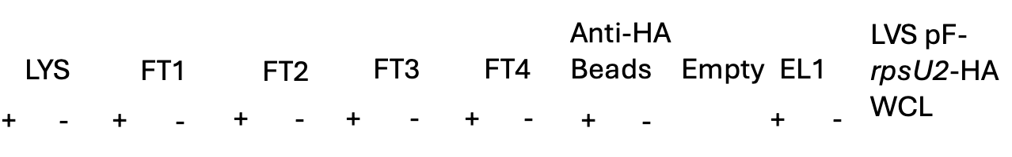
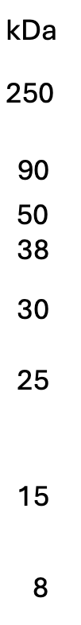
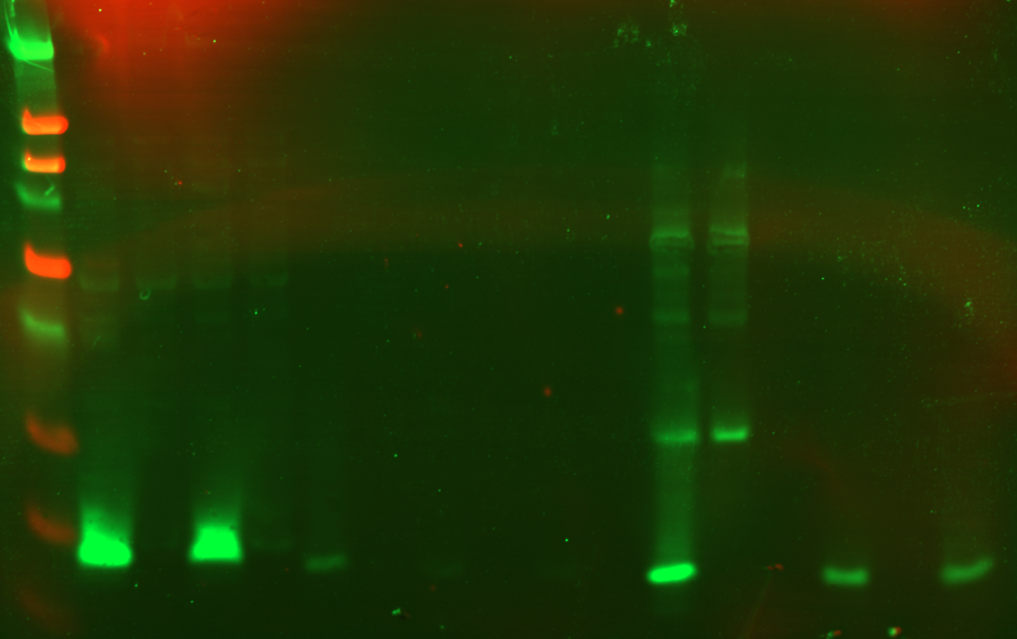
Results
Western Blot
12/21/23

