Slide 1
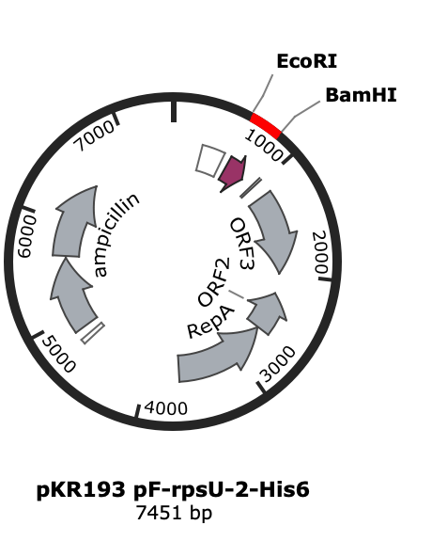
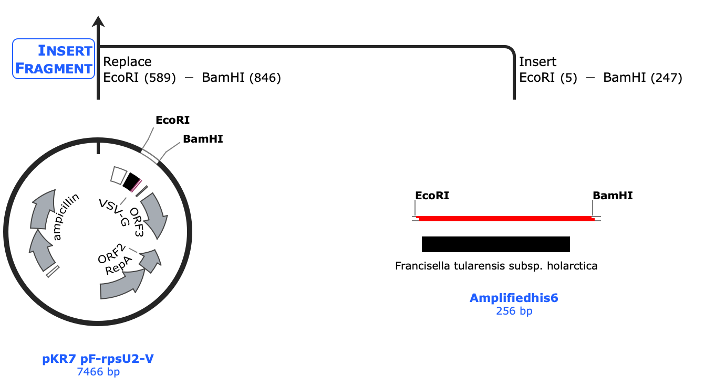
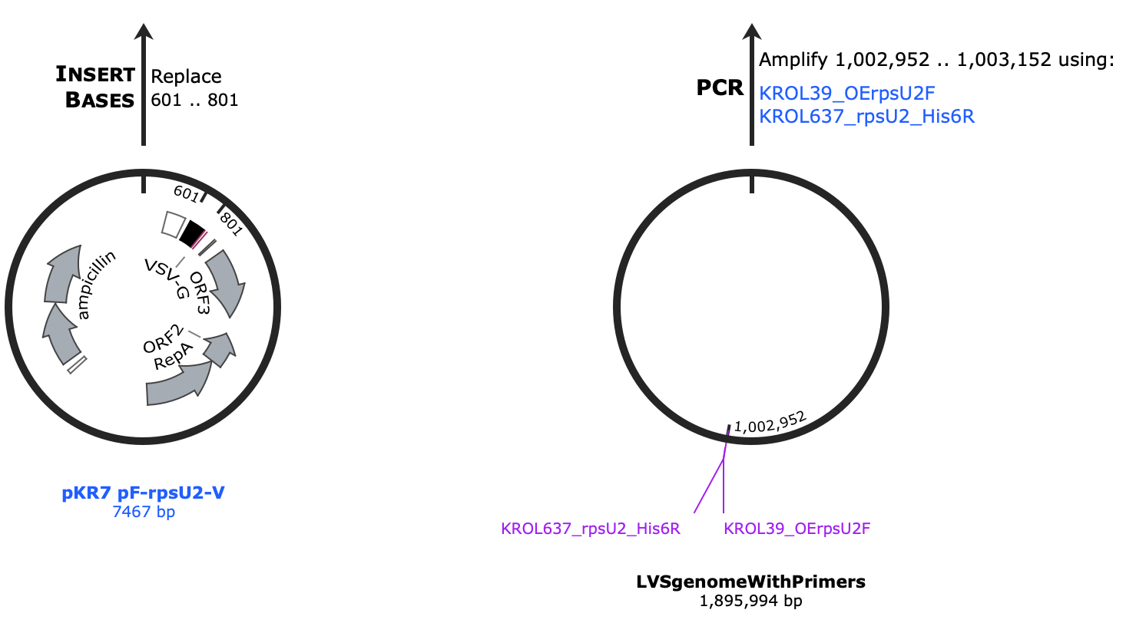
Plasmid Design
Methods:
  Design primers to amplify LVS rpsU2 gDNA and add epitope tag
  pKR7 is the vector
Results:
  In silico-designed plasmids using SnapGene
Future Directions:
  Order primers
  Start cloning

