Slide 1
Ribosome Profiling
What transcripts are being translated by different bS21 homologs?
  How do we specifically identify translation by ribosomes with these homologs?
  Immunoprecipitation
    Find epitope tags
      Small size
      Have appropriate antibody for ribosome IP
      Be able to purify antibody-epitope-ribosome complex
      Be able to purify intact proteins from IP
  Add chosen epitope tags to chromosomal rpsU at native loci

Slide 2
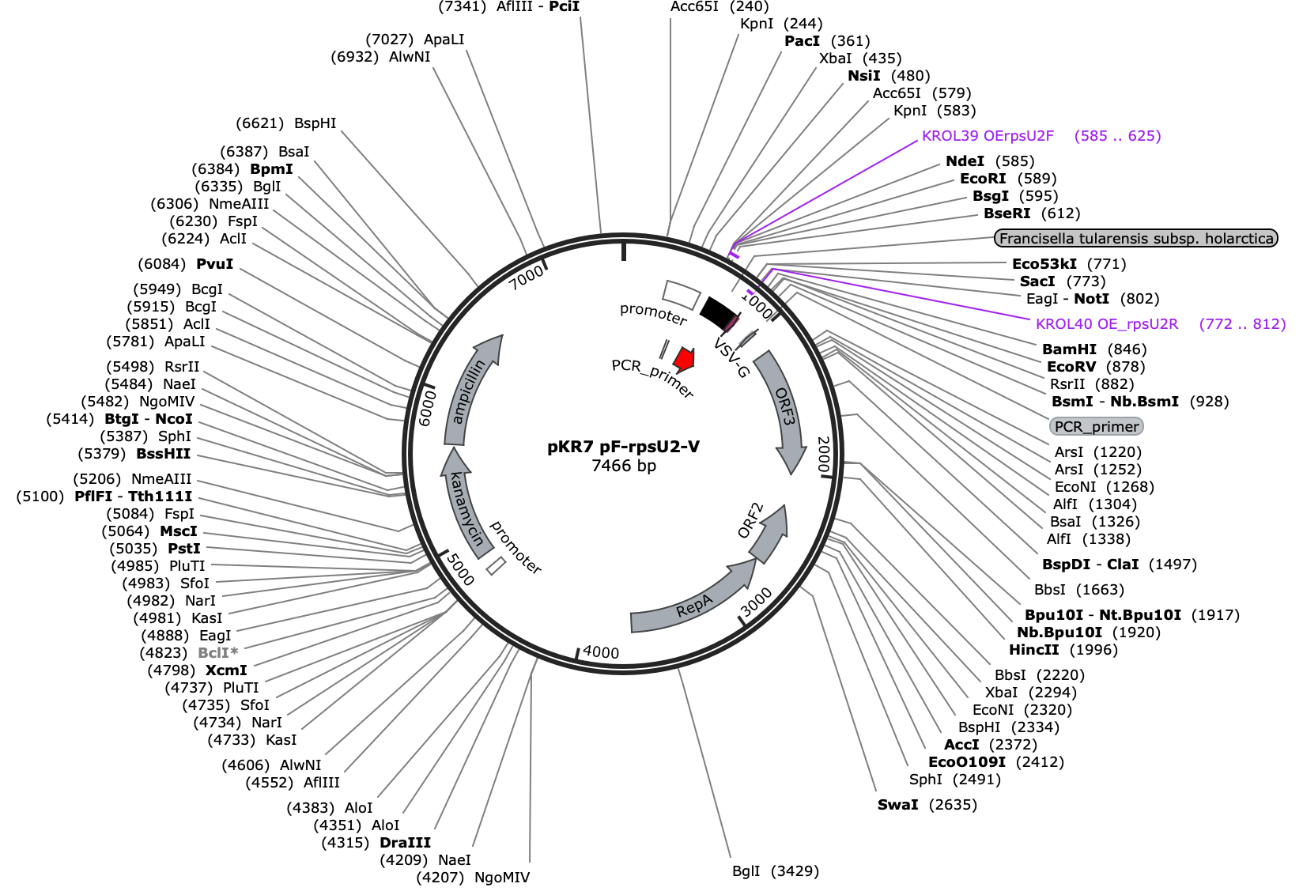
Ribosome Profiling
Chosen epitopes:
  FLAG
  His-6
  HA
  V5
Future Directions:
Find accessible reagents for purification
Design the plasmids with each tag

Slide 3
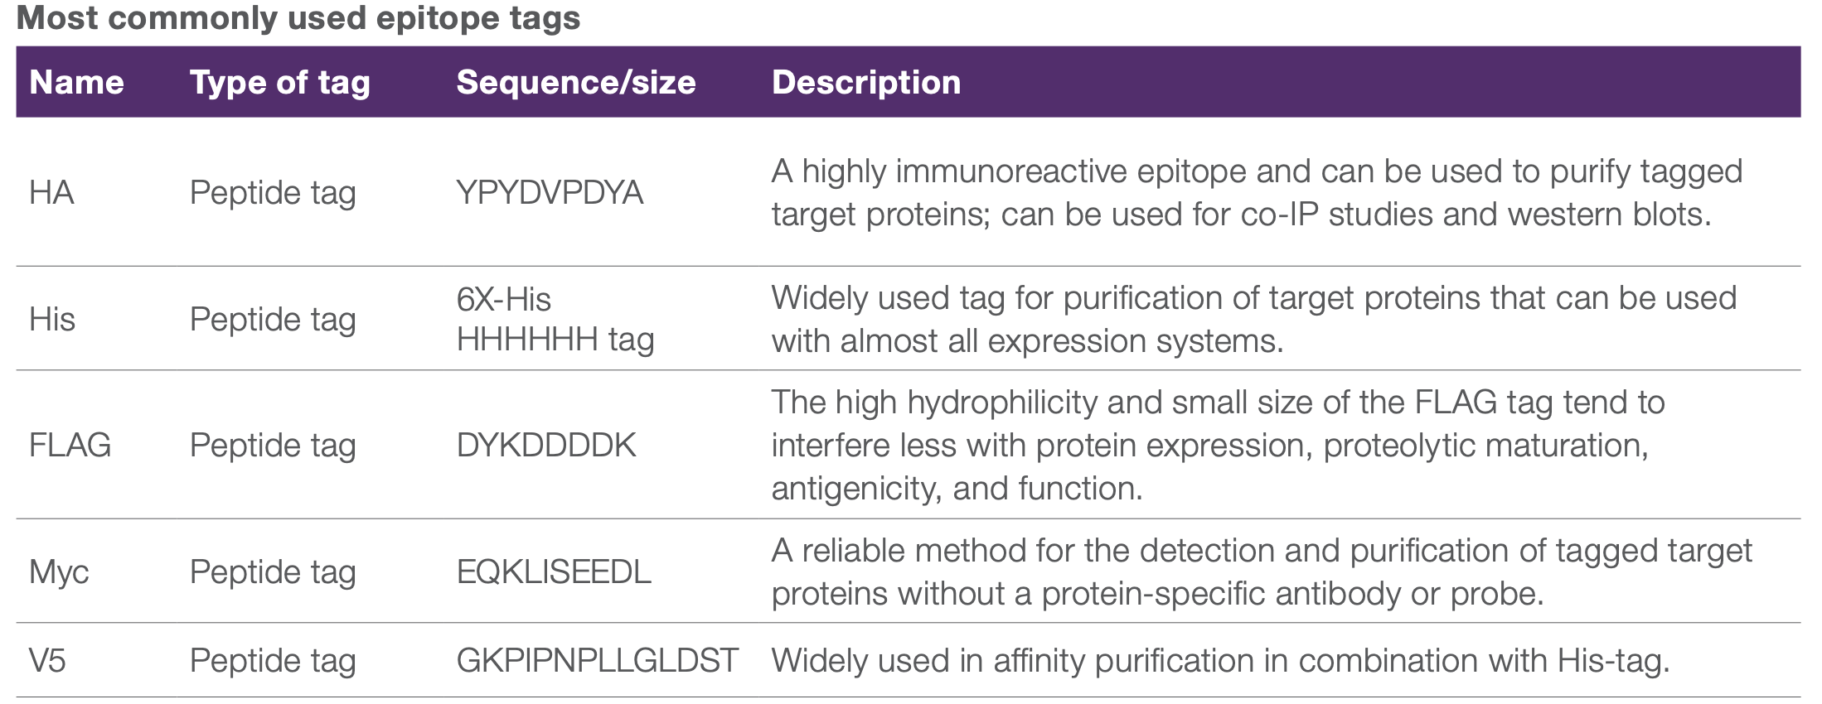
Ribosome Profiling

