Slide 1

Journal Club 2/23/24

Slide 2
Restriction modification systems
Bacterial “immune systems” that prevent incorporation of exogenous DNA
2 components: MTase and REase
Unmethylated foreign DNA enters bacterial cell and is cut out by REase (highly specific)
Self DNA is methylated by MTase (protection)

Slide 3
Mimicry-by-methylation
Derived from bacteriophages
Modify the methylation pattern of genetic tool so that it matches the host
  In vitro: methylate target sites on tools but using in vitro methylation with recombinant MTases
  In vivo: passage a plasmid through either a related restriction enzyme-deficient strain or through a heavily engineered strain that matches the methylation profile of the target strain (PAM)

Slide 4
Stealth by engineering
REases are highly conserved and toxic to hosts in the absence of cognate MTases
Exploit the inherent weakness of high target specificity to evade host RMs
  Hypothesis: if a target DNA is lacks the recognition motifs for a host’s RM system, it will be invisible to RMs and will not be degraded upon articifcial transformation
  Syngenic DNA: engineer a syngeneic DNA that is RM-silent upon transformation

Slide 5
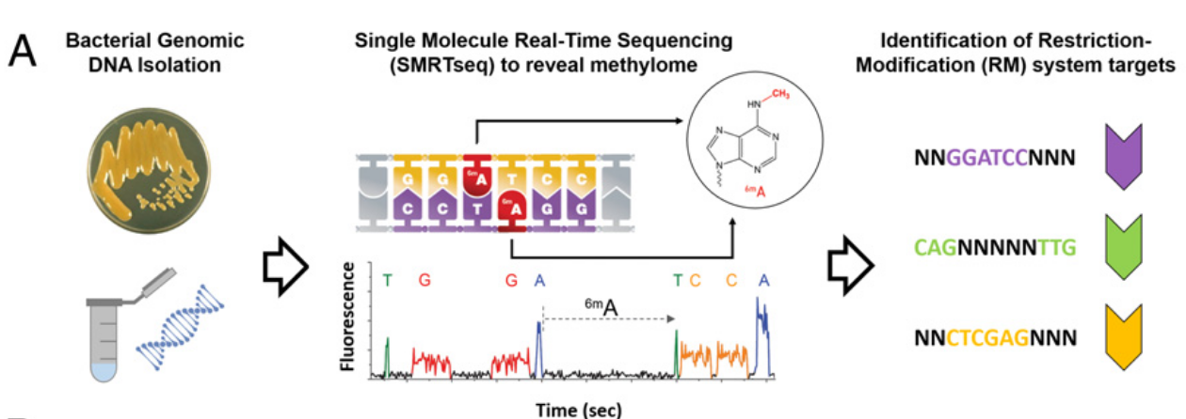
Fig. 1. Schematic representation of the SyngenicDNA approach. (A) Identification of RM system target motifs by SMRTseq. Methylome analysis of polymerase kinetics during sequencing permits detection of methylated sites at single-nucleotide resolution across the genome, revealing the exact motifs targeted by innate RM systems (indicated by colored nucleotides; N is any nucleotide) (kinetic trace image adapted from www.pacb.com).

Slide 6
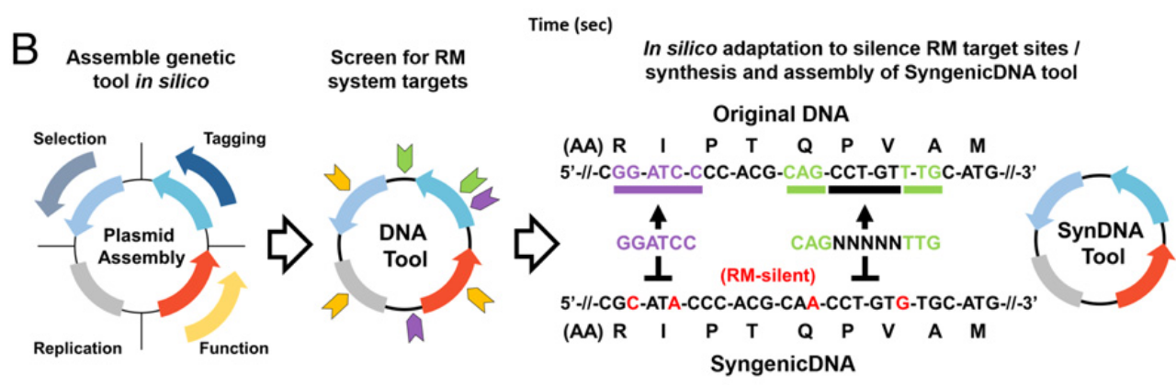
Fig. 1. (B) Assembly in silico of a genetic tool with a desired functionality, followed by screening for the presence of RM target sequences and sequence adaptation, using SNPs or synonymous codon substitutions in coding regions, to create an RM-silent template which is synthetized de novo to assemble a SyngenicDNA tool.

Slide 7
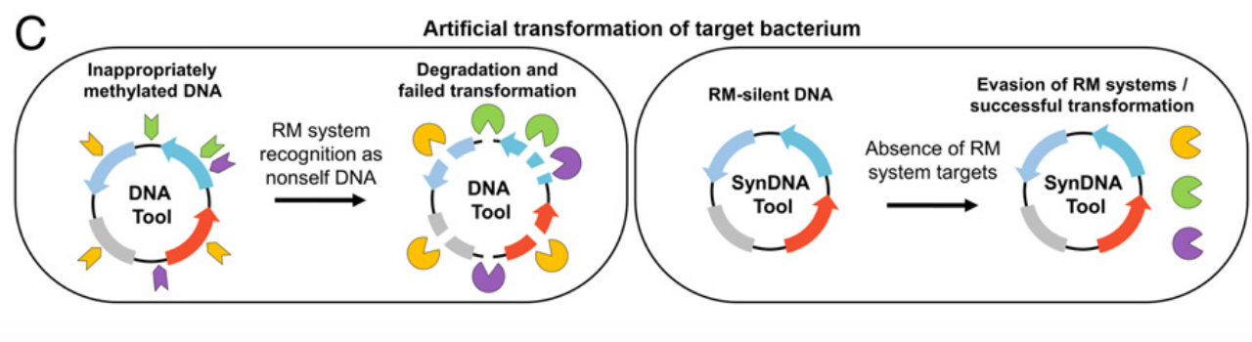
Fig. 1. (C) Artificial transformation of the bacterium of interest target bacterium. Inappropriately methylated target motifs of the original genetic tool are recognized as nonself-DNA and degraded by RM systems. In contrast, the SyngenicDNA variant retains the form and functionality of the genetic tool, but is uniquely designed at the nucleotide level to evade the RM systems and can operate as desired within the target bacterial host.

Slide 8
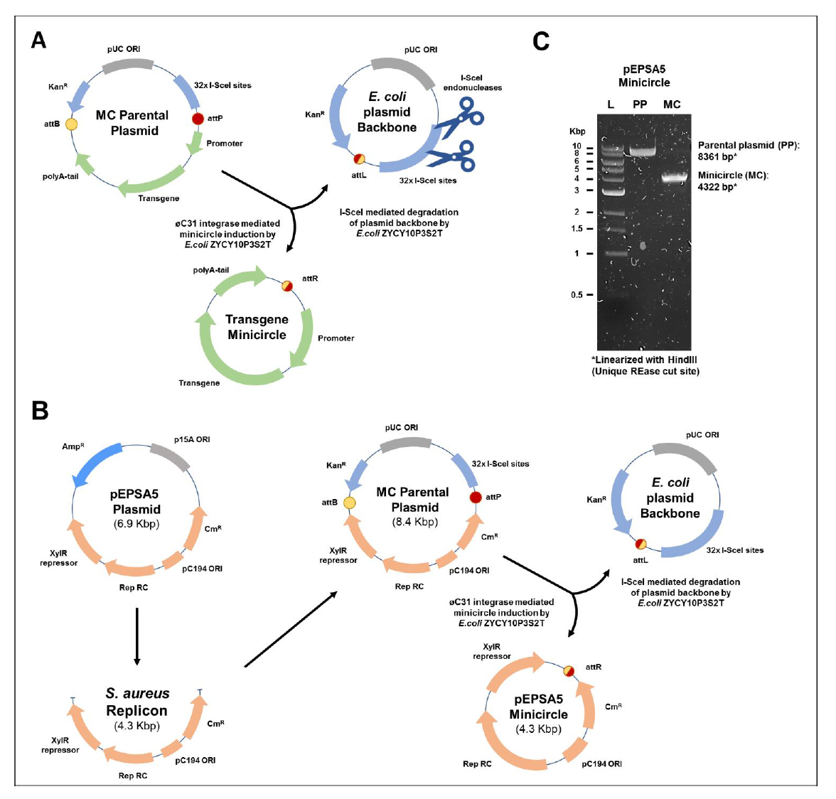
Figure S1. Repurposing of minicircle (MC) technology to produce minimalistic genetic tools for application in bacteria. (A) Current MC strategies [Kay et al (1)] are applied to produce small circular expression cassettes for stable transgene expression in eukaryote hosts. Typically, a transgene cassette containing a eukaryote promoter, transgene, and polyA tail (green arrows) is attached to an E. coli plasmid backbone within a multiple cloning site flanked by attB and attP sites (bacterial and phage attachment recognition sites of the øC31 integrase enzyme, red and yellow circles respectively) to form a parental plasmid. The E. coli backbone also contains the antibiotic-selection marker KanR (blue arrow), a pUC origin (grey box) for high-copy-number autonomous replication in E. coli, and 32x tandem repeats of the I-SceI homing endonuclease recognition site (blue box) for I-SceI targeted degradation after MC induction. The øC31 integrase and I-SceI enzymes are arabinose inducible and encoded on the chromosome of E. coli ZYCY10P3S2T (1). (B) In our repurposed bacterial MC strategy, a functional bacterial replicon/genetic tool takes the place of the eukaryotic transgene cassette. This allows for high-yield production of minimalistic genetic tools, which lack an E. coli replicon, for application in bacteria other than E. coli. We used the S. aureus replicon of the pEPSA5 plasmid to form a pEPSA5 minicircle that is 38% smaller than pEPSA5. (C) Restriction enzyme digestion of pEPSA5 parental plasmid (PP) and pEPSA5 minicircle (MC) following isolation from E. coli MC (ZYCY10P3S2T, a minicircle-producing strain). Plasmid DNA (500 ng), isolated prior to arabinose induction (PP) or 4-hours post induction (MC), was linearized with 1U of the unique cutter HindIII for 1 hour and resolved on a 1% agarose gel. Lane M, marker DNA (1 kb Ladder; NEB); lane PP, uninduced pEPSA5PP; lane MC, induced pEPSA5MC.

Slide 9
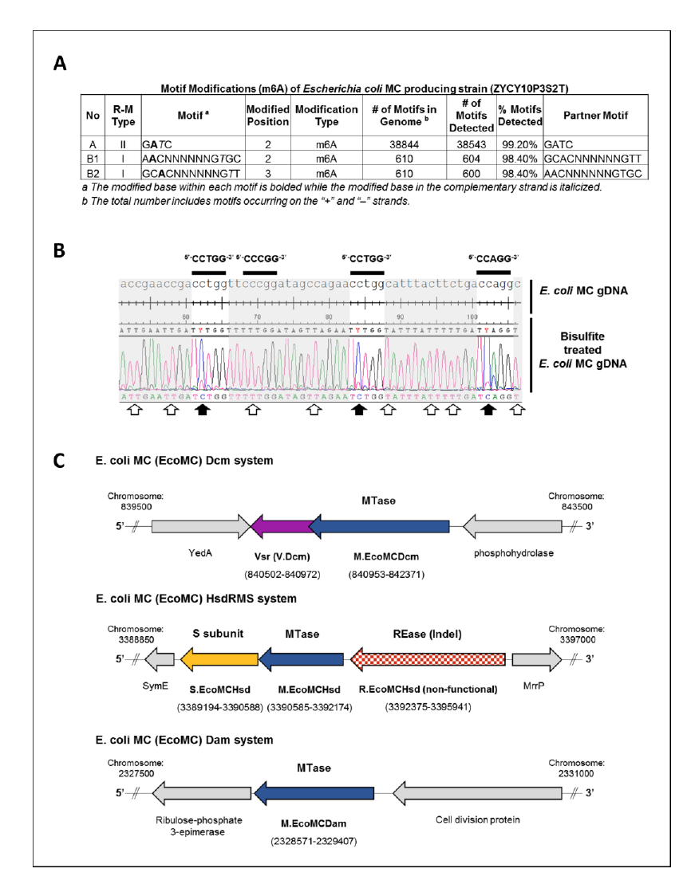
Figure S2. Methylation signatures present on E. coli MC (ZYCY10P3S2T) genomic DNA and the organization of responsible MTase gene clusters. (A) Detailed summary of 6-methyladenine (m6A)-modified motifs across the genome of E. coli MC (ZYCY10P3S2T, a minicircle-producing strain) detected by SMRTseq and Basemod analysis (the PacBio DNA modification sequence analysis pipeline, http://www.pacb.com/). RM systems were designated as Type I or II based on gene characterization through REBASE. aThe modified base within each motif is bolded while the modified base in the complementary strand is italicized. bThe total number includes motifs occurring on the + and – strands. (B) Summary of 5-methylcytosine (m5C) CCWGG-modified motifs on the E. coli MC genome. Sequence comparison and alignment of E. coli MC genomic region before and after bisulfite conversion. Unmethylated cytosine residues converted to thymine during bisulfite treatment are indicated by white arrows; m5C methylated cytosines protected from deamination are indicated by black arrows (present within CCWGG motifs, where W=A or T, but not CCCGG motifs). (C) A schematic representation showing the structure and genomic context of E. coli MC RM systems and orphan MTases. Gene assignments, nomenclature and genome coordinates publicly available at REBASE.

Slide 10
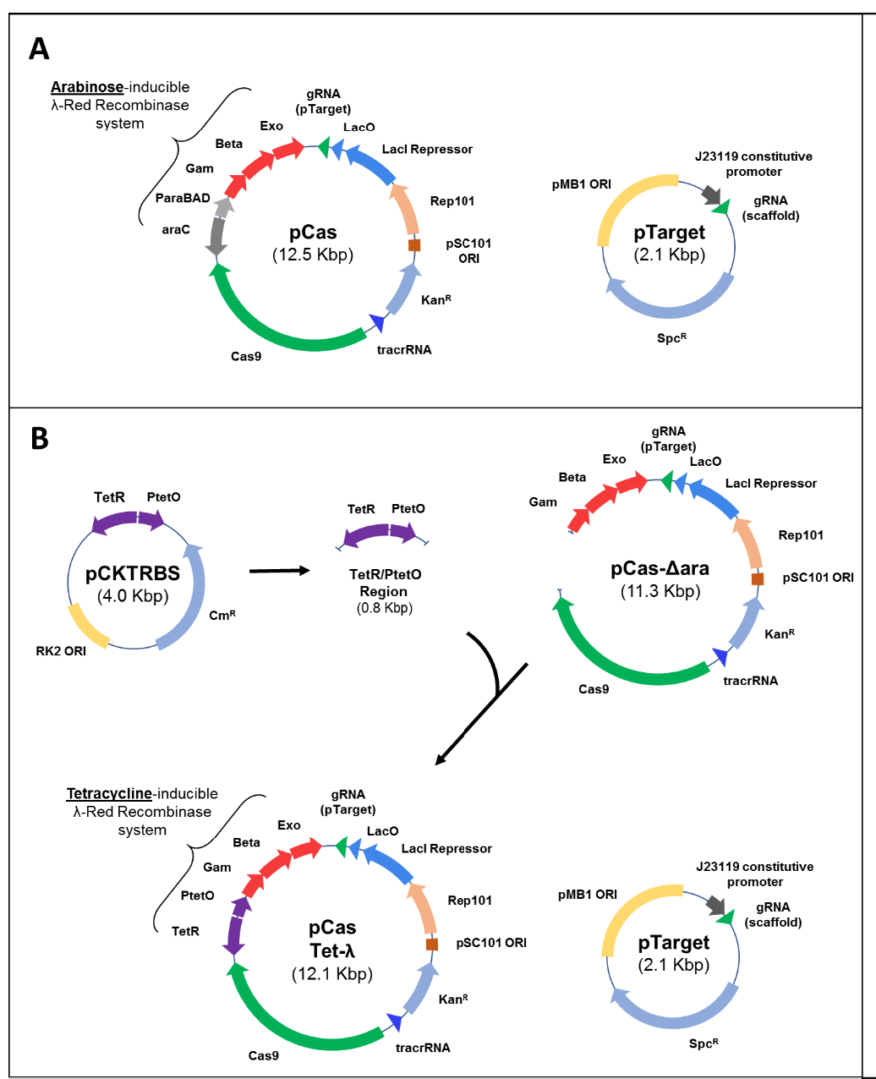
Figure S3. Engineering of an anhydrotetracycline-inducible CRISPR-Cas9/λ-Red recombineering strategy for scarless deletion of MTase 34 genes within E. coli MC (ZYCY10P3S2T). (A) The original dual plasmid (pCas and pTarget) CRISPR-Cas9/λ-Red system developed by Jiang et al. (2), with an arabinose inducible regulatory promoter/repressor module (araC-Pbad) controlling the λ-Red system (Gam, Beta, Exo). (B) Construction of the pCasTet-λ plasmid, a modified version of pCas. An 818-bp tetracycline-inducible regulatory promoter/repressor unit, TetR/PtetO, was amplified from pCKTRBS and spliced to a linear amplicon of pCas lacking the araC-Pbad module. The resultant plasmid, pCasTet-λ, contains λ-Red genes under transcriptional control of the TetR/PtetO regulatory cassette and can be used in combination with the original pTarget. (C) Assembly of DNA editing templates for MTase gene recombineering in E. coli MC. Approximately 400-bp regions from 5’ and 3’ of each MTase gene were spliced together onto a pRRS plasmid backbone to form the MTase deletion template plasmids (pRRSDcmET, pRRSHsdET, and pRRSDamET; where ET is editing template). These plasmids were used to amplify each MTase editing template prior to λ-Red recombineering.

Slide 11
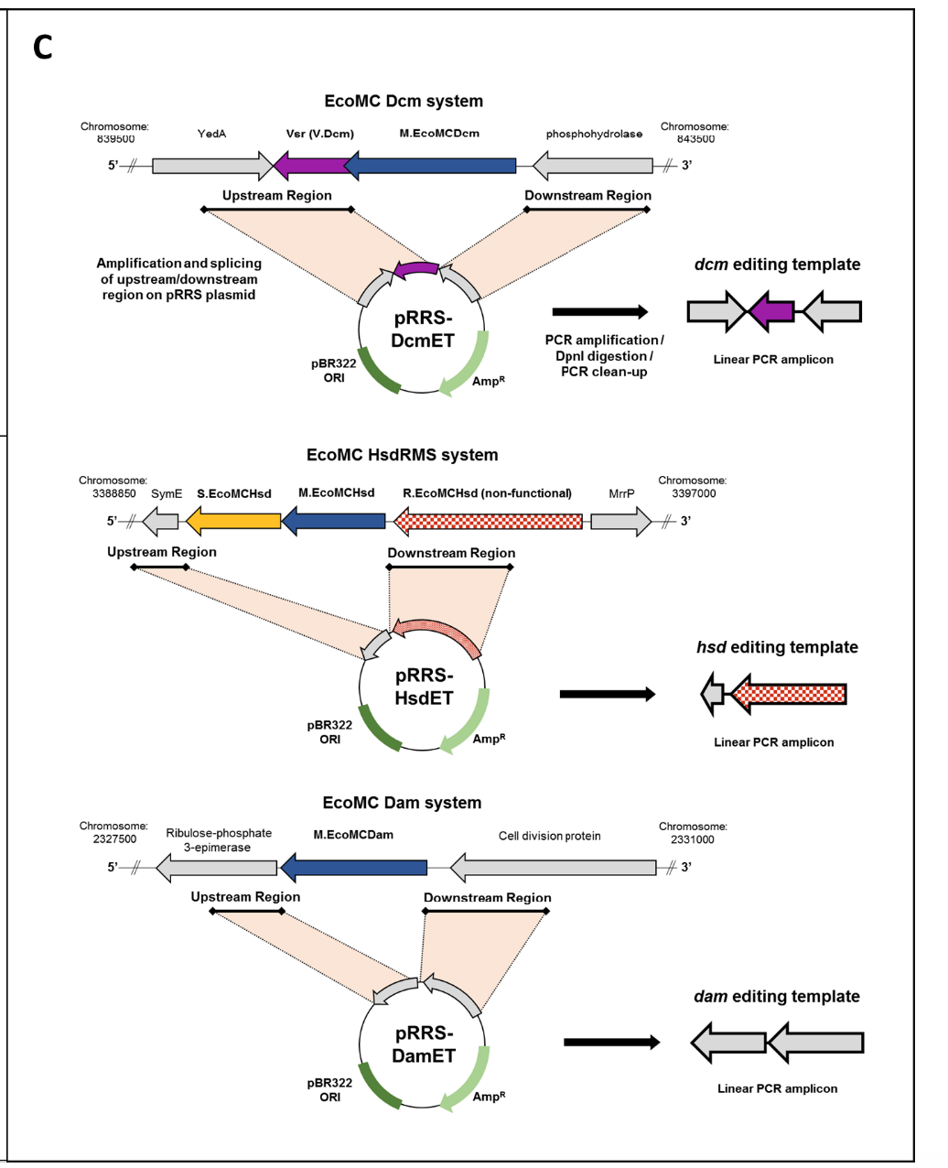
Figure S3. Engineering of an anhydrotetracycline-inducible CRISPR-Cas9/λ-Red recombineering strategy for scarless deletion of MTase 34 genes within E. coli MC (ZYCY10P3S2T). (C) Assembly of DNA editing templates for MTase gene recombineering in E. coli MC. Approximately 400-bp regions from 5’ and 3’ of each MTase gene were spliced together onto a pRRS plasmid backbone to form the MTase deletion template plasmids (pRRSDcmET, pRRSHsdET, and pRRSDamET; where ET is editing template). These plasmids were used to amplify each MTase editing template prior to λ-Red recombineering.

Slide 12
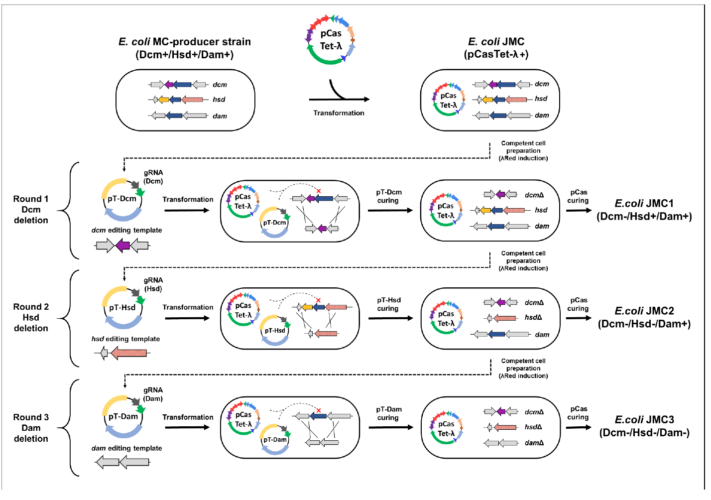
Figure S4. The CRISPR-Cas9/λ-Red recombineering scheme used in E. coli MC (ZYCY10P3S2T) for scarless MTase gene deletion. pTarget plasmids (pT-Dcm and pT-Hsd) each encode constitutively expressed gRNAs for Cas9-mediated targeting of MTase genes in unsuccessfully edited cells. gRNA sequences used are included in Table S5.

Slide 13
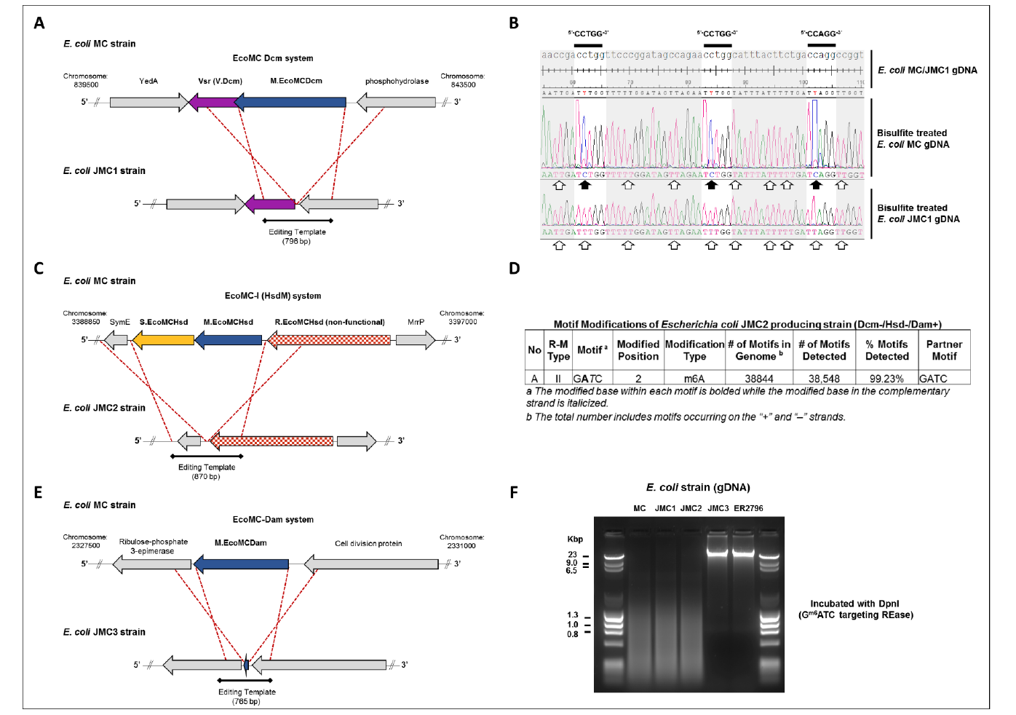
Figure S5. Schematic representations showing the context of genome editing in E. coli JMC-series strains along with phenotypic 46 confirmation of MTase deficiencies. (A) Sequence confirmed dcm deletion in E. coli JMC1. (B) Comparison of Dcm activity in E. coli MC and E. coli JMC1 strains. Alignment of genomic regions before and after bisulfite conversion, highlighting the absence of m5C-modified CCWGG motifs SUPPLEMENTARY FIGURES on E. coli JMC1 gDNA (where W is A or T). White arrows indicate unmethylated cytosine residues converted to thymine during bisulfite treatment. Black arrows indicate m5C methylated cytosines protected from deamination. (C) Sequence confirmed hsd deletion in E. coli JMC2. (D) SMRTseq/Basemod summary of modified m6A motifs across the E. coli JMC2 genome, demonstrating the absence of methylated HsdS motifs (compared to the E. coli MC strain shown in Figure 2A). (E) Sequence confirmed dam deletion in E. coli JMC3. (F) DpnI restriction of gDNA isolated from E. coli strains MC, JMC1, JMC2 and JMC3. Genoic DNA from the methyl-deficient E.coli ER2796 (NEB) is included as control. DpnI is a methyl-directed endonuclease that requires Gm6ATC for activity. JMC3 gDNA is resistant to DpnI cleavage indicating it is unmethylated at Dam (GATC) sites.

Slide 14
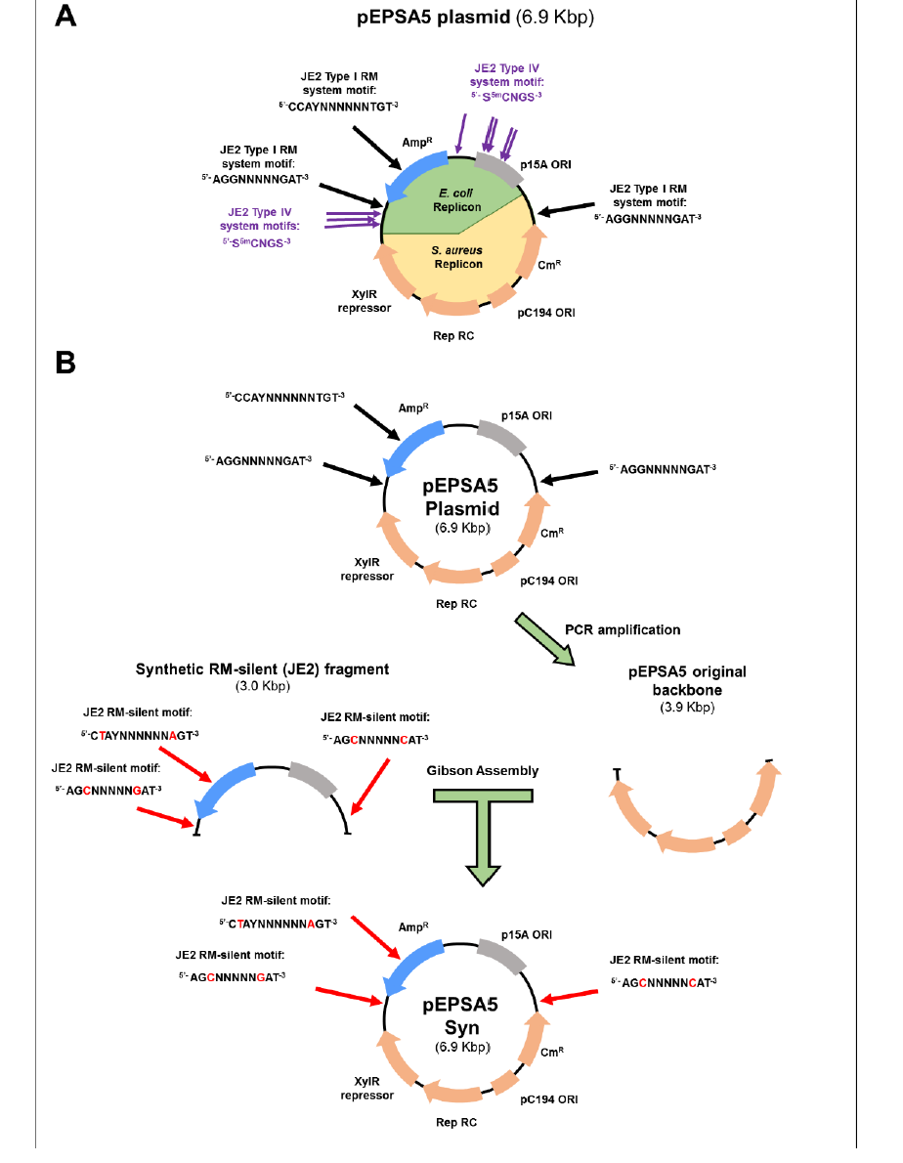
Figure S6. Schematic of pEPSA5 plasmid with S. aureus JE2 RM targets and construction of 56 pEPSA5SynJE2. (A) Forsyth and colleagues described the original pEPSA5 S. aureus–E. coli shuttle vector (3). This plasmid contains 11 individual S. aureus JE2 RM target motifs (Type I; n=3, and Type IV; n=8) that will be recognized and targeted for degradation upon transformation. (B) We assembled pEPSA5SynJE2 by replacing a 3-kbp fragment of pEPSA5 that contained three JE2 RM target motifs with a de novo synthesized RM-silent fragment. Black arrows indicate JE2 RM target motifs. Red arrows indicate those modified sites on the RM-silent fragment. Red letters indicate modified nucleotides. Type IV system targets are not shown, as these can be eliminated by propagation in a Dcm-deficient E. coli host. Both plasmids are 6850 bp in length and differed by only six nucleotides (99.91% nucleotide identity).

Slide 15
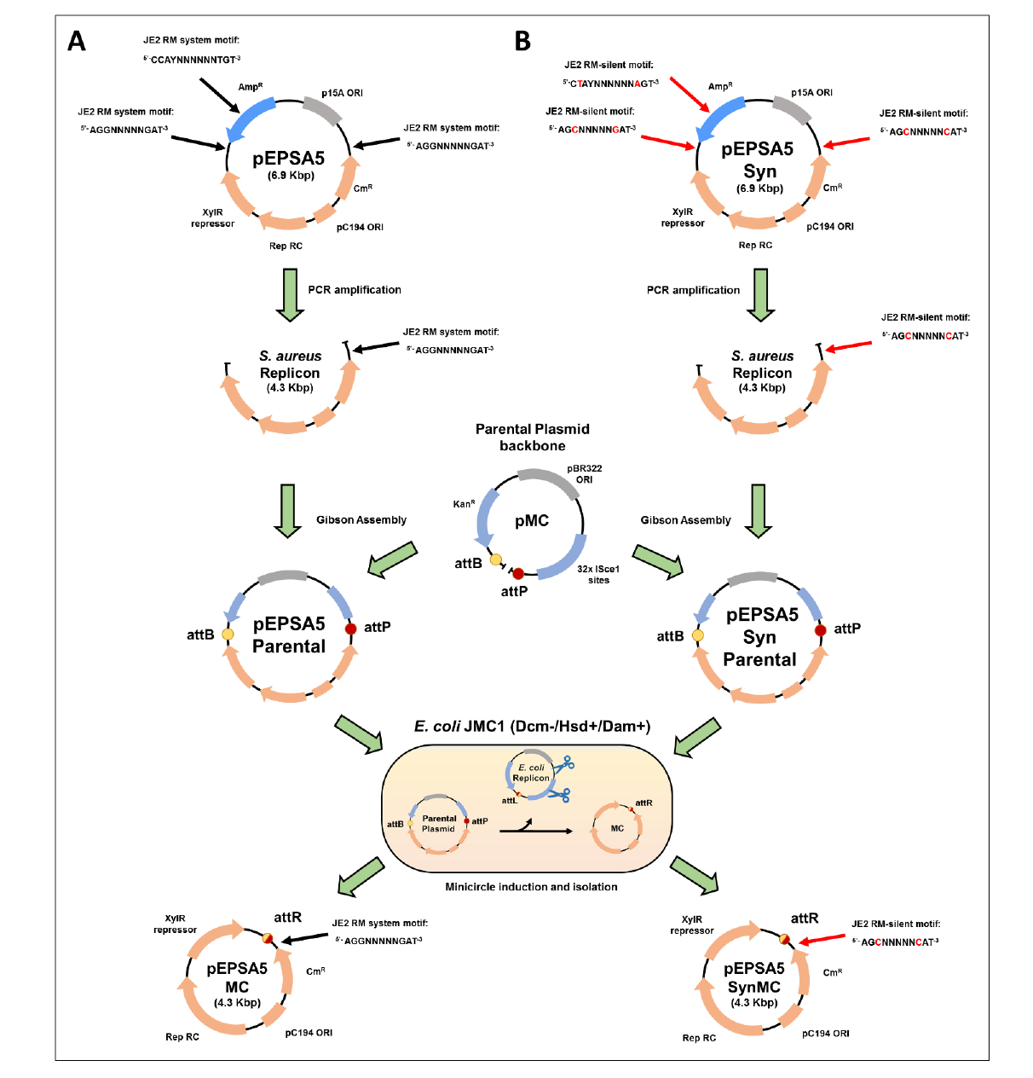
Figure S7. Assembly and propagation of pEPSA5- and pEPSA5Syn-based minicircles in E. coli JMC1. (A) The S. aureus functional replicon of pEPSA5, containing a single JE2 RM system target, was amplified to remove the original E. coli replicon. The S. aureus replicon was spliced to the pMC plasmid to form the pEPSA5 parental plasmid, which was transformed into competent E. coli JMC1 cells followed by arabinose induction of MC assembly. pEPSA5MC has a single JE2 RM system target. (B) This process was repeated for pEPSA5SynJE2, which is RM-silent with respect to JE2. pEPSA5MC and pEPSA5SynJE2MC plasmids differ by only the two nucleotides shown in red letters.

Slide 16
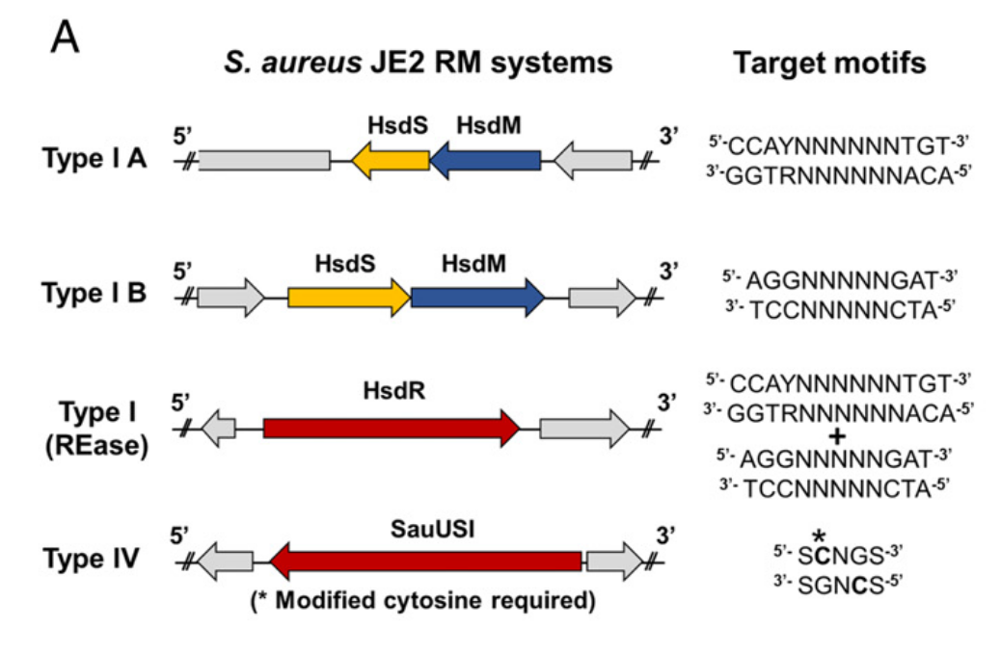
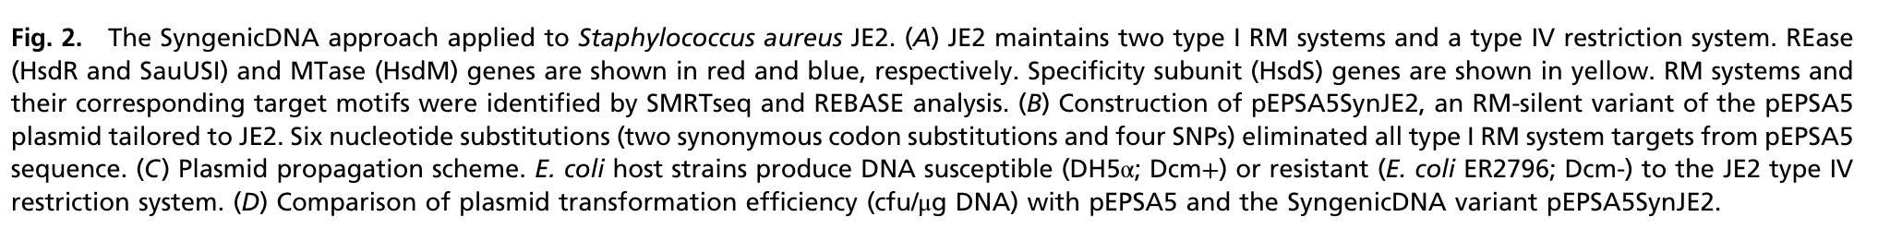

Slide 17
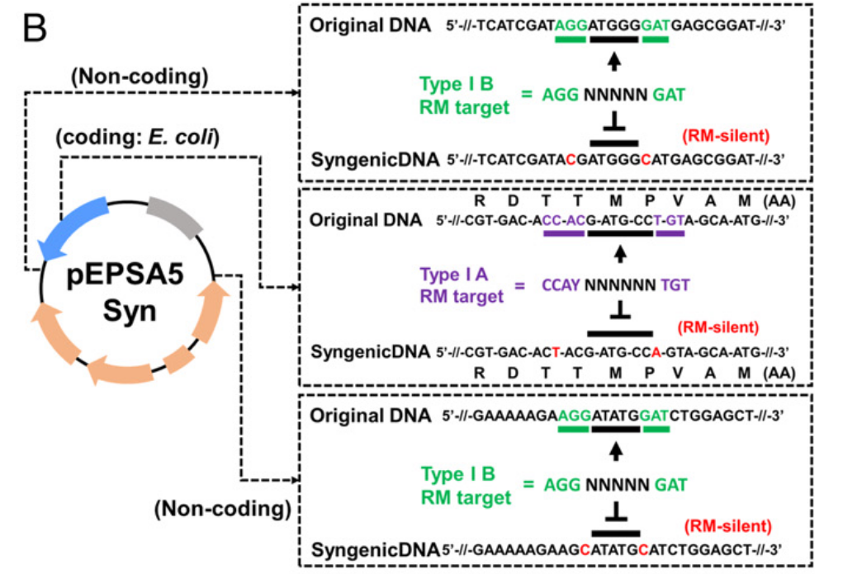

Slide 18
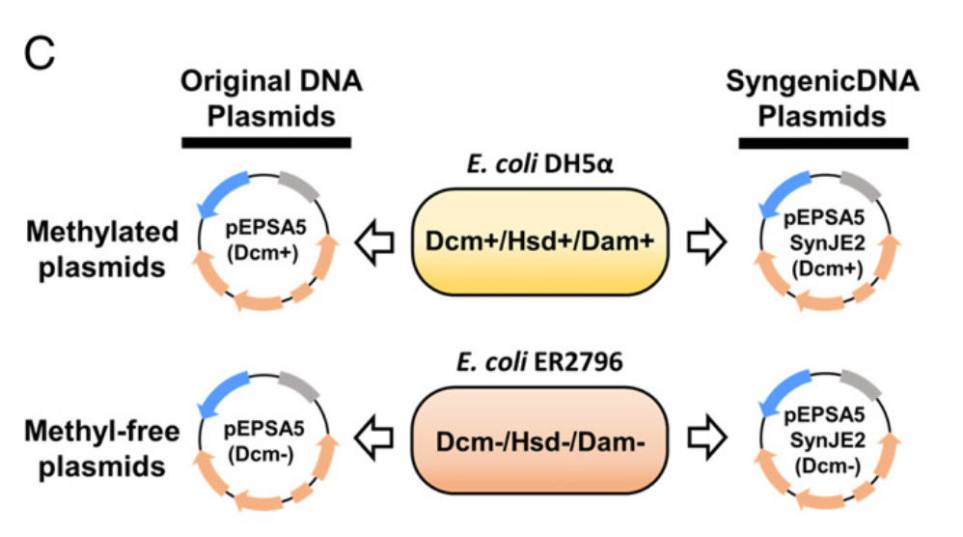

Slide 19
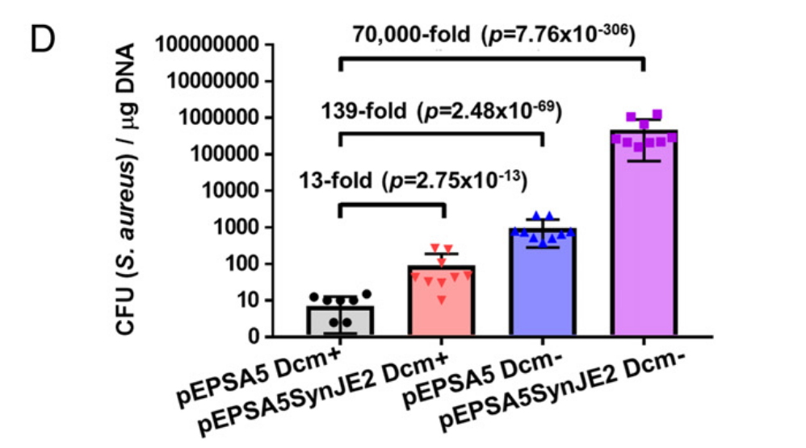

Slide 20
