Slide 1
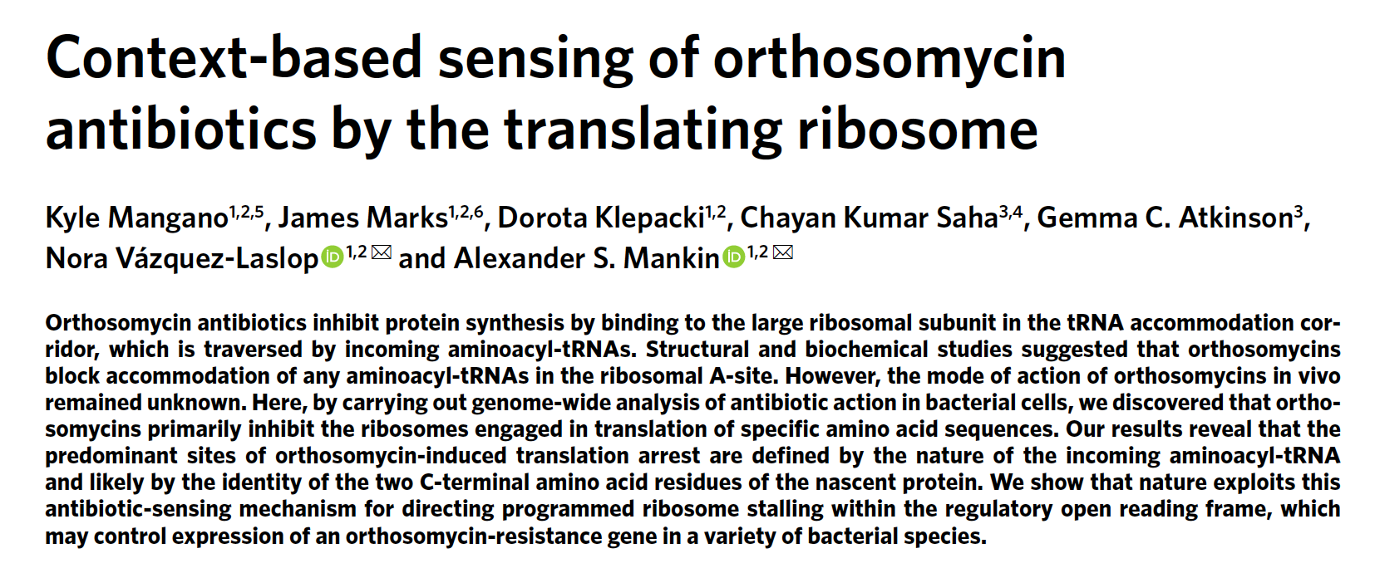

Slide 2
Orthosomycins: class of antibiotics that inhibit protein synthesis
  Interact with a site in the aa-tRNA accommodation corridor
EVN arrests ribosomes during in vitro translation
Notes:
Accomodation corridor: groove in 50S sub that is navigated by aa-tRNA on its way to PTC A site after codon-anticodon basepairing insmall sub.

Slide 3
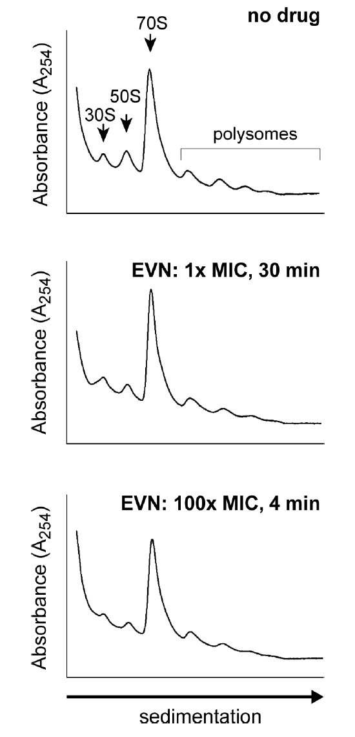
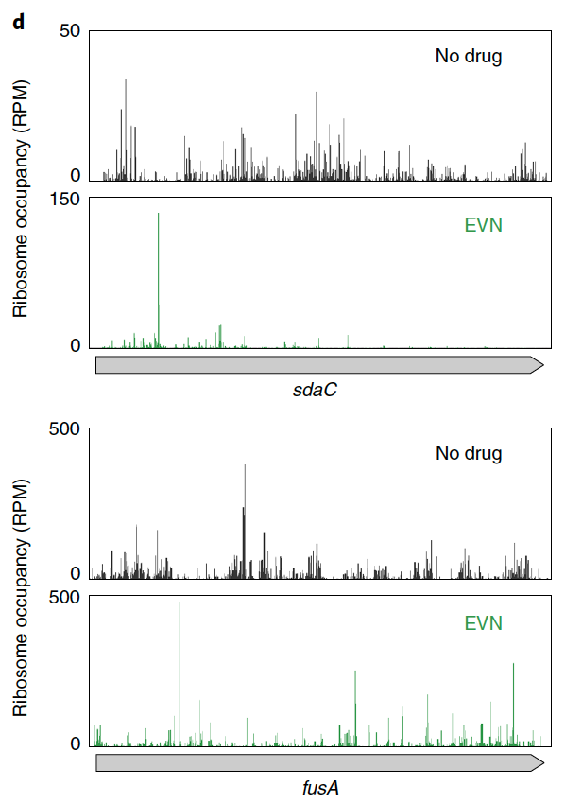
EVN inhibits translation elongation
Notes:
Does not inhibit initiation, or else ribos would run off mRNAs and there would be no polysomes
Global preservation of RPF density along ORFs plus increased ribo occupancy at first 20 aas

Slide 4
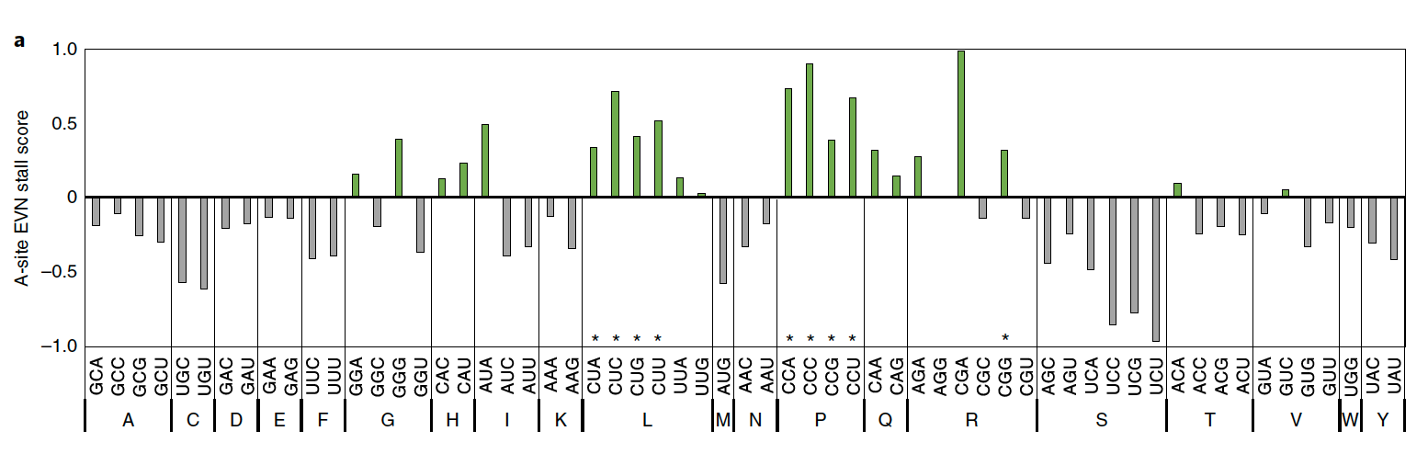
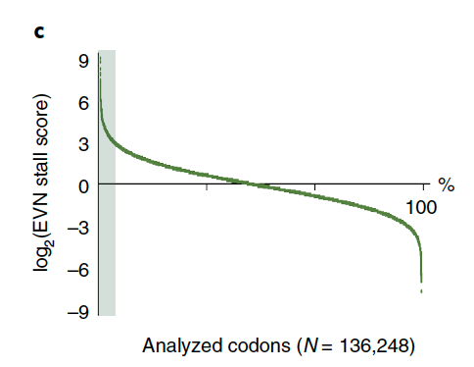
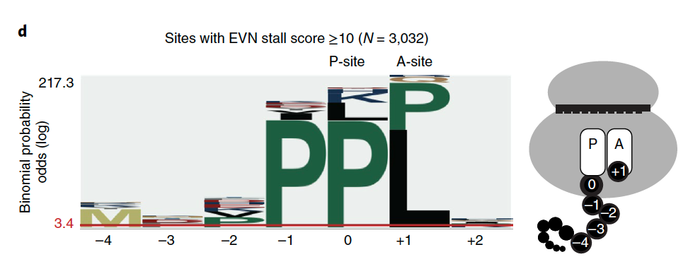
Specific features of site of EVN-induced arrest
Notes:
genome-wide stall scores of EVN for each codon in A site. Codon occupancy change relative to control. Asterisks indicate decoding by tRNAs who’s G37 is methylated to TrmD.
C. Stall scores genome wide
Proline tends to be decoded the most at these stall sites
Take-home:

Slide 5
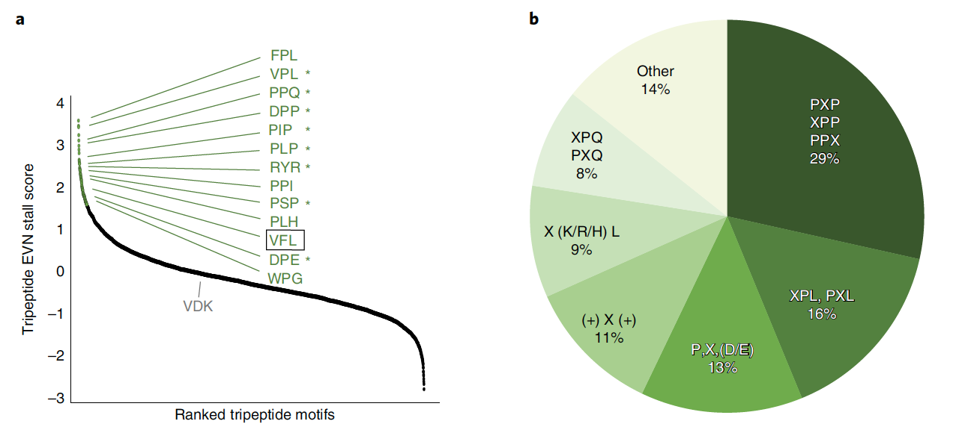
EVN arrests ribosomes at sites encoding specific tripeptide motifs
Notes:
Stall scores for tripeptides, asterisks are those that were toe-printed. VDK doesn’t stall.
Relative occurrence of tripeptides that stall, lots of prolines

Slide 6
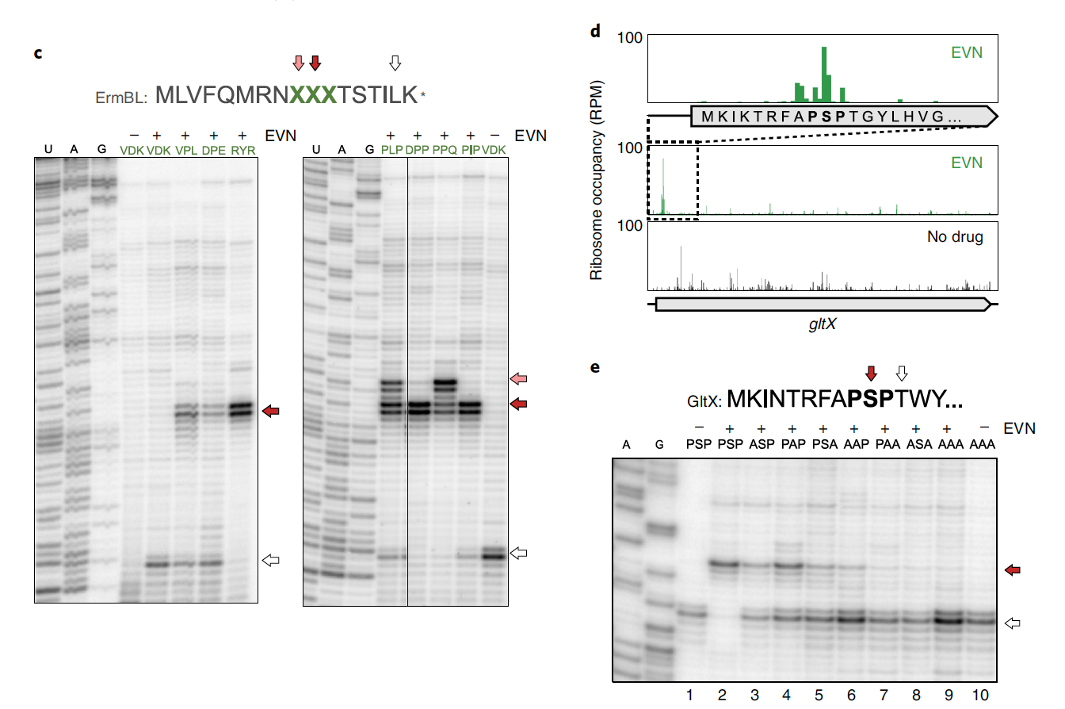
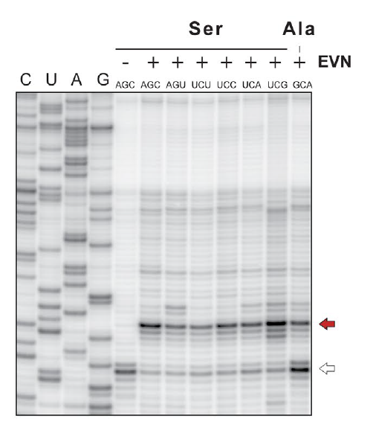
Nature of C-terminus of nascent polypeptide drives specificity of EVN action
Notes:
C. In vitro toe-printing on ermBL template (gene impervious to EVN arrest) with original VDK being subsistuted with various tripeps. Translation arrests indicated by arrows (pink indicates preceding codons)
D. Ribo density profile at PSP on another gene
E. PXP motifs toe-prints on gltX, red arrow= stalled, white arrow = escaped arrest but stalls at subsequent Thr codon because reactions are depleted by addition of inhibitor. Stalls at serine in the P site.
Replacing Ser with other aas had various effects, maybe C terminus of NPP modulates EVN. Changing things to alanine inhibited arrest
Take-home: nature of C-term aa of NPP rather than P-site tRNA drive context specificity of EVN.

Slide 7
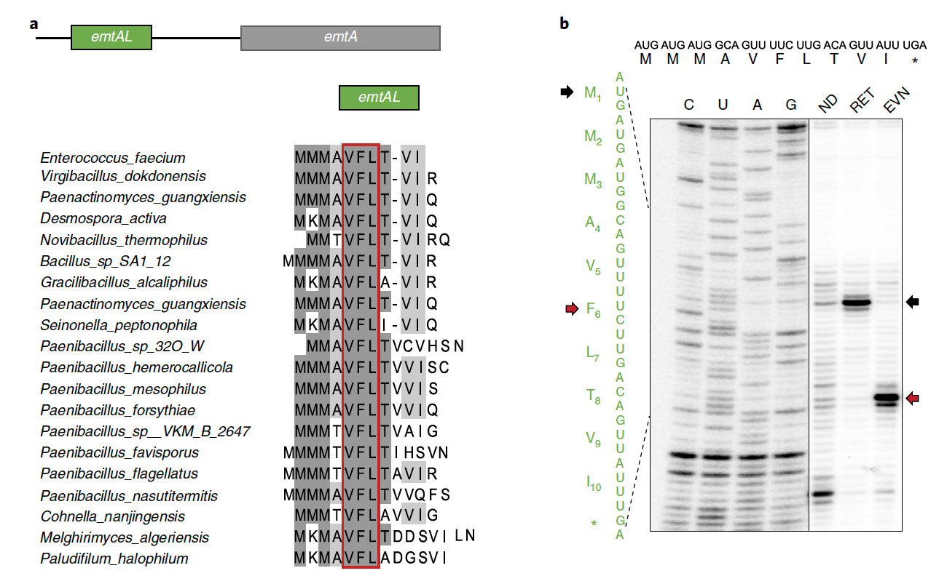
Programmed EVN-mediated arrest may control expression of OSM-resistance genes
Notes:
Small conserved leader ORF (emtAL) at 5’UTR precedes orthosomycin resistance gene emtA. Encodes a rRNA methyltrans that introduces mod of 23SRNA nucleotide in the drug-binding site
EVN stalling during emtAL ORF translation. Retapamulin helped ID first 3 Mets (black arrow). Red arrow are EVN-induced stalled ribos at Phe codon of VFL. VFL is EVN sensitive
Take-home: VFL sequence has key role in EVN ribo arrest (alanines)

Slide 8
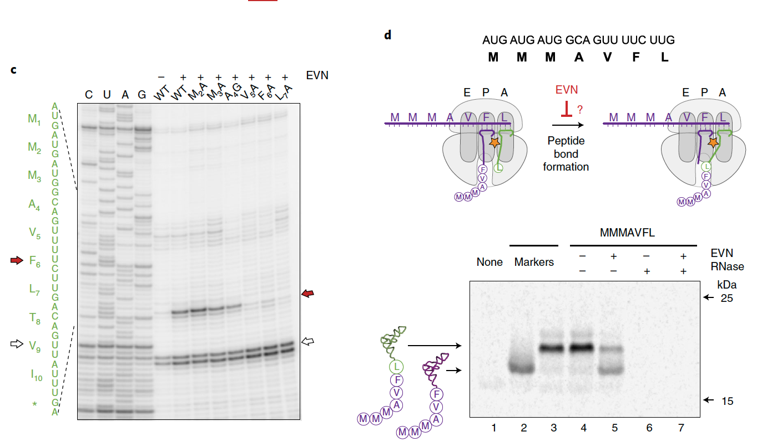
EVN interferes with transfer of nascent polypeptide to incoming aa-tRNA
Notes:
Mutant emtAL with codons 2-7 subbed with A or G, red arrows EVN stalled at Phe, white arrow is ribos trapped at Val
D. Testing whether EVN inhibits peptide bond formation, inhibition of bond formation would lead to appearance of truncated gene tRNA. In absence of drug, ribosomes stalled at truncated tRNA , but in presence of drug, accumulation of truncated tRNA was observed, therefore EVN interferes with transfer of NPP to incoming aa-tRNA
Bottom: gel of reactions of with C-term of Phe (?) with or without EVN. In agreement with toe-print that induces ribo pausing rather than complete translation arrest at VFL motif
Take-home:

Slide 9
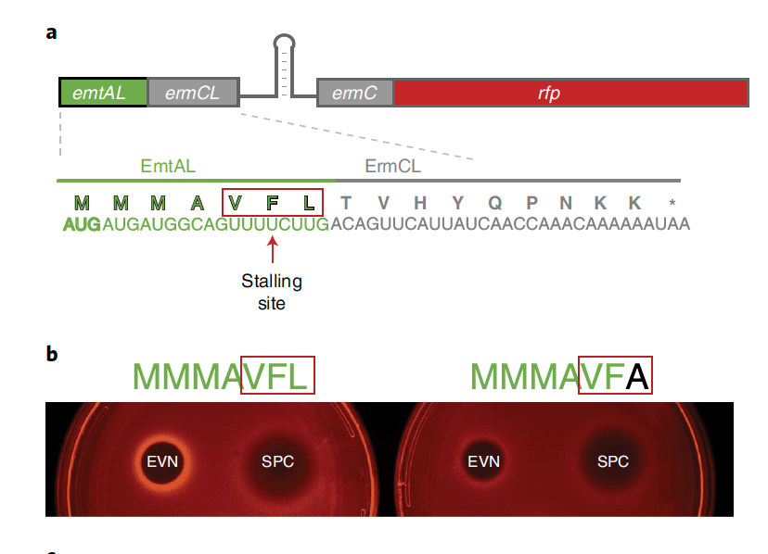
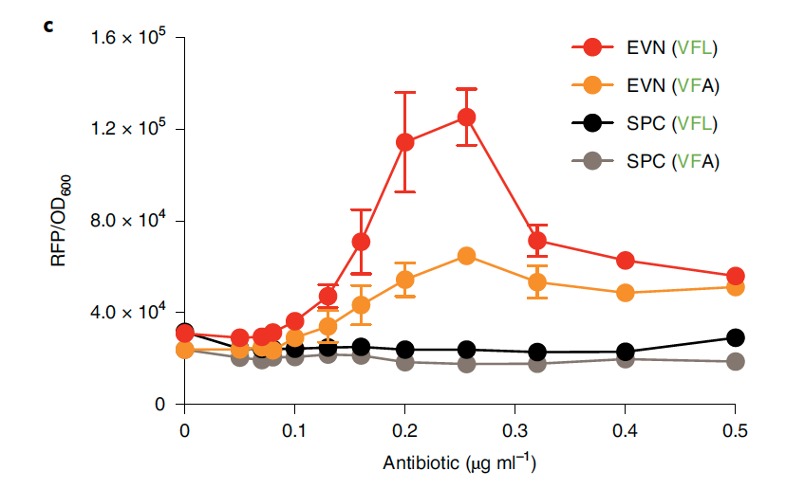
EVN arrests ribosomes translating EmtAL peptide in vivo
Conclusion: programmed translation arrest at the VFL-tripeptide is likely used for regulation of emtA resistance gene.
This sequence has likely been evolutionarily selected to facilitate sensing the abx by utilizing nascent protein and
acceptor amino acid requirements for context-specific action of OSM antibiotics
Notes:
Schematic of reporter construct. First 10 codons of ermCL were repkaced with 7 codons of emtAL leads to stalling at Phe codon
Activation of reporter expression due to FVN-dependent stalling. Subinhibitory concs of EVN express RFP. Decreased expression in VFA, spectinomycin is control
Induction of reporter in liquid culture at various concentrations
Take-home: VFL is required for translation arrest in vivo

Slide 10
