Slide 1
Investigating translation specificity of bS21 homologs in F. tularensis
Kira Bernabe
Joint Lab Meeting
5/5/23

Slide 2
Ribosome Profiling
Monitor gene expression at the level of protein synthesis
  Which regions of the genome are translated?
  When are they translated?
  How is translation regulated?
Isolate and sequence ribosome-protected mRNAs
  Capture actively translated mRNAs
  Density of ribosome over a gene (footprint) is indicative of rate of protein synthesis

Slide 3
Ribosome Profiling: Applications
Applications
  Identify regions of bacterial genome that is being translated
  Monitor changes in gene expression due to environment, stress, or loss of regulatory factor
  Estimate translational efficiency in conjunction with RNA-seq
  Probe features of translation machinery and distinct phases of translation
  Immunoprecipitate factors of interest associated with ribosomes before ribosome profiling to determine where on mRNAs the factors are engaged
Mohammad and Buskirk, 2019

Slide 4
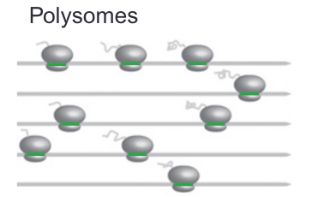
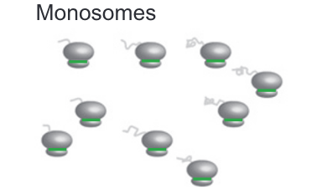
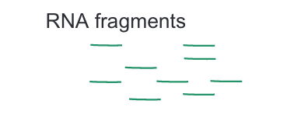



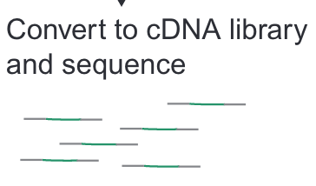
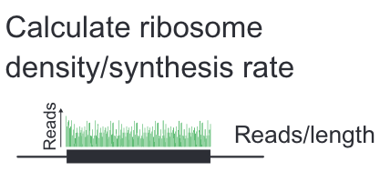

Ribosome Profiling: General Method
Johnson and Li, 2018

Slide 5
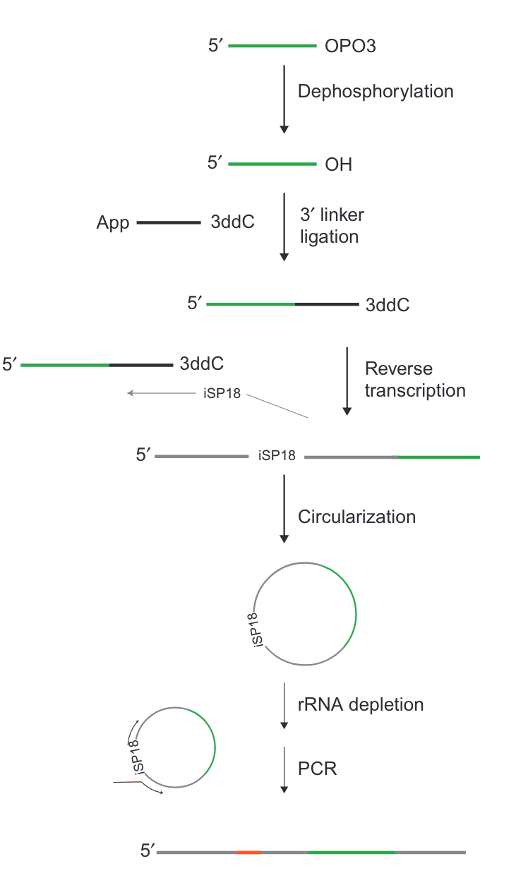
Ribosome Profiling:
Library Prep
Illumina Sequencing
Johnson and Li, 2018

Slide 6
Ribosome Profiling with bS21 in LVS
Francisella tularensis has heterogenous ribosomes
The ribosomal protein bS21 has 3 homologs
What transcripts are being translated by these different bS21 homologs?
  How do we specifically identify translation by ribosomes with these homologs?
    Immunoprecipitation of each homolog with a different epitope tag

Slide 7
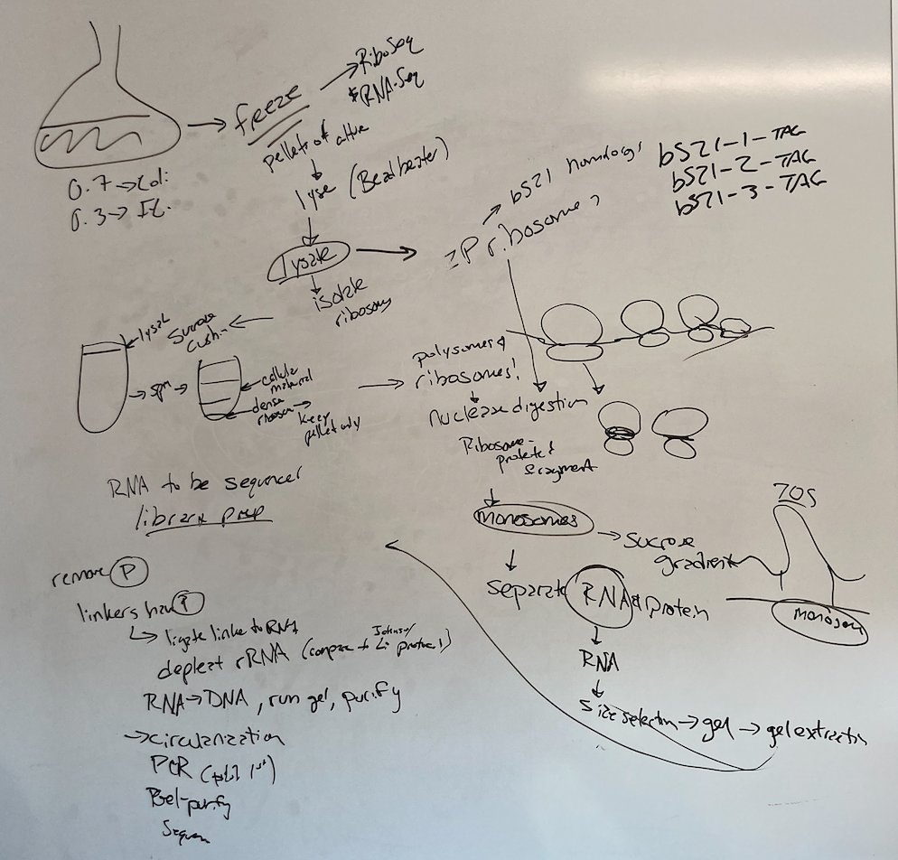
Ribosome
Profiling: Workflow

Slide 8
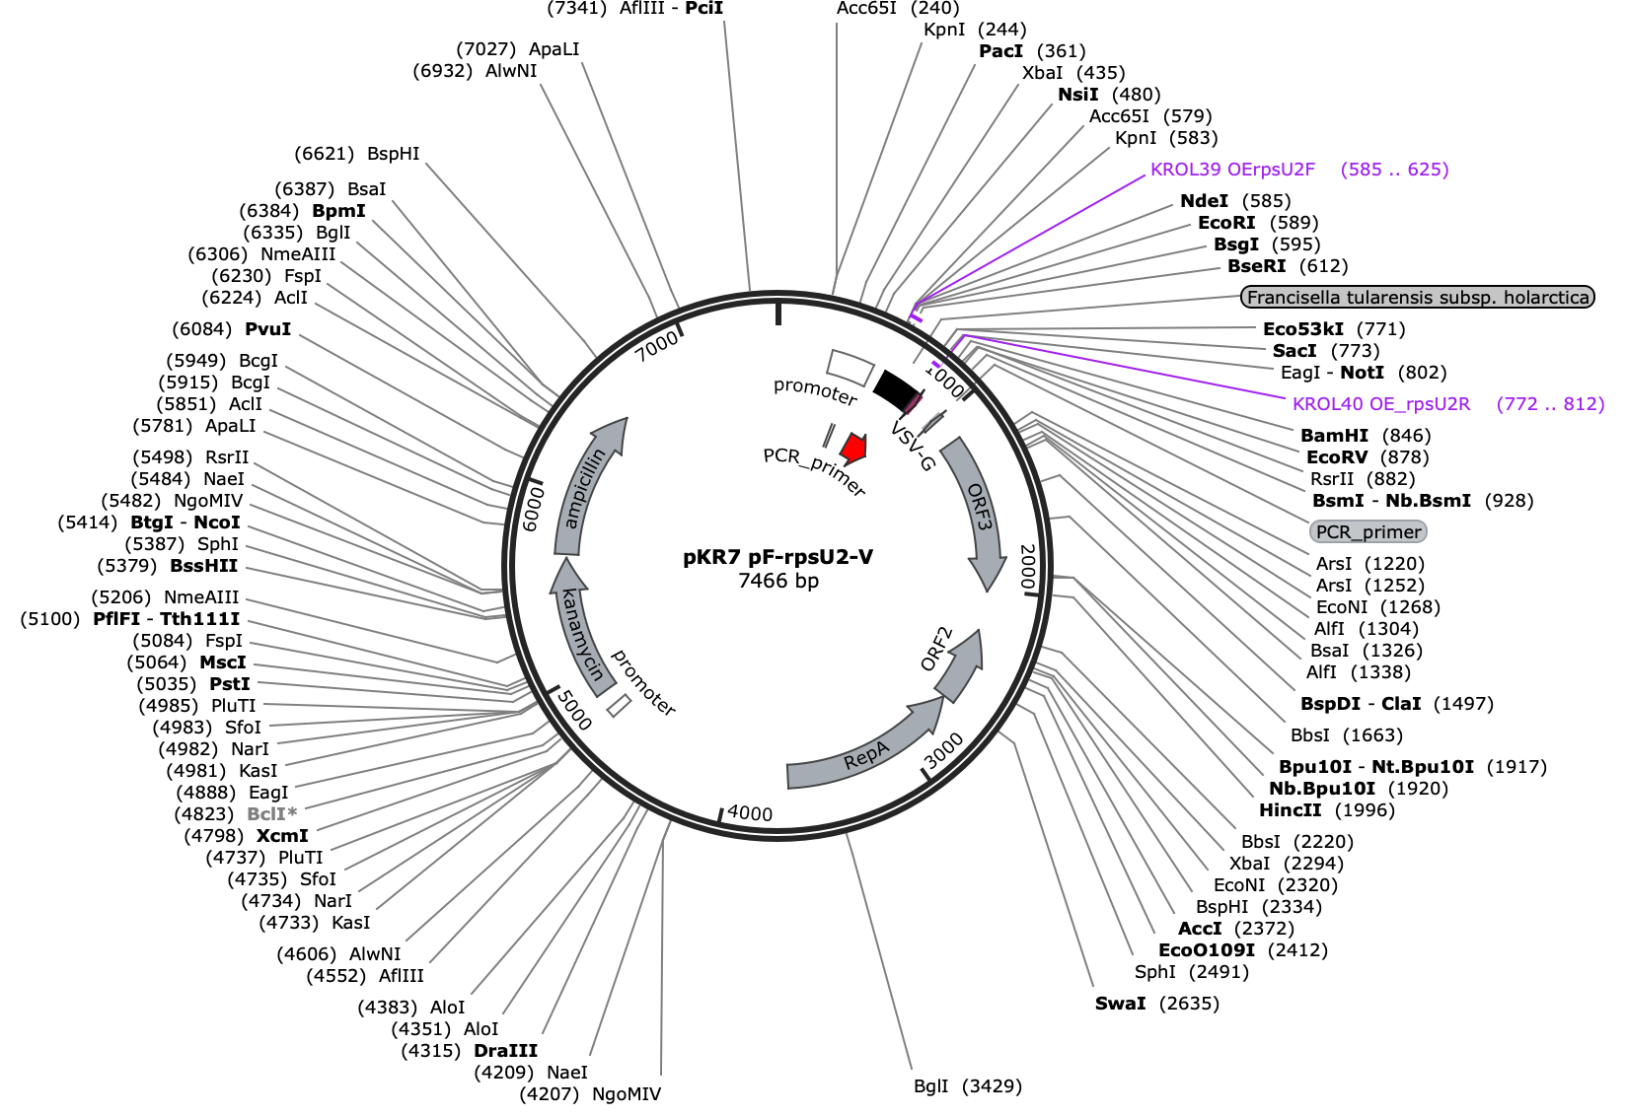
Ribosome Profiling:
Plasmid Design
Chosen epitopes:
  FLAG
  His-6
  HA
  V5
Add chosen epitope tags to chromosomal
rpsU at native loci

Slide 9
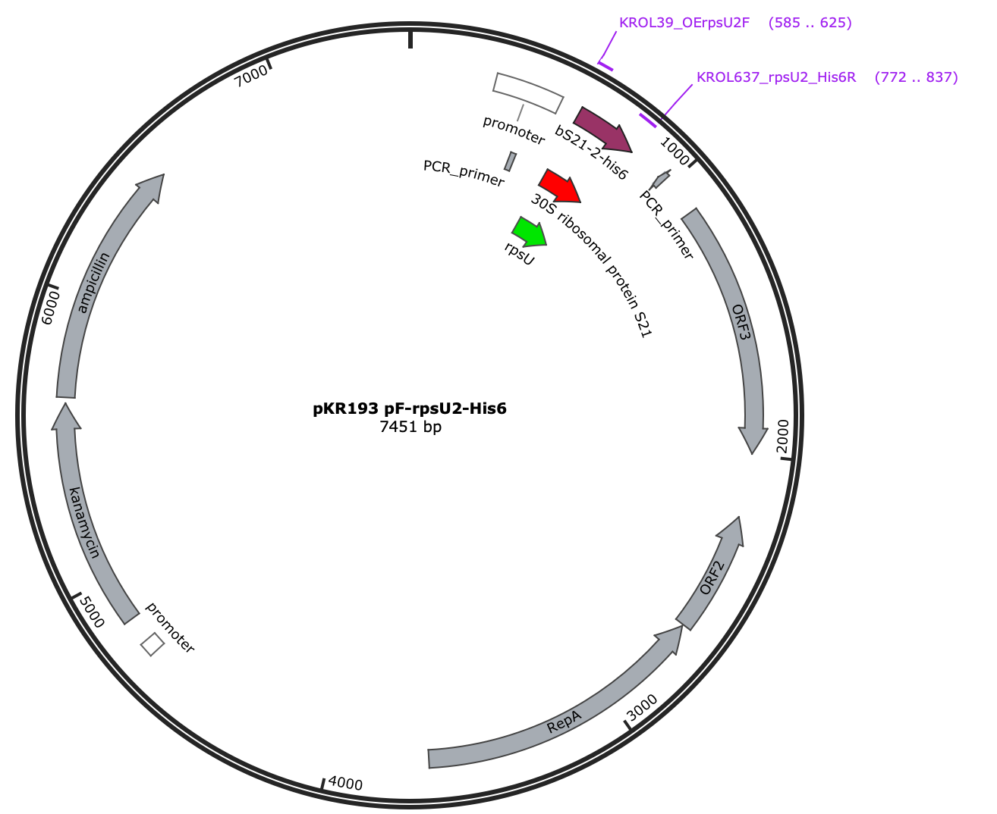
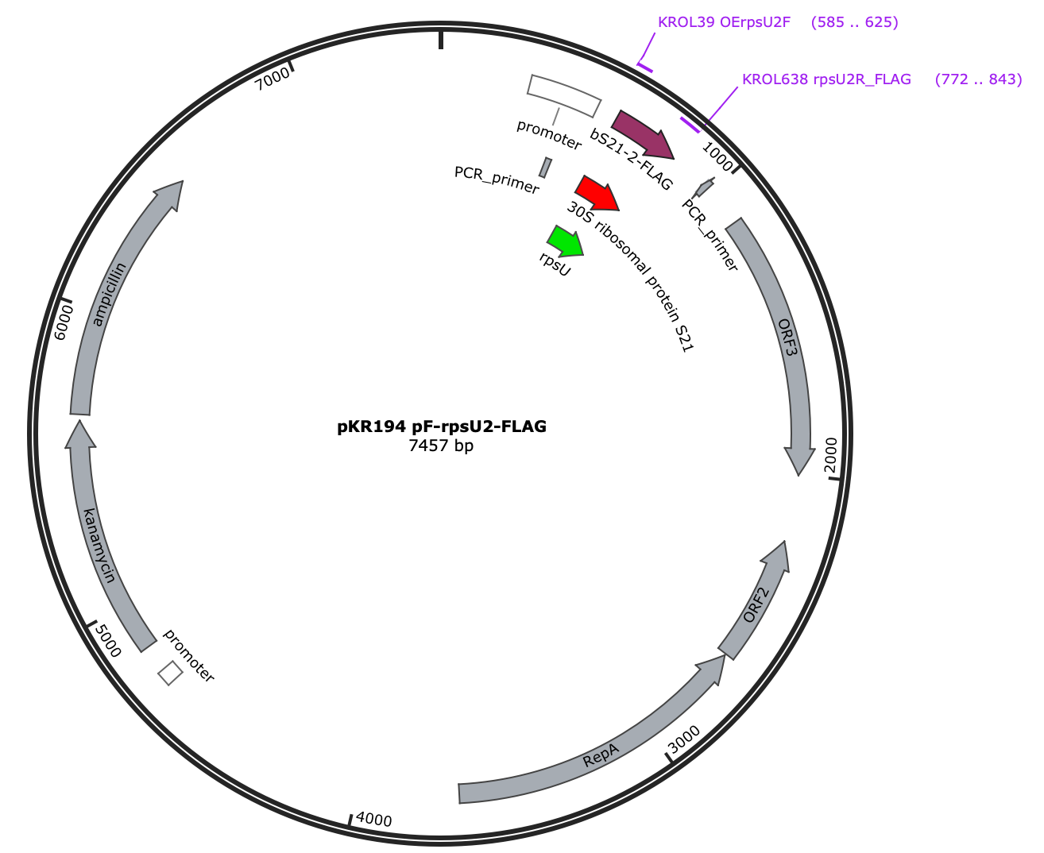
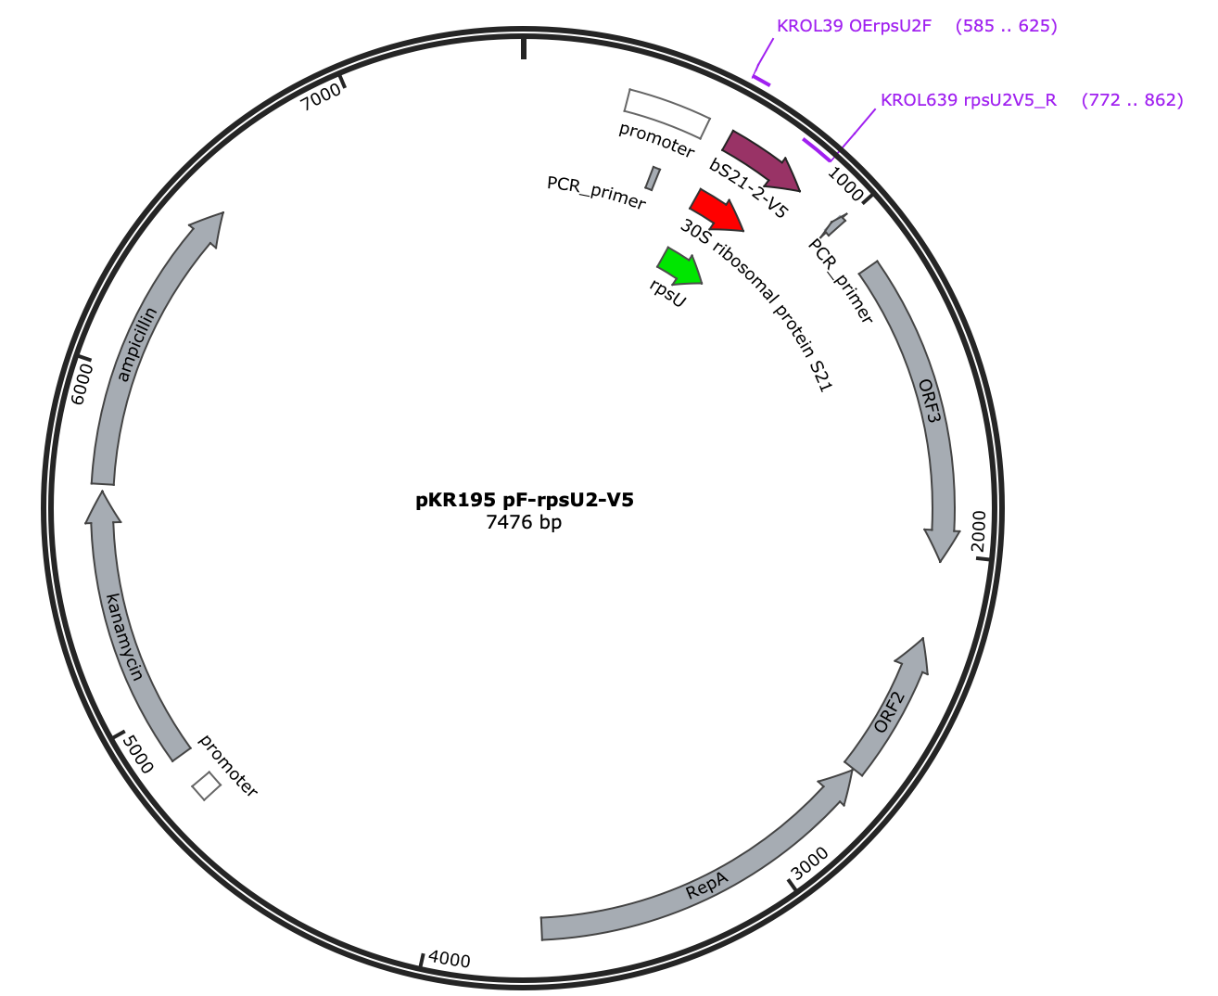
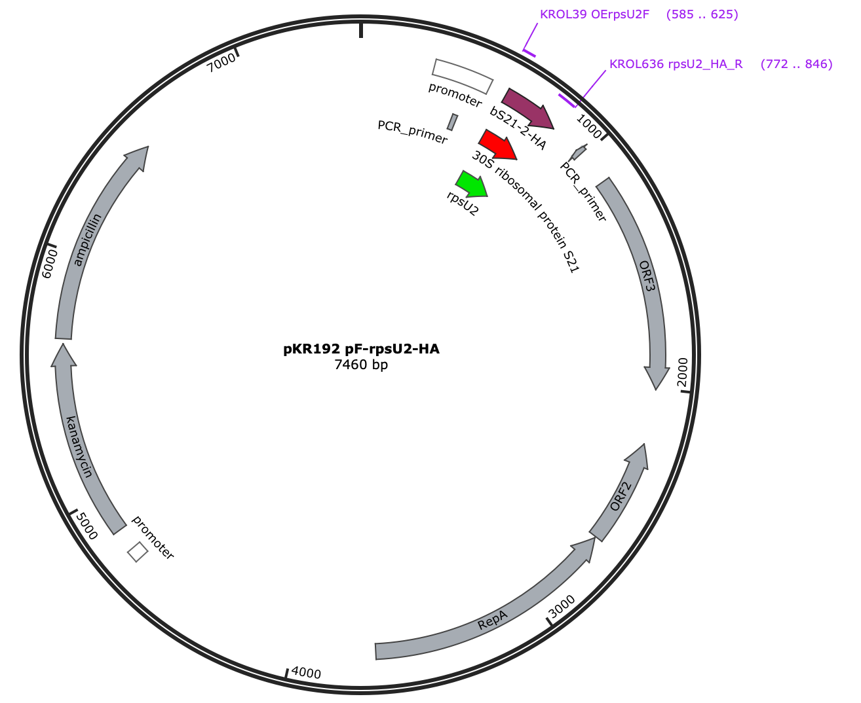
Ribosome Profiling:
Plasmid
Design
Success!

Slide 10
Ribosome Profiling: Next Steps
Immunoprecipitation and Western blots for epitope tags
Library Prep
Sequencing

Slide 11
Questions?

