Slide 1
Investigating the role of bS21 in cell wall synthesis in Staphylococcus aureus
Kira Bernabe
Joint Lab Meeting
8/8/24

Slide 2
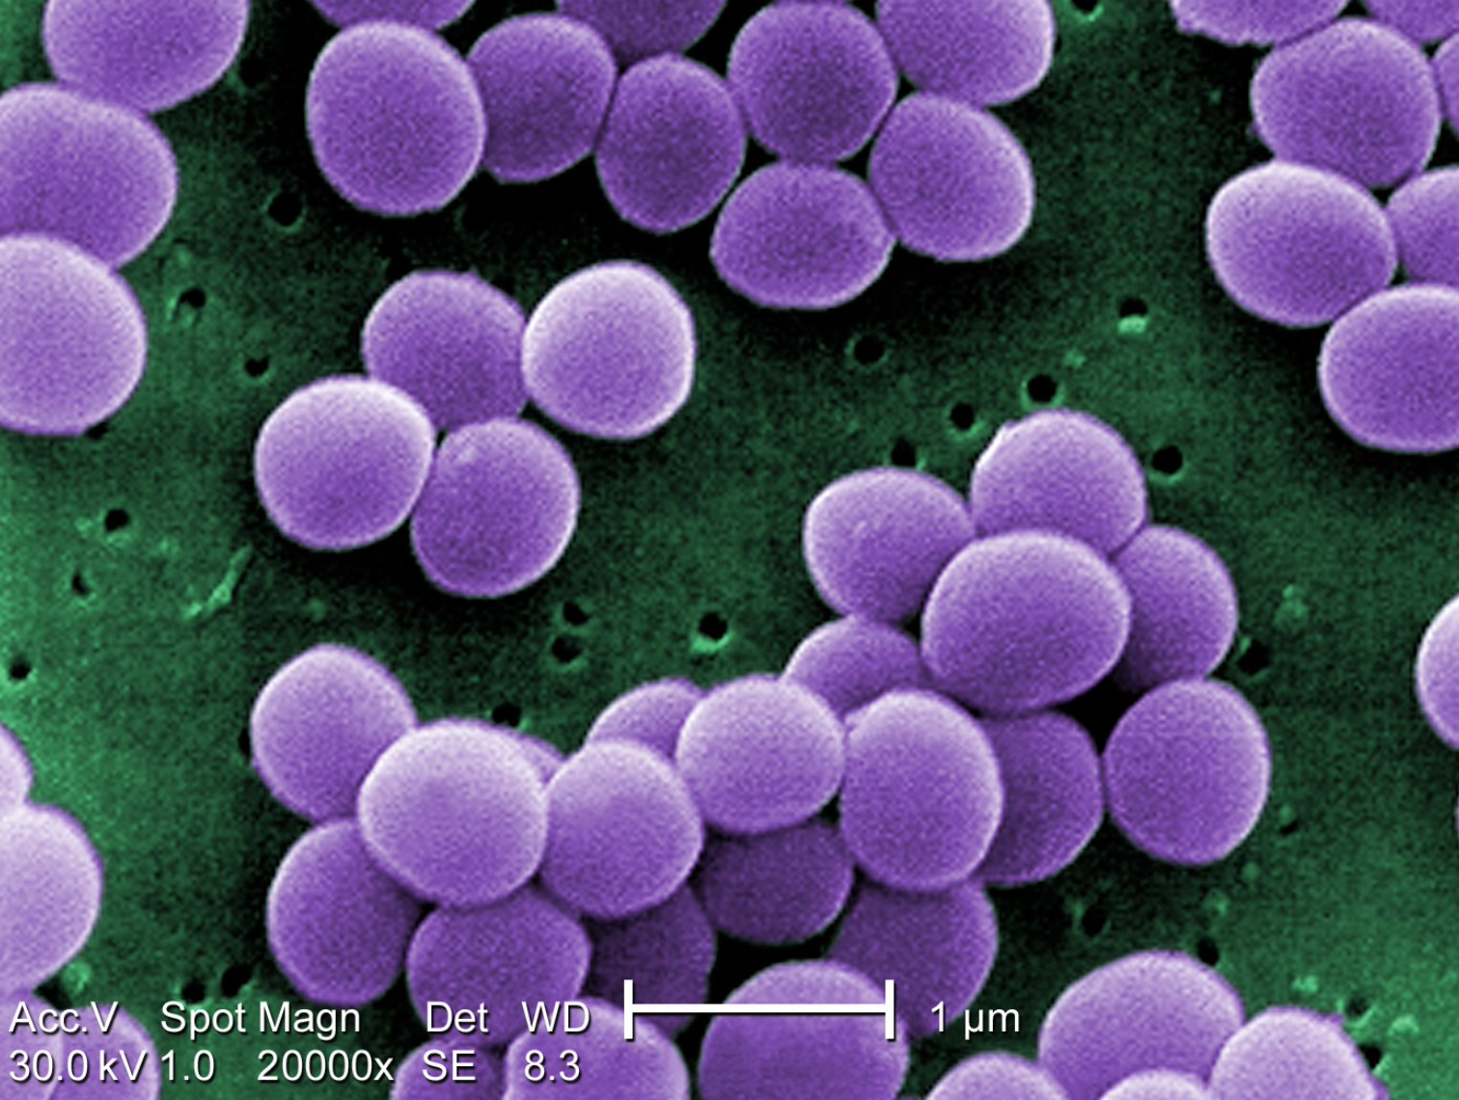
Staphylococcus aureus
Gram positive cocci found on skin
and mucus membranes
Rapid increase in antibiotic
resistance (MRSA/VRSA)
Matthew J. Arduino, CDC PHIL #11157, 2001

Slide 3
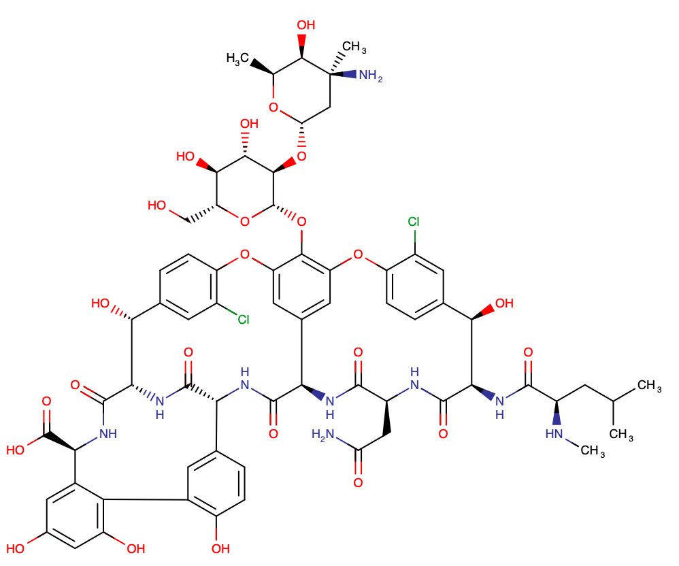
Vancomycin
Glycopeptide
Targets cell wall
“Drug of last resort”

Slide 4
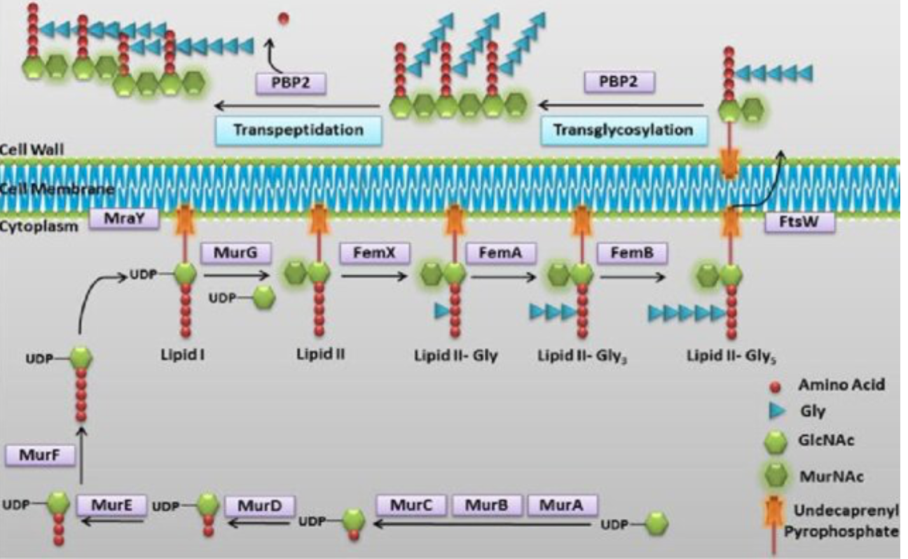
Peptidoglycan synthesis
Rani et al, 2018

Slide 5
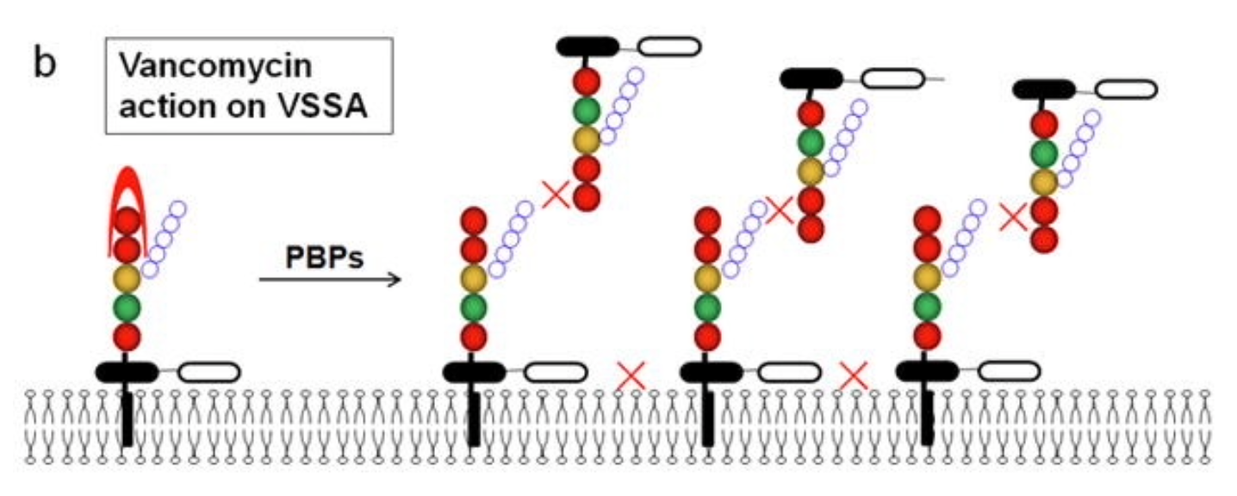
Vancomycin mechanism of action
Cong et al, 2020

Slide 6
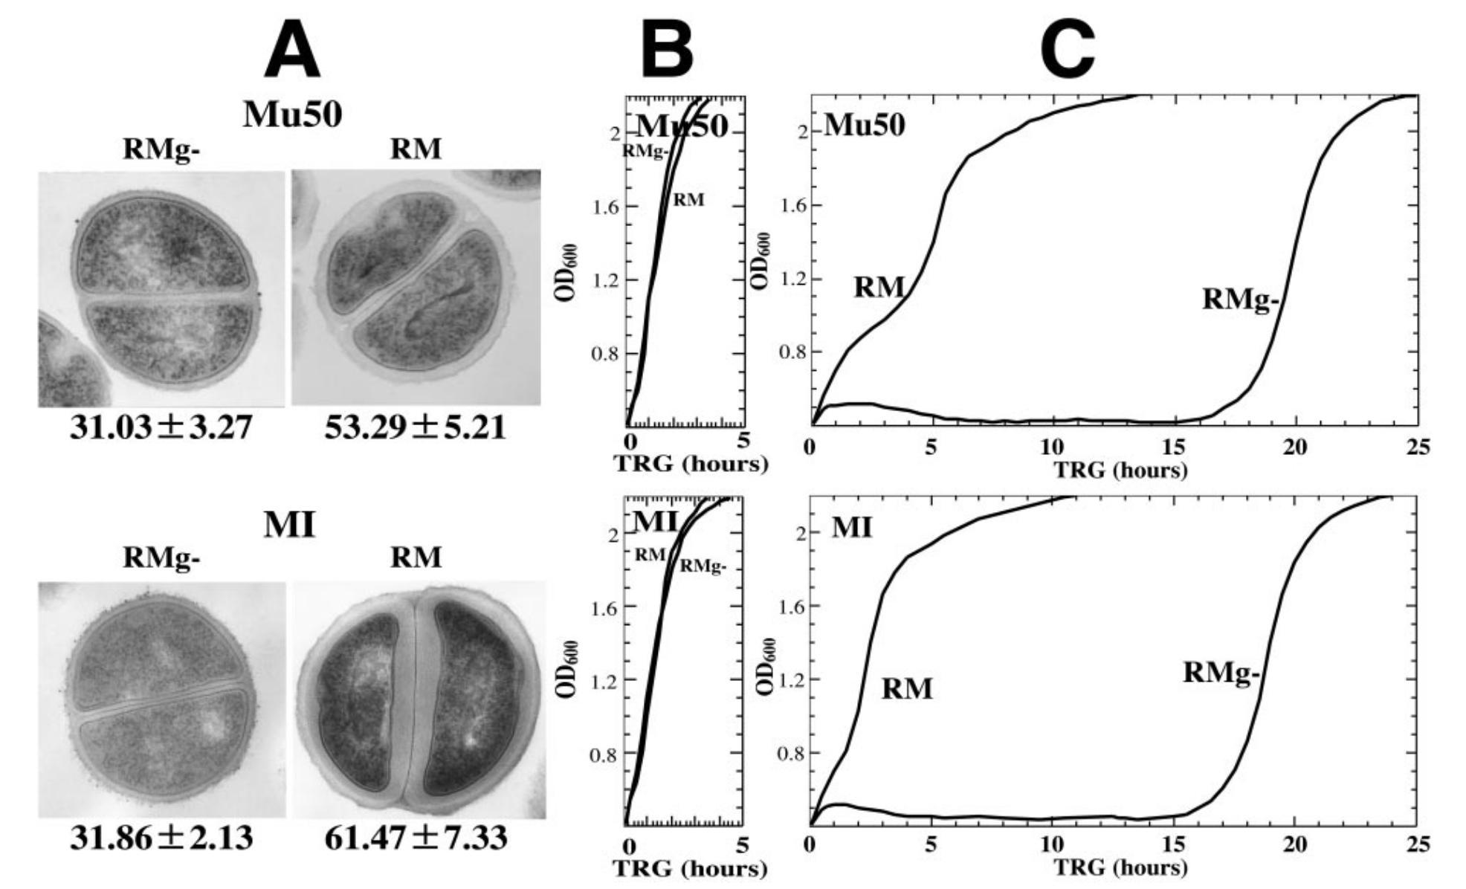
Reduced susceptibility to vancomycin could be due to increased cell wall thickness
Cui et al, 2006

Slide 7
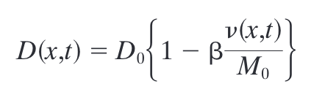
Clogging Effect Model
Cui et al, 2006

Slide 8
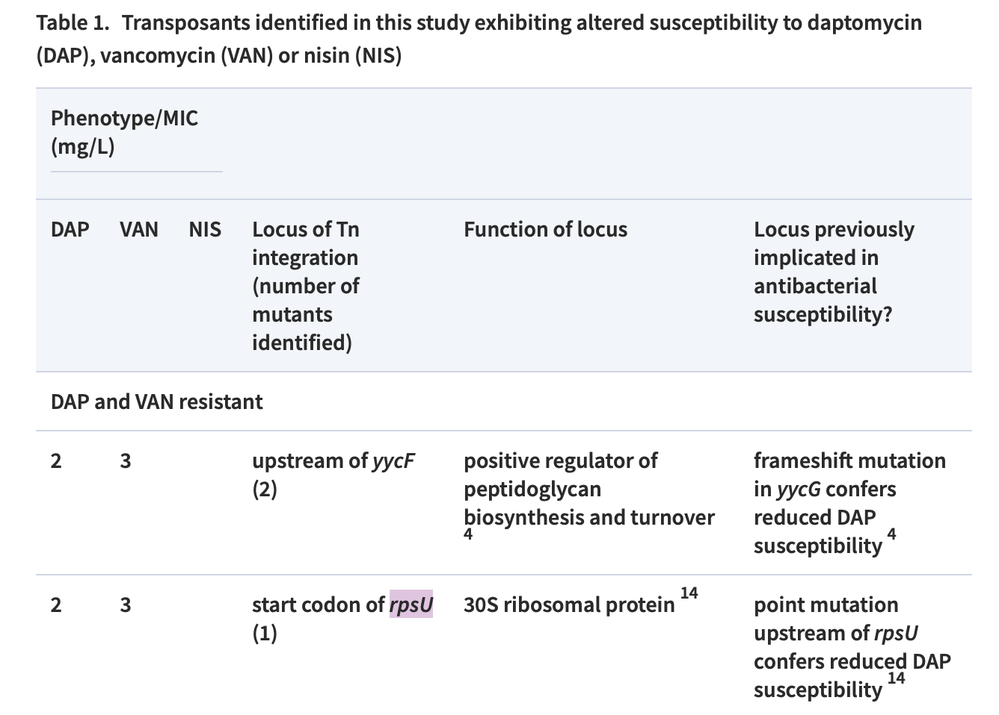
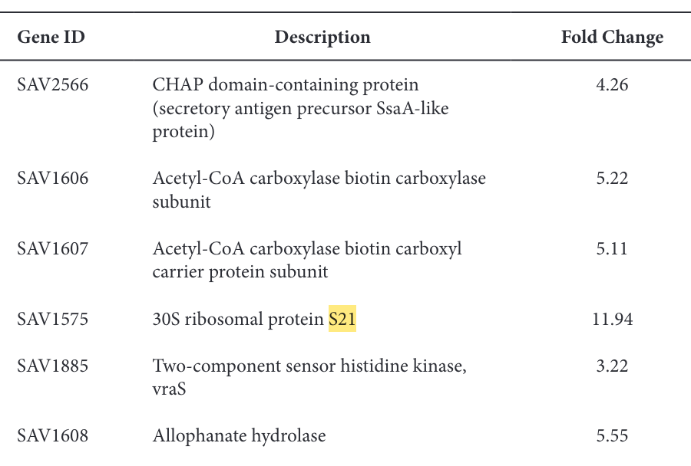
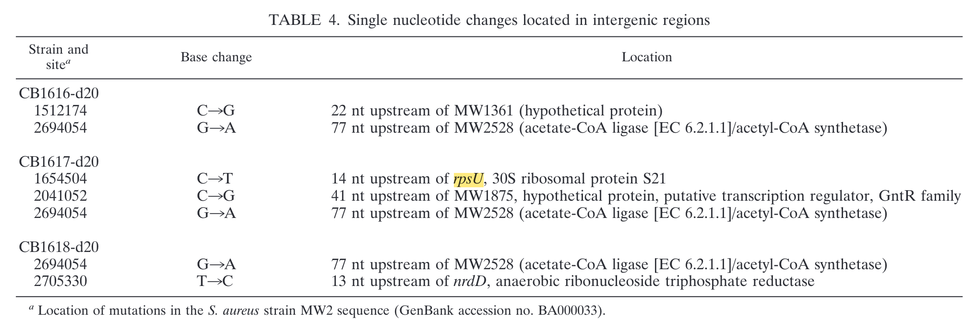
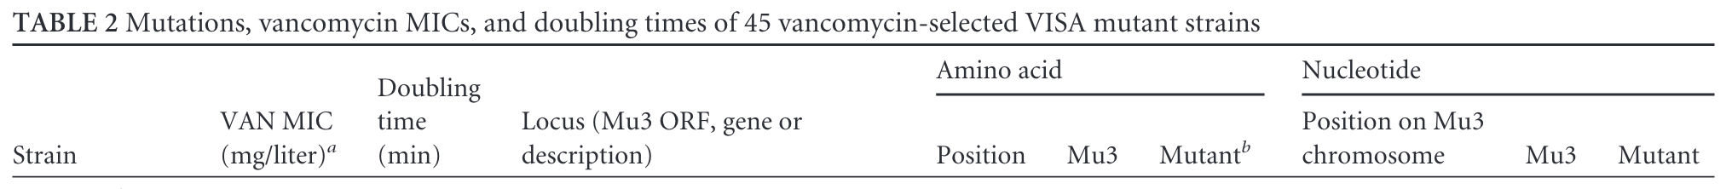
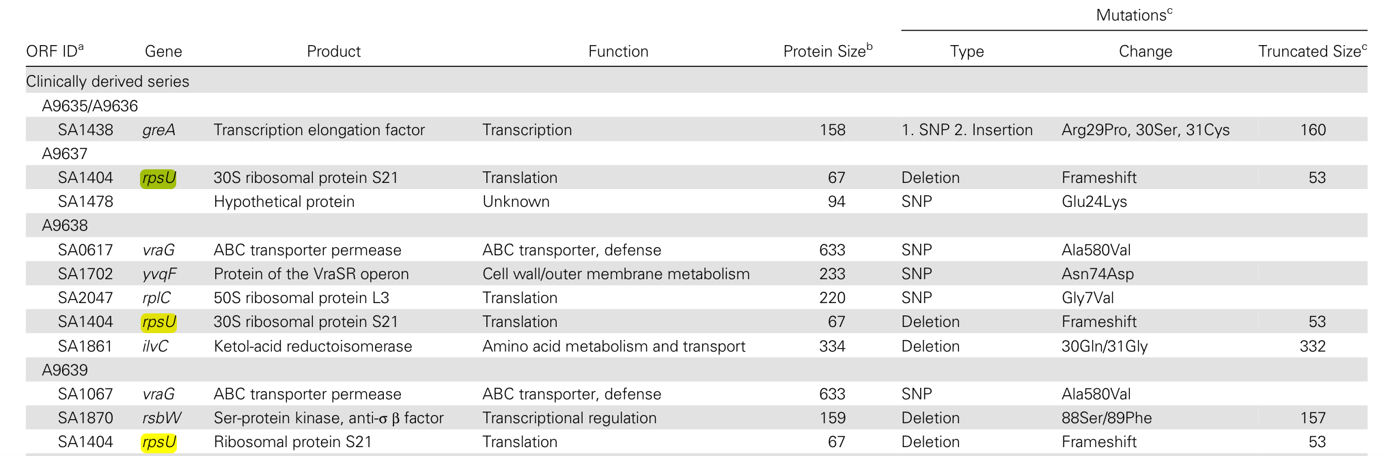

Slide 9
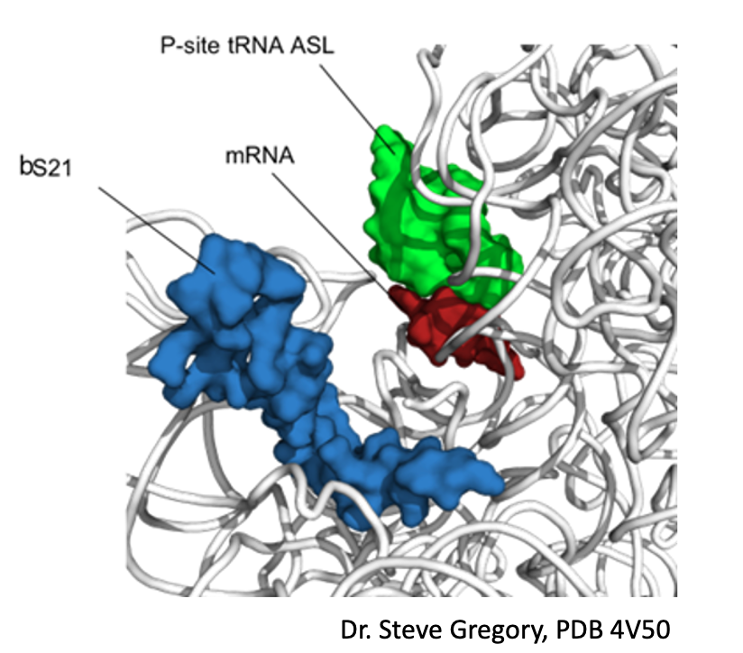
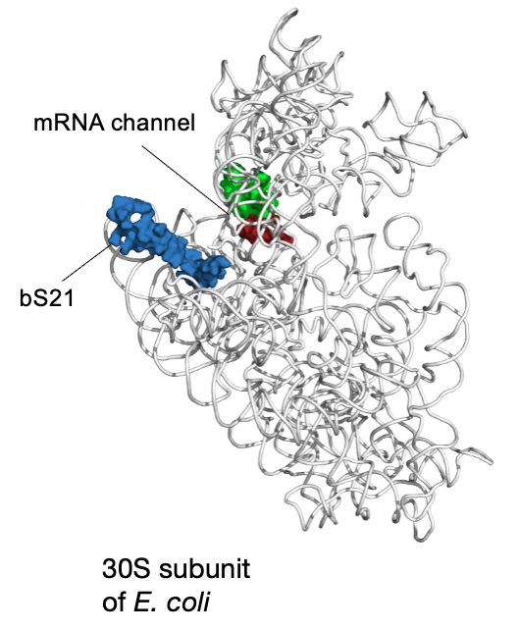
bS21: a small subunit ribosomal protein
Notes:
Can interact with 5’ UTR during translation initiation
Makes sense that has been implicated in initiation
Maybe get rid of translation initiation

Slide 10
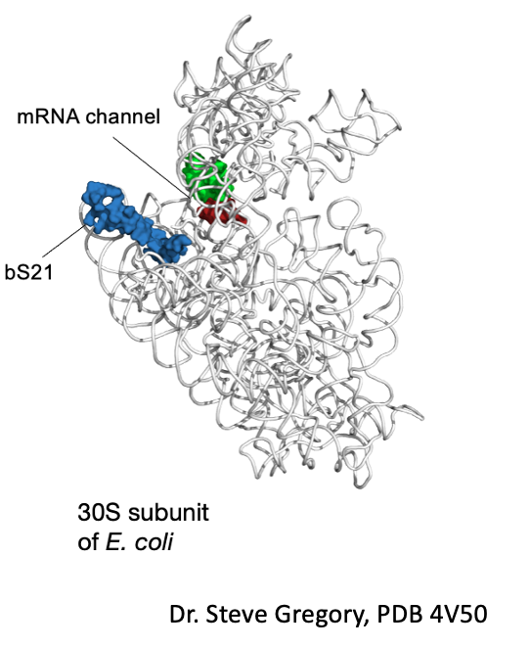
bS21 may be important for regulation of translation
  Involved in translation initiation
  Non-essential
  Can be easily exchanged
  Implicated in control of specific processes
    biofilm
    motility
    acid stress resistance
    virulence
    antibiotic resistance
Notes:
Move up translation initation
What makes ut a regulator
Encoded by phage
Transition: only one organism in which function id bS21 has been well characteirsed, a bacteria that’s’ very different from Ft, so I will tell you about it,
To explain story, I’ll remind you of salient aspects of trnalstion intation

Slide 11
Specific Aim: Investigate why the loss of bS21 in S. aureus leads to resistance to cell wall-targeting antibiotics
Hypothesis: bS21 regulates proteins involved in cell wall synthesis in S. aureus, as suggested by observed mutations of rpsU in strains that are resistant to the cell wall-targeting antibiotics vancomycin and daptomycin
Approach: Population analysis protocol to assess a change in
antibiotic susceptibility of the ∆rpsU strain compared to wild-type coupled
with transmission electron microscopy (TEM) to detect an increase in cell
wall thickness in the ∆rpsU strain

Slide 12
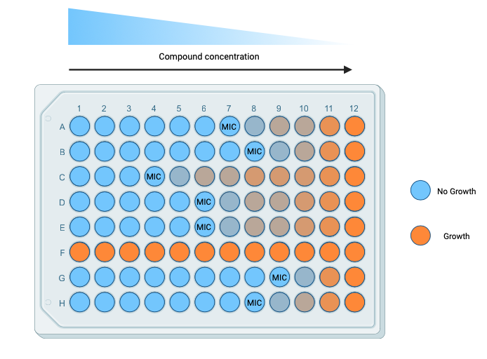
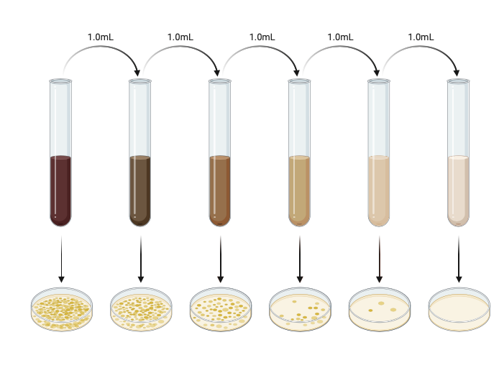
Population analysis protocol
10⁷
10⁶
10⁵
10⁴
10³
10²
Notes:
10-fold serial dilution 6X (10to8-10to2)
BHI plates with 8 2-fold dilutions of antibiotic in triplicate
Incubate for 48 hours

Slide 13
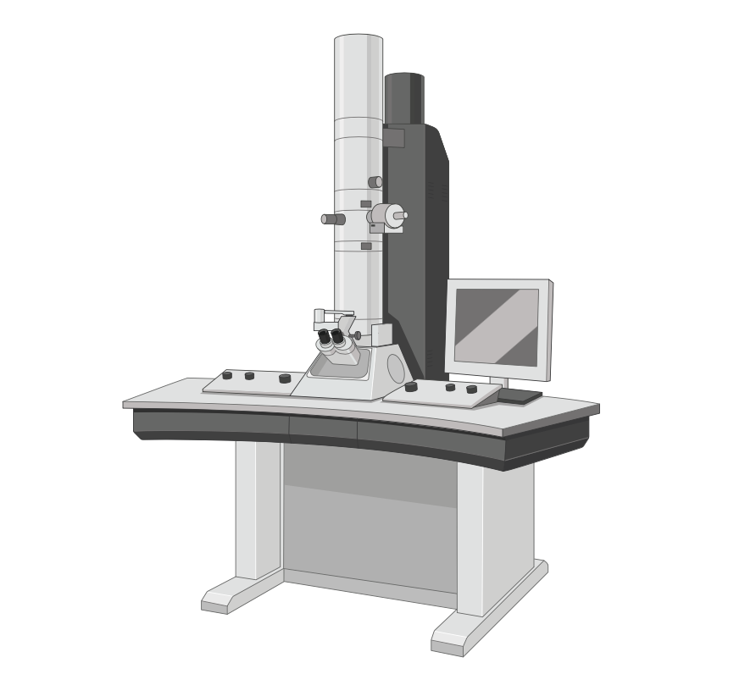


Transmission electron microscopy
Wild-type
∆rpsU
Notes:
Fix cells in 2% glutaraldehyde for 2 hours
Stain with osmium tetroxide for 2 hours (cold)
Dehydrate with ethanol and embed in resin, prepare thin sections
Stain with uranyl acetate and lead citrate
30000X

Slide 14
Data and Results

Slide 15
MICs

Slide 17
What is the effect of other antibiotics?
Antibiotic | Stock conc mg/mL | Range of concs (mg/mL) | Antibiotic Class | Target
Carbenicllin | 100 | 0.25-128 | penicillin | Cell wall
Chloramphenicol | 50 | 1-512 | chloramphenicol | 50S subunit
Kanamycin | 50 | 0.5-256 | aminoglycoside | 30S subunit
Vancomycin | 100 | 0.5-256 | glycopeptide | Cell wall

Slide 19
∆rpsU has a growth defect

Slide 20
Conclusions
S. aureus ∆rpsU shows a reduction in antibiotic susceptibility compared wild-type
After one assay, ∆rpsU shows a change in phenotype in nearly all other antibiotics tested
∆rpsU has a growth defect

Slide 21
Future Directions
Repeat MIC assay against other antibiotics
Start TEM protocol

Slide 22

Acknowledgments
Ramsey Lab
Dr Kathryn Ramsey
Alex Farah
Ben Moore
Committee Members
Dr Marta Gomez-Chiarri
Dr Steve Gregory
Janet Atoyan

