Slide 1
Exploring Preferential Translation of bS21 Homologs in F. tularensis
Joint Lab Meeting
11/10/23

Slide 2
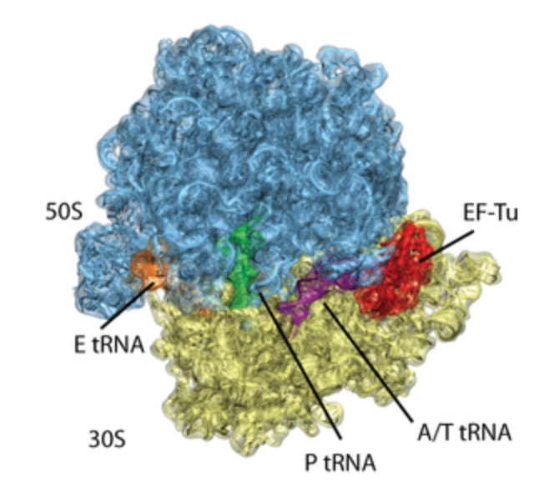
The Ribosome

Slide 3
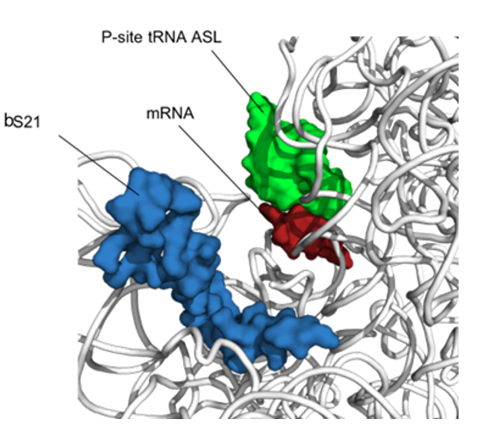
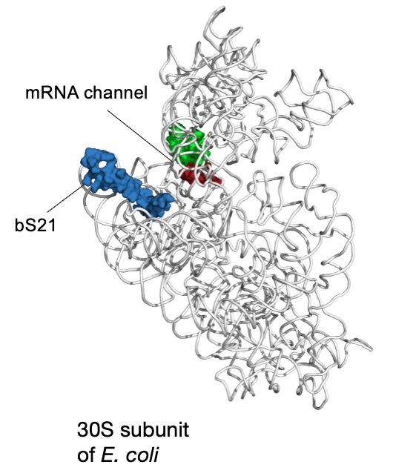
bS21: a small subunit ribosomal protein
bS21 is involved in translation initiation

Slide 4
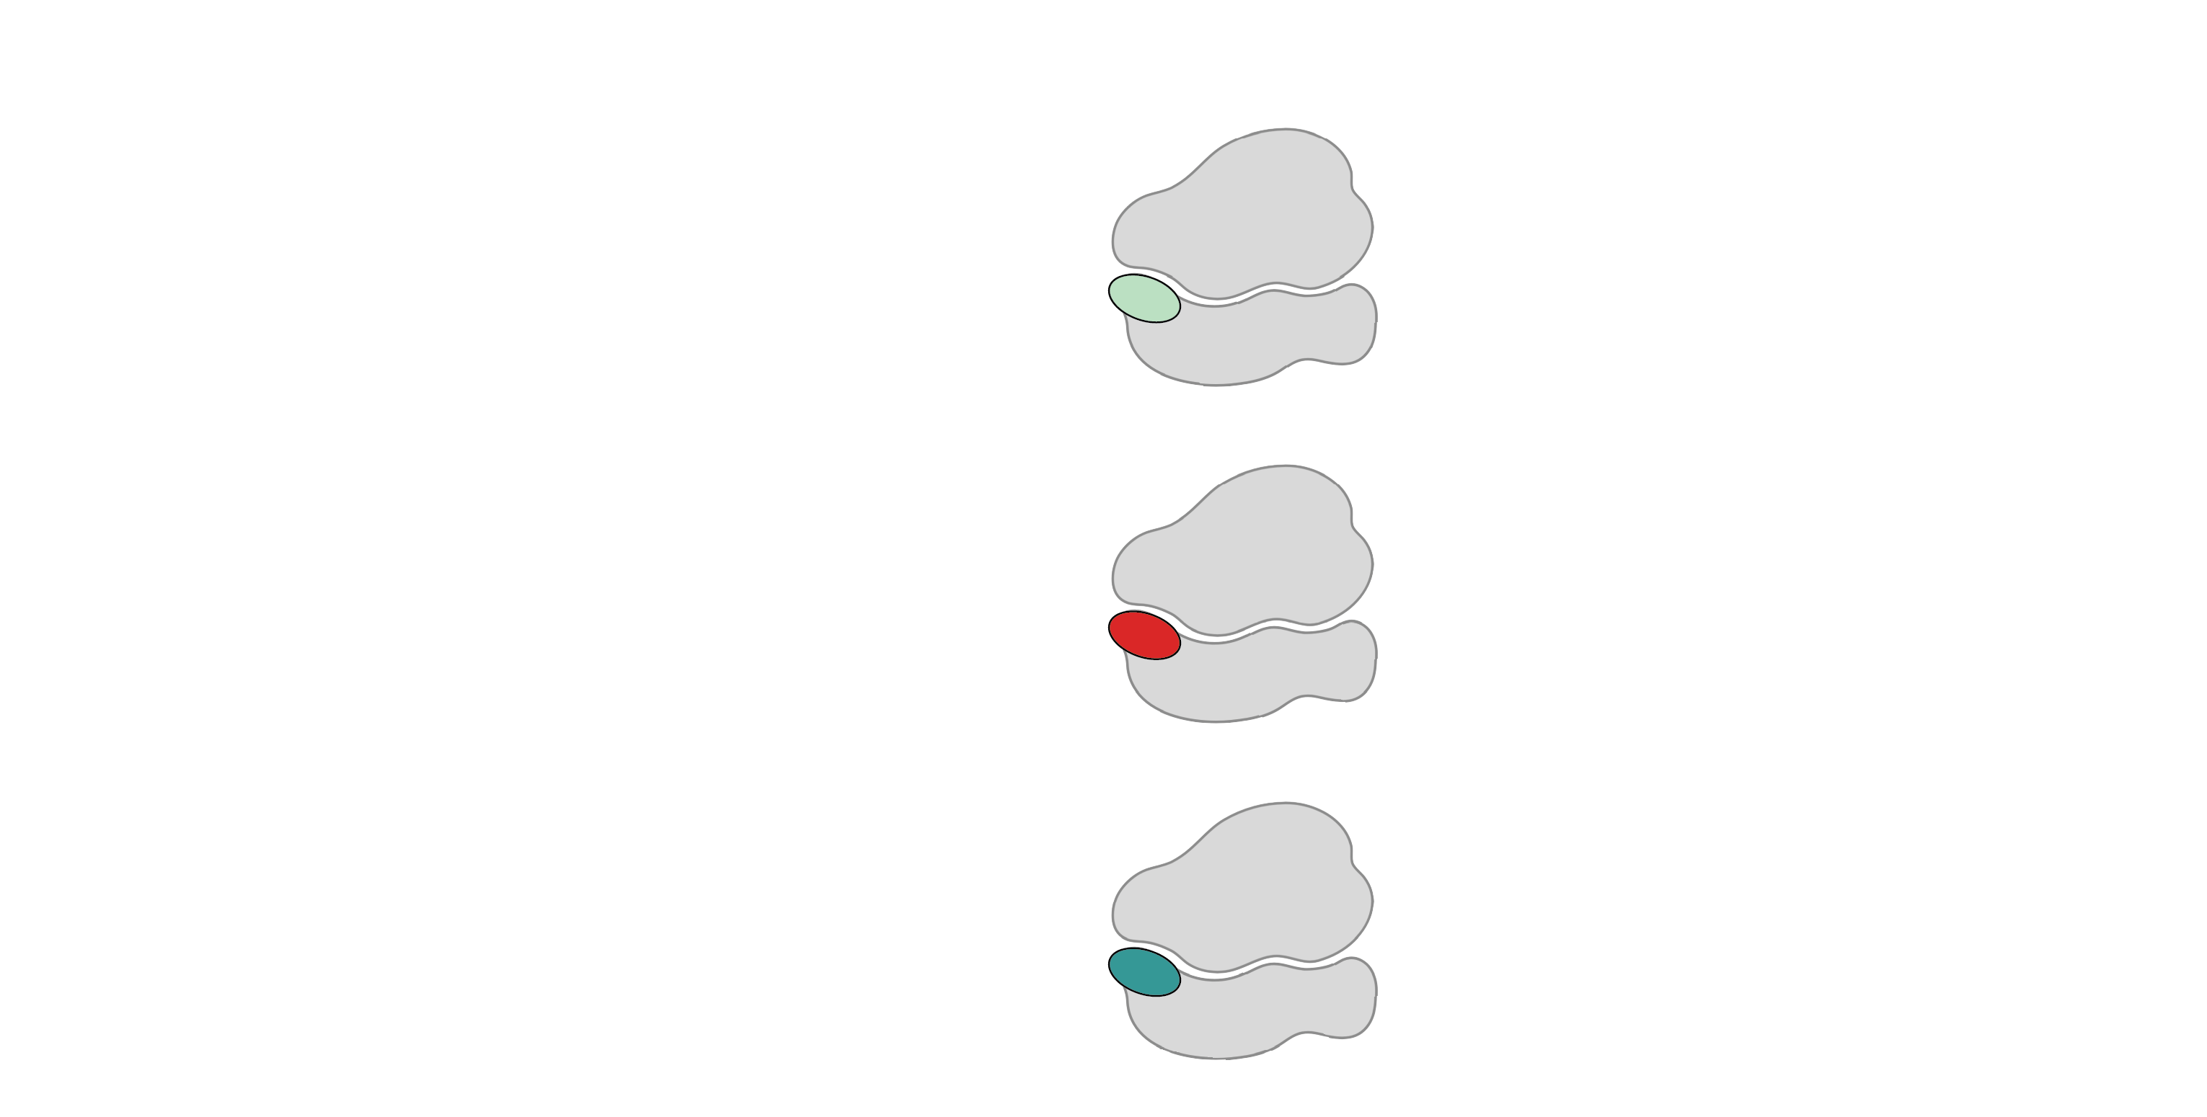
Multiple bS21 homologs lead to heterogenous ribosomes in Francisella tularensis
70S containing:
cspC
rpsU1
bS21-1
dnaG
bS21-2
rpsU2
yqeY
rpoD
rpsU3
bS21-3
Trautmann and Ramsey, 2022
How do changes in ribosome composition influence protein synthesis?
Notes:
Even though francisella has a reduced genome, it encodes three copies of the rpsU genes, which encode bS21, a protein in the small ribosomal subunit. Most bacteria have 0 or 1 of this gene. We originally, hypothesized, and have since shown, that these three proteins are produced and incorporated into ribosomes. This is a western blot of purified ribosomes from our wild-type strain as well as strains ectopically expressing each of the bS21 proteins, with a VSVG tag. This, along with some mass spec data we have of purified ribosomes, indicates that multiple classes of ribosomes are possible and occurring
This protein is also interesting to us because it is located close to the mRNA exit channel in the ribosome, and early research has identified that it is involved in translation initiation, so it is in an ideal location to be regulating gene expression at the level of translation initiation.
So this heterogeneity of ribosomes may be a mechanism of regulation, but you may not know that ribosomes are heterogeneous so let me show you other ways that may occur.

Slide 5
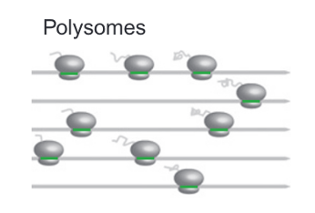
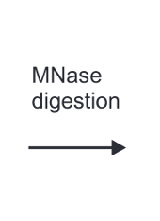
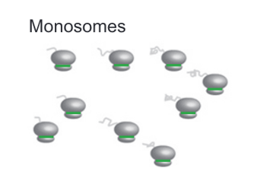
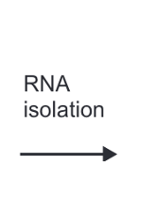
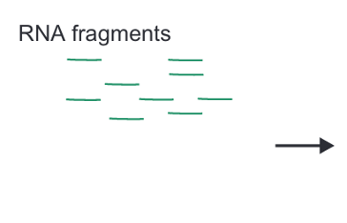
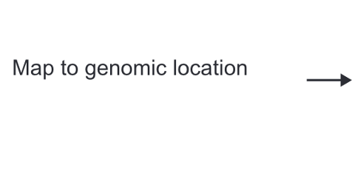
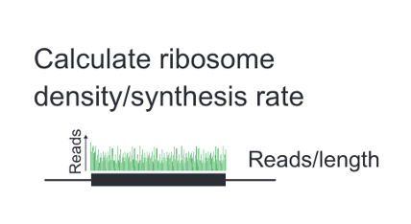
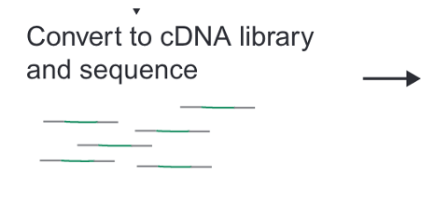
Ribosome Profiling:
Johnson and Li, 2018

Slide 6
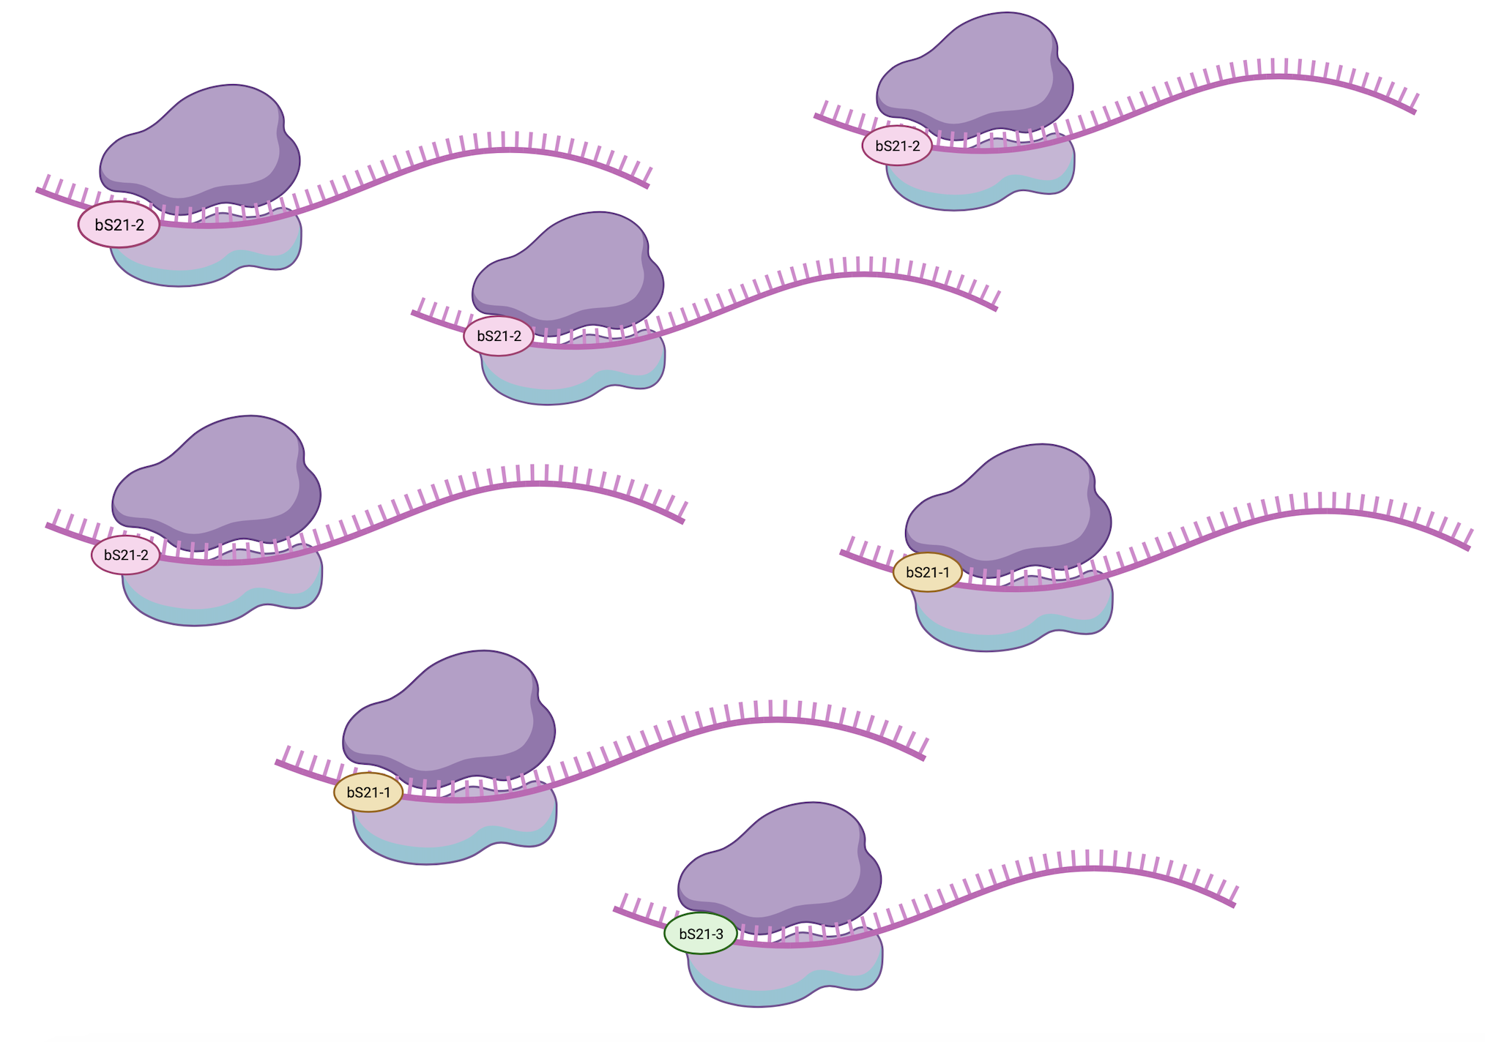
Heterogeneity of bS21 in LVS
How do we specifically identify translation by each homolog?

Slide 7
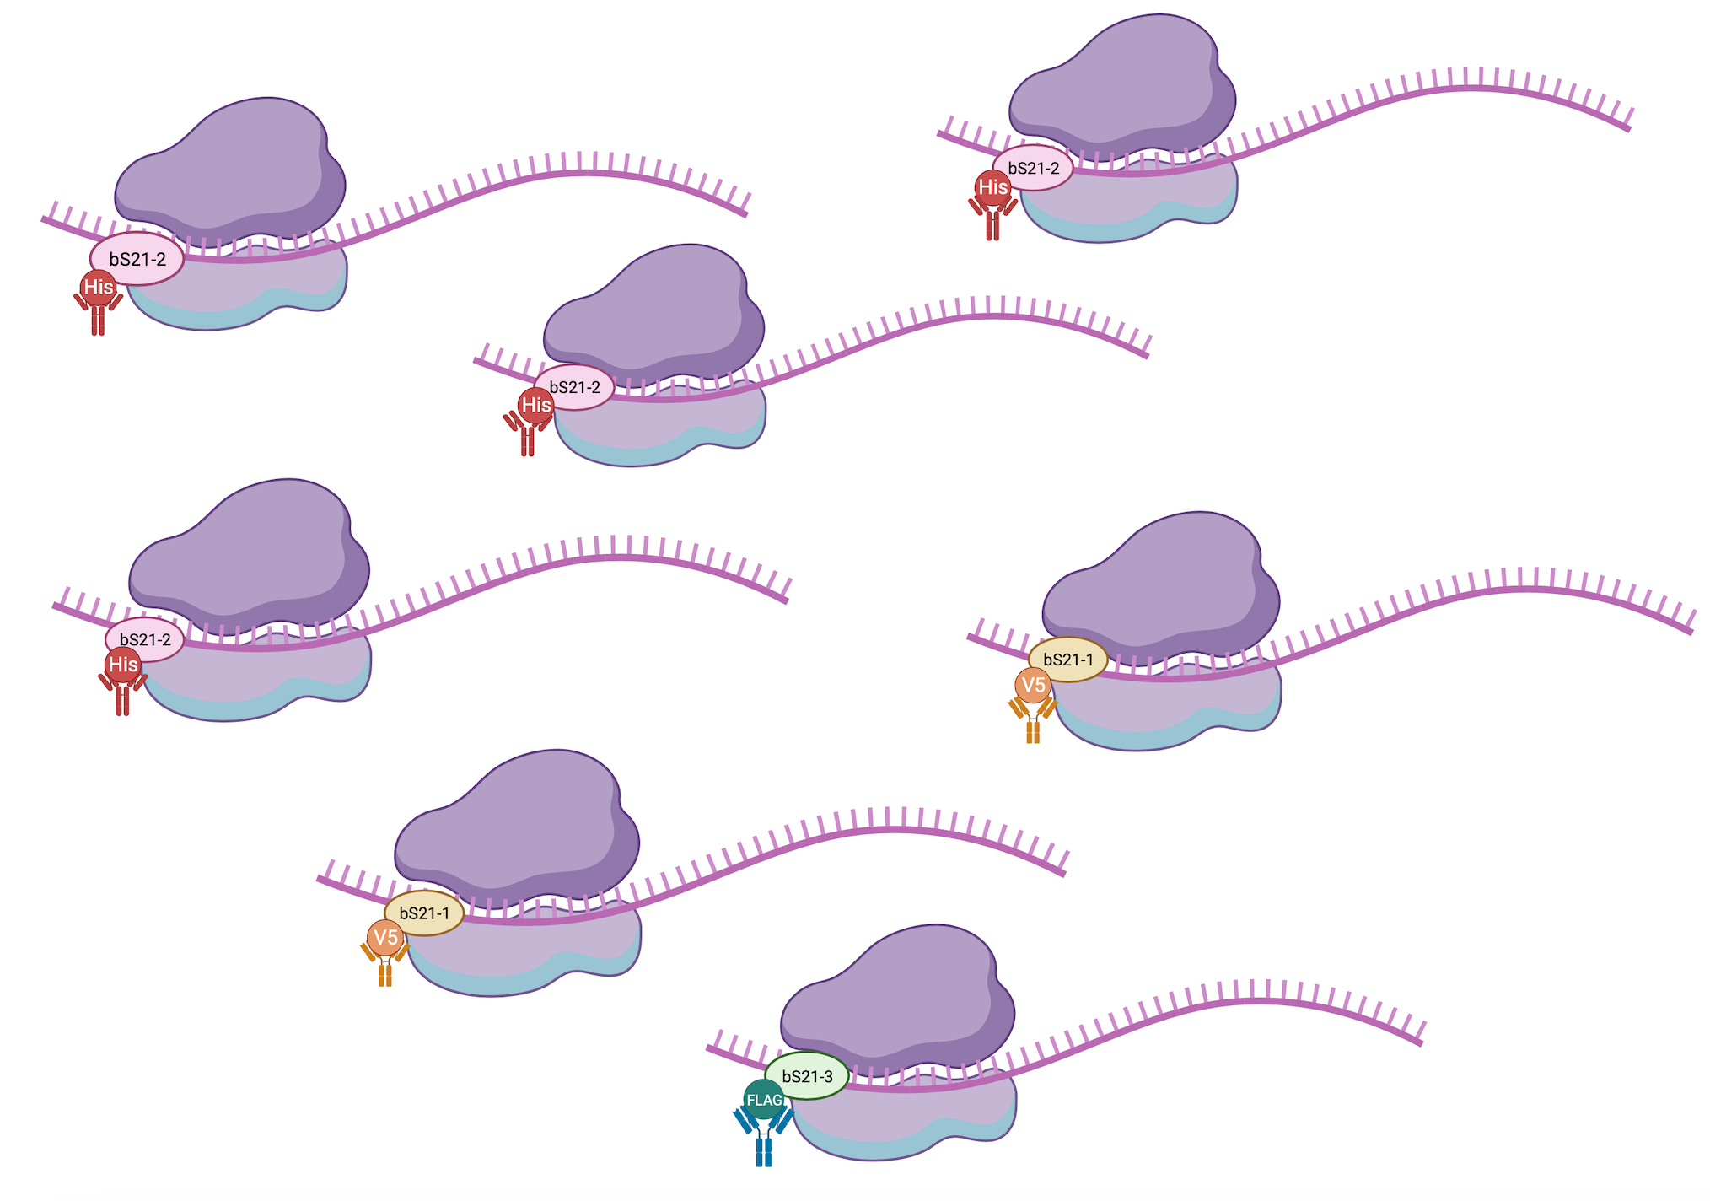
Heterogeneity of bS21 in LVS
How do we specifically identify translation by each homolog?

Slide 8
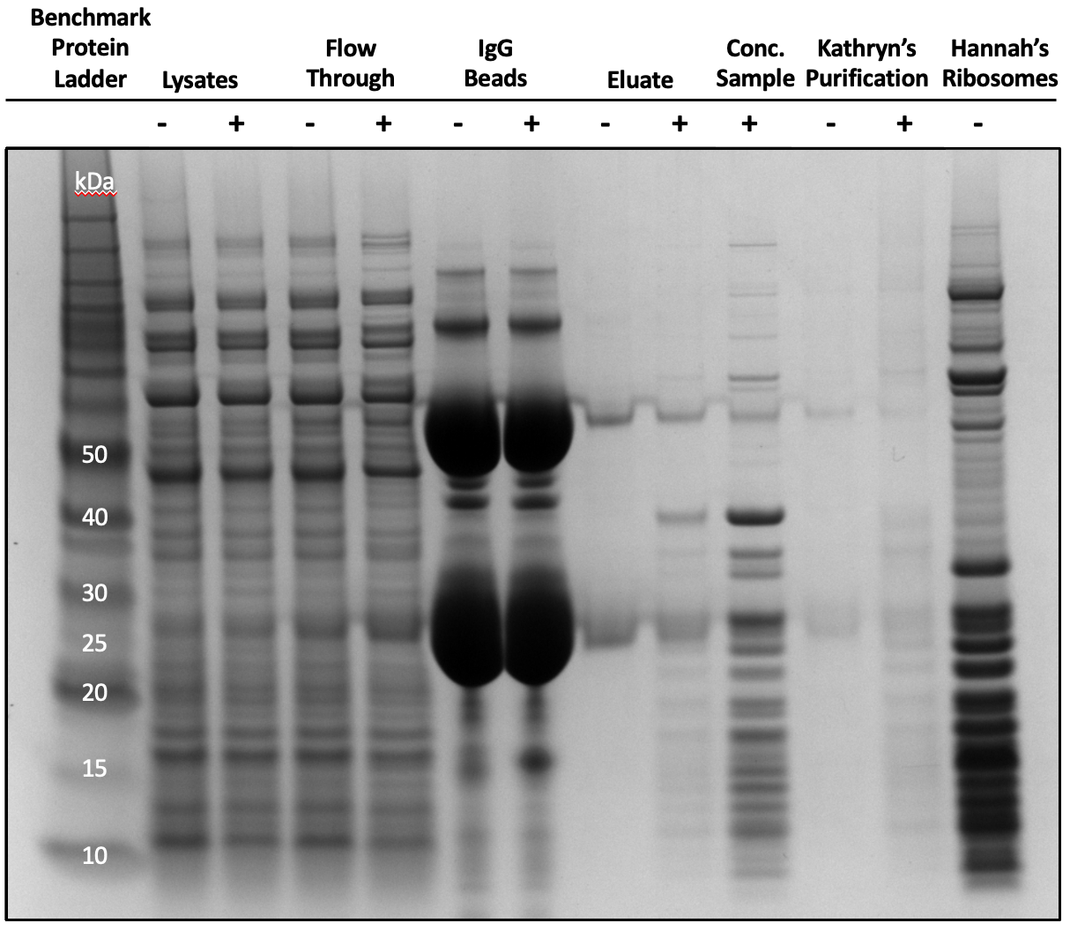
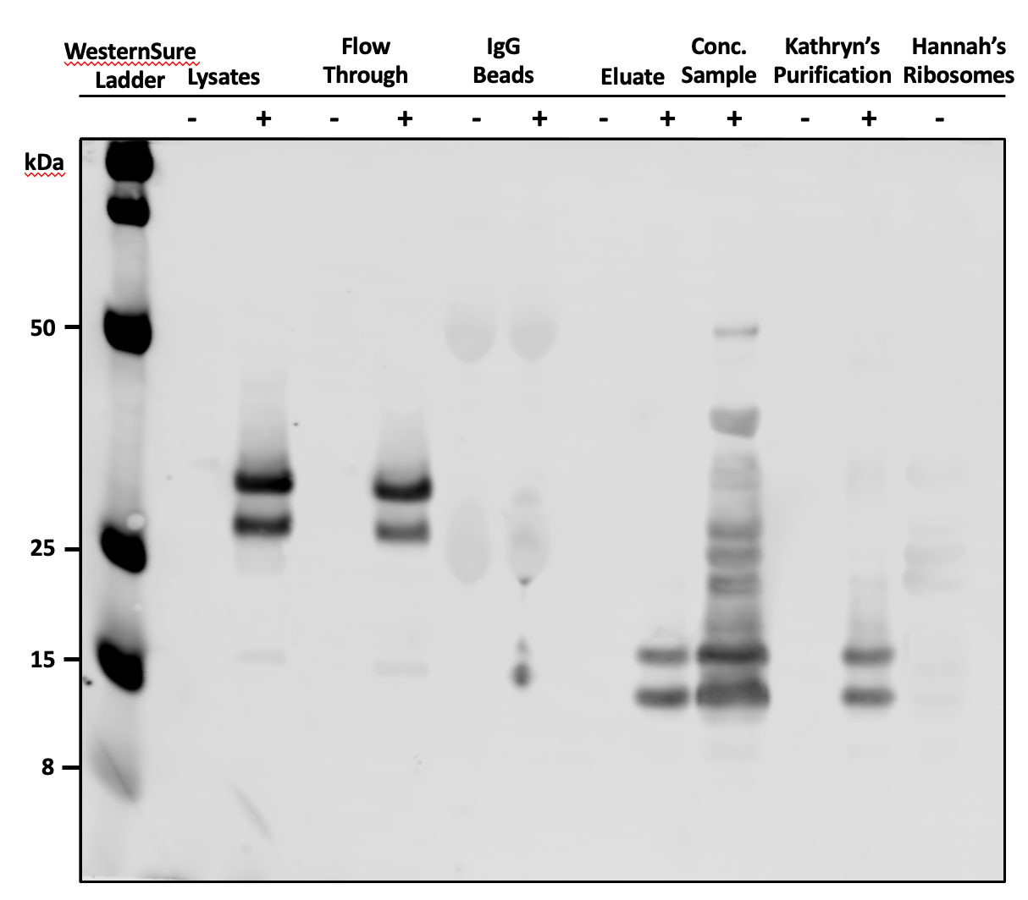
LVS-pF-bS21-2-TAP
Compound | Expected MW
IgG Heavy Chain | 55 kDa
bS21-2-TAP | 28.3 kDa
IgG Light Chain | 25 kDa
bS21-2-CBP | 12.7 kDa
bS21-2 | 7.8 kDa
Ben Moore, 2023

Slide 9
Testing epitope tags for bS21 immunoprecipitations
Epitope Tag | Number of Amino Acids | Elution
HA | 8 | HA peptide
His | 6 | Imidazole
FLAG | 9 | FLAG peptide
V5 | 14 | V5 peptide
Ectopically express on a plasmid
Test to determine integrity of function

Slide 10

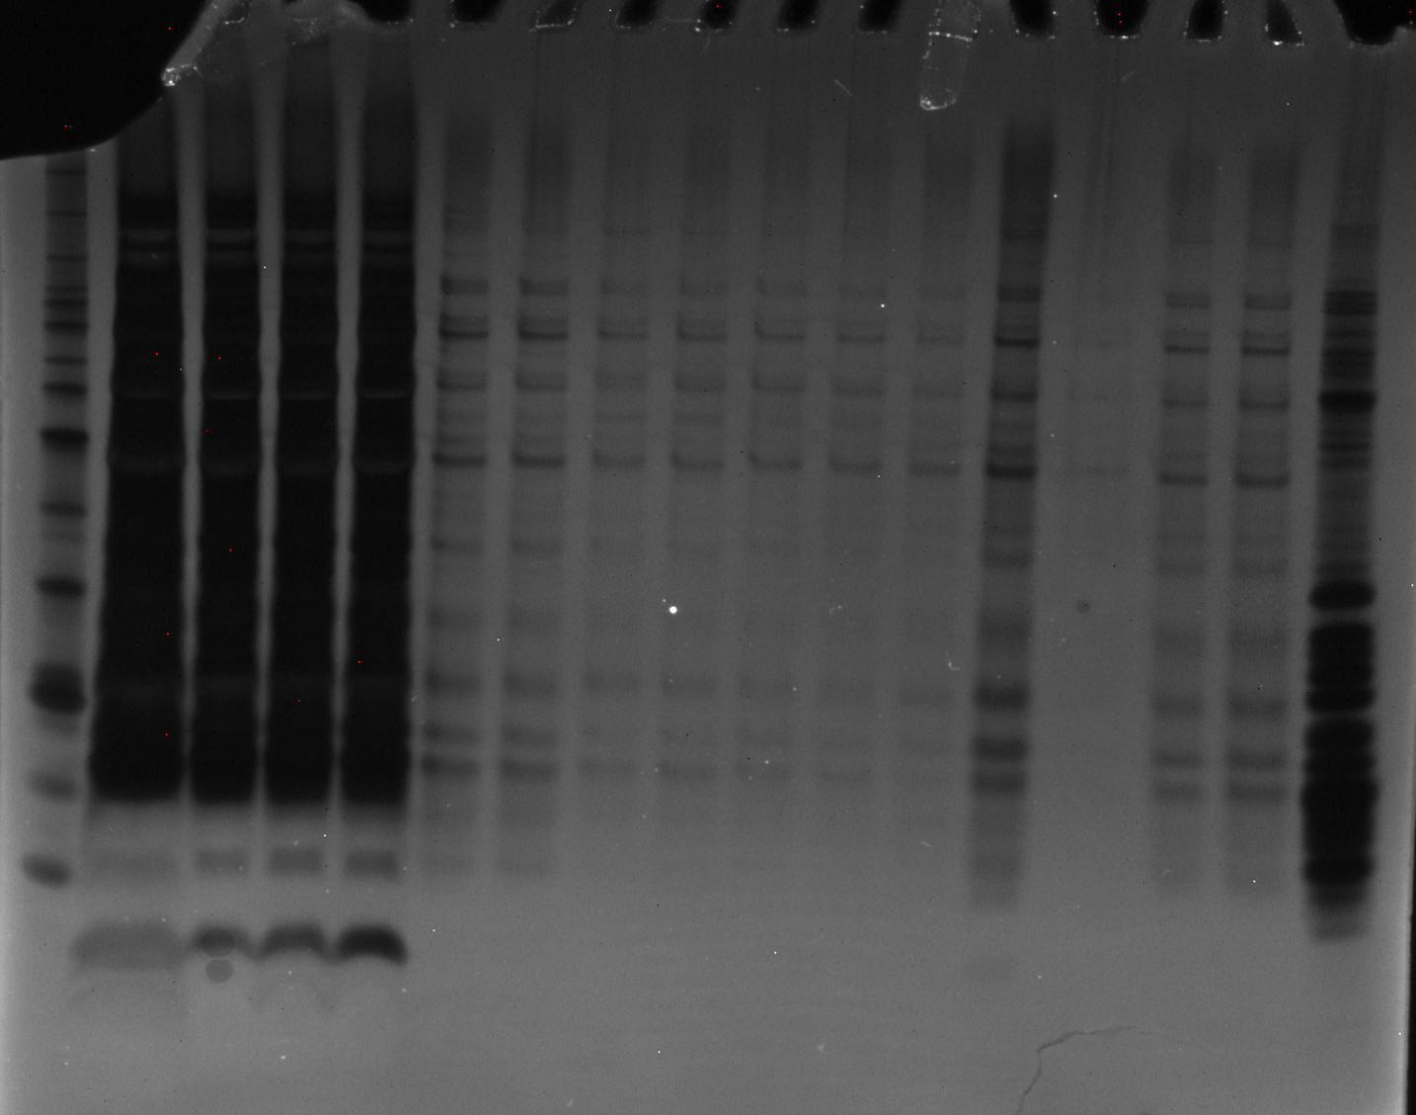
BenchMark
Ladder 1:10
Hannah’s
Ribosomes
10/27/23
Silver Stain
on GelDoc
10 kDa →

Slide 11
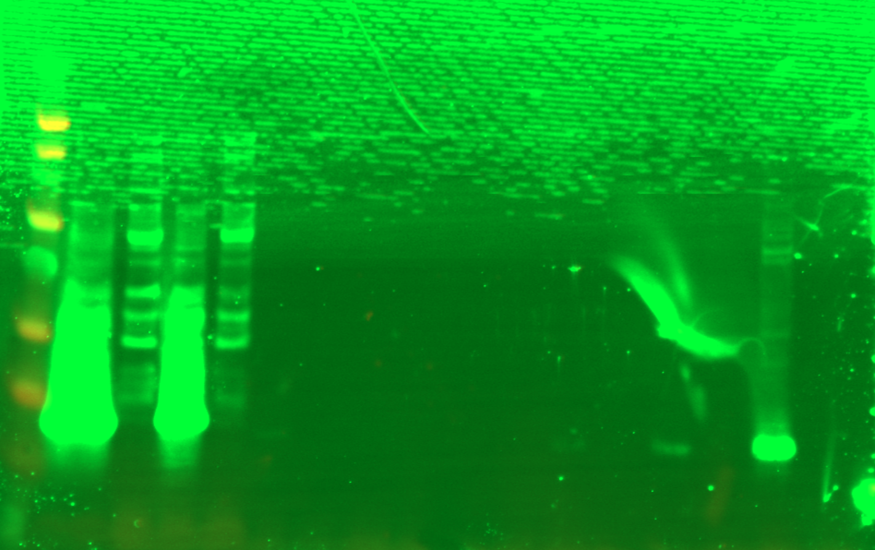
LYS
FT1
FT2
FT3
FT4
Ni-NTA
Beads
EL1
1XSLB
WesternSure
Ladder
WCL-His
+
-
+
-
+
-
+
-
+
-
+
-
+
-
IP 10/27/23
Western
8 kDa →
α-His 1:1000

Slide 12
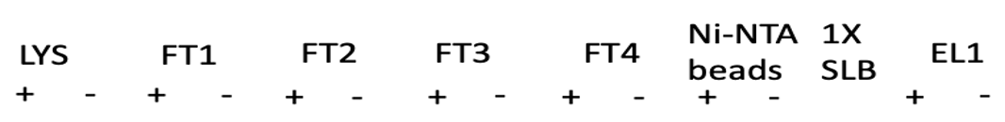
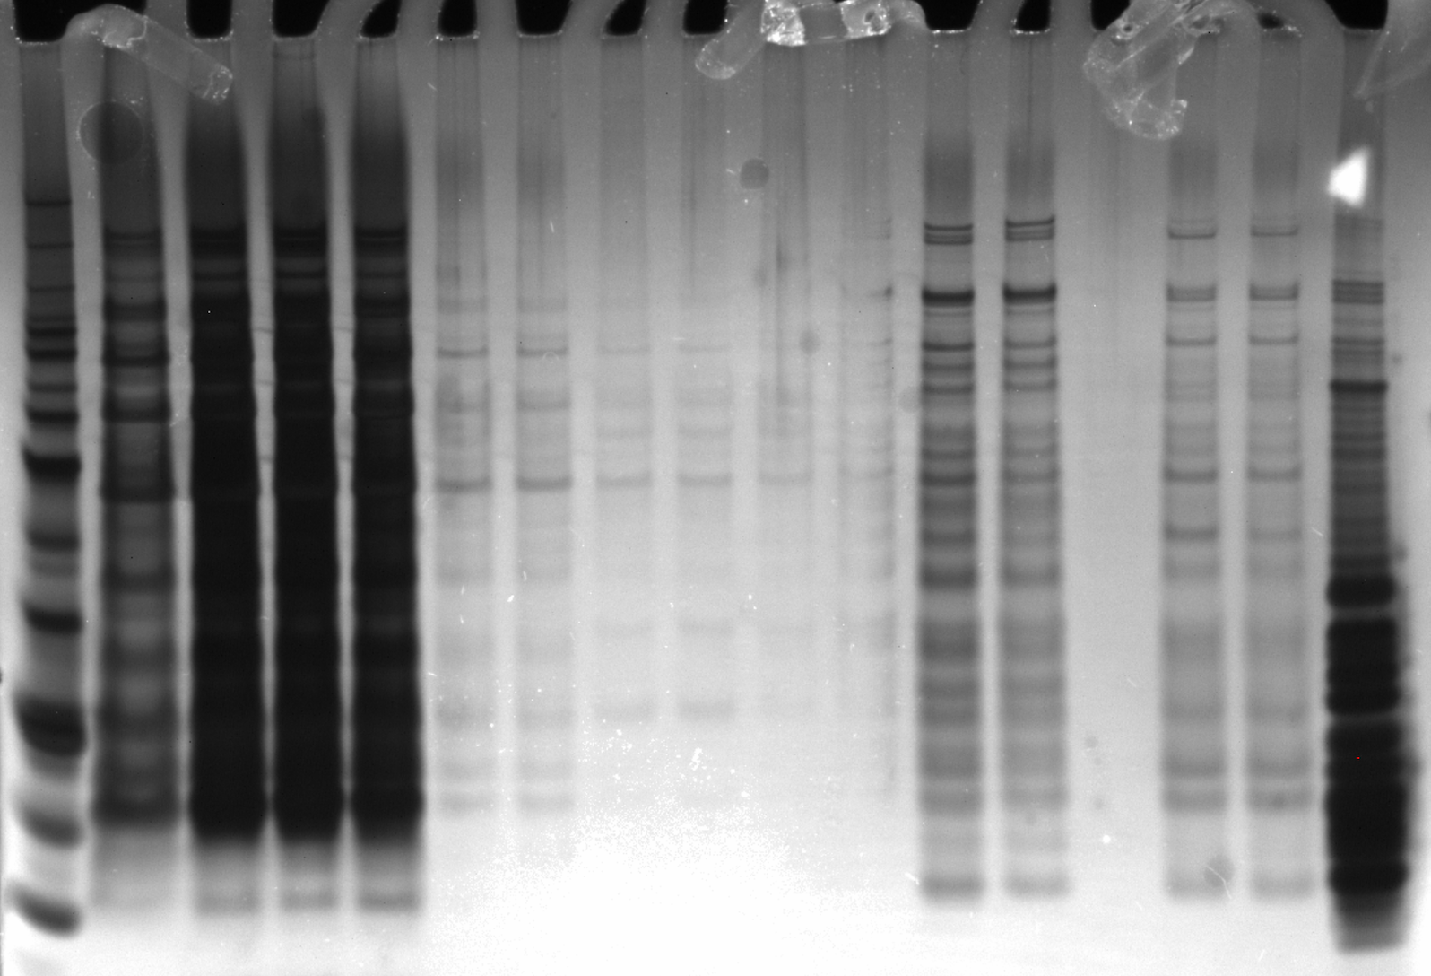
BenchMark
Ladder 1:10
Hannah’s
Ribosome
IP 11/6/23
Silver Stain

Slide 13
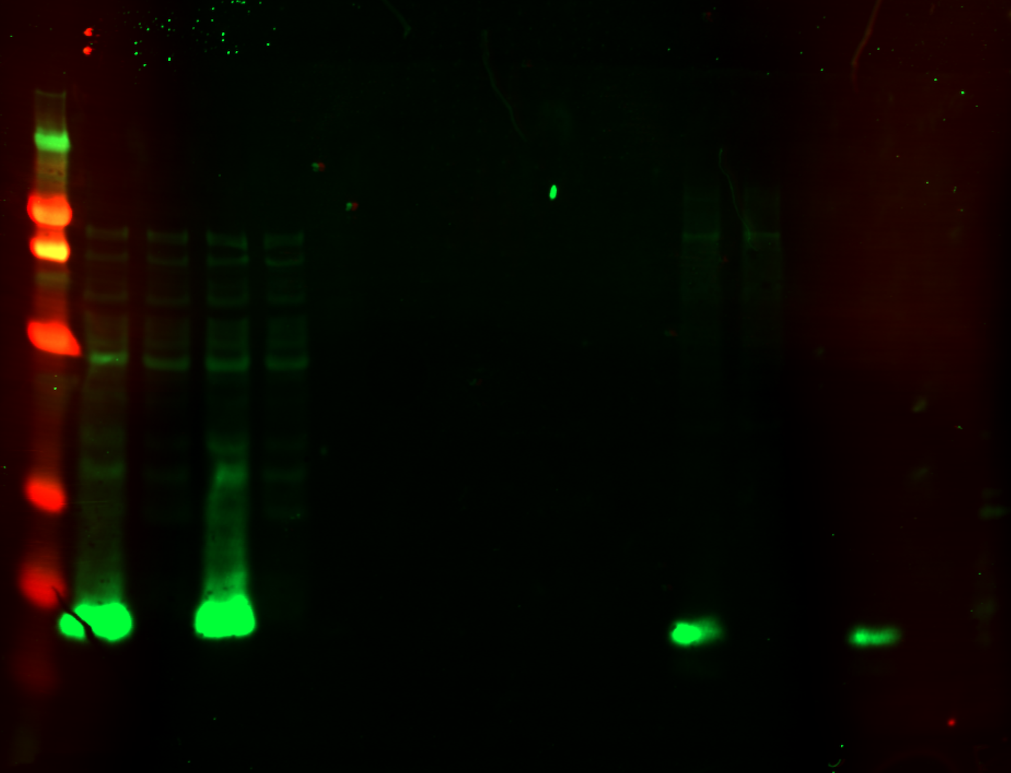
WesternSure
Ladder
His
WCL
IP 11/6/23
Western
α-His 1:1000
8 kDa →

Slide 14
Results
  Constructed plasmids with DNA specifying each epitope tag in frame of the 3’ end of rpsU2
  Introduced plasmids into LVS
  Confirmed by Western Blots
  His epitope gives a decent signal with a longer binding
Next Steps
  Continue testing IP protocols with other tags
  Confirm that bS21 is pulled down with 70S (sucrose gradients/mass spec)
  Add DNA specifying epitope tags to rpsU genes on the chromosome

Slide 15






ACKNOWLEDGEMENTS
Dr. Kathryn Ramsey
  Ben Moore
  Dr. Hannah Trautmann
  Sierra Schmidt
  Johanyx Rodriguez
Dr. Steven Gregory
URI INBRE core
  Janet Atoyan
Notes:
:
Motility and biofilm – bacillus subtilis
Acid stress resistance – listeria monocytogenes
Antibiotic resistance – staph aureus
Virulence – burkholderia pseudomallei and francisella in this work
Phage paper – Mizuno et al. 2019, Chen 2022
Bacteriodetes – Jha et al 2020 – probably autoregulating its own expression because rpsU is one of the few genes with a strong SD

Slide 16
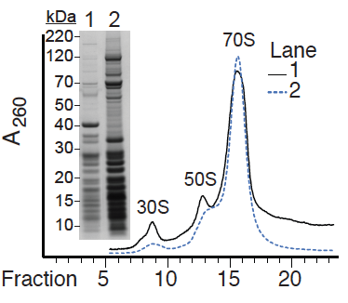
70S Ribosomes can be pulled down
Immunoprecipitated
Total ribosomes

Slide 17
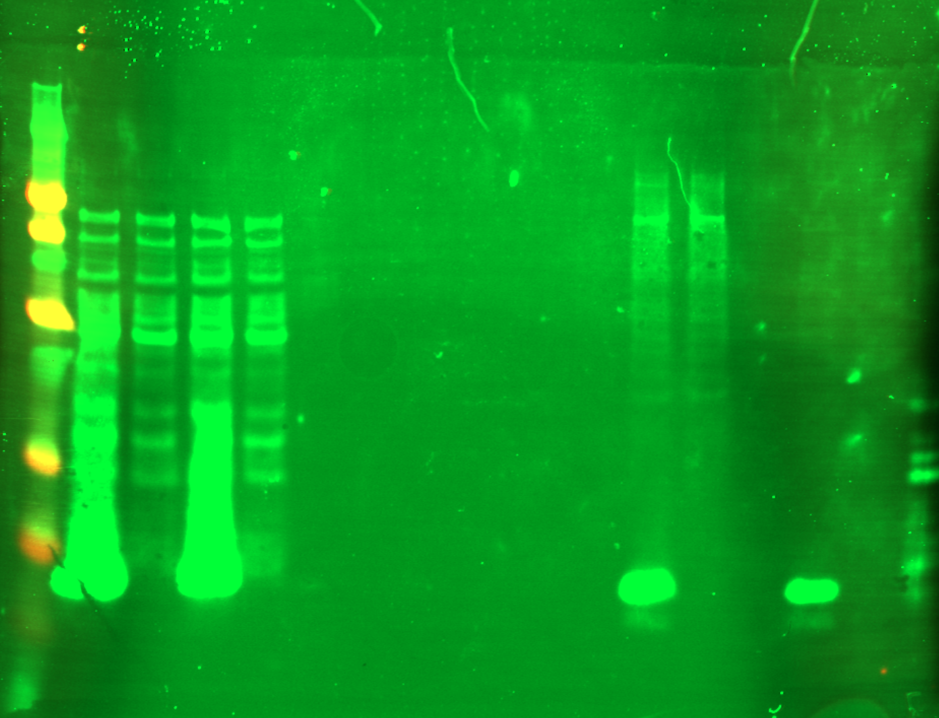
IP 11/6/23
Western

