Slide 1
Investigating translation specificity of bS21 homologs in F. tularensis
Kira Bernabe
Joint Lab Meeting
07/14/23

Slide 2
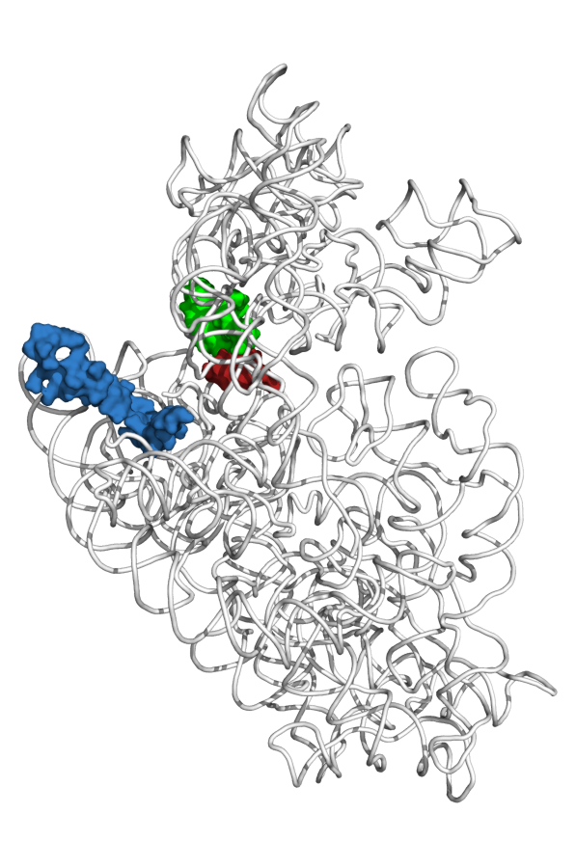
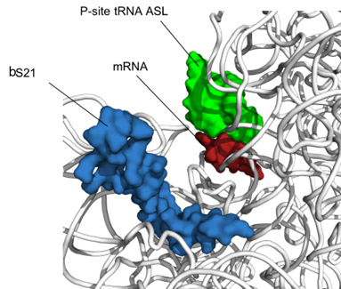
bS21: a small subunit ribosomal protein
mRNA channel
bS21
30S subunit of E. coli
bS21 may act as a regulator of translation
Notes:
Mention that the only protein depicted in the image is the bS21, folded 16s
IT HAS BEEN implicatred in blah blah
Phage don’t encode their own machinery, their own translation machinery (be more specific)
Transition:

Slide 3
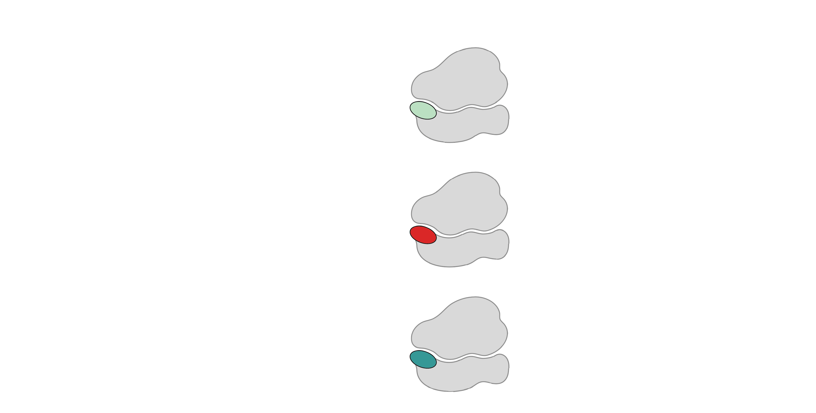
Multiple bS21 homologs lead to heterogenous ribosomes in Francisella tularensis
70S containing:
cspC
rpsU1
bS21-1
dnaG
bS21-2
rpsU2
yqeY
rpoD
rpsU3
bS21-3
Trautmann and Ramsey, 2022
How do changes in ribosome composition influence protein synthesis?
Notes:
Even though francisella has a reduced genome, it encodes three copies of the rpsU genes, which encode bS21, a protein in the small ribosomal subunit. Most bacteria have 0 or 1 of this gene. We originally, hypothesized, and have since shown, that these three proteins are produced and incorporated into ribosomes. This is a western blot of purified ribosomes from our wild-type strain as well as strains ectopically expressing each of the bS21 proteins, with a VSVG tag. This, along with some mass spec data we have of purified ribosomes, indicates that multiple classes of ribosomes are possible and occurring
This protein is also interesting to us because it is located close to the mRNA exit channel in the ribosome, and early research has identified that it is involved in translation initiation, so it is in an ideal location to be regulating gene expression at the level of translation initiation.
So this heterogeneity of ribosomes may be a mechanism of regulation, but you may not know that ribosomes are heterogeneous so let me show you other ways that may occur.

Slide 4
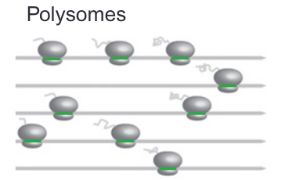
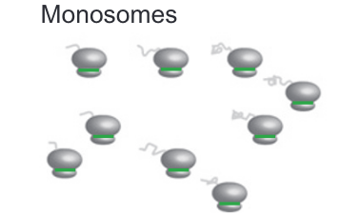
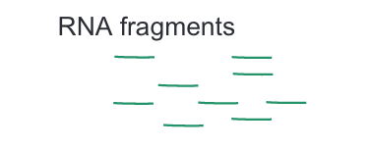



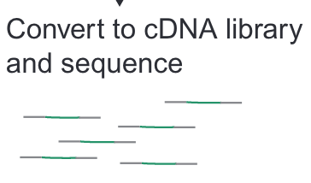
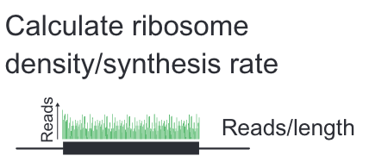

Ribosome Profiling:
Johnson and Li, 2018

Slide 5
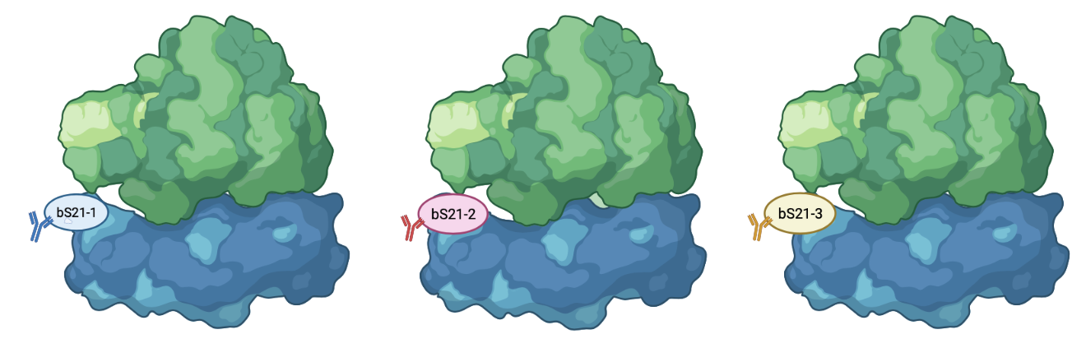



Heterogeneity of bS21 in LVS
How do we specifically identify translation by each homolog?

Slide 6
Workflow
Validate epitopes
Test efficiency of epitope pull-down
Integrate epitopes on the chromosome

Slide 7
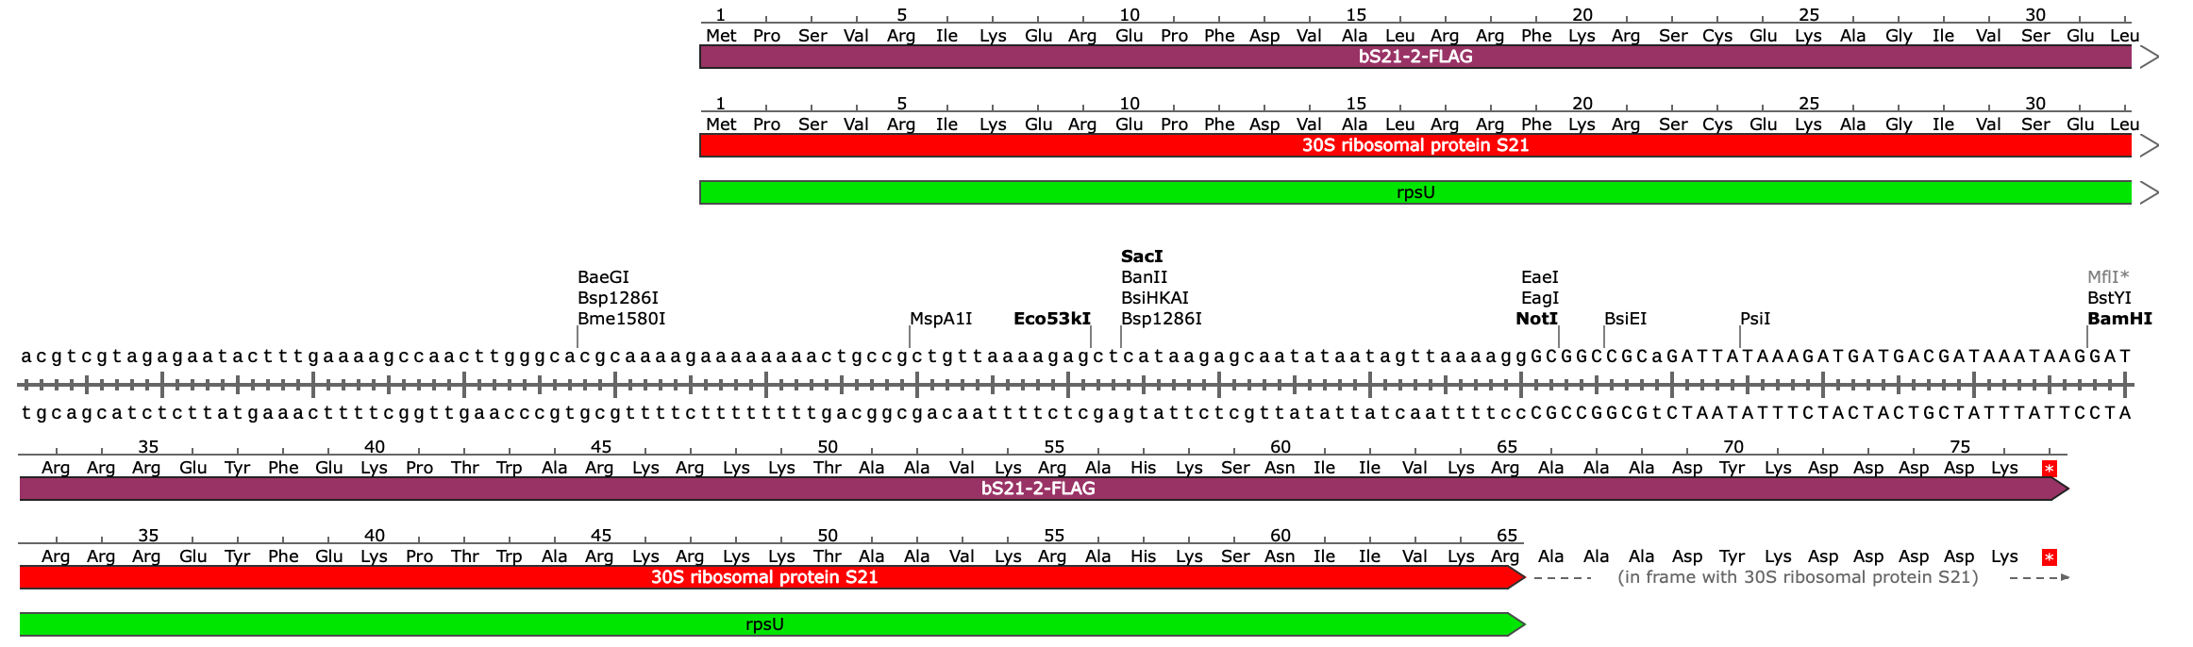
Plasmid Design
Epitope Tag | Size | Plasmid
HA | 1.1 kDa | pKR192
His | 0.8 kDa | pKR193
FLAG | 1 kDa | pKR194
V5 | 1.4 kDa | pKR195
FLAG

Slide 8
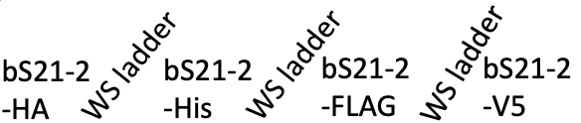
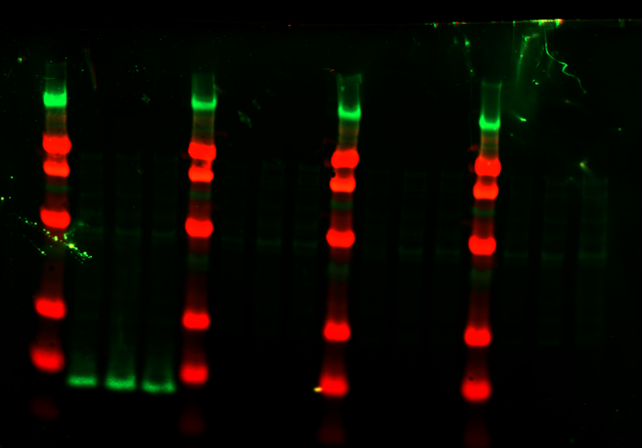
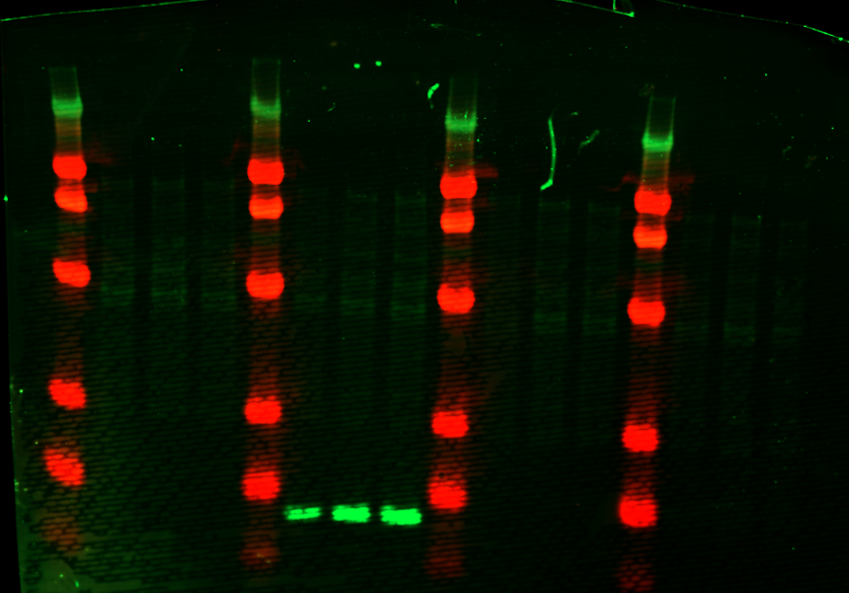
Western Blots
Western Sure Ladder
WS ladder
WS ladder
WS ladder
Western Sure Ladder
bS21-2
-HA
bS21-2
-His
bS21-2
-FLAG
bS21-2
-V5
A B C
A B C
A B C
A B C
A B C
A B C
A B C
A B C
8 kDa →
8 kDa →
α-HA
α-His

Slide 9
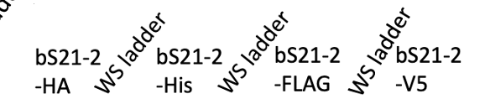
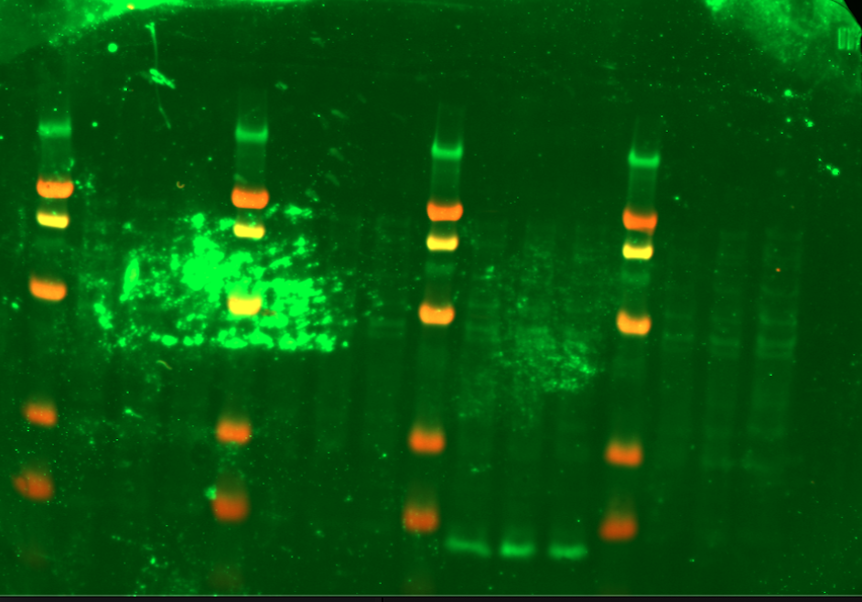
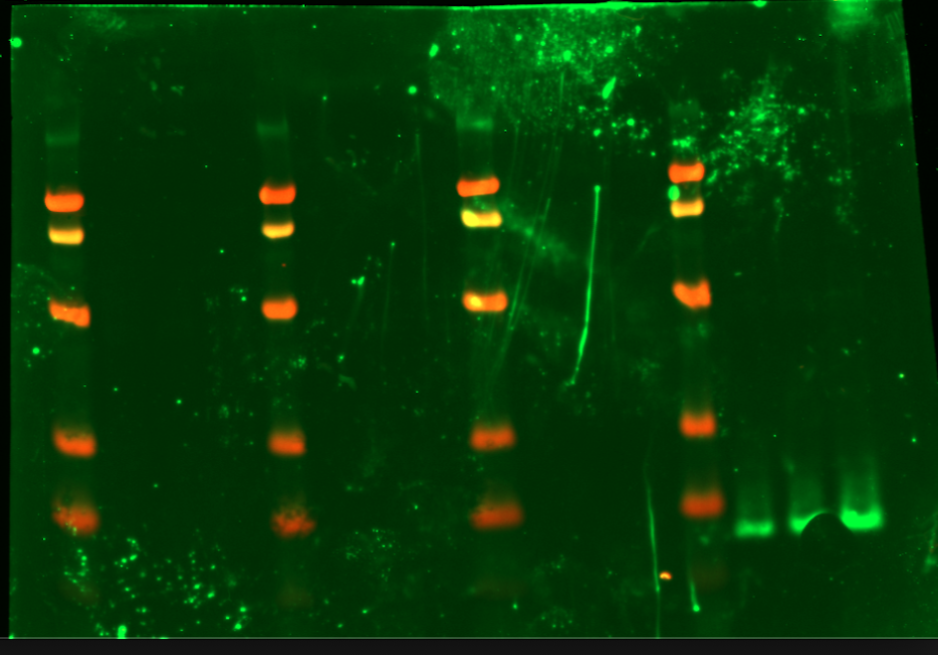
Western Blots
Western Sure Ladder
Western Sure Ladder
A B C
A B C
A B C
A B C
A B C
A B C
A B C
A B C
8 kDa →
8 kDa →
α-FLAG
α-V5

Slide 10

Workflow
Validate epitopes
Test efficiency of epitope pull-down
Integrate epitopes on the chromosome

Slide 11
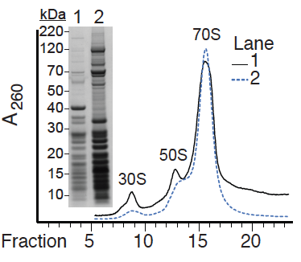
70S Ribosomes can be pulled down

Slide 12
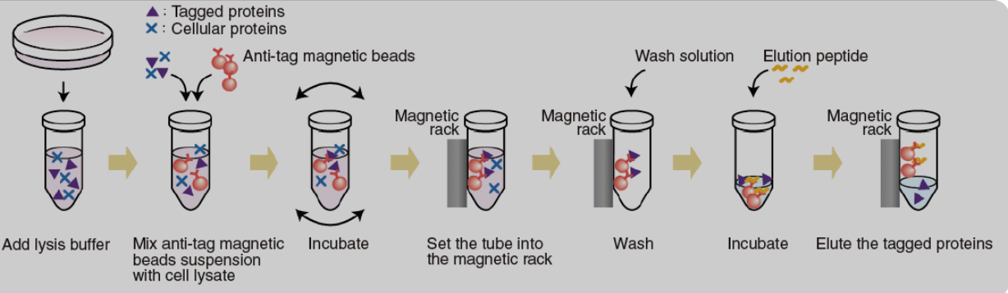
Immunoprecipitation
Epitope Tag | Size with bS21-2 | Elution
HA | 8.6 kDa | HA peptide
His | 8.3 kDa | Imidazole
FLAG | 8.5 kDa | FLAG peptide
V5 | 8.9 kDa | 1X sample buffer (?)

Slide 13
Results
  Constructed plasmids with DNA specifying each epitope tag in frame of the 3’ end of rpsU2
  Introduced plasmids into LVS
  Confirmed by Western Blots
Next Steps
  Make cell lysates for immunoprecipitation
  Test IP protocols
  Add DNA specifying epitope tags to rpsU genes on the chromosome

Slide 14






ACKNOWLEDGEMENTS
Dr. Kathryn Ramsey
  Dr. Hannah Trautmann
  Sierra Schmidt
  Ben Moore
  Adja Cissokho
  Sara Negash
Dr. Steven Gregory
URI INBRE core
  Janet Atoyan
Notes:
:
Motility and biofilm – bacillus subtilis
Acid stress resistance – listeria monocytogenes
Antibiotic resistance – staph aureus
Virulence – burkholderia pseudomallei and francisella in this work
Phage paper – Mizuno et al. 2019, Chen 2022
Bacteriodetes – Jha et al 2020 – probably autoregulating its own expression because rpsU is one of the few genes with a strong SD

