Slide 2
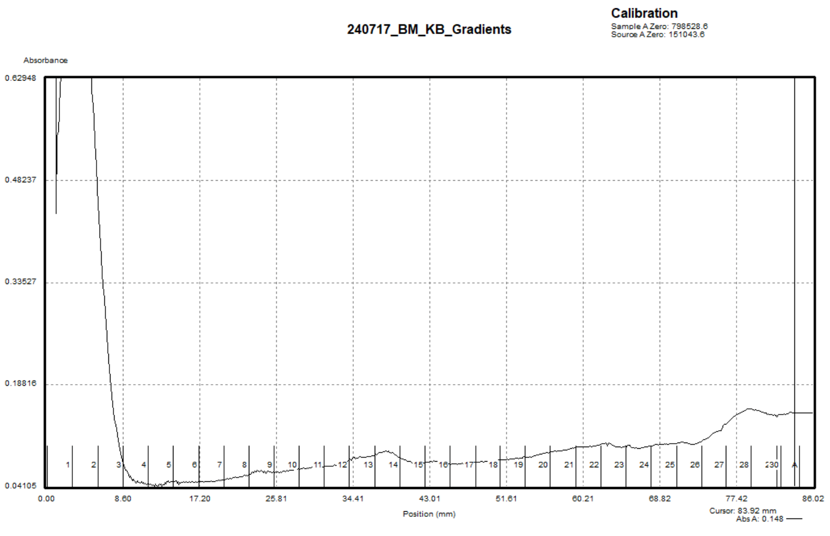
Sucrose Gradients
7/17/24

Slide 3
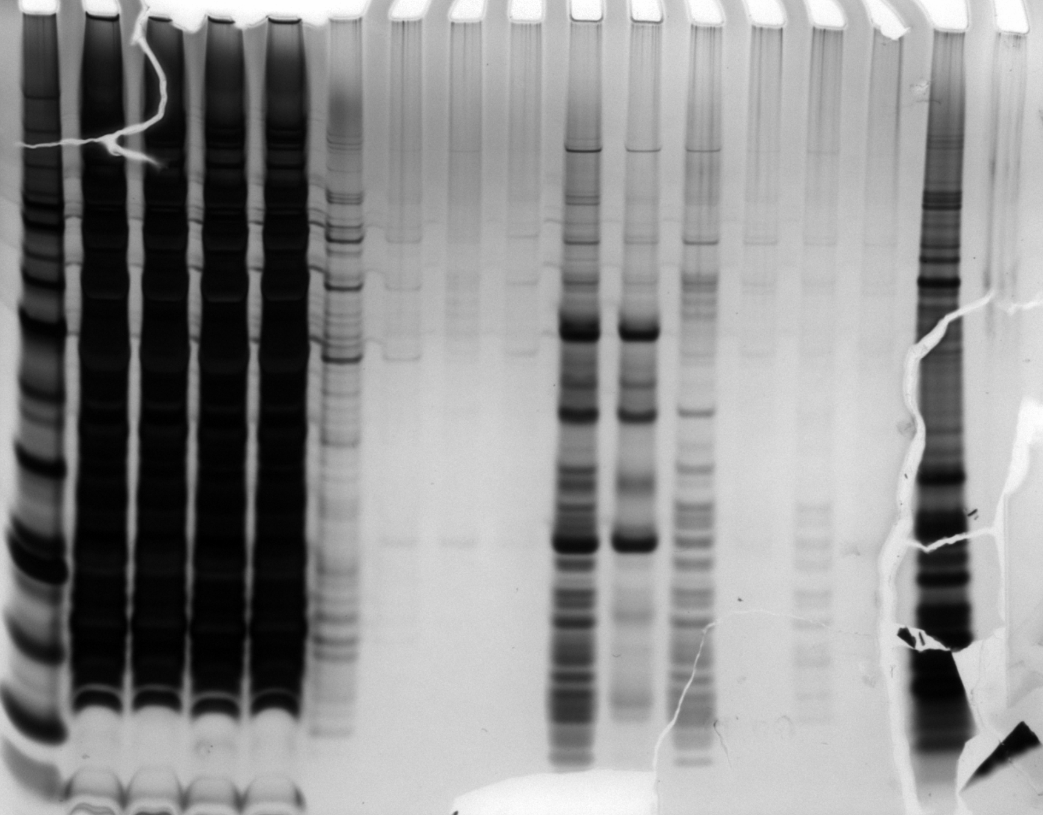
Anti-HA
Beads
Elution
New
Elution
5/20
LYS
FT1
FT5
FT6
Hannah’s
Ribos
kDa
+
-
+
-
+
-
+
-
+
-
+
-
+
-
Empty
HA-IP
Silver Stain
6/18/24
50
40
30
20
15
10

Slide 4
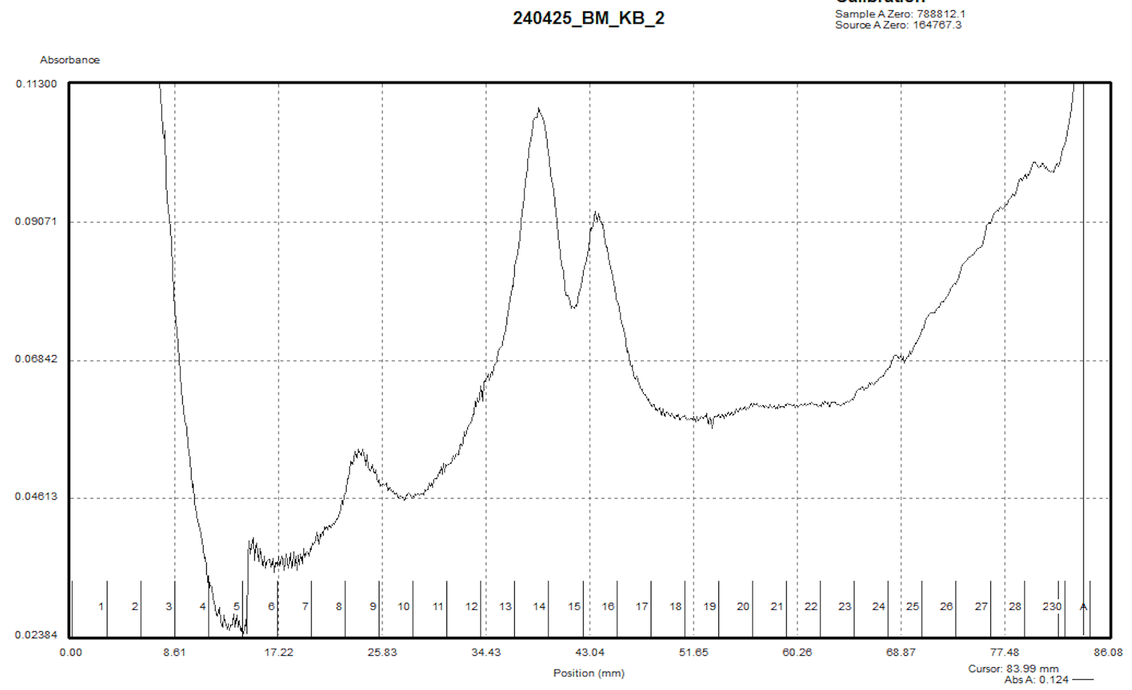

Slide 5
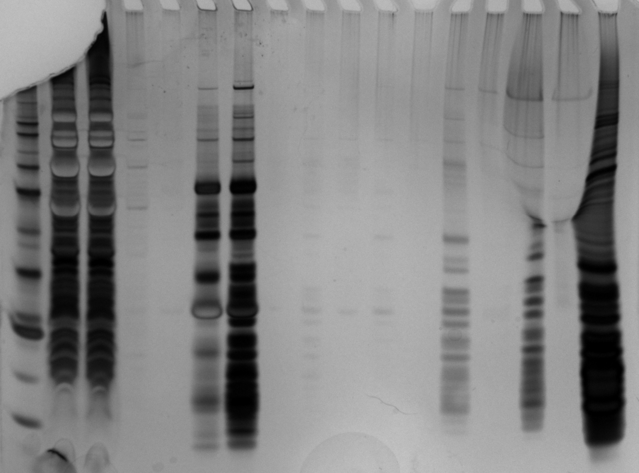
kDa
FT1
FT6
Anti-HA
Beads
1X
SLB
EL1
EL2
EL1
12/21
EL1
11/30
Hannah’s
Ribos
+
-
+
-
+
-
+
-
+
-
+
-
+
-
60
50
Silver Stain
5/24/24
40
30
20
15
10

Slide 6
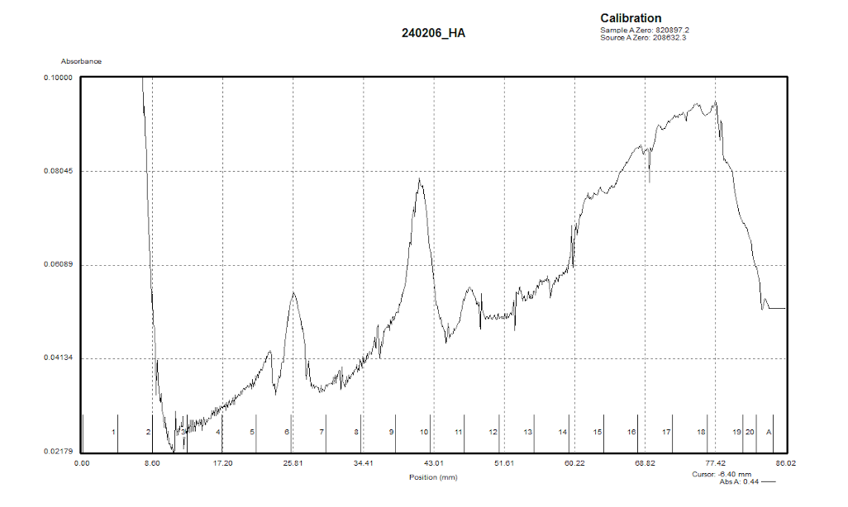

Slide 7
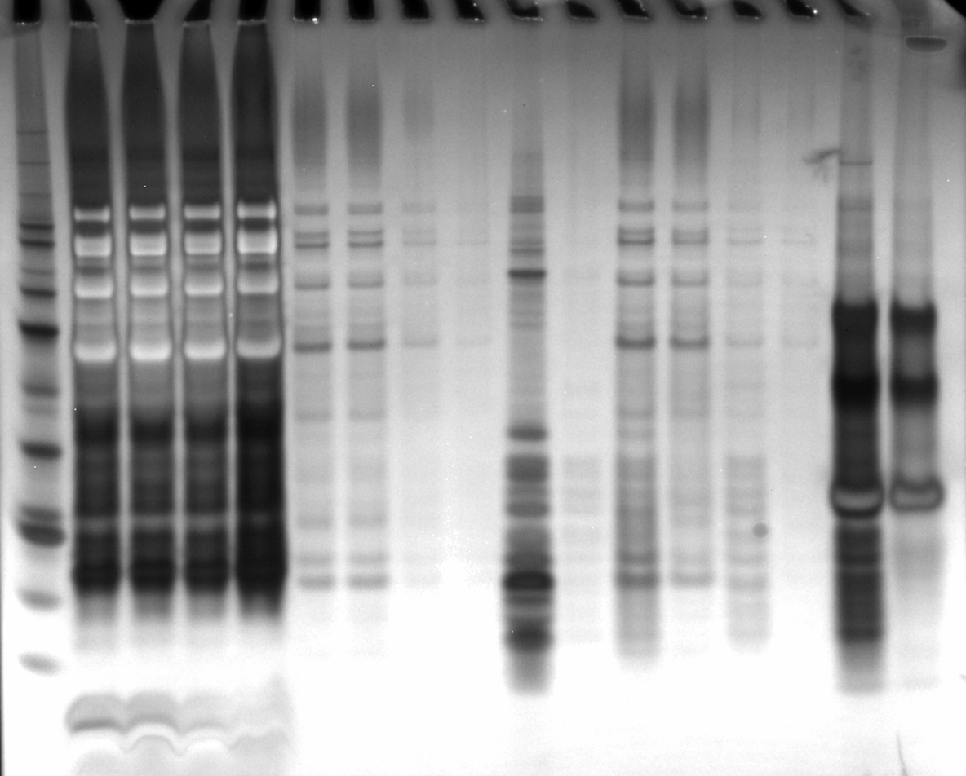
LYS
FT1
FT2
FT3
12/21
eluate
EL1
EL2
Anti-HA
beads
Hannah’s
Ribos
+
-
+
-
+
-
+
-
+
-
+
-
+
-
Silver Stain
4/16/24

