Slide 1
Exploring the effects of ribosome heterogeneity on gene regulation in Francisella tularensis
Kira Bernabe
CMB Seminar
01/26/24

Slide 2
Outline
Introduction
  Francisella tularensis
  Gene regulation and ribosome heterogeneity
  Model of F. tularensis ribosome heterogeneity and gene regulation
  Project goals
Methods Development
  Ribosome profiling overview
  Preliminary results
Future Plans

Slide 3
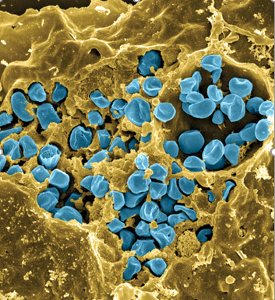
Francisella tularensis
Gram negative facultative
intracellular pathogen
Causes tularemia
Type A: F. tularensis subsp tularensis
Type B: F. tularensis subsp holarctica
  Live Vaccine Strain (LVS)
Control of virulence genes
Fischer, PNAS cover, 2006
Notes:
Transition: for specific virulence genes, we know a lot about reg at level of transcription, but we are interested in how it is controlled post transcriptionally

Slide 4
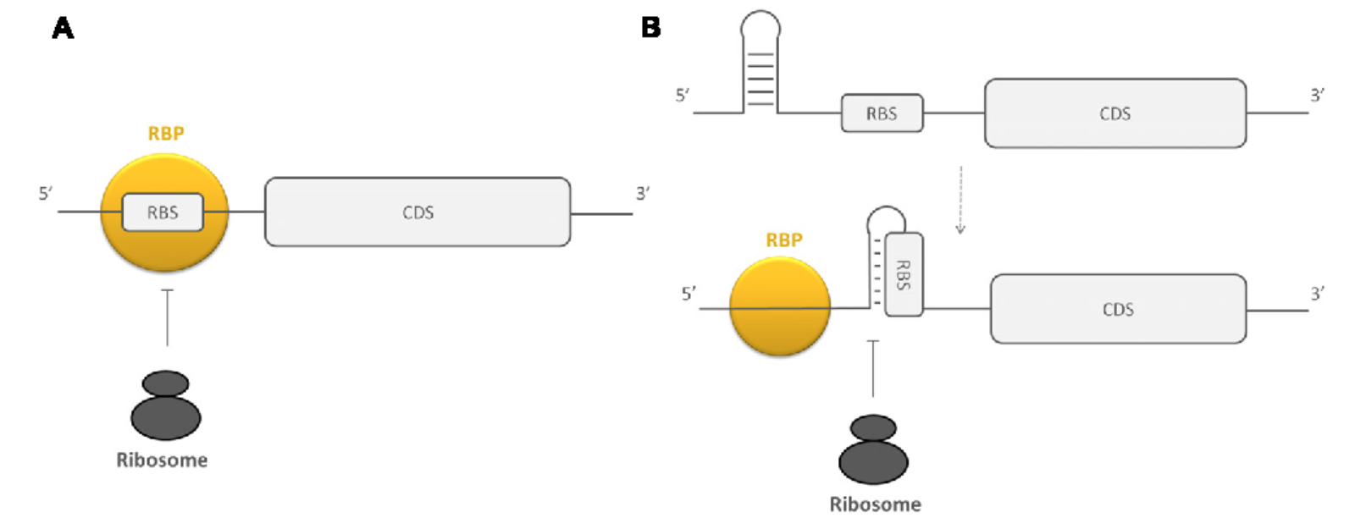
Post-transcriptional gene regulation
mRNA elements
sRNAs
RNA binding proteins
Ribosome binding proteins
Van Assche et al, 2015
Does the ribosome play a role in gene regulation?
Notes:
Small RNAs
mRNA structures that affect translation
Animate this
Animate picture
RBP assoc with mRNA and preventing translation by ribo
Secondary structure of mRNA allow access to ribo (top_
Different composition prevents ribosome biding by RBP so different structure is formed (bottom)
Transition: well characterized mechanism for post transcriptional gene regulation, does ribo play a role? I will talk about this today
Well described mechanisms of regulation for elements that act on mRNA
Less clear are examples of how ribo composition itself affects gene reg
Top right: RBPs influencing access to RBS
A: directly blocking region
B: changing secondary structure of region surrounding RBS
RNA binding proteins (HfQ, CsrA): adaptation of susceptibility of mRNA and sRNA to RNase, modulating accessibility of ribo binding site of mRNA, recruiting and assisting in interaction of mRNA with other molecules, regulate formation of transcription terminator/anti-terminator structures
mRNAs: 5’ and 3’ UTRs have regulatory capacity, degradation
sRNAs: help bacteria adapt to environmental change, base pairing with mRNA either perfectly (cis) or not (trans). Bind in vicinity of ribo binding site to inhibit translation initiation/ stimulate mRNA decay or they can do the opposite by base pairing the 5’ UTR way upstream of RBS

Slide 5
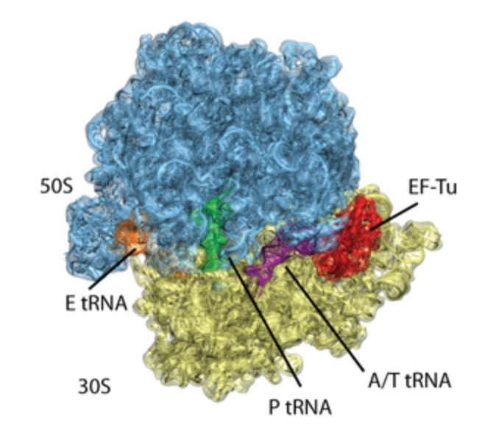
The Bacterial Ribosome
3 rRNAs
~55 r-proteins
Notes:
Transition: We solved the structure of the ribo and we thought that this is how it works, but we now know that there are other versions

Slide 6
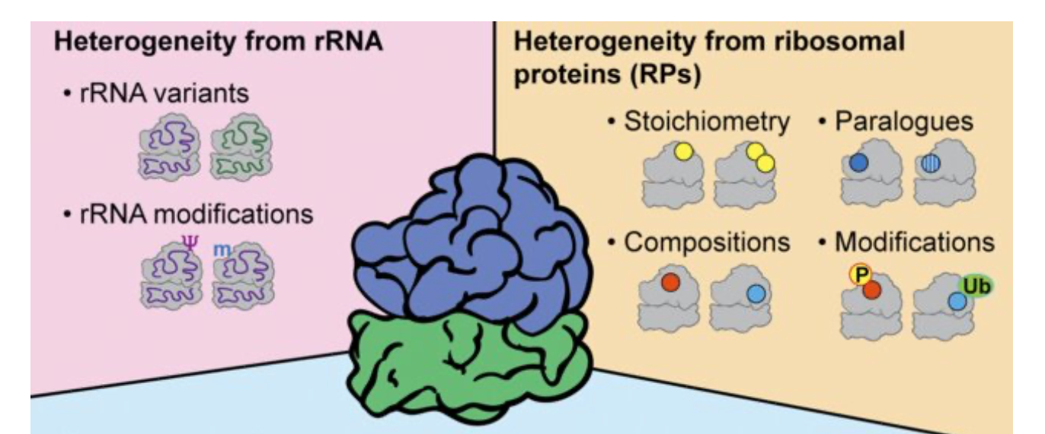
Sources of heterogeneity in ribosomes
Adapted from Li and Wang, 2020
Notes:
Transition: ex of really well understood sources of ribo hetergeneity in bacteria
i. Sequence micro-heterogeneity in rRNA operons
ii. Diverse modifications of rRNA (stars)
iii. Assembly of modified r-proteins (dots)
iv. Conditional modifications of rRNA (either during biogenesis or on mature ribosomes)
v. Removal or exchange of r-proteins (specifically referring to replacing damaged r-proteins)
vii. MazF enoribonuclease truncates 16S rRNA
Straight arrows = biogenesis
Curved arrows = mature ribos

Slide 7
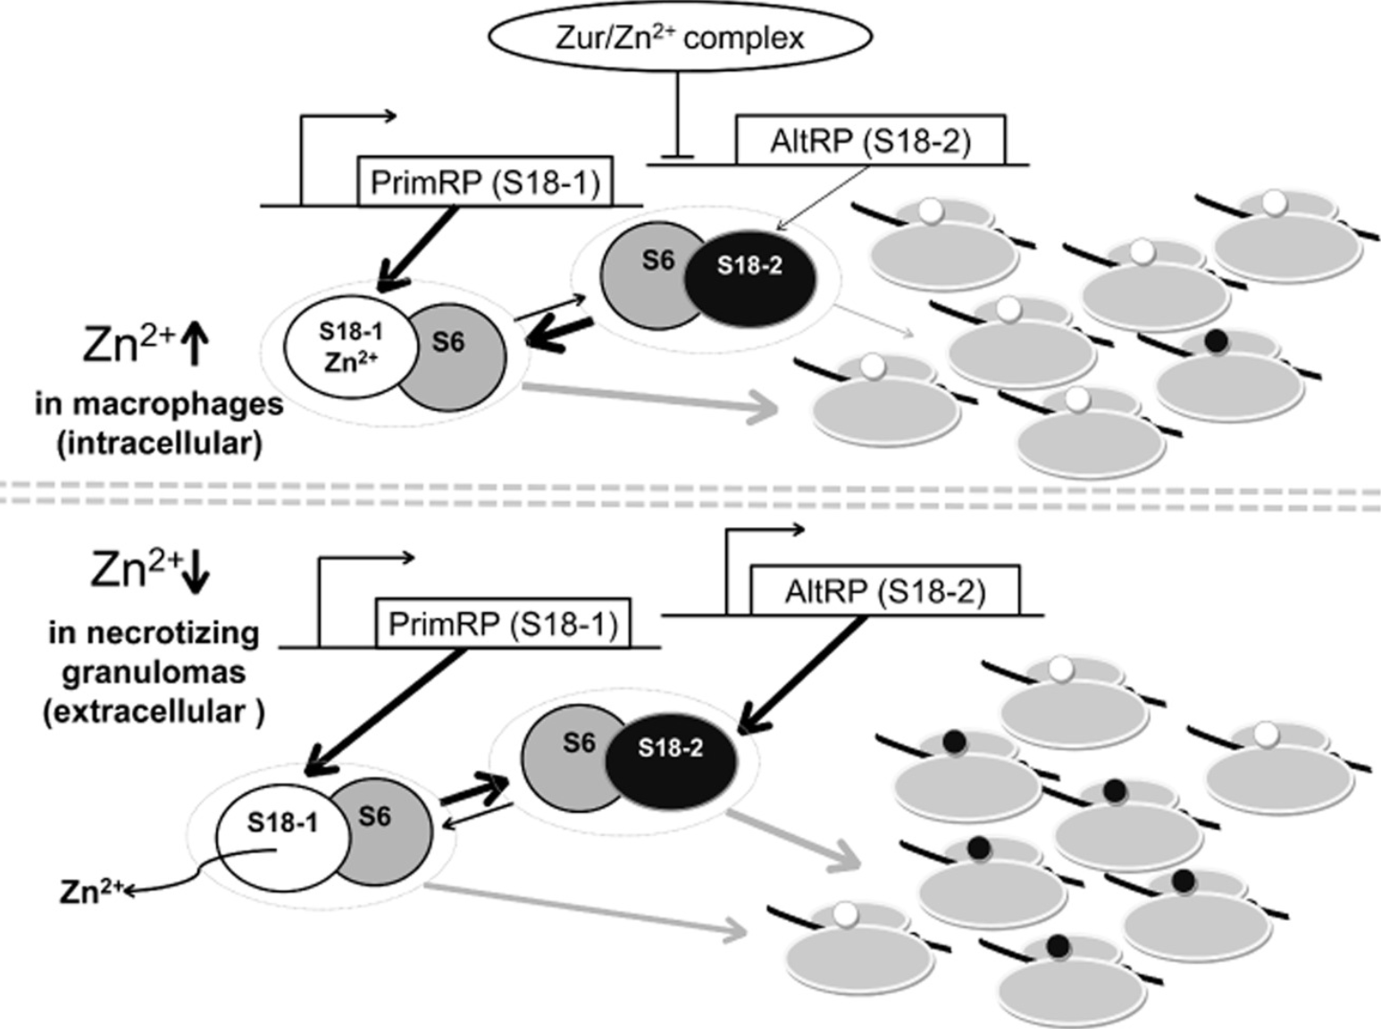
A well-described example of ribosome heterogeneity in bacteria
What is the functional significance?
Prisic et al., 2015
Notes:
Transition: there are some well characterized examkes of ribo heterogeneity
clear shift in ribosome composition over time
This model is spec to myco, other bacteria use a similar mechanism
2 different version of same RP, one with Zn, and one without
How do you know which arangement to use?
Contorleed at the level of transcription (Zur) binds to Zn, represses the operon to not coordinate Zn
Under normal condition, primary RP is produced and expression of alternate RPs is repressed

Slide 8
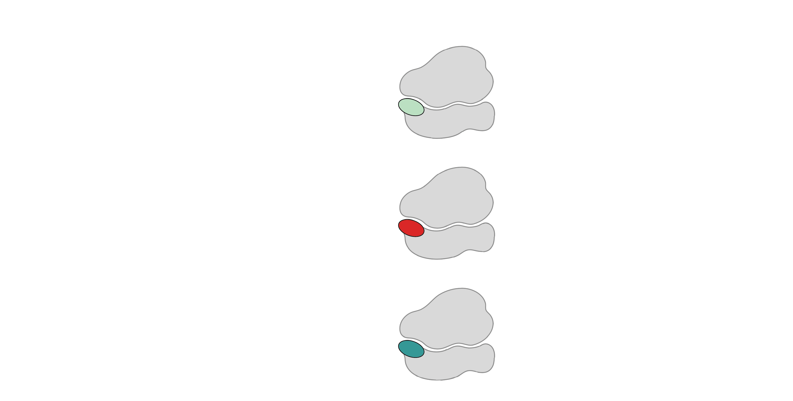
Multiple bS21 homologs lead to heterogenous ribosomes in Francisella tularensis
70S containing:
cspC
rpsU1
bS21-1
dnaG
bS21-2
rpsU2
yqeY
rpoD
rpsU3
bS21-3
Trautmann and Ramsey, 2022
Notes:
We know they do not coordinate Zn, don’t have the binding domains
Don’t know how theyre regulated
Even though francisella has a reduced genome, it encodes three copies of the rpsU genes, which encode bS21, a protein in the small ribosomal subunit. Most bacteria have 0 or 1 of this gene. We originally, hypothesized, and have since shown, that these three proteins are produced and incorporated into ribosomes. This is a western blot of purified ribosomes from our wild-type strain as well as strains ectopically expressing each of the bS21 proteins, with a VSVG tag. This, along with some mass spec data we have of purified ribosomes, indicates that multiple classes of ribosomes are possible and occurring
This protein is also interesting to us because it is located close to the mRNA exit channel in the ribosome, and early research has identified that it is involved in translation initiation, so it is in an ideal location to be regulating gene expression at the level of translation initiation.

Slide 9
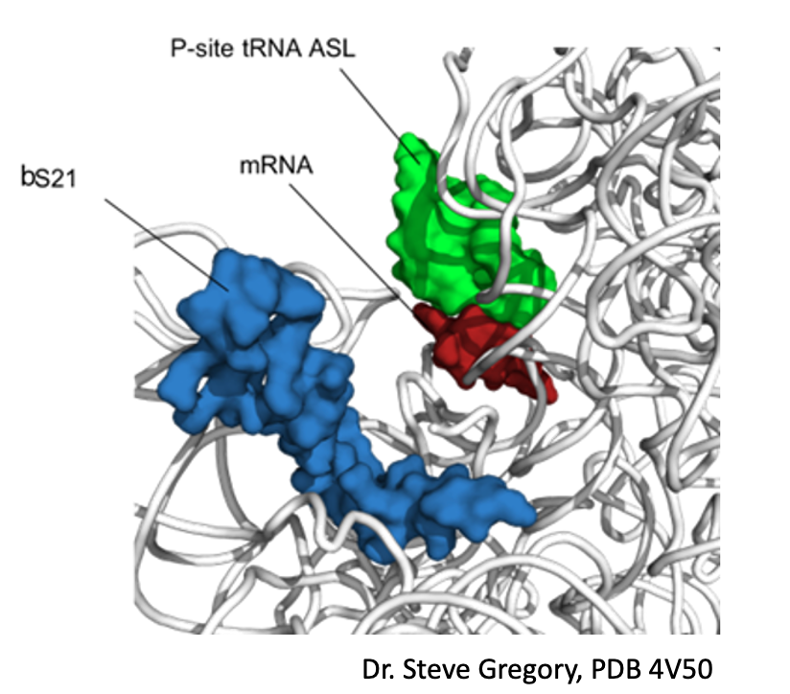
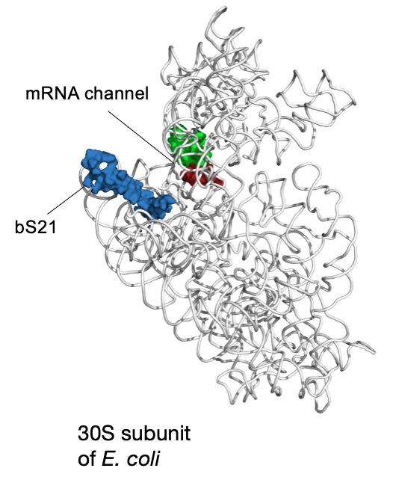
bS21: a small subunit ribosomal protein
Notes:
Can interact with 5’ UTR during translation initiation
Makes sense that has been implicated in initiation
Maybe get rid of translation initiation

Slide 10
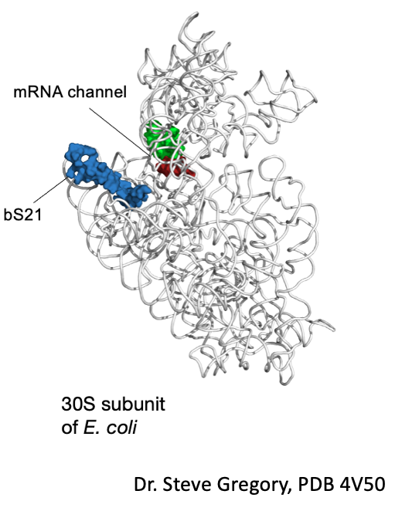
bS21 may be important for regulation of translation
  Involved in translation initiation
  Non-essential
  Can be easily exchanged
  Encoded by phage
  Implicated in control of specific processes
    biofilm
    motility
    acid stress resistance
    antibiotic resistance
    virulence
Notes:
Move up translation initation
What makes ut a regulator
Encoded by phage
Transition: only one organism in which function id bS21 has been well characteirsed, a bacteria that’s’ very different from Ft, so I will tell you about it,
To explain story, I’ll remind you of salient aspects of trnalstion intation

Slide 11
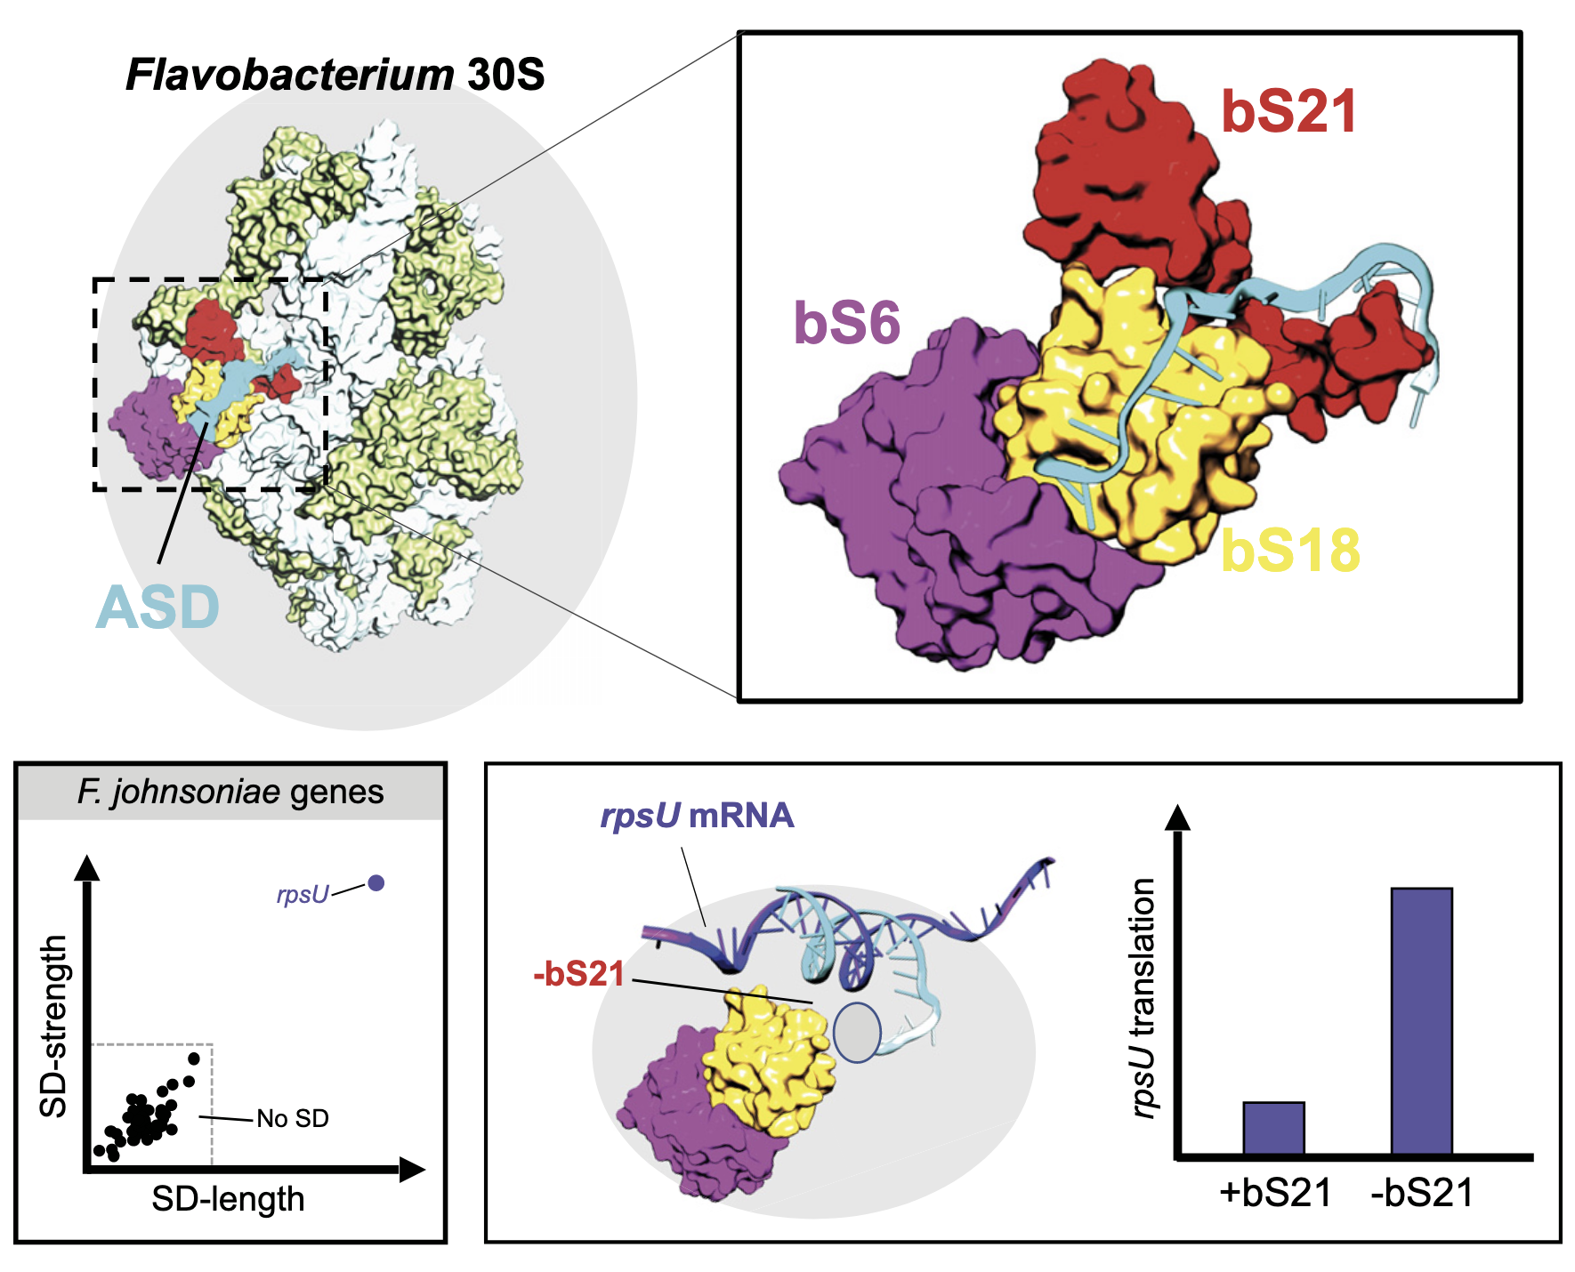
bS21-mediated specialized ribosomes in Bacteroidia
Anti-Shine-Dalgarno
(ASD)
16S rRNA
Many bacteria use SD-ASD pairing
Bacteroidia do not
  bS21 has unique C-term
5ʹ
3ʹ
A
U
UCCUCCA
5ʹ
NNNNNAGGAGGU(N₅₋₁₀)AUG(N_{n})
3ʹ
Shine-
Dalgarno (SD)
Initiation
Codon
mRNA
Jha et al., 2020; McNutt et al., 2023
Notes:
Celar example In anther orgaism of how bS21 regulates transation was uncovered recentrly, so I’ll tell you about it, but first I need to remind aspects of SALIENT aspects of translation intiiaion
These 3 proteins are different enough that they sequester ASD, depending on c-term region of bS21, unique to bacteroidia
Can move
Graph of SD, this immeditaley preoivudes a method to regulate production of bS21

Slide 12
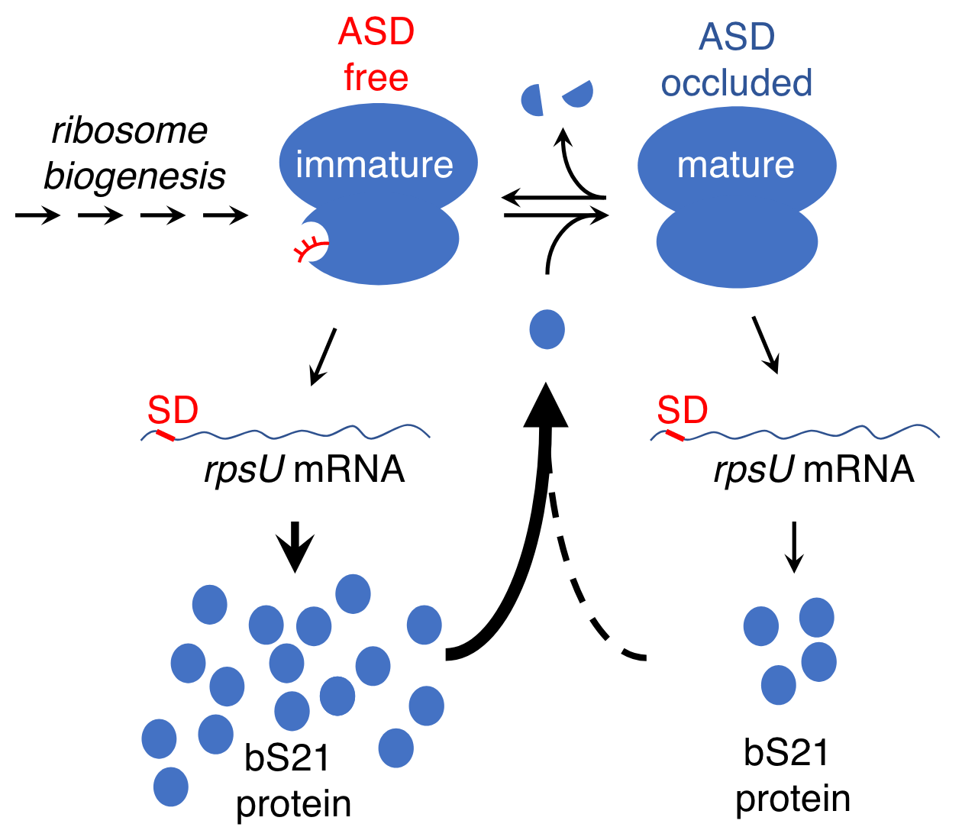
Ribosome composition in F. johnsoniae influences translation
Cells lacking bS21 have increased synthesis of mRNAs with SDs, including bS21
Jha et al., 2020; McNutt et al., 2023
Notes:
Not how bS21 works in Ft
Mention the bacteroidia C term situation again

Slide 13
Multiple bS21 homologs lead to heterogenous ribosomes in Francisella tularensis
70S containing:
cspC
rpsU1
bS21-1
dnaG
bS21-2
rpsU2
yqeY
rpoD
rpsU3
bS21-3
Trautmann and Ramsey, 2022
How do changes in ribosome composition influence protein synthesis?
Notes:
Even though francisella has a reduced genome, it encodes three copies of the rpsU genes, which encode bS21, a protein in the small ribosomal subunit. Most bacteria have 0 or 1 of this gene. We originally, hypothesized, and have since shown, that these three proteins are produced and incorporated into ribosomes. This is a western blot of purified ribosomes from our wild-type strain as well as strains ectopically expressing each of the bS21 proteins, with a VSVG tag. This, along with some mass spec data we have of purified ribosomes, indicates that multiple classes of ribosomes are possible and occurring
This protein is also interesting to us because it is located close to the mRNA exit channel in the ribosome, and early research has identified that it is involved in translation initiation, so it is in an ideal location to be regulating gene expression at the level of translation initiation.

Slide 14
bS21 homologs control gene expression
~160 proteins with altered protein abundance but not transcript abundance in cells lacking bS21-2
bS21-2 is important in controlling translation of these proteins
Notes:
I’ll show you osme data that shows why we think thisis happening at the level of translation
Initiation occirs at the 5’ end of the message

Slide 15
bS21-2 influences translation initiation of particular UTRs
0.71x
1.02x
* p < 0.005
*
bS21-2:
+
-
+
-
5ʹ UTR:
pdpA
tul4
(control)
5’ UTR 6 codons
pdpA aguuauguucuaauuaaguagaca AUG aua gca gua aaa gau
tul4 gaguauaugugaauauuuaaaaauaggaguaucuau AUG aaa aaa aua auu aag
-lacZ
Trautmann et al., 2023
Notes:
The pdpA 5ʹ UTR is responsive to bS21-2
UTR, first 6 codons (because it happens at 5’ end)

Slide 16

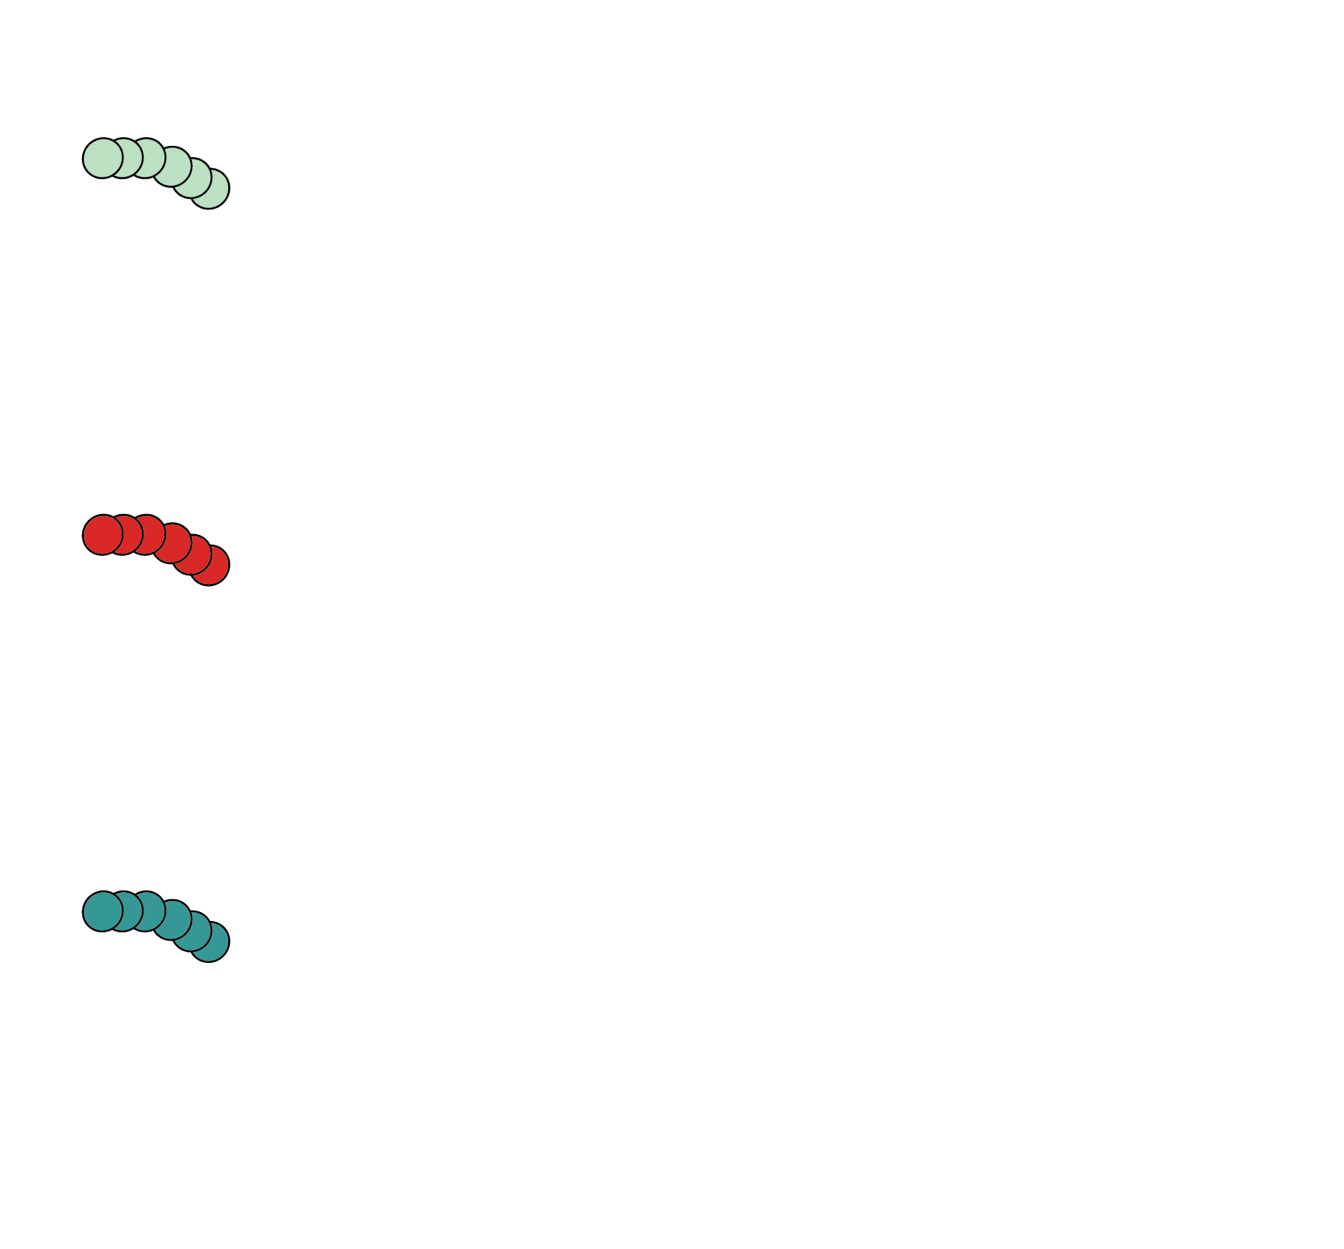
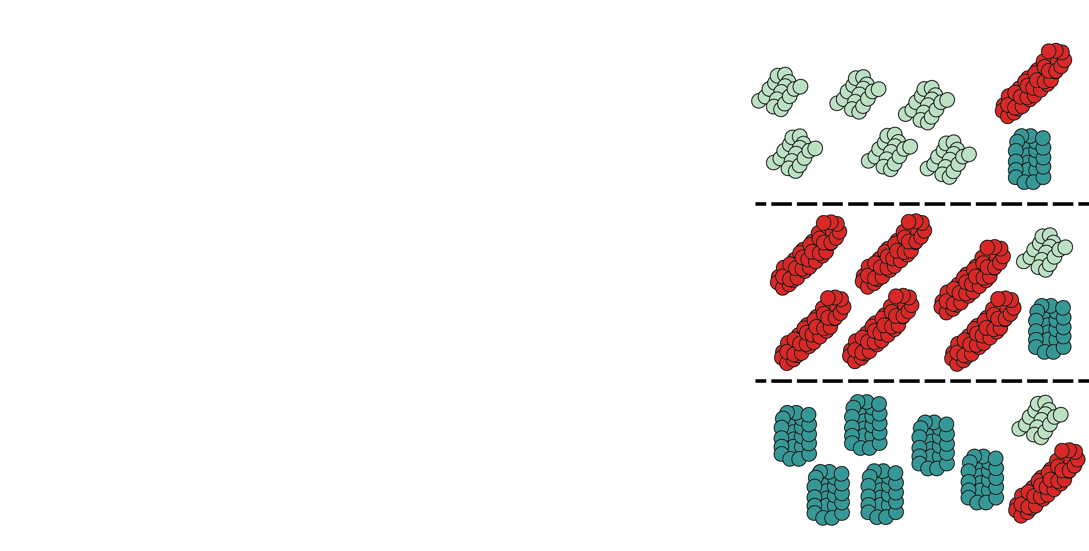
Why have multiple bS21 homologs?
Hypothesis
Incorporation of distinct bS21s:
Heterogeneous ribosomes
Altered translation initiation for distinct mRNAs
Regulation of protein expression during translation initiation
Modify the proteome
Easy to exchange, rapid response to changing conditions
Notes:
All of our data are consistent with this model
But now we want to do genome wide,
Don’t want to do a lot of assays for all 3 homologs
Next slide put goals

Slide 17
Goals
Use ribosome profiling to determine if ribosomes with different bS21 homologs are preferentially translating particular mRNAs

Slide 18
Ribosome profiling
Provides a global snapshot of translation across the genome
Reveals the position and densities of ribosomes on individual mRNAs

Slide 19
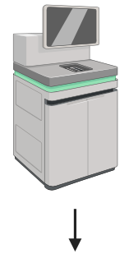
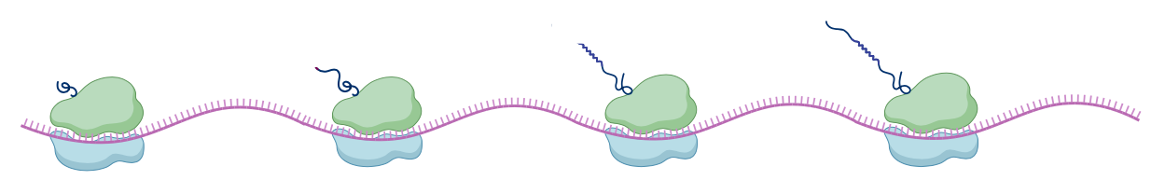
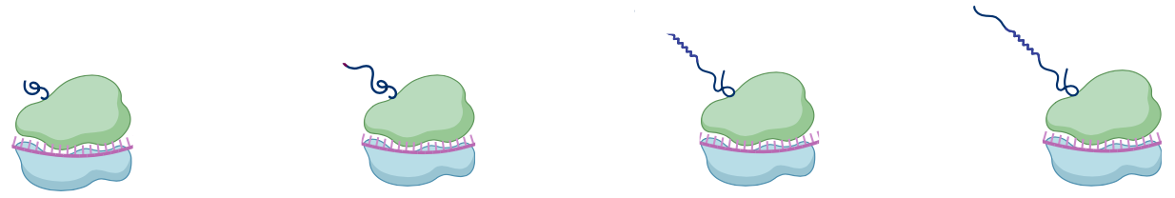
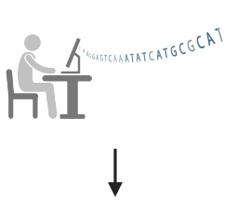
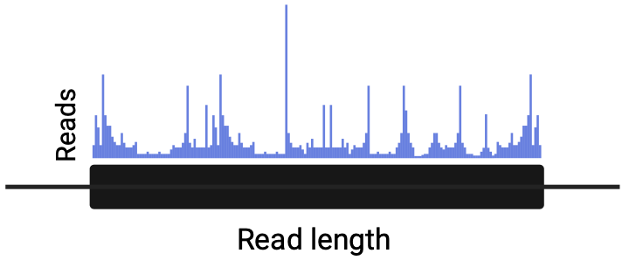
Overview of ribosome profiling
Notes:
arrows

Slide 20
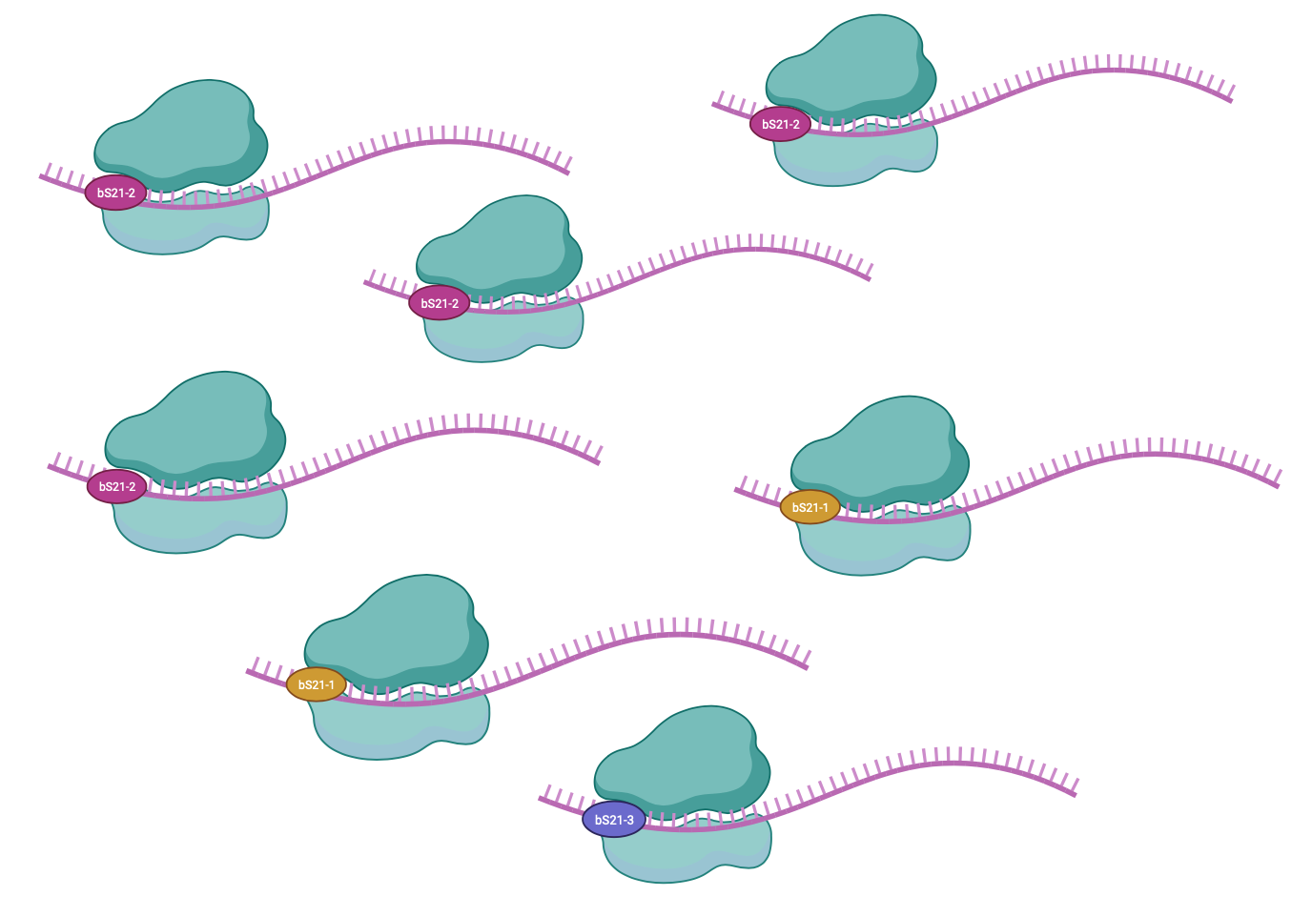
Heterogeneity of bS21 in LVS
How do we specifically identify translation by each homolog?
Notes:
Make bS21 bigger

Slide 21
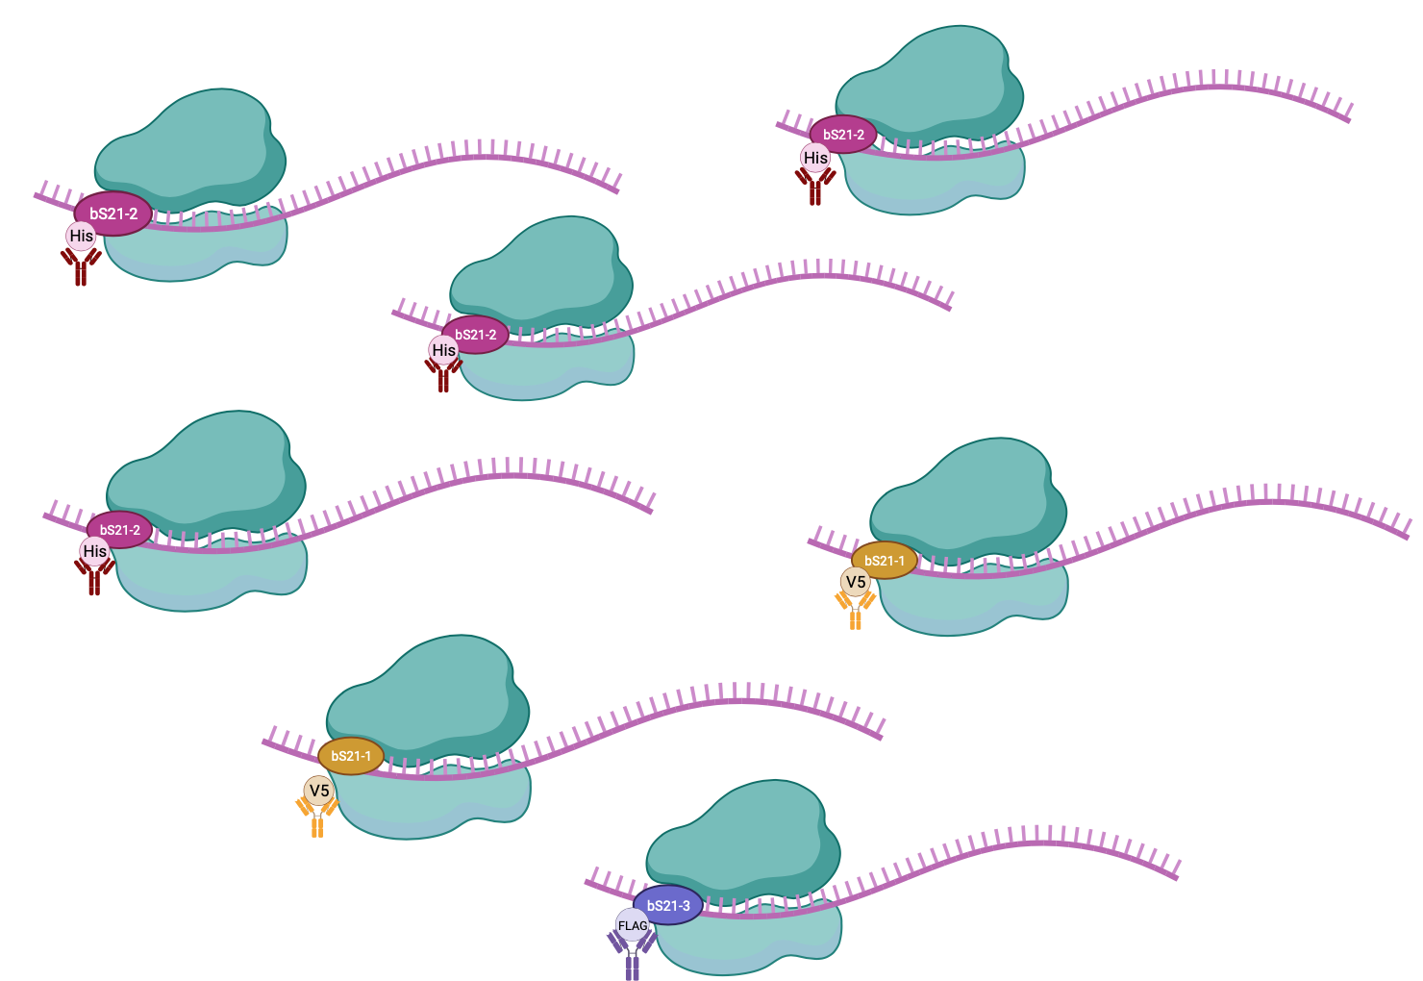
Heterogeneity of bS21 in LVS
How do we specifically identify translation by each homolog?

Slide 22
Selected epitope tags to be tested for pulldown efficiency by immunoprecipitation
Epitope Tag | Size
HA | 1.1 kDa
6X His | 0.8 kDa
FLAG | 1 kDa
V5 | 1.4 kDa
Generated strains with ectopically expressed bS21-2 with epitope tags
Notes:
WCL and ran it on a WB validate antibodies in each strain

Slide 23
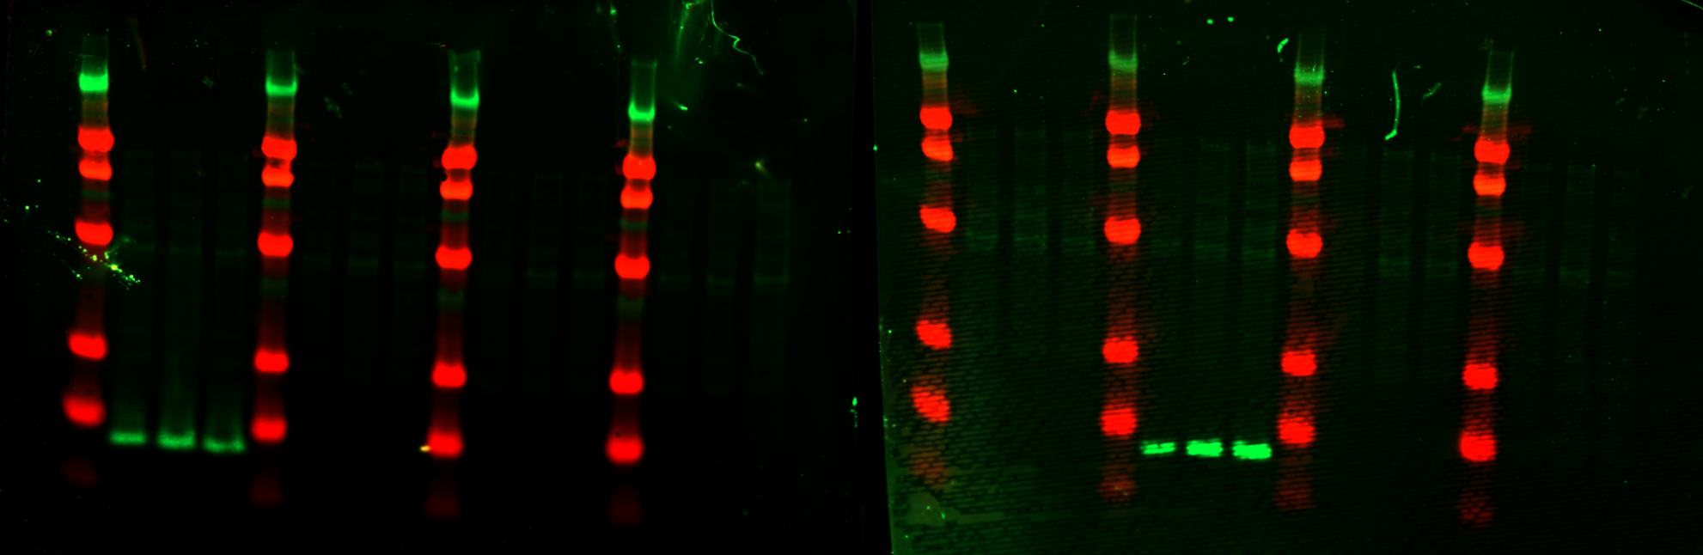
No cross-reactivity to antibodies
HA
A B C
His6
A B C
FLAG
A B C
V5
A B C
HA
A B C
His6
A B C
FLAG
A B C
V5
A B C
ladder
ladder
ladder
ladder
ladder
ladder
ladder
ladder
kDa
250
90
50
30
15
8
α-HA
α-His6
Notes:
Straighten the ladder
Underline tag name
Reveal HA in parts, his as a whole
Don’t see cross reactivity with endogenous Ft proteins

Slide 24
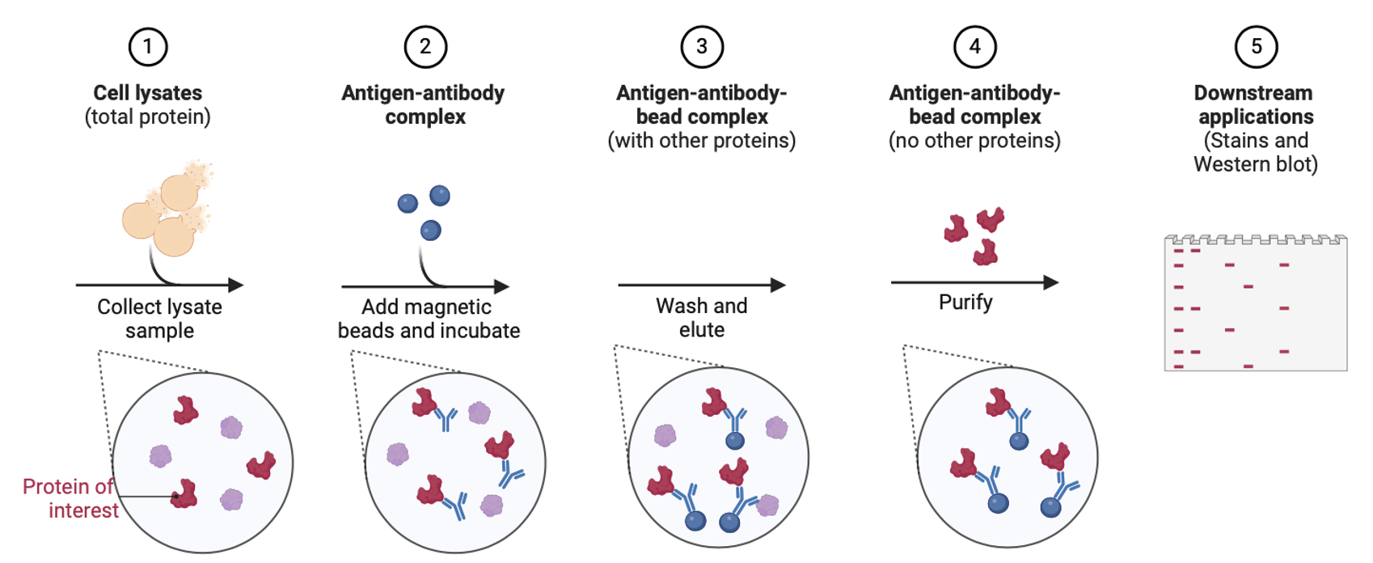
Immunoprecipitation protocol

Slide 25
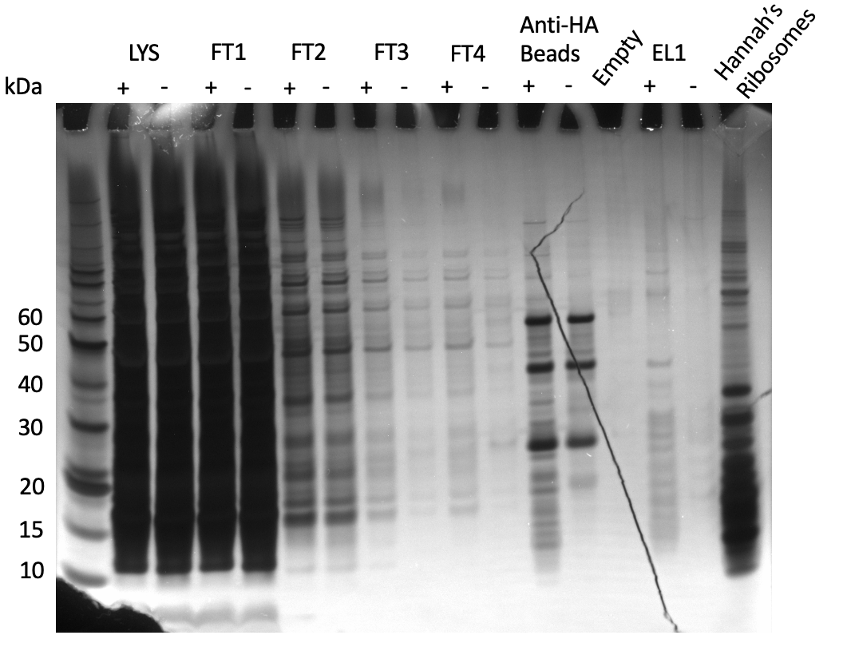
Pulling down of
70S ribosome with bS21-2-HA

Slide 26
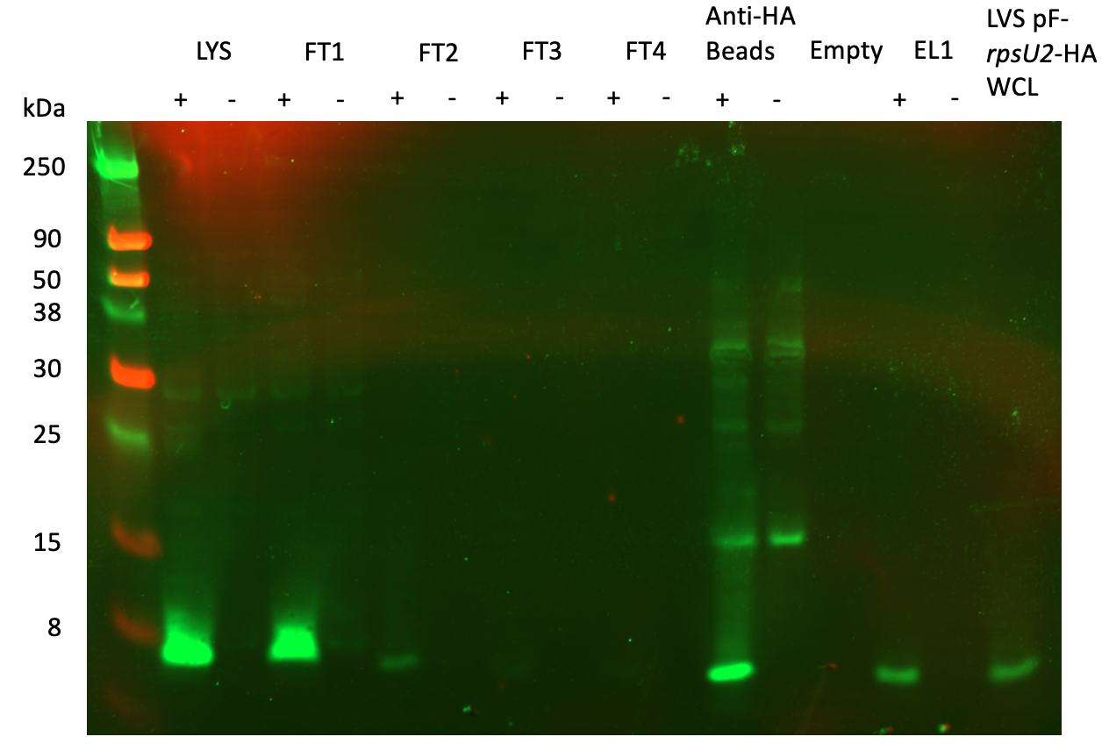
bS21-2 is pulled down
Notes:
Reveal
Binding efficiency
Buffer optimization or increasing beads

Slide 27
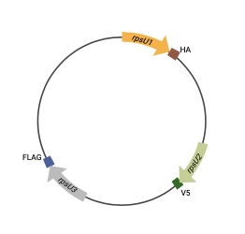
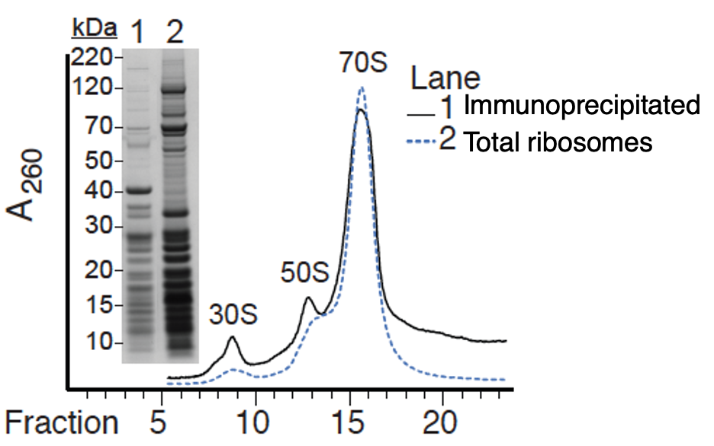
Next steps:
Perform fractionation via sucrose gradients to confirm presence of intact 70S ribosomes
Add DNA specifying epitope tags to rpsU genes on the chromosome
Notes:
Explain fractionation
Add image of prelim data

Slide 28
Future directions
  Define preferential proteome of different ribosome classes
  What RNA elements lead to preferential translation initiation
  Recapitulate results using in vitro translation assays
Notes:
In vitro assays to assess if there are other factors in vivo that influence translation of particular mRNAs
Direct by ribosome or indirect by other post-transcriptional regulators
ID genes for future drug development

Slide 29

Acknowledgments
Ramsey Lab
Dr Kathryn Ramsey
Dr Hannah Trautmann
Sierra Schmidt
Ben Moore
Alex Farah
Johanyx Rodriguez
Christina Surace
Committee Members
Dr Marta Gomez-Chiarri
Dr Steve Gregory
Janet Atoyan
Gregory Lab

Slide 30
Aim 1 Alternative Approach
Adjust our model: is it abundance of a specific homolog that governs regulation?
  If the identity of the homolog does not matter, perhaps a certain amount of any given homolog is required for preferential translation of mRNAs

Slide 31
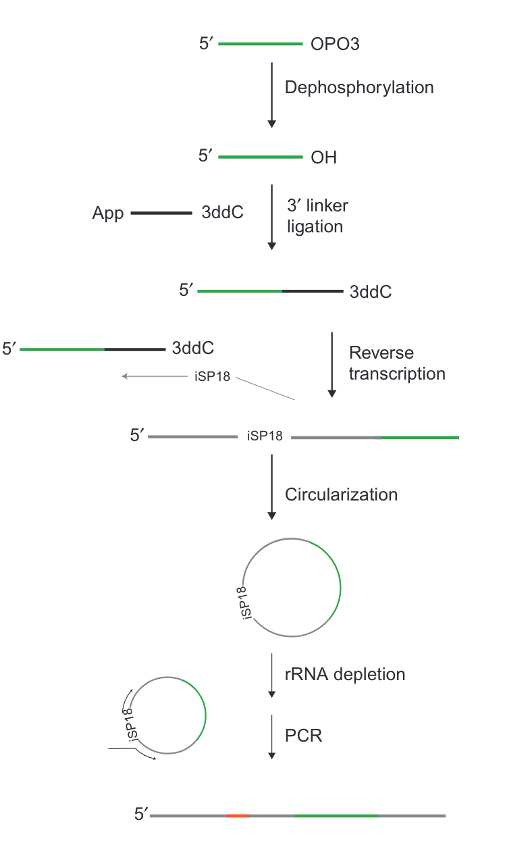
Ribosome Profiling:
Library Prep
Illumina Sequencing
Johnson and Li, 2018

Slide 32
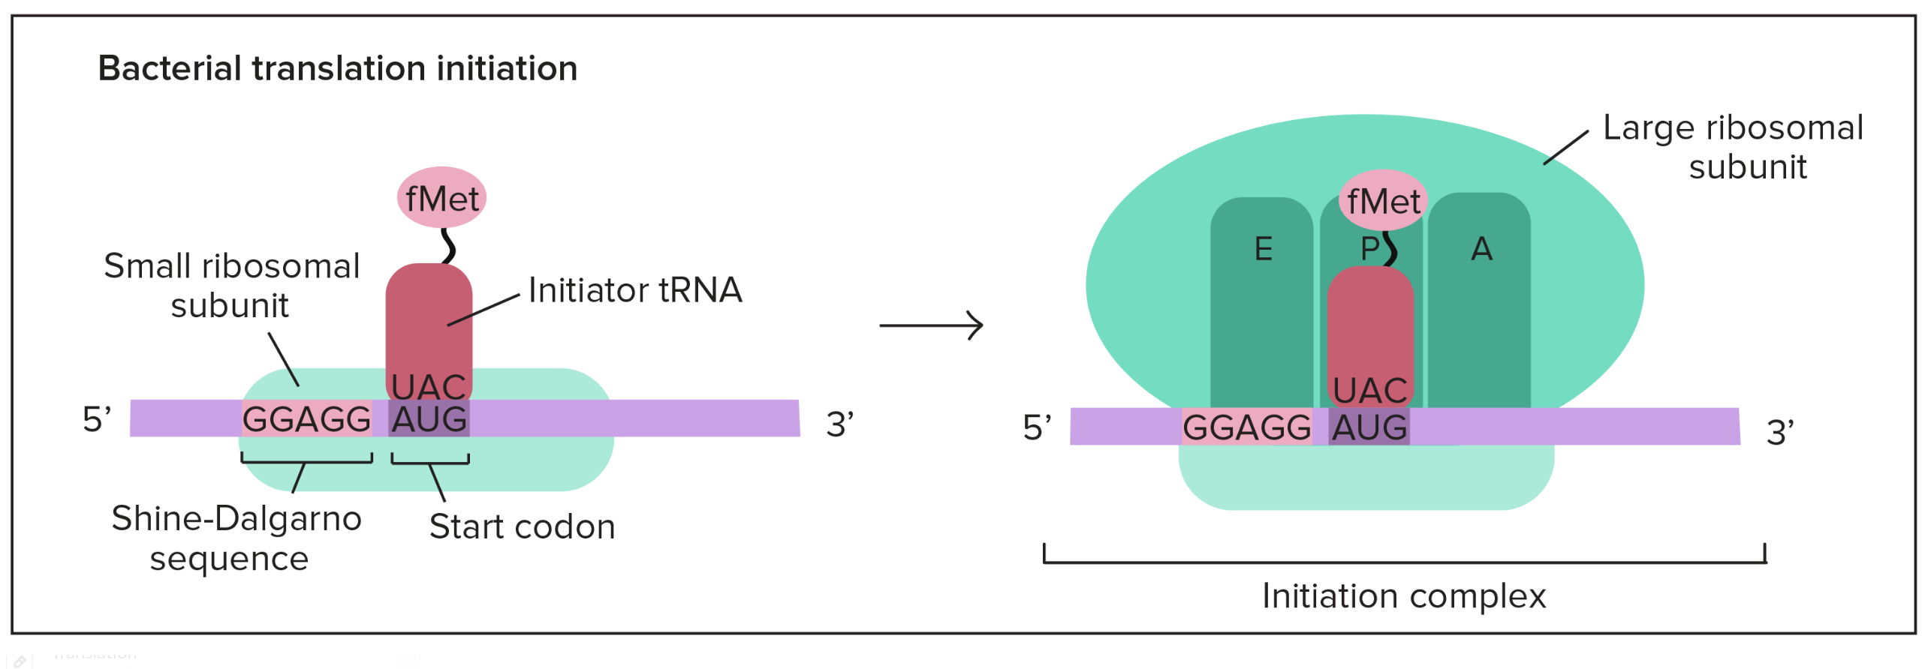
Translation initiation in prokaryotes
Khan Academy
Notes:
Translation initiation is rate limiting step of translation and is highly regulated
fMet tRNA: forymlated methionine that carries a “false” peptide bond between met amino and formyl carboxyl group
IF1: binds to A site of 30S, maybe directs fMet tRNA to P site by blocking A site
IF2: facilitates binding of fMet-tRNA
IF3: required for binding of mRNA to 30S
when does 50S bind? After initiation complex
GTP hydrolysis powers elongation
Release factor: resembles tRNA, instructs peptidyl transferase to add a water molecule at the carboxyl end of the amino acid in the P site, aa detaches from tRNA and protein is released

Slide 33
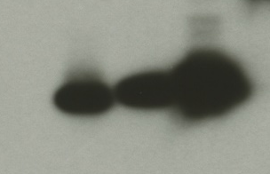
Multiplr homologs incorporate into ribosome
bS21-2-V
bS21-1-V
bS21-3-V
WT
α-VSVG

Slide 34
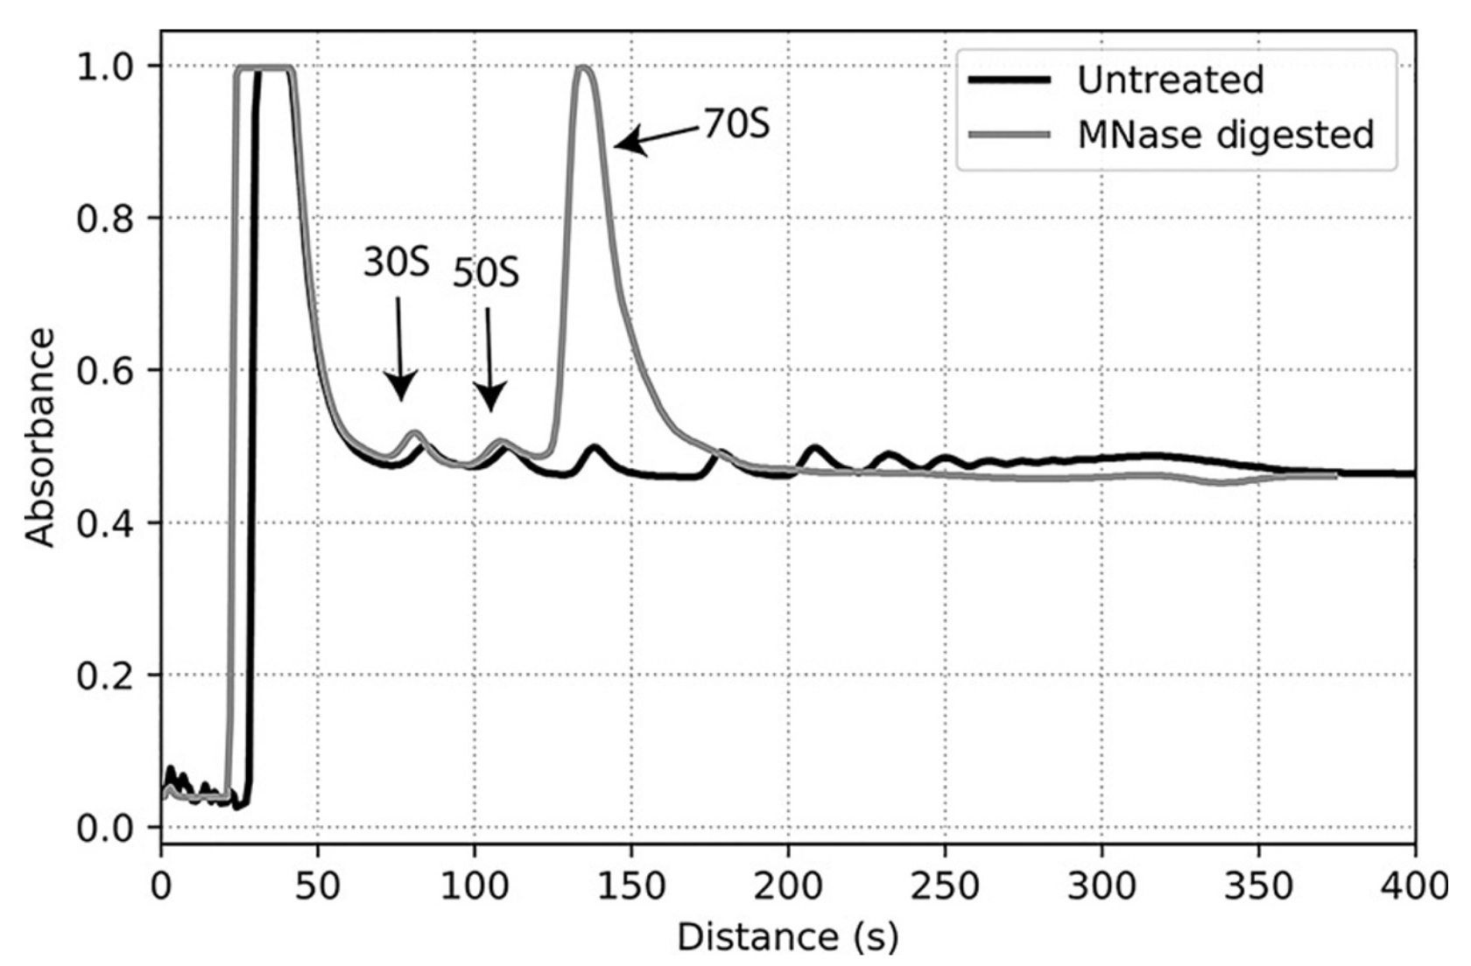

Slide 35
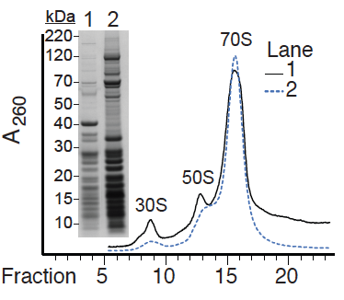
70S Ribosomes can be pulled down
Immunoprecipitated
Total ribosomes

Slide 36
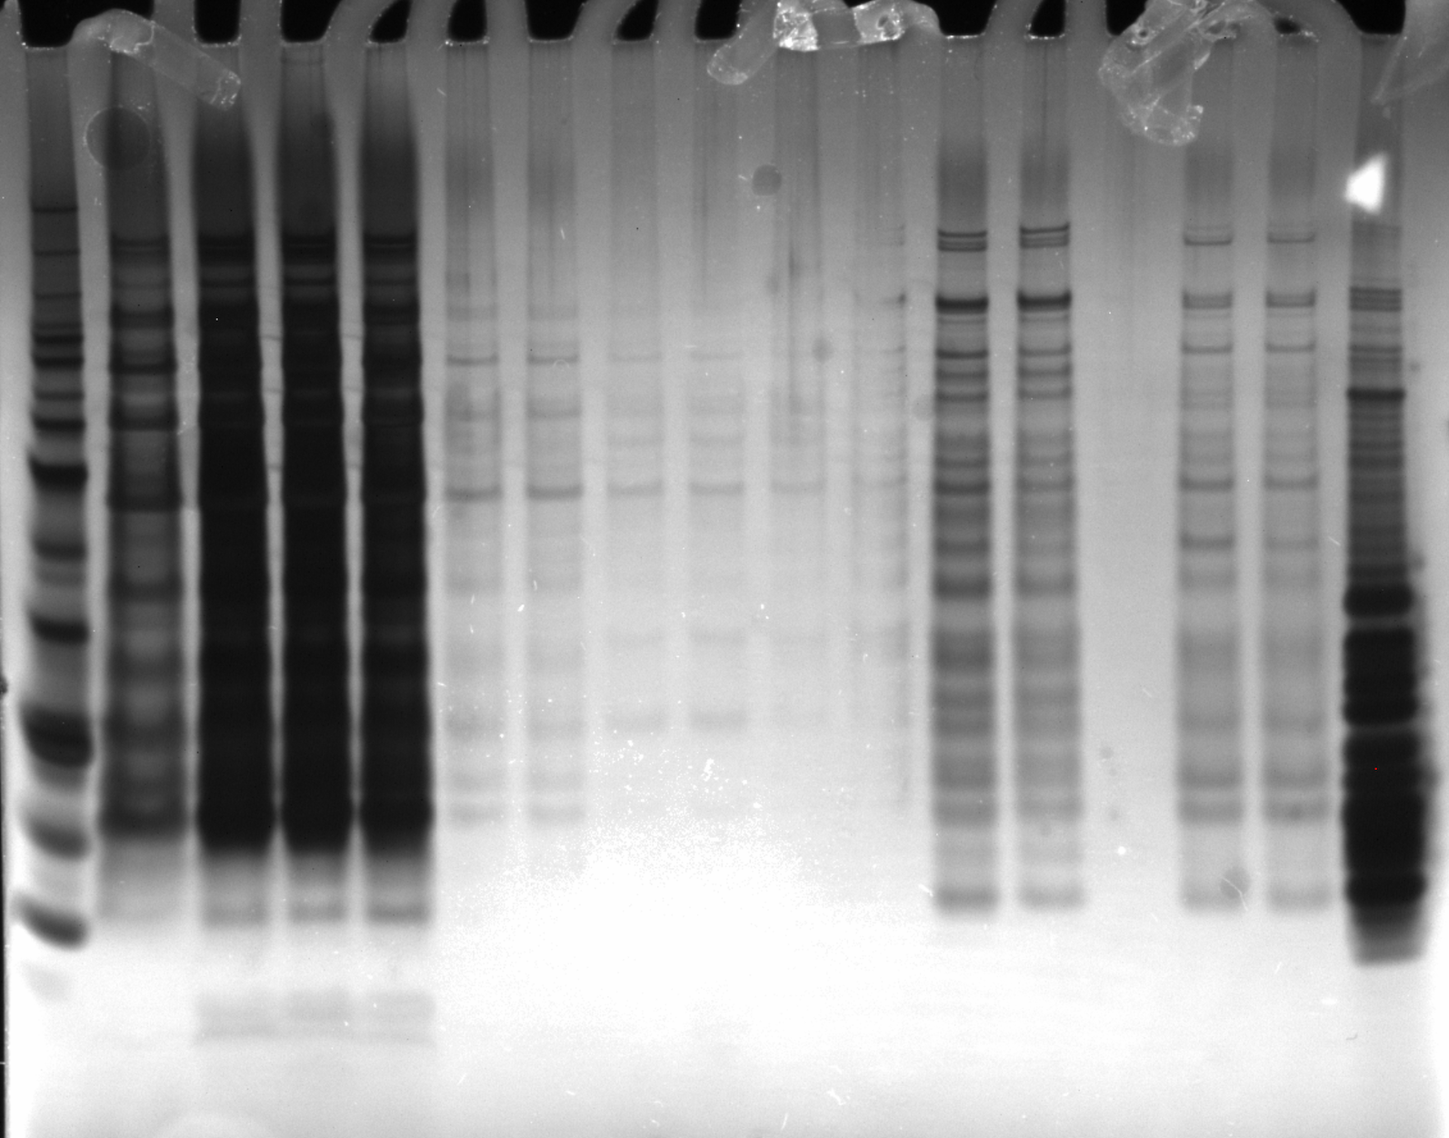
Ni-NTA
Beads
1X
SLB
Hannah’s
Ribosomes
BenchMark
Ladder 1:10
LYS
FT1
FT2
FT3
FT4
EL1
+
-
+
-
+
-
+
-
+
-
+
-
+
-
Silver Stain of
His6 IP
11/7/23

Slide 37
Ni-NTA
Beads
1X
SLB
Hannah’s
Ribosomes
BenchMark
Ladder 1:10
LYS
FT1
FT2
FT3
FT4
EL1
+
-
+
-
+
-
+
-
+
-
+
-
+
-
Silver Stain
11/7/23

Slide 38
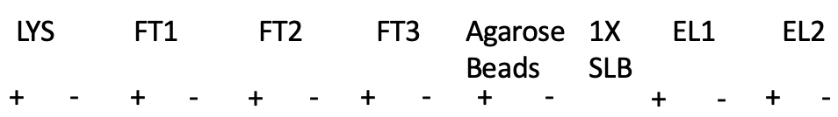
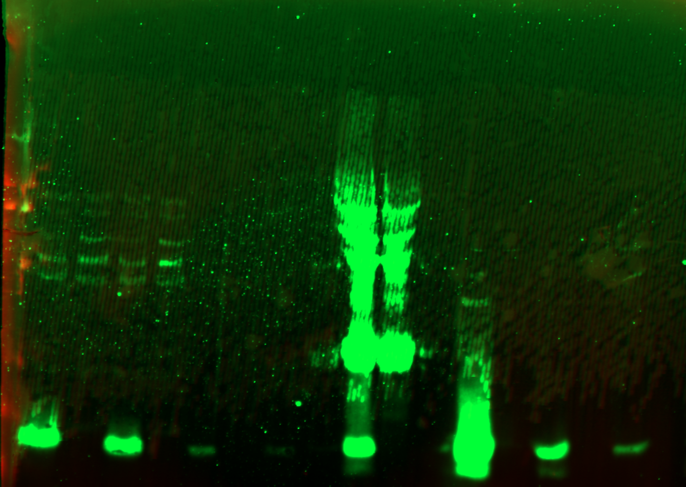
FLAG-
WCL
WesternSure
Ladder
α-FLAG 1:1000

Slide 39

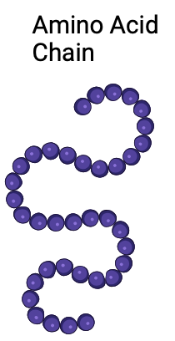

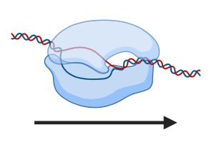
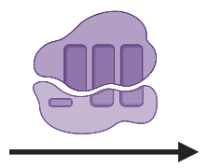


Central Dogma
Notes:
utlple regulatuions

Slide 40
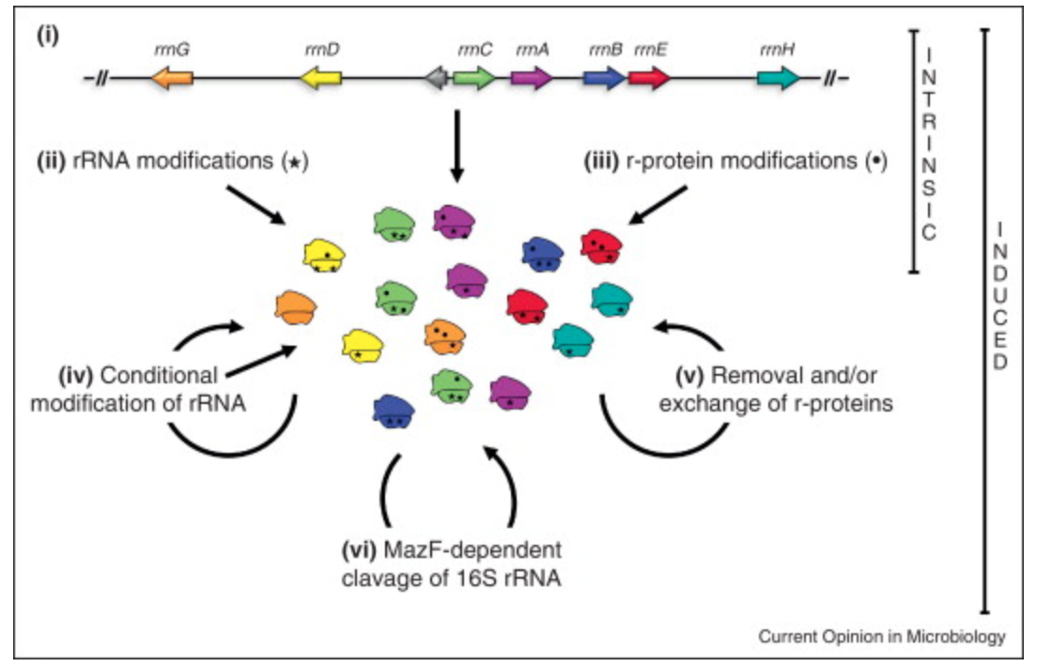
Sources of heterogeneity in ribosomes
Byrgazov et al, 2013
Notes:
i. Sequence micro-heterogeneity in rRNA operons
ii. Diverse modifications of rRNA (stars)
iii. Assembly of modified r-proteins (dots)
iv. Conditional modifications of rRNA (either during biogenesis or on mature ribosomes)
v. Removal or exchange of r-proteins (specifically referring to replacing damaged r-proteins)
vii. MazF enoribonuclease truncates 16S rRNA
Straight arrows = biogenesis
Curved arrows = mature ribos

Slide 41
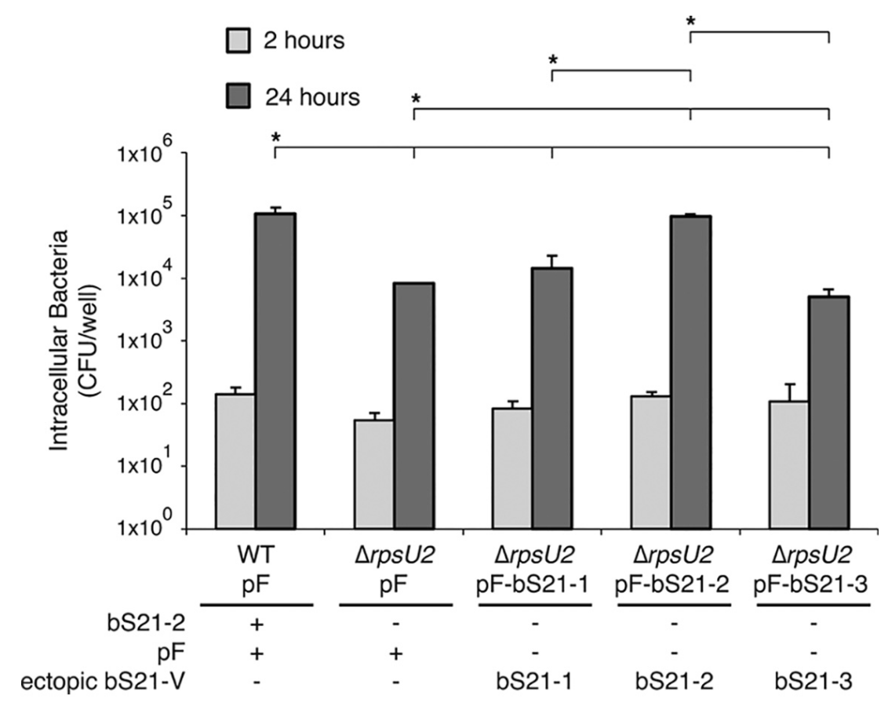
bS21-2 is specifically required for intramacrophage growth
Trautmann and Ramsey, 2022

Slide 42
Hypothesis: Different populations of ribosomes in F. tularensis will preferentially translate specific mRNAs
Specific Aim 1. Determine how incorporation of specific F. tularensis bS21 homologs into the ribosome influences translation initiation on transcripts, genome wide.
Approach: ribosome profiling and RNA-Seq to assess relative translation of all F. tularensis mRNAs across the genome

Slide 43
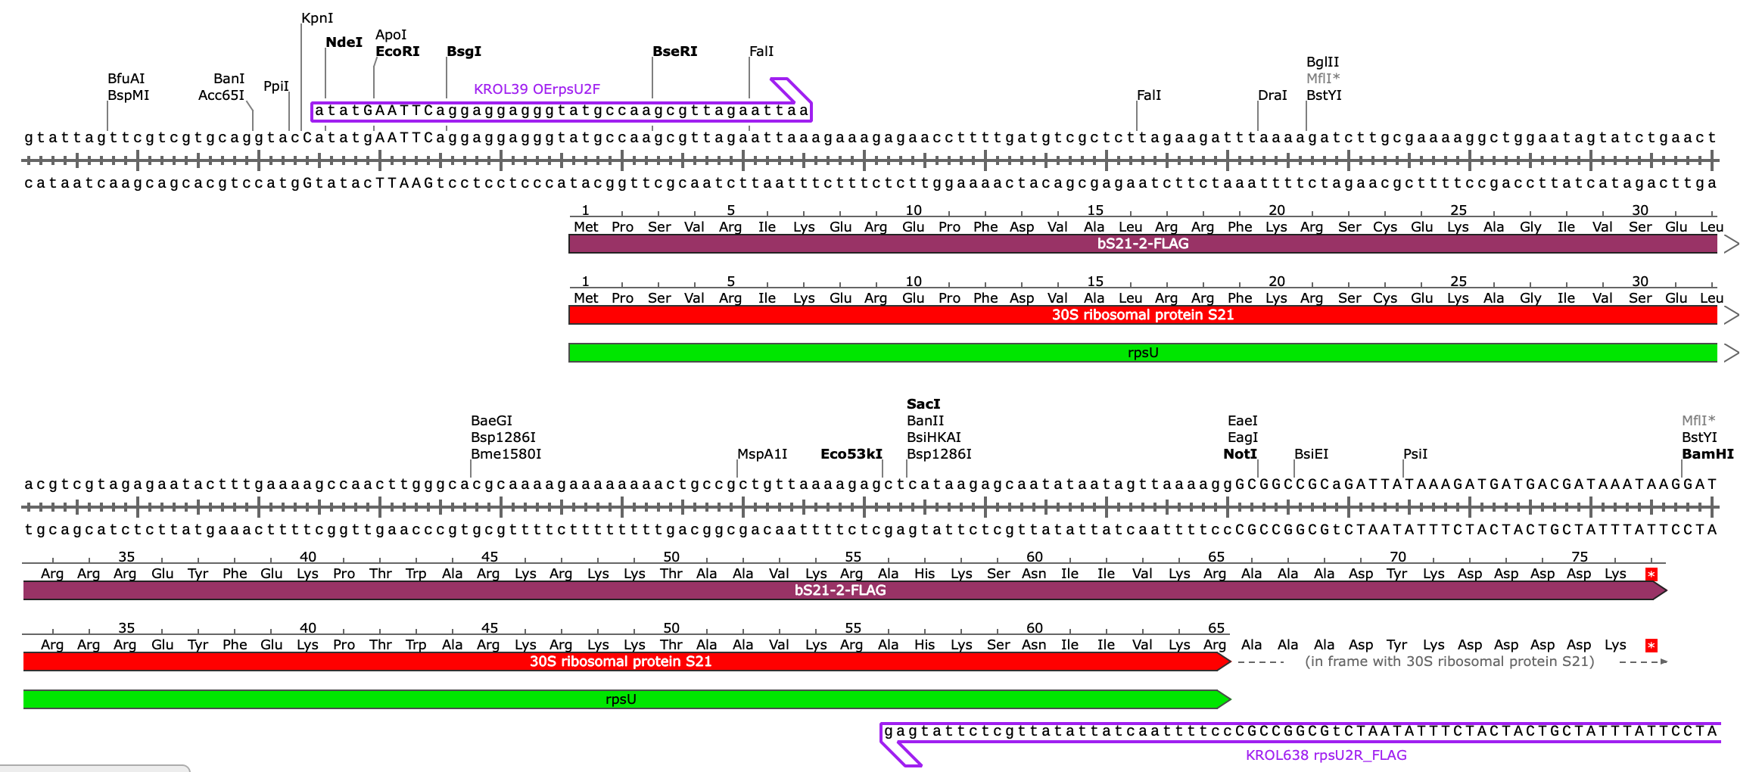
Plasmid design

Slide 44
Outline
Introduction
  F. tularensis
  Gene regulation
  Ribosome heterogeneity
Ribosome profiling for multiple classes of ribosome
  Ribosome profiling overview
  Validating IP results
  Next steps

