Slide 1
Structural insights of translation initiation of the λcl leaderless mRNA

Slide 2
Prokaryotic Translation Initiation
The ribosome binding site (RBS) places the mRNA in the initiation position
RBS is located in the 5’-UTR (aka leader), contains the Shine Delgarno sequence
Shine Delgarno is complementary to 5’ end of 16S rRNA (aka anti-Shine Delgarno)
This interaction positions start codon at P site to recognize initiator tRNA
Not essential!

Slide 3
Prokaryotic Translation Initiation
lmRNA can be directly loaded onto 70S in the presence of initiator tRNA
λcI allows transition from lytic to lysogenic cycle of phages
Encoded by lmRNA
No SD, initiation occurs in 70S rather than 30S
E coli lacking uS2 can translate λcI more efficiently
  Translation is enhanced by a down-stream box

Slide 4
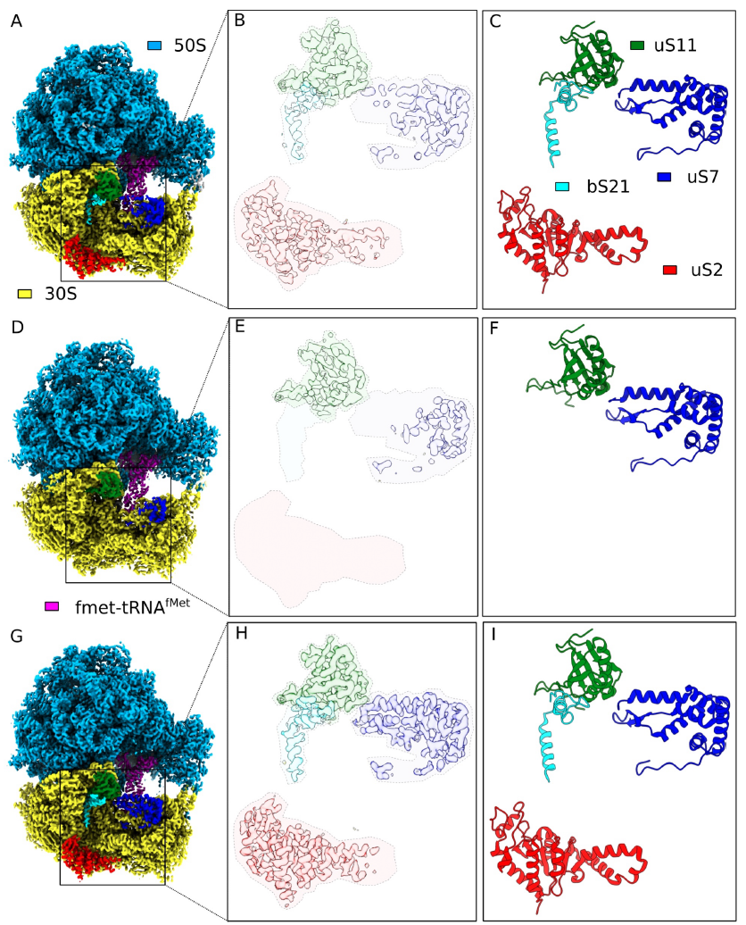
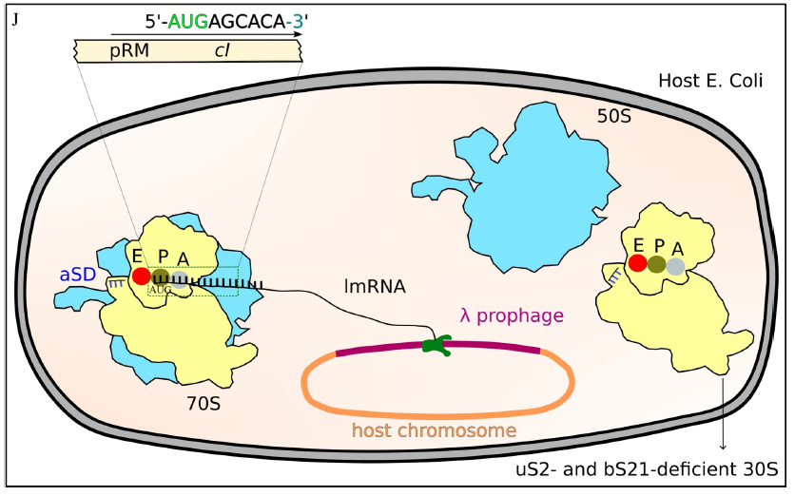
nB11
wB11
Figure 1: Comparisons between ribosomes lacking
or containing uS2/bS21 isolated from an rpsB11
mutant preparation
MR600

Slide 5
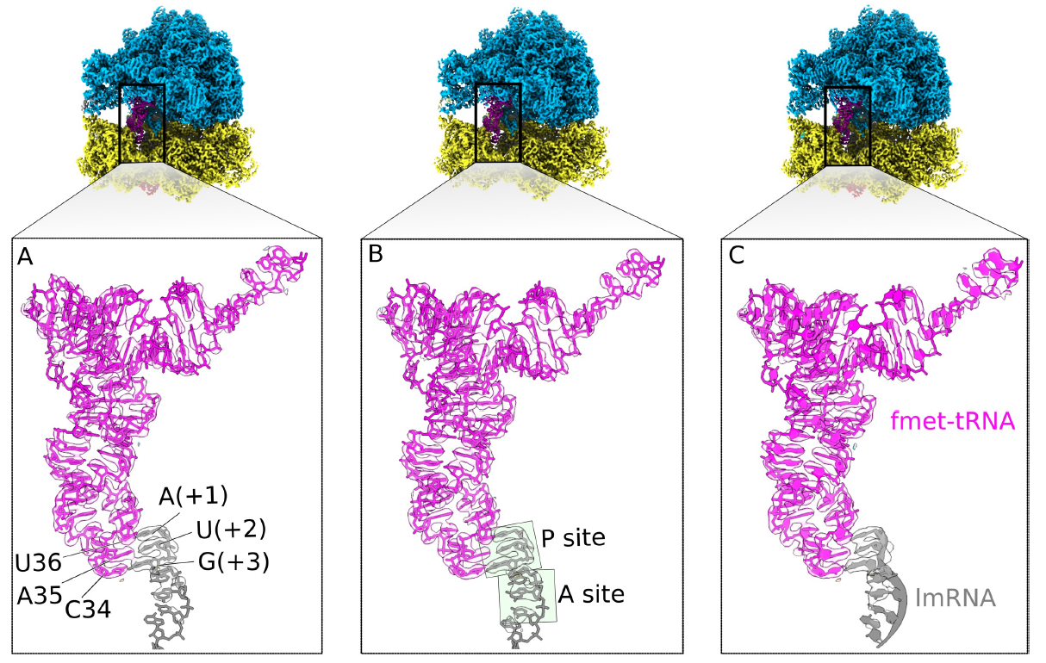
Figure 2: The λcI lmRNA interaction with both tRNA and 16sRNA
wB11
nB11
MR600
λcI lmRNA interactions with fmet-tRNA^{fMet}

Slide 6
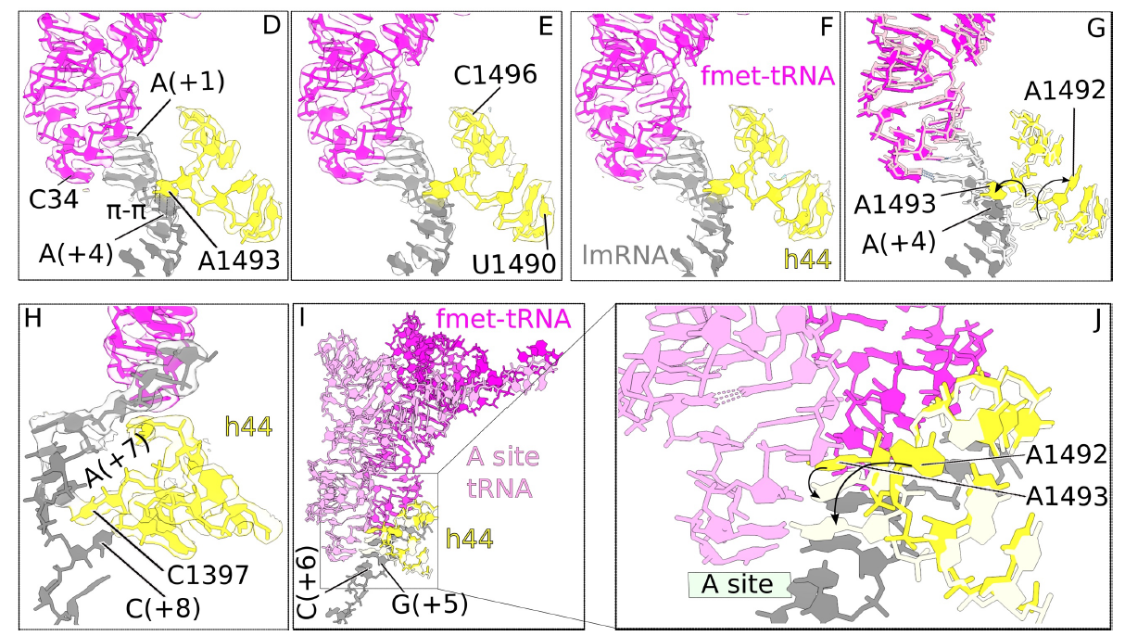
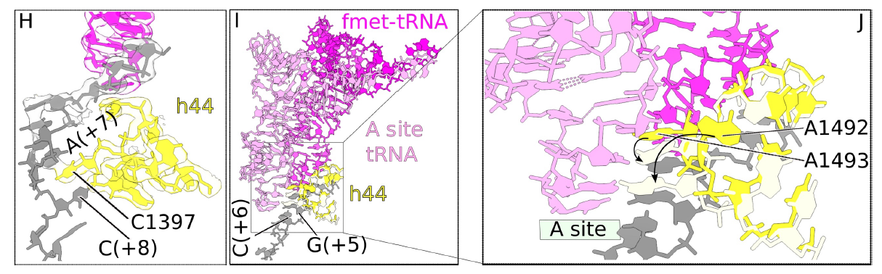
π-π stacking
Monitor base

Slide 7
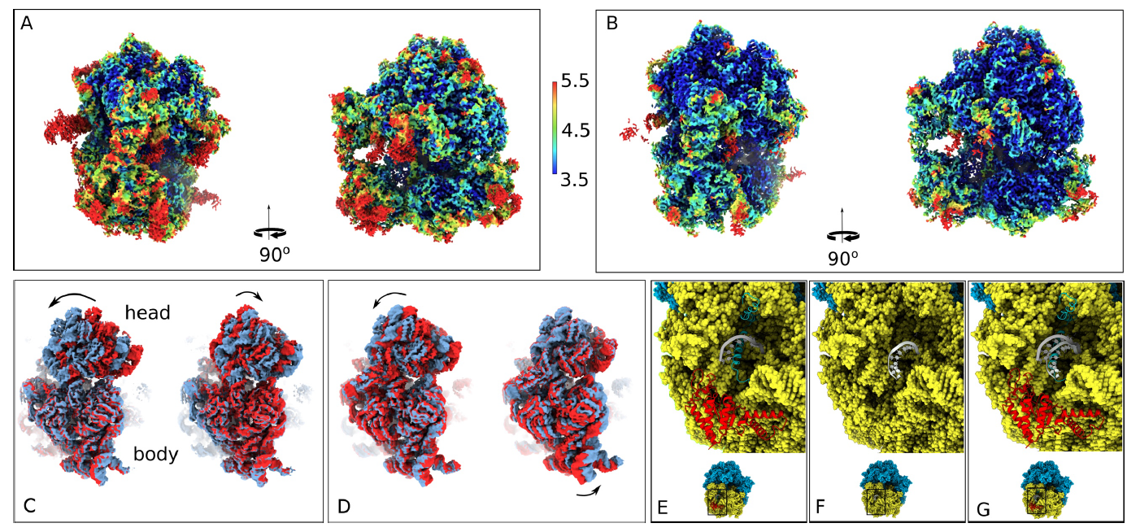
Figure 3: Dynamics od nB11 30S head and aSD shift
Removal of uS2 ans bS21 substantially increase dynamic of 30S head
Lack of bS21 causes aSD to move

Slide 8
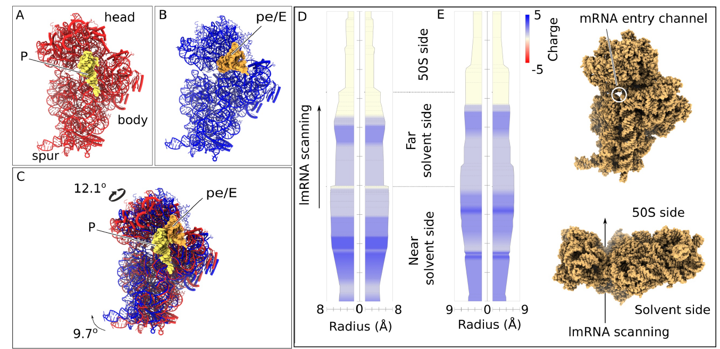
Figure 4: Dynamics and charge flow in the mRNA entrance channel due to 30S head and body
movement in nB11

Slide 9
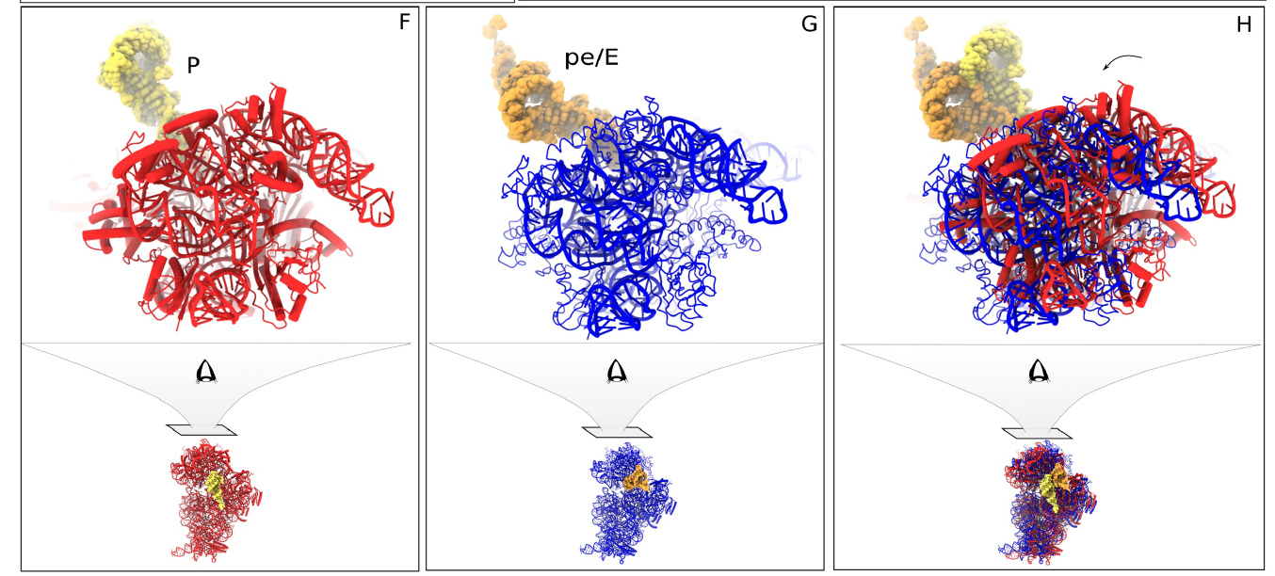

Slide 10
