Slide 1
Exploring the role of bS21 function in bacterial pathogens
Kira Bernabe
CMB Seminar
01/26/24

Slide 2
Outline
Introduction
  F. tularensis
  Gene regulation
  Ribosome heterogeneity
Ribosome profiling for multiple classes of ribosome
  Ribosome profiling overview
  Validating IP results
  Next steps

Slide 3
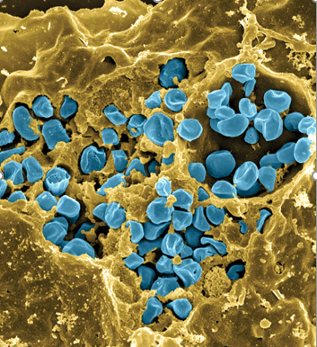
Francisella tularensis
Gram negative facultative
intracellular pathogen
Causes tularemia
Strain A: F. tularensis subsp tularensis
Strain B: F. tularensis subsp holarctica
  LVS
Control of virulence genes
Fischer, PNAS cover, 2006

Slide 4
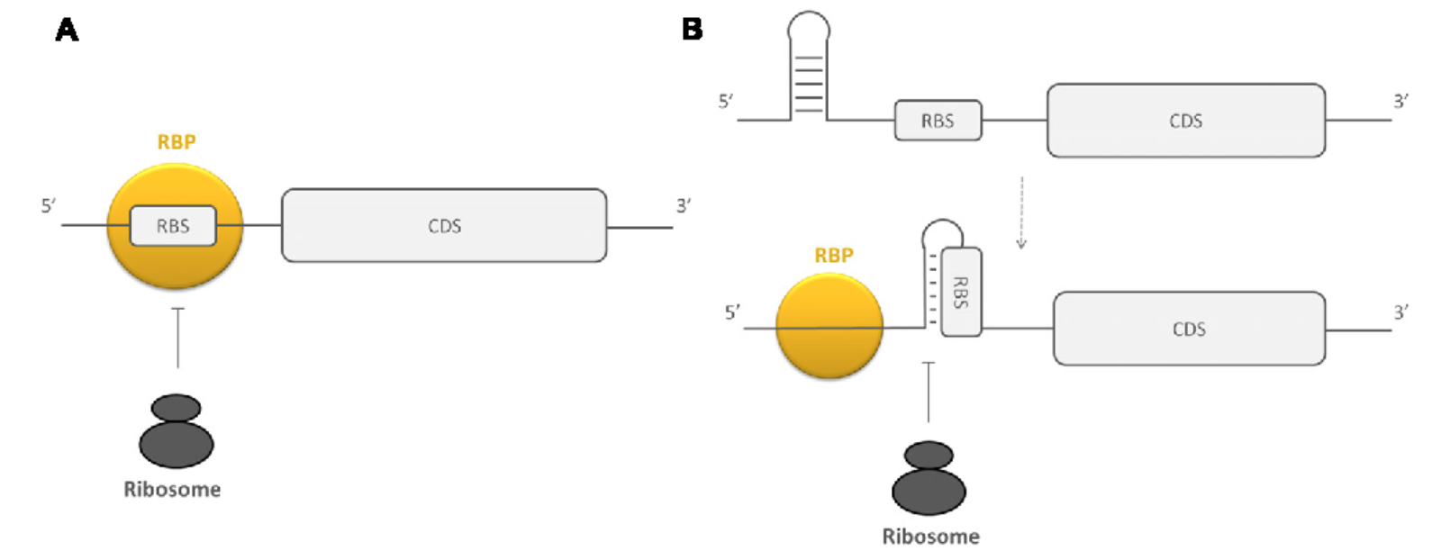
Post-transcriptional gene regulation
mRNAs
sRNAs
RNA binding proteins
Ribosome binding proteins
Van Assche et al, 2015
Notes:
Well described mechanisms of regulation for elements that act on mRNA
Less clear are examples of how ribo composition itself affects gene reg
Top right: RBPs influencing access to RBS
A: directly blocking region
B: changing secondary structure of region surrounding RBS
RNA binding proteins (HfQ, CsrA): adaptation of susceptibility of mRNA and sRNA to RNase, modulating accessibility of ribo binding site of mRNA, recruiting and assisting in interaction of mRNA with other molecules, regulate formation of transcription terminator/anti-terminator structures
mRNAs: 5’ and 3’ UTRs have regulatory capacity, degradation
sRNAs: help bacteria adapt to environmental change, base pairing with mRNA either perfectly (cis) or not (trans). Bind in vicinity of ribo binding site to inhibit translation initiation/ stimulate mRNA decay or they can do the opposite by base pairing the 5’ UTR way upstream of RBS

Slide 5
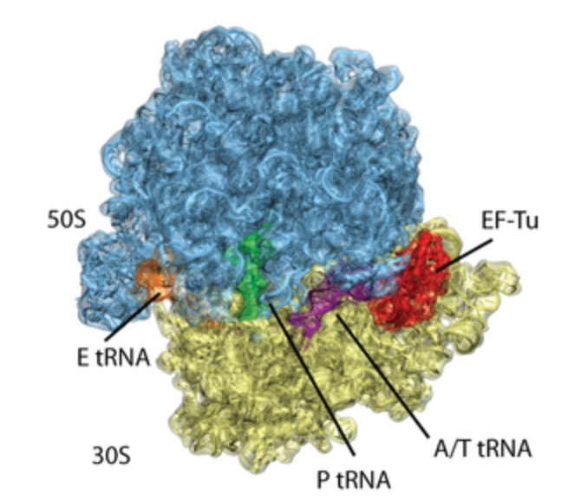
The Bacterial Ribosome
3 rRNAs
~55 r-proteins

Slide 6
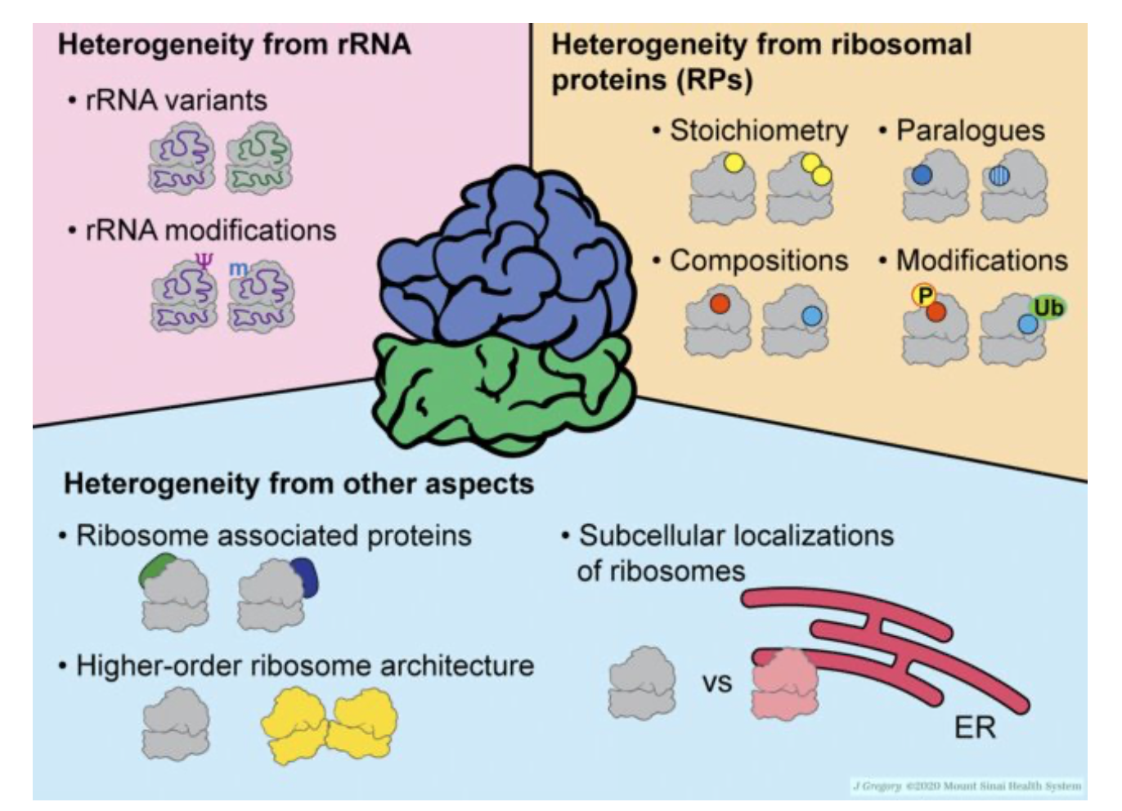
Sources of heterogeneity in ribosomes
Notes:
i. Sequence micro-heterogeneity in rRNA operons
ii. Diverse modifications of rRNA (stars)
iii. Assembly of modified r-proteins (dots)
iv. Conditional modifications of rRNA (either during biogenesis or on mature ribosomes)
v. Removal or exchange of r-proteins (specifically referring to replacing damaged r-proteins)
vii. MazF enoribonuclease truncates 16S rRNA
Straight arrows = biogenesis
Curved arrows = mature ribos

Slide 7
Multiple homologs of ribosomal proteins lead to change in phenotype in several bacteria
Mycobacterium smegmatis and Bacillus subtilis encode paralogs of several r-proteins that coordinate zinc
The transcription factor zinc uptake regulator (Zur) binds to the paralog that cannot coordinate zinc and represses it in high zinc environments
In low zinc, Zur does not bind the alternate; therefore, it is expressed, leading to heterogenous population of ribosomes

Slide 8
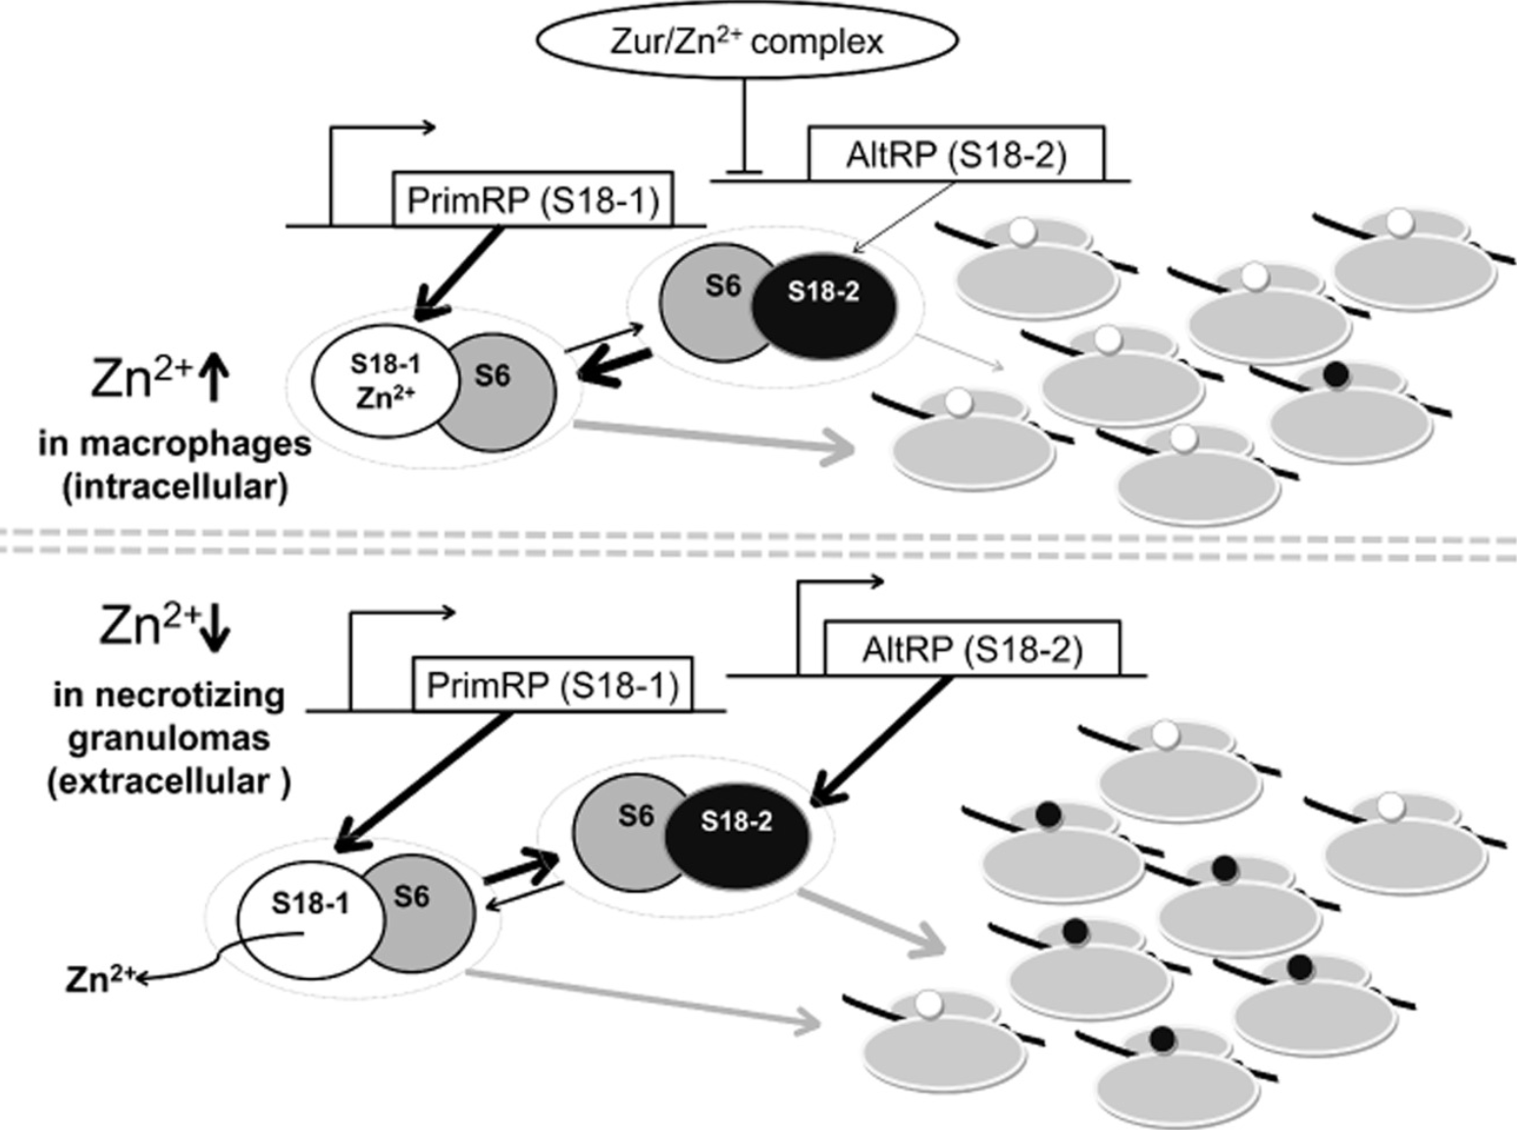
Multiple homologs of ribosomal proteins lead to change in phenotype in several bacteria
Prisic, et al 2015

Slide 9
Multiple homologs of ribosomal proteins lead to change in phenotype in several bacteria
Prisic, et al 2015
Notes:
Myco have an operon that encode several AltRPs

Slide 10
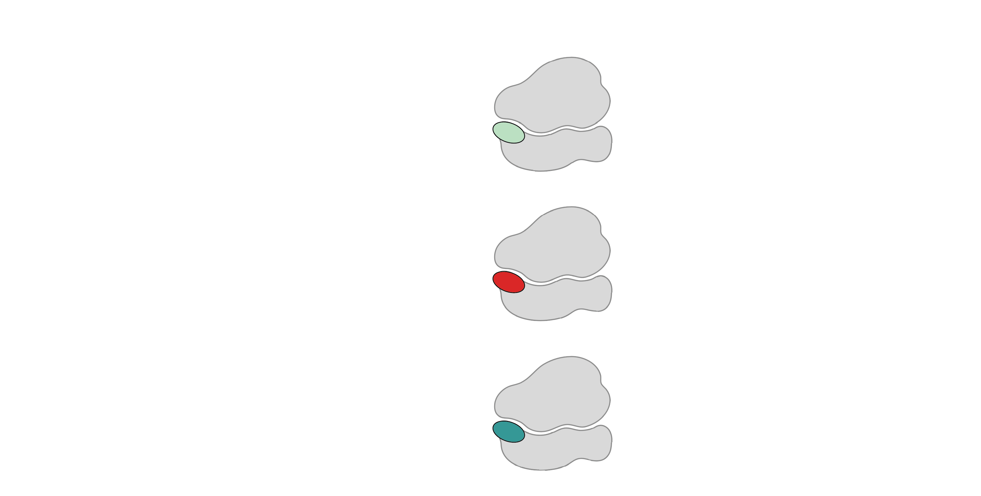
Multiple bS21 homologs lead to heterogenous ribosomes in Francisella tularensis
70S containing:
cspC
rpsU1
bS21-1
dnaG
bS21-2
rpsU2
yqeY
rpoD
rpsU3
bS21-3
Trautmann and Ramsey, 2022
Notes:
Even though francisella has a reduced genome, it encodes three copies of the rpsU genes, which encode bS21, a protein in the small ribosomal subunit. Most bacteria have 0 or 1 of this gene. We originally, hypothesized, and have since shown, that these three proteins are produced and incorporated into ribosomes. This is a western blot of purified ribosomes from our wild-type strain as well as strains ectopically expressing each of the bS21 proteins, with a VSVG tag. This, along with some mass spec data we have of purified ribosomes, indicates that multiple classes of ribosomes are possible and occurring
This protein is also interesting to us because it is located close to the mRNA exit channel in the ribosome, and early research has identified that it is involved in translation initiation, so it is in an ideal location to be regulating gene expression at the level of translation initiation.

Slide 11
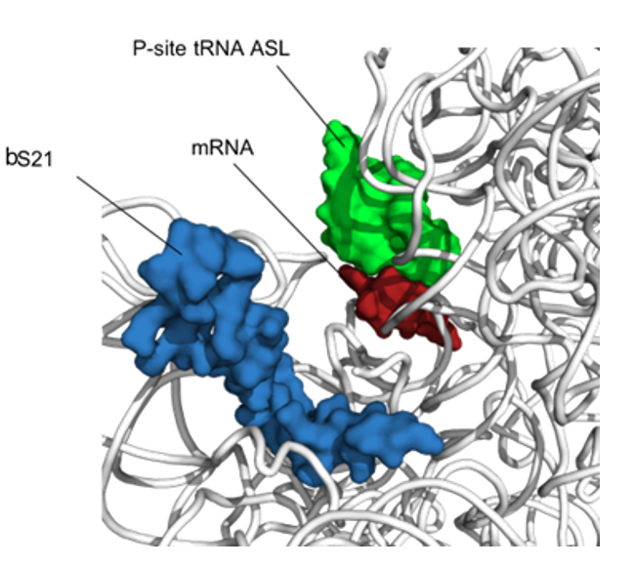
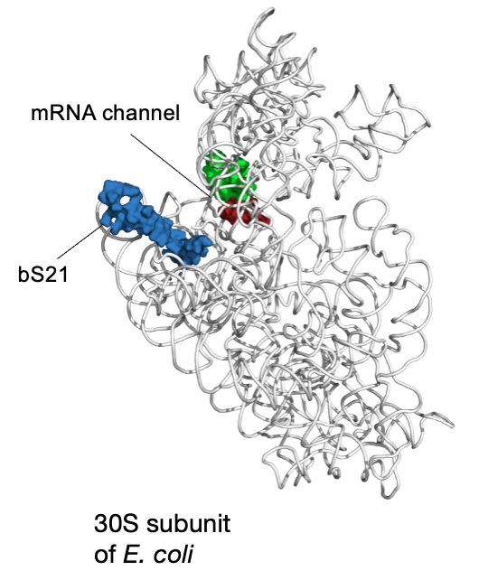
bS21: a small subunit ribosomal protein
bS21 is involved in translation initiation

Slide 12
The function of a bS21 in various bacteria
  Non-essential ?
  Can be easily exchanged
  Implicated in control of specific processes
    biofilm
    motility
    acid stress resistance
    antibiotic resistance
    virulence
  Involved in translation initiation
mRNA channel
P-site tRNA ASL
mRNA (P-site codon)
bS21
Hannah Trautmann

Slide 13
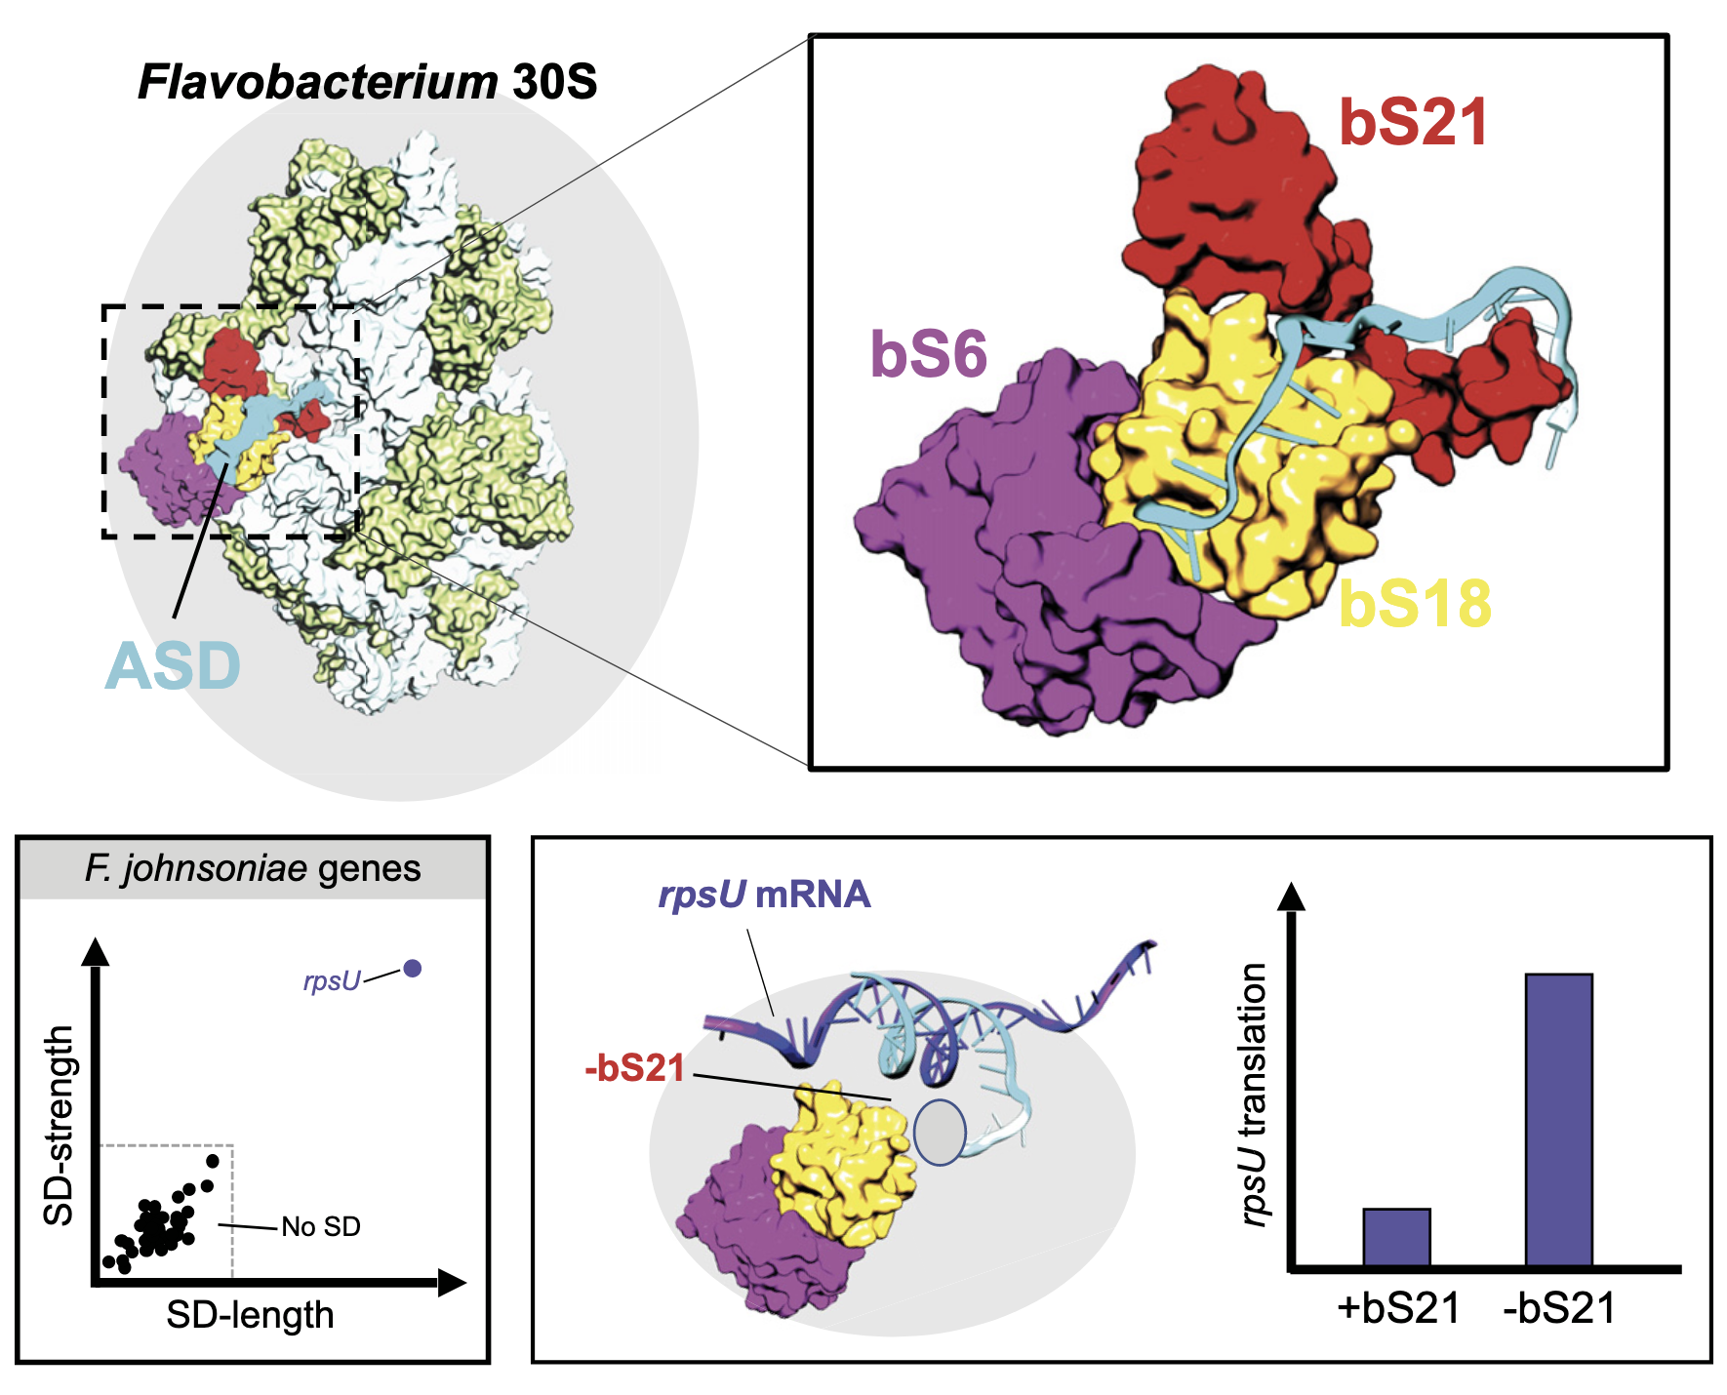
bS21-mediated specialized ribosomes in Bacteroidia
Anti-Shine-Dalgarno
(ASD)
16S rRNA
Many bacteria use SD-ASD pairing
Bacteroidia do not
  bS21 has unique C-term
5ʹ
3ʹ
A
U
UCCUCCA
5ʹ
NNNNNAGGAGGU(N₅₋₁₀)AUG(N_{n})
3ʹ
Shine-
Dalgarno (SD)
Initiation
Codon
mRNA
Jha et al., 2020; McNutt et al., 2023

Slide 14
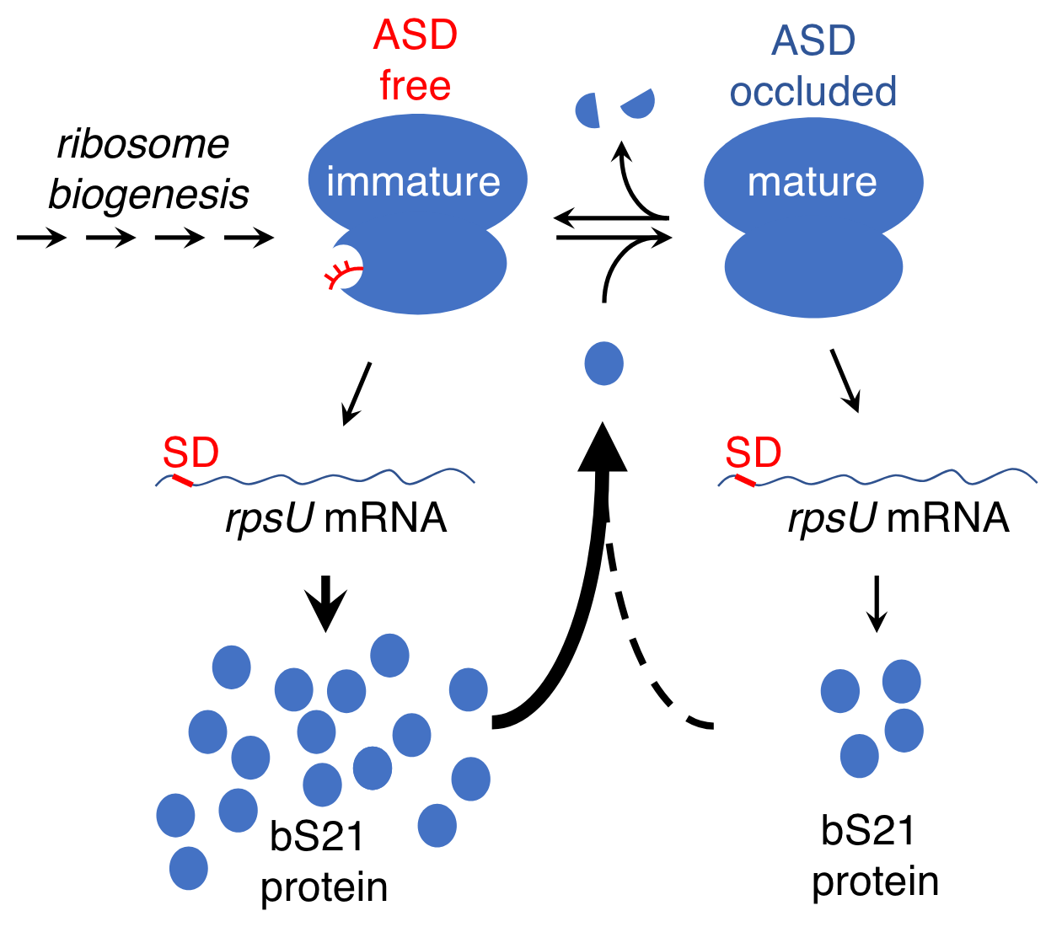
bS21 function in F. johnsoniae
Cells lacking bS21 have increased synthesis
of mRNAs with SDs, including bS21
Preferential translation of mRNAs with
or without SDs due to presence/absence of bS21

Slide 15
Multiple bS21 homologs lead to heterogenous ribosomes in Francisella tularensis
70S containing:
cspC
rpsU1
bS21-1
dnaG
bS21-2
rpsU2
yqeY
rpoD
rpsU3
bS21-3
Trautmann and Ramsey, 2022
How do changes in ribosome composition influence protein synthesis?
Notes:
Even though francisella has a reduced genome, it encodes three copies of the rpsU genes, which encode bS21, a protein in the small ribosomal subunit. Most bacteria have 0 or 1 of this gene. We originally, hypothesized, and have since shown, that these three proteins are produced and incorporated into ribosomes. This is a western blot of purified ribosomes from our wild-type strain as well as strains ectopically expressing each of the bS21 proteins, with a VSVG tag. This, along with some mass spec data we have of purified ribosomes, indicates that multiple classes of ribosomes are possible and occurring
This protein is also interesting to us because it is located close to the mRNA exit channel in the ribosome, and early research has identified that it is involved in translation initiation, so it is in an ideal location to be regulating gene expression at the level of translation initiation.

Slide 16
bS21 homologs control gene expression
~160 proteins with altered protein abundance but not transcript abundance in ∆rpsU2
bS21-2 is important in controlling translation of these proteins

Slide 17
Cells without bS21-2 translate from the pdpA 5´UTR less efficiently
0.71x
1.02x
* p < 0.005
*
bS21-2:
+
-
+
-
5ʹ UTR:
pdpA
tul4
(control)
5’ UTR 6 codons
pdpA aguuauguucuaauuaaguagaca AUG aua gca gua aaa gau
tul4 gaguauaugugaauauuuaaaaauaggaguaucuau AUG aaa aaa aua auu aag
-lacZ
Trautmann et al., 2023
Notes:
The pdpA 5ʹ UTR is responsive to bS21-2

Slide 18

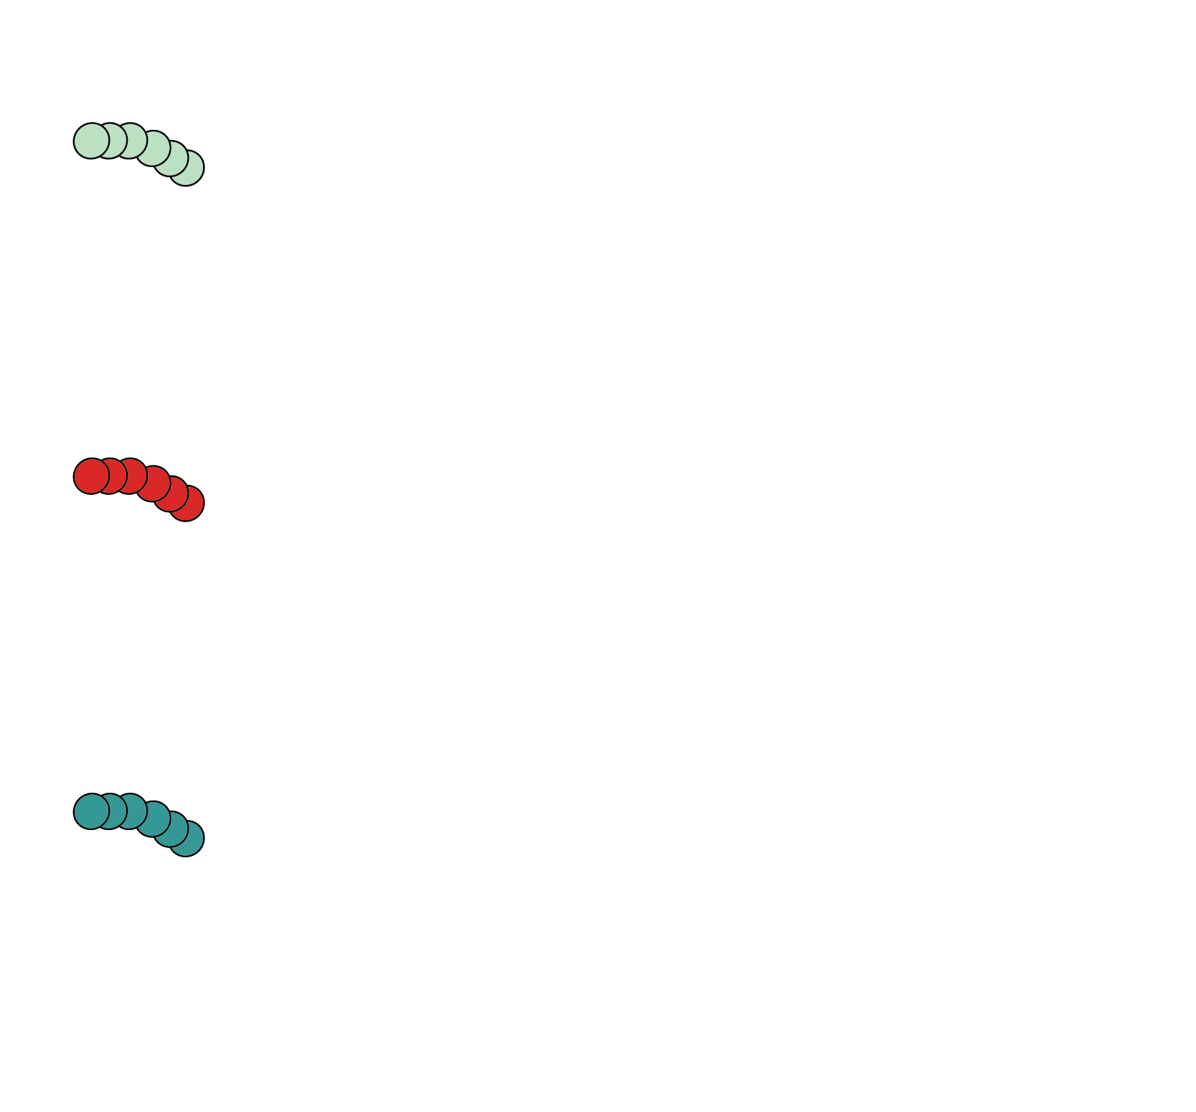
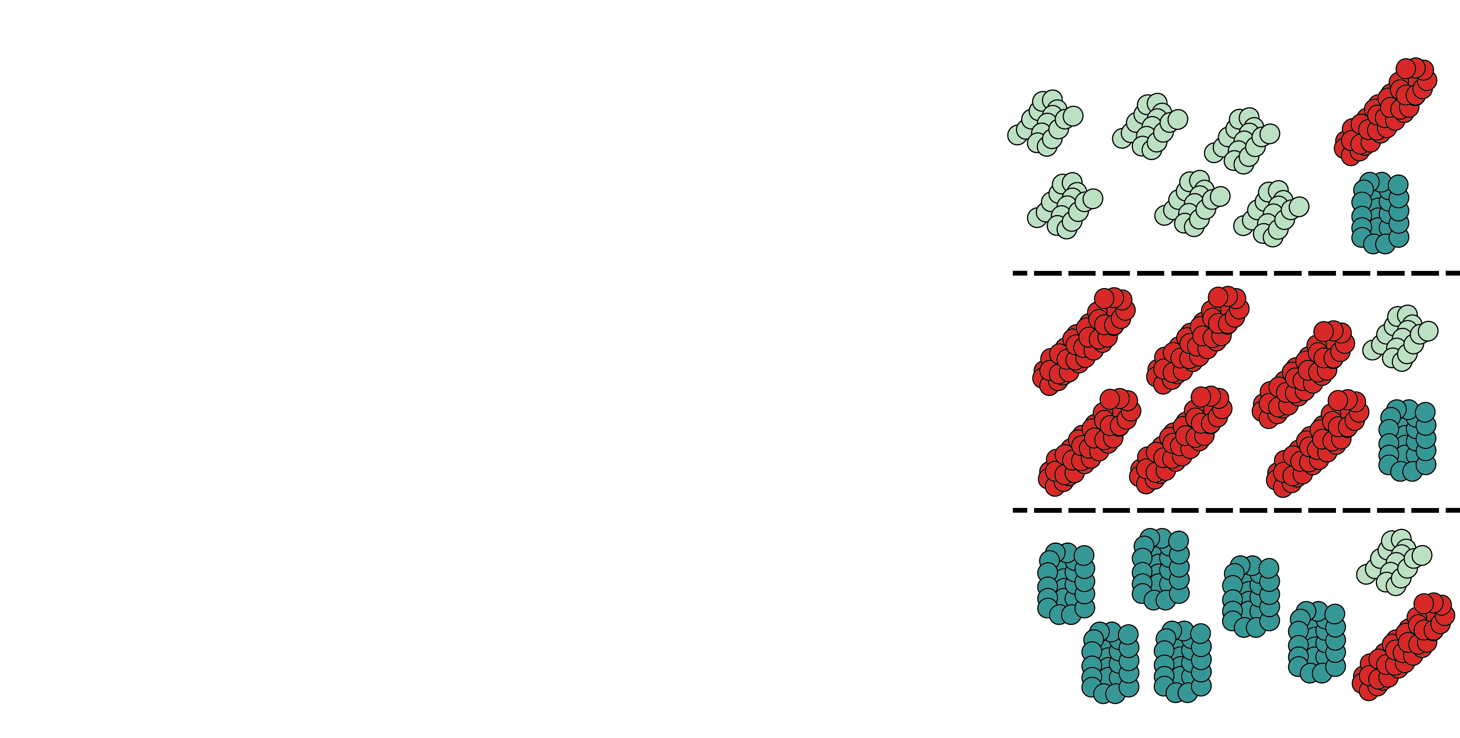
Why have multiple bS21 homologs?
Hypothesis
Incorporation of distinct bS21s:
Heterogeneous ribosomes
Altered translation initiation for distinct mRNAs
Regulation of protein expression during translation initiation
Modify the proteome
Easy to exchange, rapid response to changing conditions

Slide 19
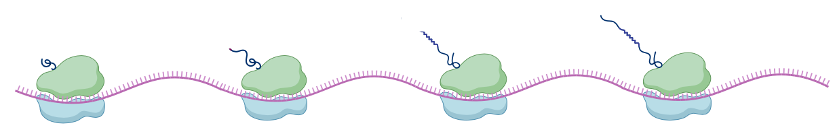

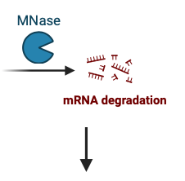
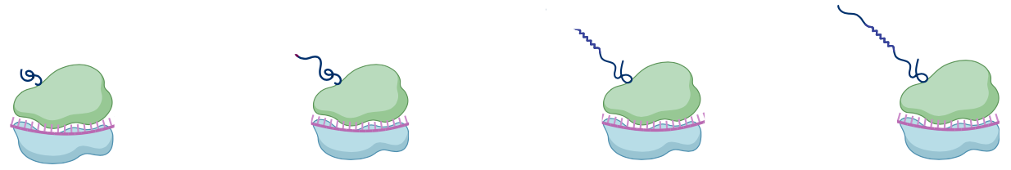
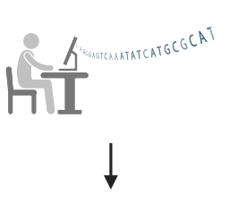
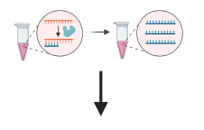
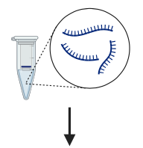
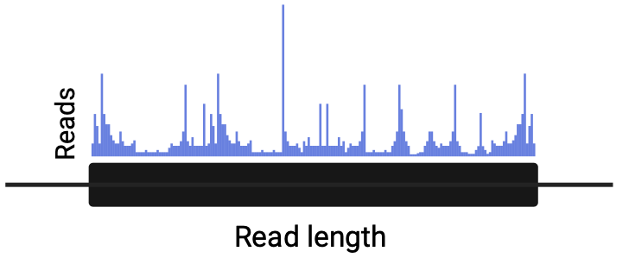
Overview of ribosome profiling

Slide 20
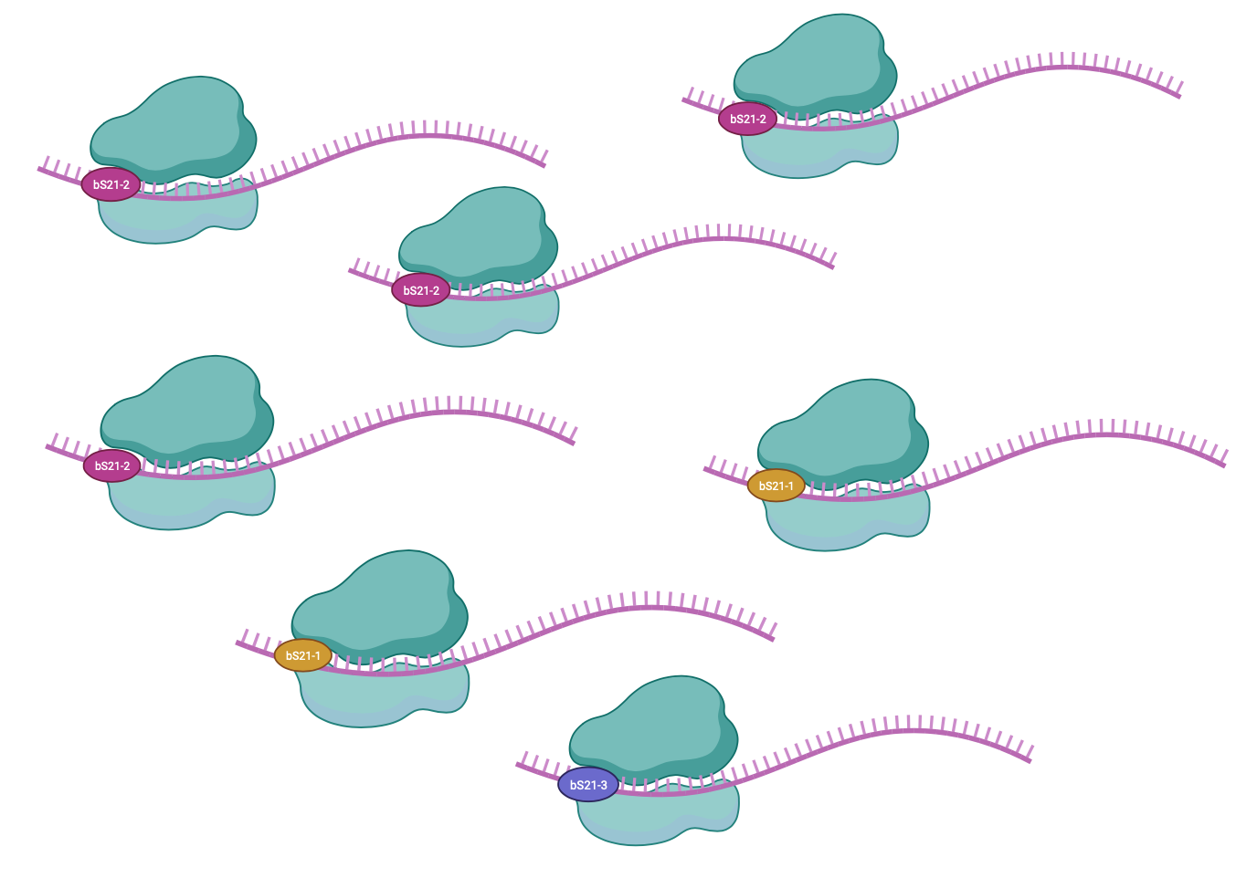
Heterogeneity of bS21 in LVS
How do we specifically identify translation by each homolog?

Slide 21
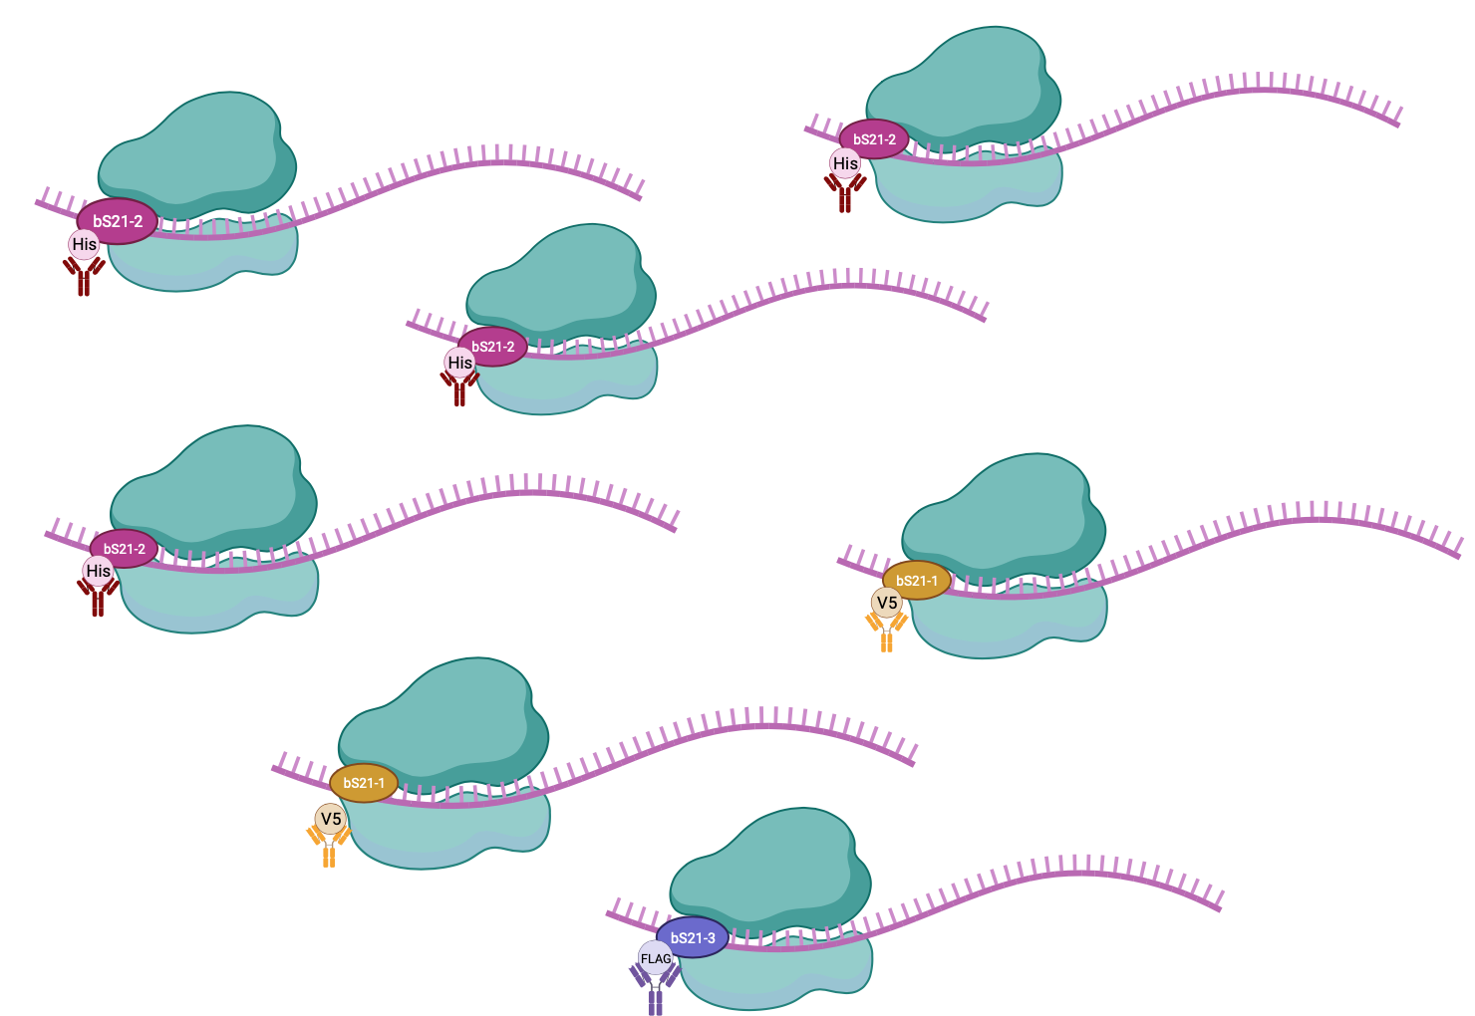
Heterogeneity of bS21 in LVS
How do we specifically identify translation by each homolog?

Slide 22
Selected epitope tags to be tested for pulldown efficiency by immunoprecipitation
Epitope Tag | Size | Plasmid
HA | 1.1 kDa | pKR192 pF-rpsU2-HA
6X His | 0.8 kDa | pKR193 pF-rpsU2-His
FLAG | 1 kDa | pKR194 pF-rpsU2-FLAG
V5 | 1.4 kDa | pKR195 pF-rpsU2-V5

Slide 23
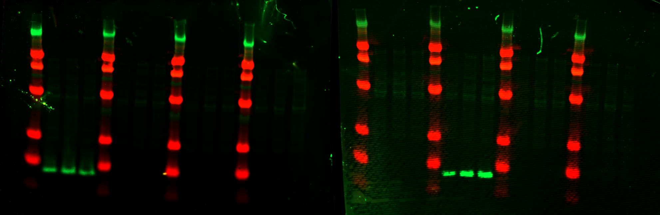
No cross-reactivity in antibodies
HA
A B C
His6
A B C
FLAG
A B C
V5
A B C
HA
A B C
His6
A B C
FLAG
A B C
V5
A B C
ladder
ladder
ladder
ladder
ladder
ladder
ladder
ladder
kDa
250
90
50
30
15
8
α-HA
α-His6

Slide 24
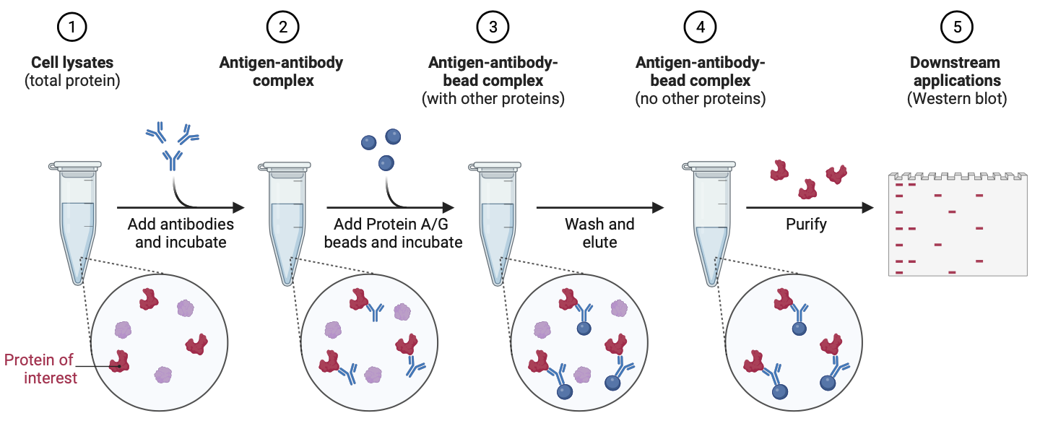
IP workflow

Slide 25
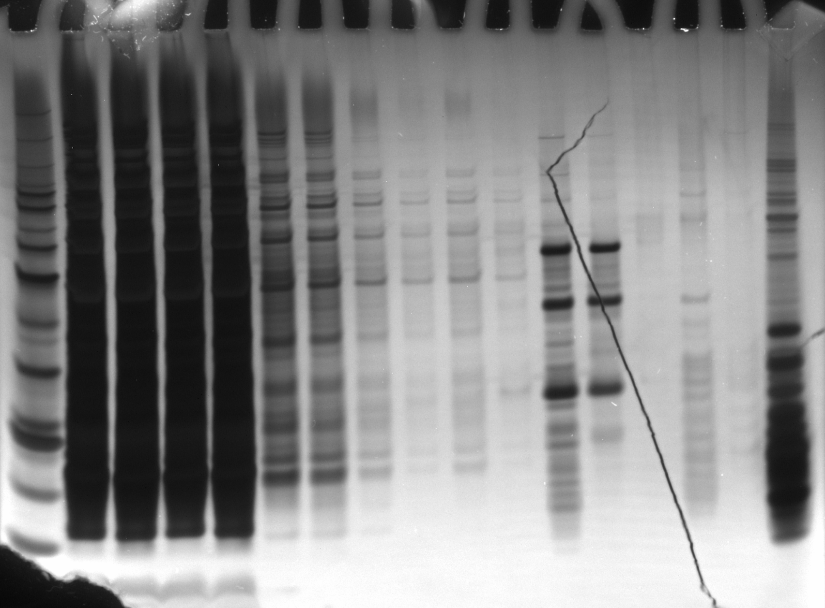
Pull-down of bS21-2 with HA tag
Anti-HA
Beads
Hannah’s
Ribosomes
LYS
FT1
FT2
FT3
FT4
Empty
EL1
kDa
+
-
+
-
+
-
+
-
+
-
+
-
+
-
60
50
40
30
HA-IP
12/21/23
Silver Stain
20
15
10

Slide 26
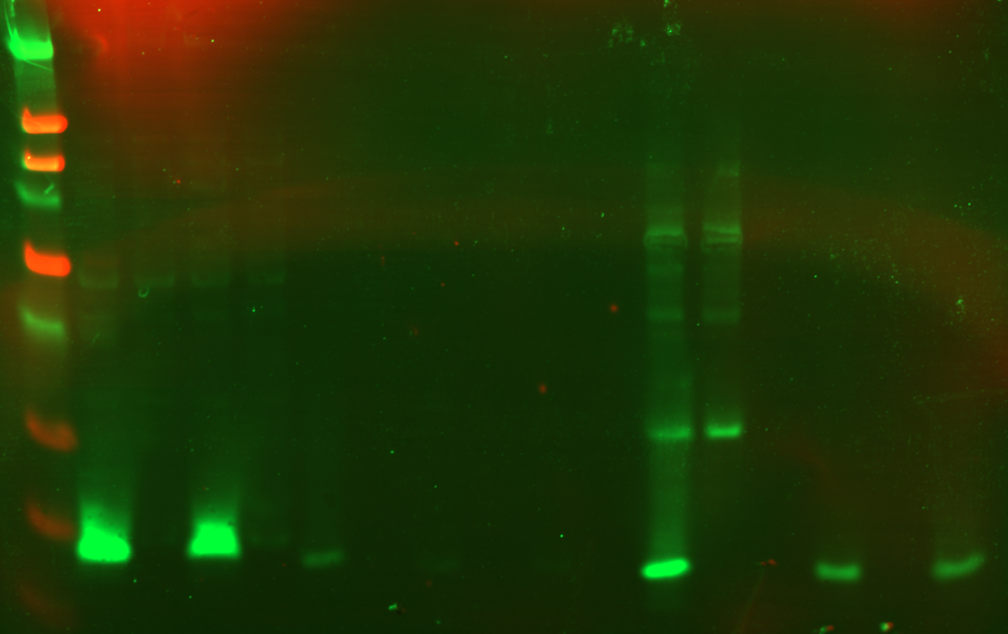
Anti-HA
Beads
LVS pF-
rpsU2-HA
WCL
LYS
FT1
FT2
FT3
FT4
Empty
EL1
kDa
+
-
+
-
+
-
+
-
+
-
+
-
+
-
250
90
50
38
30
25
15
8

Slide 27
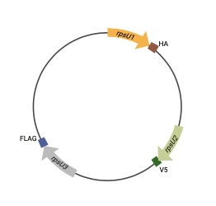
Next Steps:
Perform fractionation via sucrose gradients to confirm presence of intact 70S ribosomes
Add DNA specifying epitope tags to rpsU genes on the chromosome

Slide 28
Future Directions
  Recapitulate results using in vitro translation assays
  Define preferential proteome of different ribosome classes
  What RNA elements lead to preferential translation initiation
Notes:
In vitro assays to assess if there are other factors in vivo that influence translation of particular mRNAs
Direct by ribosome or indirect by other post-transcriptional regulators

Slide 29

Acknowledgments
Ramsey Lab
Dr Kathryn Ramsey
Dr Hannah Trautmann
Sierra Schmidt
Ben Moore
Johanyx Rodriguez
Committee Members
Dr Marta Gomez-Chiarri
Dr Steve Gregory
Janet Atoyan

Slide 30
Aim 1 Alternative Approach
Adjust our model: is it abundance of a specific homolog that governs regulation?
  If the identity of the homolog does not matter, perhaps a certain amount of any given homolog is required for preferential translation of mRNAs

Slide 31
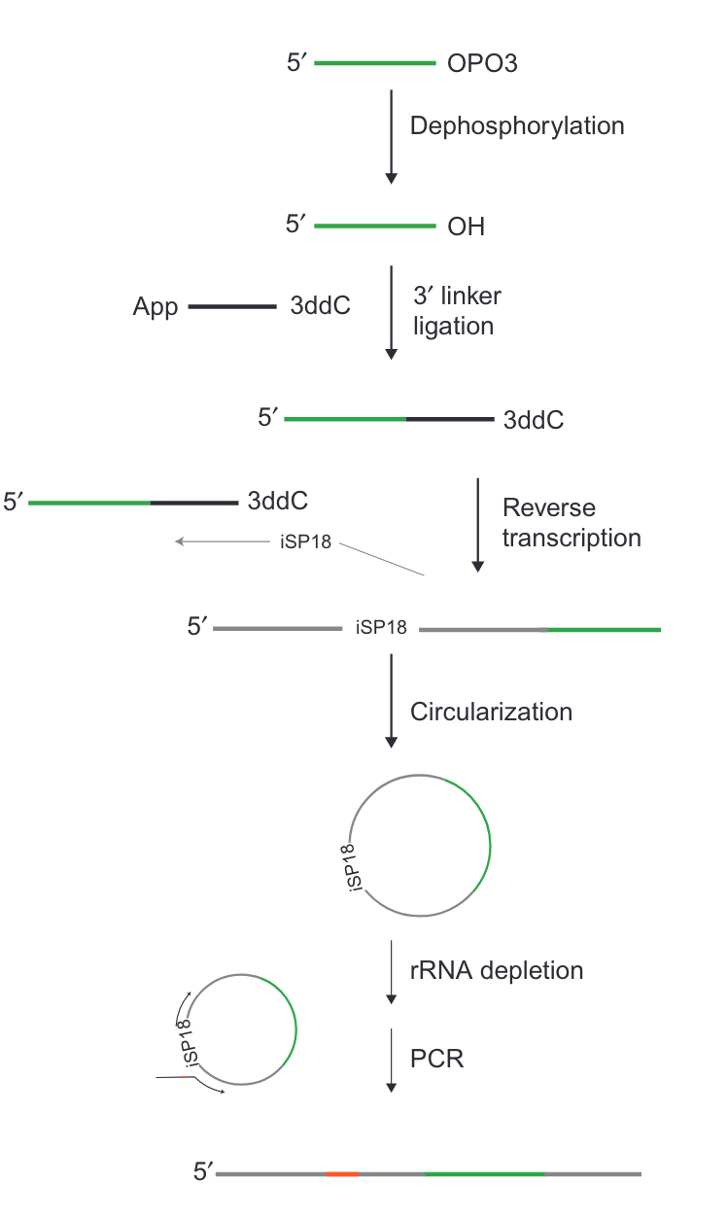
Ribosome Profiling:
Library Prep
Illumina Sequencing
Johnson and Li, 2018

Slide 32
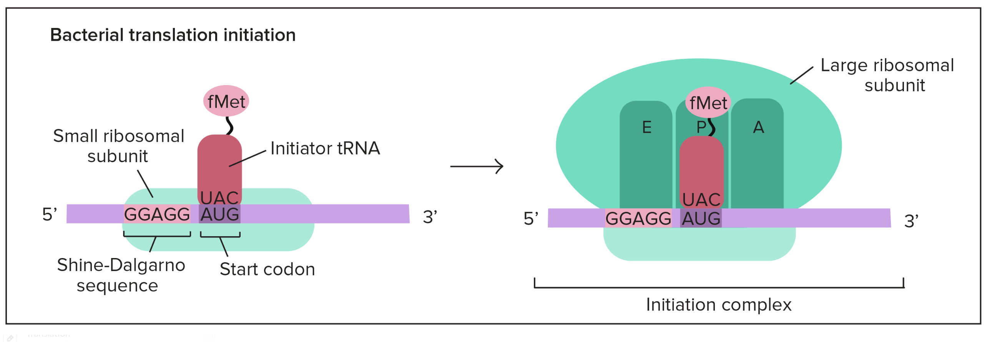
Translation initiation in prokaryotes
Khan Academy
Notes:
Translation initiation is rate limiting step of translation and is highly regulated
fMet tRNA: forymlated methionine that carries a “false” peptide bond between met amino and formyl carboxyl group
IF1: binds to A site of 30S, maybe directs fMet tRNA to P site by blocking A site
IF2: facilitates binding of fMet-tRNA
IF3: required for binding of mRNA to 30S
when does 50S bind? After initiation complex
GTP hydrolysis powers elongation
Release factor: resembles tRNA, instructs peptidyl transferase to add a water molecule at the carboxyl end of the amino acid in the P site, aa detaches from tRNA and protein is released

Slide 33
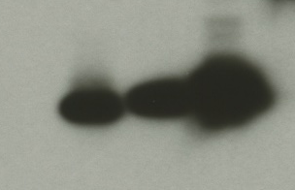
Multiplr homologs incorporate into ribosome
bS21-2-V
bS21-1-V
bS21-3-V
WT
α-VSVG

Slide 34
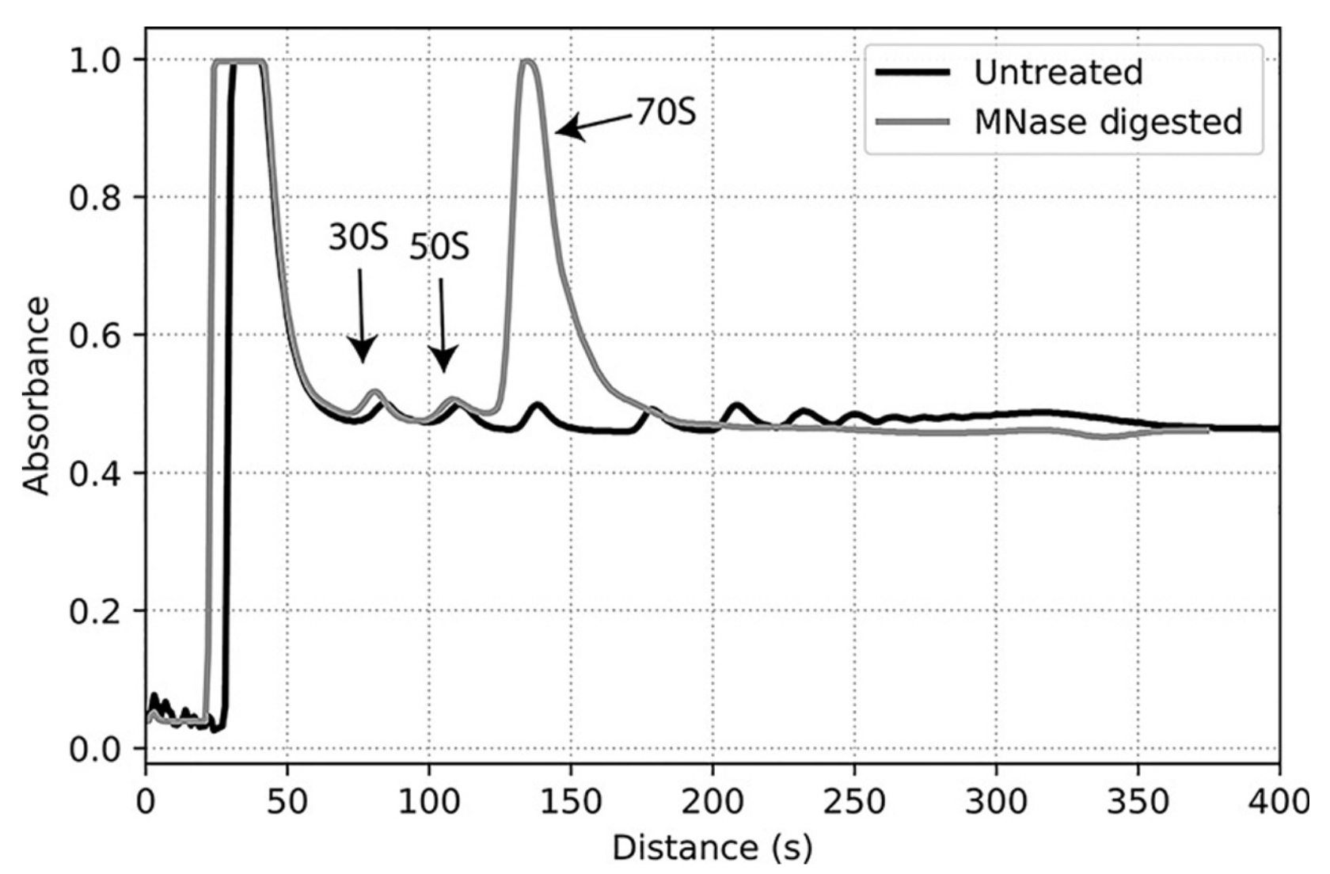

Slide 35
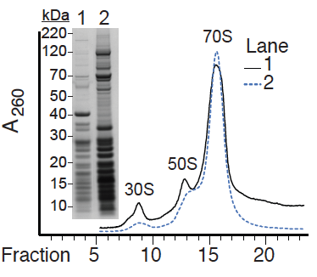
70S Ribosomes can be pulled down
Immunoprecipitated
Total ribosomes

Slide 36
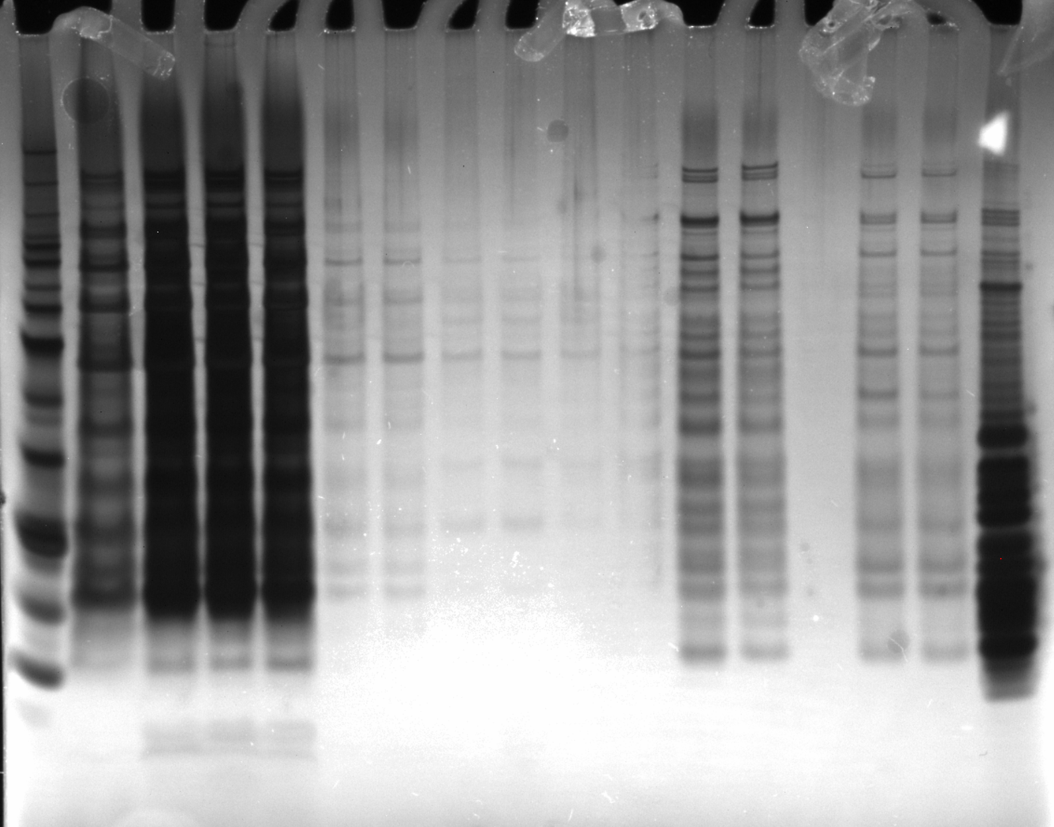
Ni-NTA
Beads
1X
SLB
Hannah’s
Ribosomes
BenchMark
Ladder 1:10
LYS
FT1
FT2
FT3
FT4
EL1
+
-
+
-
+
-
+
-
+
-
+
-
+
-
Silver Stain of
His6 IP
11/7/23

Slide 37
Ni-NTA
Beads
1X
SLB
Hannah’s
Ribosomes
BenchMark
Ladder 1:10
LYS
FT1
FT2
FT3
FT4
EL1
+
-
+
-
+
-
+
-
+
-
+
-
+
-
Silver Stain
11/7/23

Slide 38
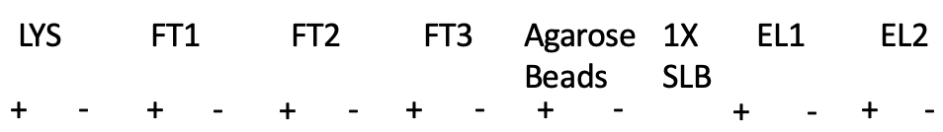
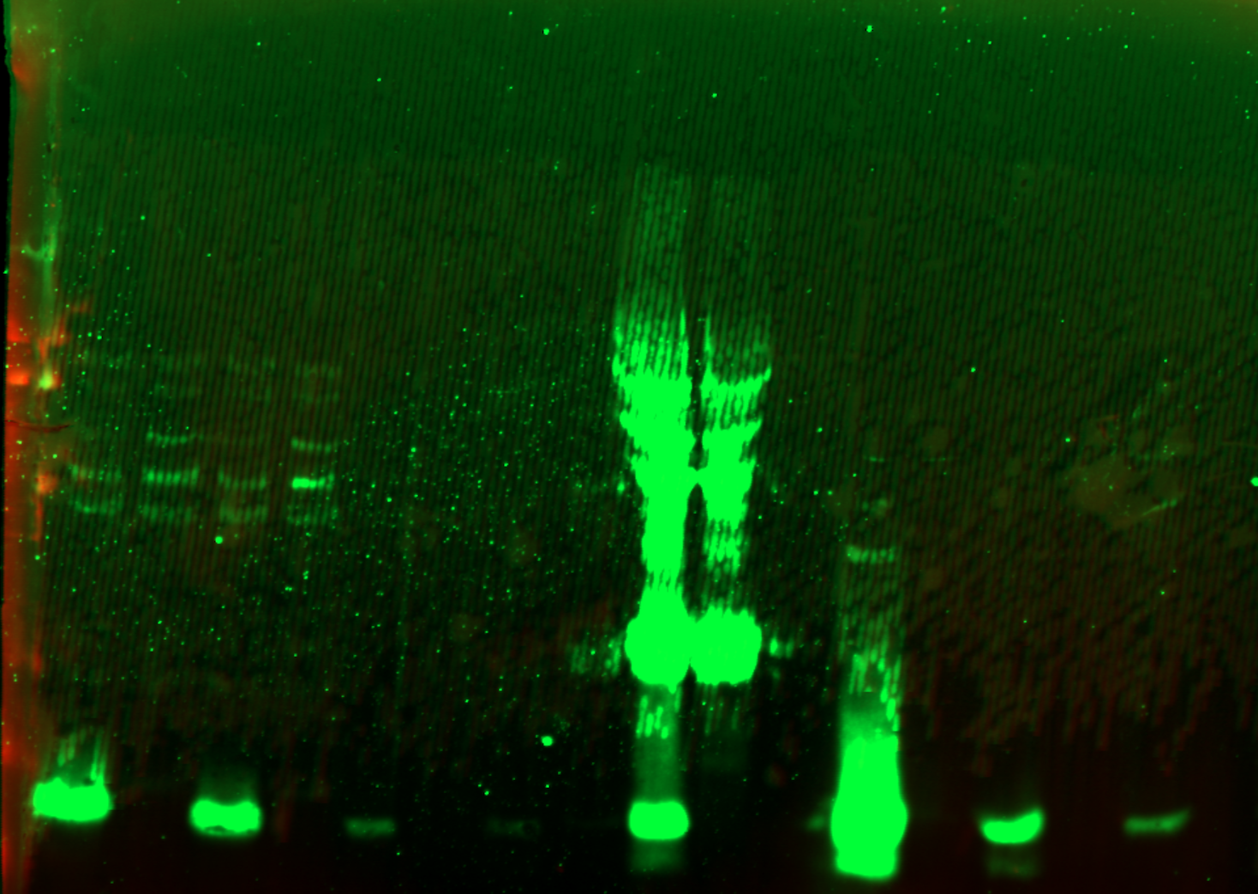
FLAG-
WCL
WesternSure
Ladder
α-FLAG 1:1000

Slide 39

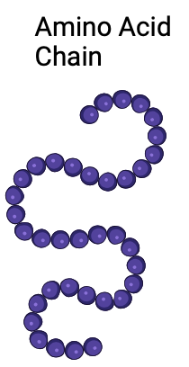

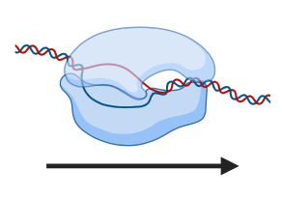
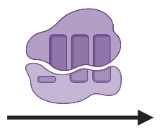


Central Dogma
Notes:
utlple regulatuions

Slide 40
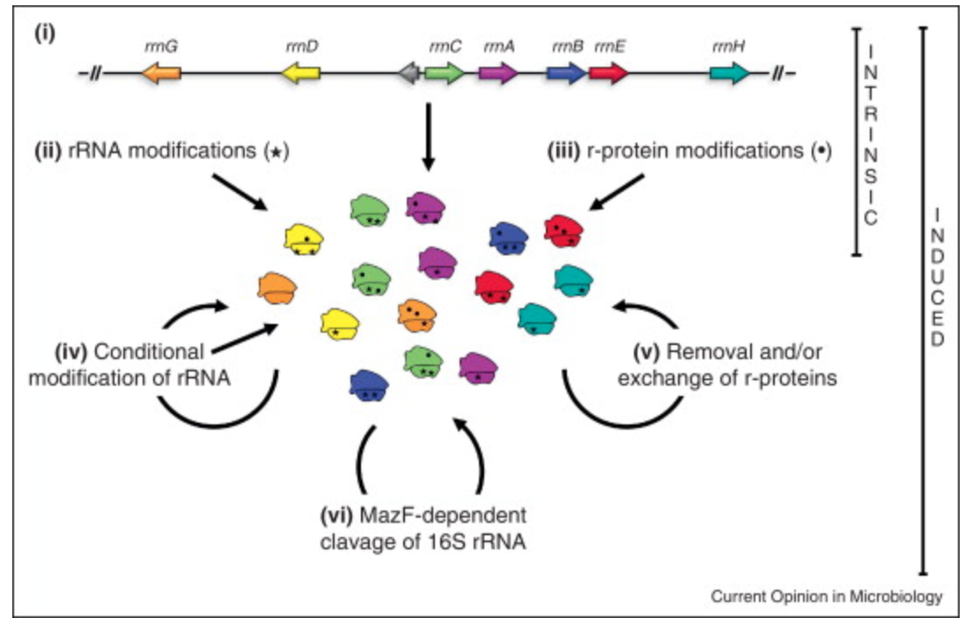
Sources of heterogeneity in ribosomes
Byrgazov et al, 2013
Notes:
i. Sequence micro-heterogeneity in rRNA operons
ii. Diverse modifications of rRNA (stars)
iii. Assembly of modified r-proteins (dots)
iv. Conditional modifications of rRNA (either during biogenesis or on mature ribosomes)
v. Removal or exchange of r-proteins (specifically referring to replacing damaged r-proteins)
vii. MazF enoribonuclease truncates 16S rRNA
Straight arrows = biogenesis
Curved arrows = mature ribos

Slide 41
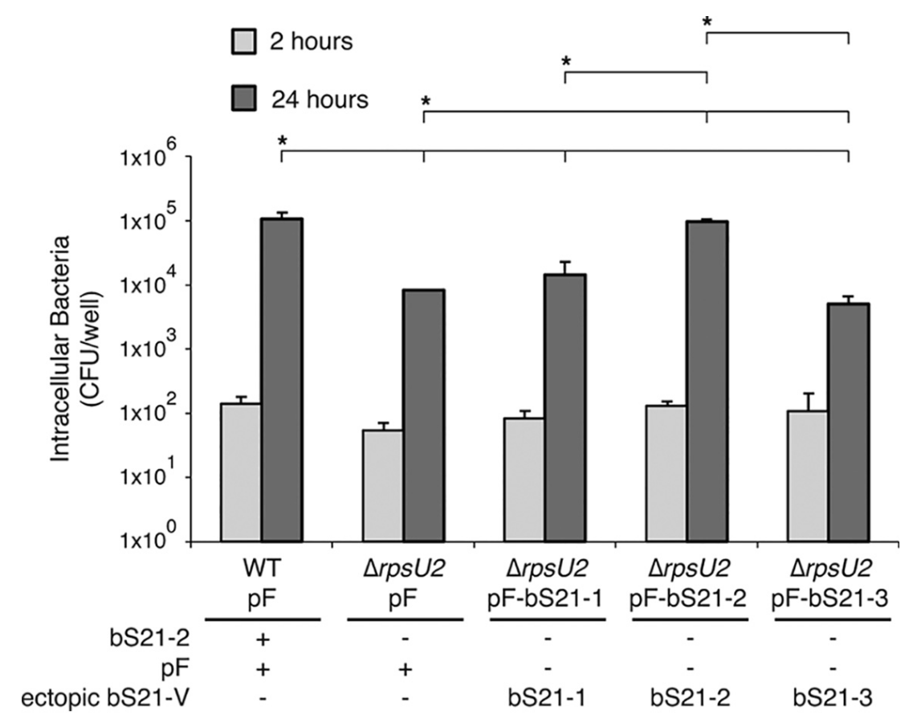
bS21-2 is specifically required for intramacrophage growth
Trautmann and Ramsey, 2022

Slide 42
Hypothesis: Different populations of ribosomes in F. tularensis will preferentially translate specific mRNAs
Specific Aim 1. Determine how incorporation of specific F. tularensis bS21 homologs into the ribosome influences translation initiation on transcripts, genome wide.
Approach: ribosome profiling and RNA-Seq to assess relative translation of all F. tularensis mRNAs across the genome

Slide 43
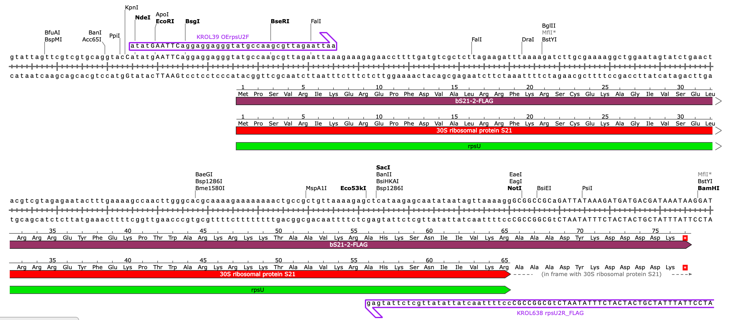
Plasmid design

