Slide 1
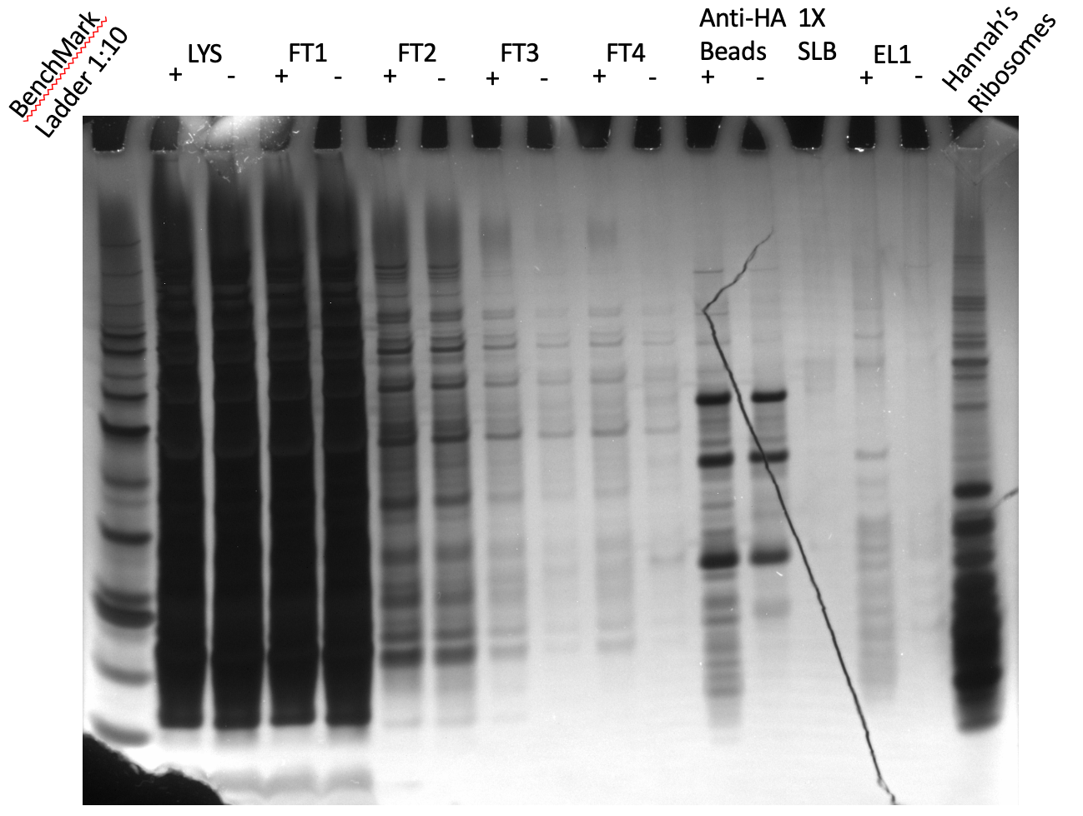

Slide 2
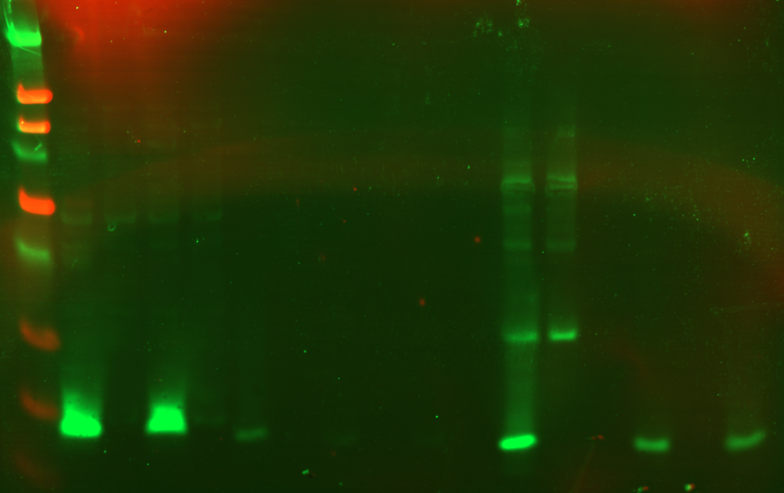
Anti-HA
Beads
LVS pF-
rpsU2-HA
WCL
LYS
FT1
FT2
FT3
FT4
Empty
EL1
kDa
+
-
+
-
+
-
+
-
+
-
+
-
+
-
250
90
50
38
30
25
15
8

Slide 3
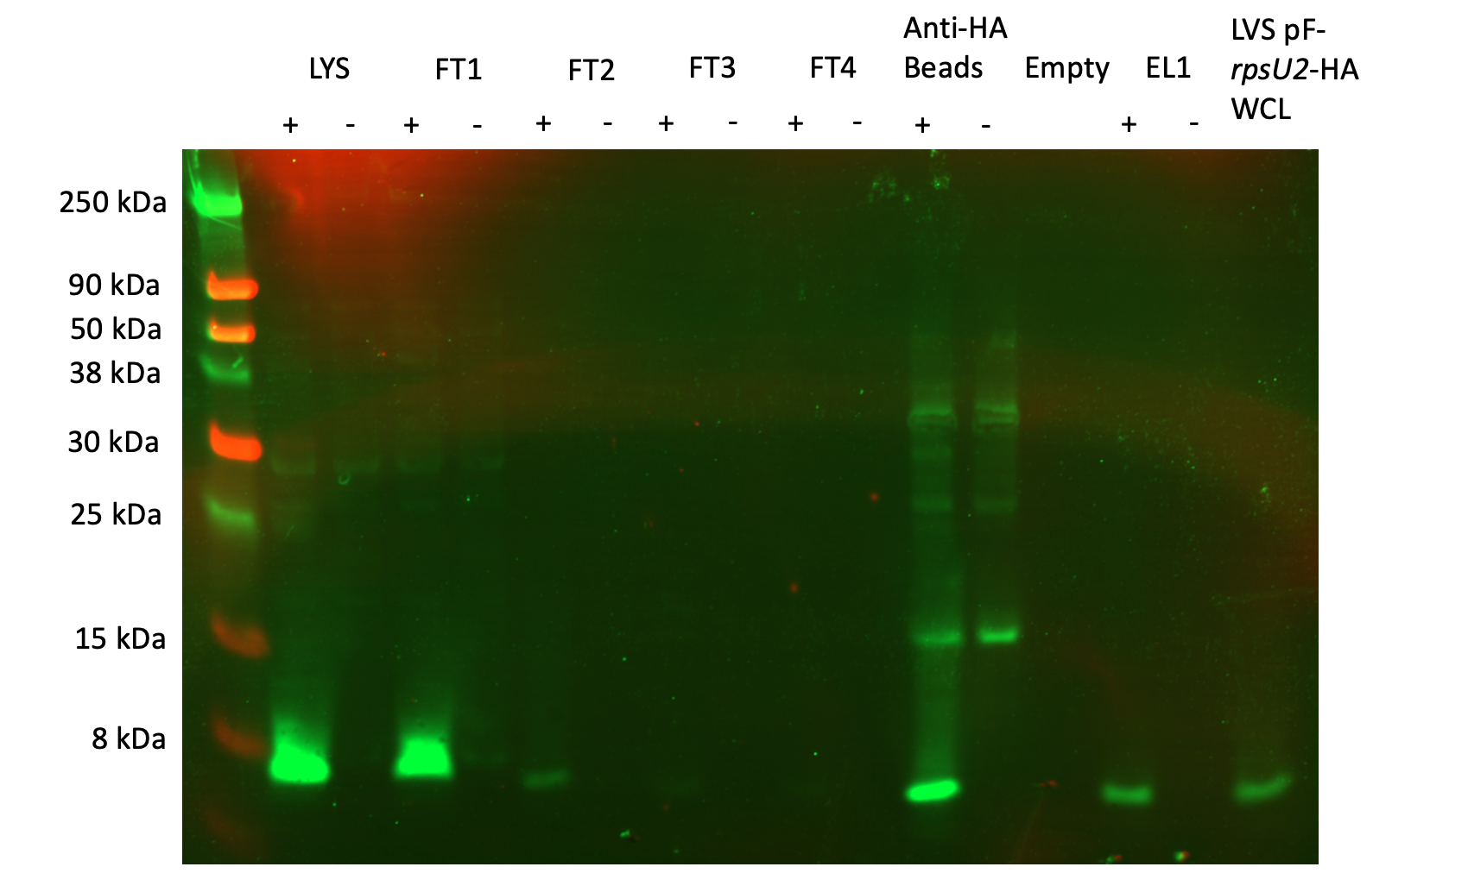

Slide 4
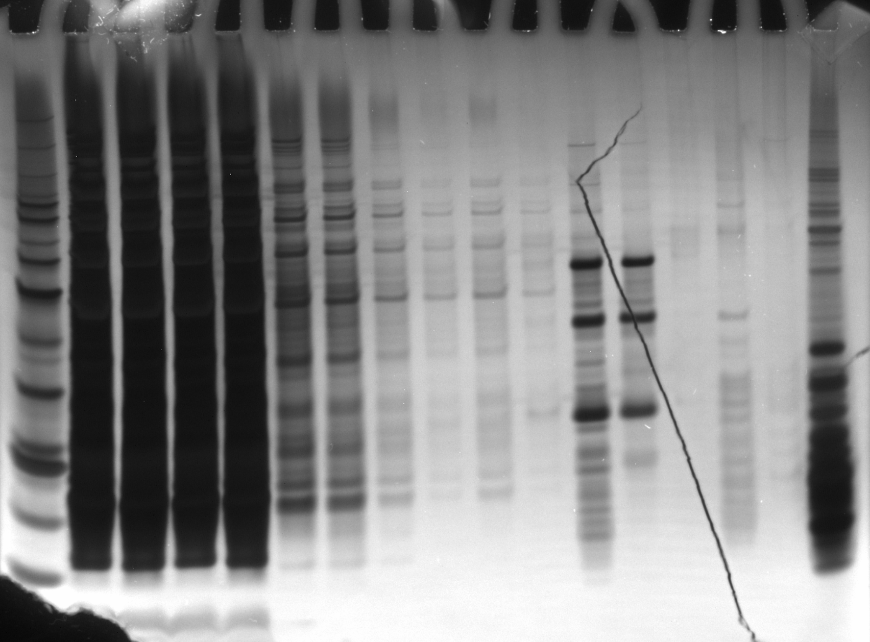
Anti-HA
Beads
Hannah’s
Ribosomes
LYS
FT1
FT2
FT3
FT4
Empty
EL1
kDa
+
-
+
-
+
-
+
-
+
-
+
-
+
-
60
50
40
30
HA-IP
12/21/23
Silver Stain
20
15
10

Slide 5
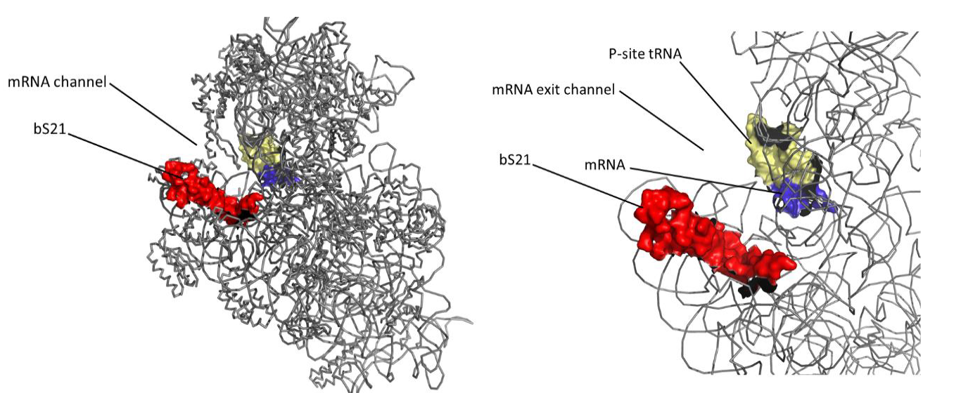

Slide 6
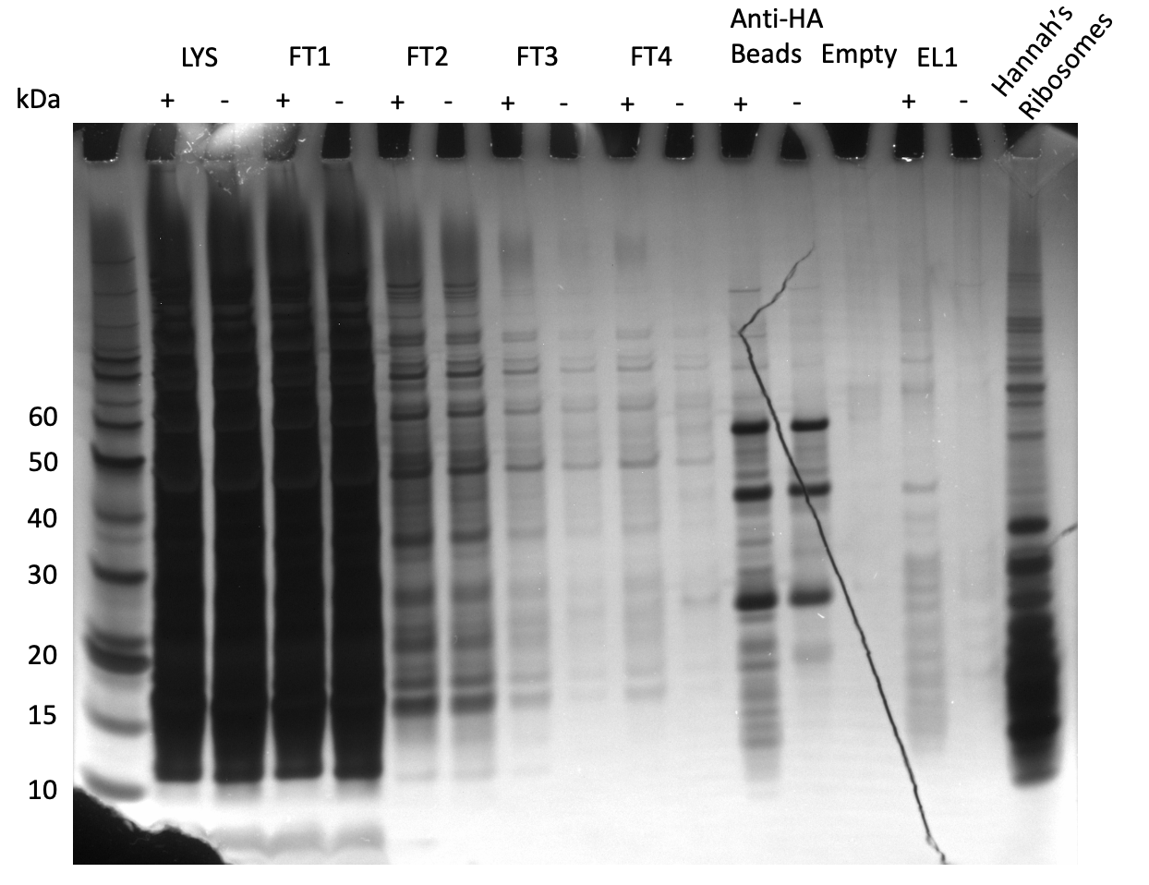
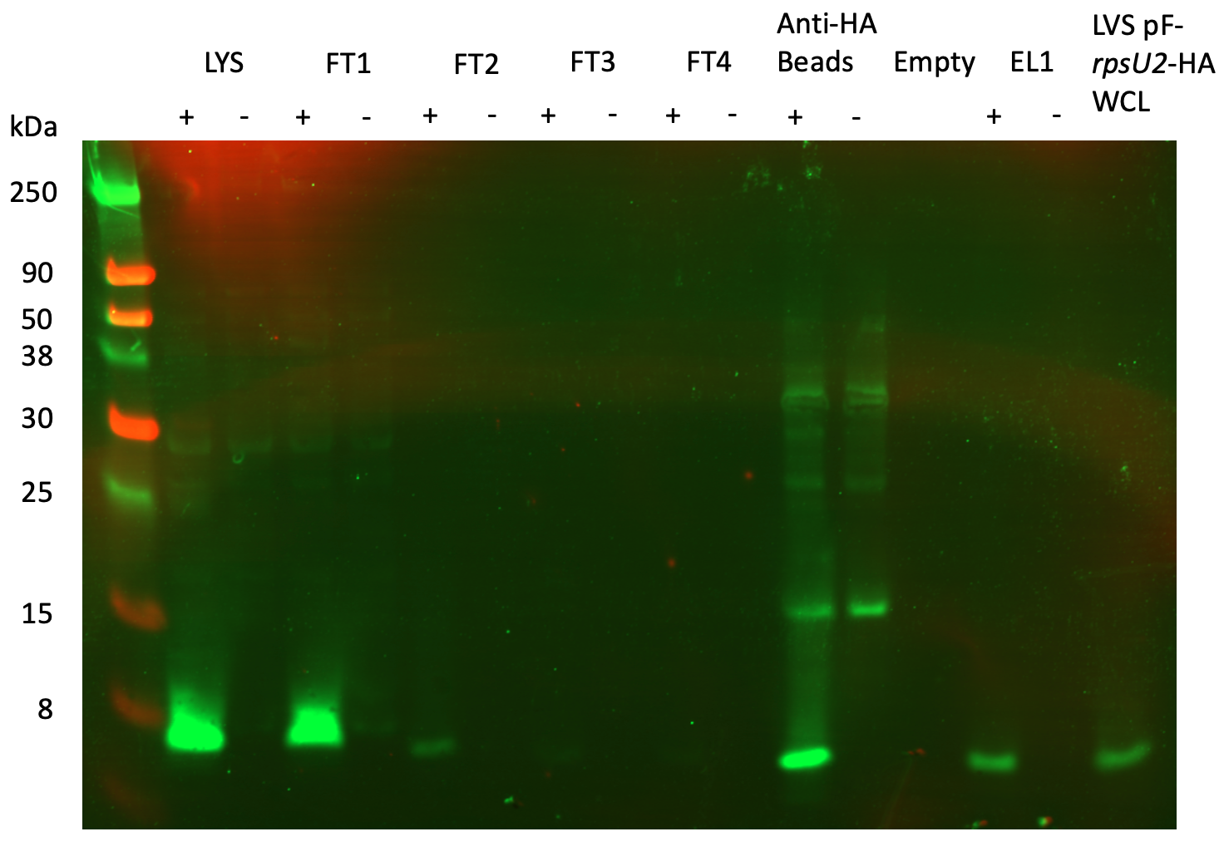

Slide 7
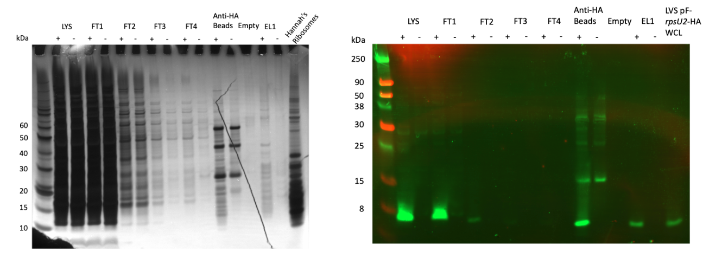

Slide 8
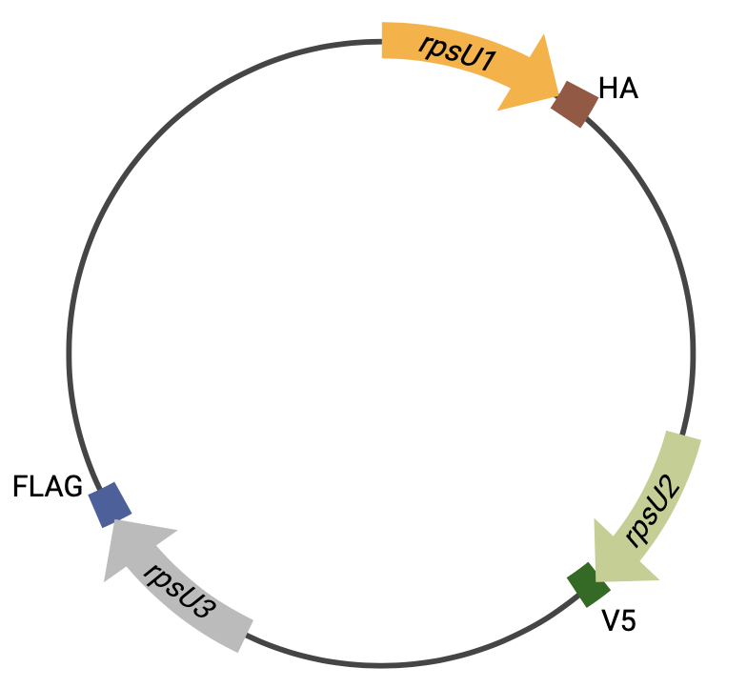

Slide 9
