Slide 1
Exploring the role of bS21 function in bacterial pathogens
Kira Bernabe
Qualifying Exam
01/16/24

Slide 2
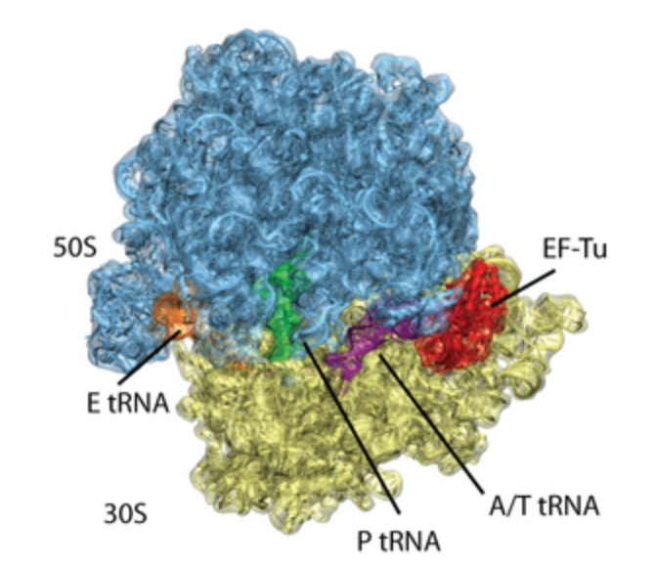
The Ribosome

Slide 3
Post-transcriptional gene regulation

Slide 4
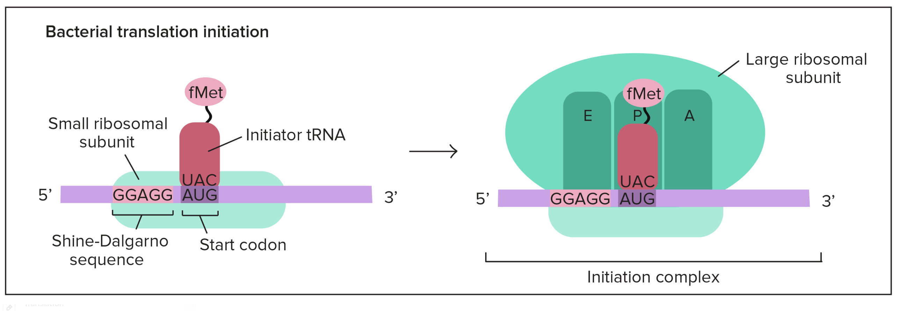
Translation Initiation
Khan Academy

Slide 5
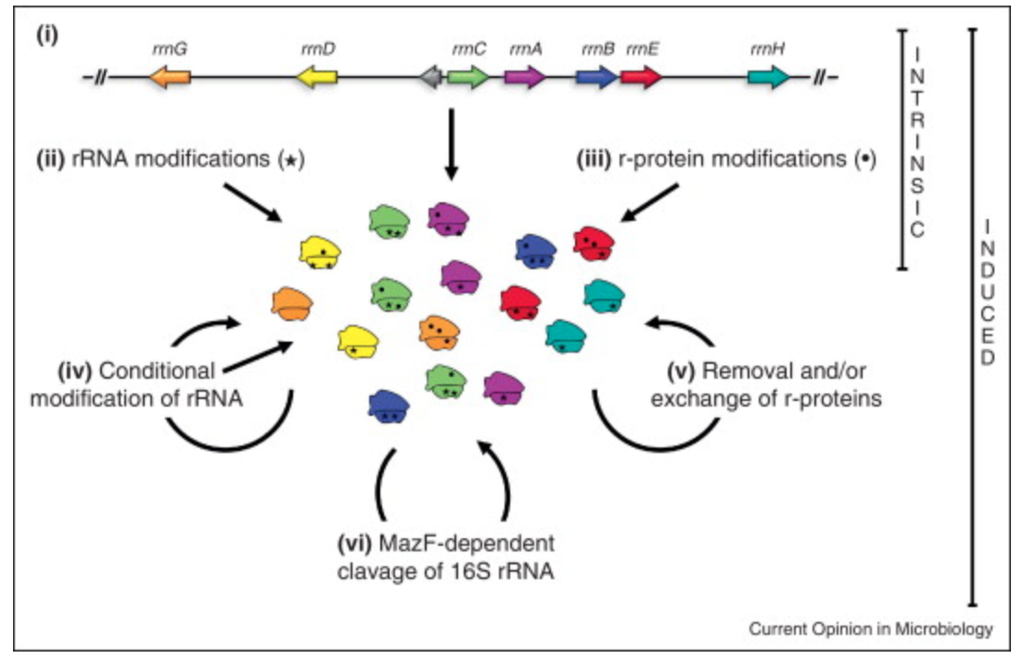
Sources of heterogeneity in ribosomes

Slide 6
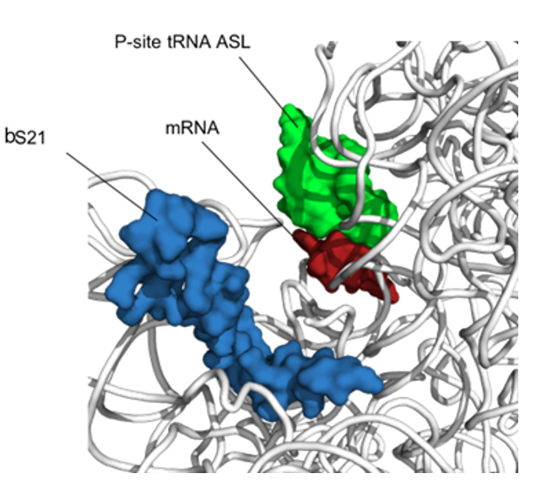
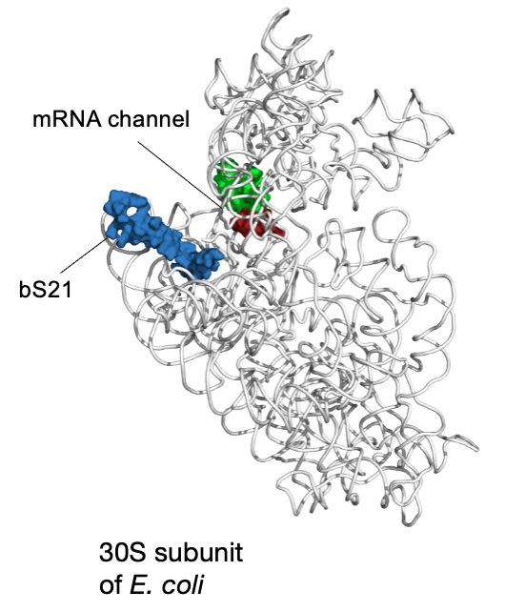
bS21: a small subunit ribosomal protein
bS21 is involved in translation initiation

Slide 7
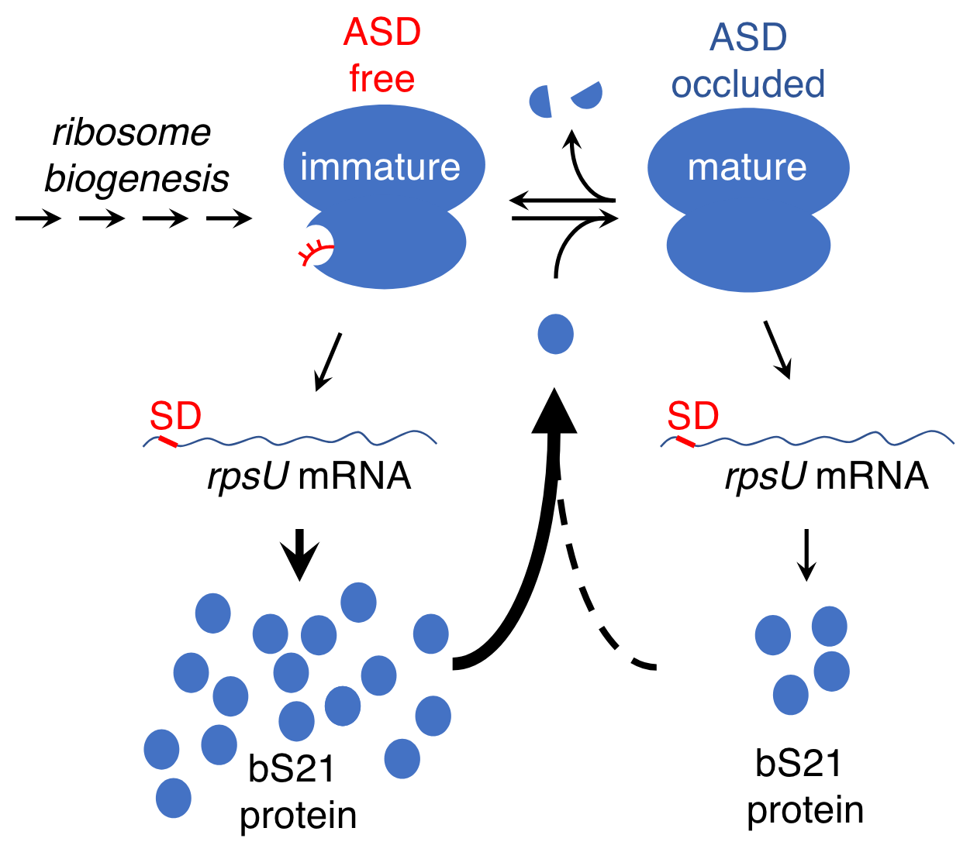
Autoregulation of bS21 in F. johnsoniae
McNutt et al, 2023

Slide 8
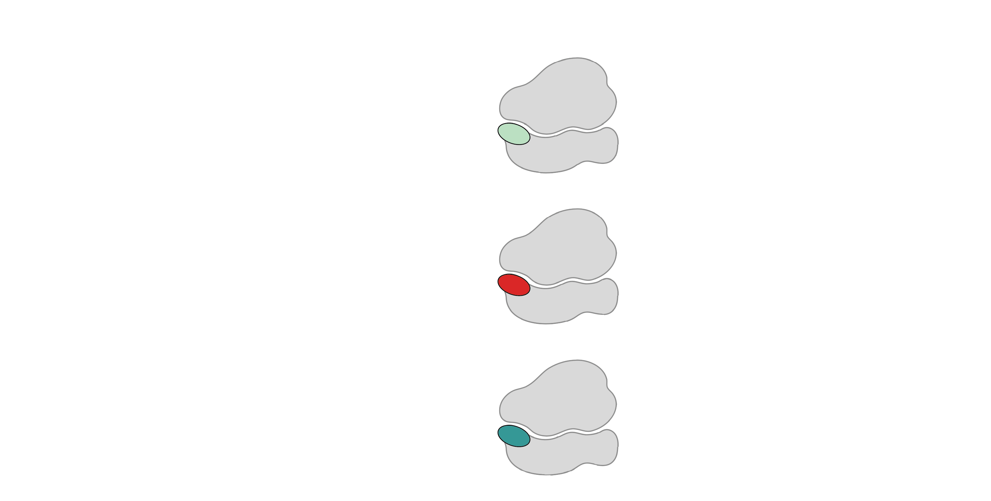
Multiple bS21 homologs lead to heterogenous ribosomes in Francisella tularensis
70S containing:
cspC
rpsU1
bS21-1
dnaG
bS21-2
rpsU2
yqeY
rpoD
rpsU3
bS21-3
Trautmann and Ramsey, 2022
How do changes in ribosome composition influence protein synthesis?
Notes:
Even though francisella has a reduced genome, it encodes three copies of the rpsU genes, which encode bS21, a protein in the small ribosomal subunit. Most bacteria have 0 or 1 of this gene. We originally, hypothesized, and have since shown, that these three proteins are produced and incorporated into ribosomes. This is a western blot of purified ribosomes from our wild-type strain as well as strains ectopically expressing each of the bS21 proteins, with a VSVG tag. This, along with some mass spec data we have of purified ribosomes, indicates that multiple classes of ribosomes are possible and occurring
This protein is also interesting to us because it is located close to the mRNA exit channel in the ribosome, and early research has identified that it is involved in translation initiation, so it is in an ideal location to be regulating gene expression at the level of translation initiation.
So this heterogeneity of ribosomes may be a mechanism of regulation, but you may not know that ribosomes are heterogeneous so let me show you other ways that may occur.

Slide 9
Aim #1 Does each homolog of bS21 preferentially translate specific subsets of mRNA?

Slide 10
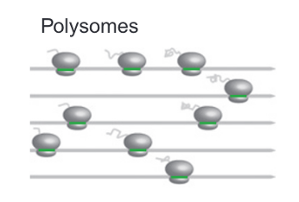
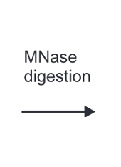
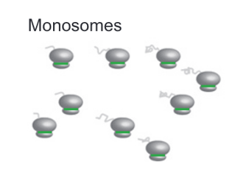
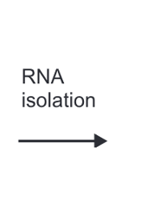
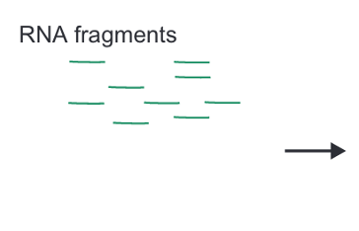
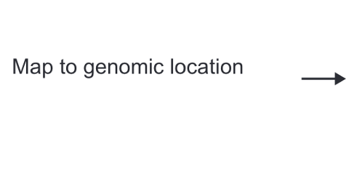
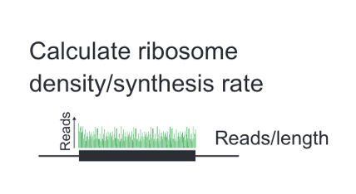
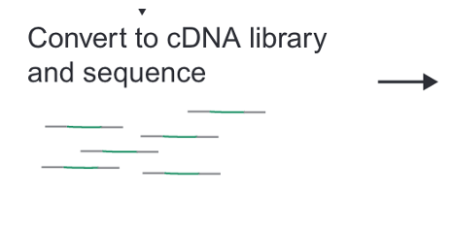
Ribosome Profiling:
Johnson and Li, 2018

Slide 11
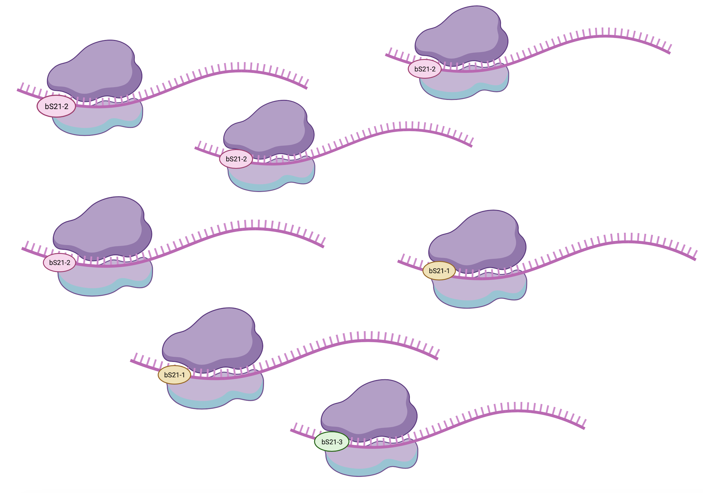
Heterogeneity of bS21 in LVS
How do we specifically identify translation by each homolog?

Slide 12
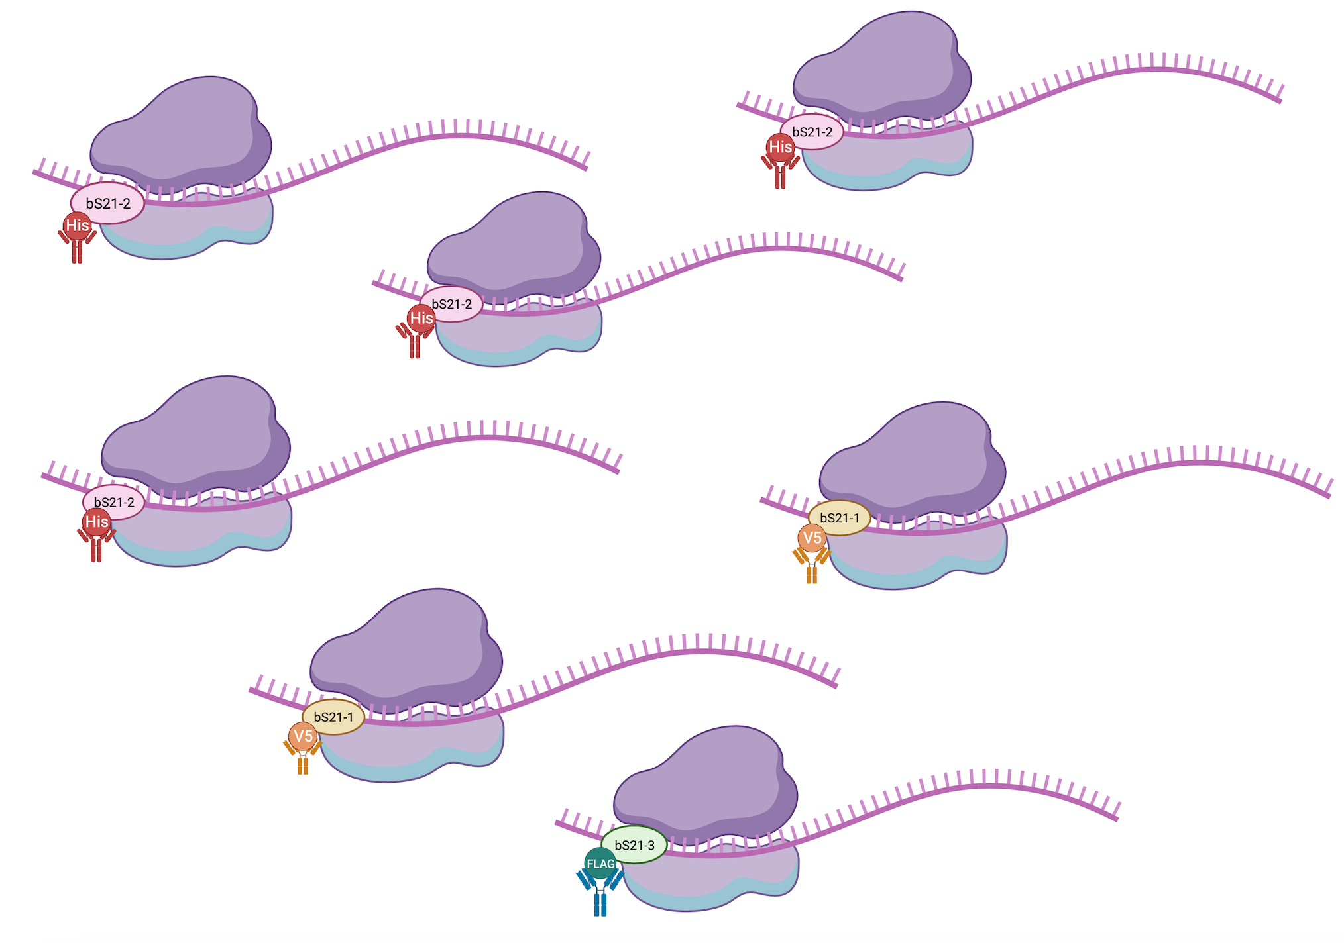
Heterogeneity of bS21 in LVS
How do we specifically identify translation by each homolog?

Slide 13
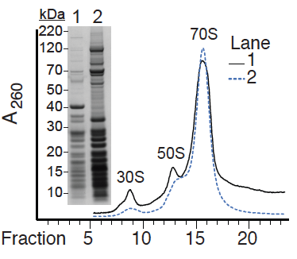
70S Ribosomes can be pulled down
Immunoprecipitated
Total ribosomes

Slide 14
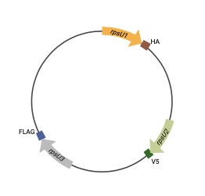

Slide 16
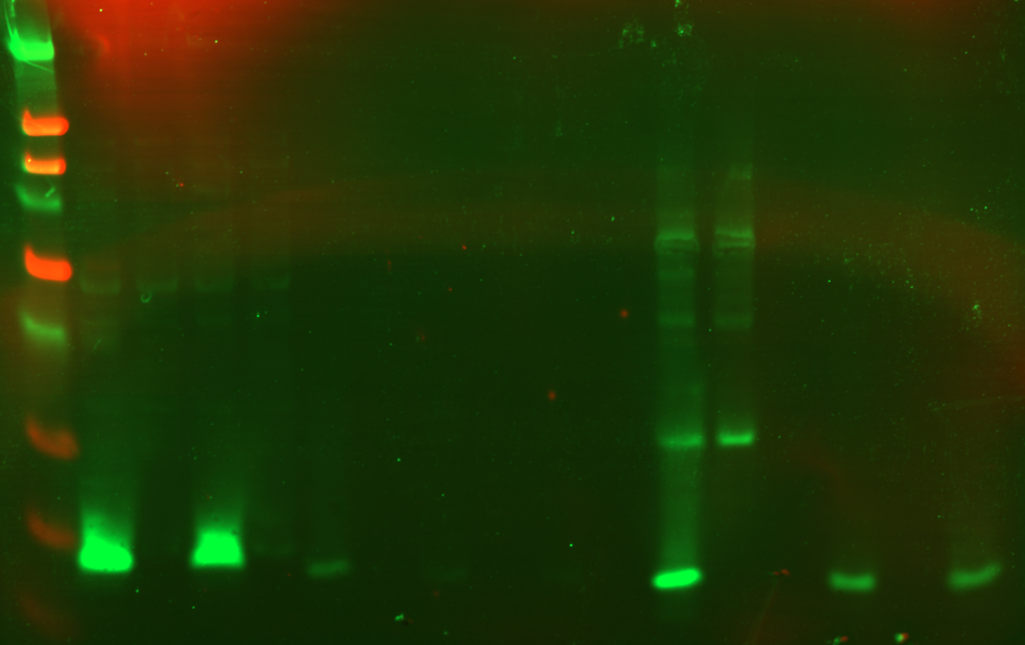
Anti-HA
Beads
LVS pF-
rpsU2-HA
WCL
LYS
FT1
FT2
FT3
FT4
Empty
EL1
kDa
+
-
+
-
+
-
+
-
+
-
+
-
+
-
250
90
50
38
30
25
15
8

Slide 17
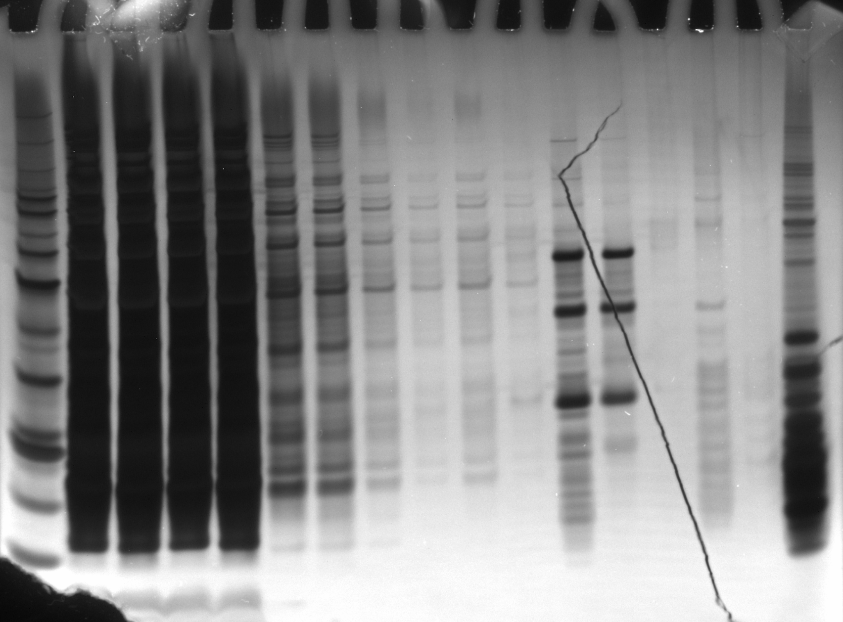
Anti-HA
Beads
Hannah’s
Ribosomes
LYS
FT1
FT2
FT3
FT4
Empty
EL1
kDa
+
-
+
-
+
-
+
-
+
-
+
-
+
-
60
50
40
30
HA-IP
12/21/23
Silver Stain
20
15
10

Slide 18
Aim #1 Alternatives
Adjust our model: is it abundance of a specific homolog that governs regulation?

Slide 19
Aim #2 Why does loss of bS21 lead to antibiotic resistance in S. aureus?

Slide 20
Aim #2 Alternatives
If we do not observe a thicker cell wall
  Take a proteomics approach
  Mass spec to evaluate relative protein abundance between cells with bS21 and cells lacking bS21

