Slide 1



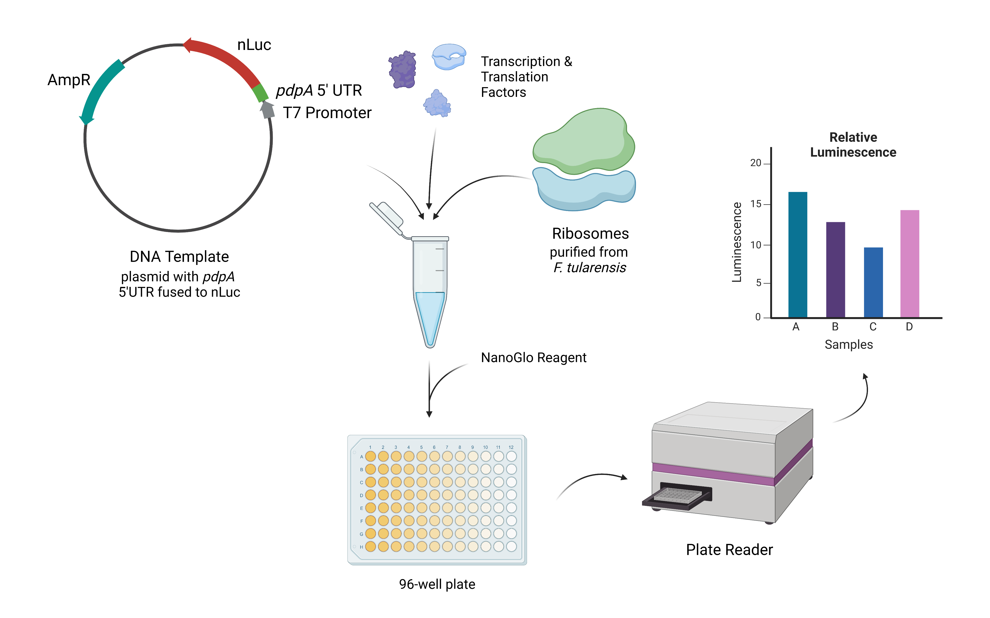


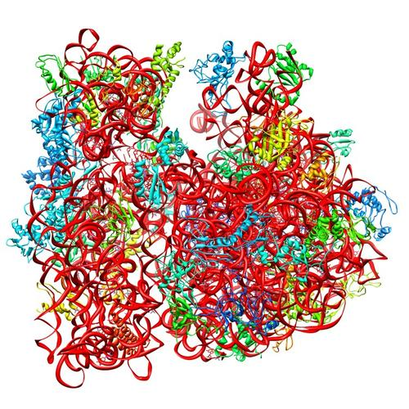
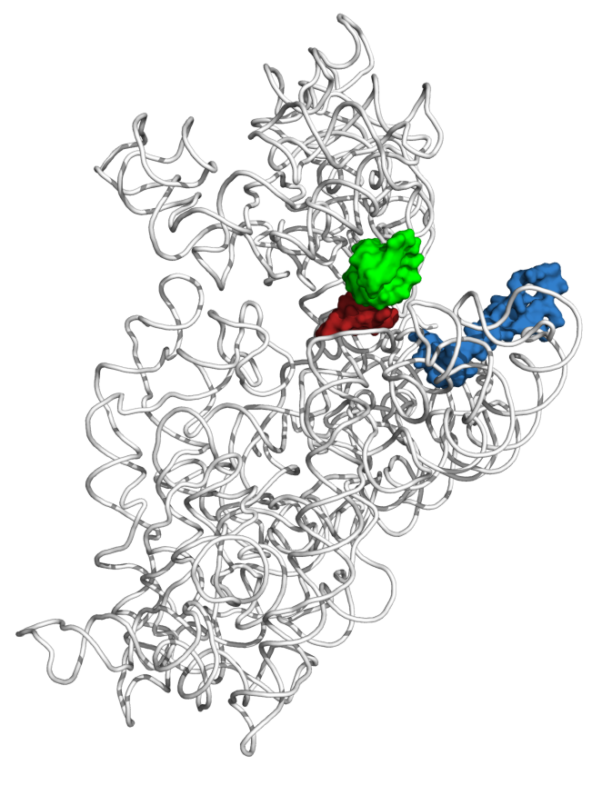
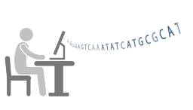
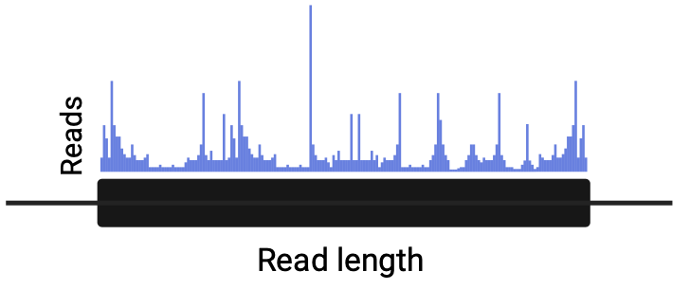
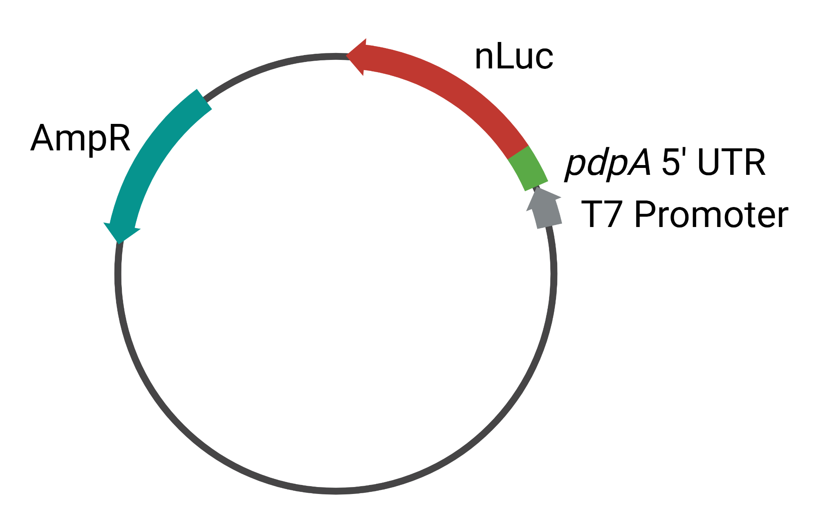
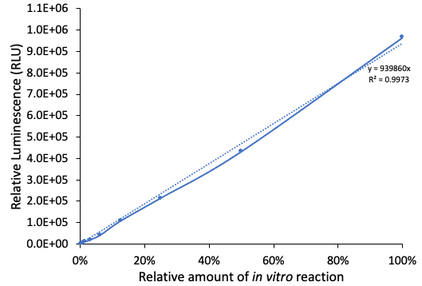
Heterogeneous ribosomes and gene expression in Francisella tularensis
Kira Bernabe^{1*}, Benjamin Moore^{1*}, Hannah S. Trautmann¹, and Kathryn M. Ramsey^{1,2}
Department of Cell and Molecular Biology, University of Rhode Island, Kingston, RI 02881
Department of Biomedical and Pharmaceutical Sciences, University of Rhode Island, Kingston, RI 02881
*Contributed equally to this work
Introduction
Role of bS21-2 in vivo
in vitro translation
Ribosome Profiling
Francisella sp. encode three bS21 homologs
bS21-2 is important for intramacrophage growth
Overview of in vitro translation assay
Overview of ribosome profiling
The rpsU genes encode the small subunit ribosomal protein bS21.
1
Isolation of actively translating ribosomes
2
Digestion of unprotected mRNA
bS21 is involved in translation initiation
3
Purification of mRNA footprints
E. coli 70S ribosome
30S ribosome (RNA and bS21)
P-site tRNA ASL
mRNA (P-site codon)
bS21
4
Creation of cDNA libraries for high-throughout sequencing
mRNA channel
5
Identification and comparison of translated mRNAs
bS21 is located near the anti-Shine Dalgarno helix, near the mRNA exit channel and is implicated in translation initiation
Figure 3. Cells without bS21-2 have an intramacrophage growth defect, which can be complemented by ectopic expression of bS21-2. Growth of F. tularensis LVS cells within J774A.1 cells, infected at MOI of 5 – 10. J774A.1 cells were lysed and bacteria were plated for enumeration (CFU) 24 hours post-infection. *p < 0.05 using Benjamini-Hochberg correction.
Creation of a sensitive, easily-modified reporter
Profiling ribosomes with specific bS21 homologs
F. tularensis ribosomes are heterogenous
bS21-2 controls key virulence factors, type VI secretion system proteins
A
B
Experiment
1
2
3
4
Restriction enzyme sites
Luminescence (RLU)
Ribosomes in cells
Figure 6. Generating and validating NanoLuc reporters for in vitro translation assays. A. Schematic of pKR212, a plasmid containing DNA specifying an mRNA with the pdpA 5ʹ UTR fused to the gene for the NanoLuc luciferase (nLuc). Inclusion of DNA specifying restriction enzyme sites flanking the 5ʹ UTR allows for easy exchange of leader sequences using standard cloning techniques. B. Standard curve demonstrating sensitivity and linear range of in vitro translation assays using NEB-provided ribosomes, the pKR208 reporter template, which specifies a tul4 5ʹ UTR – NanoLuc reporter fusion, and the Promega Nano-Glo™ Luciferase Assay System.
Ribosome profiling will be performed using cells containing a single bS21 homolog with an epitope tag for immunoprecipitation or all ribosomes.
Figure 1. F. tularensis ribosomes are heterogenous with respect to bS21. (A) Chart indicating purity of wild-type ribosomes. (B) Table with spectral counts corresponding to bS21 homologs, identified from individual ribosome purifications from wild-type cells. ND: not detected. (C) Each bS21 homolog can be incorporated into ribosomes. Top: Sucrose gradient sedimentation profile from actively-translating wild-type cells containing an empty vector. Bottom: Immunoblot analysis of fractions from sucrose gradient sedimentation performed on actively-translating cells ectopically expressing indicated VSV-G-tagged bS21 homolog.
Immuno-
precipitation
Figure 4. bS21-2 is a regulator of T6SS component protein abundance. (A) Immunoblot analysis of indicated T6SS protein abundance. Immunoblot against VSV-G was included to demonstrate production of bS21-2-V. (B) Quantification of immunoblots from A. Band intensities for each protein was normalized to total protein on the membrane. *p < 0.05 using Benjamini-Hochberg correction.
Purified F. tularensis ribosomes have more variability in activity and density
Ribosomes profiled
Model
Control by bS21-2 is leader sequence-dependent
Purification of 70S ribosomes by immunoprecipitating a bS21 homolog
A
B
A
B
Luminescence (RLU)
A₂₆₀
E. coli
F. tularensis
Density
(low – high)
Figure 5. 5 ́ UTRs are sufficient to lead to bS21-2-mediated changes in translation. (A) Diagram of the translational reporter fusions used. (B) Relative fluorescence for indicated gfp translational fusion reporters in cells with (+; WT) or without (−; ΔrpsU2) bS21-2. (C) Relative β-galactosidase activity for indicated lacZ translational fusions in cells with (+; WT) or without (−; ΔrpsU2) native bS21-2, or with ectopically expressed bS21-2 from a plasmid (pF-bS21-2). Strains without ectopically expressed bS21-2 contained an empty vector (pF). *p < 0.05. ns = not significant.
Figure 7. Comparison of ribosomes purified from E. coli and F. tularensis LVS. All ribosomes were purified using a sucrose cushion. A. Chart comparing activity of E. coli and F. tularensis ribosomes in in vitro translation assay. Letters on x-axis represent independent ribosome purifications, circles represent technical replicates, horizontal lines represent averages of technical replicates. Assays used the pKR214 reporter template, which specifies a tul4 5ʹ UTR – NanoLuc reporter fusion. B. Sucrose gradient sedimentation profiles of purified ribosomes from indicated species.
Figure 8. Assessing purification of 70S ribosomes by immunoprecipitating bS21-2-HA. F. tularensis cells either contained a plasmid ectopically expressing bS21-2-HA (“+”) or an empty vector (“-”). A. Immunoblot analysis of indicated samples taken during immunoprecipitation of bS21-2-HA or of final elution. B. Silver stained gel of final elution, comparing immunoprecipitated material to empty vector control and all F. tularensis ribosomes purified by sucrose cushion.
Figure 2. Incorporation of distinct bS21 homologs into ribosomes leads to preferential translation initiation to modulate protein abundance. One of three bS21 homologs may be incorporated into ribosomes and preferentially translate specific mRNAs in a sequence-dependent manner. bS21 homologs may be easily exchanged among assembled 70S ribosomes.
Funding for this work was provided by
NIGMS 1R35GM150599 – KMR
NIGMS CARTD-COBRE Pilot Project Award, P20GM121344 – KMR
NIGMS/RI-INBRE Early Career Development Award, P20GM103430 – KMR
Rhode Island Foundation Medical Research Grant, 2798_20190602 - KMR
USDA NIFA, Hatch Formula, 1017848 – KMR
References
Trautmann, H. S., & Ramsey, K. M. (2022). A Ribosomal Protein Homolog Governs Gene Expression and Virulence in a Bacterial Pathogen. J. Bacteriol, 204(10), e0026822.
Trautmann, H. S., Schmidt, S. S., Gregory, S. T., & Ramsey, K. M. (2023). Ribosome heterogeneity results in leader sequence-mediated regulation of protein synthesis in Francisella tularensis. J. Bacteriol, e0014023.

