Slide 1
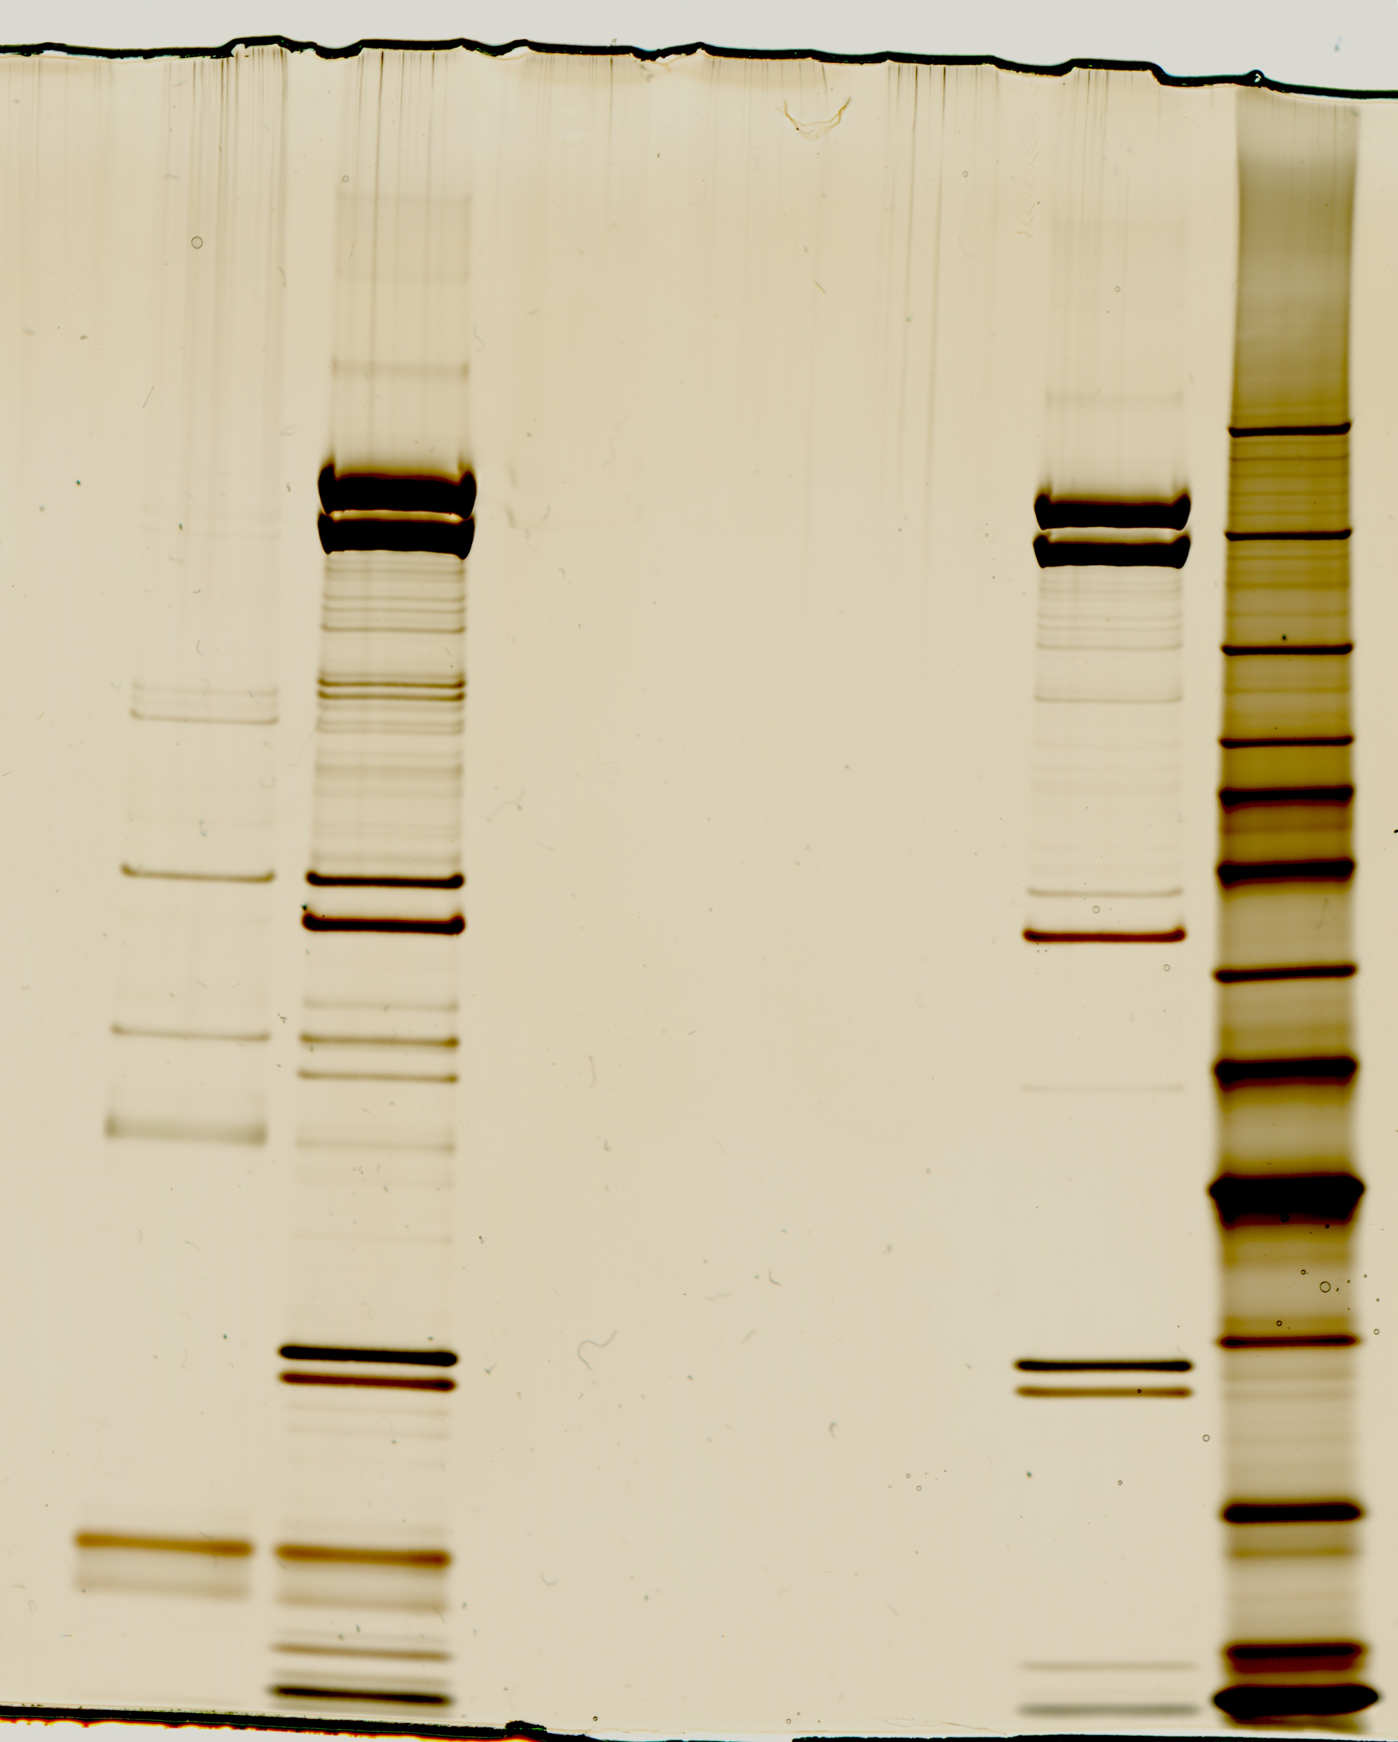
5/30/18 protein purification
BenchMark Ladder
WT (untagged)
β′ -TAP
10 μl unconcentrated protein,
silver stain
β′-CBP and β
σ⁷⁰
α1 and α2
MglA and SspA

Slide 2
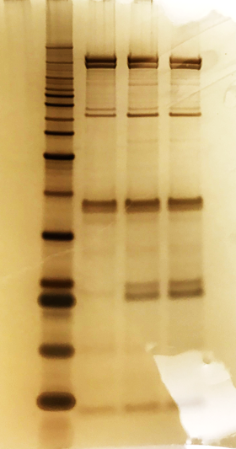
BenchMark
Ladder
10/28/18 protein purification
∆mglA β′ -TAP
10 μl unconcentrated purified protein,
silver stain
β′ -TAP 1
β′ -TAP 2
β′-CBP and β
Sample #
1 ∆mglA β′ -TAP
2 β′ -TAP 1
3 β′ -TAP 2
σ⁷⁰
α1 and α2
MglA and SspA
ω

Slide 3
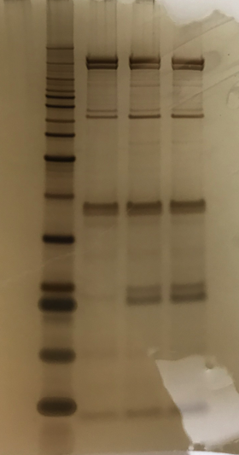
BenchMark
Ladder
10/28/18 protein purification
∆mglA β′ -TAP
10 μl unconcentrated purified protein,
silver stain
β′ -TAP 1
β′ -TAP 2
Expected sizes, kDa
220
β′-CBP and β
β = 151
160
120
σ⁷⁰
σ⁷⁰ = 67.6
100
50
40
α1 = 35
α2 = 35.3
α1 and α2
30
MglA = 23.6
SspA = 23.9
25
MglA and SspA
20
15
10
ω
ω = 8.17

Slide 4
BenchMark
Ladder
10/28/18 protein purification
∆mglA β′ -TAP
10 μl unconcentrated purified protein,
silver stain
β′ -TAP 1
β′ -TAP 2
Expected sizes, kDa
β′-CBP and β
β = 151
σ⁷⁰
σ⁷⁰ = 67.6
α1 = 35
α2 = 35.3
α1 and α2
MglA = 23.6
SspA = 23.9
MglA and SspA
ω
ω = 8.17

