Slide 1

Validating the Genetic Requirements of F. tularensis
Joint Lab Meeting
2/21/2024

Slide 2
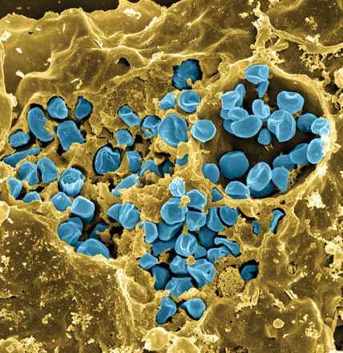
Fransciella tularensis
Causes tularemia
Highly infectious
Potential bioweapon
F. tularensis subsp. holarctica LVS
Intracellular growth is essential to cause disease
Project: Manipulating F. tularensis LVS to figure out what is necessary for F. tularensis to survive in freshwater
Fischer, PNAS cover 2006

Slide 3

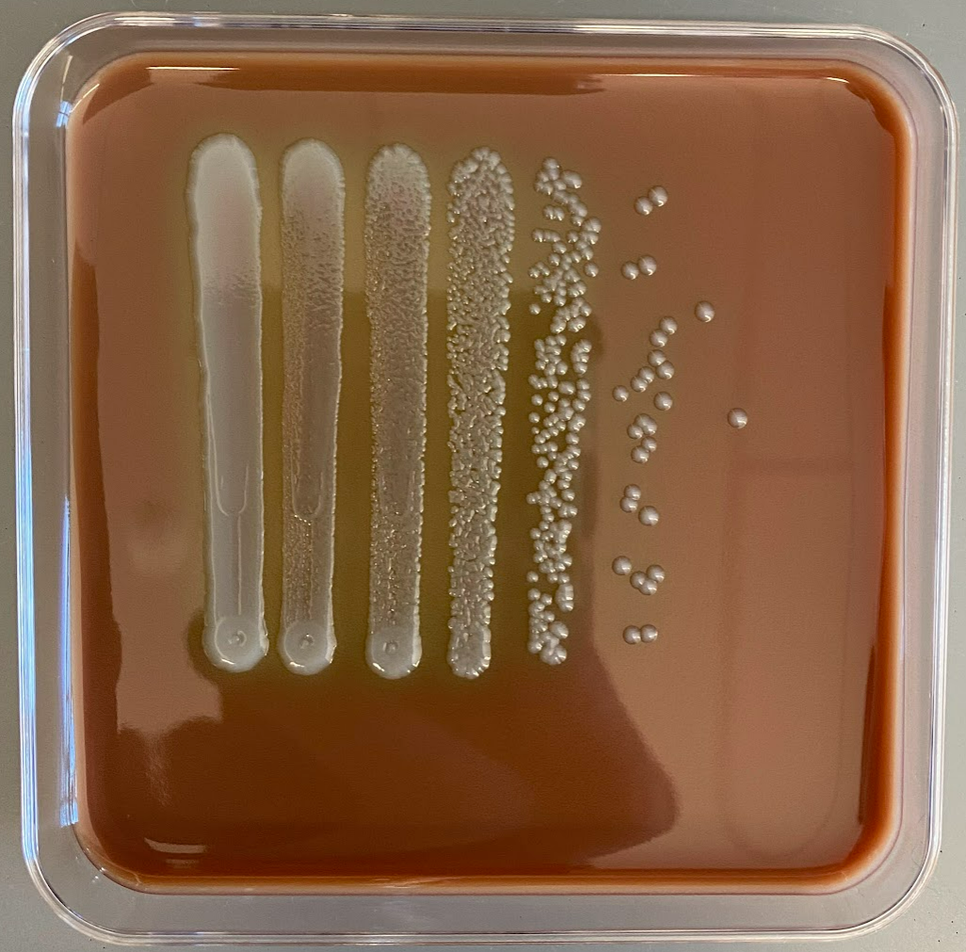
Background
Beaver River
+ 0.03 OD LVS
F. tularensis
x3
x3
x3
4°C
16°C
25°C
Serially diluted from 1 to 10⁻⁶
Plated on days: 0, 1, 2, 4, 7, 14, 21, 28, 35, 42, 50, 63, 69
Aisling’s Question: What are the main genetic requirements for the survival of F. tularensis in fresh water?
Her Results: After performing a freshwater survival assay and transposon insertion sequencing, she found a possible candidate which was gene mpl
Next steps: Colony PCR tubes were placed in thermocycler overnight. Will take a look at them today and started prepping for minprep.

Slide 4
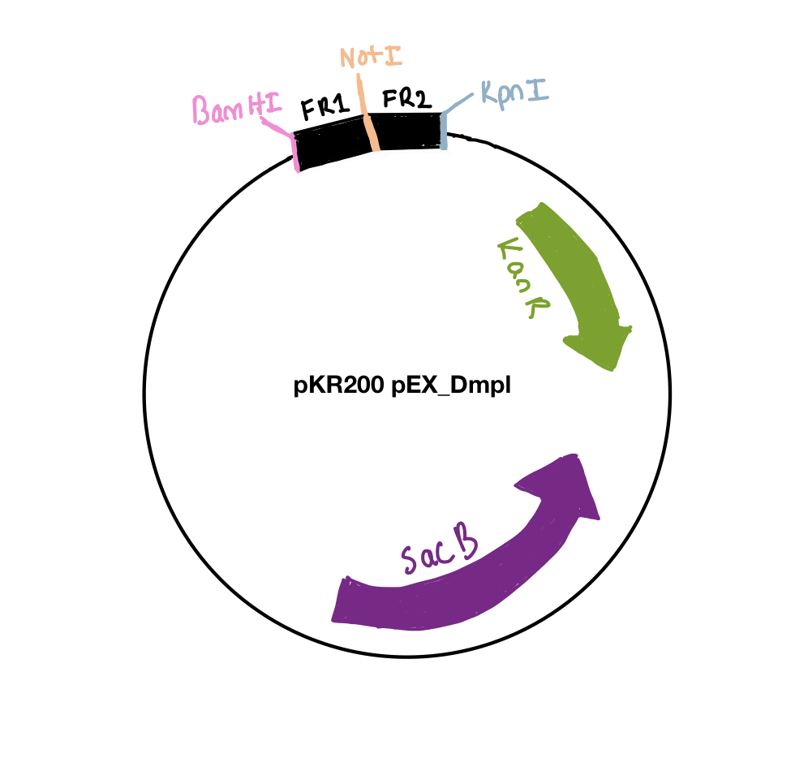
pKR200

Slide 5
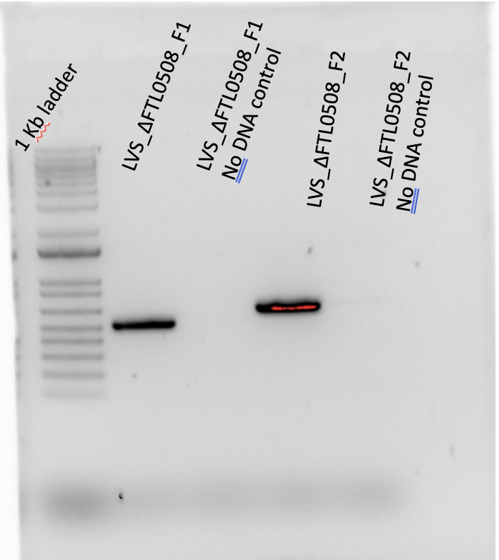
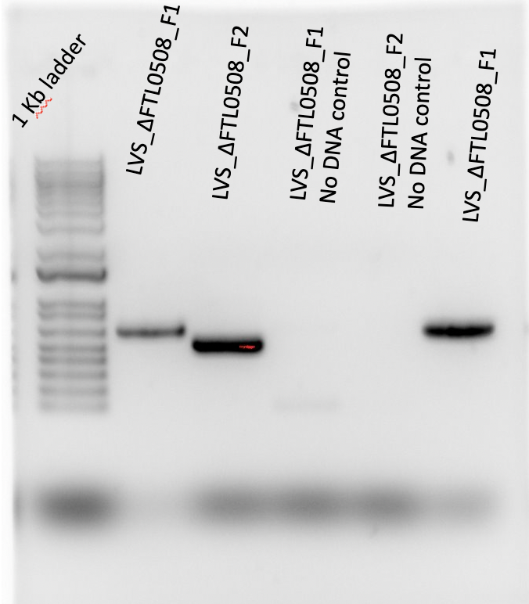
Making pKR200: PCR and Purification
Started with PCR using primers KROL 660 and KROL 661 for FTL_0508_Fragment 1
Used primers KROL 662 and KROL 663 for FTL_0508_Fragment 2

Slide 6
Making pKR200: Digests
Tube | DNA | Enzyme(s) | DNA Volume (uL) | H₂O Volume (uL)
1 | DFTL_0508_F1 | BamHI-HF and Noti-HF | 15 | -
2 | DFTL_0508_F2 | NotI-HF and KpnI-HF | 15 | -
3 | Backbone (pKR12) | BamHI-HF and KpnI-HF | 5 | 10
Performed a digest and eventually gel purified the digest

Slide 7
Making pKR200: Ligation & Transformation
Component | Reaction 1 (uL) | Reaction 2 (uL) | Master Mix (3x)
H₂O | 11.5 | 11.5 | 34.5
10x ligase buffer | 2.0 | 2.0 | 6
Insert | 4.0 | - | -
Backbone | 2.0 | 2.0 | 6
Ligase | 0.5 | 0.5 | 1.5
TOTAL | 20.0 | 20.0 | 48
Ligation:
Tube number | Purpose | DNA | Volume of DNA | Final volume to plate | Number of kanamycin-containing plates
1 | (+) control | pKR12 | 1 uL | 20uL,100 ul | 2
2 | (-) control | None | 0 | 20ul ,100 ul | 2
3 | Backbone Ligation | pKR12 (digested) | 8 uL | 100 uL, remaning | 2
4 | Ligation | Pkr200 | 8 uL | 100uL, remaining | 2
Total number of plates |  |  |  |  | 8
Transformation:

Slide 9
Electroporating pKR200 into LVS
After 6 attempts ….

Slide 10
Selecting Cross-Outs for Sucrose Selection

Slide 11
Future Steps

