Slide 1

JULY 2024
Joint Lab
Meeting
Johanyx Rodriguez

Slide 2
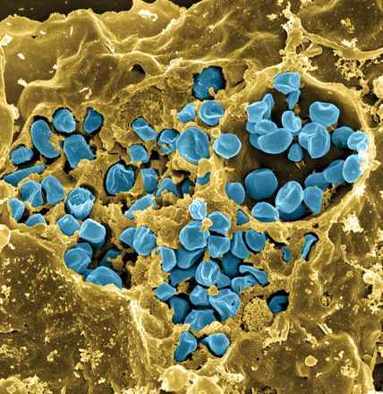
Introduction
Francisella tularensis
  Tularemia
  Potential bioweapon
  Live Vaccine Strain (LVS)
Fischer, PNAS cover 2006

Slide 3
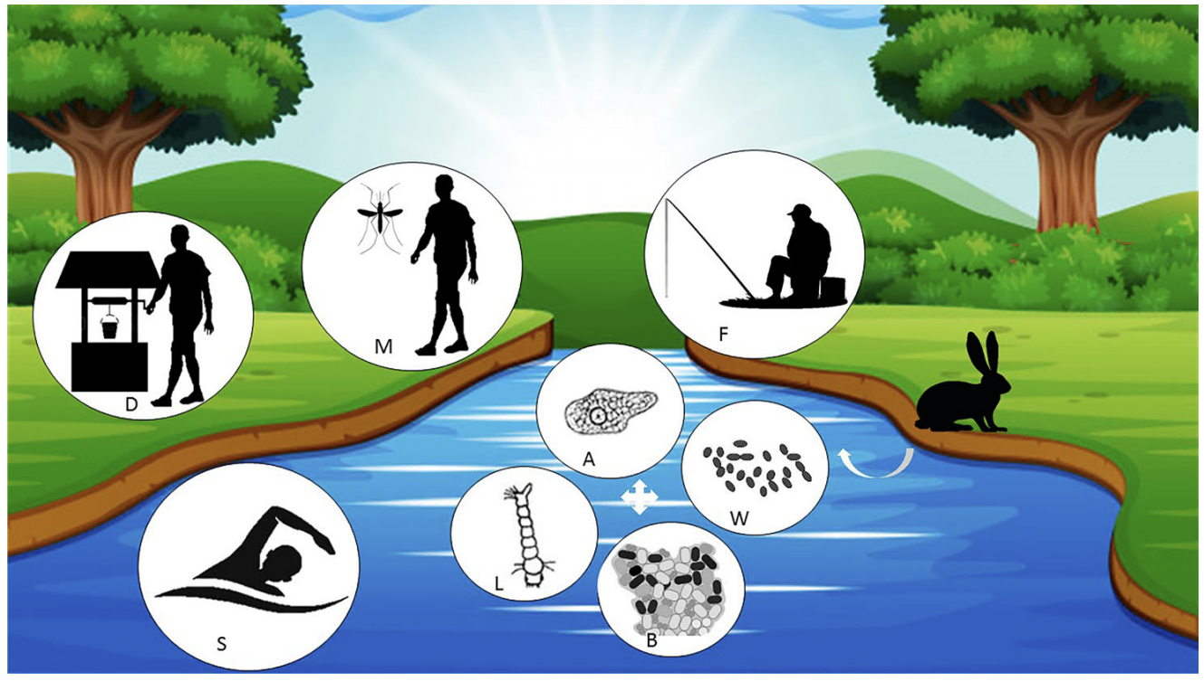
F. tularensis in Freshwater
Why study F. tularensis?
No person to person transmission
Tularemia infection comes from environmental sources
What are genetic requirements for survival of F. tularensis in freshwater?
Hennebique, A., Boisset, S., & Maurin, M. (2019).

Slide 4
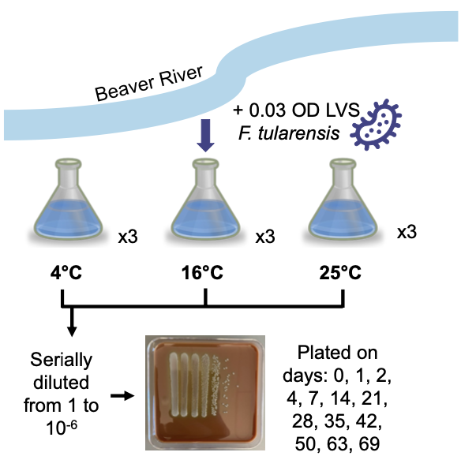
  Establishing a model system for F. tularensis survival in freshwater
Macaraeg, Spring 2023
What are genetic requirements for survival of F. tularensis in freshwater?
Macaraeg, Spring 2023

Slide 5
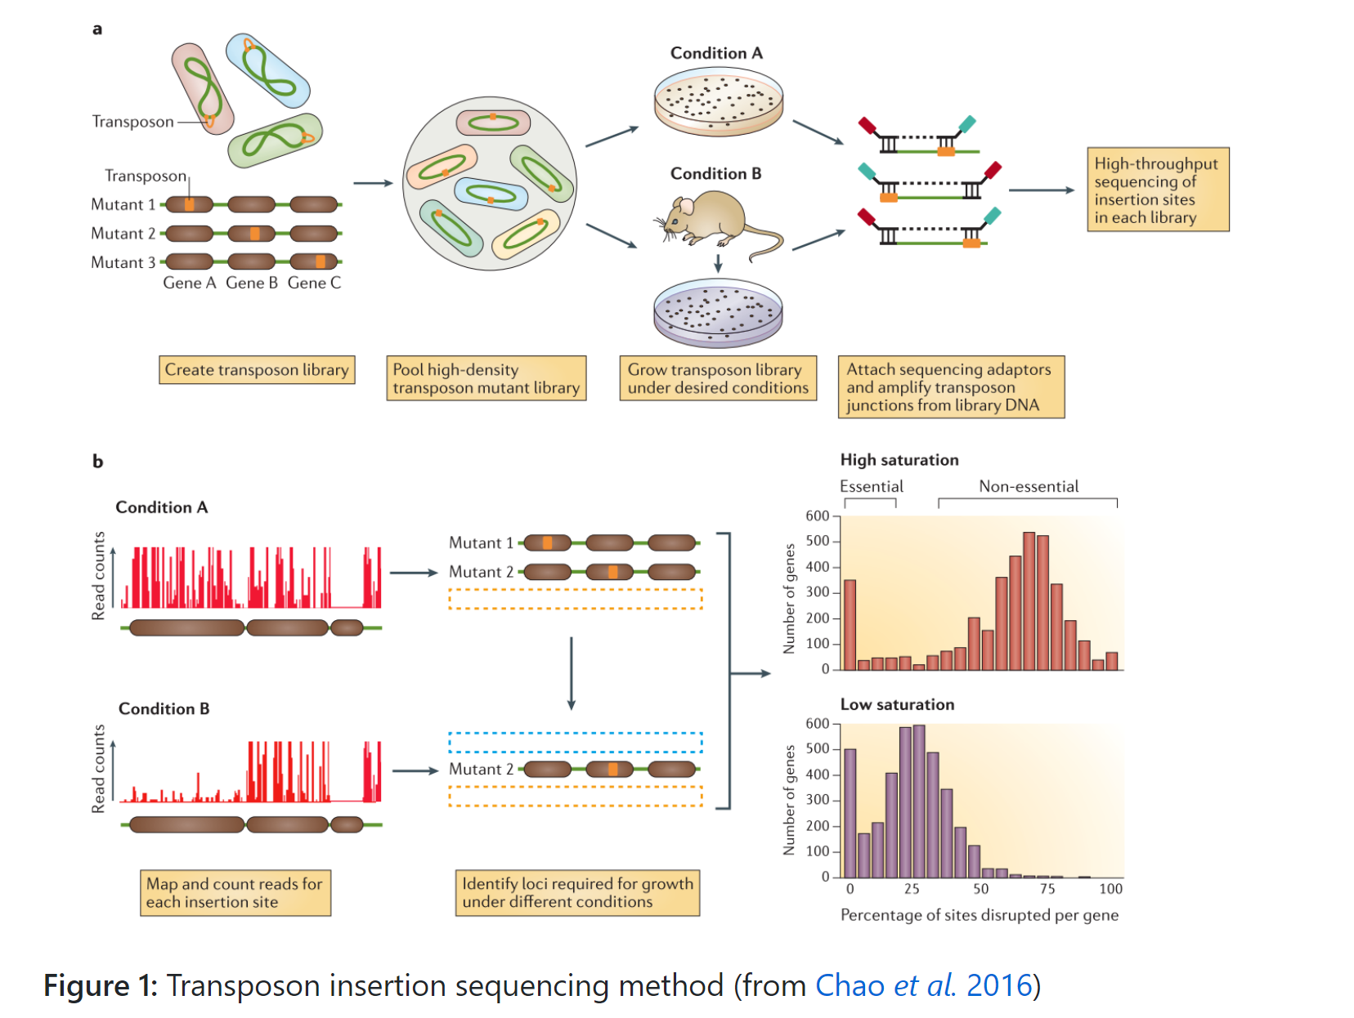
  Transposon Insertion Sequencing

Slide 6
  Transposon Insertion Sequencing
Chao et al, 2016

Slide 7
  Transposon Insertion Sequencing
Chao et al, 2016

Slide 8
  Transposon Insertion Sequencing
Chao et al, 2016

Slide 9
  Transposon Insertion Sequencing
Chao et al, 2016

Slide 10
  Transposon Insertion Sequencing

Slide 11
  Tn-Seq was performed on F. tularensis in freshwater
Made transposon mutant library
Pooled the mutants
Took all of those and put into freshwater survival assay
Samples 0, 7, 14 days
  Found CFU/ml
  Made Tn-Seq library from gDNA
  Sequence Tn-Seq Library
Macaraeg, Spring 2023

Slide 12
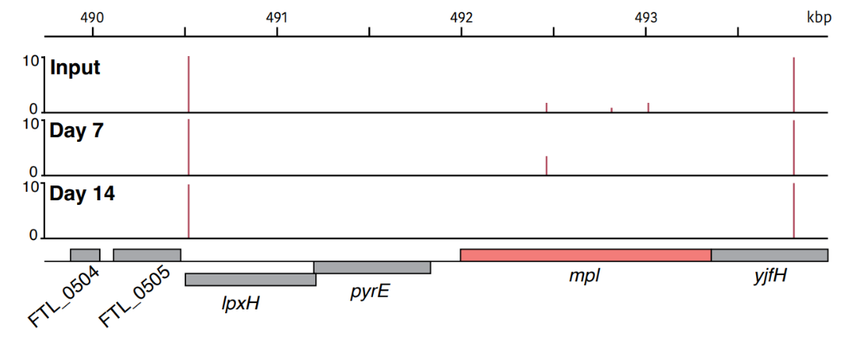
mpl is important for F. tularensis to survive in model system
Macaraeg, Spring 2023
Mpl encodes murein peptide ligase

Slide 13
Johanyx’s Question
  Can we validate that the gene mpl is necessary for the survival of F. tularensis in freshwater?
  Make a strain of LVS that lacks the gene mpl

Slide 14
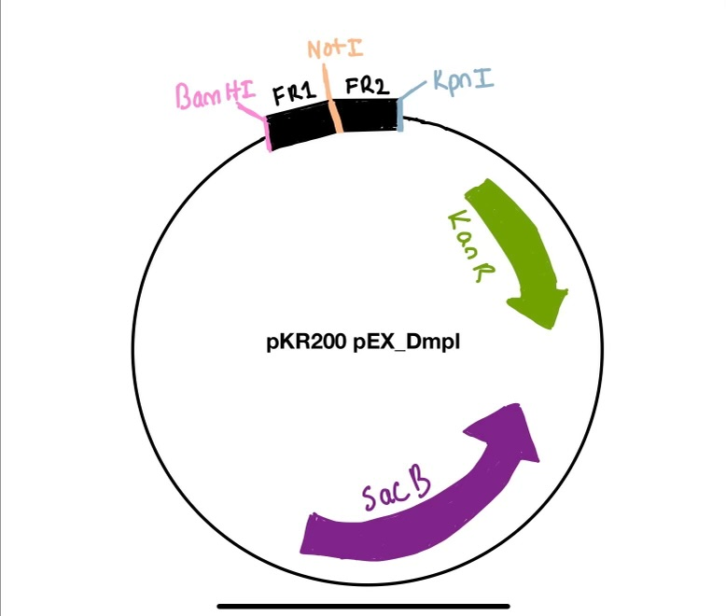
Making a plasmid to delete gene mpl

Slide 15
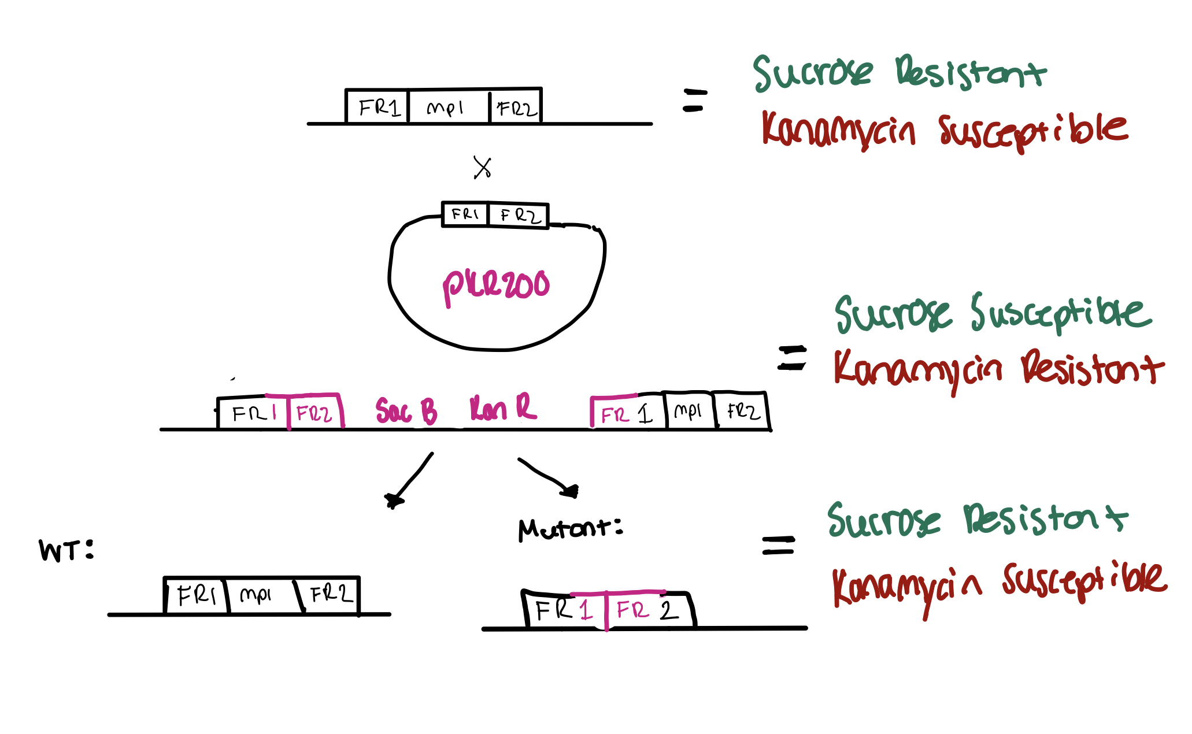
What is Allelic Exchange?
Exchange of genetic material of our plasmid DNA and host genome of F. tularensis

Slide 16
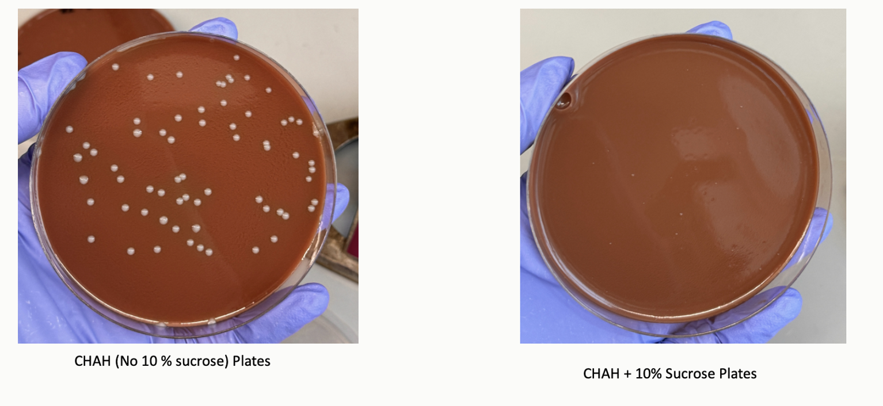
What’s expected from Sucrose Selection?

Slide 17
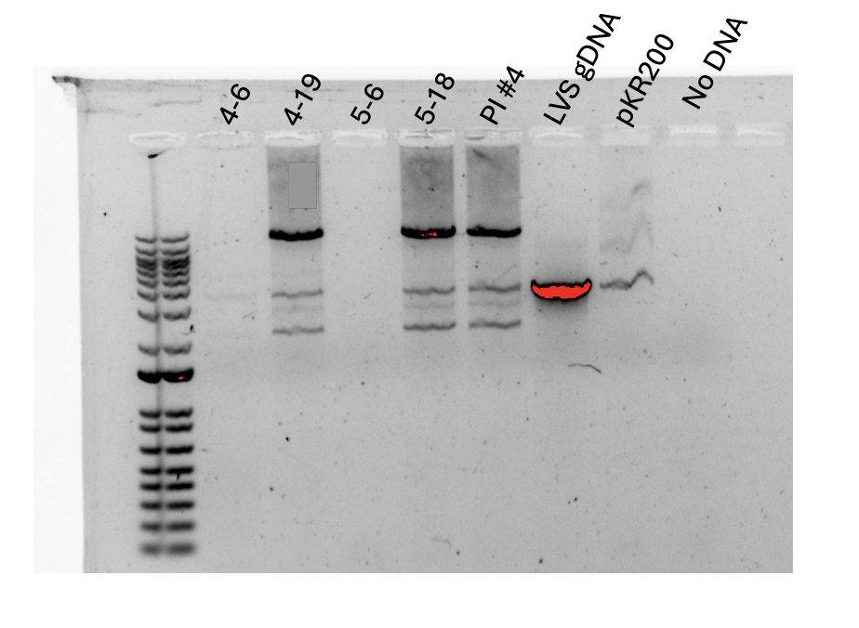
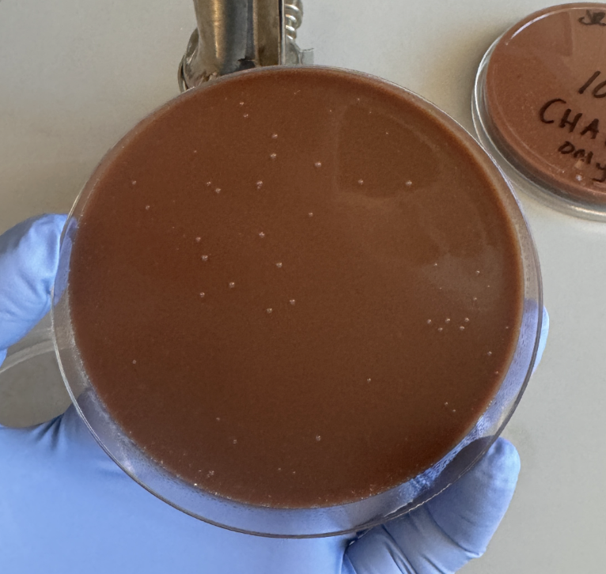
The reality after sucrose selection
1 Kb Ladder
Light growth
3000
2000
1500
Same amount of colonies on CHAH plates
Expected BP for Mutant: 2212
Expected BP for WT: 3549
My sucrose plates
One of many colony PCRs ….

Slide 18
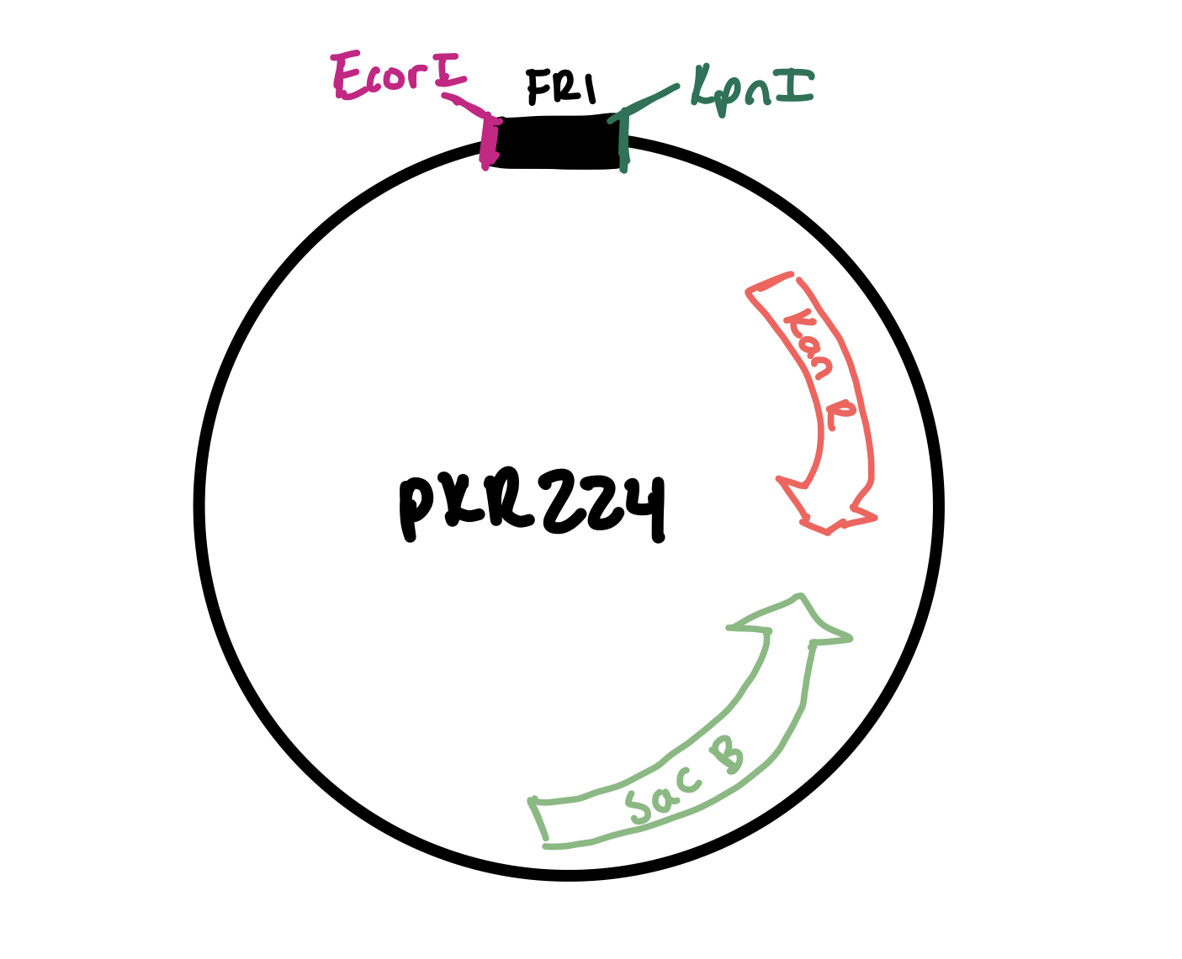
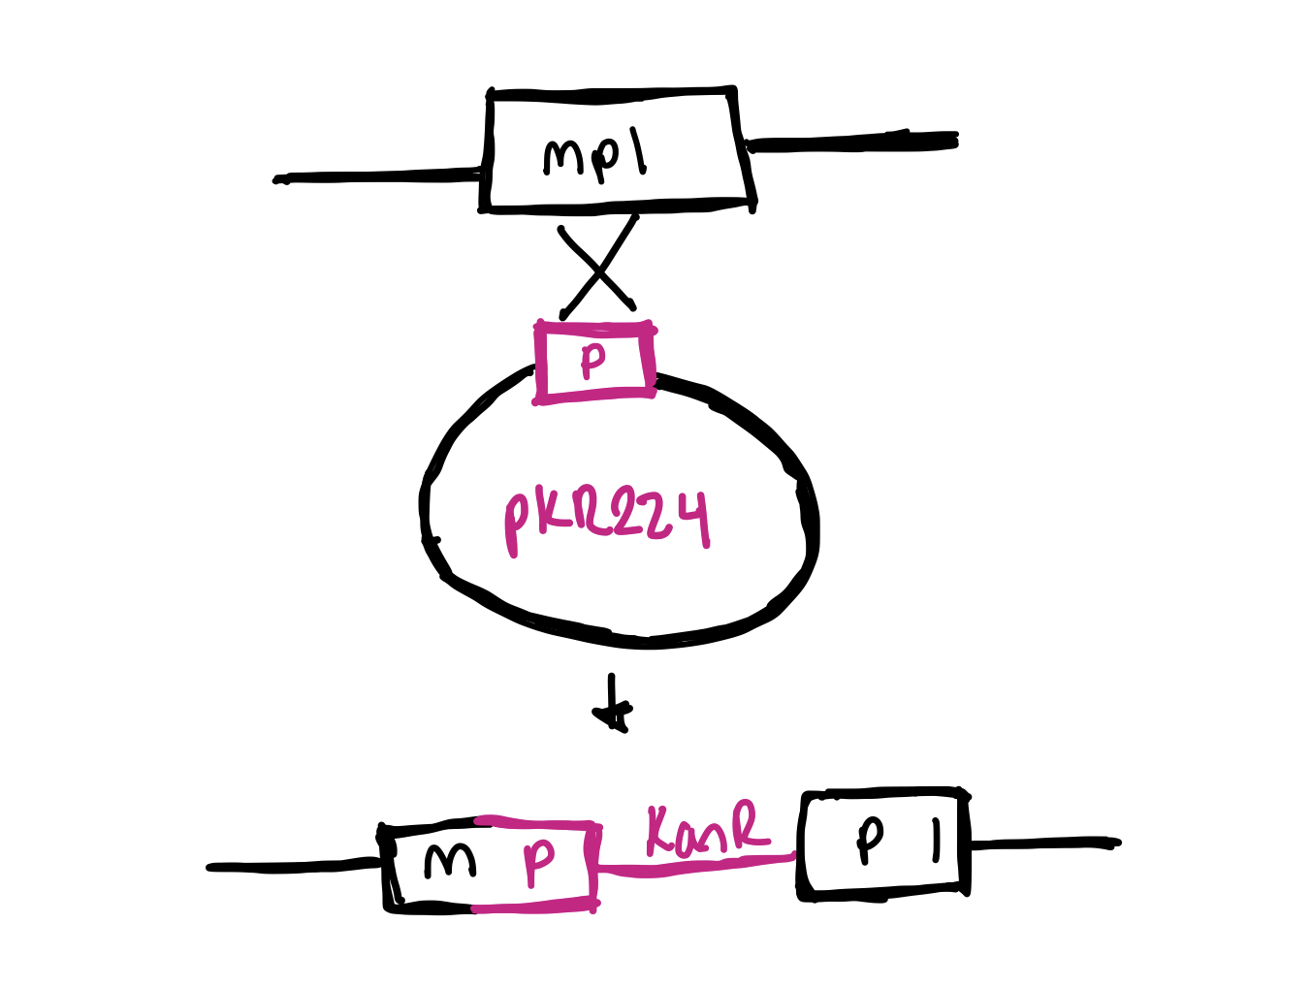
The Back-Up Plan
A plasmid that interrupts gene mpl

Slide 19
While we figure this out, there’s something else cooking on the side….

Slide 20
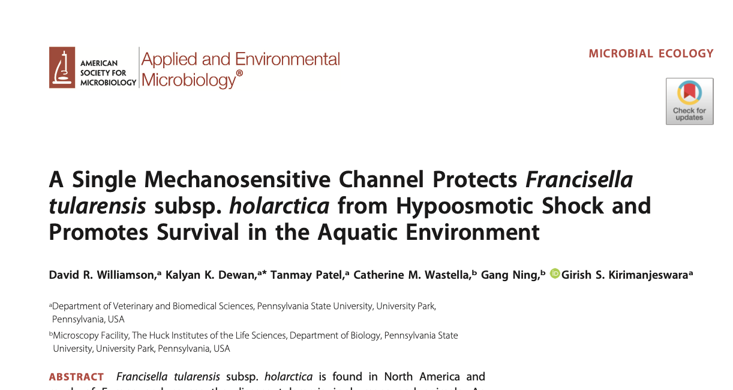
Who is FtMscS?
Protect F. tularensis from hypoosmotic shock
FtMscS is required ”to survive from host niche to freshwater” (Williamson et al, 2020)
The only gene implicated for survival in freshwater
Williamson et al looks at short-term survival, I am looking at long-term survival in freshwater

Slide 21
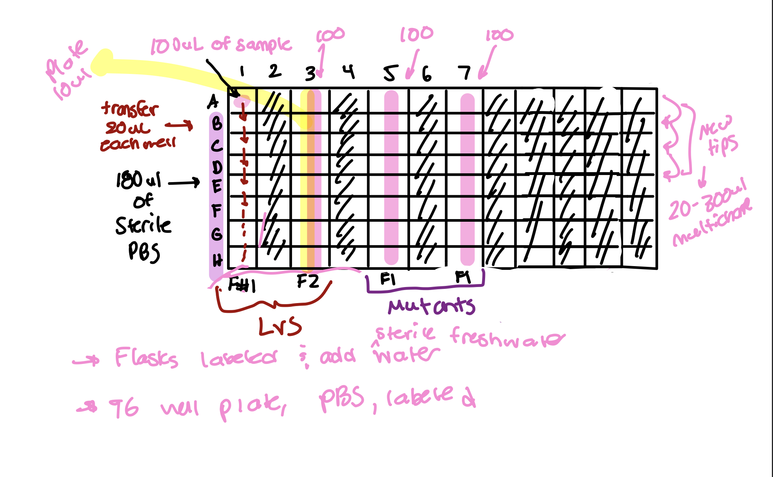

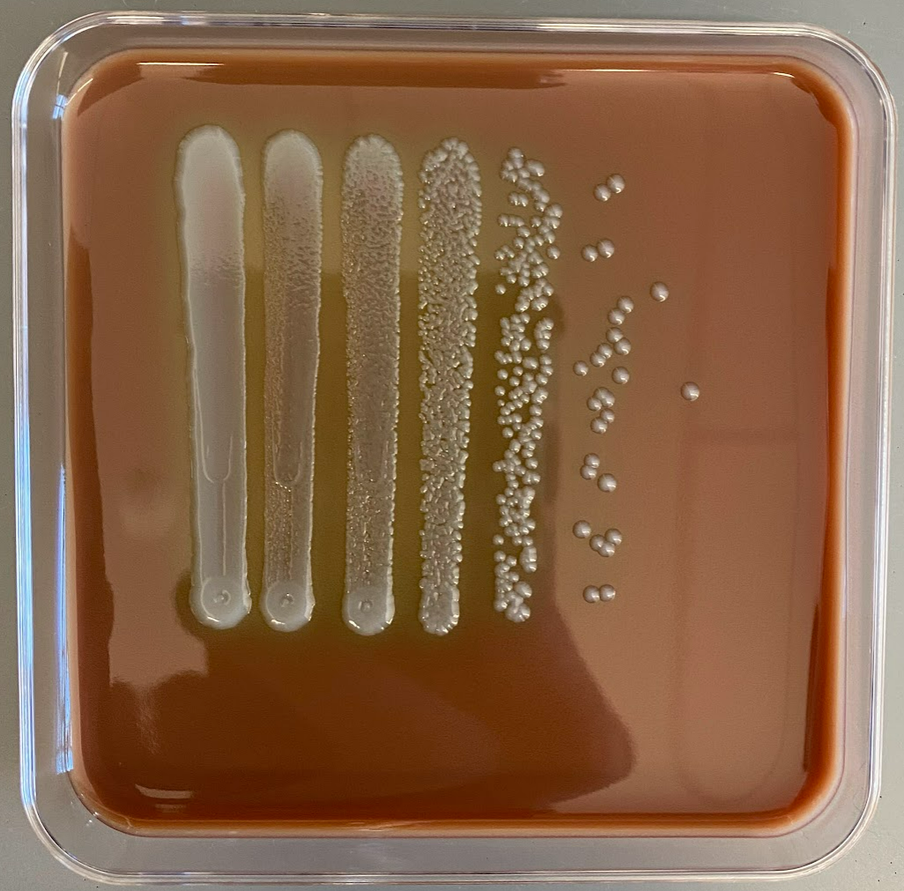
Let’s do a survival assay!
Beaver River
+ 0.03 OD LVS
F. tularensis
LVS
4°C
Mutant
Serially diluted from 1 to 10⁻⁶
Plated on days: 0, 1, 3, 7, 15, 43, 67

Slide 22
MscS is not critical for long term survival
Blue: LVS
Orange: LVS ∆mscS

Slide 23
But hmmm, what’s going on here?
I inoculated the LVS and mutant flask with the same OD of 0.03
🤔
Replce graph
So the starting amount of viable cells should be the same?
MscS seems to be important to survive hypoosmotic shock

Slide 24
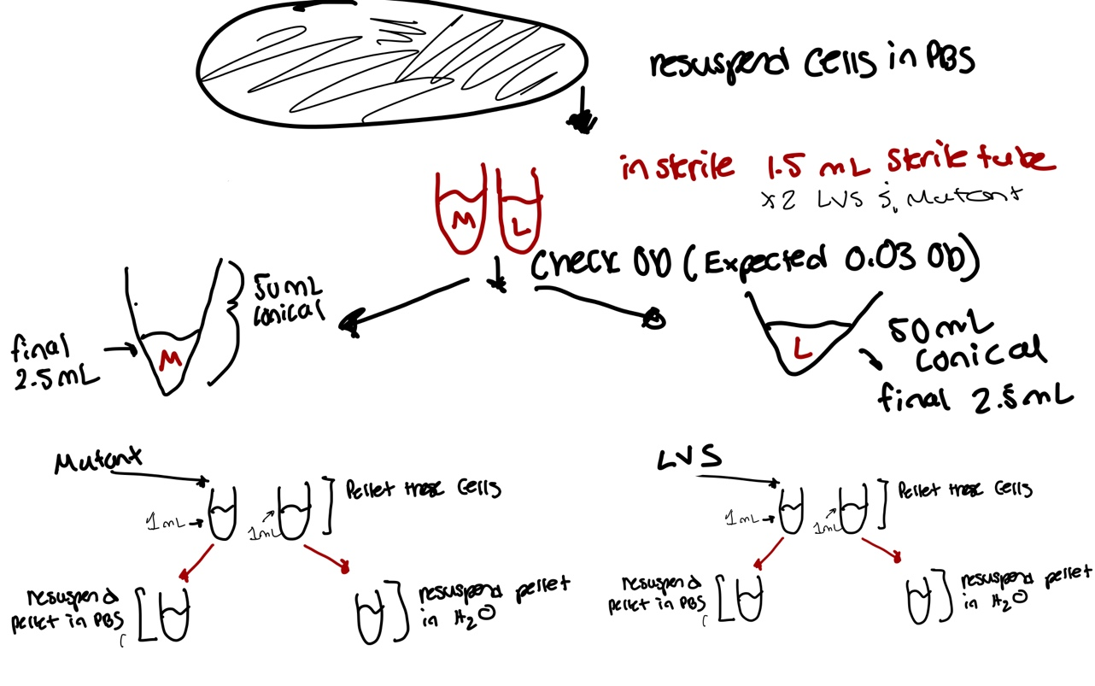
Hypoosmotic shock at beginning of survival assay!

Slide 25
mscS seems important for hypoosmotic shock

Slide 26
PBS vs Freshwater Results?

Slide 27
Conclusion
It has been tricky to delete gene mpl
  Primary integrant has not behaved the way we thought it would
mscS gene protects F. tularensis during hypoosmotic shock

Slide 28
Future Directions
I will use the backup plan strategy (interrupting the mpl gene)
Once I obtain this mutant, I will test it in a freshwater survival assay
Will make plasmids to complement loss of mpl and mscS

Slide 29






Acknowledgements
The Ramsey Lab
  Dr. Kathryn Ramsey
  Kira Bernabe
  Ben Moore
  Alex Farah
  Aisling Macaraeg
Me hard at work in lab:

